Slide 1
Progress Update: Pseudogene Mapping
Chelsea Ju
2013.08.08

Slide 2
Approach
Data Preparation
Download the file describes pseudogene-parent relationship from pseudogene.org (version 72).
Identify the genomic region (and exon boundary) of pseudogenes and parents.
Based on the genomic regions, extract the sequence from reference genome (HG19)
Assume pseudogenes do not express at all, reads are generated from parents only, using dwigsim (sequencing error follows an uniformly increasing error rate of 0.02).
Map the reads to reference genome using TopHat2

Slide 3
Approach
Data Analysis
Count:
From mappable reads, count the fragments that fall within the region of pseudogenes and parents
Compute FPKM:
Normalize the fragment count by gene size and total fragments
Linear Regression:
Model the FPKM relationship between pseudogenes and parents using linear regression

Slide 4
Results
Number of Pseudo/Parents Pairs | 99 (92 Parents) |  | 399 (377 Parents) |  | 16902 (6398 Parents)
Total Gene Length (bp) | 184316 |  | 757656 |  | 14798936
Coverage and Read Length | Reads (#) | Mapped Reads(%) | Reads (#) | Mapped Reads(%) | Reads (#) | Mapped Reads(%)
10X 35L | 50250 | 0.824 | 210530 | 0.820 | 4164192 | 0.815
10X 100L | 17590 | 0.637 | 73702 | 0.639 | 1457666 | 0.647
100X 35L | 502558 | 0.823 | 2105504 | 0.821 | 41641006 | 0.815
100X 100L | 175910 | 0.635 | 737096 | 0.641 | 14577420 | 0.647
Read Length = 35, Mapped~ 82%
Read Length = 100, Mapped~ 64%

Slide 5
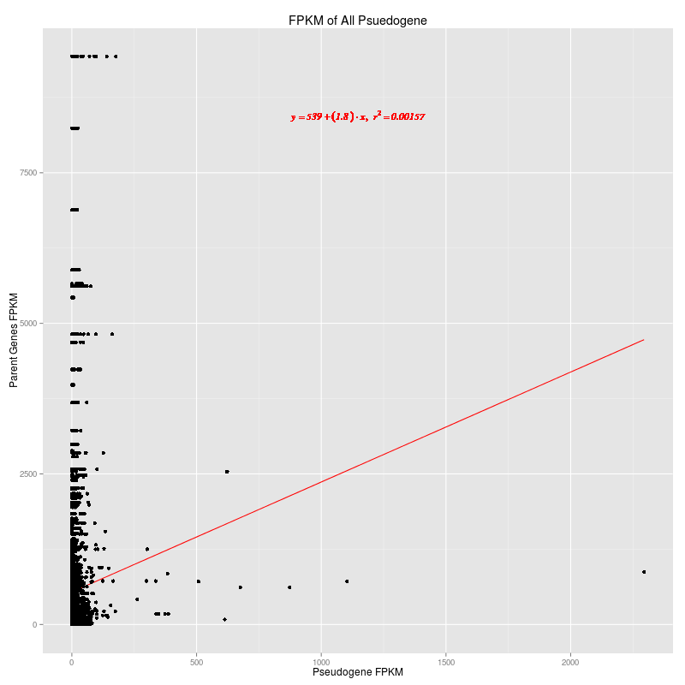
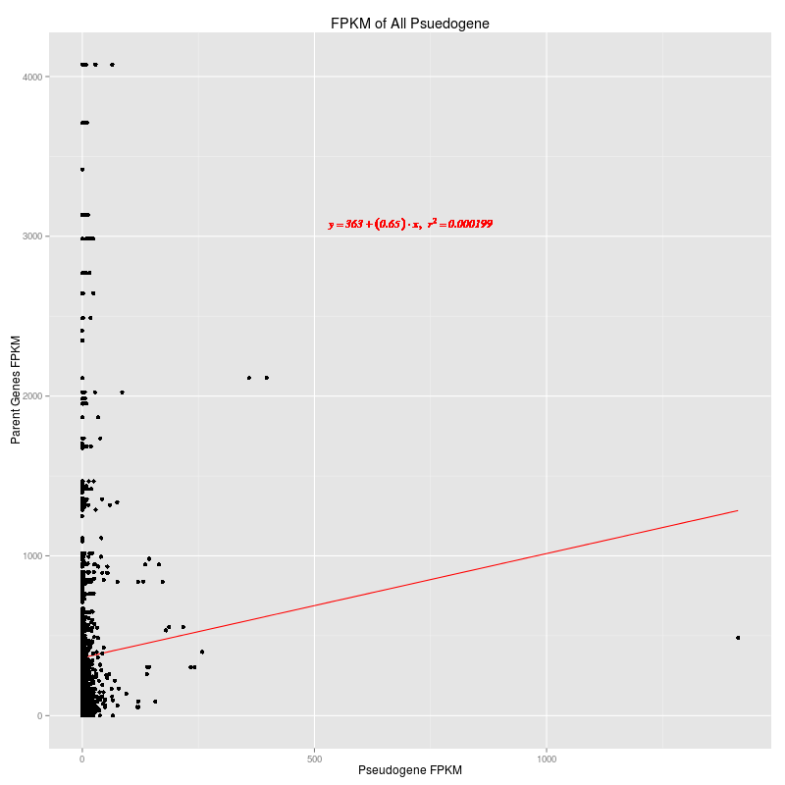
Results: All Pseudogenes
Coverage: 10X; Read Length: 35bp
Coverage: 10X; Read Length: 100bp

Slide 6
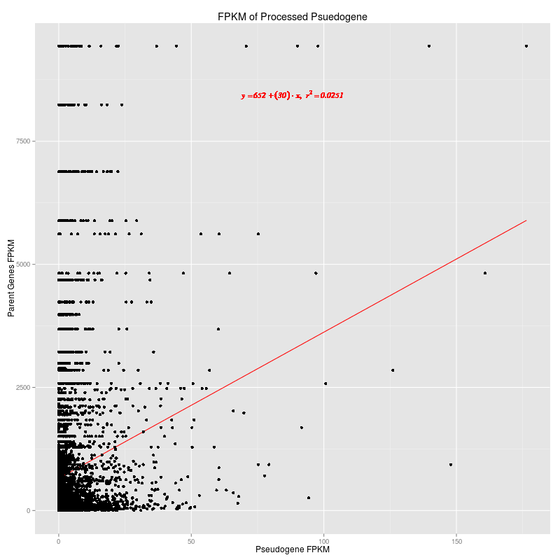
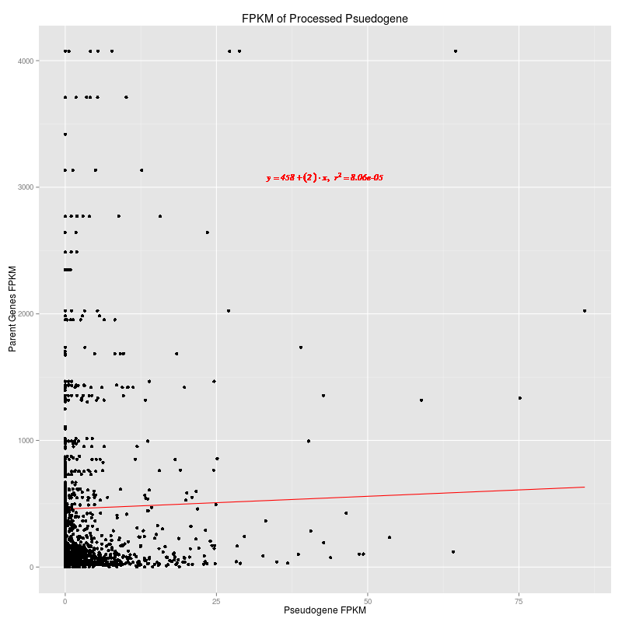
Results: Processed Pseudogenes
Coverage: 10X; Read Length: 35bp
Coverage: 10X; Read Length: 100bp

Slide 7
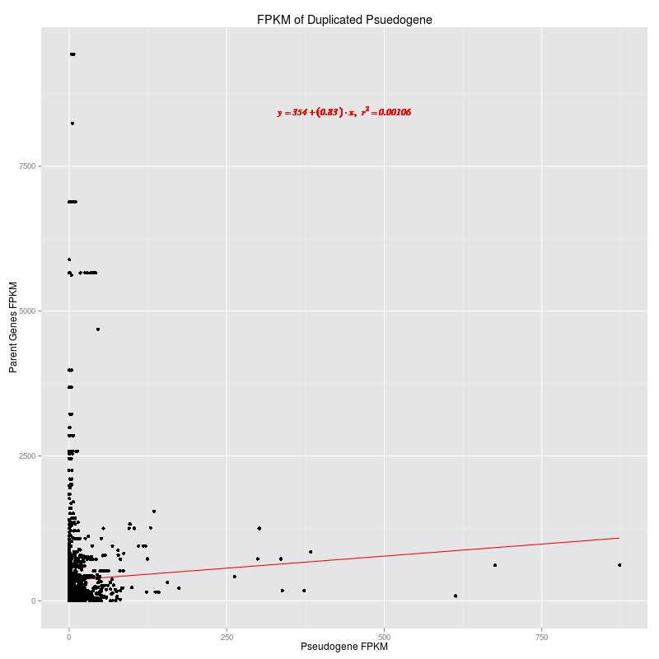
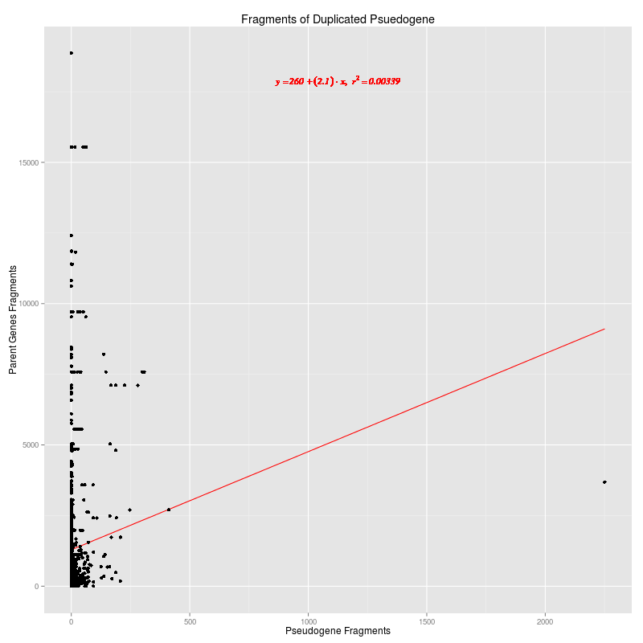
Results: Duplicated Pseudogenes
Coverage: 10X; Read Length: 35bp
Coverage: 10X; Read Length: 100bp

Slide 8
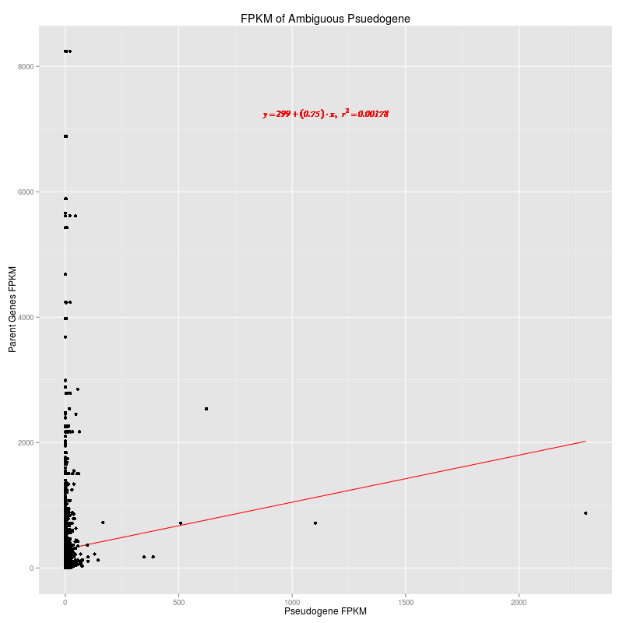
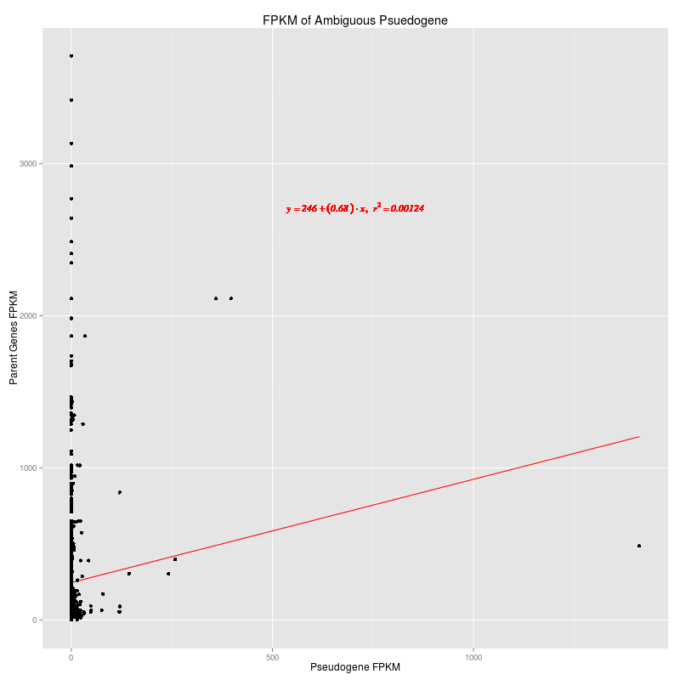
Results: Ambiguous Pseudogenes
Coverage: 10X; Read Length: 35bp
Coverage: 10X; Read Length: 100bp

