Slide 1
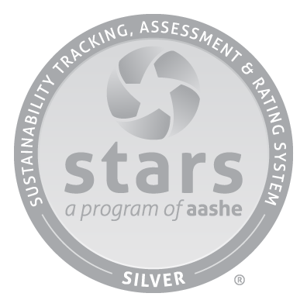

2022 STARS Rating Report for West Chester University
Sustainability Tracking, Assessment, & Rating System
Association for the Advancement of Sustainability in Higher Education
Score 55 / 100
October 2022
An institution’s score is based on the percentage of points it earns by pursuing relevant credits across four main categories: Academics (AC), Engagement (EN), Operations (OP), and Planning & Administration (PA).
Institutions may earn up to four Innovation & Leadership (IN) points for exemplary and path-breaking initiatives that are not covered by other STARS credits or that exceed the highest criterion of a standard credit.
Points are achieved through the following formula: Points Achieved/Points Possible + Innovation & Leadership Points.
WCU earned extra points in innovation & leadership areas such as center for sustainability across the curriculum, food bank, Full-time faculty employment, and grounds certification.
This report contains the results of the application for a STARS rating to be submitted for West Chester University of Pennsylvania upon the receipt of the President's Letter of Affirmation. The STARS rating is an official recognition that a university has met the requirements prescribed within the STARS Sustainability Tracking, Assessment, and Rating System as created, maintained, and administered by the Association for the Advancement of Sustainability in Higher Education (AASHE).
Notes:
Full Draft to look at-
Audience- WCU campus community- sharing info about the work we are doing

Slide 2
Strengths: Academics
Undergraduate and Graduate program
Strengths: Engagement
Employee and Student Orientation
Strengths: Operations
Biodiversity
Strengths: Administration
Sustainability coordination and planning
Immersive experience
Campus as a living laboratory
Community Partnerships
Electronics Purchasing
Hazardous Waste Management
Assessing employee satisfaction and diversity, equity & inclusion
Inter-campus Collaboration
Student Educators Program
Support for underrepresented groups
Academics | Improvement Opportunity | Points Achieved | Possible | 36.94 | 58
Curriculum | Develop and identify sustainability related courses |  | 26.51 | 40
Research | Policies that implement sustainability research reporting in My CV |  | 10.43 | 18
Engagement | Improvement Opportunity | Points Achieved | Possible | 19.40 | 41
Campus Engagement | Develop staff professional development or training on sustainability |  | 8.99 | 21
Public Engagement | Develop methods to track sustainability related community service hours |  | 10.41 | 20
Operations | Improvement Opportunity | Points Achieved | Possible | 29.92 | 72
Air & Climate | Reduce GHG emissions in the near term |  | 4.90 | 11
Buildings | Increase maintenance in accordance with a single-attribute, sustainable management program |  | 0.23 | 8
Energy | Accelerate energy efficiency |  | 5.89 | 10
Food & Dining | Increase % of purchases of sustainably or ethically produced products |  | 2.45 | 8
Grounds | Organic landscape management program |  | 2.59 | 4
Purchasing | Increase percentage of cleaning and janitorial product purchases that are third party certified |  | 2.23 | 6
Transportation | Incorporate alternative fuel vehicles into fleet |  | 3.45 | 7
Waste | Implement institutional waste reduction behavioral change initiatives |  | 4.51 | 10
Water | Implement institutional water waste behavioral change initiatives |  | 3.67 | 8
Planning & Administration | Improvement Opportunity | Points Achieved | Possible | 19.15 | 34
Coordination & Planning |  |  | 7.50 | 9
Diversity & Affordability | Increase cultural competence trainings and activities for the community |  | 7.67 | 10
Investment & Finance | Work to screen endowments from fossil fuels |  | 0 | 8
Well-being & Work | Creating a smoke-free campus |  | 3.98 | 7
Innovation & Leadership | Improvement Opportunity | Points Achieved | Possible | 3 | 4
Total |  | Points Achieved | Possible | 105 | 205
Innovation and Leadership
This category recognizes institutions that are seeking innovative solutions to sustainability challenges by demonstrating sustainability leadership in ways that are not captured in STARS.
Areas to Improve: Academics
By building out a "database" of "sustainability" courses as identified by instructors, we could capture a broader pool of SI/SF courses
Areas to Improve: Engagement
Mention sustainability in the WCU mission statement
Producing a “green guide” for students sustainable life practices
Areas to Improve: Operations
Areas to Improve: Administration
Quantify air pollution
Require all students to complete diversity training at orientation
Expand institutional support for low-income students
WCU should adopt university wide sustainability learning outcomes by looking at examples from other schools.
Tracking community service hours of students and employees
Implementing sustainability into graduate orientation.
Use Green Seal cleaning products in buildings on campus
Change percent of expenditures on cleaning and janitorial products to meet recognized sustainability standards
Restrict outdoor smoking or make WCU a smokefree campus
Institutions may earn up to 4 additional credits on their STARS rating, with each credit being worth a maximum of 0.5 bonus points.

