Slide 1
Extra Challenge
Company has a directory where they store concepts, intents, values, etc. These would be used to find meaning in naturally spoken sentences. Currently these words and their meanings are being imported by hand.
We conceived a web crawler who’s purpose would be to train their model to recognize categories of words.

Slide 2
Outline of Program
LEVEL 1 LINKS
LEVEL 2 TEXT
Our program currently would only store 3 links from the homepage, and parse the text on each of those webpages.
Obviously this is not optimal and should be extended to scan all links and multiple levels of depth.

Slide 3
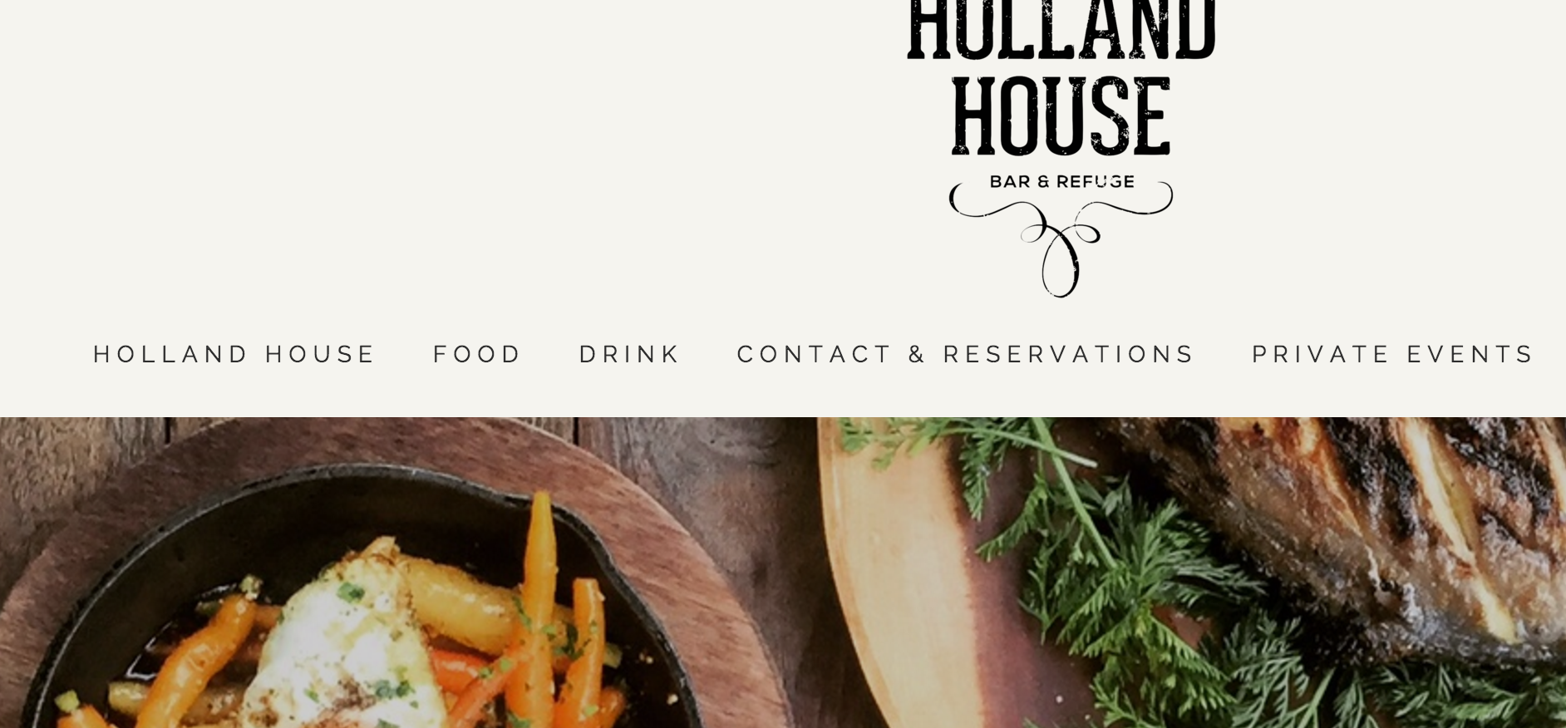
Holland House
Food
Drink
Contact & Reservations
…
We scan the home page of a given website and store all the link names as separate nodes in a graph (tree).
LEVEL 1 LINKS
The child nodes would contain hashmaps with the parsed text of each webpage stored as individual words and the frequency at which they appear.

Slide 4
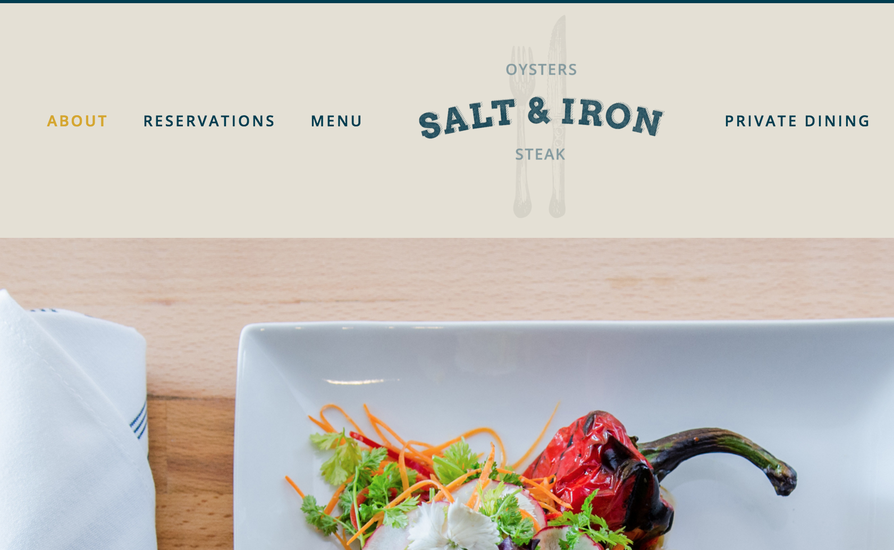
Another Example
LEVEL 1 LINKS
About
Reservations
Menu
Private Dinning

Slide 5
How do we know that ‘Menu’ and ‘Food’ will lead to the same type of page?
i.e How do we tell our program that these words mean the same thing.
We check the level 2 (text)
LEVEL 1 LINKS
LEVEL 2 TEXT

Slide 6
We check the level 2 (text)
Our program will scan through the text on the first (3) links we find on the homepage. This means we will store the text found for ‘Holland House’, ‘Food’, ‘Drink’, etc
The text will be parsed to extract individual words
Problem: Can’t tell if a word contains a space
Ex: How to know if we should store ‘bok choy’ as two separate word
Parsing in general is very challenging
Individual words will be stored in a hashmap, one hashmap for each of the 3 links.
This is so we can keep track of how frequently specific words appear (Local Popularity)
The frequency of each word will be used to assign a ‘popularity score’ to each word. Both popularity specific to one website and popularity across all scanned webpages will be considered.

Slide 7
Popularity Score, continued
Local Popularity = Frequency / Total words on 1 Webpage
Global Popularity = Webpages on Which Word Appears / Total Webpages Visited
Ex: Words like ‘sauce’, ‘chicken’, ‘pepper’ appear often on a given menu.
Problem: Words like ‘special’ and ‘extra’ might also appear often.
Temporary solution: Provide an exclusion list for words like that.
Words like ’pizza hut’ might appear often on one menu but if they are not popular words on any other menu, we can probably conclude ’pizza hut’ is not a food item.
Alternatively, global popularity will be used to make inferences about the actual category names. This will allow us for example to consider ‘Menu’ and ‘Our Pizzas’ will lead to the same type of menu-page.

Slide 8
Popularity scores will be used to evaluate how much we trust that a word belongs to a specific category.
Ex: If the word ’Bread’ appears on the menu page of 13/15 websites, then we can be confident that bread is a food item.
Similarly, if clicking ‘Menu’ on the first website leads to a page with popular food items (according to our algorithm we can say Global Popularity > 80%) and ‘Food’ also takes us to a page with popular food items, then we can conclude that ‘Menu’ and ‘Food’ are alternative ways to represent the same concept. Another example would be to conclude that ‘Contact Us’, ‘Contact Information’ and ‘How to Reach Us’ are alternative ways of representing the same concept since they take us to webpages with similar content.

Slide 9
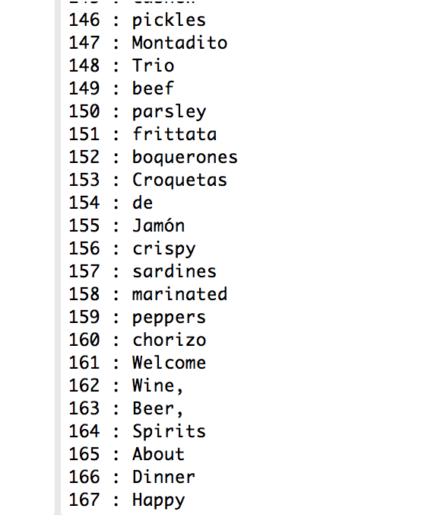
What does this look like visually?
Clicking on ‘Menu’ takes us to a page where we extracted the following data:
Storing the first 500 words that we find. Numbers represent the index of each word in the array they are stored in.
Occurrences of each word on the given webpage:
(Each word appeared once)
(Sample output from our Java Program)

Slide 10
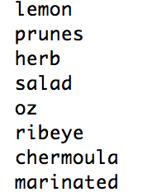
Finally,
LEVEL 1 LINKS
LEVEL 2 TEXT
Step 3
Generate JSON file
Food Item : {“lemon”, “prunes”, “herb” …}
Holland House
For words that have popularity > 80% (or any specified threshold) we can generate a JSON file.
Food
Drink

Slide 11
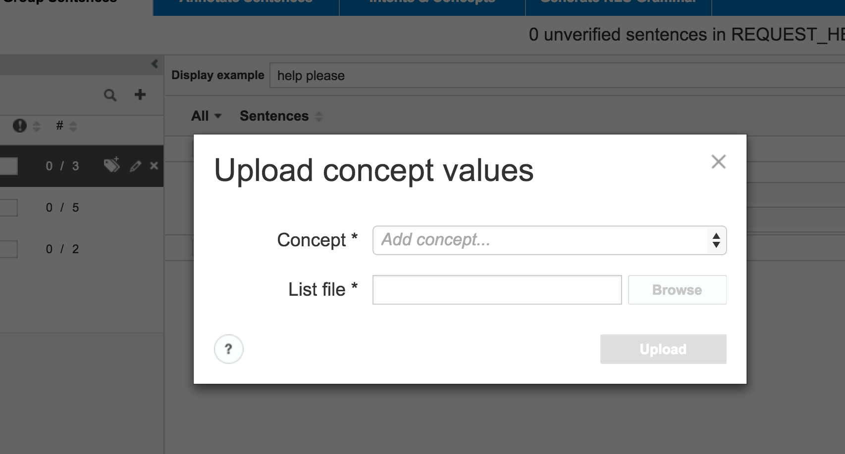
Step 3
Generate JSON file
Food Item : {“lemon”, “prunes”, “herb” …}
For words that have popularity > 80% (or any specified threshold) we can generate a JSON file.
The JSON file will be (manually) uploaded into Experience Studio where the data we collected will be converted to a usable format. This will eliminate or reduce the need to input values by hand.

Slide 12
Nicole Ayalon and Chelsea Ma

