Slide 2
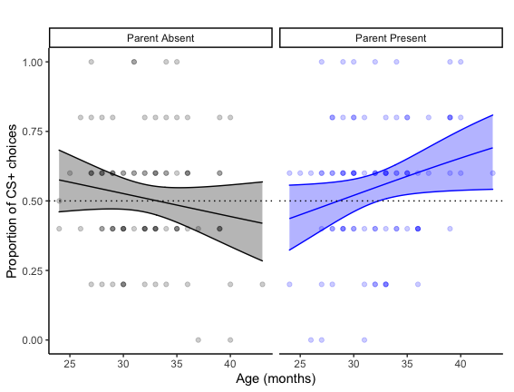
Notes:
These points are jittered for visual clarity

Slide 3
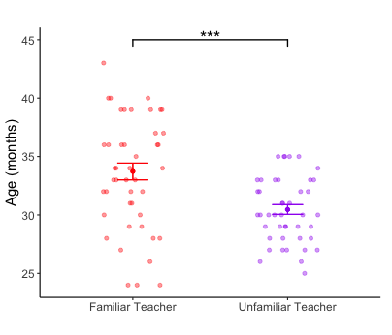


Slide 5
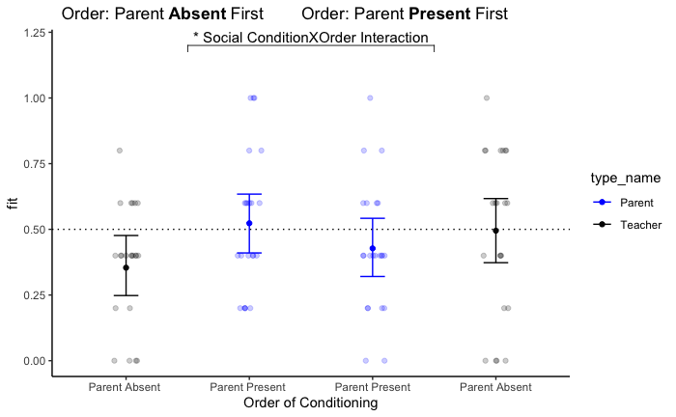

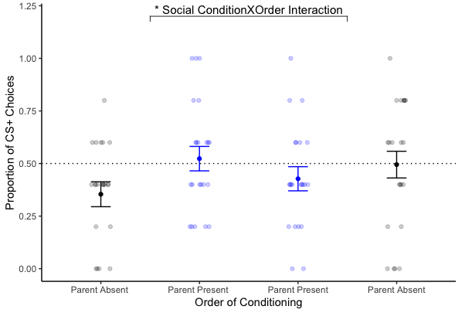
*
#

Slide 6
Figure 1. Schematic of Study 1 design: Conditioning and Testing Paradigm. A. Conditioning Phase: During conditioning, toddlers were presented with stimuli on a computer screen. For each condition, toddlers sat next to a teacher and experimenter. For the Parent Present condition, the parent was also seated next to the toddler; for the Parent Absent condition, the parent sat far behind the toddler. B. Recall Test (T-maze): Following the conditioning phase, toddlers were brought to a play tent where, sitting in their teacher’s lap, the teacher pointed to both of the doors (left and then right) and told the toddler that behind each shape was the same prize (e.g. a sticker/small toy, shown as an example on the first trial). The toddler was prompted to choose from which door they wanted to retrieve their prize. Each toddler completed 5 randomized trials before returning to the computer. C. Recall Test: Toddlers were shown both shapes, side-by-side, and asked which shape was their favorite. Toddlers then completed the next condition (parent or teacher). Order of social context was randomized between participants.
Figure 2. Social Context by Age Interaction. Age was associated with choosing the CS+ more often in the Parent Present context compared to the Parent Absent context (β = .09 , p = .02). Plotted are the model fitted regression lines for each social context with age in months (mean = 31.7) on the x-axis and the proportion of CS+ chooses on the y-axis with shaded 95% confidence intervals. The dotted line represents chance (50%) for choosing the CS+. Each data point represents an individual subjects’ raw score.
Figure 3. Age Confounded with Teacher Familiarity. Older toddlers were more likely to be paired with a more familiar teacher. Plotted are the means and standard error bars for each context (Familiar vs. Unfamiliar Teacher) on the x-axis and age in months on the y-axis (t(71) = 4.01, p < .001) , with individual subjects’ ages, jittered. *** indicates p < .001.
Figure 4. Schematic of Study 2 design: Conditioning and Testing Paradigm. A. Conditioning phase: During conditioning, toddlers were seated in a highchair next to a familiar teacher. In the Parent Present condition, the parent was also seated next to the toddler. For the Parent Absent condition, the parent was out of the room. B. Recall Test: Following the conditioning phase, while still seated in a highchair, toddlers were presented with two wooden boxes with the CS+ & CS- shapes affixed on top. They were asked to choose from which box they wanted their sticker prize and repeated this protocol 5 times. C. Recall Test (liking): Toddlers viewed the CS+ and CS- shapes on a computer screen, and were asked “Which is your favorite?”.
Figure 5. Social Context by Order Interaction. The order of social context (Parent Present vs. Parent Absent first) significantly interacted with parents' presence to predict toddlers' preference choices (β = -.99, p = .04). Toddlers who underwent the Parent Absent context first (left panel), were less likely to prefer the CS+ when the parent was absent (choices were significantly different from .5; t(21) = -2.65, p = .01). If toddlers underwent conditioning in the Parent Present context first (right panel), there was no main effect of social context on preference choices. The y-axis indicates the probability of choosing the CS+ shape, and the x-axis shows social context. Mean and standard error bars are model fits and individual subjects’ raw data (percentage of the CS+ chosen across 5 trials) are plotted as individual data points. # indicates p < .05 difference from .5, * indicates p < .05 for the interaction.

