Slide 1
Self-Learning Tutorial: EDA & Predictive Modeling of Chronic Illnesses
AI in Healthcare
MSAI SPR 25
UT Austin

Slide 2
Overview
Introduction
Data Used
Background & Goal
Environment Setup
EDA (Exploratory Data Analysis)
Data Preprocessing
Predictive Modeling
Conclusion

Slide 3

Introduction

Slide 4
Data USED
Dataset: Chronic illness: symptoms, treatments and triggers from Kaggle
Download: export.csv (686.17 MB)
About the data:
Size: 7,976,223 rows x 9 cols
Source: Flaredown app, used for tracking chronic autoimmune and invisible illnesses
Includes conditions, symptoms, treatments, food, tags (“trackables”) recorded by users
Also includes weather, user info, and if applicable, HBI (Harvey Bradshaw Index), "a standardized metric to gauge the severity of Crohn's disease"

Slide 5
Background & Goal

Slide 6
Environment Setup

Slide 7

EDA (Exploratory Data Analysis)

Slide 8
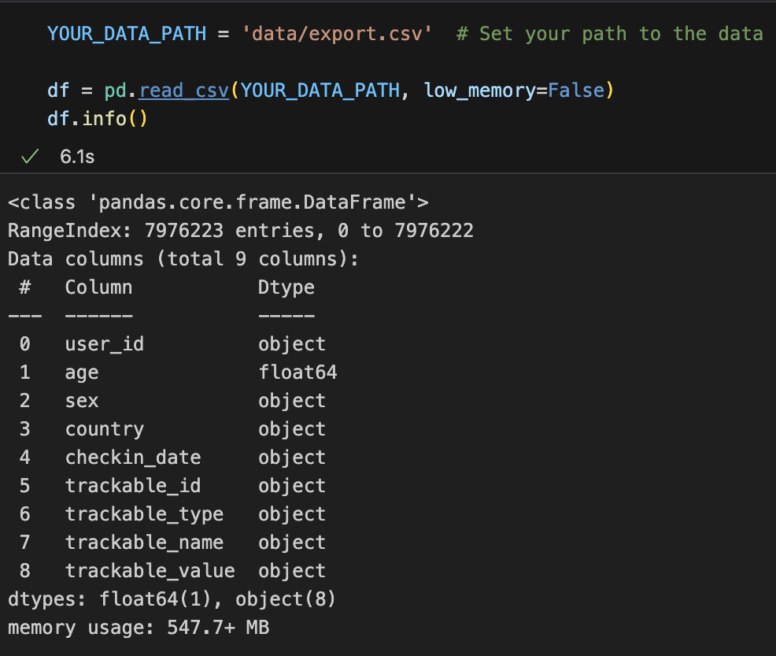
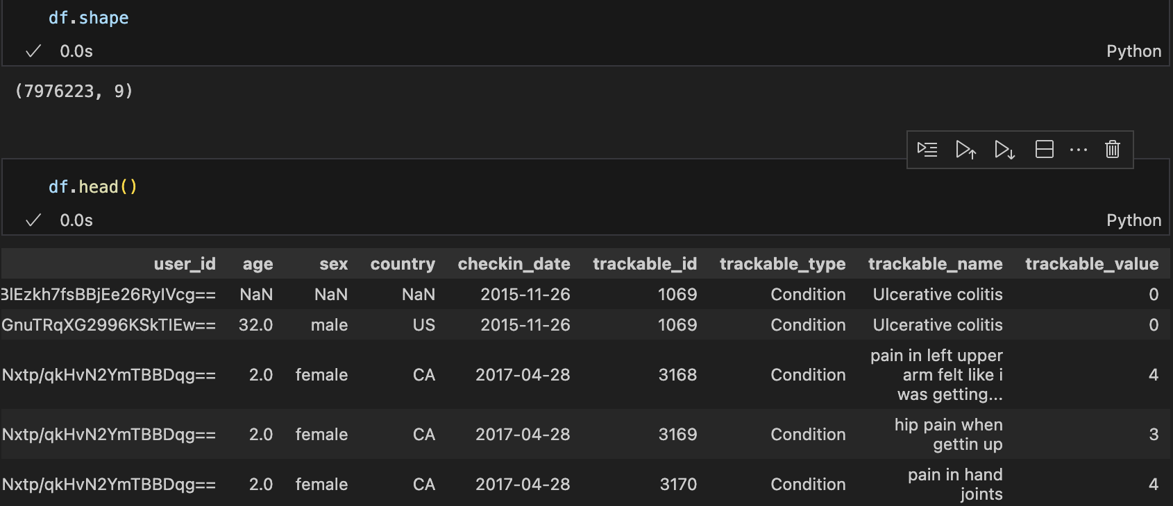
Load & Preview Data
Download export.csv from Kaggle
Set your data path, then use pandas to load and preview data

Slide 9
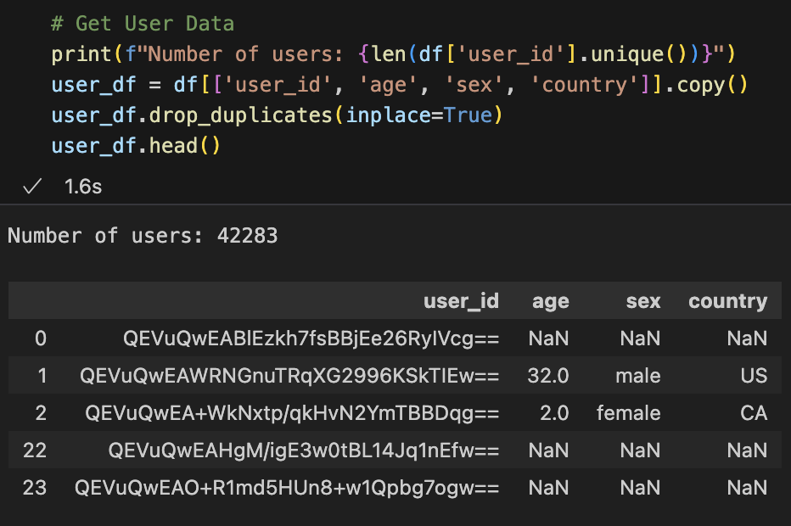
Get User Data
Get subset of data with drop duplicates for unique user info:
user_id, age, sex, and country

Slide 10
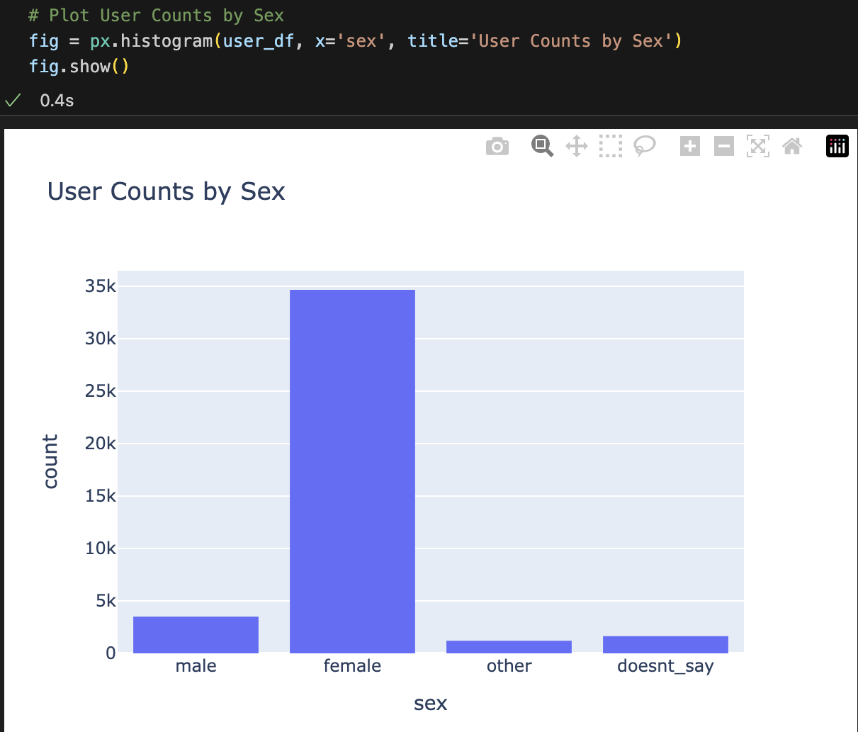
User Counts by Sex
Plot user counts by sex with Plotly express histogram
The vast majority of users (82%) are female

Slide 11
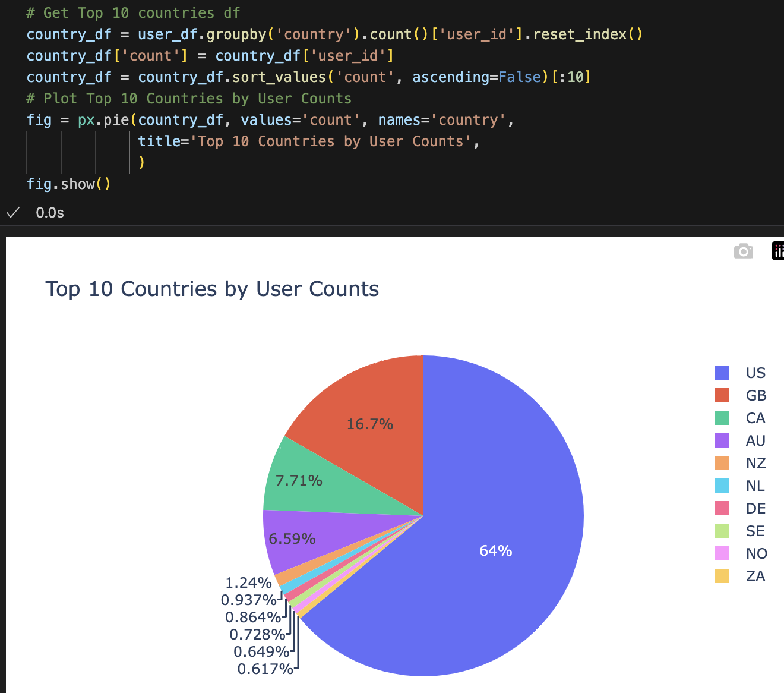
top 10 countries by user counts
Get top 10 countries with sorted (descending) groupby() counts
Plot with Plotly express pie chart
Top countries: US, followed by Great Britain, Canada, Australia, then New Zealand and others

Slide 12
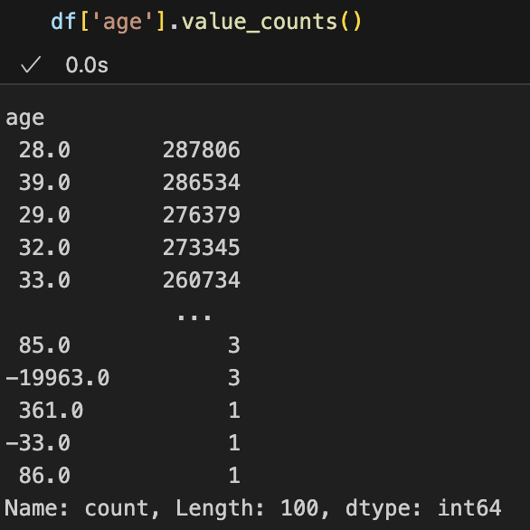
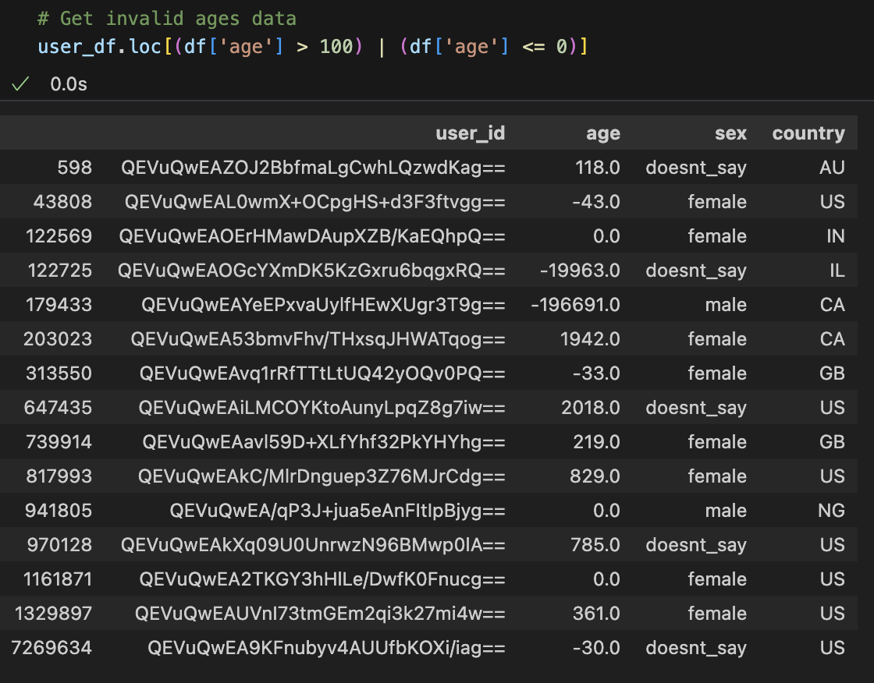
Preview User Age Data
There are invalid ages (> 100 or <= 0), so let's remove them next

Slide 13
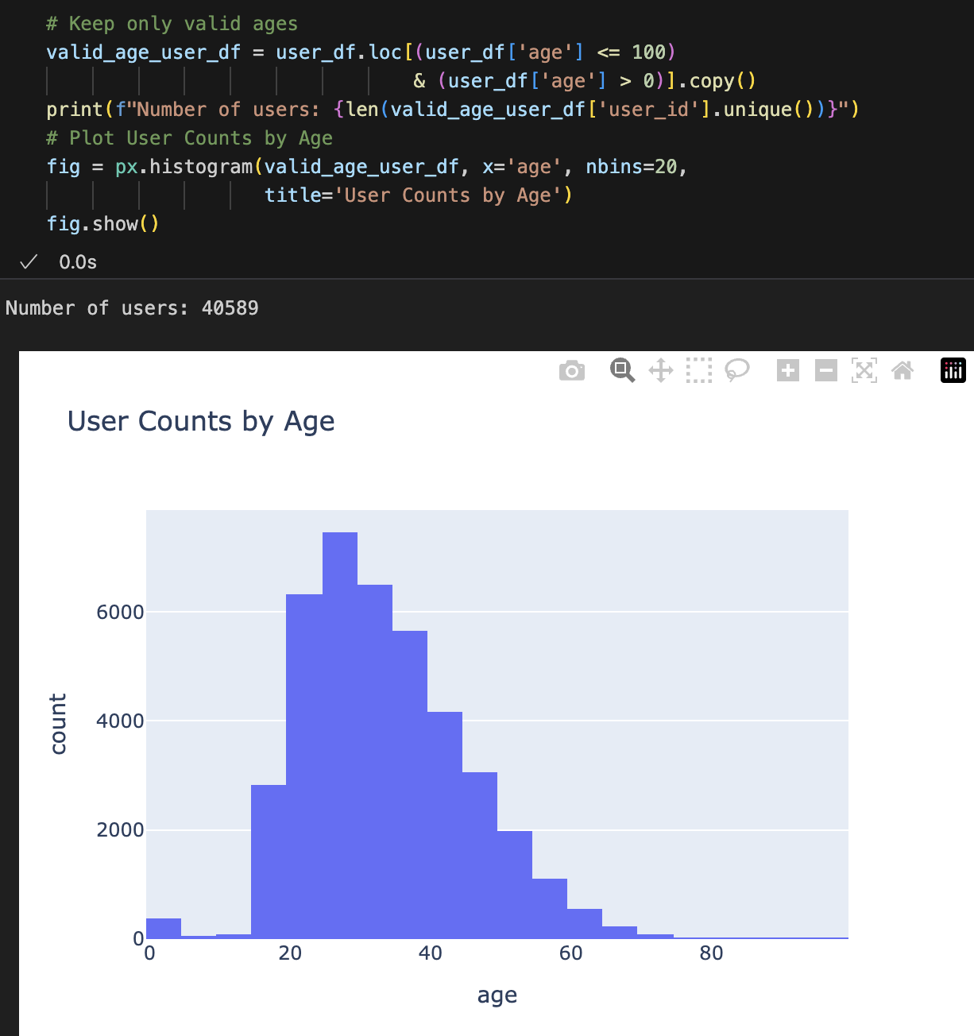
User Counts by Age
Get and plot user counts by (valid) age
Most users (7,475 or 18%) are 25-29
There is a good number of users (380) aged 0-4
Perhaps these users are parents tracking their baby's health

Slide 14
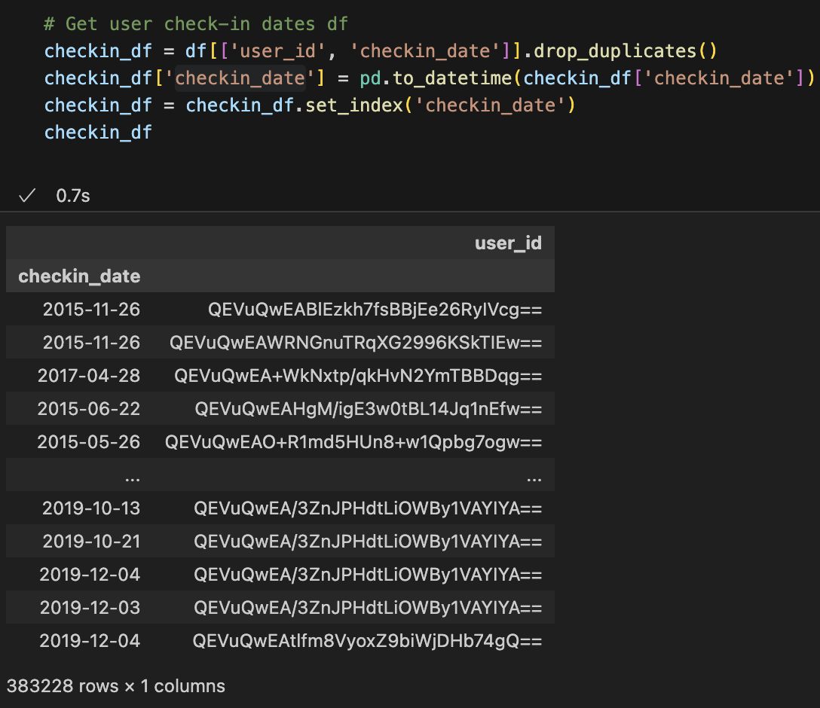
Get Check-in Dates
Get subset of data with unique check-in dates per user
Convert ‘checkin_date’ to datetime and set it as index

Slide 15
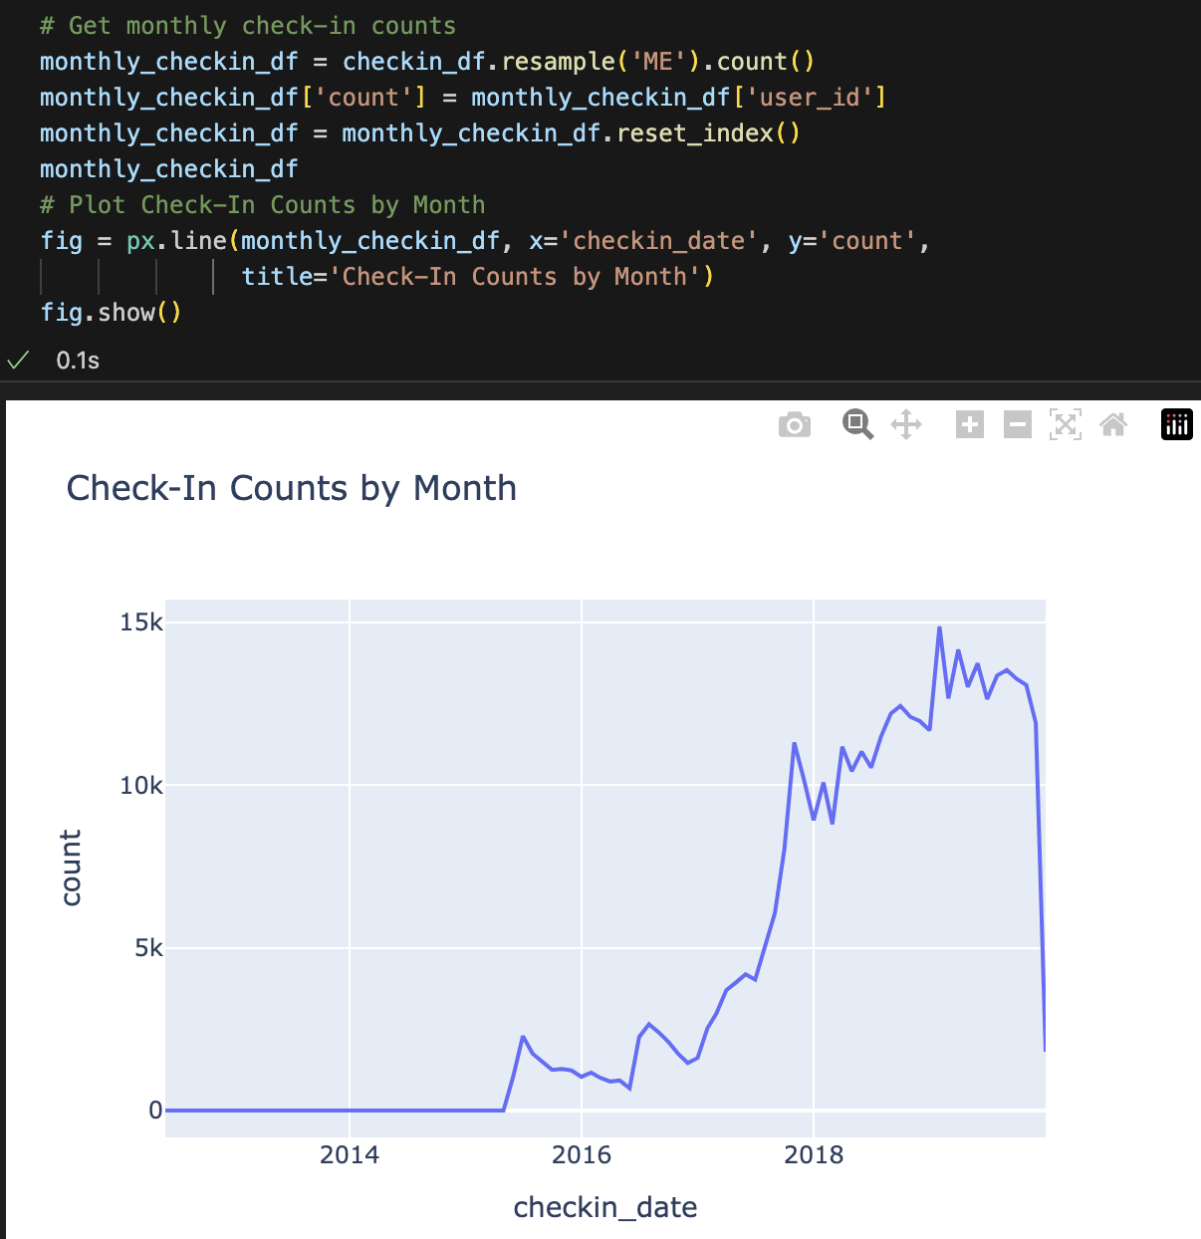
Check-in counts by month
Get check-in counts by month with .resample(‘ME’), or “Month End”
Plot with Plotly express line chart
The highest number of check-ins occurred in Jan 2019
This may be due to excitement for the new year and New Year's resolutions
There is a dropoff in check-in counts in Dec 2019
This may be due to the dataset ending with only partial data for the final month

Slide 16
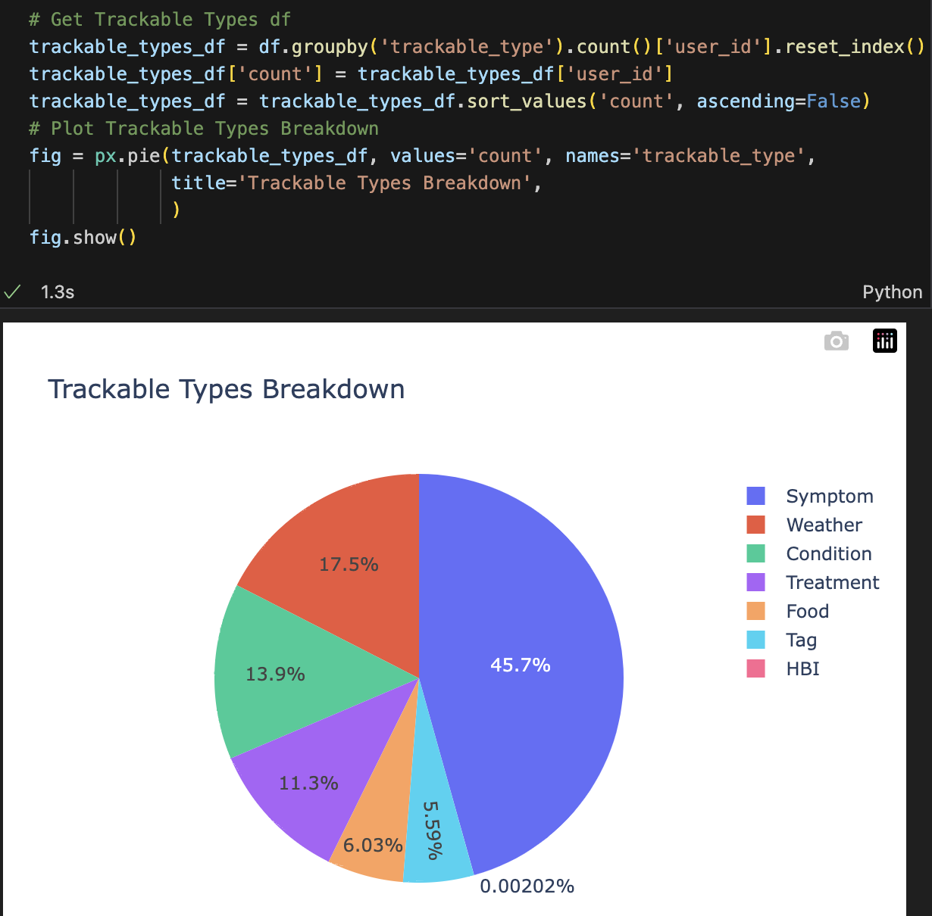
Trackable Types
Get trackable type counts with sorted (descending) groupby() counts
Plot with Plotly express pie chart
Top trackable types: Symptom, followed by Weather, Condition, Treatment, Food, then Tag and HBI

Slide 17
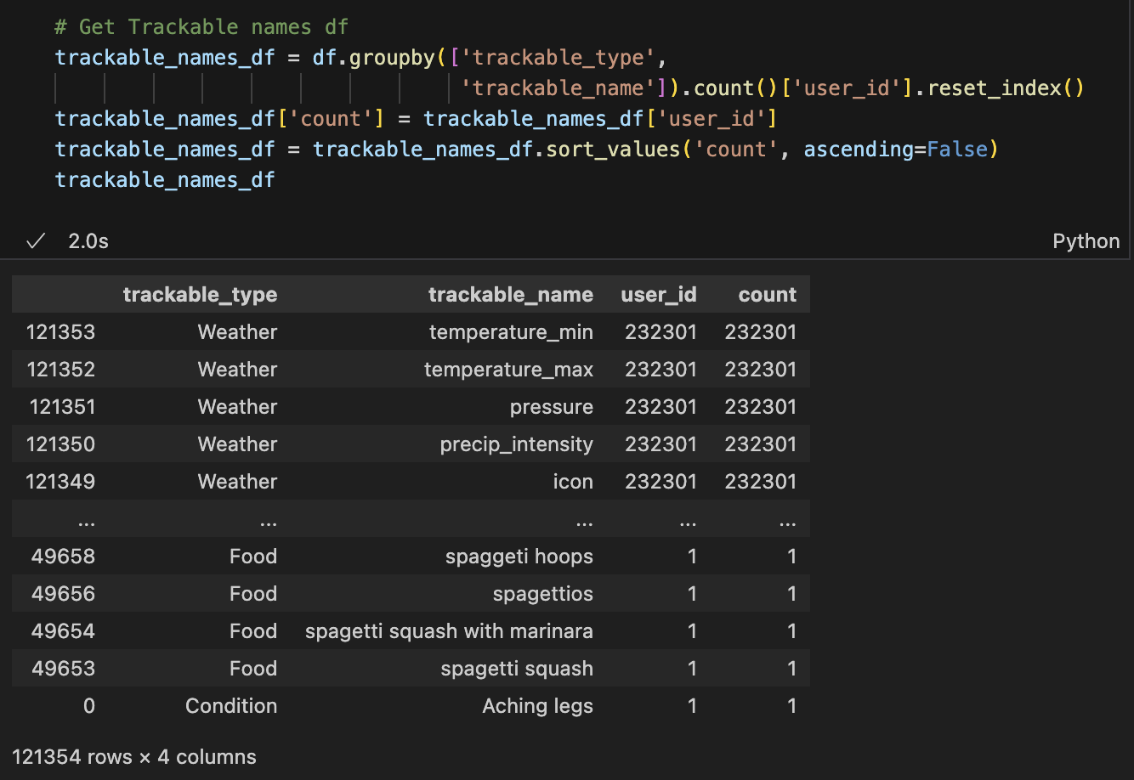
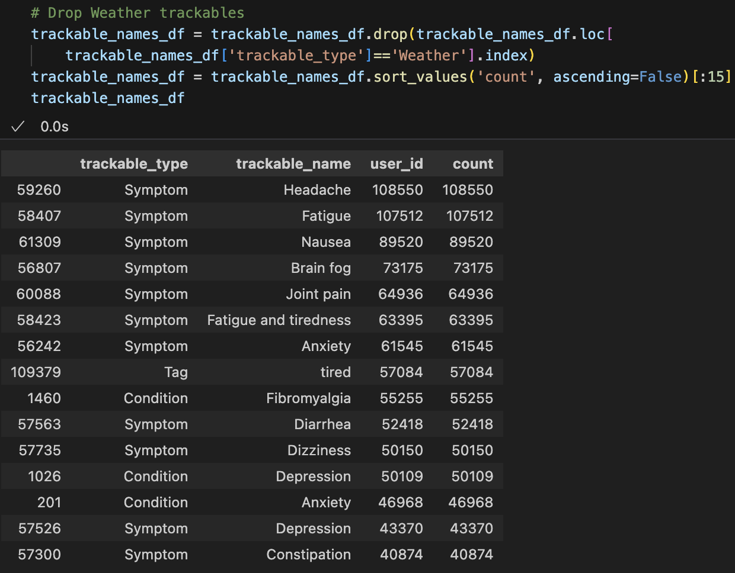
Get Trackable Names
Get trackable names with sorted (descending) groupby() counts
Let's drop Weather trackables, which are pulled via API and not user input

Slide 18
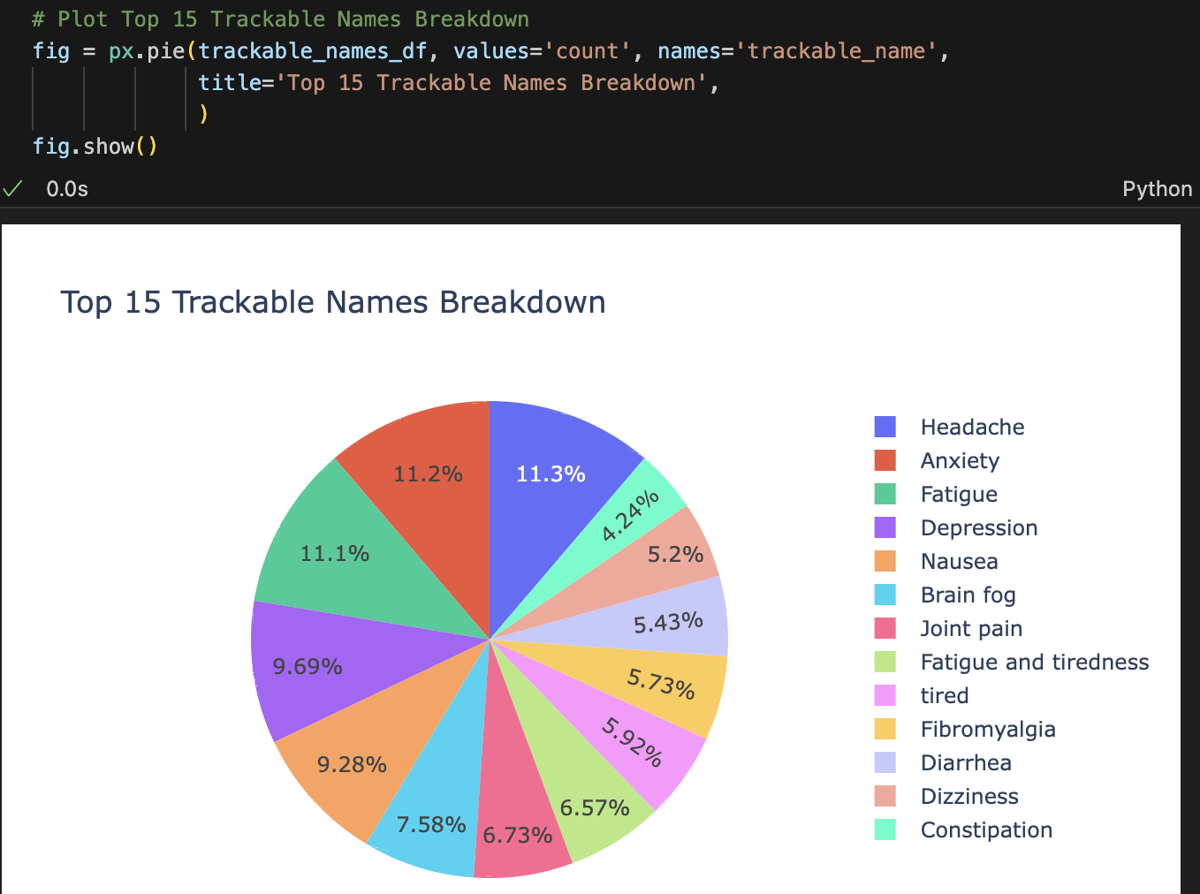
Top 15 Trackable Names
Plot with Plotly pie chart
The top trackable names: Headache, followed by Anxiety, Fatigue, Depression, and then Nausea and others

Slide 19

Data Preprocessing

Slide 21

Predictive Modeling

Slide 23
Conclusion

Slide 24
Thank you!

