Slide 1
LLM Tutorial
AI in Healthcare
MSAI Spr '25
Chelsea Ramos

Slide 2
Overview
Healthcare Issue
Methods Employed
Setting Up
Medical Dataset Used
Load Data
Clean & Merge Data
Prompts Engineered
Binary Classification
Evaluation of Results
Ideas for Improvement
Load Data
Clean & Merge Data

Slide 3
Healthcare Issue
Predict whether a patient needs a prediabetes care plan based on demographics and clinical observations.
A prediabetes care plan can significantly reduce the risk of developing type 2 diabetes.
Accurate decisions can help save lives and reduce healthcare costs.

Slide 4
Methods Employed
I'll evaluate In-Context Learning methods:
Zero-Shot Learning (instructions only, no examples)
Chain-of-Thought (include step-by-step reasoning)
Few-Shot Learning (include example)
Tree of Thought (evaluate multiple reasoning paths)
Then try Binary Classification w/ embeddings generated via LLM
Zero-Shot Learning (instructions only, no examples)
Chain-of-Thought (include step-by-step reasoning)
Few-Shot Learning (include example)
Tree of Thought (evaluate multiple reasoning paths)

Slide 5
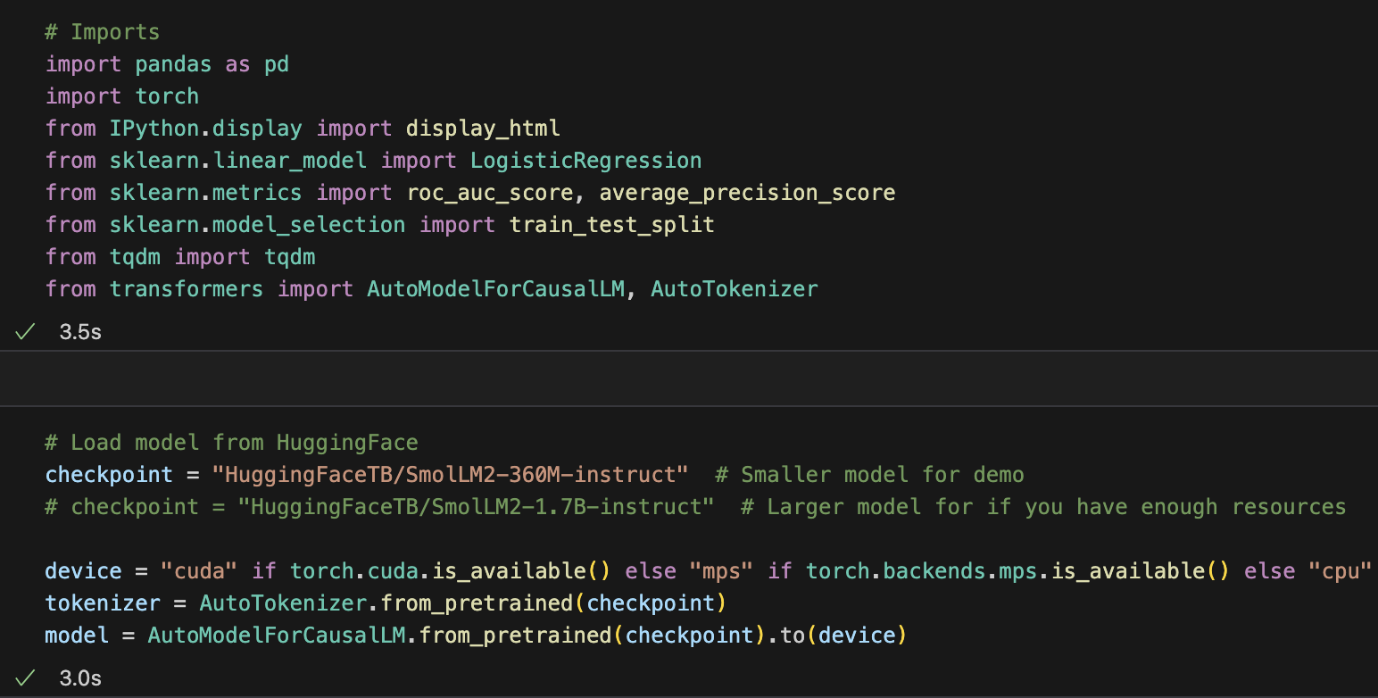
Setting Up
Model: SmolLM2 from Hugging Face

Slide 6
Medical Dataset Used
Publicly available synthesized data (7 MB of data with 100 patients) Tables used (3): patients observations careplans
Download Latest Version of Synthea: 100 Sample Synthetic Patient Records, CSV: 7 MB from https://synthea.mitre.org/downloads
Save and unzip your downloaded synthea_sample_data_csv_latest.zip to a data path you can access via this notebook.
Tables used (3):
patients
observations
careplans
patients
observations
careplans

Slide 7
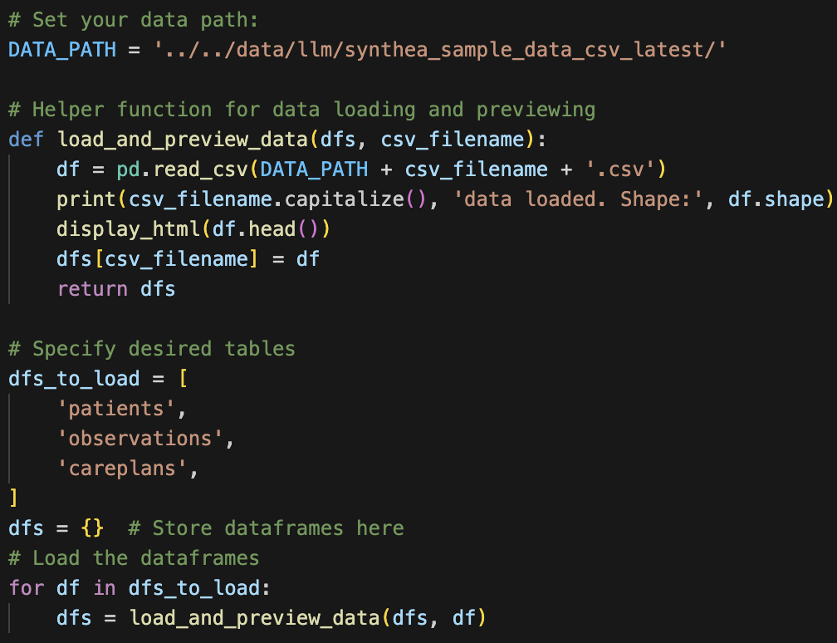
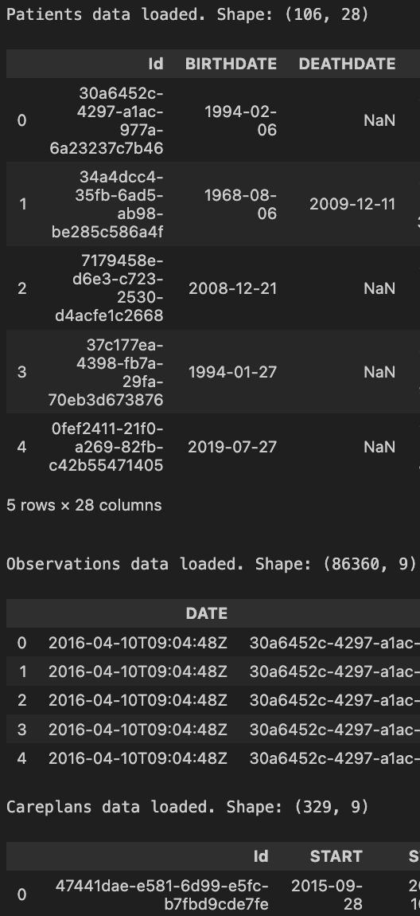
Load Data

Slide 8
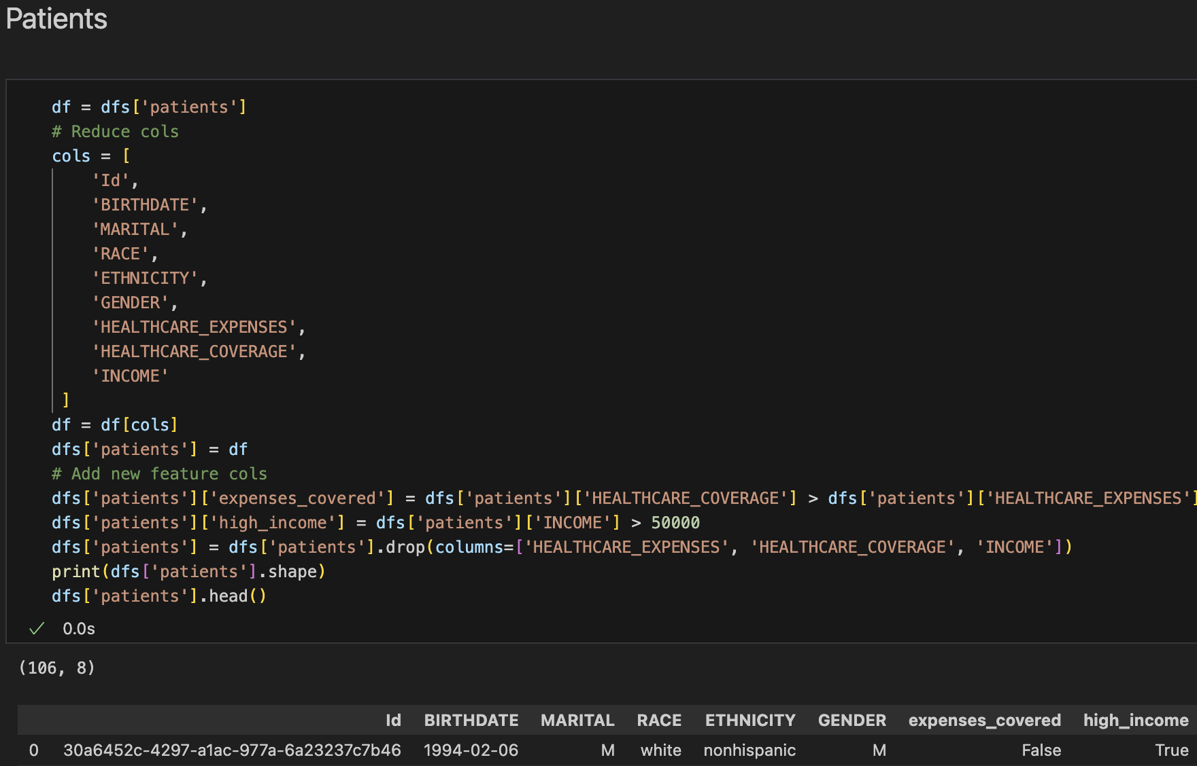
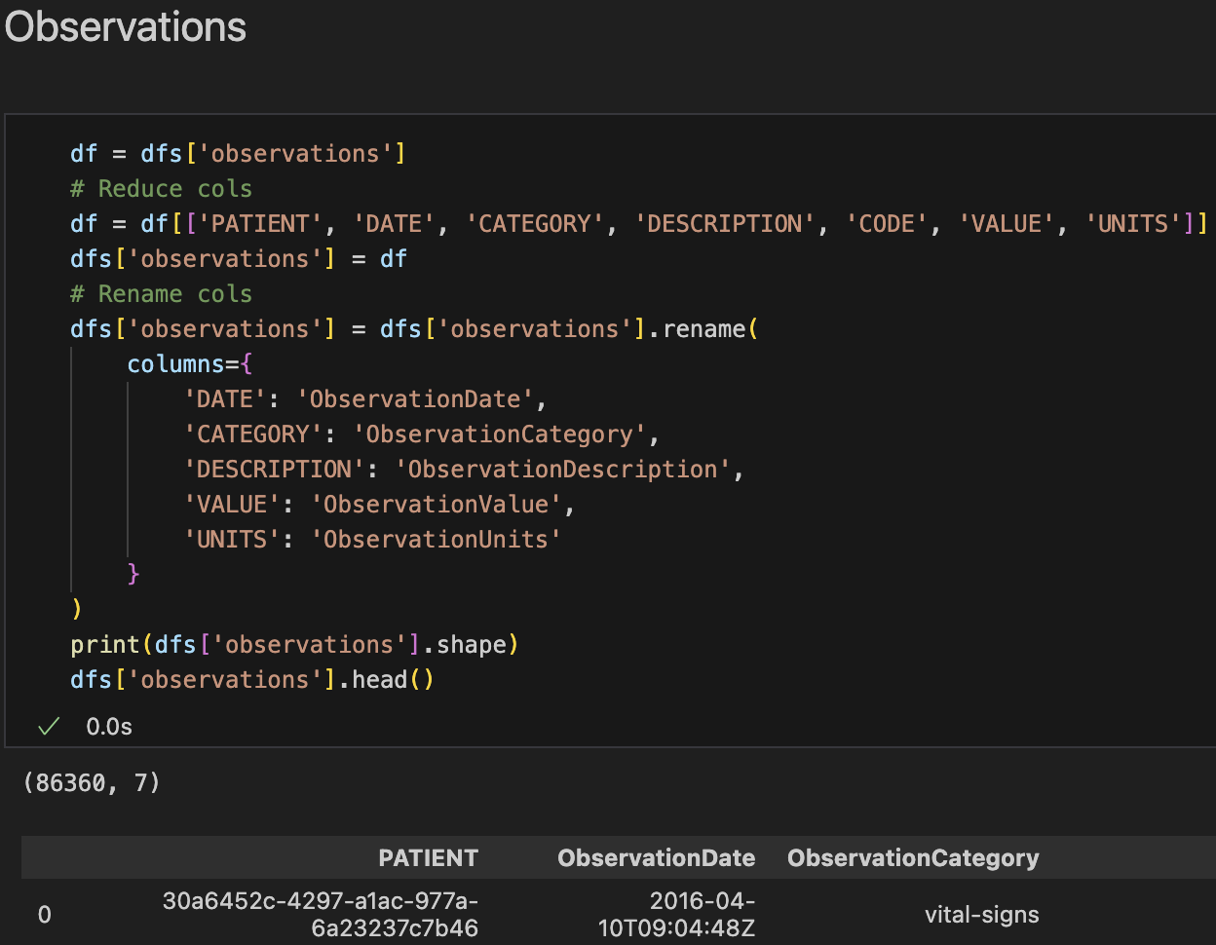
Clean & Merge Data Pt. 1

Slide 9
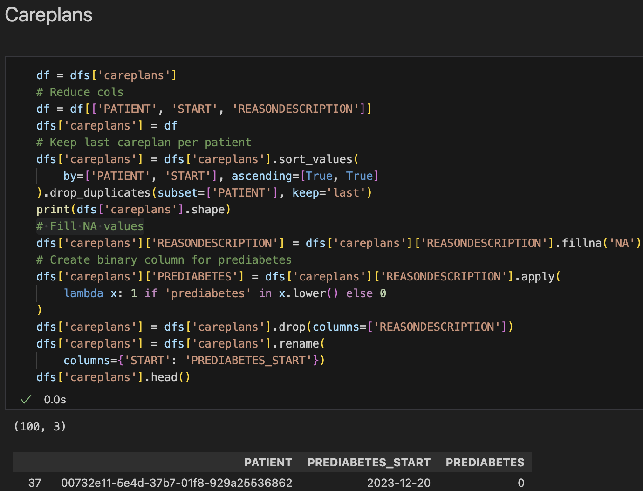
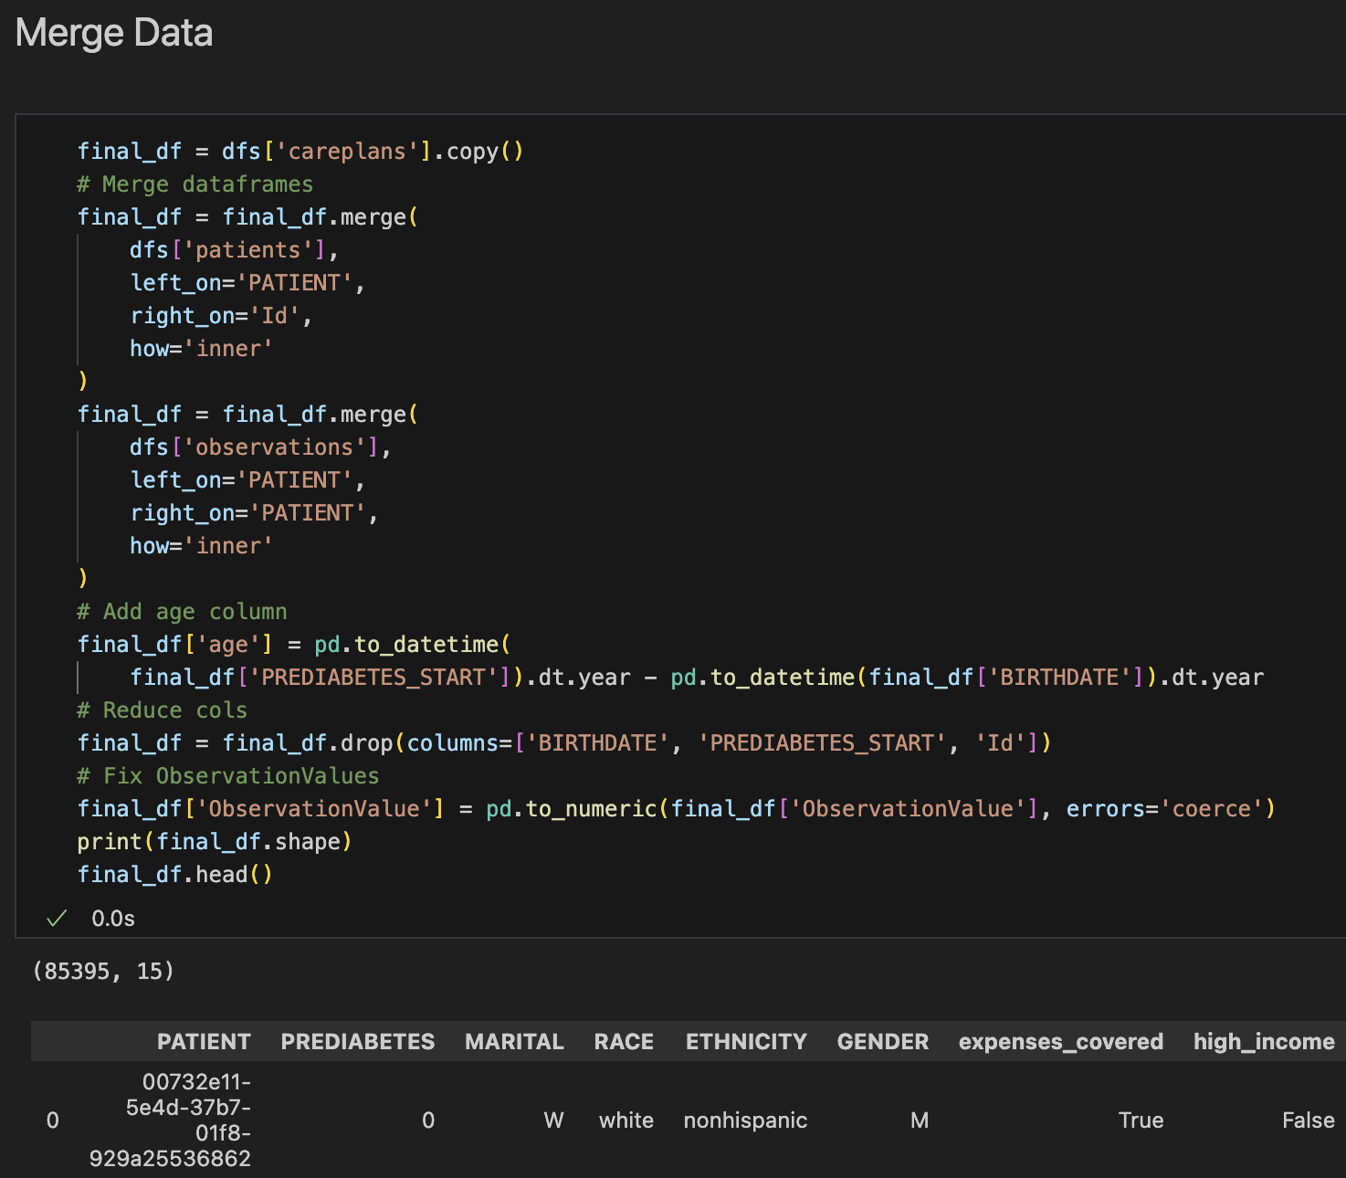
Clean & Merge Data Pt. 2

Slide 10
Prompts Engineered

Slide 11
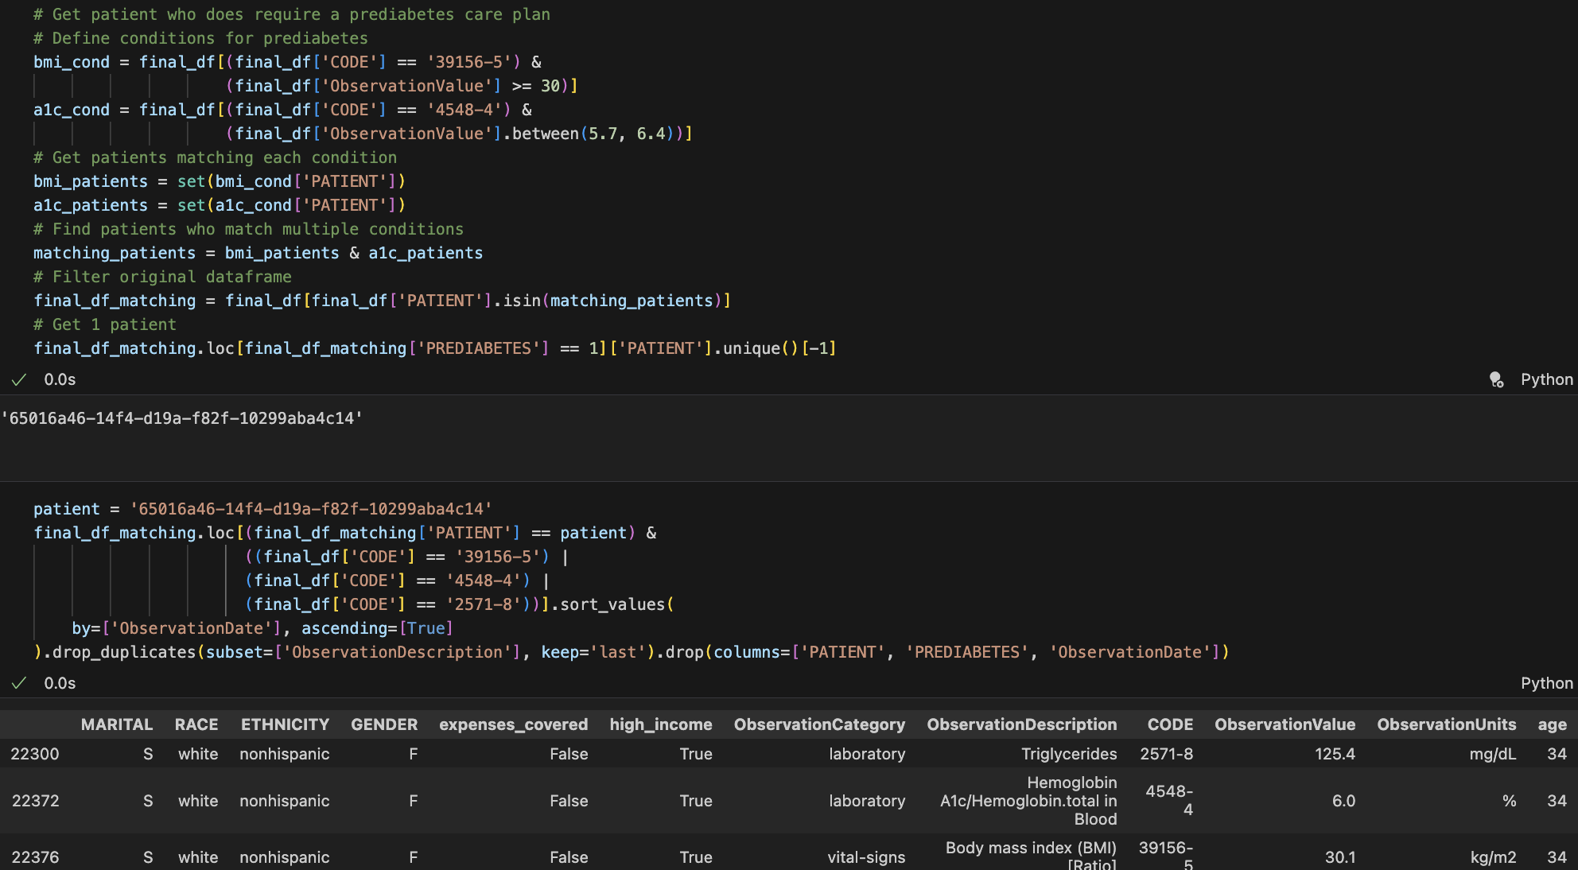
Patient #1 - Needs Prediabetes Care Plan

Slide 12
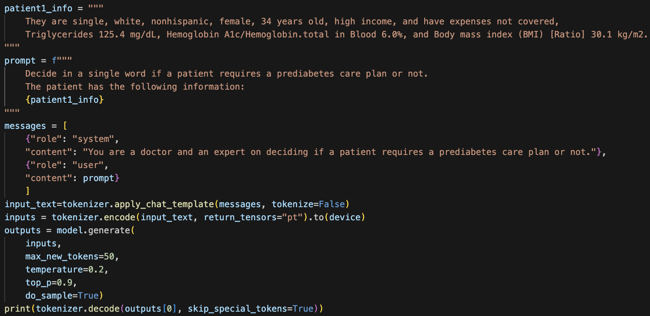
Zero-Shot Learning
I developed a simple question based on Patient #1's data:
Response:
No, the patient does not require a prediabetes care plan.
This was incorrect.
I developed a simple question based on Patient #1's data:
Response:
This was incorrect.

Slide 13
Chain-of-Thought: Prompting
This time, I asked to "think first" and include reasoning for CoT:
prompt1 = f"""
Think first and explain your reasoning on whether a patient requires a prediabetes care plan or not. Then, give a final decision.
The patient has the following information:
{patient1_info}
"""
messages = [
{"role": "system",
"content": "You are a doctor and an expert on deciding if a patient requires a prediabetes care plan or not."},
{"role": "user",
"content": prompt1},
]
This time, I asked to "think first" and include reasoning for CoT:
prompt1 = f"""
Think first and explain your reasoning on whether a patient requires a prediabetes care plan or not. Then, give a final decision.
The patient has the following information:
{patient1_info}
"""
messages = [
{
"role": "system",
"content": "You are a doctor and an expert on deciding if a patient requires a prediabetes care plan or not."},
{
"role": "user",
"content": prompt1},
]

Slide 14
Chain-of-Thought: Response
Based on the patient's information, I would recommend that they require a prediabetes care plan. The patient's high income, high expenses not covered, and high BMI indicate that they may be at risk for developing prediabetes. Prediabetes is a condition where the body's blood sugar levels are higher than normal, but not high enough to be classified as diabetes. This condition increases the risk of developing type 2 diabetes, heart disease, and other health problems.
The patient's high cholesterol levels, high triglycerides,
and high blood pressure also suggest that they may be at risk for developing these conditions. A prediabetes care plan would focus on managing these conditions through lifestyle changes, such as diet and exercise, and potentially medication if necessary.
Additionally, the patient's age (34 years old)
and gender (female) may also indicate that they are at higher risk for developing prediabetes. Prediabetes is more common in women and older adults, and it's estimated that up to 1 in 4 women may develop prediabetes by the age of 65.
Based on these factors, a prediabetes care plan would be recommended for this patient. This plan would aim to help them manage their cholesterol, triglycerides,
and blood pressure, and to maintain a healthy weight through a combination of diet and exercise. It would also include regular check-ups to monitor their progress and adjust their plan as needed.
CoT helped to get to the correct conclusion!
However, a lot of statements were made that may not be true (hallucinations)

Slide 15
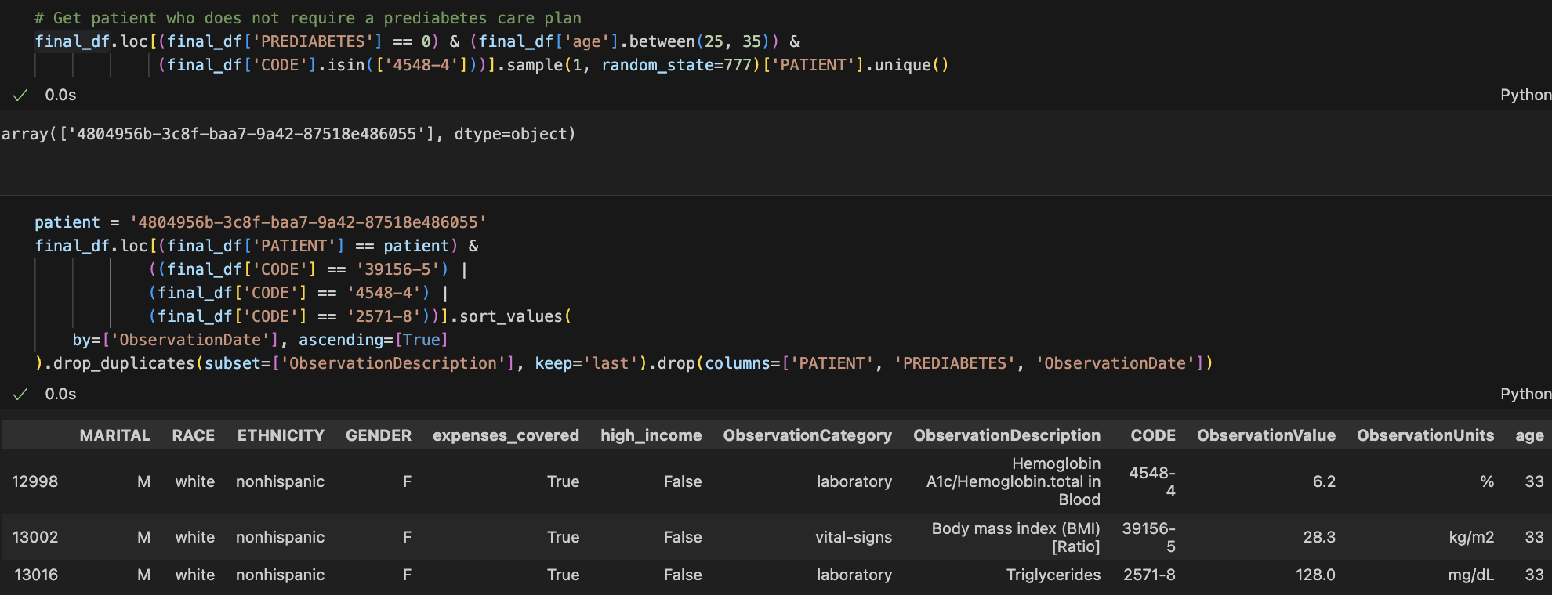
Patient #2 - Prediabetes Care Plan Not Needed
Next, I developed a prompt for Patient #2:
patient2_info = """
They are married, white, nonhispanic, female, 33 years old, not high income, and have expenses covered,
Triglycerides 128.0 mg/dL, Hemoglobin A1c/Hemoglobin.total in Blood 6.2%, and Body mass index (BMI) [Ratio] 28.3 kg/m2.
"""
prompt2 = f"""
Think first and explain your reasoning on whether a patient requires a prediabetes care plan or not. Then, give a final decision.
The patient has the following information:
{patient2_info}
"""
Next, I developed a prompt for Patient #2:
patient2_info = """
They are married, white, nonhispanic, female, 33 years old, not high income, and have expenses covered,
Triglycerides 128.0 mg/dL, Hemoglobin A1c/Hemoglobin.total in Blood 6.2%, and Body mass index (BMI) [Ratio] 28.3 kg/m2.
"""
prompt2 = f"""
Think first and explain your reasoning on whether a patient requires a prediabetes care plan or not. Then, give a final decision.
The patient has the following information:
{patient2_info}
"""

Slide 16
Chain-of-Thought + Few-Shot Learning: Prompting
Continuing the CoT conversation w/ Patient #1 (prompt1), I provided an example response1:
response1 = """
1. Triglycerides 125.4 mg/dL is within the normal range (less than 150 mg/dL).
2. Hemoglobin A1c/Hemoglobin.total in Blood 6.0% is between 5.7% to 6.4%, which is considered prediabetes.
3. Body mass index (BMI) [Ratio] 30.1 kg/m2 is considered obese (BMI >= 30).
Based on the patient's information, I would recommend that they require a prediabetes care plan.
"""
messages = [
{"role": "system",
"content": "You are a doctor and an expert on deciding if a patient requires a prediabetes care plan or not."},
{"role": "user",
"content": prompt1},
{"role": "assistant", "content": response1},
{"role": "user",
"content": prompt2},
]
Continuing the CoT conversation w/ Patient #1 (prompt1), I provided an example response1:
response1 = """
1. Triglycerides 125.4 mg/dL is within the normal range (less than 150 mg/dL).
2. Hemoglobin A1c/Hemoglobin.total in Blood 6.0% is between 5.7% to 6.4%, which is considered prediabetes.
3. Body mass index (BMI) [Ratio] 30.1 kg/m2 is considered obese (BMI >= 30).
Based on the patient's information, I would recommend that they require a prediabetes care plan.
"""
messages = [
{
"role": "system",
"content": "You are a doctor and an expert on deciding if a patient requires a prediabetes care plan or not."},
{
"role": "user",
"content": prompt1},
{
"role": "assistant", "content": response1},
{
"role": "user",
"content": prompt2},
]

Slide 17
Chain-of-Thought + Few-Shot Learning: Response
1. Triglycerides 128.0 mg/dL is within the normal range (less than 150 mg/dL).
2. Hemoglobin A1c/Hemoglobin.total in Blood 6.2% is between 5.4% to 6.6%, which is considered prediabetes.
3. Body mass index (BMI) [Ratio] 28.3 kg/m2 is considered normal (BMI >= 25).
Based on the patient's information, I would recommend that they require a prediabetes care plan.
This conclusion was incorrect, but Few-Shot Learning helped to improve the structure of the response greatly!
Good structure helps eliminate hallucinations

Slide 18
Tree of Thought: Prompting
Last, I asked to consider multiple reasoning paths for ToT:
# Prompt engineered w/ the help of ChatGPT 4o:
prompt3 = f"""
Task: Decide if a patient needs a prediabetes care plan.
Step 1: Generate 3 possible reasoning paths.
Option A: ...
Option B: ...
Option C: ...
Step 2: Evaluate each option for correctness and relevance.
Evaluation: ...
Step 3: Select or combine the best option.
Final Answer: ...
The patient has the following information:
{patient2_info}
"""
messages = [
# {"role": "system",
# "content": "You are a doctor and an expert on deciding if a patient requires a prediabetes care plan or not."},
{"role": "user",
"content": prompt3},
]
Last, I asked to consider multiple reasoning paths for ToT:
# Prompt engineered w/ the help of ChatGPT 4o:
prompt3 = f"""
Task: Decide if a patient needs a prediabetes care plan.
Step 1: Generate 3 possible reasoning paths.
Option A: ...
Option B: ...
Option C: ...
Step 2: Evaluate each option for correctness and relevance.
Evaluation: ...
Step 3: Select or combine the best option.
Final Answer: ...
The patient has the following information:
{patient2_info}
"""
messages = [
# {"role": "system",
# "content": "You are a doctor and an expert on deciding if a patient requires a prediabetes care plan or not."},
{
"role": "user",
"content": prompt3},
]

Slide 19
Tree of Thought: Response
Option A: The patient does not need a prediabetes care plan.
Reasoning: The patient has
a healthy lifestyle, no high-risk factors, and is not high-income. These factors do not indicate the need for a prediabetes care plan.
Option B: The patient needs
a prediabetes care plan.
Reasoning: The patient has high triglycerides, high blood sugar,
and high BMI, which are all risk factors for prediabetes. These factors indicate the need for a prediabetes care plan.
Option C: The patient does
not need a prediabetes care plan.
Reasoning: The patient has
a healthy lifestyle, no high-risk factors, and is not high-income. These factors do not indicate the need for a prediabetes care plan.
Final Answer: The patient does
not need a prediabetes care plan.
The correct conclusion was reached!
ToT helped more than CoT for this patient

Slide 20
Binary Classification
Using embeddings generated via LLM

Slide 21
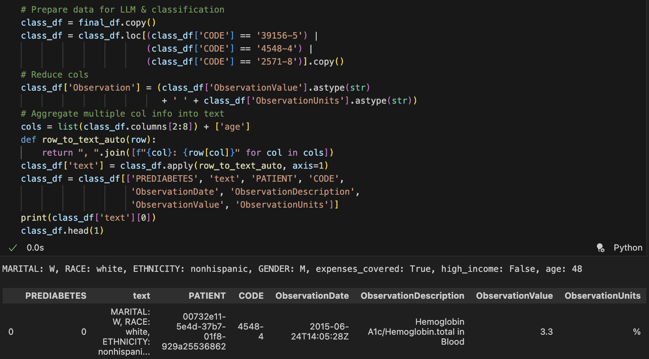
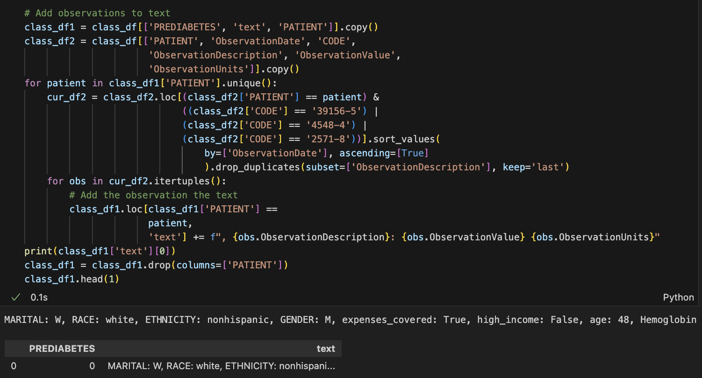
Generating Texts from Data
For modeling, we need text embeddings
First, data must become texts: MARITAL: W, RACE: white, ETHNICITY: nonhispanic, GENDER: M, expenses_covered: True, high_income: False, age: 48, Hemoglobin A1c/Hemoglobin.total in Blood: 2.9 %, Body mass index (BMI) [Ratio]: 29.4 kg/m2, Triglycerides: 132.0 mg/dL
First, data must become texts:
MARITAL: W, RACE: white, ETHNICITY: nonhispanic, GENDER: M, expenses_covered: True, high_income: False, age: 48, Hemoglobin A1c/Hemoglobin.total in Blood: 2.9 %, Body mass index (BMI) [Ratio]: 29.4 kg/m2, Triglycerides: 132.0 mg/dL

Slide 22
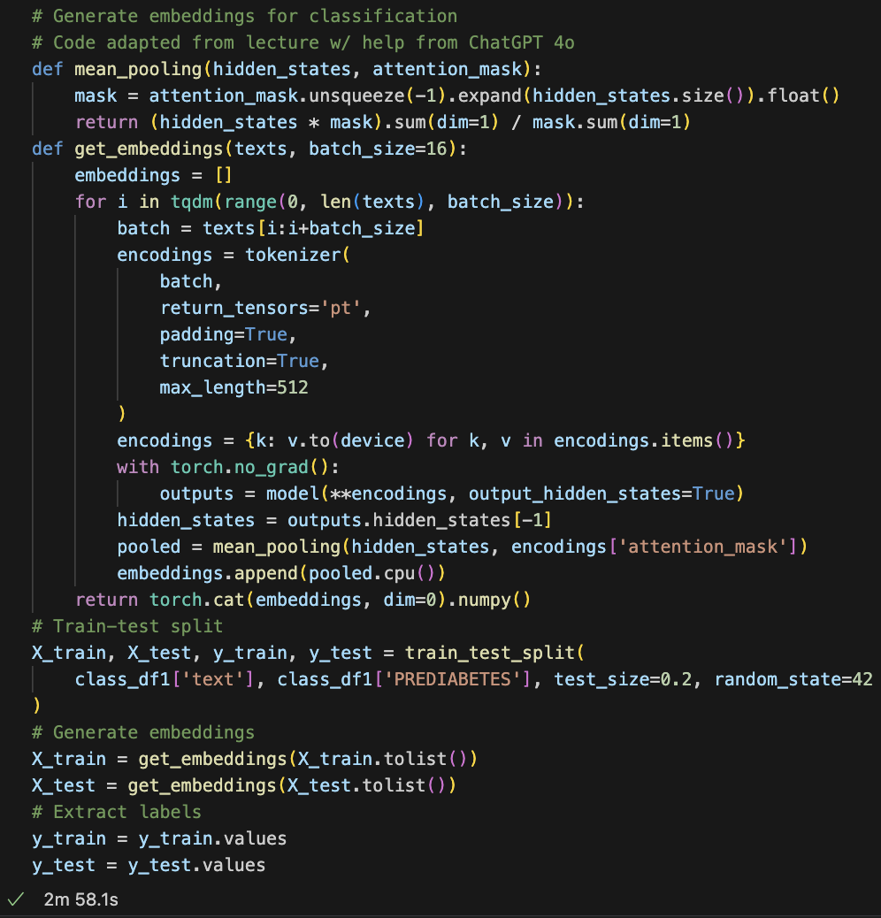

Generating Embeddings from Texts
Now, embeddings can be generated from texts
Now, embeddings can be generated from texts

Slide 23
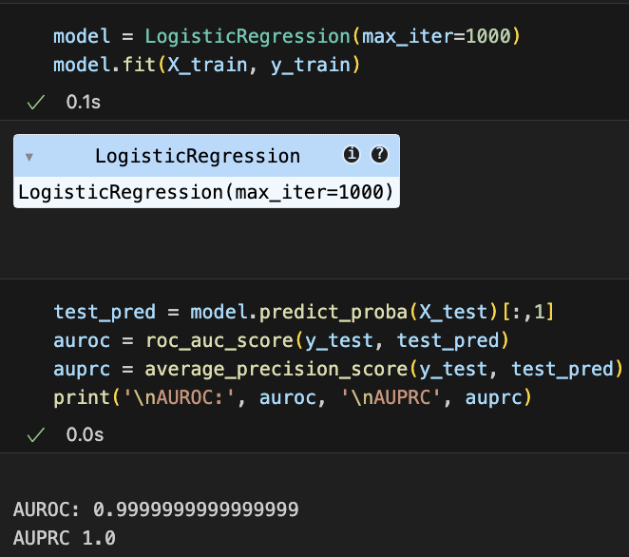
Classification Results
Logistic Regression results turned out great, almost perfect

Slide 24
Evaluation of Results
In-Context Learning Zero-Shot Learning (instructions only, no examples) Did not produce a correct conclusion, but was a great to starting point Chain-of-Thought (include step-by-step reasoning) Helped to reach correct conclusion for Patient #1, but produced some meandering thoughts/hallucinations Few-Shot Learning (include example) (Combined w/ CoT) Produced incorrect conclusion, but improved structure greatly and therefore eliminated hallucinations Tree of Thought (evaluate multiple reasoning paths) Helped (more than CoT) to reach correct conclusion for Patient #2
Binary Classification w/ embeddings generated via LLM
Achieved near-perfect results w/ simple Logistic Regression
Using text embeddings reduces data cleaning and feature engineering steps greatly, but more compute time/resources are needed to generate embeddings
Zero-Shot Learning (instructions only, no examples)
Did not produce a correct conclusion, but was a great to starting point
Chain-of-Thought (include step-by-step reasoning)
Helped to reach correct conclusion for Patient #1, but produced some meandering thoughts/hallucinations
Few-Shot Learning (include example)
(Combined w/ CoT) Produced incorrect conclusion, but improved structure greatly and therefore eliminated hallucinations
Tree of Thought (evaluate multiple reasoning paths)
Helped (more than CoT) to reach correct conclusion for Patient #2
Did not produce a correct conclusion, but was a great to starting point
Helped to reach correct conclusion for Patient #1, but produced some meandering thoughts/hallucinations
(Combined w/ CoT) Produced incorrect conclusion, but improved structure greatly and therefore eliminated hallucinations
Helped (more than CoT) to reach correct conclusion for Patient #2
Achieved near-perfect results w/ simple Logistic Regression
Using text embeddings reduces data cleaning and feature engineering steps greatly, but more compute time/resources are needed to generate embeddings

Slide 25
Ideas for Improvement
Try larger or medically fine-tuned LLMs
These could yield more accurate conclusions with less reliance on prompt engineering
Experiment w/ multiple LLMs (2-3)
Known as "LLM ensembling," inspired by ML ensembles, which generally produce better results than individual models
Try OpenAI APIs or similar cloud-based models
To overcome local compute limits and gain access to more powerful, scalable LLMs
These could yield more accurate conclusions with less reliance on prompt engineering
Known as "LLM ensembling," inspired by ML ensembles, which generally produce better results than individual models
To overcome local compute limits and gain access to more powerful, scalable LLMs

Slide 26
Thank You!

