Slide 1

NYC Restaurant Grades
By: Chelsea Prudencio

Slide 2
NYC Open Data: Restaurant Grades
Given by the Department of Health and Mental Hygiene (DOHMH). Each row in the dataset represents a restaurant inspection done by the NYC Department of Health.
The key fields I will be focusing on in my warehouse will be:
DBA (Restaurant Name)
Cuisine Description
Cuisine Type
Boro
Violation Description
Grade

Slide 3
Business Requirements
Identify NYC high risk areas based on Restaurant Grades
Analyze common factors influencing inspection grades
Identify recurring violations within different cuisine types Analyzing different inspection records to see if certain cuisine types have a commonality in specific violations.

Slide 4
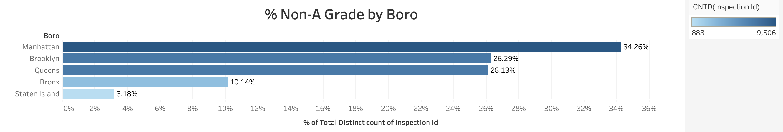

Slide 5
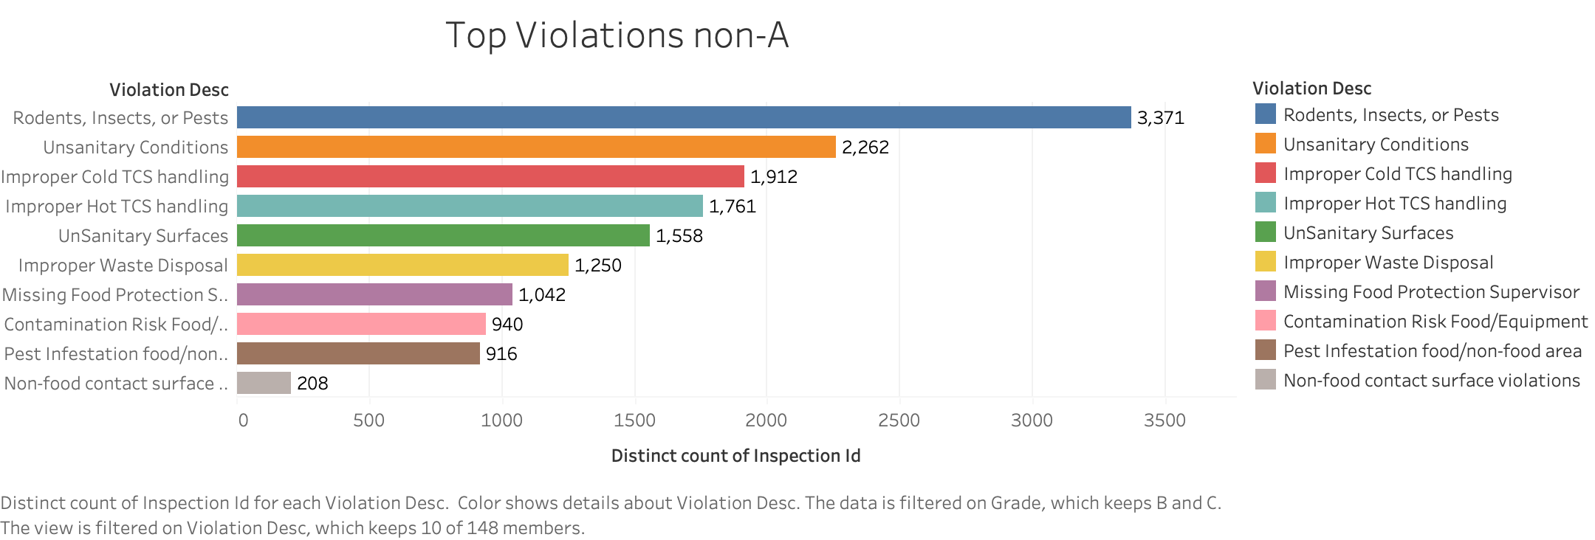

Slide 6
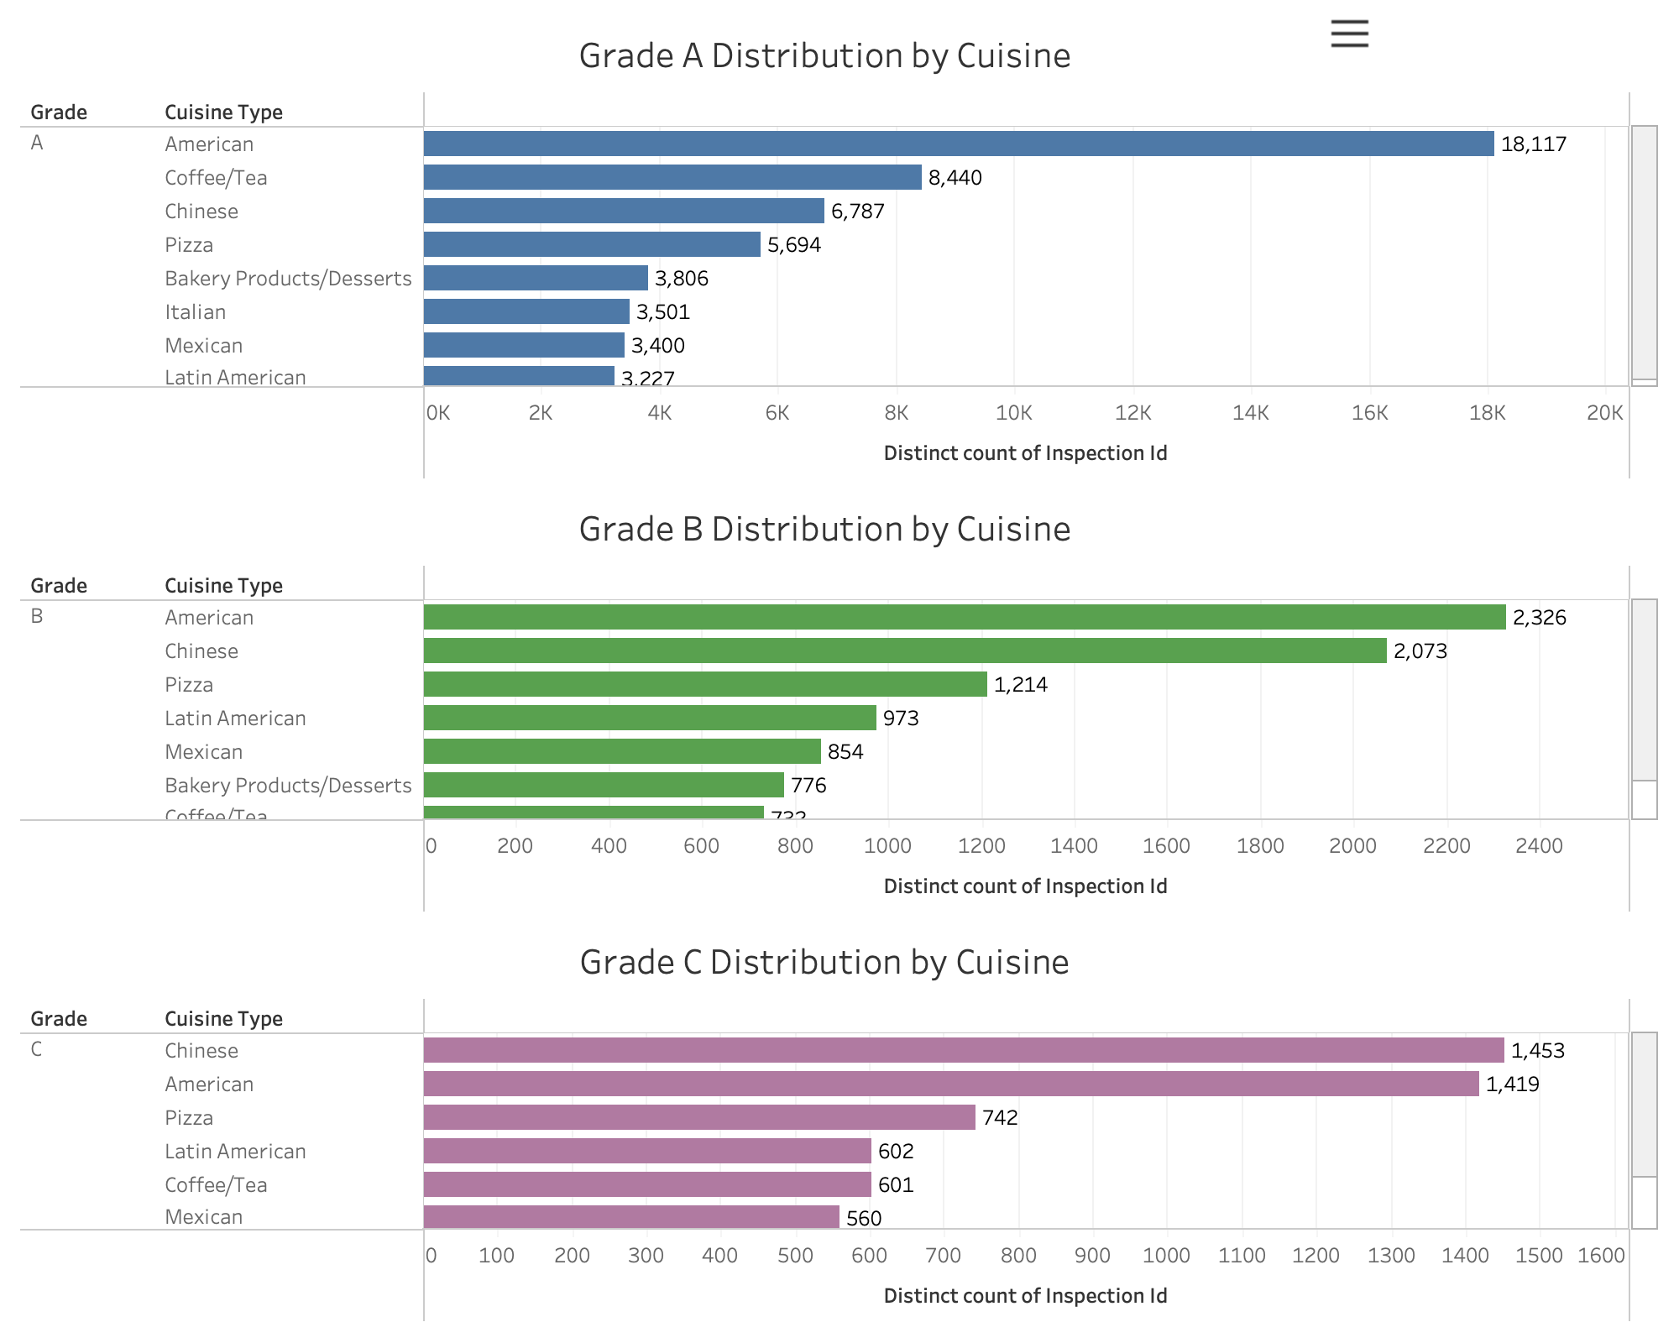

Slide 7
Takeaways
Manhattan, Brooklyn, and Queens account for over 85% of all non-A restaurant inspections
The most common violations tied to lower grades:
Pests
Unsanitary conditions, and
Improper temperature control
Chinese, American, and Latin American Cuisine show a higher proportion of B and C grades

Slide 8
Recommendations
NYC health inspectors should prioritize boroughs and ZIP codes with high concentrations of non-A grades for future inspection scheduling.
Restaurant owners can focus on violation categories most associated with grade drops, especially those involving pest control and food handling.
Food safety educators and consultants should create custom programs for at-risk cuisines, helping improve compliance and public trust.

