Slide 1
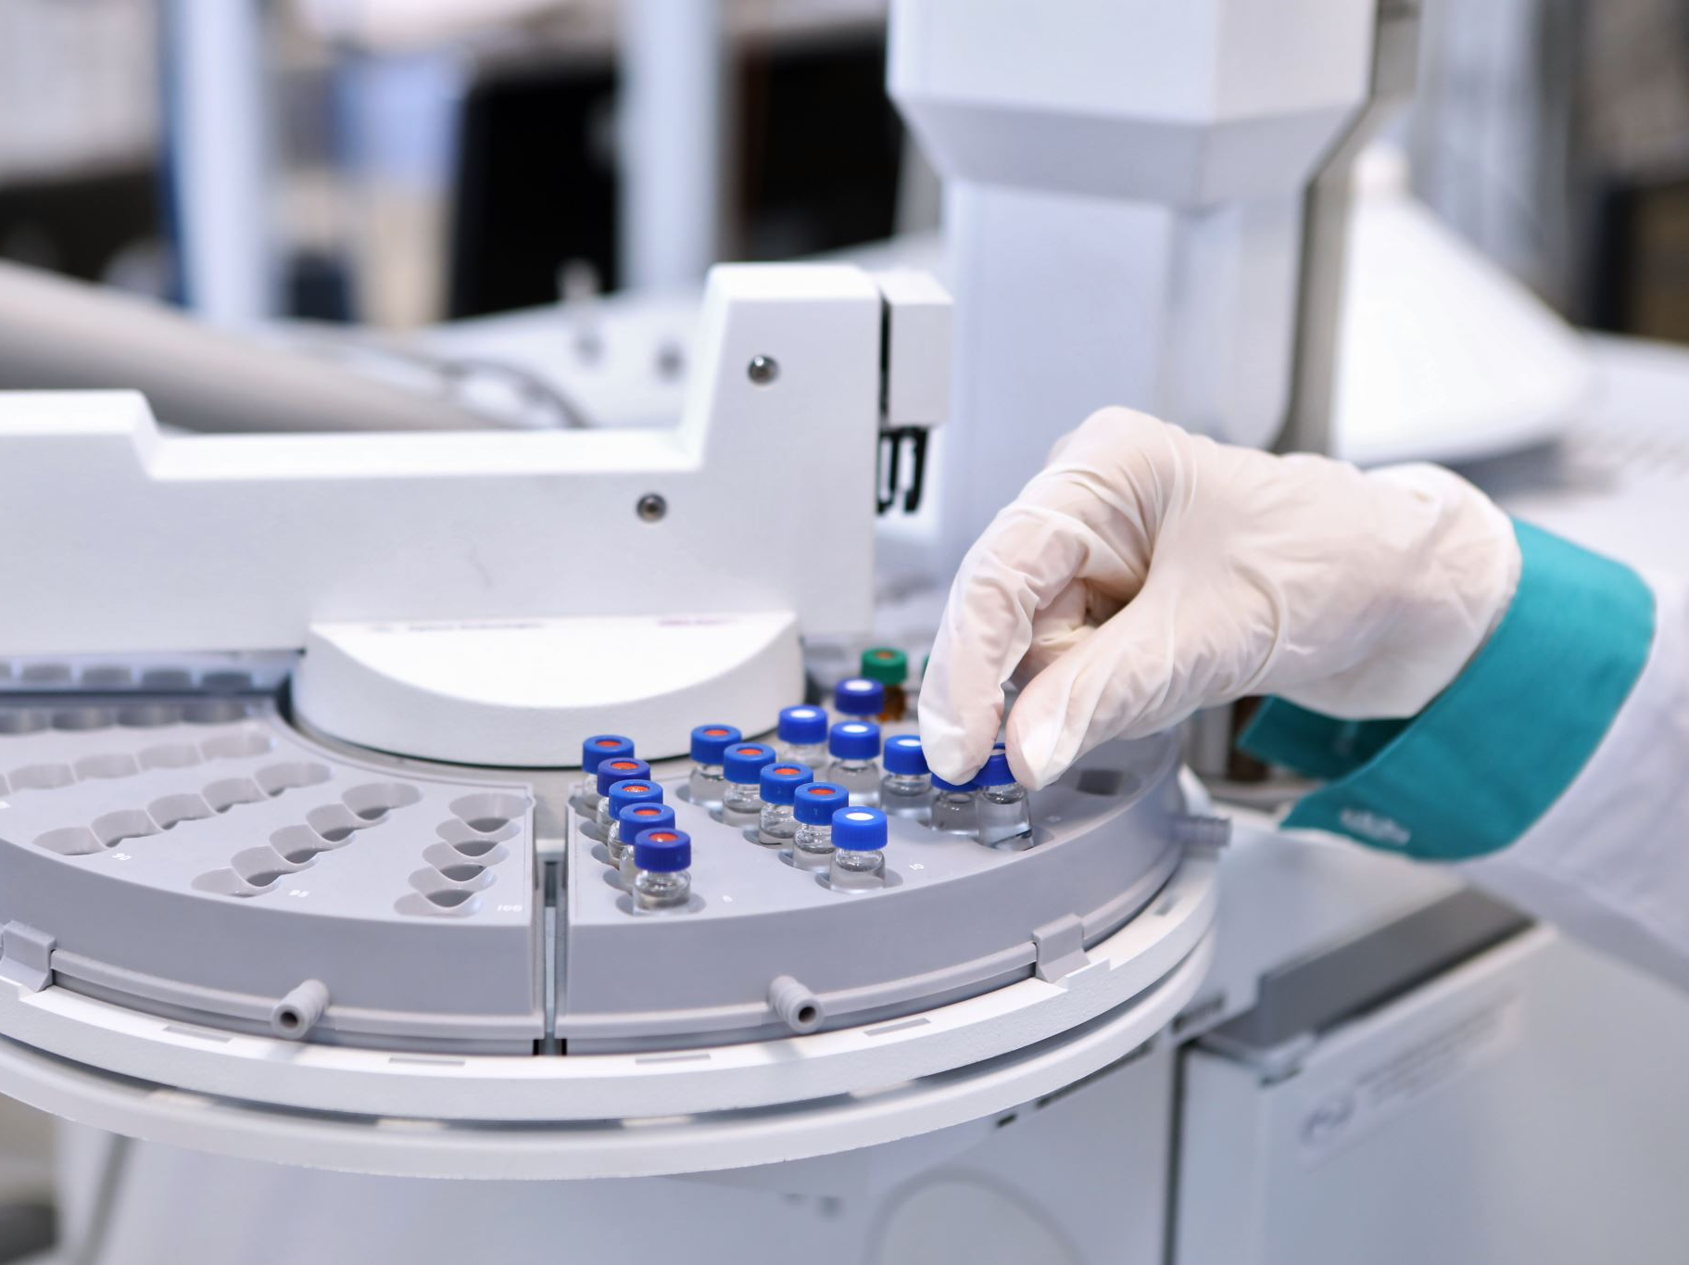
Predicting Diabetes Using Machine Learning
Chelsea Veneziano
Notes:
In this presentation, I walk through how I built a predictive model to help identify patients at risk for diabetes using clinical data.

Slide 2
Introduction
Diabetes affects over 37 million people in the U.S.
Many cases go undiagnosed until symptoms become severe.
Early detection is key to prevention and better health outcomes.
Machine learning offers a way to support faster, more accurate risk identification.
Notes:
This project focuses on predicting diabetes using machine learning. Diabetes is a growing health issue, and many people live with it without knowing. Early detection makes a big difference, but traditional screening doesn’t always catch it in time. With data and machine learning, we can build models that help flag high-risk individuals earlier so they can get care sooner and avoid long-term complications.

Slide 3
Project Goal
Use clinical data to develop a predictive model that can support early detection of diabetes and reduce the number of undiagnosed cases.
Notes:
The goal of this project was to create a predictive model that can help flag individuals who may be at risk for diabetes. The idea is to identify those at risk early, before symptoms get worse or go unnoticed. By using clinical data and testing different machine learning models, the goal was to find the approach that delivers the best balance of accuracy and real-world usefulness for healthcare providers.

Slide 4

Dataset Overview
Based on the Pima Indians Diabetes dataset (sourced from Kaggle)
768 patient records with 8 clinical features
Includes health metrics like Glucose, BMI, Blood Pressure, Insulin, and Age
Outcome column shows if the patient was diagnosed with diabetes (1 = Yes, 0 = No)
Notes:
This project used the Pima Indians Diabetes dataset, which is a well-known dataset in the health and data science community. It includes records from 768 female patients of Pima Indian heritage, each with eight clinical features such as glucose level, BMI, insulin, blood pressure, and age. The dataset also has a target variable that tells us whether each patient was diagnosed with diabetes or not. It’s a great dataset for testing classification models and learning from real health indicators.

Slide 5
Data Preparation
Replaced 0s with median values in features like Glucose, Insulin, BMI, etc.
Capped extreme outliers at the 99th percentile to reduce distortion
Standardized features to ensure fair comparison across variables
Split data into 80% training and 20% test set for model evaluation
Notes:
For data prep, I first cleaned up any 0 values in important health features like glucose and BMI—since 0 isn’t realistic for these, I treated them as missing and replaced them with the median. I also capped extreme values to reduce the impact of outliers, which can throw off machine learning models. After that, I standardized all the features so they were on the same scale. Finally, I split the dataset into training and test sets—80% for training the models and 20% for testing how well they generalize.

Slide 6
Key Features
Glucose and BMI were the strongest predictors in the final model
Higher glucose levels were clearly associated with increased diabetes risk
BMI also showed a meaningful difference between diabetic and non-diabetic groups
Feature importance and visualizations confirmed clinical relevance
Notes:
After training the models, glucose and BMI clearly emerged as the most important features for predicting diabetes. This result aligned well with clinical knowledge, as both are widely recognized risk factors. The visualizations showed noticeable differences between diabetic and non-diabetic patients based on these features, and the model’s feature importance scores supported those patterns. It was reassuring to see that the model’s behavior reflected real-world medical insights.

Slide 7
Models Used
Logistic Regression: A simple, interpretable starting point
Random Forest: A tree-based model that improves accuracy and handles complex data well
XGBoost: A powerful boosting algorithm tested for comparison
Notes:
I tested three models: Logistic Regression, Random Forest, and XGBoost. Logistic Regression was my baseline model. Random Forest and XGBoost are more complex and allow me to capture deeper, nonlinear patterns in the data. Testing multiple models gave me the ability to compare their strengths and weaknesses.

Slide 8
Evaluation Metrics
Accuracy: Overall correctness of the model
Precision: How often positive predictions were correct
Recall: How well the model found actual positive cases
F1-Score: Balance between precision and recall
ROC-AUC: Measures how well the model separates classes
Notes:
I used several evaluation metrics to get a full picture of how the models performed. Accuracy tells us how often the model was right overall. Precision focuses on how many of the positive predictions were actually correct, while recall shows how well the model found actual diabetes cases. The F1-score balances both precision and recall, which is especially important in medical settings. Lastly, the ROC-AUC score shows how well the model can distinguish between diabetic and non-diabetic patients. Together, these metrics helped me decide which model was most reliable.

Slide 9
Model Results
Logistic Regression: 77% accuracy, 65% recall
Random Forest: 77% accuracy, 69% recall (best overall balance)
XGBoost: 73% accuracy, 73% recall (more false positives)
Notes:
Logistic Regression gave me a solid baseline with 77% accuracy, but its recall for diabetic patients was the lowest at 65%. Random Forest matched that 77% accuracy and raised recall to 69%, making it the most balanced model for this project. XGBoost had the highest recall at 73%, but lower accuracy (73%) and lower precision, which meant more false positives. Based on this comparison, Random Forest was the most reliable and practical option for identifying at-risk individuals.

Slide 10
Final Model Choice
Random Forest was the most balanced model overall
Tied for the highest accuracy (77%)
Strong recall for identifying diabetic patients (69%)
Balanced performance across all evaluation metrics
Notes:
After comparing all three models, Random Forest stood out as the best choice. It tied for the highest accuracy at 77% and was the most balanced when looking at precision, recall, and F1-score. This balance is especially important in medical predictions, where we want to avoid both false positives and false negatives. That’s why I selected Random Forest as the final model for this project

Slide 11
Conclusion
Random Forest provided the best overall balance for predicting diabetes
Glucose and BMI were the most influential features
Model results supported what is already known in clinical practice
Predictive modeling can help identify high-risk patients earlier
Notes:
In the end, Random Forest was the most reliable model for predicting diabetes. It provided a strong balance of accuracy and recall, and its feature importance scores identified glucose and BMI as the top predictors, both of which are already known to be key clinical indicators. The fact that the model's results aligned with medical knowledge gave me more confidence in its usefulness. Overall, this project shows how predictive modeling can support earlier identification of at-risk individuals and help guide more timely interventions.

Slide 12
Future Improvements
Add
Add new features (e.g., family history, lifestyle factors) or combine with additional datasets
Fine-tune
Fine-tune model parameters to boost accuracy and reduce false predictions
Try
Try more advanced models like neural networks or support vector machines (SVM)
Notes:
To improve this project further, I could add more detailed features like family history or physical activity, or even bring in data from other sources. I’d also look into fine-tuning the model’s hyperparameters, which could help improve accuracy and reduce misclassifications. Lastly, I’d be interested in testing out more advanced models like neural networks or SVM to see if they can capture more complex patterns in the data.

Slide 13
Tools & Libraries
Python: Main programming language used for all analysis
Pandas & NumPy: For data cleaning, manipulation, and numerical operations
Scikit-learn: For building, training, and evaluating machine learning models
XGBoost: For testing a gradient boosting model
Seaborn & Matplotlib: For creating visualizations and exploring feature relationships
Jupyter Notebook: For organizing, running, and documenting all code and analysis
Notes:
For this project, I used Python as the main programming language. Pandas and NumPy were key for preparing and working with the data. I used Scikit-learn to build and evaluate the Logistic Regression and Random Forest models, and XGBoost to test an additional boosting model. For visualizations, I used Seaborn and Matplotlib to help explore feature relationships and support my findings. Everything was done in Jupyter Notebook, which made it easy to keep my code and analysis organized.

Slide 14
References
American Diabetes Association. (2024). Standards of medical care in diabetes—2024. Diabetes Care, 47(Supplement 1), S1–S300. https://doi.org/10.2337/dc24-Sint
Chen, T., & Guestrin, C. (2016, August). XGBoost: A scalable tree boosting system. In Proceedings of the 22nd ACM SIGKDD International Conference on Knowledge Discovery and Data Mining (pp. 785–794). https://doi.org/10.1145/2939672.2939785
Kaggle. (n.d.). Pima Indians diabetes database. https://www.kaggle.com/datasets/uciml/pima-indians-diabetes-database
Pedregosa, F., Varoquaux, G., Gramfort, A., Michel, V., Thirion, B., Grisel, O., ... & Duchesnay, É. (2011). Scikit-learn: Machine learning in Python. Journal of Machine Learning Research, 12, 2825–2830.
Waskom, M. L. (2021). Seaborn: Statistical data visualization. Journal of Open Source Software, 6(60), 3021. https://joss.theoj.org/papers/10.21105/joss.03021
Notes:
These references include the key tools and sources I used throughout the project, including the dataset, visualization and modeling libraries, and clinical guidance from the American Diabetes Association to support the use of glucose and BMI as relevant risk factors.

