Slide 1


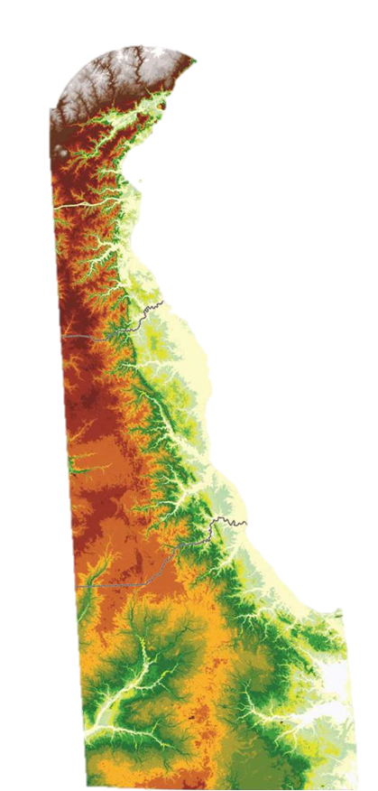
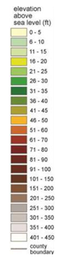
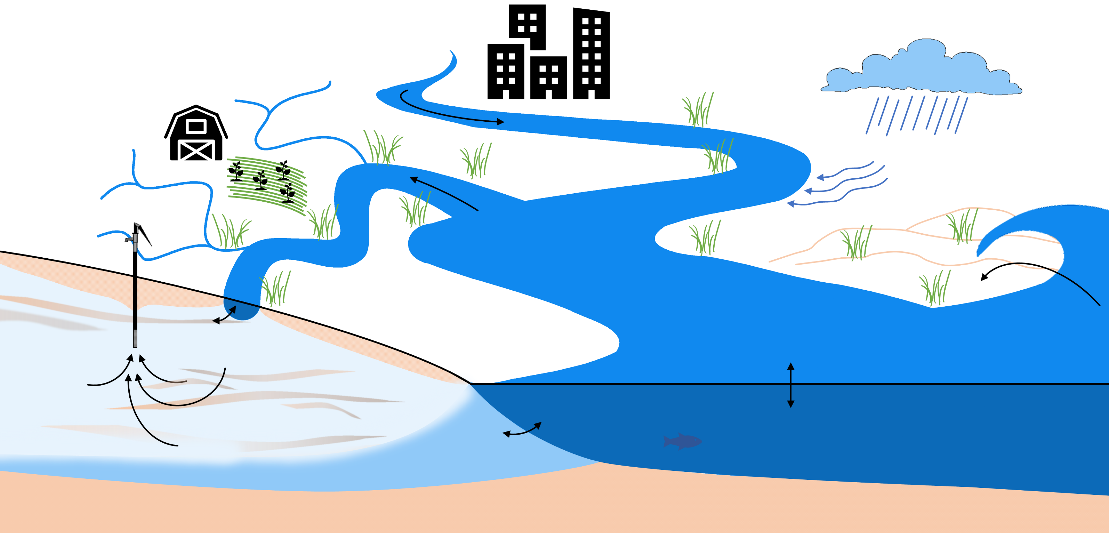
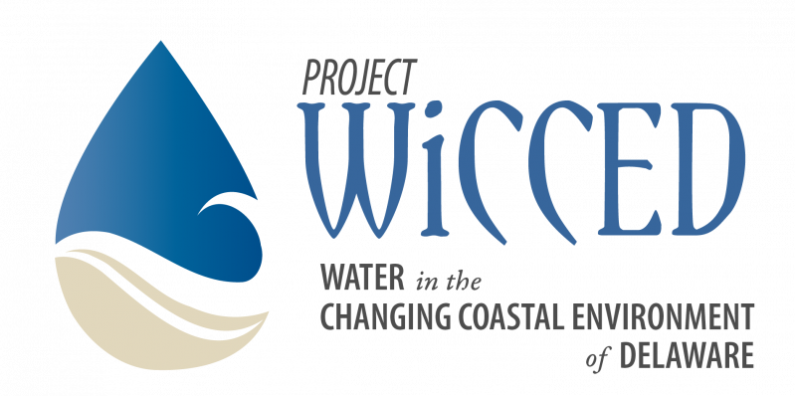
Coastal salinization vulnerability through coupled
groundwater-surface water interactions Chelsea Peters Department of Geological Sciences, University of Delaware
MOTIVATION
QUESTIONS
FUTURE GOALS
The problem of saltwater intrusion along coasts has been widely recognized for its importance with regard to water resource management and planning. The drivers of salinization—such as sea level, storms and tides, precipitation and recharge, hydrologic connectivity, and water use—vary in space, time, frequency, and duration. Field studies and hydrologic models can begin to quantify the impact of these hydrologic processes in the future. But without considering the variability and interactions between multiple saltwater intrusion pathways, these studies may grossly mischaracterize the problem. The importance of a holistic approach to assessing these various processes is recognized but difficult to model and quantify. Here we consider coupled groundwater-surface water interactions along the coast to assess the relative importance of salinization drivers.
How do feedbacks between surface and subsurface water systems alter salinization patterns?
What is the effect of reduced freshwater flow in coastal aquifers and streams?
What are the relative effects of human activities and climate change to nearshore salinization?
What are the main drivers of salinization along the Delaware coast and how will those drivers change in the future?
We plan to review and consolidate previous work on each of these coastal drivers of salinization. Using Delaware as a case study, we will consider the relative impact of surface and subsurface salinization, as well as the feedbacks between the systems. This region is especially vulnerable to the effects of sea level rise, with rates approximately twice the global mean. Delaware’s flat topography, low mean elevation, and significant development and agriculture along the coast may also exacerbate the changes in near-coast hydrology over the next century. By identifying trends in climate patterns, stream discharge, groundwater level, and pumping rates, we hope to model risks for future water managers.
Elevation of Delaware as derived from LiDAR (Delaware Geological Survey, 2017).
0 10km
Groundwater and surface water extraction for human consumption, irrigation, or industry can greatly accelerate saltwater intrusion by reducing groundwater head and stream freshwater flow. Water use often has a greater impact than climate change and sea level rise.
In low relief landscapes, it is primarily freshwater flow from streams and groundwater that limits the movement of saline water inland.
The effect of evapotranspiration and precipitation on variations in salinity is highly dependent on site location and is likely to change with climate.
Groundwater irrigation lowers water tables and increases evapotranspiration and freshwater runoff to streams. Site specific hydraulic conductivity and pumping distributions are important factors when consider the overall impact of the water use.
Along the coastline, where topographic gradients are often low, surface water runoff can be small. However, nearshore geology, impervious surface, and irrigation can increase the runoff to estuarine streams and the sea.
Estuarine hydrology is driven by the tide and river discharge. The salinity often gradually decreases upstream, but can also be hypersaline with high rates of evaporation and low rates of freshwater inflow. The direction of flow oscillates, which can alter the volume and surface area of the system.
Pumping, drawdown, and the associated redirection of hydraulic gradients likely have the greatest impact on coastal salinization. By pulling saline water inland and reducing base flow in stream, wells can completely alter the balance of hydrologic system.
As the water table rises in response to sea-level rise, the amount of groundwater discharge to the stream increases.
Groundwater discharge into a stream can be
composed of terrestrial groundwater or recirculated
stream water. This exchange in the intertidal zone is complicated by variable degrees of tidally-forced changes in volume, mixing,
and density. Sea level and water table rises
will alter these exchanges.
Tides can propagate great distances from the coastline through aquifers and tidal channels. This energy transfer can advect saline water inland and diffuse the gradient from fresh to saltwater.
The frequency and magnitude of storm surge events are expected to increase with storm intensity. The recharge and overflow associated with these events may have lasting impacts depending on the hydrogeology of the coastal region. Topography and land use are major controls on the magnitude and duration of storm surge effects.
Submarine groundwater discharge, or inflow of fresh-to-brackish groundwater from land into the sea, is controlled by the hydraulic gradient that pushes focused, dispersed,
and recirculated coastal
groundwater seaward.
The denser saltwater moves into
the coastal aquifer, forming a wedge under the fresh groundwater, described by the Ghyben‐Herzberg relation. Mixing occurs in the transition zone due to dispersion and diffusion.
Sea level rise is associated with not only changes in the elevation of the ocean surface, but also the lateral movement of the land-water interface.

