Slide 1
INTERNSHIP PROJECT • OCTOBER 2026
SAAS SUBSCRIPTION
CHURN PREDICTION
Using Machine Learning
SUBMITTED BY
Javiya Chelsy
Naviotech Solution Pvt. Ltd.
Submission Date: 30 October 2026
01 / 12

Slide 2
02
Introduction
What is Customer Churn?
Customer churn occurs when a customer stops using a subscription service.
High churn can reduce business revenue.
Churn prediction helps identify customers who may leave.
This project analyzes customer data and estimates churn risk using a machine learning model.
Problem Statement: To develop a simple web application that helps users analyze customer behaviour and predict potential subscription churn.
02 / 12

Slide 3
03
Project Objectives
Analyze customer subscription data.
Display important customer statistics through a dashboard.
Visualize customer churn, monthly charges and tenure.
Search and filter customer records.
Predict churn using customer information.
Allow filtered records to be downloaded as a CSV file.
03 / 12

Slide 4
04
Technologies Used
TECHNOLOGY PURPOSE
Python Application logic
Streamlit Web interface
Pandas Data processing
Matplotlib Data visualization
Scikit-learn Machine learning environment
Joblib Loading the saved model
CSV Storing customer data
04 / 12

Slide 5
05
Dataset Description
Dataset: saas_churn_dataset.csv
Attributes:
Target Variable:
CustomerID
TenureMonths
MonthlyCharges
UsageHours
SupportTickets
PaymentDelays
Churn
0 — Active customer
1 — Churned customer
05 / 12

Slide 6
06
System Architecture and Workflow
User → Streamlit Web Application → Customer Dataset and Saved Model → Data Analysis and Prediction → Results and Visualizations
Main Modules: Dashboard, Customer Data Explorer and Churn Prediction.
06 / 12

Slide 7
07
Business Dashboard
Dashboard Features:
• Total Customers
• Active Customers
• Churned Customers
• Churn Rate
• Customer Status Chart
• Monthly Charges and Tenure Histograms
Purpose: To provide a quick visual overview of customer subscription data.

Slide 8
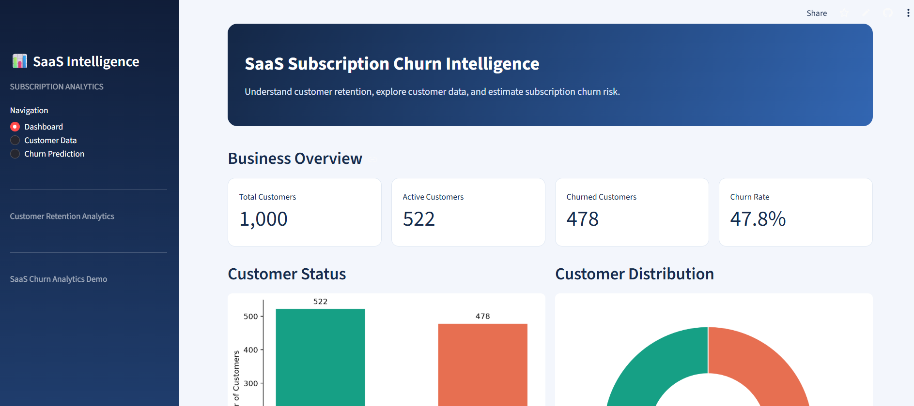
08
Customer Data Explorer
• Search customers by Customer ID.
• Filter records by Active or Churned status.
• Select the number of records to display.
• View filtered customer information.
• Download filtered records as a CSV file.
Benefit: Makes customer data easier to search, review and export.

Slide 9
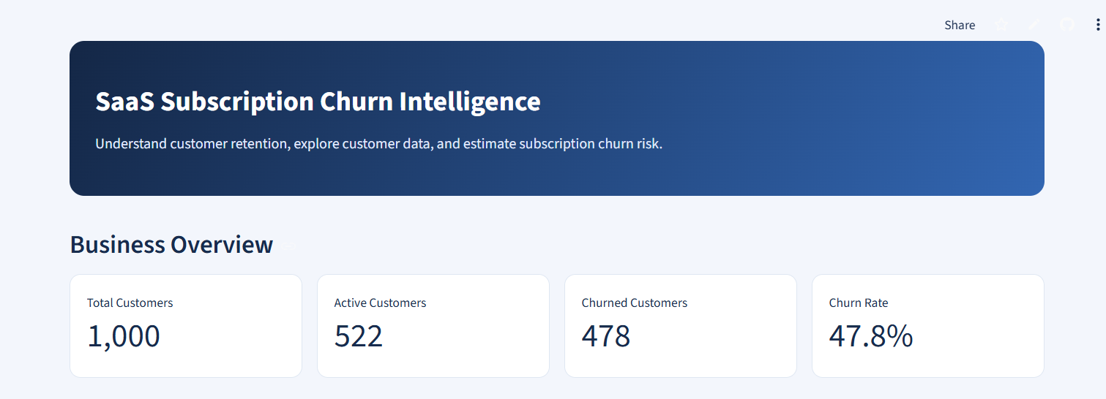
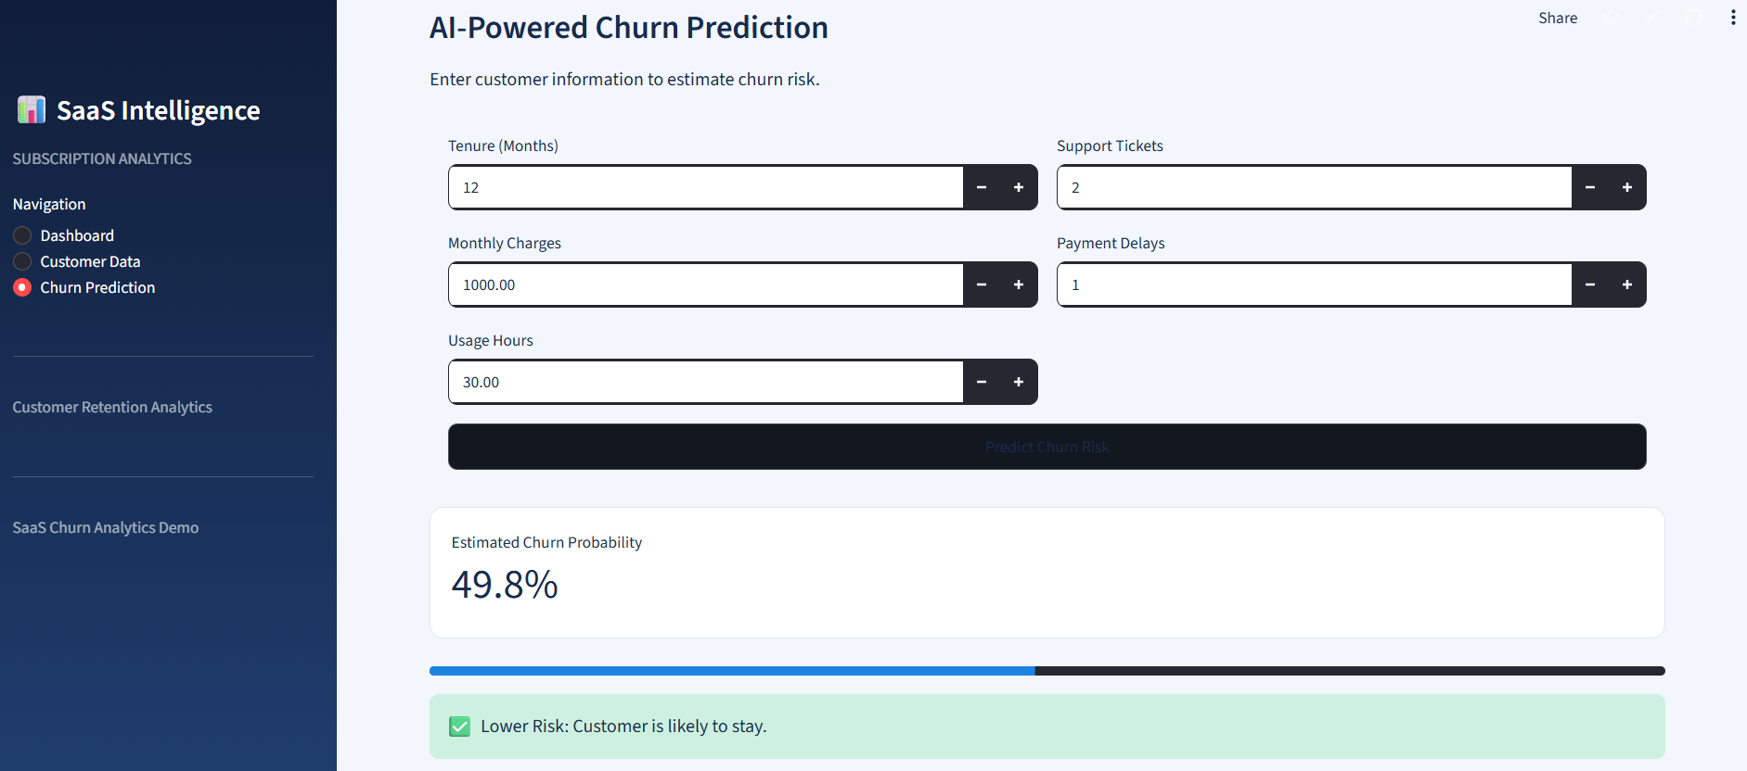
09
Churn Prediction
Input Features
Tenure (Months)
Monthly Charges
Usage Hours
Support Tickets
Payment Delays
Prediction Process
Enter customer information.
Submit the input to the saved machine learning model.
Display the predicted churn class.
Display estimated churn probability when supported by the model.
09 / 12

Slide 10
10
Conclusion and Future Scope
Conclusion:
• Developed a web-based customer churn analysis application.
• Displays customer statistics and interactive visualizations.
• Provides customer search, filtering and CSV export.
• Uses a saved machine learning model for churn prediction.
Future Scope:
• Evaluate the model using accuracy, precision, recall and F1-score.
• Integrate a live database.
• Add feature importance and improved risk analysis.
• Develop customer retention recommendations.
GitHub: https://github.com/chelsyjaviya130-svg/saas-subscription-churn-prediction
Live Demo: https://chelsy-saas-churn-demo.streamlit.app/

Slide 11
THANK YOU!
12 / 12

