Slide 1
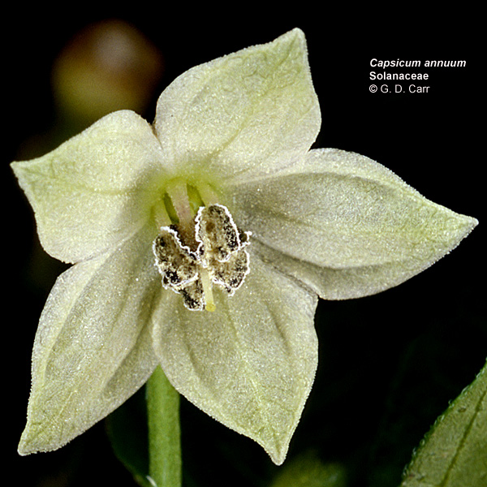
Genome Size and Life Style of Solanaceae
Chelsea Pretz
PCM 2018

Slide 2
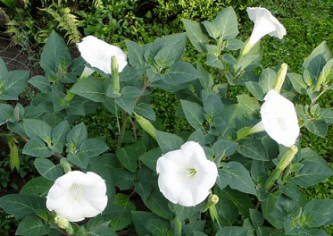
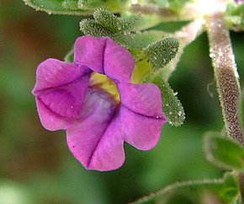
Life Style in Solanaceae
Not Annual – lives more than one season. (biannual, perennial)
Annual – only lives one season
Notes:
Introduction (1-2 slides) that lays out the relevant background related to the *biological question*. E.g. if your question is do tropical species have smaller genomes, what is the biological background information that would lead us to expect any relationship

Slide 3
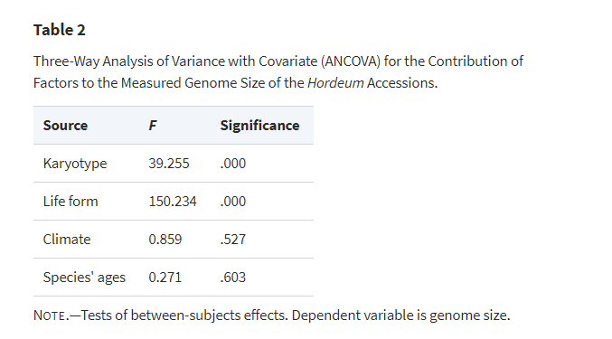
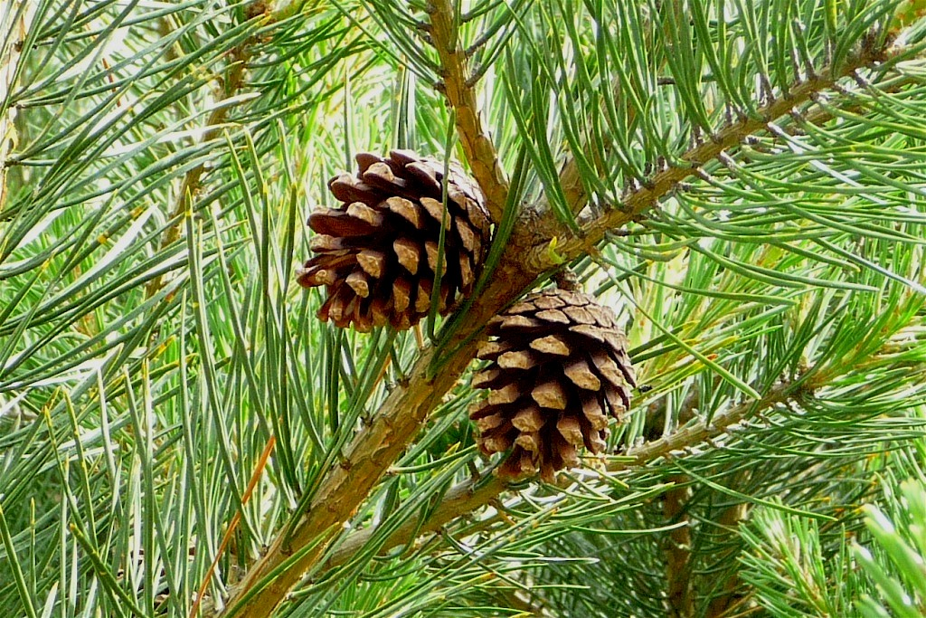
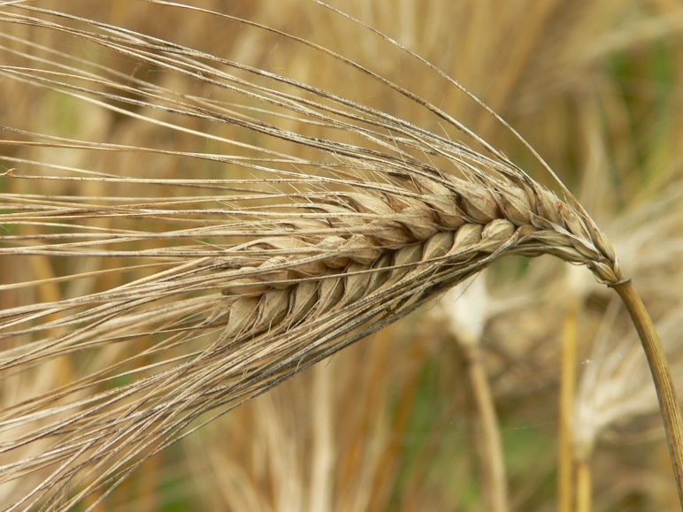
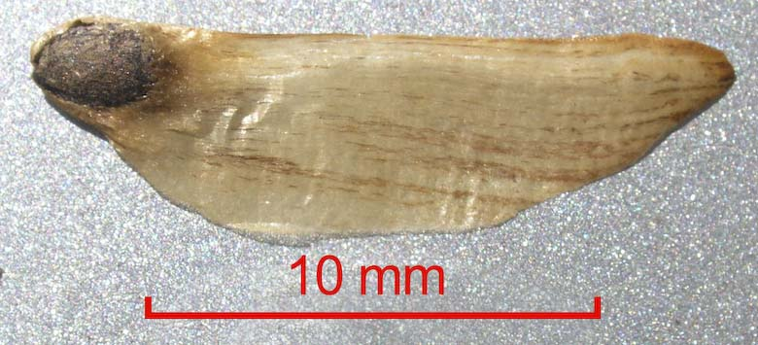
Previous work with genome size
Hordeum Phylum
Pinus Phylum
Jakob, S.S., A. Meister, F. R. Blattner. (2004). The Considerable Genome Size Variation of Hordeum Species (Poaceae) Is Linked to Phylogeny, Life Form, Ecology, and Speciation Rates. Molecular Biology and Evolution, Volume 21, Issue 5, 1 May 2004, Pages 860–869
Eva Grotkopp, Marcel Rejmánek, Michael J. Sanderson, Thomas L. Rost, and P. Soltis Evolution Aug 2004 : Vol. 58, Issue 8, pg(s) 1705- 1729 https://doi.org/10.1554/03-545
Notes:
-> “Correlations of intraspecific genome size variation with the length of vegetation period were found in H. marinum populations from Western Europe but were not significant within two species from South America”
-> We found that the strongest correlation was between genome size and seed mass. Because the growth quantities specific leaf area and leaf area ratio (and to a lesser extent relative growth rate) are strongly negatively related to seed mass, they were also negatively correlated with genome size.

Slide 4
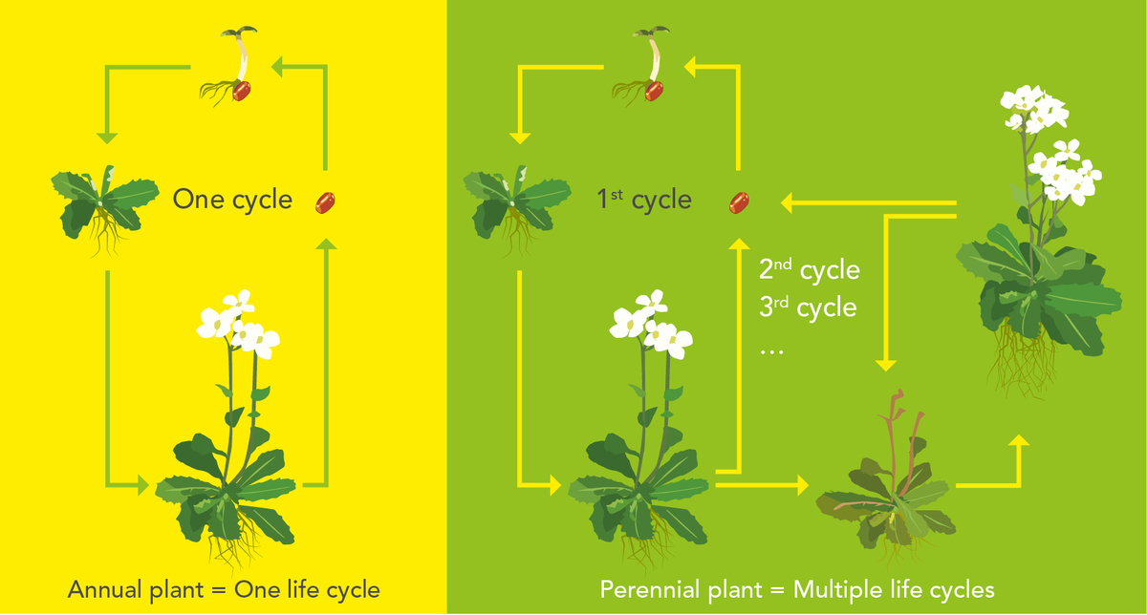
Does annual plants have a smaller genome?
I hypothesis that annual plants on average, have a smaller genome due to the fact that they have a fast reproduction rate. I expect perennial plants have a large genome for since the is less pressure for fast growth and requires more adaptively throughout its life.
Notes:
Question + hypothesis + rationale (1 slide) -- what is the question? what is your hypothesis (i.e. what do you think the answer is)? why do you think this? These are separate elements, so please present each. They should follow logically from your introduction.

Slide 5
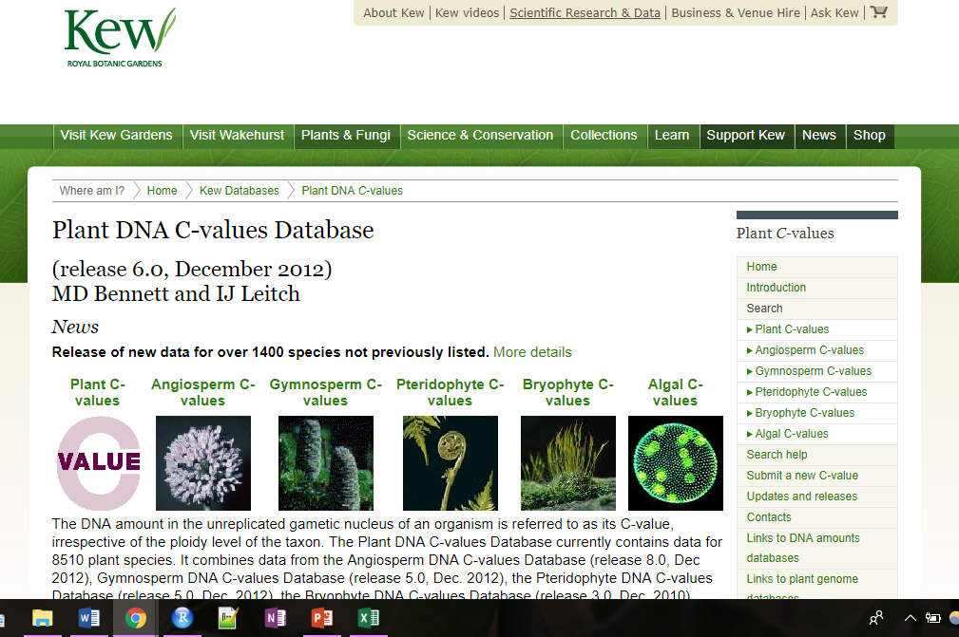
Approach
Data: Kew Botanical Garden c-value Database: http://data.kew.org/cvalues/
Tree Dataset: 114 taxa
Notes:
Approach (2 slides) -- where is your data coming from? source of tree? size of dataset (how many taxa), methods of analysis (this should align with the previous section, that is, you don't need to tell me how the analysis works per se, but instead why is this the right analysis to address this question)

Slide 6
Methods
PhyloAnova
Reasoning: To test of the means of “annual” and “non-annual” are different
Different Models:
chromosome number ~ life form
genome size ~ chromosome number
genome size ~ life form
Genome size ~ chromosome number + life form
Notes:
-> Pagel’s lambda using the "fitDiscrete()" function in the R package geiger . Pagel’s lambda is a multiplier of the off-diagonal elements of a variance–covariance matrix, which best fits the distribution of data at the tips of the phylogeny. Values vary between 0 (phylogenetic independence) and 1 (traits evolve according to a Brownian process).
** Pagel’s lambda using a discrete fit
Reasoning: To determine phylogenetic independence with a variance-covariance matrix.

Slide 7
Results
Model | LnLike Value | AIC Values | P-value | Residual standard error
chromosome number ~ life form | -451.334 | 908.6679 | 0.0092 | 13.13198
Genome size ~ chromosome number | -197.1063 | 400.2127 | 1.00E-04 | 1.317146
Genome size ~ life form | -194.8883 | 395.7765 | 2.00E-04 | 1.330237
Genome size ~ chromosome number + life form | -193.1446 | 394.2892 | 0.0032 (lf), 0.0010 (ch#) | 1.271947
Notes:
Results (2 slides) -- often one descriptive -- what is the distribution of variation across the taxa in your traits and another with statistical results, e.g. are two traits significantly related with pvalues, effect sizes, other parameter estimates. Be sure not to leave this section without saying whether the results support your hypothesis or not
-> In this residual versus fits plot, the points appear randomly scattered on the plot. None of the groups appear to have substantially different variability and no outliers are apparent.

Slide 8
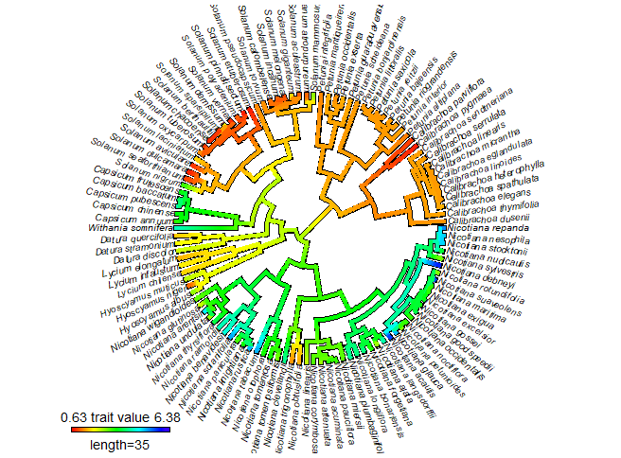
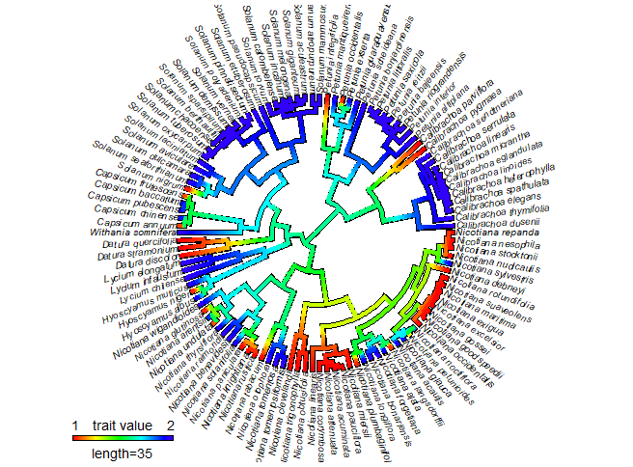
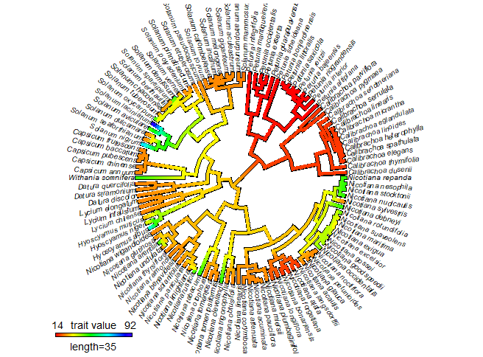
Phylogeny
Genome Size
Life Form
Chromosome #
Annual Non-annual

Slide 9
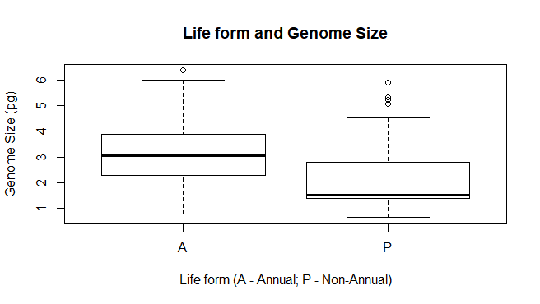
But…. How does size relate to life form?

Slide 10
Conclusions
There is a difference between annual plants and perennial plants genome size.
Perennial plants seem to have smaller size and range. This could be due to different selection pressure on genome size.
Next: Test if perennial plants have BM evolution using an OU model with two different optimums.
Could this be due to other factors?
Type 1 error. Is genome size stochastic?
Would adding more sample show two different means within perennial plants?
Notes:
Conclusions (1-2 slides) -- if your hypothesis was wrong, why do you think it didn't pan out? if it was right, what are the next steps?

Slide 11
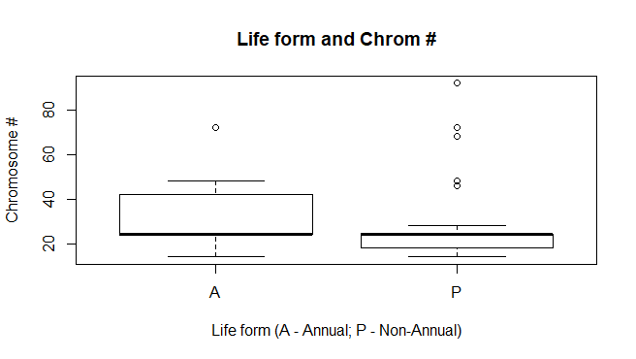
For fun..

Slide 12
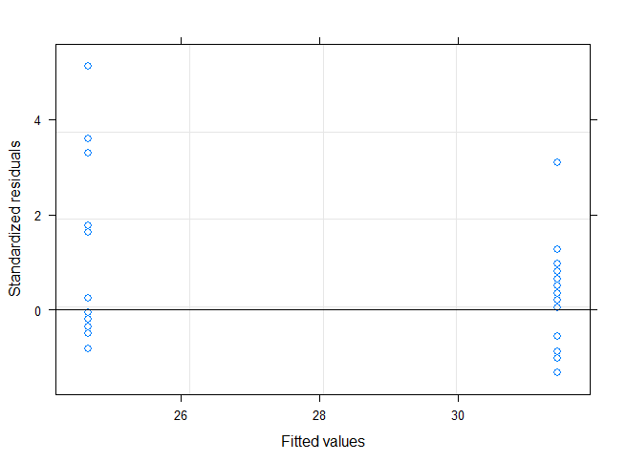
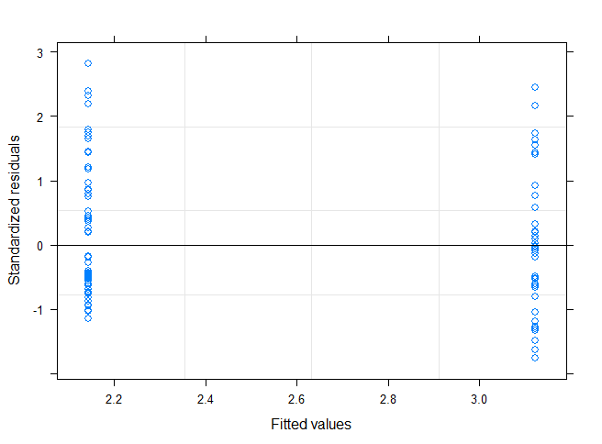
Plotted Fits
genome size ~ life form chromosome number ~ life form

Slide 13
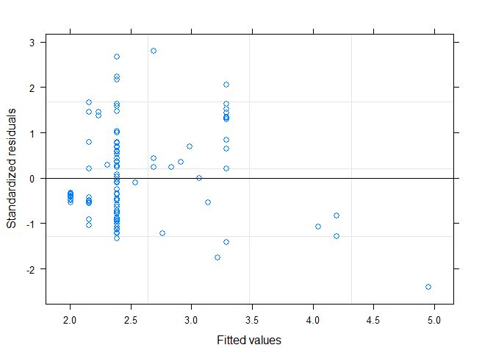
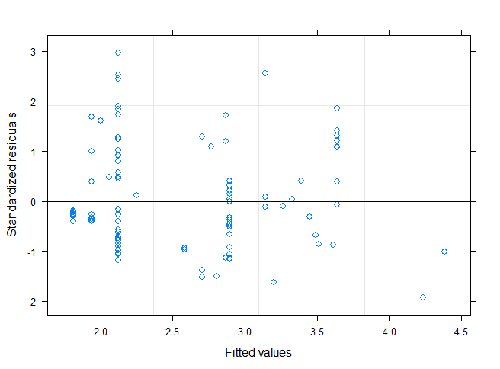
Plotted Fit Cont.
Genome size ~ chromosome number +
life form
Genome size ~ chromosome number

