Slide 1
Molecular Dynamics of a Fluid
Introduction to Programming Languages
Lab introduction

Slide 2
Our lab question
Can we use molecular dynamics to study how temperature and density affect the structure and motion of a fluid?

Slide 3
Monte Carlo and molecular dynamics
Monte Carlo
Propose random particle displacements
Accept or reject moves using energy and temperature
Sample equilibrium configurations
Molecular dynamics
Calculate forces on particles
Update positions and velocities
Generate a trajectory through physical time

Slide 4
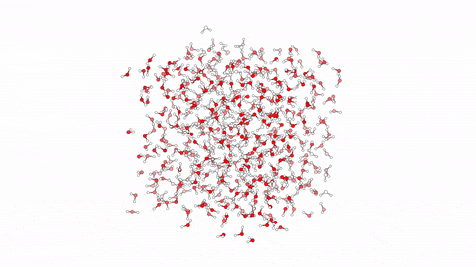
Molecular Dynamics

Slide 5
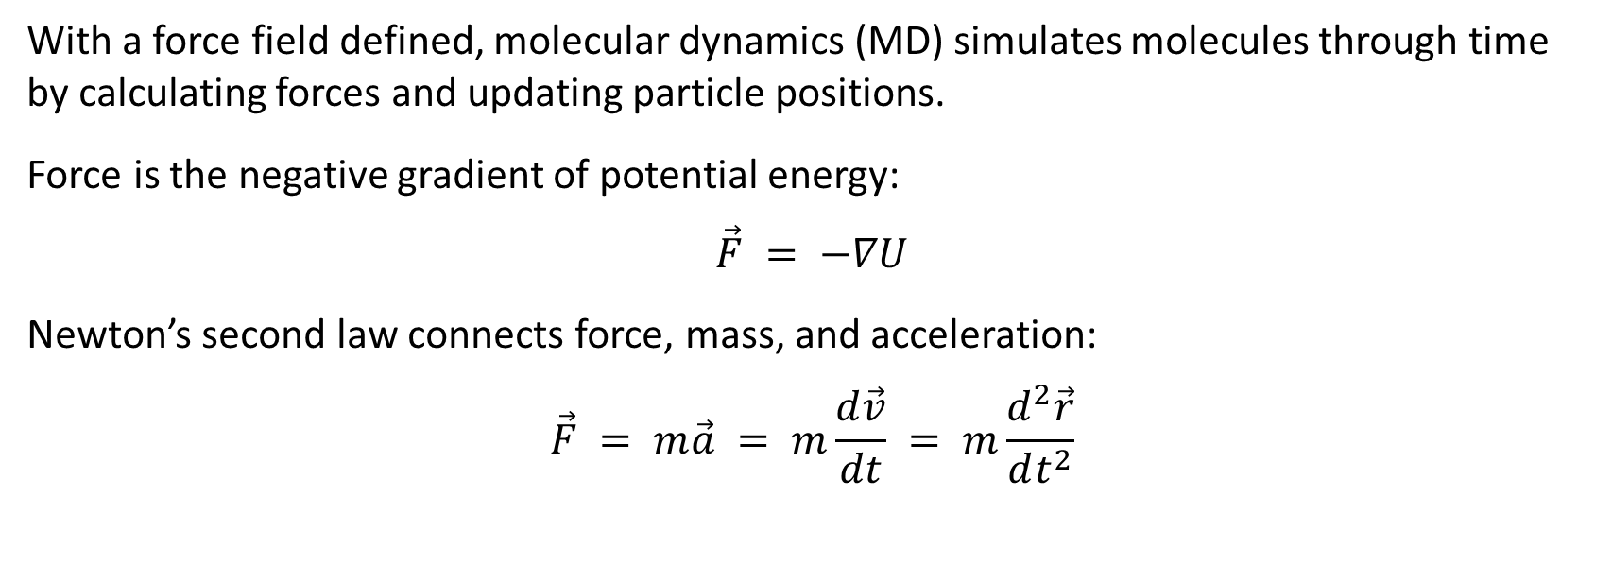
Molecular dynamics
With a force field defined, molecular dynamics (MD) simulates molecules through time by calculating forces and updating particle positions.
Force is the negative gradient of potential energy:
$$\vec{F} = −∇U$$
Newton’s second law connects force, mass, and acceleration:
$$\vec{F} = m\vec{a} = m\frac{d\vec{v}}{dt} = m\frac{d^{2}\vec{r}}{dt^{2}}$$

Slide 6
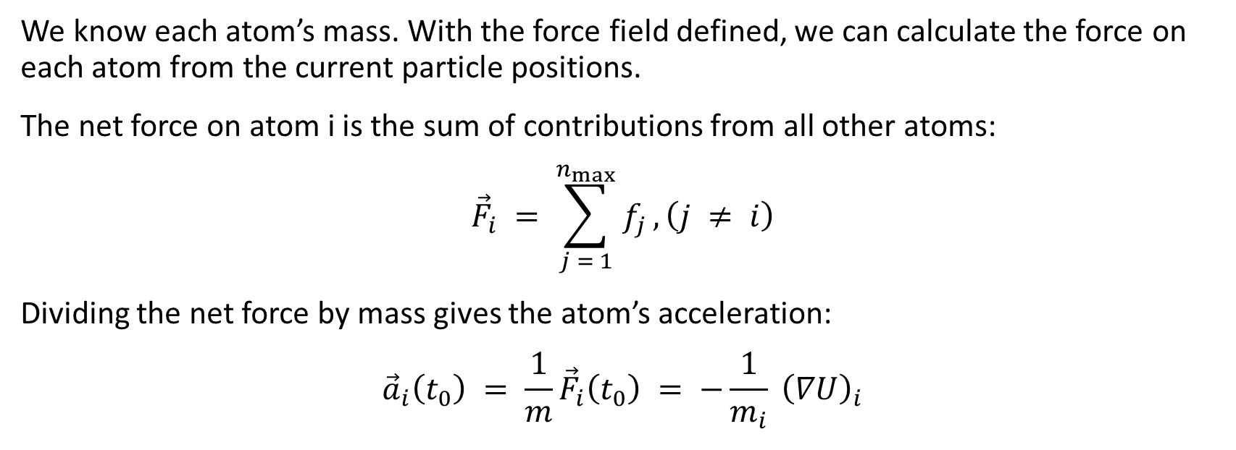
Forces and acceleration
We know each atom’s mass. With the force field defined, we can calculate the force on each atom from the current particle positions.
The net force on atom i is the sum of contributions from all other atoms:
$${\vec{F}}_{i} = \sum_{j = 1}^{n_{max}}{f_{j}}, \left(j ≠ i\right)$$
Dividing the net force by mass gives the atom’s acceleration:
$${\vec{a}}_{i}\left(t_{0}\right) = \frac{1}{m}{\vec{F}}_{i}\left(t_{0}\right) = −\frac{1}{m_{i}} {\left(∇U\right)}_{i}$$

Slide 7
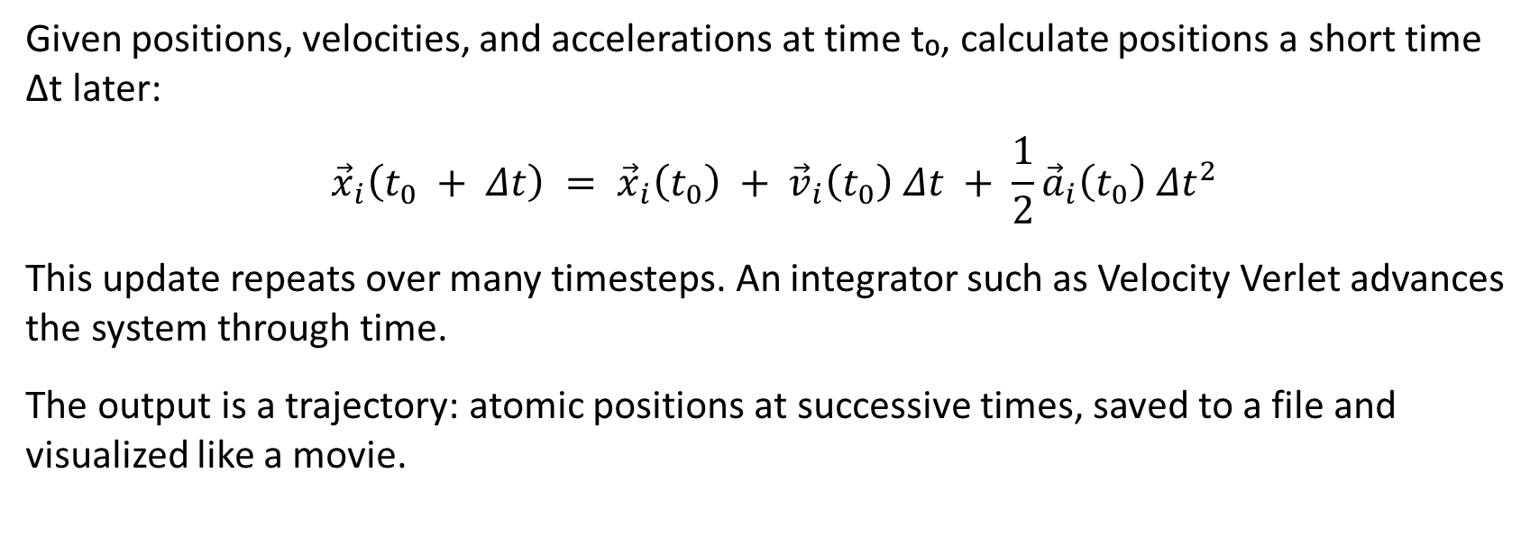
Updating positions through time
Given positions, velocities, and accelerations at time t₀, calculate positions a short time Δt later:
$${\vec{x}}_{i}\left(t_{0} + Δt\right) = {\vec{x}}_{i}\left(t_{0}\right) + {\vec{v}}_{i}\left(t_{0}\right) Δt + \frac{1}{2}{\vec{a}}_{i}\left(t_{0}\right) {Δt}^{2}$$
This update repeats over many timesteps. An integrator such as Velocity Verlet advances the system through time.
The output is a trajectory: atomic positions at successive times, saved to a file and visualized like a movie.

Slide 8

Simulation workflow
Our previous program
Define the particles, temperature, and density
Run Monte Carlo simulation (equilibration)
ASE molecular dynamics
Convert units and set up the system
Run MD and save the trajectory
Analyze structure with RDF and motion with MSD
We’ll use Atomic Simulation Environment (ASE) for this lab.

Slide 9
Equilibration: the expected pattern
Initial coordinates may not represent equilibrium
Energy changes during an initial transient
Later values fluctuate around a stable mean
Check stability before production

Slide 10
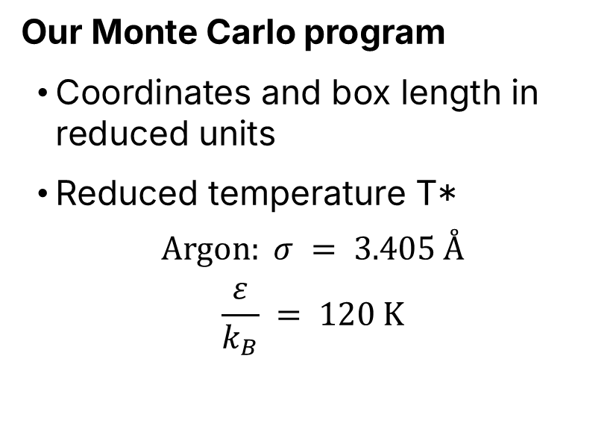
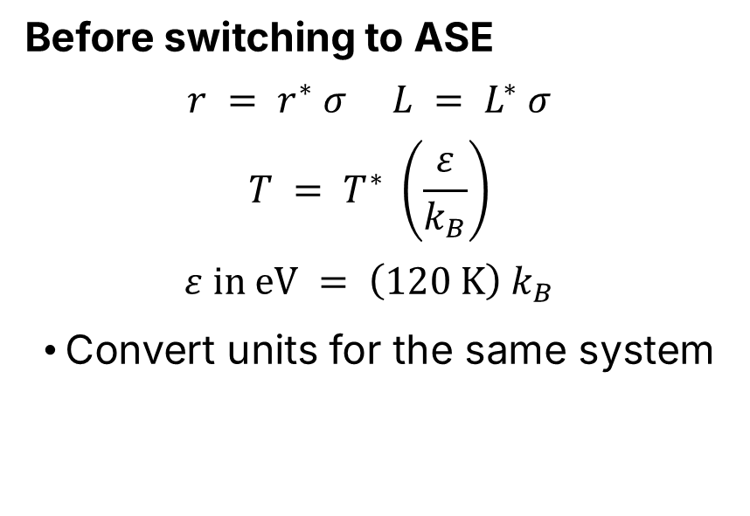
A reminder about units
Our Monte Carlo program
Coordinates and box length in reduced units
Reduced temperature T*
$$Argon: σ = 3.405 Å$$
$$\frac{ε}{k_{B}} = 120 K$$
Before switching to ASE
$$r = r^{∗} σ L = L^{∗} σ$$
$$T = T^{∗} \left(\frac{ε}{k_{B}}\right)$$
$$ε in eV = \left(120 K\right) k_{B}$$
Convert units for the same system

Slide 11
ASE objects
atoms = Atoms('Ar' * num_atoms,
positions=equilibrated_coords)
atoms.set_cell([box_length_real] * 3)
atoms.set_pbc(True)
lj_calculator = LennardJones(
epsilon=epsilon_eV, sigma=sigma,
rc=3*sigma)
atoms.calc = lj_calculator
dyn_prod = VelocityVerlet(
atoms, timestep)
Atoms holds the positions and simulation cell
The calculator supplies energy and forces
The integrator advances the system through time
Course connection
Where do you see classes, attributes, and methods?

Slide 12
NVE production
Constant N, V, and E
Particle count, volume, and total energy
Assign velocities using the target temperature
4 fs timestep; 1,250 steps
Save a frame every 25 steps
How much physical time?
Energy exchange (eV)
Temperature can fluctuate in NVE.
Time / ps | Total | Potential | Kinetic
0.0 | −13.060 | −17.671 | 4.612
0.1 | −13.060 | −17.599 | 4.539

Slide 13
Measurements: Structure and motion
RDF describes arrangement. MSD describes motion.

Slide 14
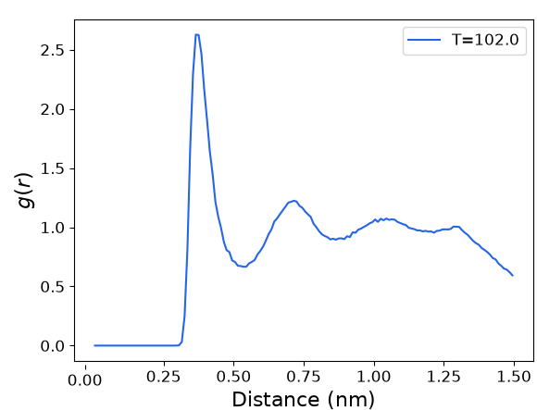
Radial distribution function
A reminder from our previous lab
g(r) compares local and average particle density
Peaks show preferred distances
Our MD result
The distance axis uses nm
How might temperature or density change g(r)?

Slide 15
What is the diffusion coefficient?
Particles in a fluid continually move. Over time, their positions spread away from where they started.
The self-diffusion coefficient, D, quantifies this spreading due to random molecular motion.
A larger D means a larger typical displacement over the same elapsed time.
Units are length squared per time. This lab reports D in Å²/ps.
MD provides the physical time needed to measure diffusion.

Slide 16
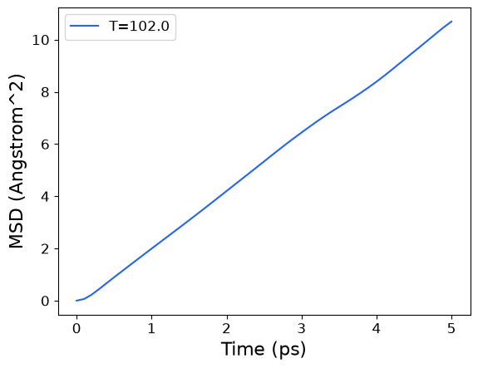
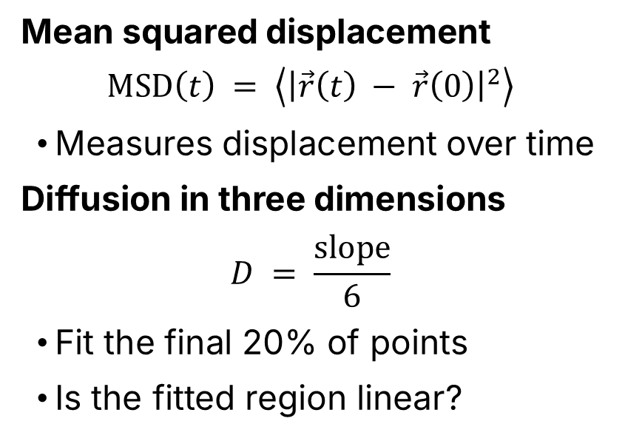
Diffusion from MSD
Mean squared displacement
$$MSD\left(t\right) = \left\langle {\left|\vec{r}\left(t\right) − \vec{r}\left(0\right)\right|}^{2}\right\rangle$$
Measures displacement over time
Diffusion in three dimensions
$$D = \frac{slope}{6}$$
Fit the final 20% of points
Is the fitted region linear?

Slide 17
In this lab
Structure and motion
Change density or temperature
Compare RDF and diffusion
At low density, reassess equilibration
Explain differences using evidence
Programming
Explore ASE classes and source code
Identify methods and attributes
Examine inheritance and modularity
Connect objects to course concepts

