Slide 1
Batplot – a lightweight command-line plotting tool customized for you

Slide 2
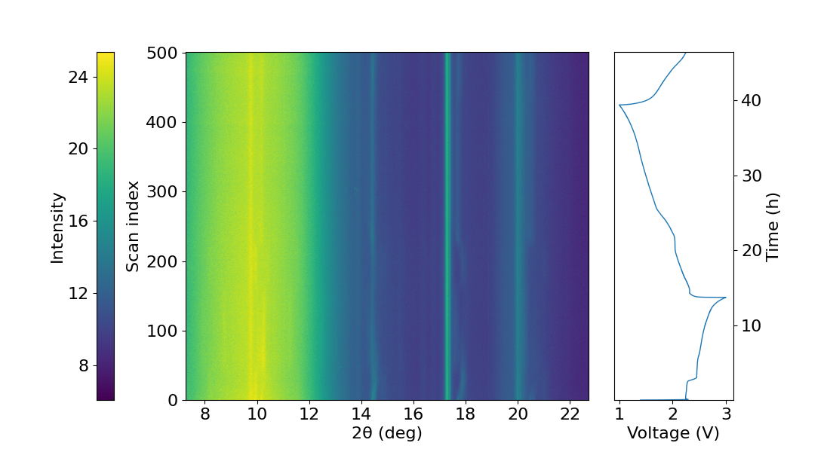
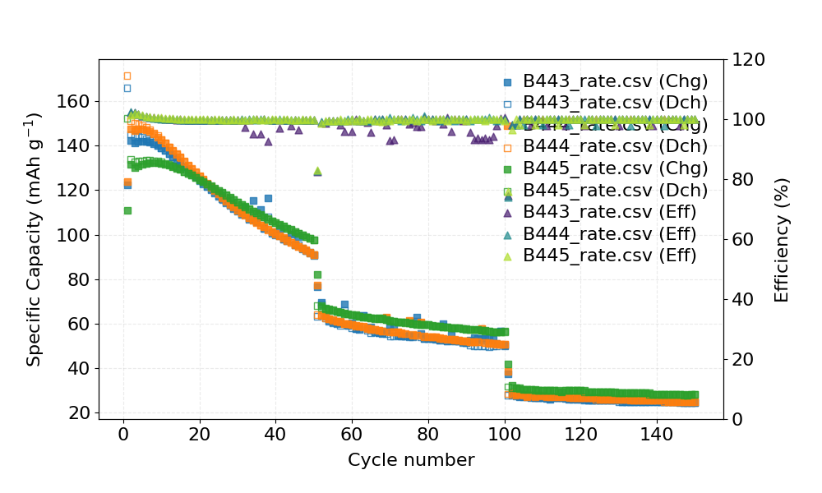
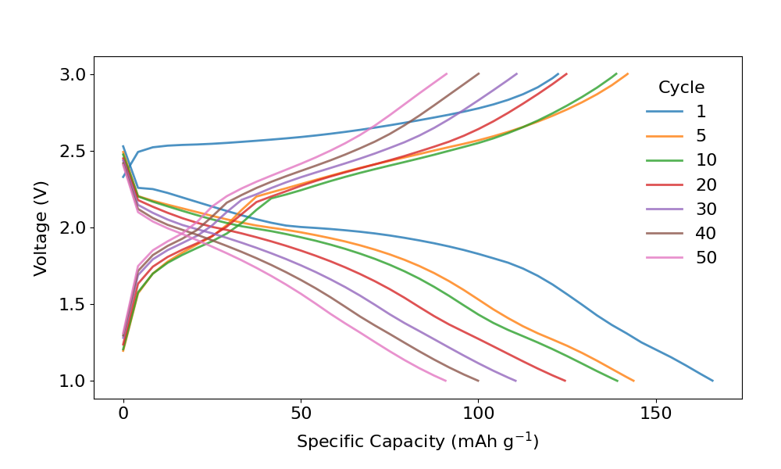
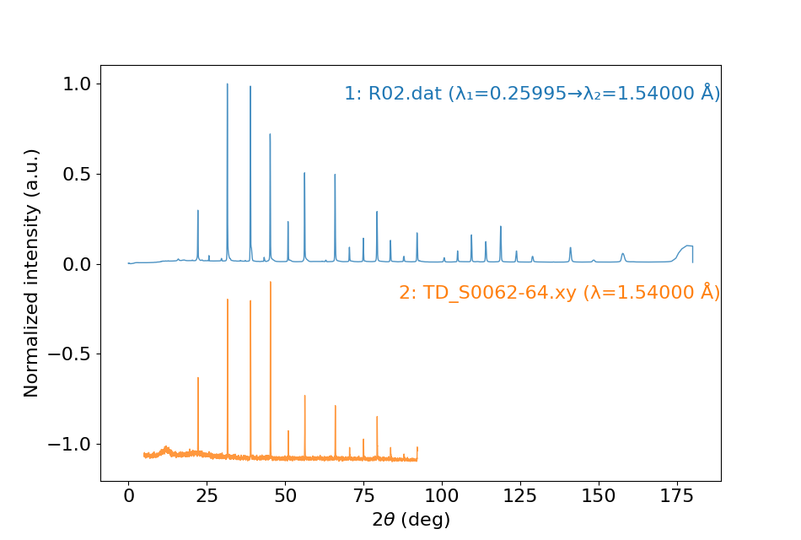
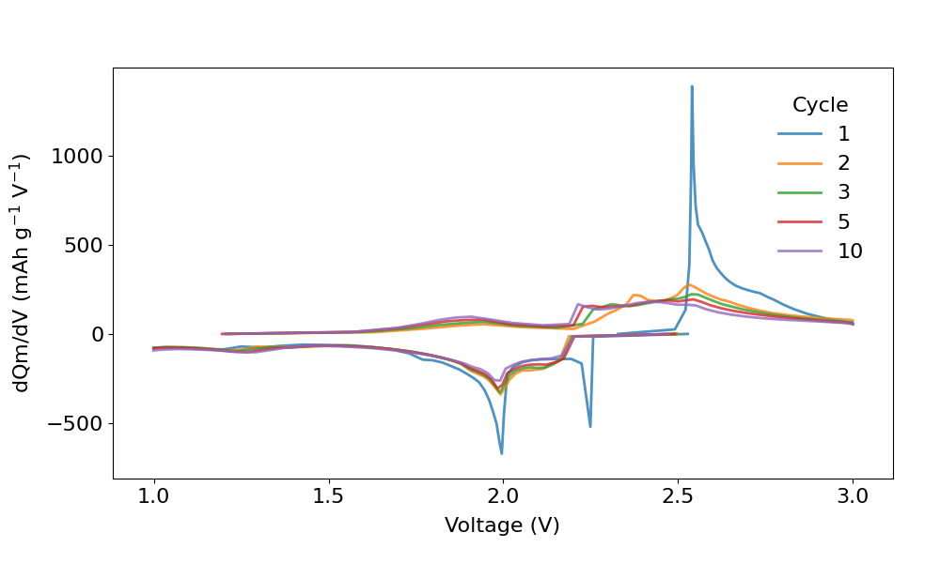
What it can do:
Contour plots
Electrochemistry
1D plots

Slide 3
Installation
Install anaconda prompt
In your terminal, create a new environment “batplot” by doing following:
conda create –n batplot python=3.13
conda activate batplot
batplot -h
after a few seconds, you should see a long help message displayed in your terminal
3. Always make sure to use conda to activate the batplot environment before using batplot.

Slide 4
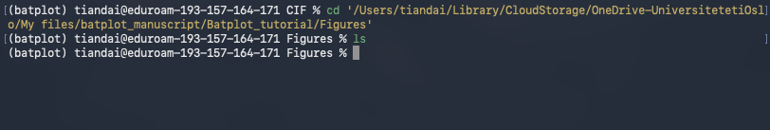
How to work with terminal (can be skipped or find a youtube video)
Commands cd and ls are two only commands you need to know.
cd: change directory
cd path: navigate to that path
cd ../: go back to parent path
(alternatively, you can right-click the file/folder and copy the
path or just drag the file/folder into terminal)
ls: list all files
2. Now, try to navigate to Figures under batplot_tutorial folder in your terminal.
3. Use ls to list all files, and you should see nothing because the folder is empty.

Slide 5
General code structure
The command structure of batplot is:
batplot path/files --flag1 --flag2 --flag3 ...
you can swap or mix the sequence of flags and path/files, but a clean structure is always better
path:
Contains all the data files, indicating where batplot should be effective on
Used for batch processing, multi-curve plot and contour plot
flag:
Commands for the data files, indicating what to do to the dataset

Slide 6
1D plots - XRD
Now we will use a XRD data file to demonstrate how batplot works
Data file R02.dat was collected from BM31, ESRF, it contains three columns, x y and e.
By default, batplot will use the first and second column to plot as x and y.
Now, let's do:
batplot path/XRD/R02.dat
You can either navigate to the path containing this file or just drag the file into terminal, I prefer the second approach
An error pops up, because batplot doesn't know what type of data file it is, the extension .dat can be many things. You need to tell batplot what type of data that you are providing.

Slide 7
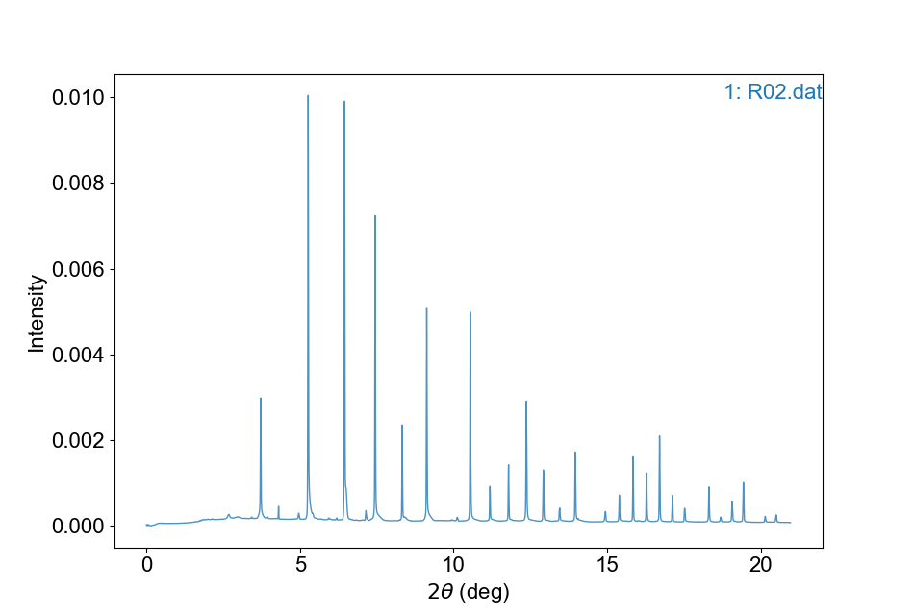
1D plots - XRD
In batplot, the type of file is indicated by its x axis, and for XRD, the x axis is usually 2theta, now let's add a flag:
batplot path/XRD/R02.dat --xaxis 2theta
You should then see a plot window popping up.
Remember to always close the plot window so the terminal can be used for new plotting, if you are to work on multiple figures, use separate terminals for each.

Slide 8
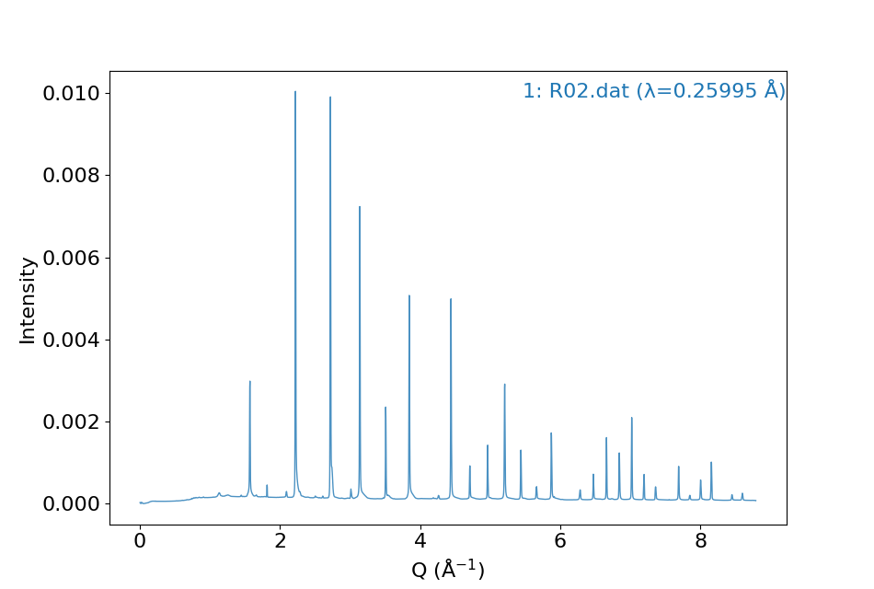
1D plots - XRD
Sometimes, it is preferred to plot data in Q space instead of 2theta. To do that, a wavelength is needed:
batplot path/XRD/R02.dat --wl 0.25995
You should then see a new plot with x axis displayed as Q
Alternatively, you can do:
batplot path/XRD/R02.dat:0.25995
In both cases, --xaxis flag is no longer needed, as providing a wavelength is an indicator of the data being XRD

Slide 9
1D plots - XRD
You can change the x range by using --xrange flag:
batplot path/XRD/R02.dat --wl 0.25995 --xrange 2 4
To save, use --out file.svg flag:
batplot path/XRD/R02.dat --wl 0.25995 --xrange 2 4 --out fig.svg
The figure will be saved in a separate folder.
There is no --yrange flag, the y axis is automatically adjusted according to the selected data range.

Slide 10
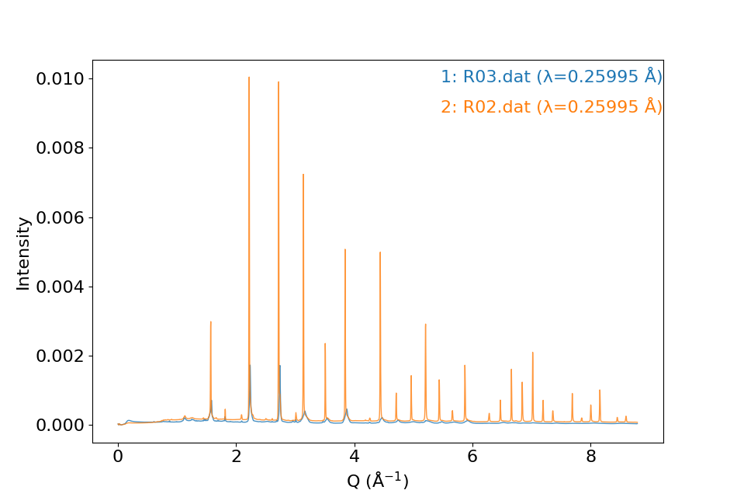
1D plots - XRD
If you have multiple XRD files, you can plot them together in one panel:
batplot path/XRD/R02.dat path/XRD/R03.dat --wl 0.25995

Slide 11
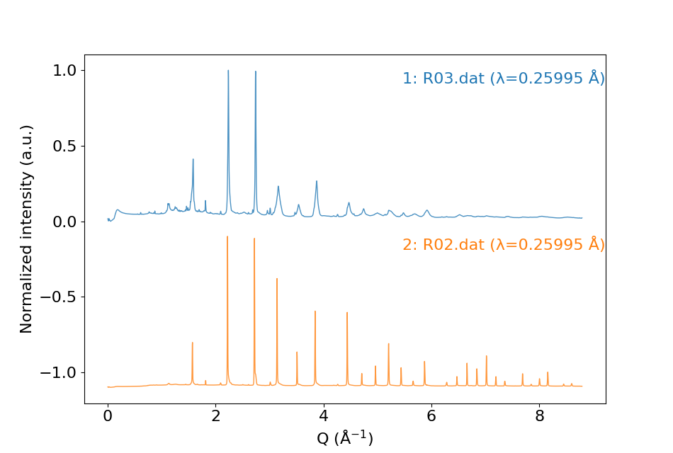
1D plots - XRD
Instead of overlaying the plots, you can also use stack mode by adding --stack flag
batplot path/XRD/R02.dat path/XRD/R03.dat --wl 0.25995 --stack

Slide 12
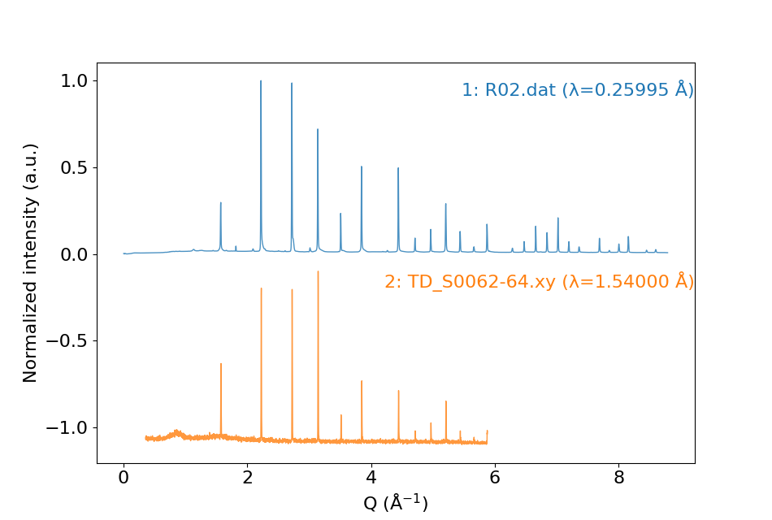
1D plots - XRD
If you have multiple XRD files with different wavelength (e.g. if you want to compare the data from synchrotron and in-house, you can convert them into Q or your preferred wavelength by specifying wavelength of each of them)
batplot path/XRD/R02.dat:0.25995 path/XRD/TD_S0062-64.xy:1.54 --stack
Synchrotron
In-house (Cu)
In this case, --wl flag is no longer needed because the wavelengths are already provided in individual date files, this approach also works for single file.
--stack is recommended in this case as different instruments have different intensity scale

Slide 13

1D plots - XRD
In rare case, you can convert one date file into another file's wavelength:
batplot path/XRD/R02.dat:0.25448:1.54 path/XRD/TD_S0062-64.xy:1.54 --stack --xaxis 2theta
Synchrotron
In-house (Cu)
--xaxis 2theta needs to be included in this case

Slide 14
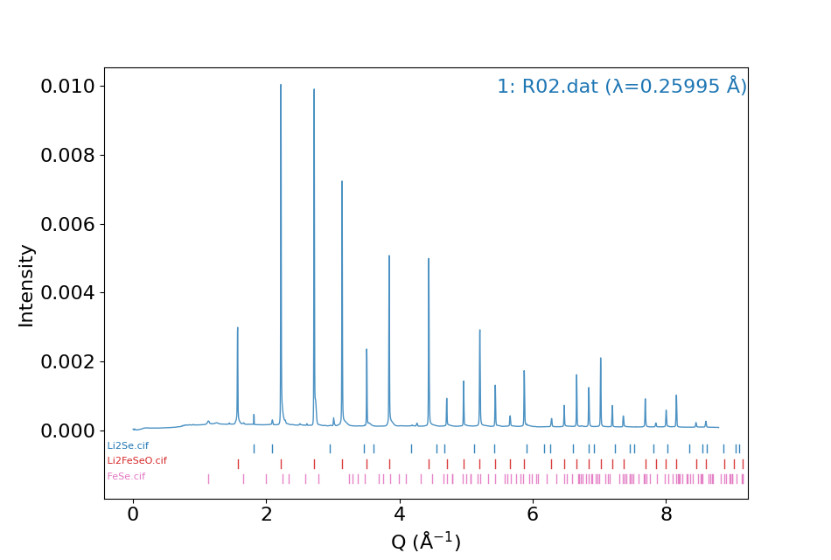
1D plots - XRD
Add CIF files to show the tick labels:
batplot path/XRD/R02.dat:0.25448:1.54 Li2Se.cif Li2FeSeO.cif FeSe.cif --wl 0.25995

Slide 15
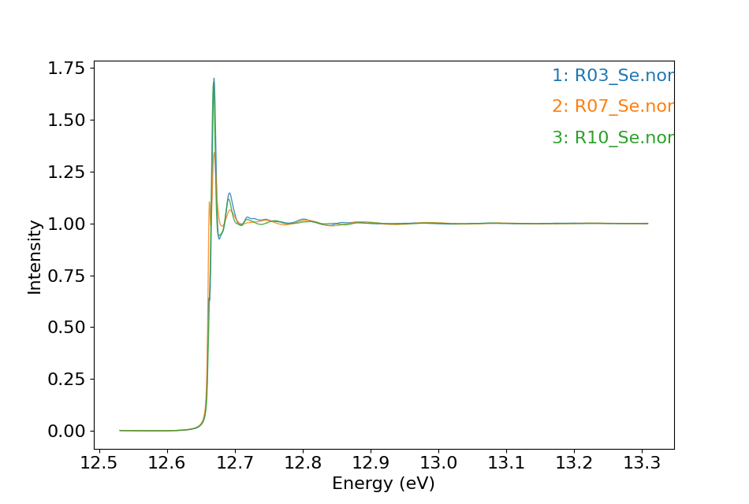
1D plots - XAS
Same as XRD, no --xaxis flag needed as .nor is XAS-specified extention
batplot R03_Se.nor R07_Se.nor R10_Se.nor

Slide 16
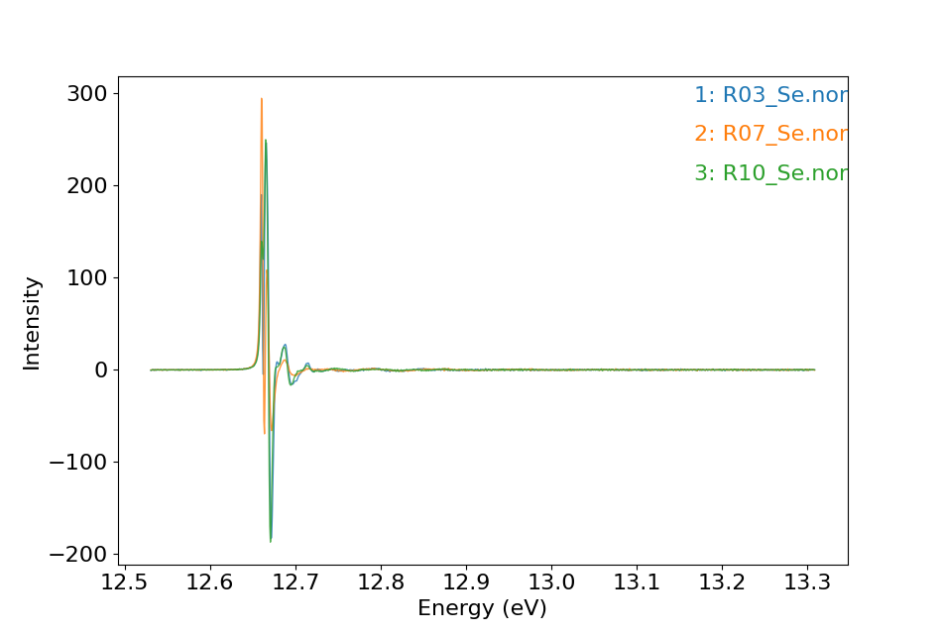
1D plots - XAS
Use --1d (--2d) to plot the first (second) derivative, this works for all types of data
batplot R03_Se.nor R07_Se.nor R10_Se.nor --1d

Slide 17
1D plots - extra features
Batplot can help you convert XRD data into different wavelength with --convert flag:
batplot path/XRD/R02.dat --convert 0.25448 1.54
This will convert the original data into a new wavelength and export the file into a new folder under the path.
In addition, you can convert the data into Q space using:
batplot path/XRD/r2c2_01_001_0001p.dat --convert 0.25448 q

Slide 18
1D plots - extra features
All type of data files are supported, as long as it can be opened in a text or excel format.
If different columns are to be plotted other than the first and second, do:
batplot file.dat --readcol 2 4
This will plot column 2 and column 4 as x and y, respectively.

Slide 19
1D plots - extra features
Use allfiles to plot all files in one folder
batplot /path/to/your/folder allfiles --xaxis 2theta
Or use all(ext)files to plot the files with selected extension:
batplot /path/to/your/folder allnorfiles

Slide 20
1D plots - extra features
For batch processing (not recommended)
batplot /path/to/your/folder --all --xaxis 2theta

Slide 21
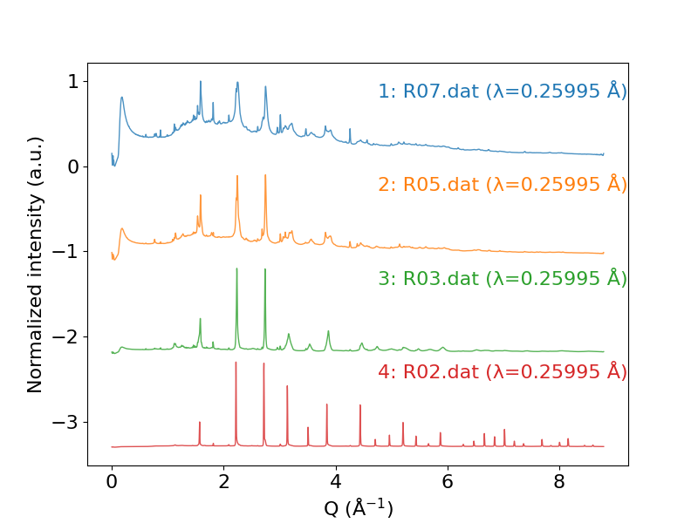
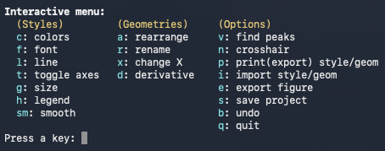
1D plots – Interactive menu
Let's go back to XRD folder.
Use --i flag to activate interactive menu:
batplot path/XRD/R02.dat path/XRD/R03.dat path/XRD/R05.dat path/XRD/R07.dat --wl 0.25995 --stack --i

Slide 22
1D plots - extra features
For batch processing with style enabled (under testing)
batplot /path/to/your/folder style.ps --all --xaxis 2theta

Slide 23
Electrochemistry – support Neware (.csv) and Biologic (.mpt) files, more to be added
Galvanostatic Cycling (GC): --gc
Cyclic Voltammetry (CV): --cv
Capacity Per Cycle (CPC): --cpc
Differential Capacity (dQdV): --dqdv
batplot file.csv --gc --i
batplot file.mpt --gc --mass 5 --i

Slide 24
Electrochemistry – support Neware (.csv) and Biologic (.mpt) files, more to be added
Galvanostatic Cycling (GC): --gc
Cyclic Voltammetry (CV): --cv
Capacity Per Cycle (CPC): --cpc
Differential Capacity (dQdV): --dqdv
batplot file1.csv file2.csv file3.csv --cpc --i

Slide 25
Electrochemistry – support Neware (.csv) and Biologic (.mpt) files, more to be added
Galvanostatic Cycling (GC): --gc
Cyclic Voltammetry (CV): --cv
Capacity Per Cycle (CPC): --cpc
Differential Capacity (dQdV): --dqdv
batplot file1.csv --dqdv --i

Slide 26
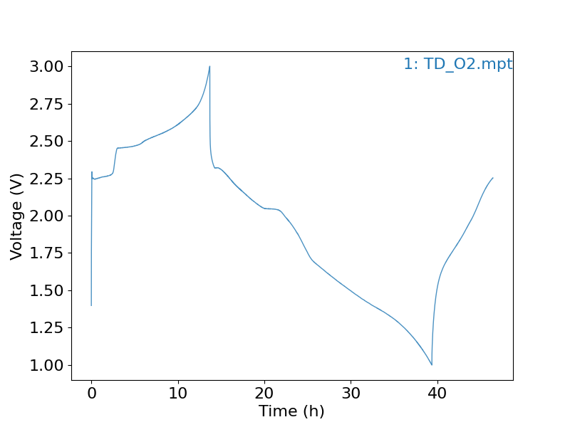
Electrochemistry – support Neware (.csv) and Biologic (.mpt) files, more to be added
Galvanostatic Cycling (GC): --gc
Cyclic Voltammetry (CV): --cv
Capacity Per Cycle (CPC): --cpc
Differential Capacity (dQdV): --dqdv
batplot file1.csv --xaxis time --i

Slide 27
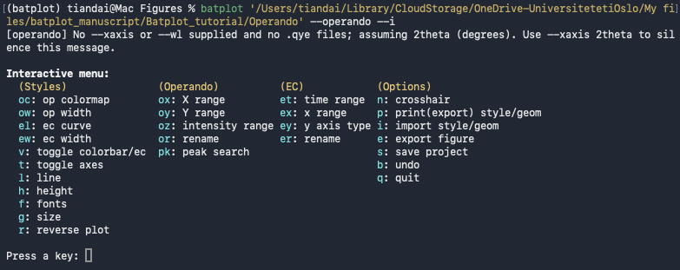
Operando contour plot
To plot operando data, all files needs to be placed in one folder (data files (xy, xye, dat, txt, nor, chik, chir) with ec data (optional)).
Now, copy path of the Operando folder, and do:
batplot path/to/Operando --operando --i
batplot path/to/Operando --operando --wl 0.709 --i

Slide 28
Questions and suggestions?

