Slide 1







Quantum Dynamics of an electron in an infinite square well
$$V\left(x\right)=∞$$
$$V\left(x\right)=∞$$
$$for$$
$$for$$
$$x≤0$$
$$x≥L$$
$$x$$

Slide 2
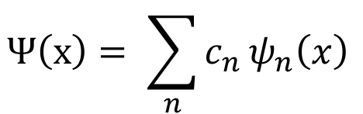
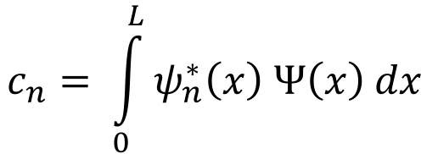
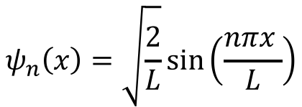
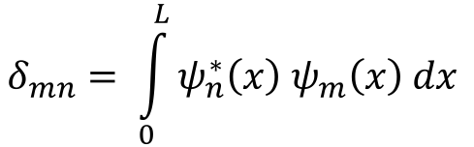
Basis of Energy Eigenstates:
$$ψ_{n}\left(x\right)=\sqrt{\frac{2}{L}}\sin\left(\frac{nπx }{L}\right)$$
$$δ_{mn}= \int_{0}^{L}{ψ_{n}^{∗}\left(x\right) ψ_{m}\left(x\right) dx }$$
$$Ψ\left(x\right)= \sum_{n}^{ }{c_{n}}ψ_{n}\left(x\right)$$
$$c_{n}= \int_{0}^{L}{ψ_{n}^{∗}\left(x\right) Ψ\left(x\right) dx}$$
$$V\left(x\right)=∞$$
$$V\left(x\right)=∞$$
$$for$$
$$for$$
$$x≤0$$
$$x≥L$$
$$x$$

Slide 3
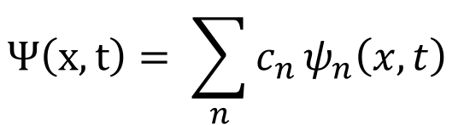
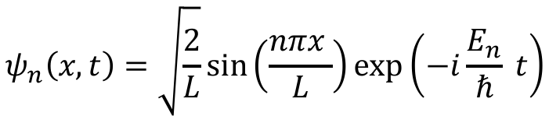
Time-evolution in basis of energy eigenstates:
$$ψ_{n}\left(x, t\right)=\sqrt{\frac{2}{L}}\sin\left(\frac{nπx }{L}\right)\exp\left(−i\frac{E_{n}}{ℏ} t\right)$$
$$Ψ\left(x,t\right)= \sum_{n}^{ }{c_{n}}ψ_{n}\left(x,t\right)$$
$$V\left(x\right)=∞$$
$$V\left(x\right)=∞$$
$$for$$
$$for$$
$$x≤0$$
$$x≥L$$
$$x$$

Slide 4
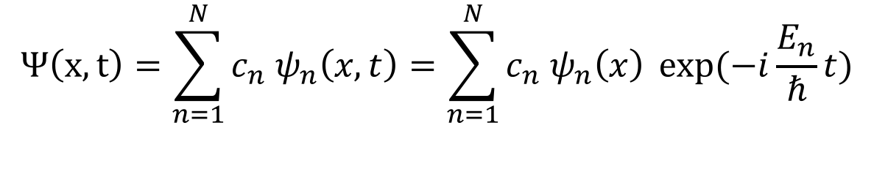
Gaussian Wavepacket Dynamics
$$Ψ\left(x,0\right)=\frac{1}{σ\sqrt{2π} }exp\left(−\frac{1}{2}{\left(\frac{\left(x−x_{0}\right)}{σ}\right)}^{2}\right) exp\left(i k_{0} x\right)= \sum_{n=1}^{N}{c_{n}{ ψ}_{n}\left(x\right)}$$
$$Ψ\left(x,t\right)=\sum_{n=1}^{N}{c_{n}{ ψ}_{n}\left(x,t\right)=\sum_{n=1}^{N}{c_{n}{ ψ}_{n}\left(x\right)} exp⁡(−i\frac{E_{n}}{ℏ}}t)$$
$$V\left(x\right)=∞$$
$$V\left(x\right)=∞$$
$$for$$
$$for$$
$$x≤0$$
$$x≥L$$
$$x$$

Slide 5
Outline Part 1 – Create and Validate the expansion in the basis of PIB Energy Eigenstates
Create grid x of 2000 x-values between 0 and box of length L=500 atomic units
Create an array Psi of Gaussian wavepacket values using custom function Gauss_Packet(x, x0, sig, k0) with x0 = 200, k0 = 0.4, sig = 15 (all atomic units)
Create an array n of PIB quantum numbers between 1 and N using np.linspace
Determine the complex amplitude for all N PIB energy eigenfunctions to create a superposition that approximates the Gaussian Wavepacket using custom function FourierAnalysis(x, Psi, n, L)
Create an array of superposition values psi_exp using complex amplitudes from step 4
Plot Psi and psi_exp to visualize goodness of the fit using plt.plot(x, y, style, …) and plt.show()

Slide 6
Hints
Imports module called numpy, which has many built-in capabilities for doing mathematical operations
Function that takes an array of x-values x, an array of complex wavefunction values PsiX, array of possible quantum numbers n, and length of box L and returns an array of complex expansion coefficients to cn to construct PsiX in terms of PIB energy eigenfunctions
import numpy as np
def FourierAnalysis(x, PsiX, n, L):
cn = np.zeros(len(n),dtype=complex)
dx = x[1]-x[0]
for i in range (0,len(cn)):
som = 0+0j
psi_i = PIB_Func(x, n[i], L)
for j in range (0, len(x)):
som = som + psi_i[j]*PsiX[j]*dx
cn[i] = som
return cn
Function that takes an array of x-values x, the quantum number n, and the length of the box L and returns array of PIB energy eigenfunction values psi_n
def PIB_Func(x, n, L):
psi_n = np.sqrt(2./L)*np.sin(n*np.pi*x/L)
return psi_n
Create an array x of 1000 x-values between 0 and 100 using numpy’s linspace function
psi_n = np.sqrt(2./L)*np.sin(n*np.pi*x/L)

Slide 7
Plotting Hints
Imports module called matplotlib and pyplot which has functionalities for plotting functions and data
from matplotlib import pyplot as plt
Create an array x of 200 x-values between -1 and 1, create an array y of 200 values each defined as y=x² between x=-1 and 1, create a plot object which plots the values of y against the values of x with a red line
x = np.linspace(-1, 1, 200)
y = x**2
plt.plot(x, y, 'red')
plt.show()

