Slide 1
Predicting Use of a Bike-Share System
Steven Rea, Chi-Liang (Daniel) Kuo, Litong “Leighton” Dong

Slide 2
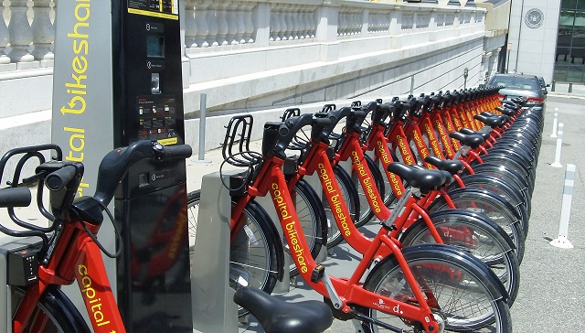
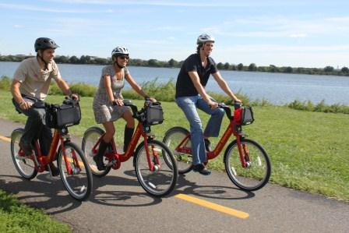
Problem Statement
What is bike sharing?
What is the problem?
Why should we solve the problem?

Slide 3
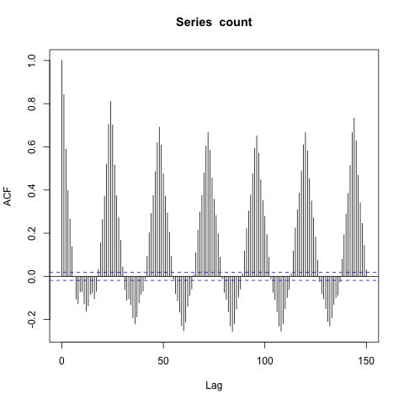
Exploratory Data Analysis
& Feature Engineering/Selection
Time Series Analysis
New Features
day of the week
is daylight
is working hour
day part
is Sunday

Slide 4
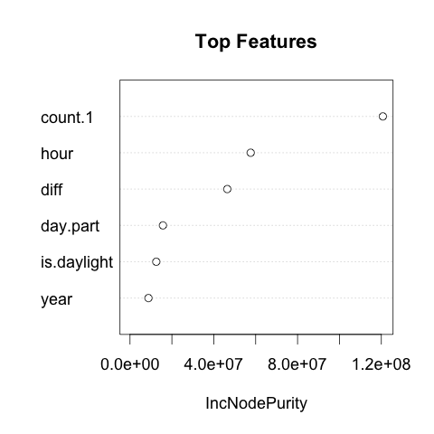
Model Selection
Why Random Forest?
Regression
Parallelizable
Iterative Process
OOB MSE & Pseudo R-Square

Slide 5
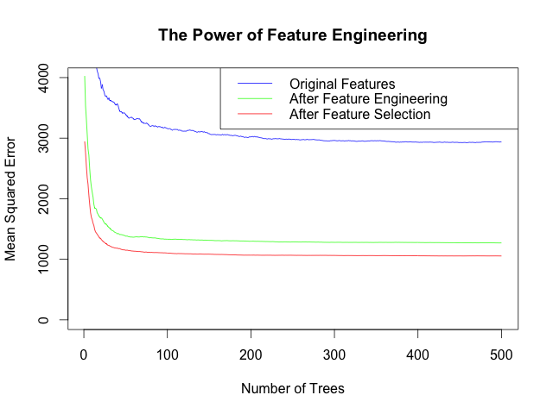
Results
1st Model: Average missed prediction: 55 (daily average target: 190)
Final model: Average missed prediction: 30 (daily average target: 190)
Kaggle score rank: top 36%

Slide 6
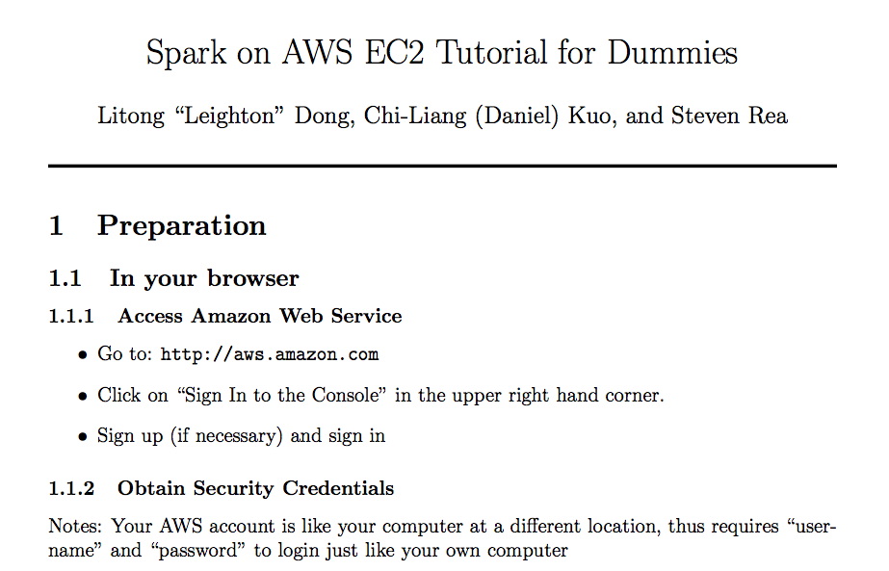
Conclusion
Tools
R
Apache Spark
Tutorial

Slide 7
Info
Github
https://github.com/ldong7/Bike-Share_Demand_Public
Emails:
Steven Rea: srea64@gmail.com
Chi-Liang (Daniel) Kuo: ckuo7@dons.usfca.edu
Litong “Leighton” Dong: ldong070314@gmail.com
USF Website
http://www.usfca.edu/artsci/msan/students/

