Slide 1
Can ATP supply keep up
when demand increases?
How ATP concentration responds to higher demand
How feedback sensitivity changes recovery
CCBS 2026 / Lecture 13 / Part 3: ATP feedback
Wang Zixuan, Jin Chengwei, Supeng
01
Notes:
SPEAKER SCRIPT
This part asks how ATP concentration responds when energy demand increases. We first calculate the new ATP level, then follow its response in time. Finally, we ask how feedback sensitivity changes the recovery.
The example will show a lower working ATP concentration at higher demand. It will also show that stronger feedback sensitivity can slow recovery or destabilize that working point.
PRESENTER REFERENCE
The ATP feedback model assumes fixed volume, fixed kinetic parameters during a demand step and externally specified ATP demand. This reduced model provides a controlled example, rather than a quantitative fit to a specific cell.
Equation source (LaTeX)
Sources
https://chemaoxfz.github.io/assets/ccbs/2026fall/lecture13-core.html

Slide 2
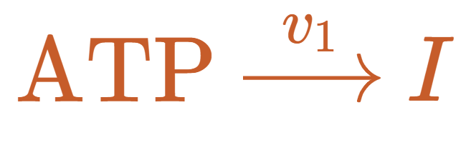
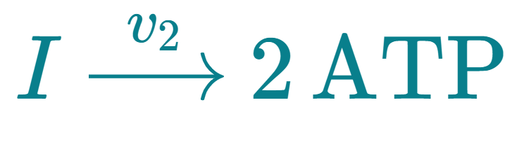
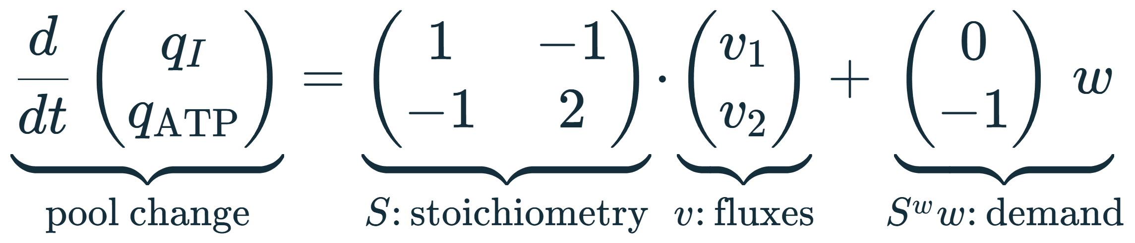
ATP reactions and concentration balances
Investment
Process | I rate | ATP rate
Investment | +v₁ | −v₁
Payoff | −v₂ | +2v₂
Demand | 0 | −w
Payoff
Flux units: concentration per unit time (for example, mM per second)
01 Model
02
Notes:
SPEAKER SCRIPT
Here, q denotes concentration. The two state variables are the intermediate pool, I, and the ATP pool. The reaction fluxes v one and v two have units of concentration per time. The external demand, w, has the same units.
The investment reaction consumes one ATP and creates one intermediate. The payoff reaction consumes one intermediate and produces two ATP. The table records each reaction's contribution to the two concentration rates.
The matrix equation collects the same bookkeeping. S contains the stoichiometric coefficients. Its first column describes investment, and its second column describes payoff. Multiplying S by the flux vector gives the changes produced by the reactions. External demand contributes zero to I and minus w to ATP.
At this stage, none of the variables has a bar. They still carry physical units.
PRESENTER REFERENCE
These are lumped reactions. Fuel, ADP, phosphate and other species are omitted. The coefficient two belongs to this reduced teaching model and is not the complete yield of glycolysis. The model assumes fixed volume. Its q variables represent the retained concentration pools after eliminating fast binding states.
TERMINOLOGY
Reaction flux means the rate at which a reaction proceeds per unit volume in this concentration model. Its units are concentration per unit time, for example millimolar per second. Concentration per unit time is a unit description, not the name of the variable. The external demand w is an ATP consumption flux. Both q and v are two-component column vectors.
Equation source (LaTeX)
q_I,q_{\mathrm{ATP}}:\ \text{concentrations}\qquad v_1,v_2:\ \text{reaction fluxes}\qquad w:\ \text{ATP demand flux}
Sources
https://chemaoxfz.github.io/assets/ccbs/2026fall/lecture13-core.html

Slide 3
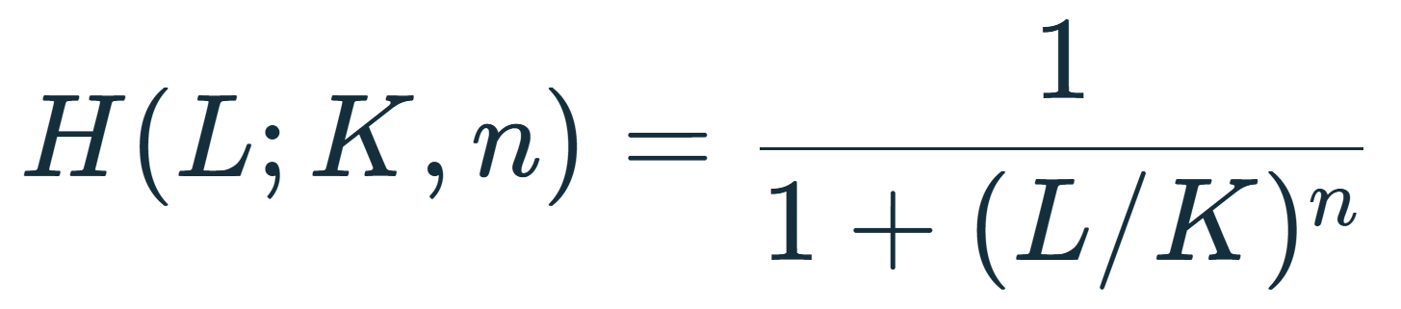
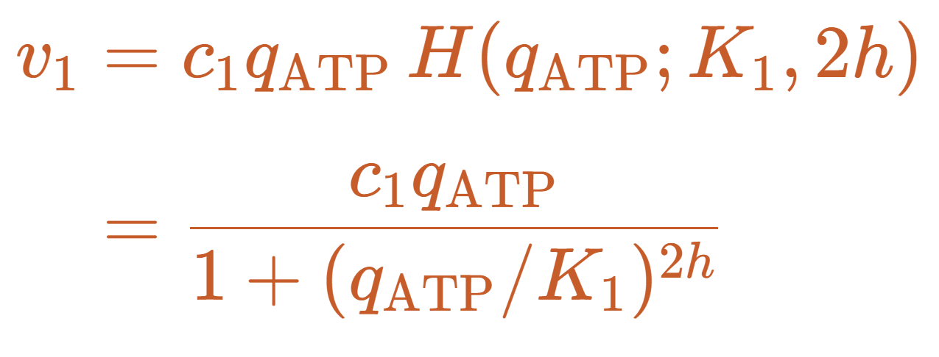
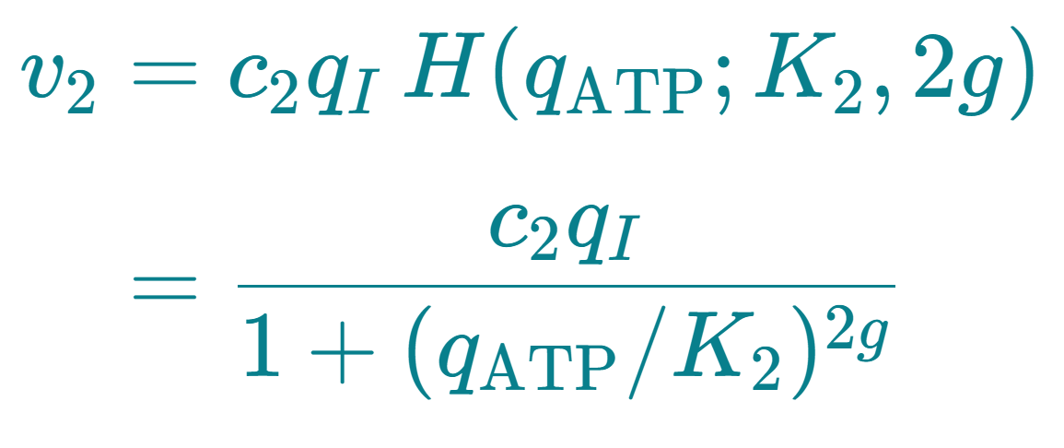
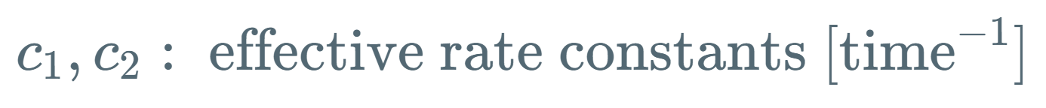
Hill-type inhibition supplies the rate laws
H: remaining active fraction
L: inhibitor concentration
K: half-inhibition concentration
n: response steepness
Investment
Payoff
ATP is the investment substrate.
ATP also inhibits the enzyme.
I is the payoff substrate.
ATP inhibits the payoff enzyme.
01 Model
03
Notes:
SPEAKER SCRIPT
The reaction balance tells us where material goes. We also need a rule for how fast each reaction runs.
We use an inhibitory Hill function, H. L is the inhibitor concentration, K is the concentration at half activity, and n controls the steepness. H decreases from one toward zero as the inhibitor concentration increases.
For investment, the flux is c one times ATP concentration times H. The ATP factor represents the substrate needed for the reaction. H represents the fraction of activity remaining under ATP inhibition. Substituting the Hill function gives the fraction shown on the second line.
For payoff, the substrate factor is I, while the inhibitor is still ATP. That explains why I appears in the numerator and ATP appears in the denominator.
The effective rate constants c one and c two include fixed enzyme abundance. The inhibition exponents are two h and two g. In this notation, h and g are half the corresponding Hill exponents.
PRESENTER REFERENCE
These are effective kinetic assumptions consistent with the course model, not a unique derivation from every microscopic reaction. ATP plays two roles in investment: substrate and inhibitor. Lower ATP does not increase investment at every possible concentration. The later example follows the inhibition-dominated branch near the reference state. A fitted Hill slope does not directly count binding sites.
Equation source (LaTeX)
Sources
https://chemaoxfz.github.io/assets/ccbs/2026fall/lecture13-core.html
https://pubmed.ncbi.nlm.nih.gov/19779939/

Slide 4
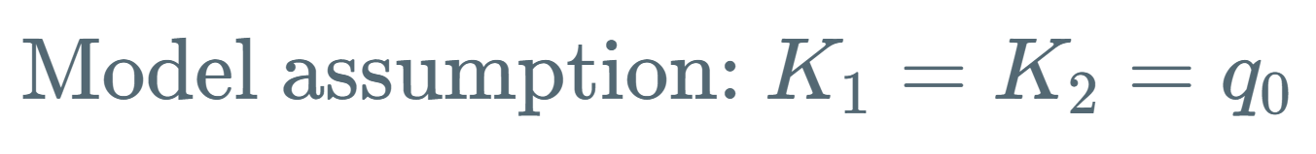
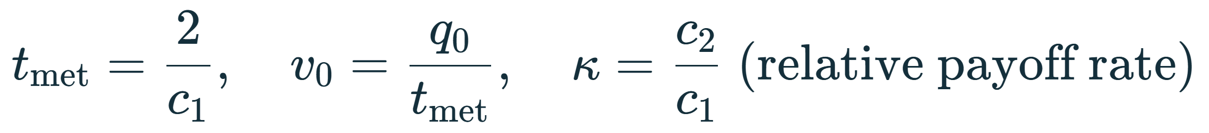
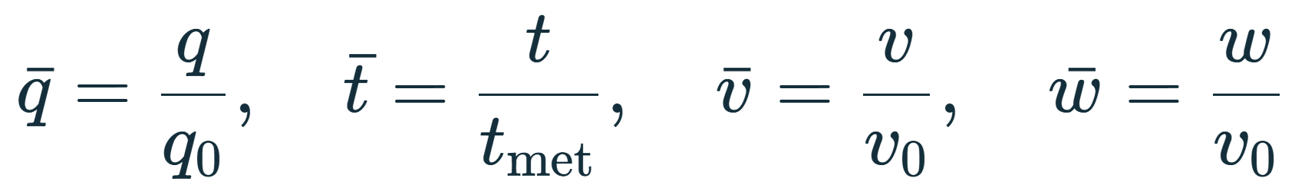
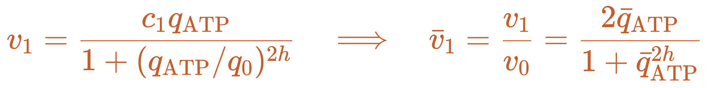
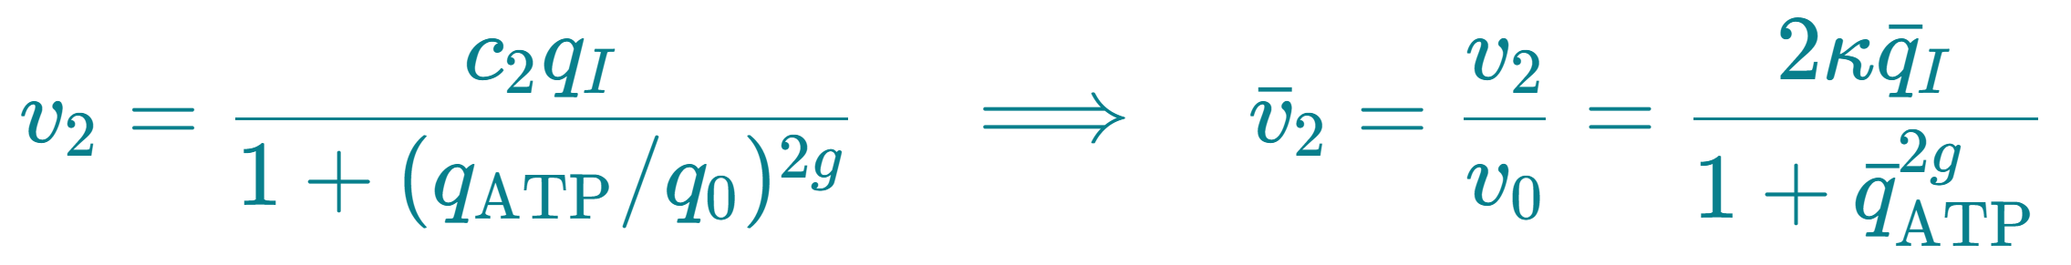
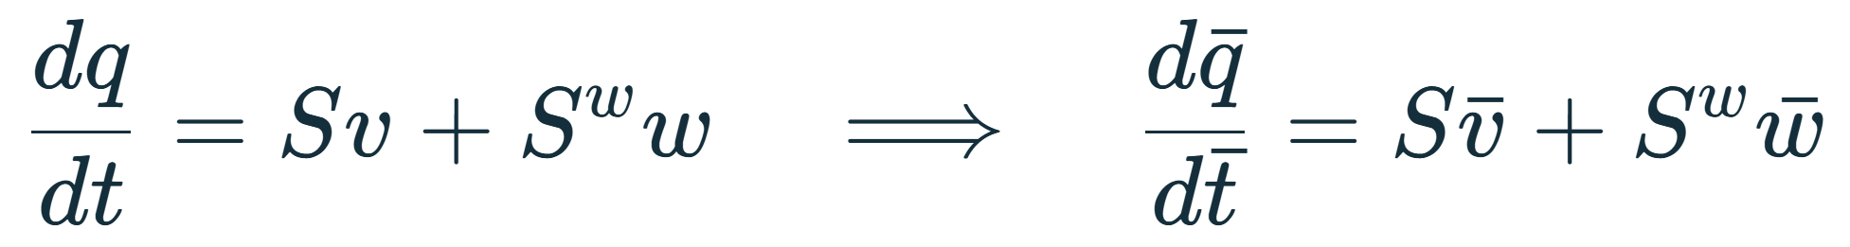
Normalization preserves the concentration balance
01 Model
04
Notes:
SPEAKER SCRIPT
We now define the bars. We assume a common inhibition scale: K one and K two both equal q zero. This is a model assumption.
We measure concentration in units of q zero, time in units of t met, and flux in units of v zero. We choose t met equal to two divided by c one, and v zero equal to q zero divided by t met. Kappa is the ratio c two over c one.
The arrows show the original equations on the left and their normalized versions on the right. In the first flux, c one times t met becomes two. In the second, c two times t met becomes two kappa.
The concentration balance keeps the same S matrix because both concentrations use the same scale, and both fluxes use the same flux scale. Every later time axis shows normalized time, not seconds.
PRESENTER REFERENCE
Substitute q = q0 qbar and t = t_met tbar into dq/dt. The chain rule gives dq/dt = (q0/t_met) dqbar/dtbar. The right side becomes v0 (S vbar + S^w wbar). Since v0 = q0/t_met, the common factor cancels.
For investment, v1/v0 = c1 q0 qbar_ATP / {v0 [1 + qbar_ATP^(2h)]} = c1 t_met qbar_ATP / [1 + qbar_ATP^(2h)] = 2 qbar_ATP / [1 + qbar_ATP^(2h)]. For payoff, the same substitution gives c2 t_met = 2 c2/c1 = 2 kappa.
Different physical K values cannot both disappear through this common rescaling. If K1 differs from K2, the normalized denominators retain their distinct scale ratios.
Equation source (LaTeX)
Sources
https://chemaoxfz.github.io/assets/ccbs/2026fall/lecture13-core.html

Slide 5
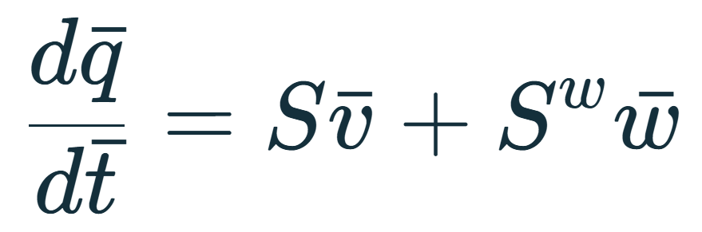
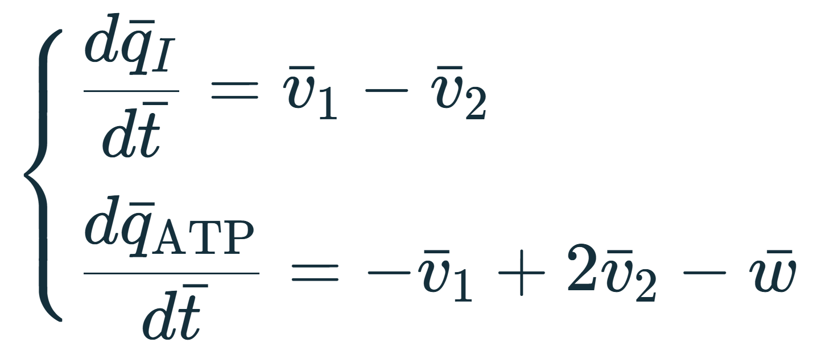
The steady-state condition follows from the balance
At steady state, both derivatives are zero
Concentrations stay constant while production and consumption continue.
01 Model
05
Notes:
SPEAKER SCRIPT
Let us derive the steady-state condition from the matrix balance. The first row of the normalized matrix equation gives the intermediate rate: investment minus payoff. The second gives the ATP rate: minus investment, plus twice payoff, minus demand.
At steady state, both concentration derivatives are zero. The first equation says that the two reaction fluxes must be equal. Substituting this into the second equation says that each reaction flux must equal demand.
The star marks a steady-state value. The bar marks normalization. They have different meanings.
Notice that a steady state can carry nonzero flux. ATP production and consumption continue, but the concentrations stay constant. Solving these equations locates a candidate working point. It does not yet prove that disturbances will decay.
Equation source (LaTeX)
Sources
https://chemaoxfz.github.io/assets/ccbs/2026fall/lecture13-core.html

Slide 6
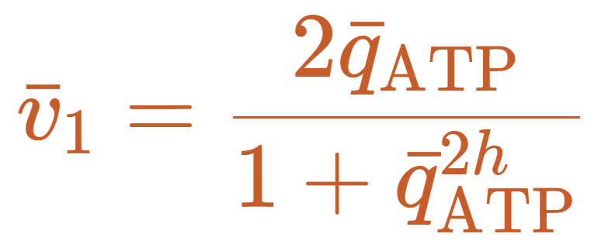
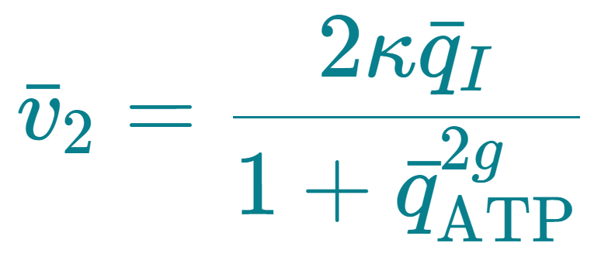
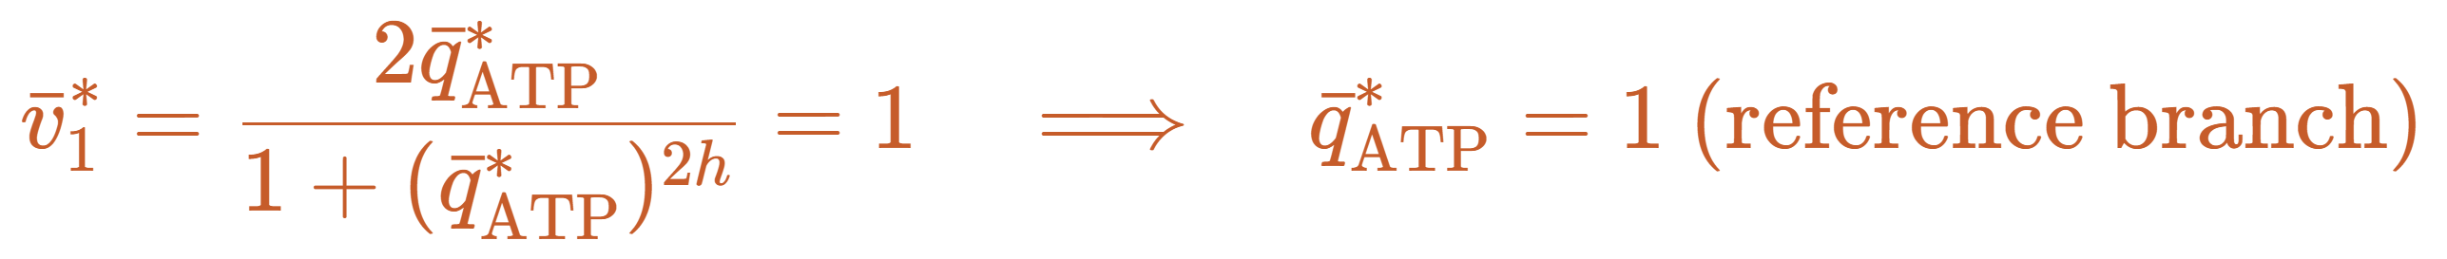
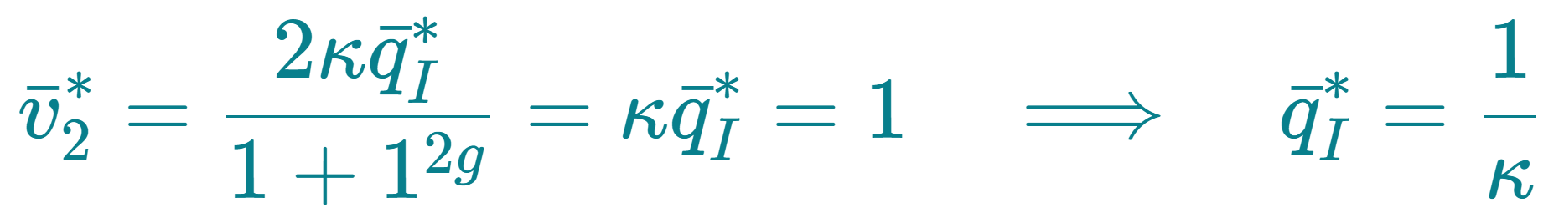
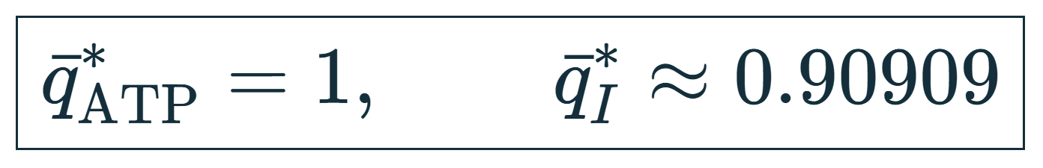
The normalized model and its reference state
Illustrative model parameters, not fitted measurements.
01 Model
06
Notes:
SPEAKER SCRIPT
These are the normalized flux laws that we will use from now on. Let the reference demand equal one, and require both reaction fluxes to equal one.
On the reference branch, ATP equal to one satisfies the first equation, because two divided by two equals one.
Now substitute that ATP value into the second flux. Its denominator also becomes two, so the payoff flux is kappa times the intermediate concentration. Setting that flux to one gives I equal to one over kappa.
For our example, kappa is one point one, g is zero point three, and h is two point five. The reference concentrations are therefore ATP equal to one and I approximately zero point nine zero nine zero nine. The reaction fluxes and demand are all one, although the concentrations are not both one.
PRESENTER REFERENCE
We select the reference root qbar_ATP = 1. The investment equation can have another positive root. The reference root exists for every h, but its stability still depends on h.
Setting both concentrations to one with kappa = 1.1 would give vbar1 = 1 and vbar2 = 1.1. At demand one, the derivatives would then be -0.1 for I and +0.2 for ATP. That point is not a steady state.
PARAMETER CHOICE
For example, choose kappa = 1.1, g = 0.3 and h = 2.5. These are illustrative model parameters, not experimentally fitted values or random samples. We keep kappa and g fixed and vary h later to isolate investment-feedback sensitivity. In an experiment, h would be estimated from the ATP-dependent investment-rate curve together with the other kinetic parameters. The investment Hill exponent is 2h.
Equation source (LaTeX)
\text{For example: }\quad\kappa=1.1,\quad g=0.3,\quad h=2.5
Sources
https://chemaoxfz.github.io/assets/ccbs/2026fall/lecture13-core.html

Slide 7
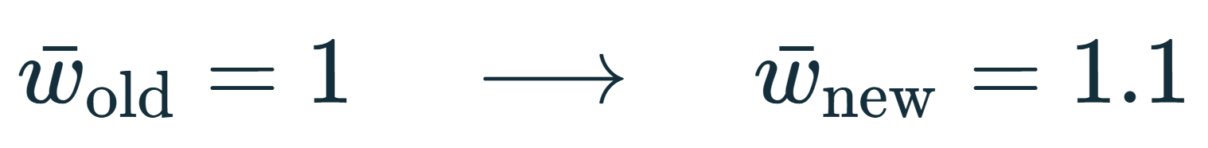
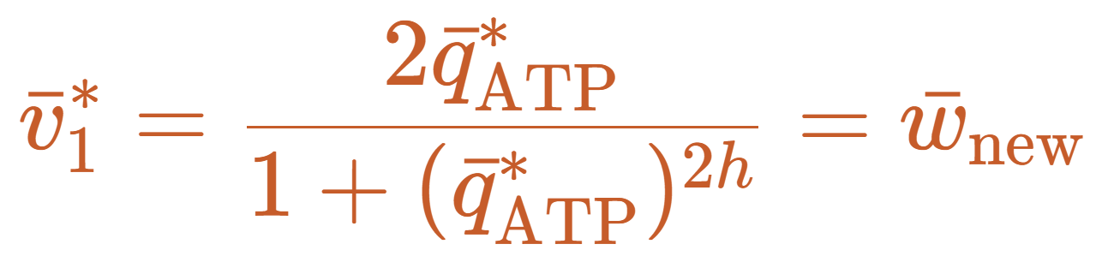
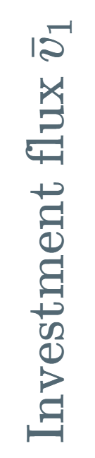
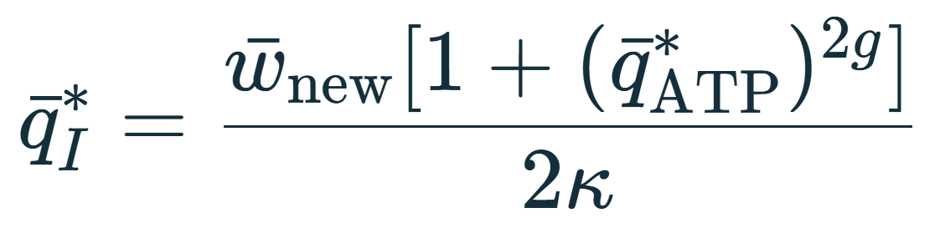

Higher demand shifts the candidate steady state
Higher demand moves the working state
02 Demand
07
Notes:
SPEAKER SCRIPT
We now change demand from one to one point one. All kinetic parameters remain fixed at the example values.
At the new steady state, investment flux must equal the new demand. The orange equation on the left is exactly the orange curve on the right. The horizontal lines show the old and new demand levels.
We follow the intersection near the old ATP concentration. The increased demand intersects this descending branch at a lower ATP concentration. Once ATP is known, the payoff balance gives I.
The bottom comparison shows both states with the same precision. ATP changes from one to zero point nine two seven four nine. I changes from zero point nine zero nine zero nine to zero point nine seven seven nine two.
On this branch, lowering ATP relieves inhibition strongly enough to increase investment flux despite the smaller ATP substrate pool. The higher I pool supports the increased payoff. These equations locate a candidate steady state. We next check how the system moves toward it.
PRESENTER REFERENCE
Parameters remain h = 2.5, g = 0.3 and kappa = 1.1. The steady equations are vbar1 = vbar2 = wbar. The ATP equation can have more than one positive root, so the calculation follows the inhibition-dominated branch connected to the reference ATP value of one. The plotted quantities are flux versus concentration, not time.
Equation source (LaTeX)
\begin{gathered}\bar q_{\mathrm{ATP}}^{*}=1,\quad \bar q_I^{*}=0.90909\end{gathered}\quad\longrightarrow\quad\begin{gathered}\bar q_{\mathrm{ATP}}^{*}=0.92749,\quad \bar q_I^{*}=0.97792\end{gathered}
Sources
https://chemaoxfz.github.io/assets/ccbs/2026fall/lecture13-core.html

Slide 8
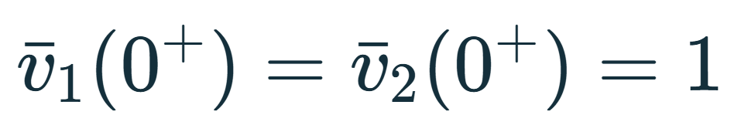
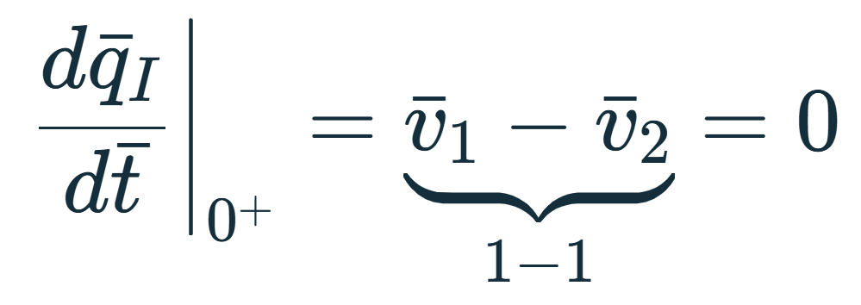

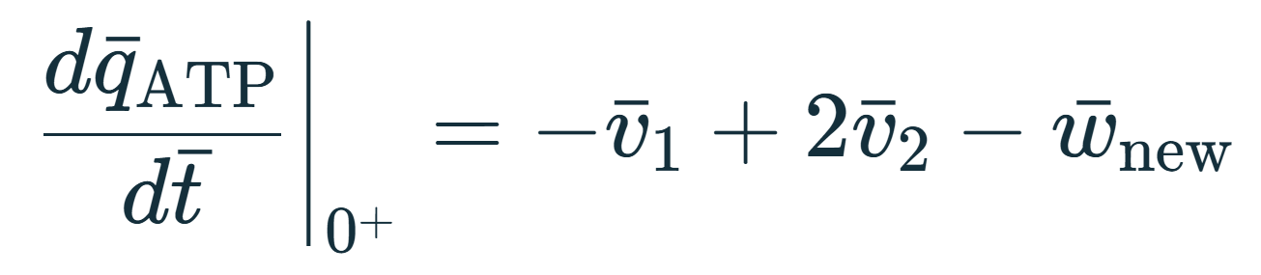
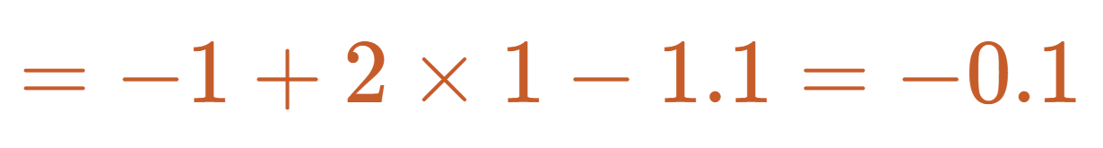
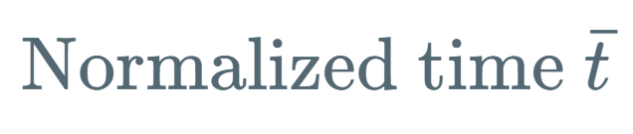
ATP falls before supply adjusts to higher demand
Immediately: demand rises,
but production has not changed.
Why does production dip?
Then: investment spends ATP before the extra payoff catches up.
03 Response
08
Notes:
SPEAKER SCRIPT
First consider the instant just after demand increases. Concentrations cannot jump. The reaction fluxes depend on those concentrations, so both fluxes are still one at this instant.
The intermediate derivative is v one minus v two. Substituting one minus one gives zero. The ATP derivative is minus v one, plus twice v two, minus the new demand. Substituting the numbers gives minus zero point one.
The immediate ATP decline therefore has a simple cause: consumption has increased before production changes.
The arrow asks why net ATP production initially dips. This is a second effect, distinct from the immediate ATP concentration decline. Net ATP production, P, equals minus v one plus twice v two. It starts at one, then briefly falls below one. As ATP falls, inhibition weakens and investment accelerates. That investment spends ATP before the extra payoff catches up. Later, the intermediate accumulates and supports more ATP production.
The dashed line is the new demand. ATP decreases when net production lies below that line and increases when production lies above it.
PRESENTER REFERENCE
The initial demand deficit and the subsequent dip in net production have different causes. The initial deficit follows from concentration continuity and the demand step alone. The production dip also depends on the investment-payoff kinetics. For the example h = 2.5, g = 0.3 and kappa = 1.1, at the reference point, dPbar/dtbar = (h - 1 - 2g)(wbar_old - wbar_new) = -0.09 for the stated parameters. P is a flux, not the ATP concentration.
Equation source (LaTeX)
Sources
https://chemaoxfz.github.io/assets/ccbs/2026fall/lecture13-core.html

Slide 9
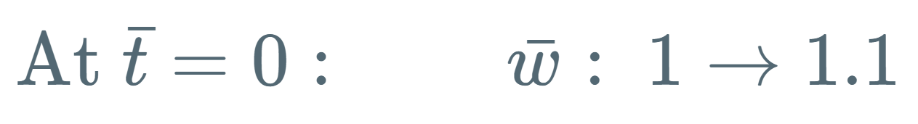

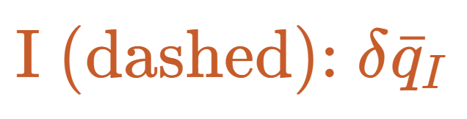

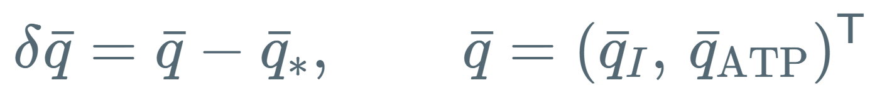
I and ATP approach the new steady state together
ATP changes the rates.
The rates change I.
I changes the ATP payoff.
At the marked crossing,
I is still above its steady value,
so ATP keeps rising.
Here, each cycle reduces the disturbance. The oscillations gradually decay.
03 Response
09
Notes:
SPEAKER SCRIPT
We can now follow the two concentrations together. At normalized time zero, demand steps from one to one point one. Higher demand first lowers ATP. ATP changes the reaction rates. The difference between those rates changes I, and I changes the ATP payoff.
The column vector qbar contains I first and ATP second. Delta qbar means qbar minus its new steady-state vector. Each plotted curve is one component of this vector deviation. The teal solid line is ATP, and the orange dashed line is I. Zero means that a concentration equals its new steady value, not that the concentration itself is zero.
Look at the marked upward crossing. ATP has reached its steady-state value, but I is still above its own steady-state value. The excess intermediate supports extra payoff, so ATP keeps increasing and overshoots.
In this example, the net effect of the coupled feedback reduces the disturbance over successive cycles. The oscillations therefore fade. Negative feedback alone is not enough to guarantee this result. We will check it mathematically with the Jacobian.
PRESENTER REFERENCE
At the marked crossing, vbar1 equals the new demand because ATP equals its steady-state value. Since I remains above its steady-state value, vbar2 exceeds demand, and the ATP derivative remains positive. The same demand-step trajectory continues here with h fixed at 2.5. The next slide changes the experimental protocol to a local perturbation test.
Equation source (LaTeX)
\text{At }\bar t=0:\qquad \bar w:\ 1\to1.1
\delta\bar q=\bar q-\bar q_*,\qquad\bar q=(\bar q_I,\,\bar q_{\mathrm{ATP}})^{\mathsf T}
Sources
https://chemaoxfz.github.io/assets/ccbs/2026fall/lecture13-core.html

Slide 10

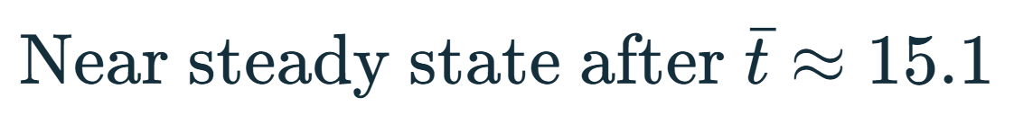
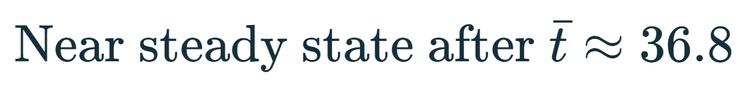
Feedback sensitivity changes the recovery time
h = 2.5
h = 2.8
04 Stability
10
Notes:
SPEAKER SCRIPT
Does the disturbance decay for every h? To isolate this question, we now fix demand at one point one. For each h, we start at its own new steady state and add the same small ATP perturbation, zero point zero zero one. I starts at its steady-state value.
Both cases recover, but h equal to two point eight recovers more slowly. The two charts use the same vertical scale. The time windows differ: the left plot ends at twenty and the right plot ends at forty-five, so compare the time labels rather than the physical widths.
Using the same small tolerance for both deviations, the settling times are about fifteen and thirty-seven normalized time units. Stronger sensitivity does not necessarily give faster recovery. Investment changes immediate ATP spending as well as the later payoff through I.
PRESENTER REFERENCE
This is a local stability test at fixed demand, not another demand step. Settling means that both absolute deviations fall below 0.00001 and remain below it through the simulation endpoint of 80. The numerical settling times are 15.08 and 36.76. The initial perturbation values and the settling tolerance are reference details rather than slide subtitles. Mathematical asymptotic convergence does not reach exactly zero at a finite time.
Equation source (LaTeX)
\text{Small perturbation around each steady state at }\bar w=1.1
Sources
https://chemaoxfz.github.io/assets/ccbs/2026fall/lecture13-core.html

Slide 11

The same small disturbance can grow
h = 3.1
More sensitive investment
changes ATP spending
more strongly.
I changes the later payoff.
Here, the coupled response
amplifies the disturbance.
The disturbance grows instead of settling.
04 Stability
11
Notes:
SPEAKER SCRIPT
We repeat exactly the same perturbation test with h equal to three point one. Demand remains fixed, and the initial ATP displacement is still zero point zero zero one.
This time, the oscillations grow. The trajectory moves away from the candidate steady state. The vertical range is larger than on the previous slide, so check the y-axis values.
The more sensitive investment reaction changes ATP spending more strongly. I then changes the later payoff. For these parameters, the combined response amplifies the disturbance instead of damping it.
The label above the graph identifies h = 3.1. The growing oscillations indicate departure from the candidate state. The Jacobian on the next slide explains why.
PRESENTER REFERENCE
This finite trajectory shows departure from the local steady state. It does not by itself establish a permanent limit cycle, an unbounded long-term solution, or cell death in a biological system.
Equation source (LaTeX)
\text{Same perturbation test at }\bar w=1.1
Sources
https://chemaoxfz.github.io/assets/ccbs/2026fall/lecture13-core.html

Slide 12
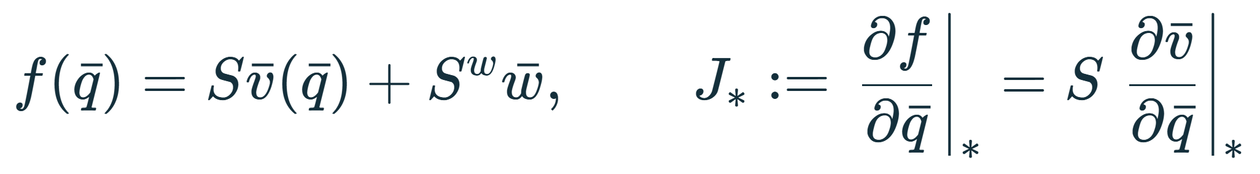
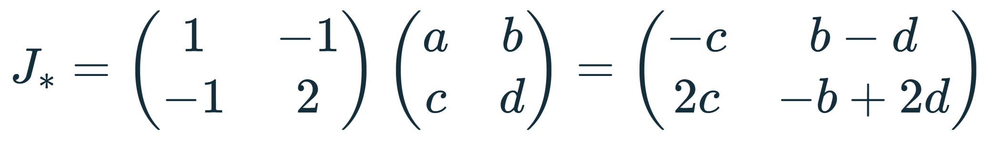
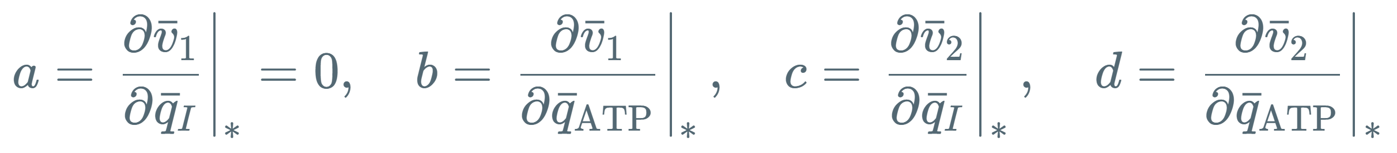
The Jacobian explains decay and growth
h | tr J* | det J* | Small disturbance
2.5 | −0.593 | 1.381 | Decays
2.8 | −0.258 | 1.737 | Decays more slowly
3.1 | +0.063 | 2.083 | Grows
Negative trace closer to zero means slower decay.
04 Stability
12
Notes:
SPEAKER SCRIPT
The Jacobian differentiates the full concentration dynamics, f, with respect to the concentrations. Since demand is fixed during this test, its derivative is zero. We therefore multiply S by the flux-derivative matrix.
We label that matrix in the usual order: a and b in the first row, c and d in the second. The first entry, a, is zero because investment does not depend directly on I. The other entries describe how investment responds to ATP, and how payoff responds to I and ATP.
Multiplying by S gives the state Jacobian shown here. Near steady state, it determines how a small concentration disturbance changes.
All three examples have a positive determinant and complex-conjugate eigenvalues. For this oscillatory case, the local amplitude envelope varies as the exponential of one half the trace times time. A negative trace gives decay. A negative trace closer to zero gives slower decay. A positive trace gives growth.
That is why the trace values in the table explain the three time traces. The middle case is still stable, but its trace is less negative, so it loses its disturbance more slowly.
PRESENTER REFERENCE
State ordering is (qbar_I, qbar_ATP), and flux ordering is (vbar1, vbar2). Set a = partial vbar1 / partial qbar_I = 0, b = partial vbar1 / partial qbar_ATP, c = partial vbar2 / partial qbar_I, and d = partial vbar2 / partial qbar_ATP, all evaluated at the relevant new steady state. Then J = [[-c, b-d], [2c, -b+2d]].
Writing A = qbar_ATP and I = qbar_I for this reference paragraph only, b = 2[1 + (1-2h)A^(2h)]/[1+A^(2h)]^2, c = 2 kappa/[1+A^(2g)], and d = -4 kappa g I A^(2g-1)/[1+A^(2g)]^2.
For a two-dimensional real matrix with complex-conjugate eigenvalues, their common real part is trace(J)/2. The linear solution has this exponential envelope, multiplied by sinusoidal terms. Individual coordinate magnitudes need not decrease at every instant. The relation explains local asymptotic damping, not a universal nonlinear settling-time formula. The trace-determinant stability test requires trace < 0 and determinant > 0. The complex-pair condition is trace^2 - 4 determinant < 0. All three displayed cases meet the latter condition.
Each J is evaluated at its own demand-1.1 steady state. If demand depended on concentration, its state derivative would also contribute to J.
Equation source (LaTeX)
J_*=\begin{pmatrix}1&-1\\-1&2\end{pmatrix}\begin{pmatrix}a&b\\c&d\end{pmatrix}=\begin{pmatrix}-c&b-d\\2c&-b+2d\end{pmatrix}
Sources
https://chemaoxfz.github.io/assets/ccbs/2026fall/lecture13-core.html

Slide 13
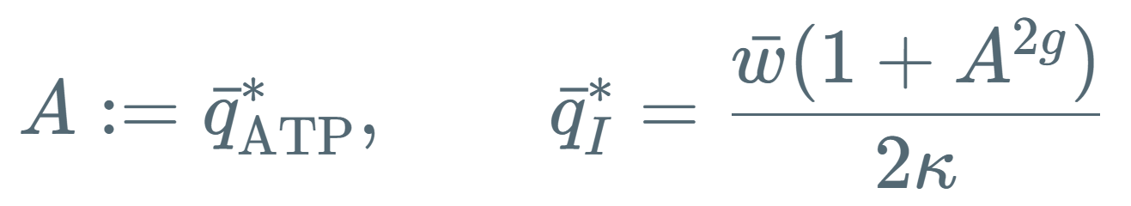
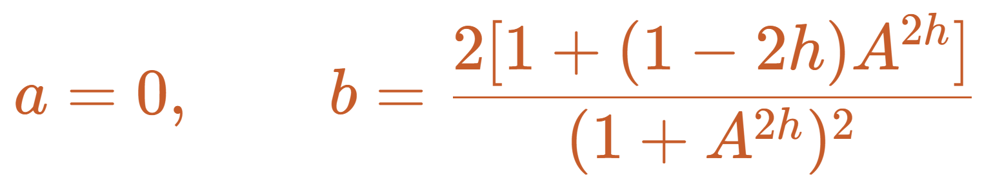
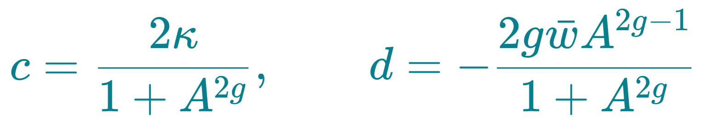
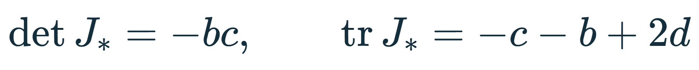
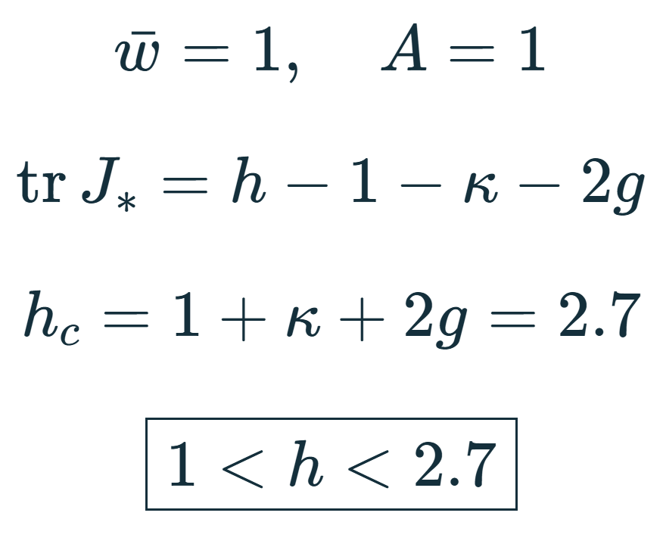
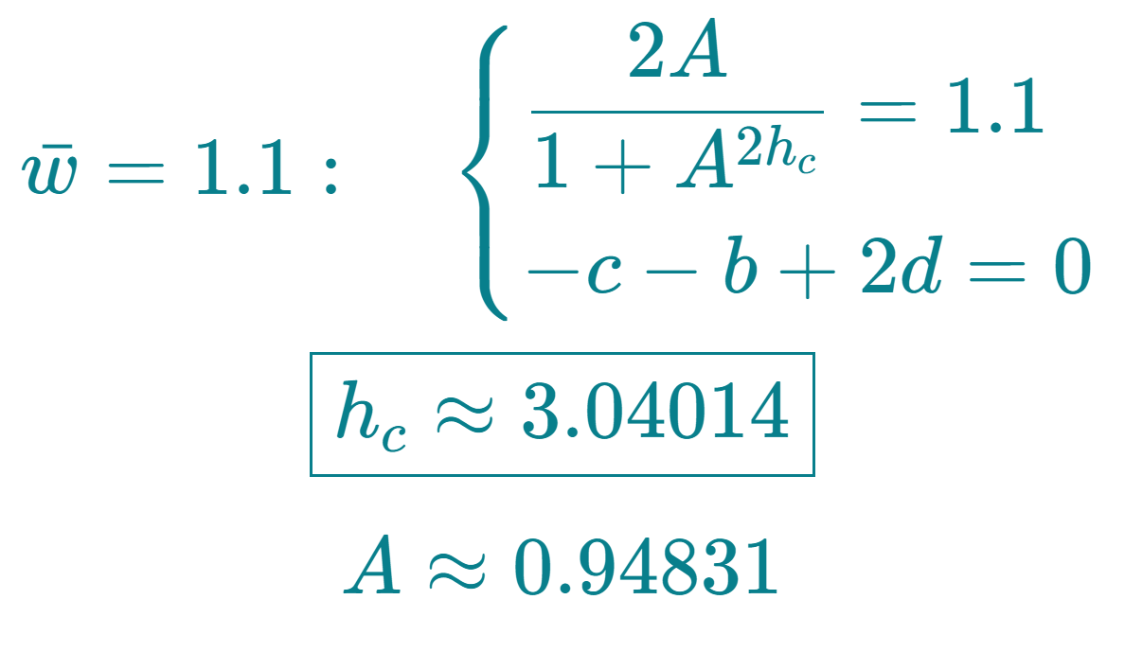
The critical h depends on ATP demand
A stable linearization has det J* > 0 and tr J* < 0.
Reference demand
After the demand increase
04 Stability
13
Notes:
SPEAKER SCRIPT
We can now calculate a stability boundary rather than only compare three examples. On this page, A is shorthand for the steady ATP concentration.
Differentiate the two flux laws. The four entries a, b, c and d appear in the same order as on the previous slide. The derivative a is zero, and c is positive. Substituting the steady payoff balance simplifies d.
The determinant is minus b times c. The trace is minus c minus b plus twice d. On the descending investment branch, b is negative, so the determinant is positive. The sign of the trace then separates local decay from local growth.
At the original demand of one, the reference ATP value is exactly one. This gives the explicit stable interval: h is greater than one and less than one plus kappa plus twice g. Our parameters make the upper boundary two point seven.
After demand increases to one point one, ATP itself depends on h. We must solve the steady-state equation together with the zero-trace condition. This gives a critical h of about three point zero four zero one four, with ATP about zero point nine four eight three one.
That is why two point five and two point eight are locally stable at the new demand, whereas three point one is unstable. The threshold belongs to this demand and this branch.
PRESENTER REFERENCE
Write A = qbar_ATP^*, I = qbar_I^*. The equilibrium satisfies 2A/(1+A^(2h)) = wbar and I = wbar(1+A^(2g))/(2 kappa).
a = 0.
b = 2[1+(1-2h)A^(2h)]/(1+A^(2h))^2.
c = 2 kappa/(1+A^(2g)).
d = -4 kappa g I A^(2g-1)/(1+A^(2g))^2 = -2g wbar A^(2g-1)/(1+A^(2g)).
J = [[-c,b-d],[2c,-b+2d]]. Its trace is -c-b+2d and its determinant is -bc. The two-dimensional linearization is Hurwitz exactly when trace < 0 and determinant > 0.
At wbar = 1 on the reference branch A = 1, b = 1-h, c = kappa and d = -g. Therefore trace = h-1-kappa-2g and determinant = kappa(h-1). The strict linear stability interval is 1 < h < 1+kappa+2g = 2.7. Equality requires nonlinear analysis.
For general demand, substitution of A^(2h)=2A/wbar-1 into trace=0 yields
h_c = A/(2A-wbar) * [1 + 2 kappa A/(wbar(1+A^(2g))) + 4g A^(2g)/(1+A^(2g))].
This expression must still be solved together with the equilibrium relation because A depends on h. At wbar = 1.1, kappa = 1.1 and g = 0.3, the selected boundary is h_c = 3.0401391891, A = 0.9483140898, I = 0.9843299506, determinant = 2.0142069817. This is an implicit analytic boundary with a numerical root, not a closed-form constant valid for all demands. It does not by itself prove a nonlinear Hopf bifurcation or a stable limit cycle.
The old reference state at demand one is already unstable for h = 2.8 or 3.1. This is why the comparison slides use small perturbations of each NEW demand-1.1 steady state, not the same demand-step experiment for every h.
Equation source (LaTeX)
A:=\bar q_{\mathrm{ATP}}^{*},\qquad \bar q_I^{*}=\frac{\bar w(1+A^{2g})}{2\kappa}
a=0,\qquad b=\frac{2[1+(1-2h)A^{2h}]}{(1+A^{2h})^2}
c=\frac{2\kappa}{1+A^{2g}},\qquad d=-\frac{2g\bar w A^{2g-1}}{1+A^{2g}}
\det J_*=-bc,\qquad\operatorname{tr}J_*=-c-b+2d
\begin{gathered}\bar w=1,\quad A=1\\[5pt]\operatorname{tr}J_*=h-1-\kappa-2g\\[5pt]h_c=1+\kappa+2g=2.7\\[6pt]\boxed{1<h<2.7}\end{gathered}
\begin{gathered}\bar w=1.1:\quad\begin{cases}\displaystyle\frac{2A}{1+A^{2h_c}}=1.1\\[5pt]-c-b+2d=0\end{cases}\\[7pt]\boxed{h_c\approx3.04014}\\[4pt]A\approx0.94831\end{gathered}
Sources
https://chemaoxfz.github.io/assets/ccbs/2026fall/lecture13-core.html

Slide 14
ATP level and recovery after a demand increase
Higher demand lowers ATP on this branch.
Increasing h can slow or destabilize recovery.
Why does ATP settle lower?
Lower ATP relieves inhibition enough to raise investment flux.
The larger I pool then supports the higher ATP payoff.
Here, relief of inhibition outweighs the loss of ATP substrate.
Closing
14
Notes:
SPEAKER SCRIPT
Here is the answer to our ATP question. On the branch we studied, greater demand lowers the working ATP concentration. Changing h changes how the ATP disturbance decays, and sufficiently large h causes it to grow.
For h equal to two point five, a ten-percent demand increase lowers the final ATP level from one to about zero point nine two seven five. The two reaction fluxes reach one point one, so production can support the higher demand at that lower ATP level.
Why lower ATP? ATP inhibits investment as well as serving as its substrate. Around this working point, the relief of inhibition dominates the loss of substrate. Lower ATP therefore allows a larger investment flux. The higher intermediate pool then supports the higher payoff flux. If ATP returned to its old value of one, investment would return to one and could not sustain the new demand of one point one.
At fixed demand one point one, increasing h from two point five to two point eight gives slower recovery. At three point one, the candidate steady state is locally unstable. A more sensitive investment response therefore does not guarantee better ATP regulation.
PRESENTER REFERENCE
These statements apply to the selected branch and fixed kappa and g. Implicit differentiation of vbar1(A,h) = wbar gives dA/dwbar = 1/b < 0 on the descending branch.
Changing h also moves the candidate ATP level: A is 0.927487 for h=2.5, 0.940805 for h=2.8 and 0.949892 for h=3.1 at demand 1.1. The final candidate in this list is unstable and must not be described as a settled ATP level. In the stable cases ATP need not return to its old concentration for supply to match demand.
The model does not predict that lower ATP always increases production. At sufficiently low ATP the substrate limitation dominates. No experimental parameter fit or universal cellular response is claimed.
Equation source (LaTeX)
h=2.5:\qquad \bar w:1\to1.1,\quad \bar q_{\mathrm{ATP}}^{*}:1\to0.92749,\quad \bar v_1^{*}=\bar v_2^{*}=1.1
Sources
https://chemaoxfz.github.io/assets/ccbs/2026fall/lecture13-core.html

Slide 15
Q&A
Thank you
15
Notes:
SPEAKER SCRIPT
Thank you for listening. We welcome your questions.
DISCUSSION REFERENCE
The example is a reduced teaching model. Experimental calibration is necessary before making predictions about a specific cell. The plots distinguish a finite demand step from local perturbations about each new steady state. All plotted times are dimensionless.
Equation source (LaTeX)
Sources

