Slide 1
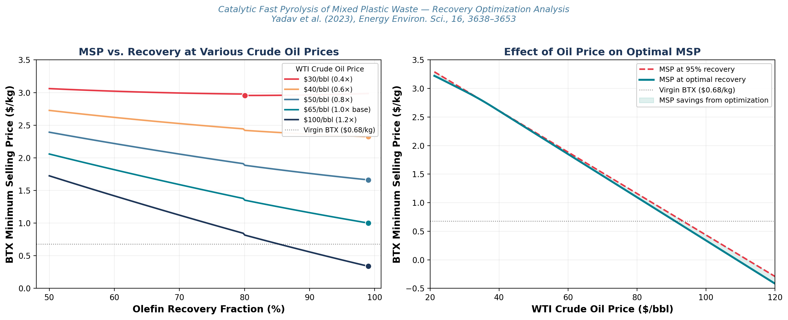
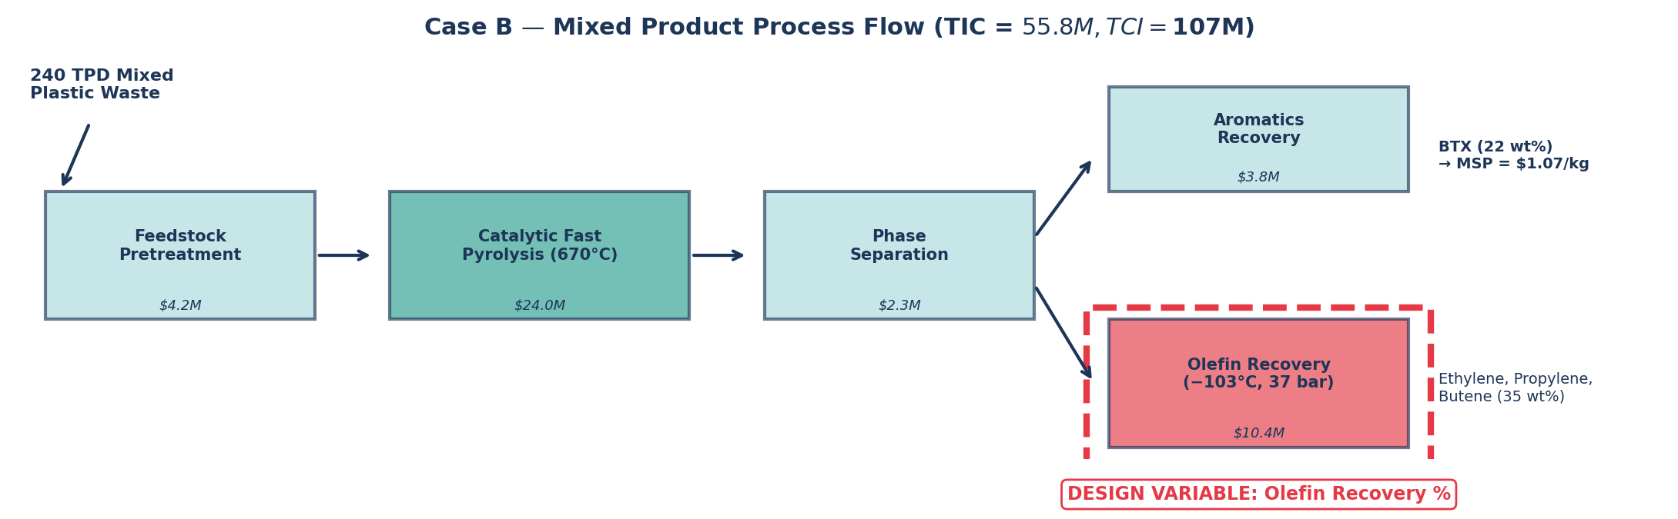
CATALYTIC FAST PYROLYSIS OF MIXED PLASTIC WASTE
Yadav et al. (2023) Energy Environ. Sci., 16, 3638
Olefin Recovery Optimization for BTX Aromatics Team members: El Hadj Souleymane Sr, Tommy Yue, Michael Nguyen, Mark Heien
DESIGN QUESTION
At base oil prices, maximizing olefin recovery (>95%) minimizes BTX MSP, but at low crude prices an interior optimum (~80%) emerges due to cryogenic separation OPEX.
How does olefin recovery fraction affect BTX MSP — and how does crude oil price volatility shift the optimal design point?
01
BASE-CASE OIL ($65/bbl)
Sensitivity Setup Parameter Varied: Olefin recovery fraction Range Explored: 0.80 – 0.99Method: Python sensitivity sweep(economic model calibrated to $1.07/kg BTX MSP; Seider cost scaling)
Maximize recovery (>95%). Olefin revenue exceeds marginal cryogenic cost. MSP: $1.07 → $1.00/kg (−6.5%)
02
LOW OIL PRICE (<$40/bbl)
Interior optimum at ~80%. Cryogenic OPEX for ethylene (−103°C) not justified when co-product prices collapse.
03
CONTEXT
CAPEX / OPEX COMPARISON
Recovery = secondary lever (−6%). Refinery integration (−32%) and feedstock cost dominate.
 | BASE (95%) | LOW-OIL (80%) | HIGH-OIL (99%) | UNIT
Olefin sep. capital | $10.4 | $8.0 | $11.5 | $M
Total capital investment | $107 | $102 | $109 | $M
Olefin revenue | $49.2 | $41.4 | $51.3 | $M/yr
Olefin sep. utility cost | $9.2 | $6.8 | $9.9 | $M/yr
BTX MSP | $1.07 | $1.37 | $1.00 | $/kg
vs. virgin BTX ($0.68/kg) | 1.57× | 2.01× | 1.47× | —
Python sensitivity | Seider cost scaling | Calibrated to $1.07/kg MSP
Olefin recovery is a secondary economic lever that improves feasibility at high oil prices, while crude‑price volatility motivates flexible recovery designs to control cost risk in plastic upcycling.

