Slide 1
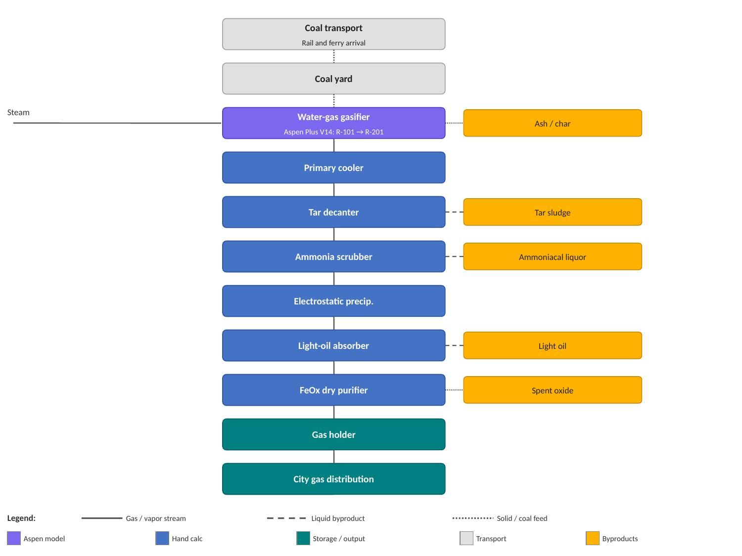
Block Flow Diagram — Pre-1937 Seattle Gas Works Coal Gasification Plant (Lake Station)
Production target: 170,000 Nm³/day city gas at 0 °C, 1 atm

