Slide 1
Gaussian Process Regression and Bayesian Optimization on Latent Embedding of Protein Sequences
Xinran Lian
Department of Chemistry
University of Chicago
2023/3/2

Slide 2
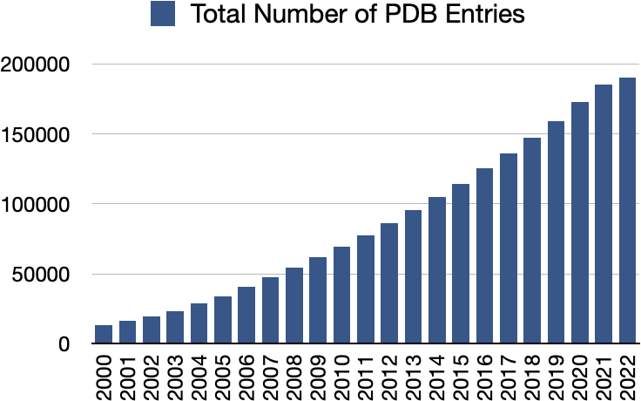


Growth of protein database and data-driven protein design
Our dataset of protein homolog family
……
Design the member with a specific function
PDB (Protein Data Bank) Statistics
Notes:
The answer is yes. With growth of protein sequence database, we can now extract information from, and even design new members in a protein family. For example, if we have a dataset of protein sequences, containing many paralogs, and we want to design synthetic proteins of a specific function, what should we do?

Slide 3
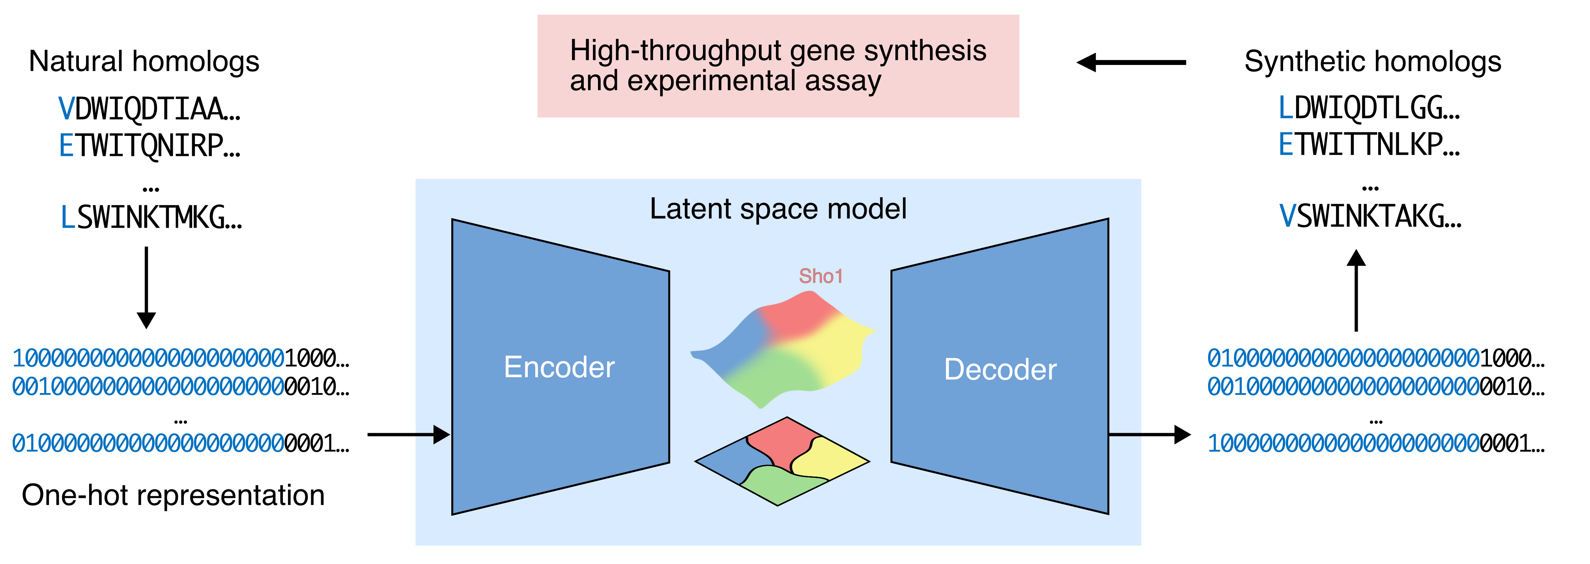
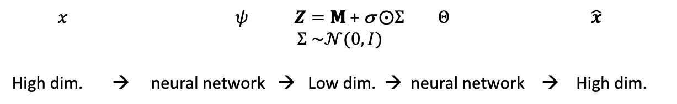
Design proteins with a latent space model – Variational Autoencoder (VAE)
$x$ $ψ$ $Z=\text{Μ}\text{ + }\text{σ} ⨀Σ$ $Θ$ $\hat{x}$
$$Σ \sim 𝒩(0,I)$$
High dim. → neural network → Low dim. → neural network → High dim.
Notes:
We will need a protein design tool and a model system. Let’s firstly talk about the model system

Slide 4
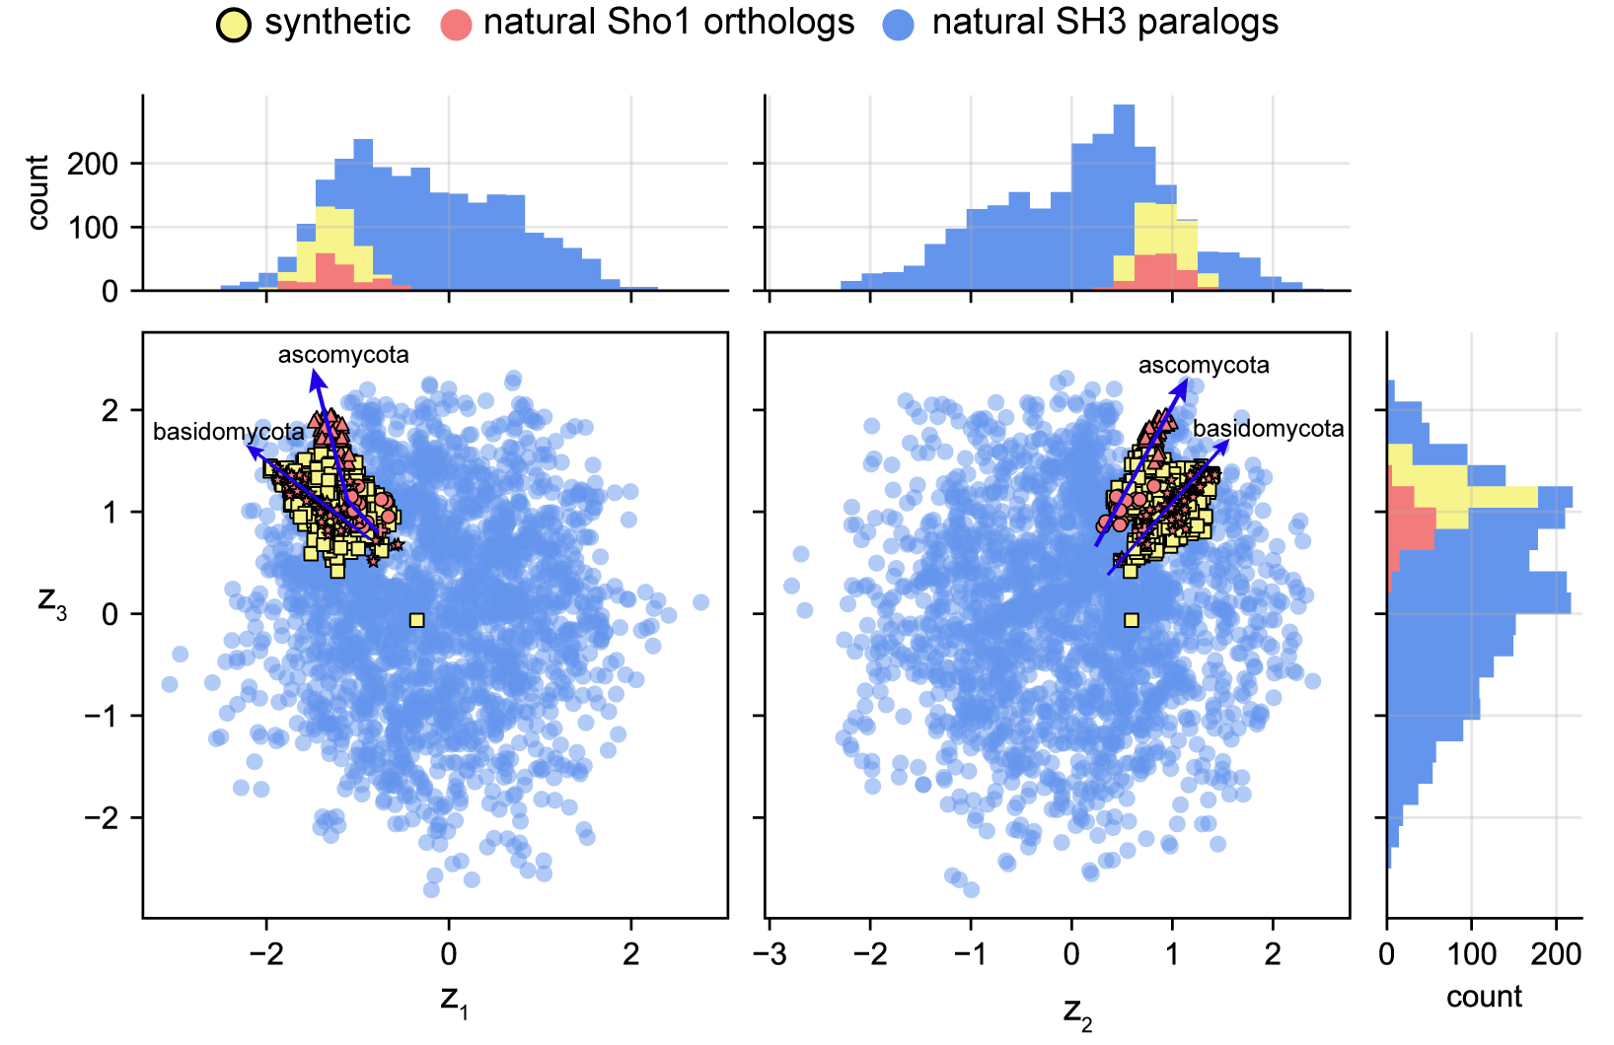
Design proteins with a latent space model – Variational Autoencoder (VAE)
In the VAE latent space, designed functional sequences locate in the same area as the natural ones.
Designed functional
Designed non-functional
Natural functional
Lian et al. Biorxiv, 2022
Notes:
So how about the distribution in the latent space? We scattered designed and natural sequences together. Designed functional sequences overlapped with natural sequences. And filled the gap between the natural sequences caused by divergence in different phylogeny groups, also extended to the outside area where natural sequences never explored. This is a sign that our model can not only use but also extend the natural constraints of functionality.

Slide 5
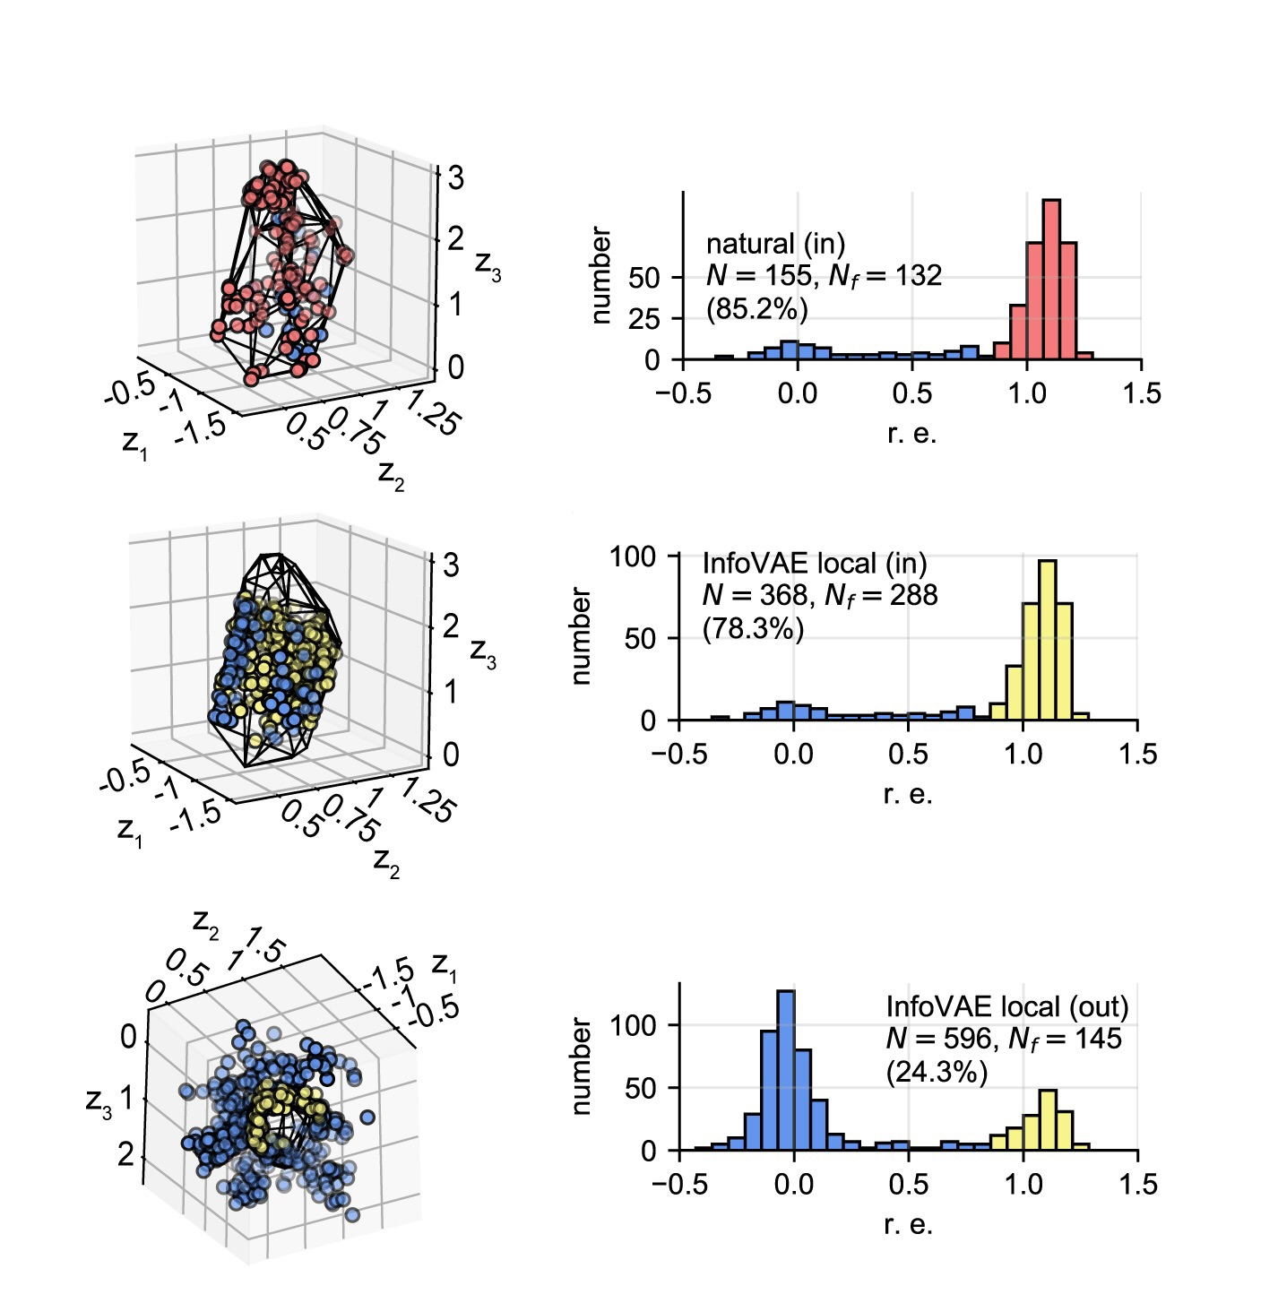
Convex hull: evaluate the function by location in the latent space
Convex hull
Designed functional
Designed non-functional
Natural functional

Slide 6

The training and test set for GPR and SVR
$X$: latent variables $Z$ of shape $5090×3$
$y$: protein function score of shape $5090×1$
$X_{train}$: $Z$of 80% of the natural sequences
$X_{test}$ : $Z$ of designed sequences of shape $2855×3$

Slide 7
Kernel function of a single-task GP
noise_prior = gpy.priors.NormalPrior(0,1)
lengthscale_prior = gpy.priors.GammaPrior(2, 0.5)
outputscale_prior = gpy.priors.GammaPrior(2, 0.1)
likelihood = gpy.likelihoods.GaussianLikelihood(
noise_prior = noise_prior,
noise_contraint = gpy.constraints.GreaterThan(1e-4))
covar_module = gpy.kernels.MaternKernel(nu = 2.5,
lengthscale_prior = lengthscale_prior,
lengthscale_constraint = gpy.constraints.GreaterThan(0.001))
covar_module = gpy.kernels.ScaleKernel(covar_module, outputscale_prior = outputscale_prior)

Slide 8
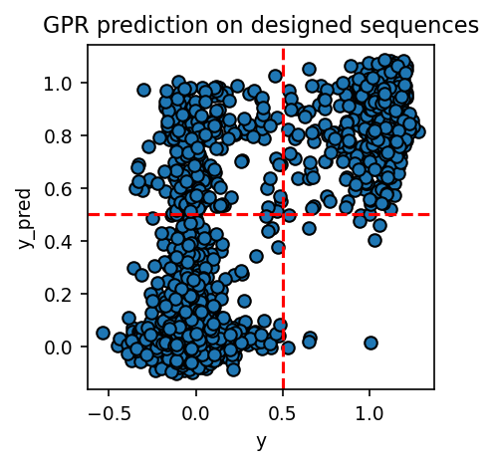
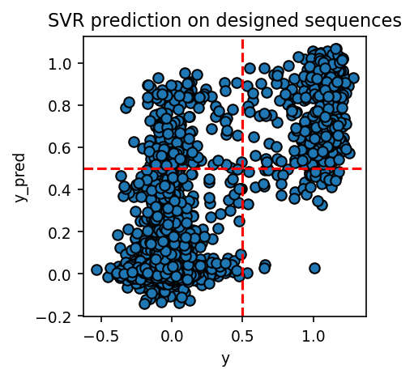


Train GPR and SVR on natural sequences to predict designed sequences
$$F1=0.806±0.009$$
$$F1=0.819±0.004$$

Slide 9
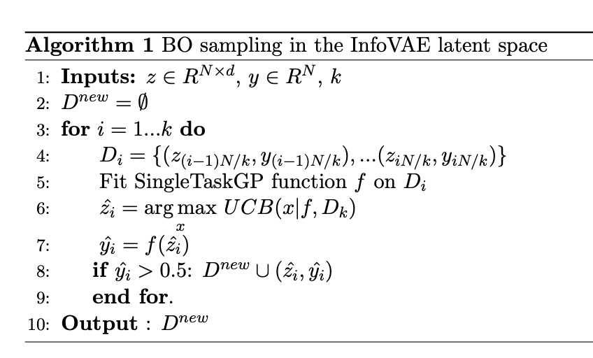
BO query in the latent space

Slide 10
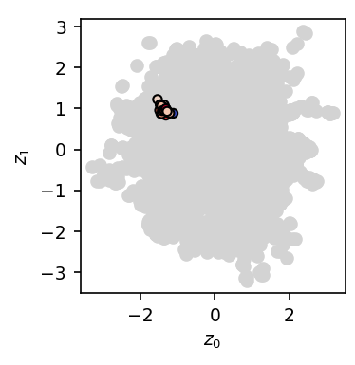
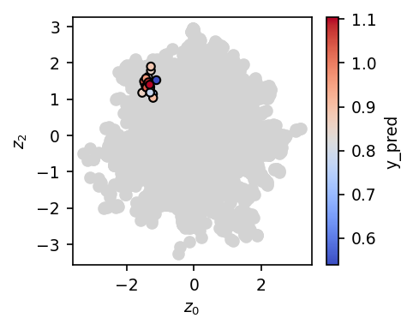
BO sampled latent variables (blue)

Slide 11
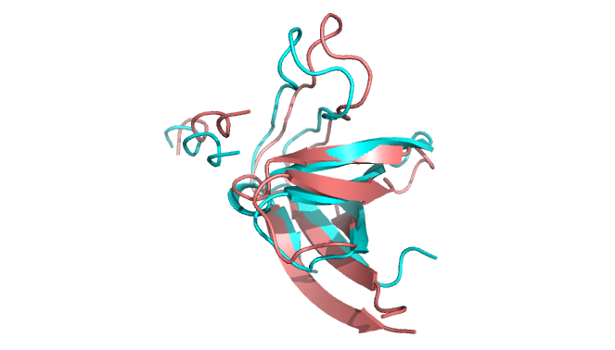
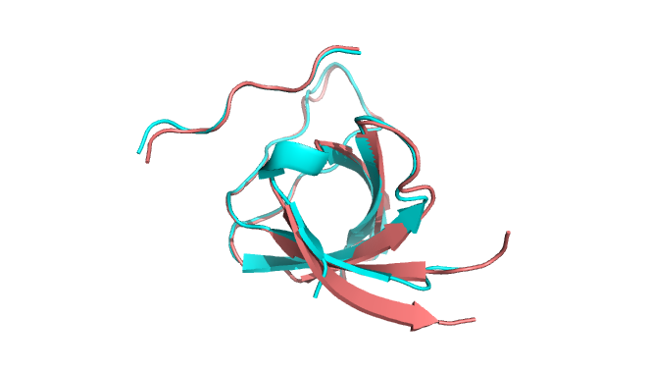
AlphaFold prediction of BO sampled sequences
A B
Sequence 1
Top natural ID: 83%
2VKN ID: 56%
Sequence 2
Top natural ID: 85%
2VKN ID: 59%
Red: wild-type functional protein in budding yeast (PDB ID:2VKN)
ColabFold

Slide 12
Conclusions
GPR and SVR has comparable performance on function prediction (but GPR is much slower)
BO sampled sequences are with viable ligand-binding structure predicted by AlphaFold.

