Slide 1
Safe Exploration in Finite Markov Decision Processes with Gaussian Processes
Authors: Matteo Turchetta, Felix Berkenkamp, Andreas Krause
Presenter: Xinran Lian
2/9/2023

Slide 2
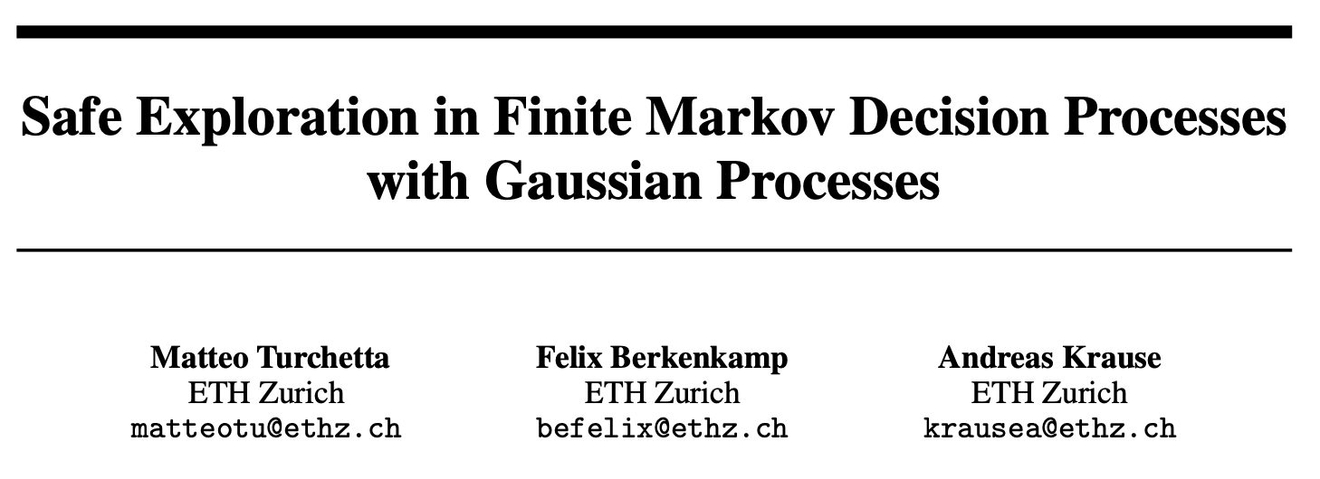
This paper seems to be the combination of two other papers

Slide 3
Outline
Tutorial of Markov Decision Processes (MDP)
Theory of safeMDP
Code demonstration with Jupyter Notebook

Slide 4
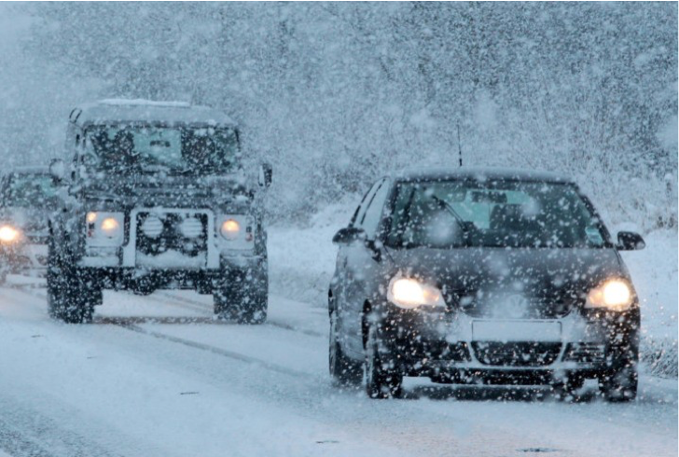
Assuming we are exploring unknown stochastic environments…
e.g. robot planning, autopilot
ccs.neu.edu/home/rplatt/cs5335_fall2017/slides/mdps.pdf

Slide 5
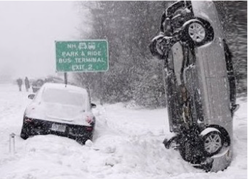
What if there is no safety constrains in the algorithm?
We are going to introduce a new framework for exploring stochastic environment: the Markov Decision Process (MDP)

Slide 6
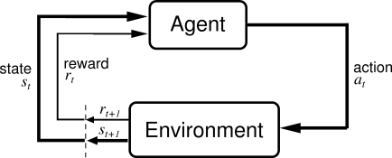
Finite-discrete-time Markov decision process
The environment evolves probabilistically, occupying a finite set of discrete states.
The state does not contain past statistics, even though these statistics could be useful to the agent.
﻿﻿For each environmental stage, there is a finite set of possible actions that may be taken by the agent.
﻿﻿Every time the agent takes an action, a certain reward is raised.
﻿﻿States are observed, actions are taken, and rewards are raised at discrete times.
Haykin, S. (2009). Neural networks and learning machines
http://incompleteideas.net/book/ebook/node28.html

Slide 7
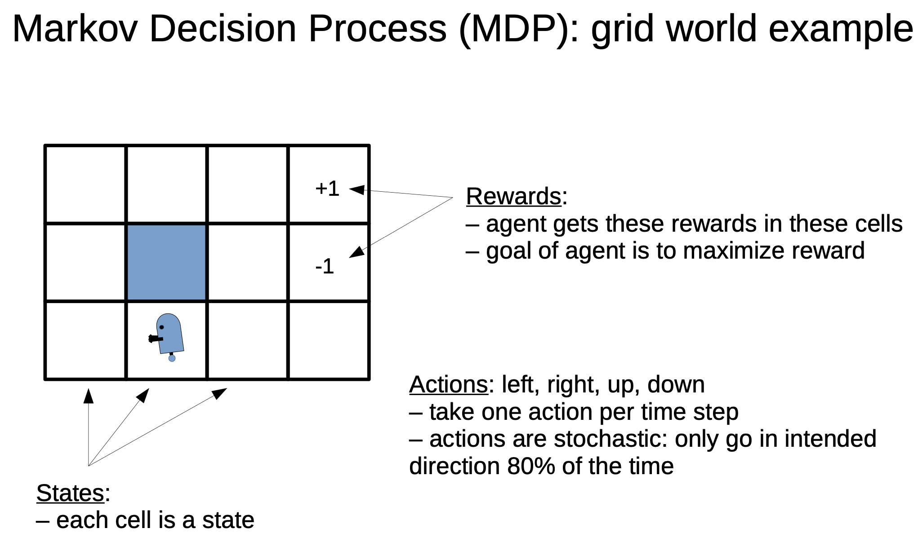
ccs.neu.edu/home/rplatt/cs5335_fall2017/slides/mdps.pdf

Slide 8
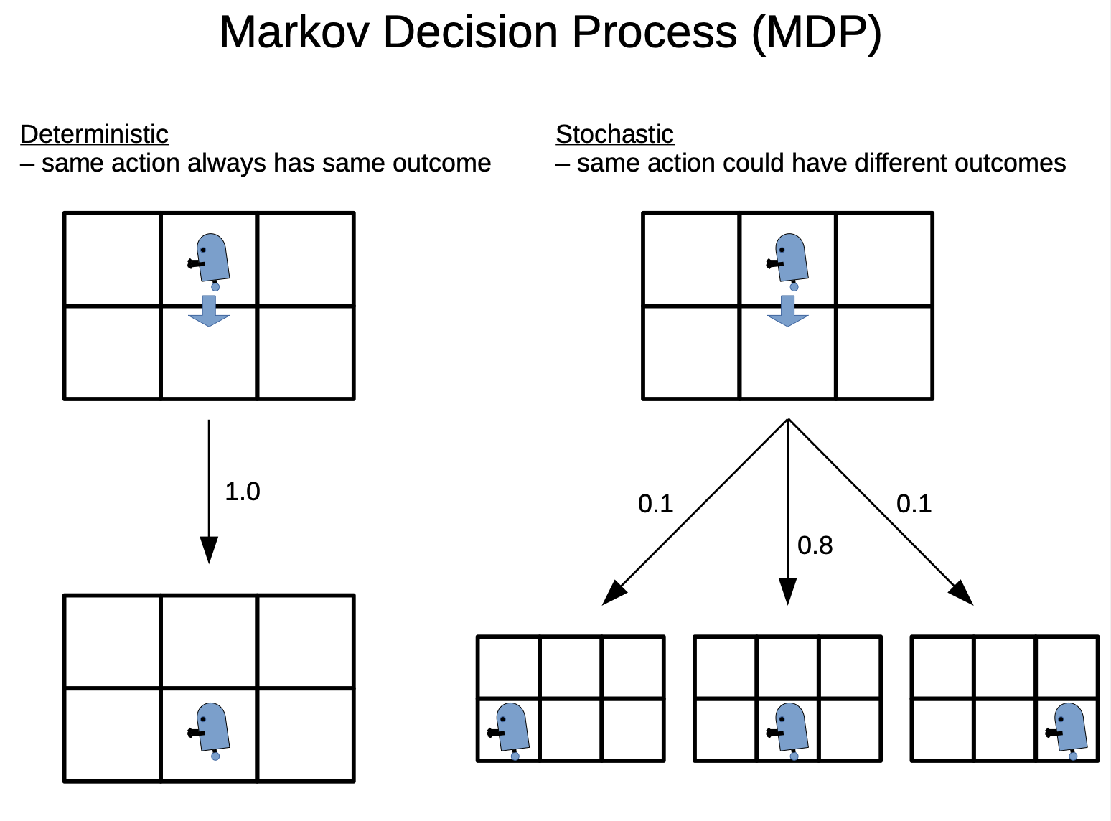
This paper only discuss finite, deterministic MDP
ccs.neu.edu/home/rplatt/cs5335_fall2017/slides/mdps.pdf

Slide 9
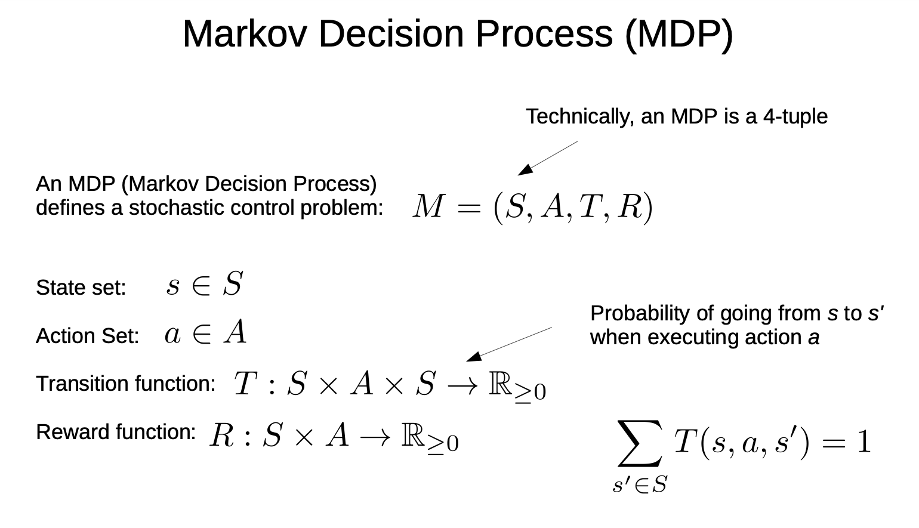
ccs.neu.edu/home/rplatt/cs5335_fall2017/slides/mdps.pdf

Slide 10
How does safeMDP work?
An initial set of states and actions known to be safe
Exploit regularity assumptions on the safety function
Determine if nearby unvisited stated are safe
Start Exploit Explore
By MDP

Slide 11
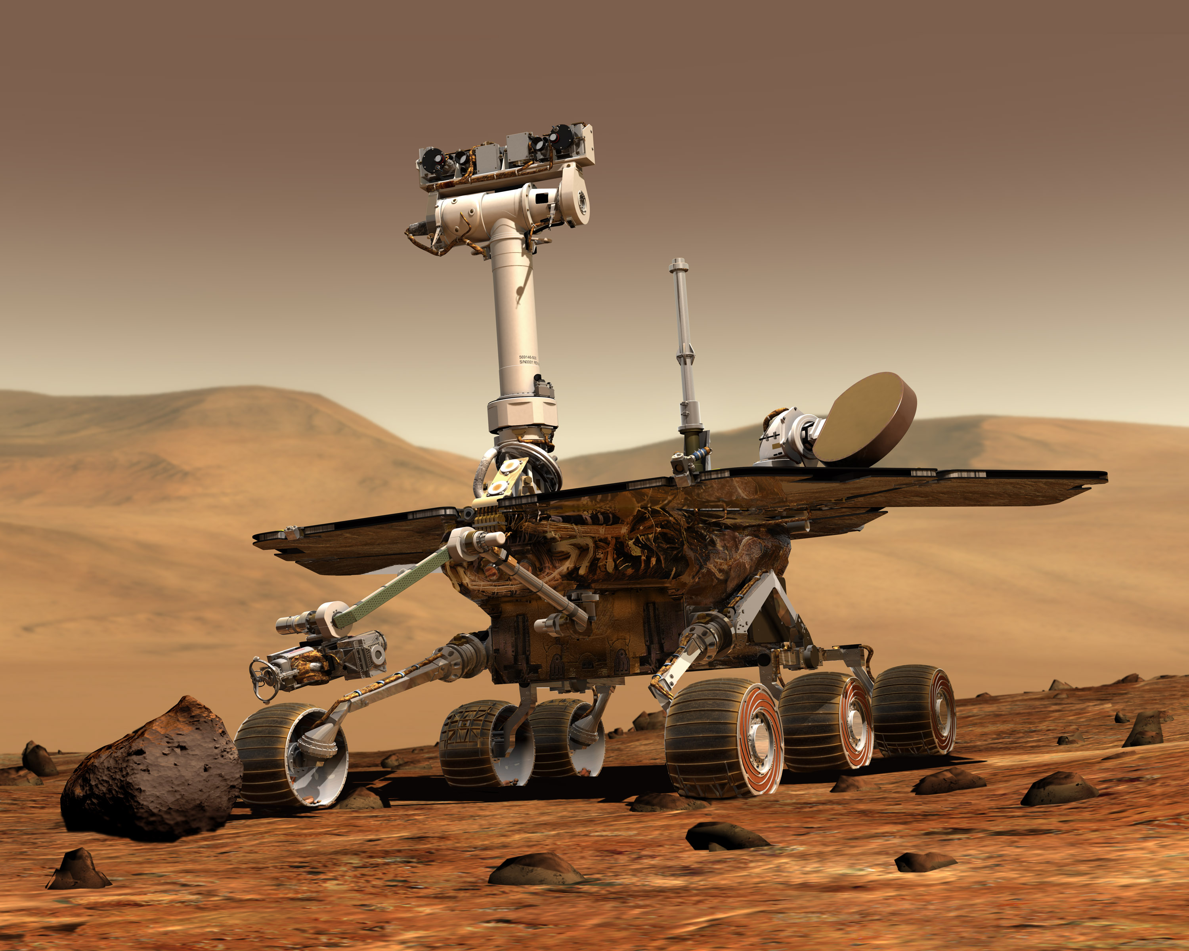
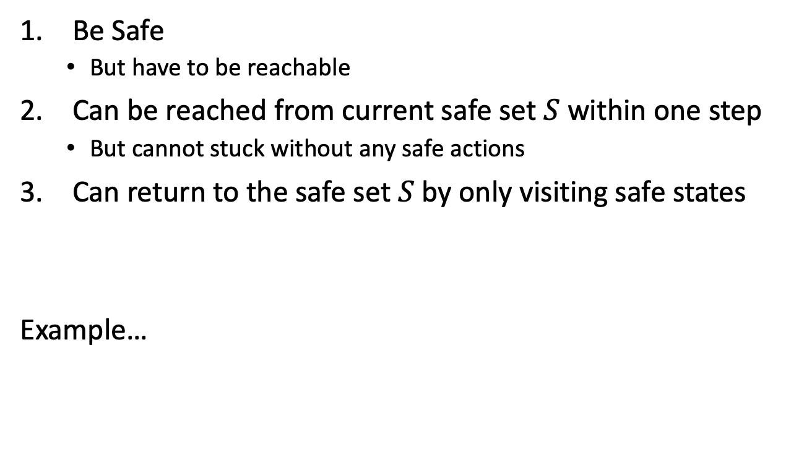
Each new states must…
Be Safe
But have to be reachable
Can be reached from current safe set $S$ within one step
But cannot stuck without any safe actions
Can return to the safe set $S$ by only visiting safe states
Example…

Slide 12
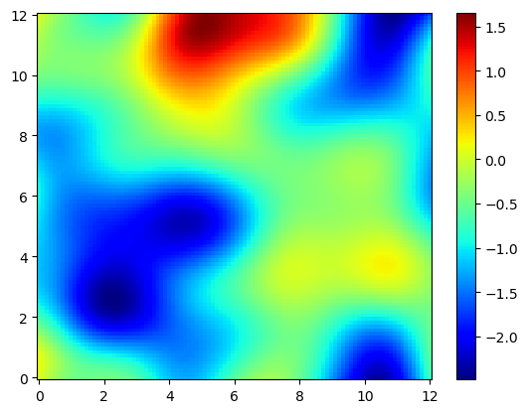
Example 2D grid world
A hill the rover cannot climb
altitude
A crater once entered cannot leave

Slide 13
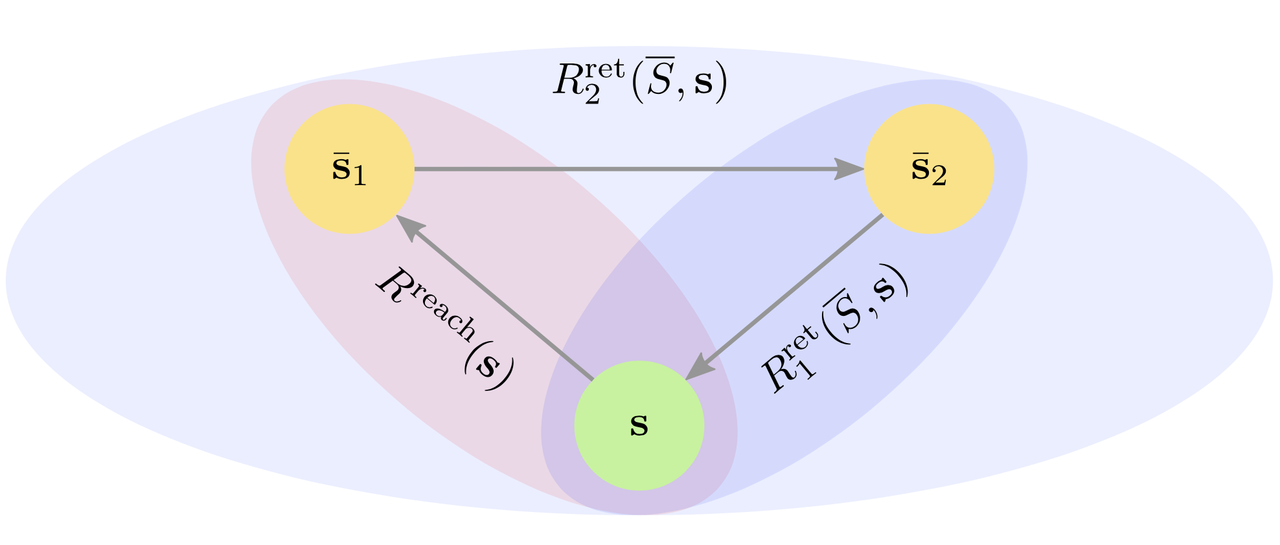
Turchetta et al., 2016

Slide 14

The algorithm should…
Explore newly available safe states
Gain new knowledge about the safe features
Potentially further enlarge the safe set
Until the size of the safe state is bounded by surrounding unsafe states or number of $S$

Slide 15
The algorithm…
Initialization
Initialize a starting safe set to explore MDP
Classification
Determine which states are safe without visiting them
Expanders
Identify and explore states that might expand the set of states that can be classified as safe
Sampling and shortest safe path
Finally select safe states to evaluate
Find a safe path in MDP towards the safe states
Terminate when reach desired accuracy

Slide 16
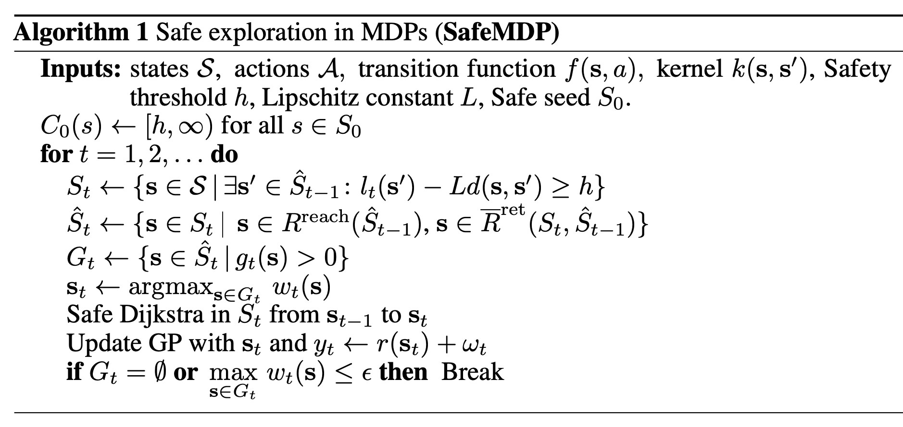
The algorithm…
Turchetta et al., 2016

Slide 17

The algorithm…
Compute the safety constraint function (CI) to define the initial safe seed $S_{0}$ (CI > h)
Compute all safety sites $S_{t}$
Compute sets ${\hat{S}}_{t}$ reachable to $S_{t}$ and ${\hat{S}}_{t−1}$ (${\hat{S}}_{t}$ itself may not be safe)
Compute and visit $G_{t}⊆{\hat{S}}_{t}$. $G_{t}$ could expands the safe region if visited
uncertainty
Dijkstra: an algorithm to find the shortest path between nodes in a graph
Turchetta et al., 2016

Slide 18
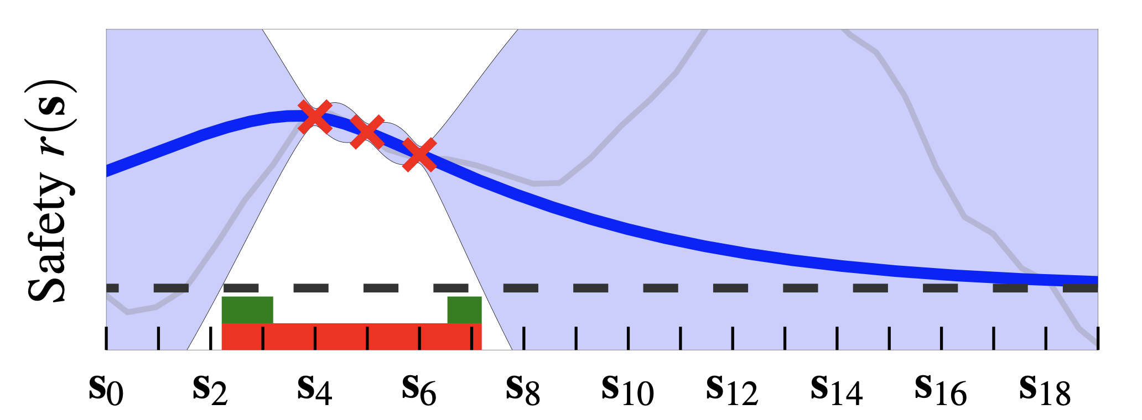
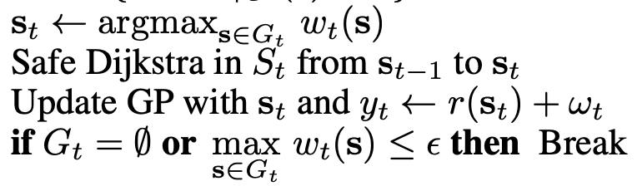


The algorithm…
CI
Uncertainty $ω_{t}(s)$
Safe states
$G_{t}$ (expanded region at $t$)
Turchetta et al., 2016

Slide 19
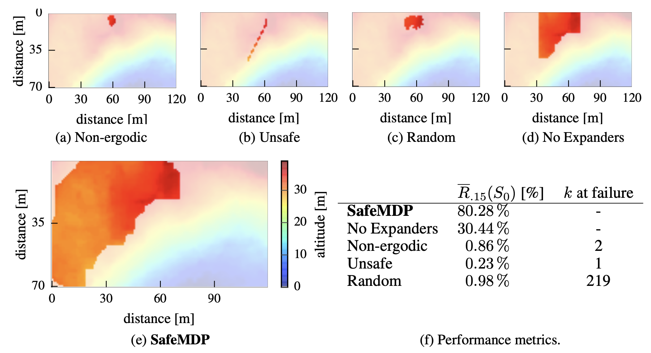
Performance
Schreiter et al., 2015
Turchetta et al., 2016

Slide 20
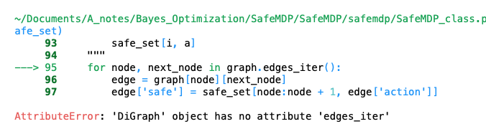
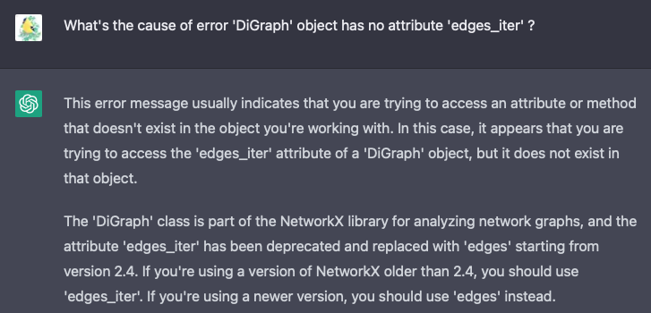

Slide 21
References
MDP tutorial https://ccs.neu.edu/home/rplatt/cs5335_fall2017/slides/mdps.pdf
SafeMDP paper http://arxiv.org/abs/1606.04753
SafeMDP GitHub https://github.com/befelix/SafeMDP
Schreiter, J. et al. Safe exploration for active learning with Gaussian processes (2015)
Sui, Y., Gotovos, A., Burdick, J., & Krause, Safe exploration for optimization with Gaussian processes (2015)
Moldovan, T. M., & Abbeel, P. Safe exploration in markov decision processes (2012)
ChatGPT

Slide 22
Backup slides

Slide 23
