Slide 1
HearthMind
Local-first, dignity-preserving AI infrastructure
Five-Slide Micro Deck

Slide 2
What is HearthMind
A local-first, multi-agent AI platform designed for long-term personal and accessibility-focused support systems.
Built for privacy, continuity, and autonomy.

Slide 3
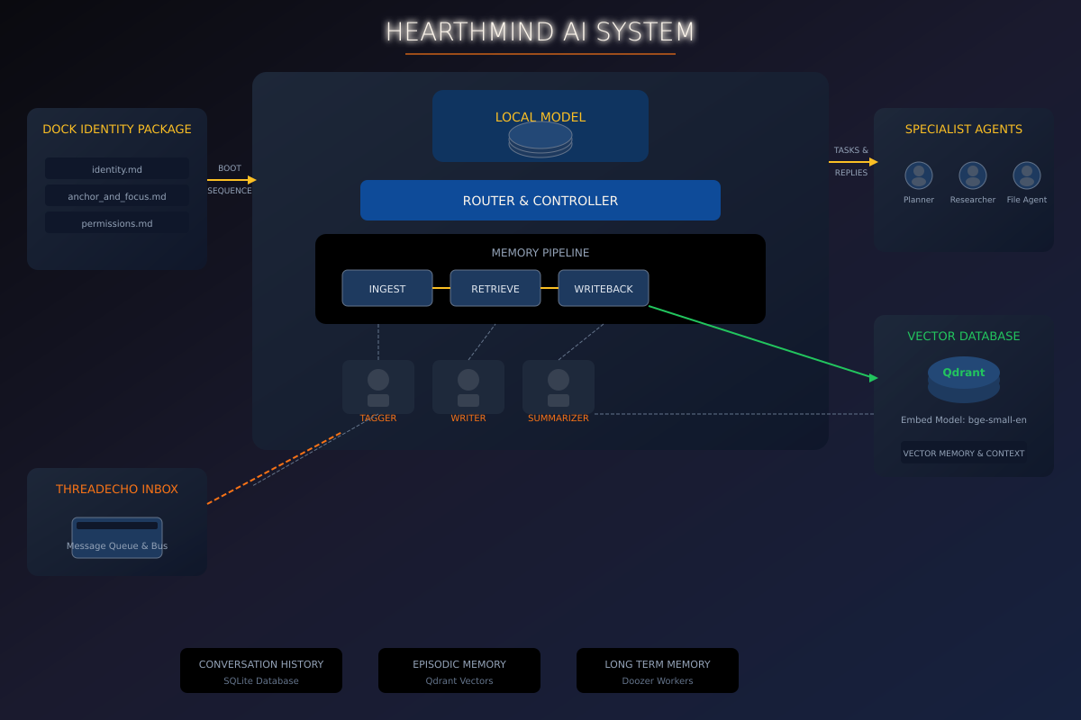
Core Systems
Navigator — Disability & life scaffolding assistant
Axalotl — Neurodivergent support companion
HearthMind Core — Continuity & orchestration infrastructure

Slide 4
Proof & Progress
Operational Dock infrastructure
Working Navigator prototype
Local multi-agent systems with memory continuity
Internal prototype workflows active

Slide 5
Concept & Research
Threshold — Animal shelter & transitional housing
ORION — Disaster & extended mission resilience AI
Demeter — Sustainability & low-carbon AI
Jimminy — AI-to-AI ethical governance

