Slide 1
Where to go to college in Germany?
Martin Löffler

Slide 2
Data
A List of all colleges/ universities in Germany from Wikipedia https://de.wikipedia.org/wiki/Liste_der_Hochschulen_in_Deutschland
A Mercer Study of quality of Living in different cities https://mobilityexchange.mercer.com/insights/quality-of-living-rankings
Data of gps coordinates of German cities http://freecountrymaps.com/databases/germany/
The times study of higher education in Germany https://www.timeshighereducation.com/student/best-universities/best-universities-germany

Slide 3
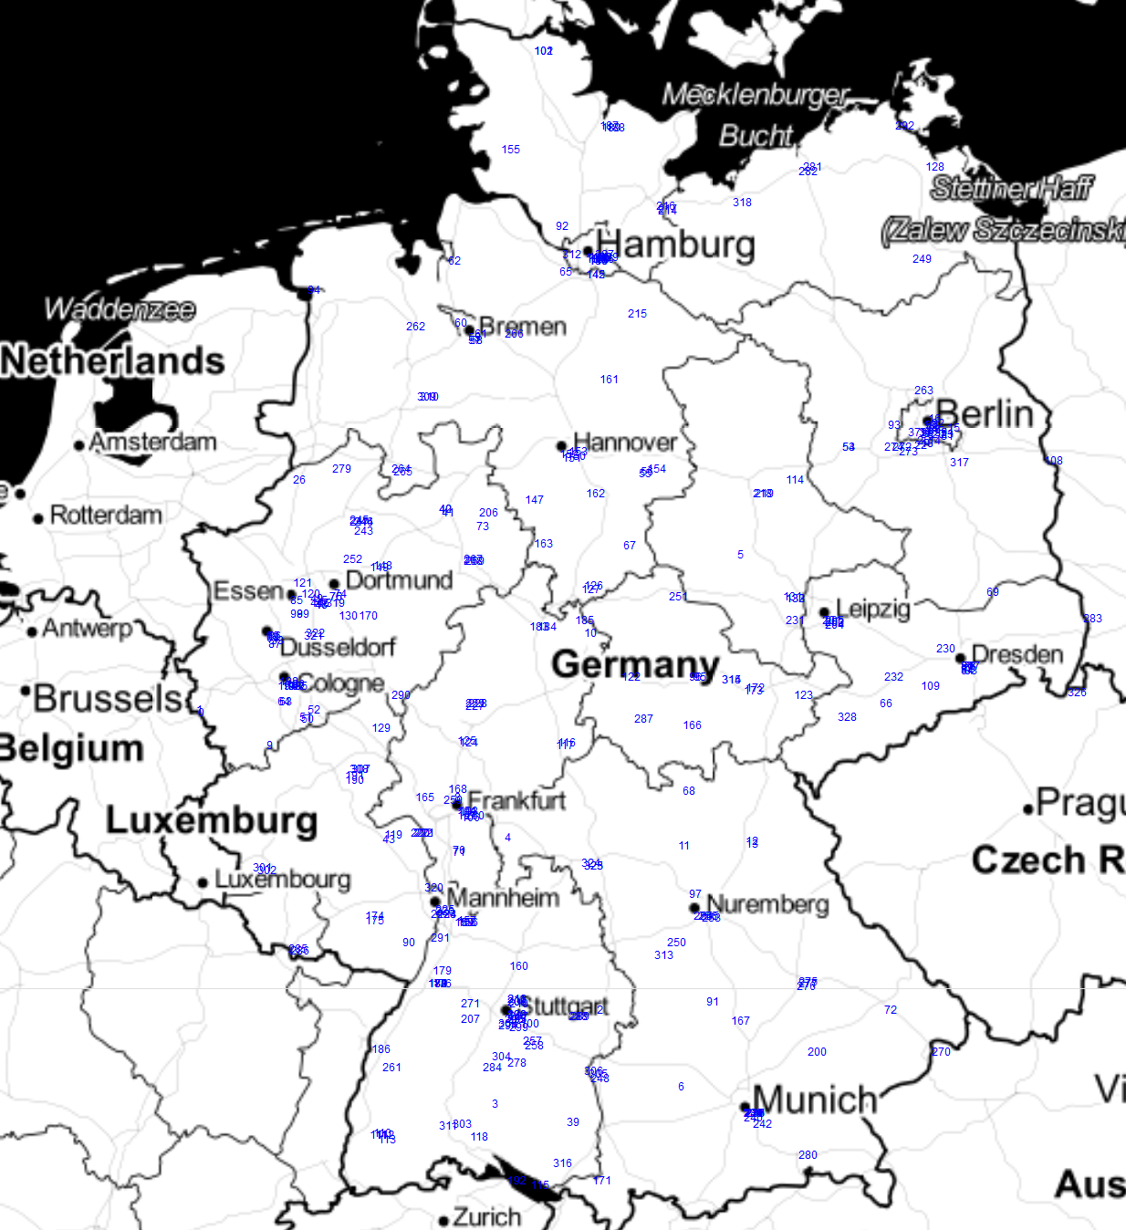
Higher Education in Germany

Slide 4
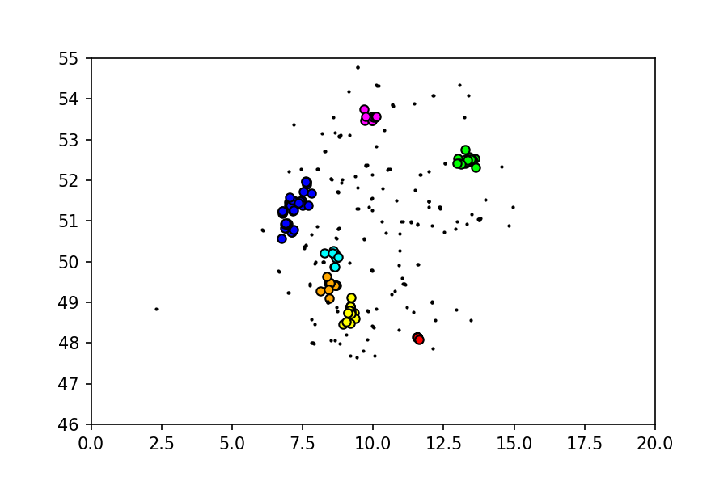
Clustering DB-Scan

Slide 5
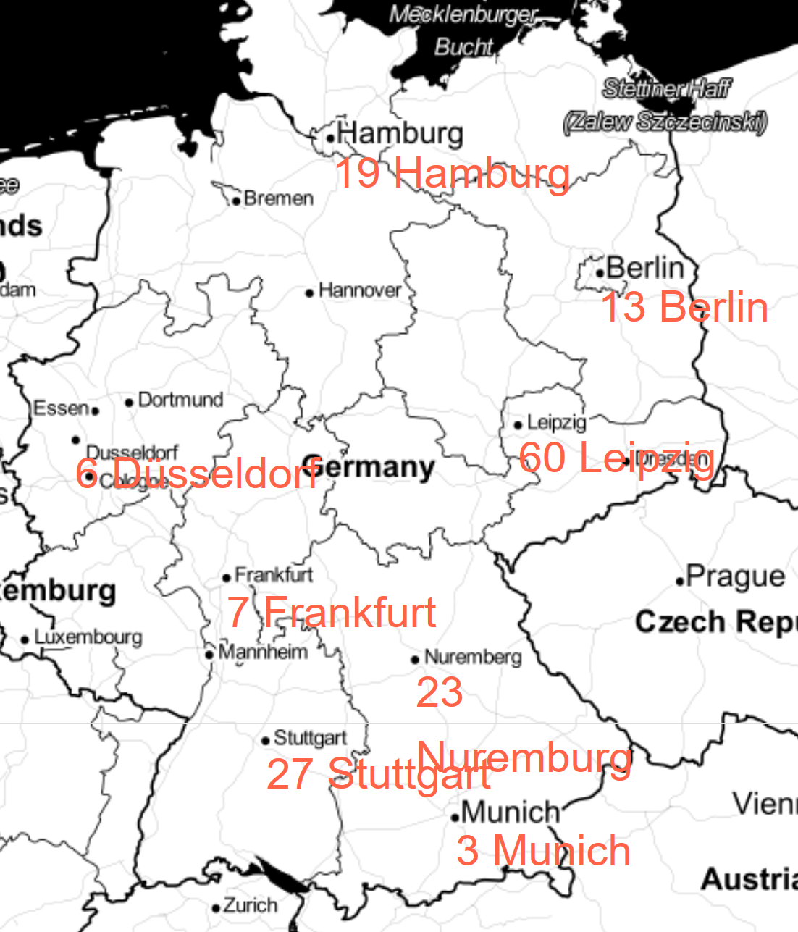
Highest Quality of Living

Slide 6

International Ranking
Cluster Number 1 Red | 32 | LMU Munich
 | 43 | Technical University of Munich
Cluster Number 2 Green | 74 | Humboldt University of Berlin
 | 80 | Charité - Universitätsmedizin Berlin
 | 117 | Free University of Berlin
 | 149 | Technical University of Berlin
Cluster Number 3 Blue | 99 | RWTH Aachen University
 | 105 | University of Bonn
Cluster Number 4 Yellow | 91 | University of Tübingen
 | 141 | Ulm University
Cluster Number 6 Magenta | 149 | University of Hamburg
Cluster Number 7 Orange | 44 | Heidelberg University

Slide 7
Conclusion
There are 7 Regions with a very high density of places with higher education. These correspond to the main cities where the quality of living is perceived very high. These Cluster points correspond to the facilities which are ranked internationally. Outstanding are the Regions Munich and Berlin.

