Slide 1


Montego Airline
Executive Summary
Presented by
Tushar Muley
October 10, 2021

Slide 2
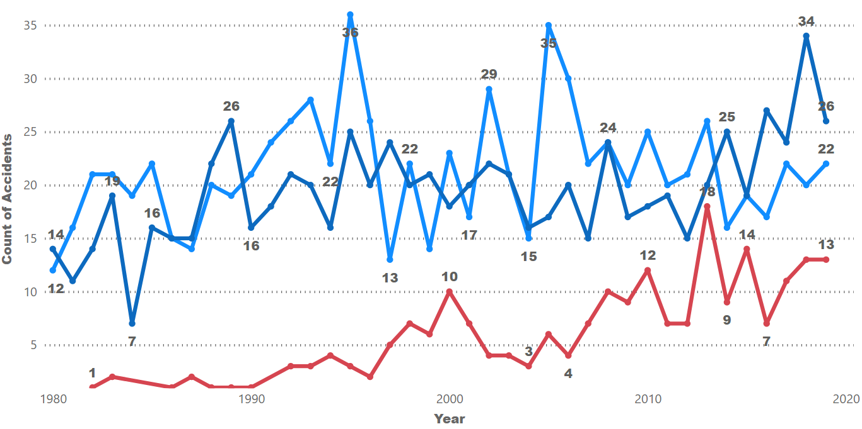



Airline Accidents by Manufacturer
Manufacturer Safety
Montego Airline
Airbus manufactured air planes have a better accident rate compared to their rivals
Overall accidents are down for the two biggest airline manufactures Airbus and Boeing

Slide 3
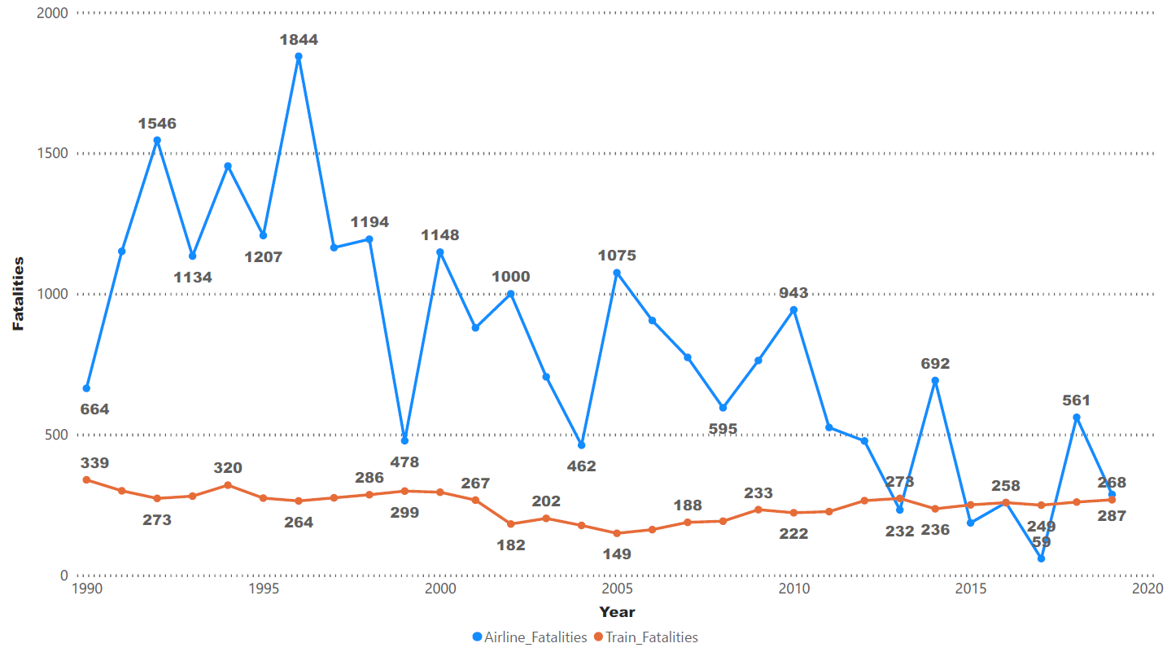
Fatalities by different Commercial Travel Modes
Comparing Commercial Travel
Montego Airline
Airline fatalities are below train fatalities for the years reported
Commercial air travel is safer than commercial train travel

Slide 4
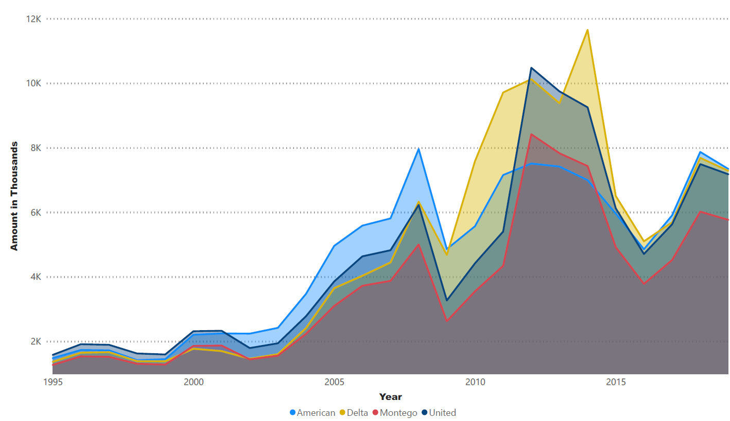
Airline Fuel Expense
Fuel Cost Compared to our Competition
Montego Airline
Our competitors struggled to control fuel costs
Montego Airline better negotiation and hedging reduced our fuel costs. Lowering our biggest expense line item

Slide 5
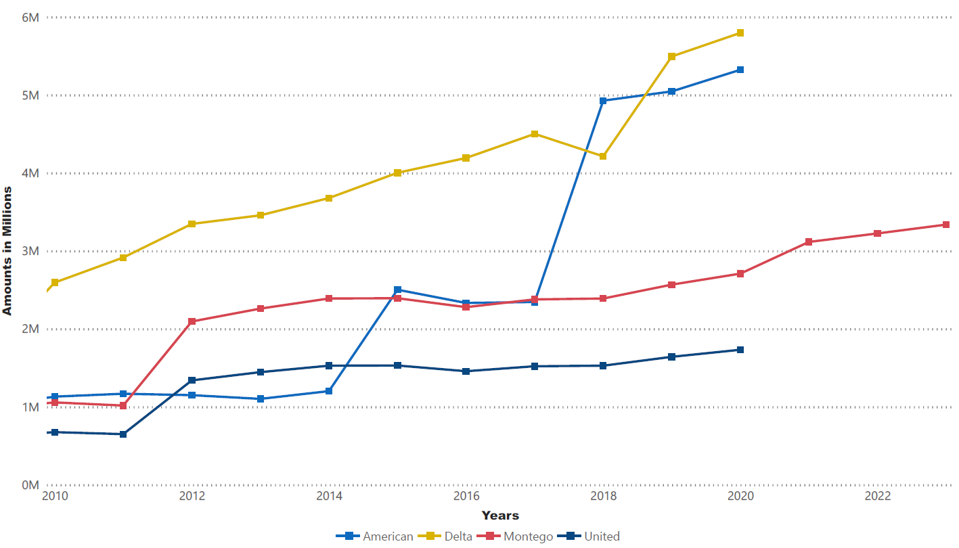
Fee by Competition + Montego Air Forecast for 2020 - 2022
Fee Revenue
Montego Airline
Forecasted
Two of our main competitors have higher fees
Montego Airline has made stead profits from the current fees structure
Forecasts for 2021–2023 show an increase of 2.5% each year

Slide 6
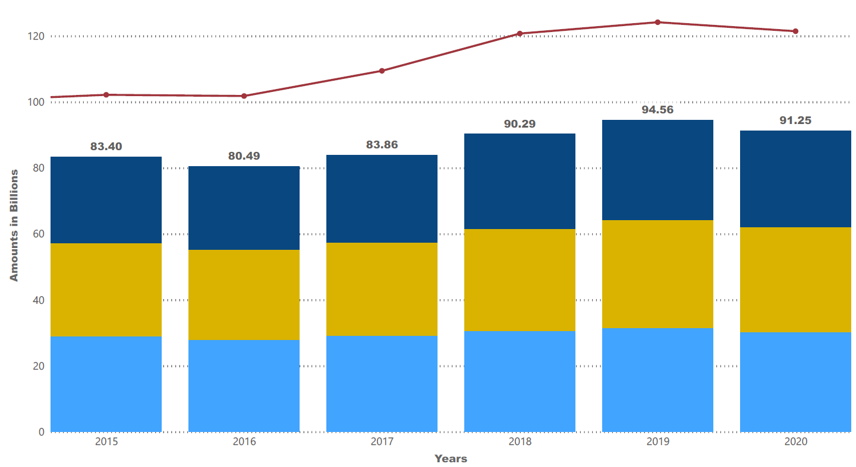
Actual Revenue and Expenses
Competitor Revenue and Expenses
Montego Airline
United
United
United
United
United
United
United
United
United
United
Delta
Delta
Delta
Delta
Delta
Delta
American
American
American
American
American
American
Expenses are higher than expected
Stead Revenue growth current year 2021
Forecast growth by 5.75% year over year for 2022 - 2023

Slide 7
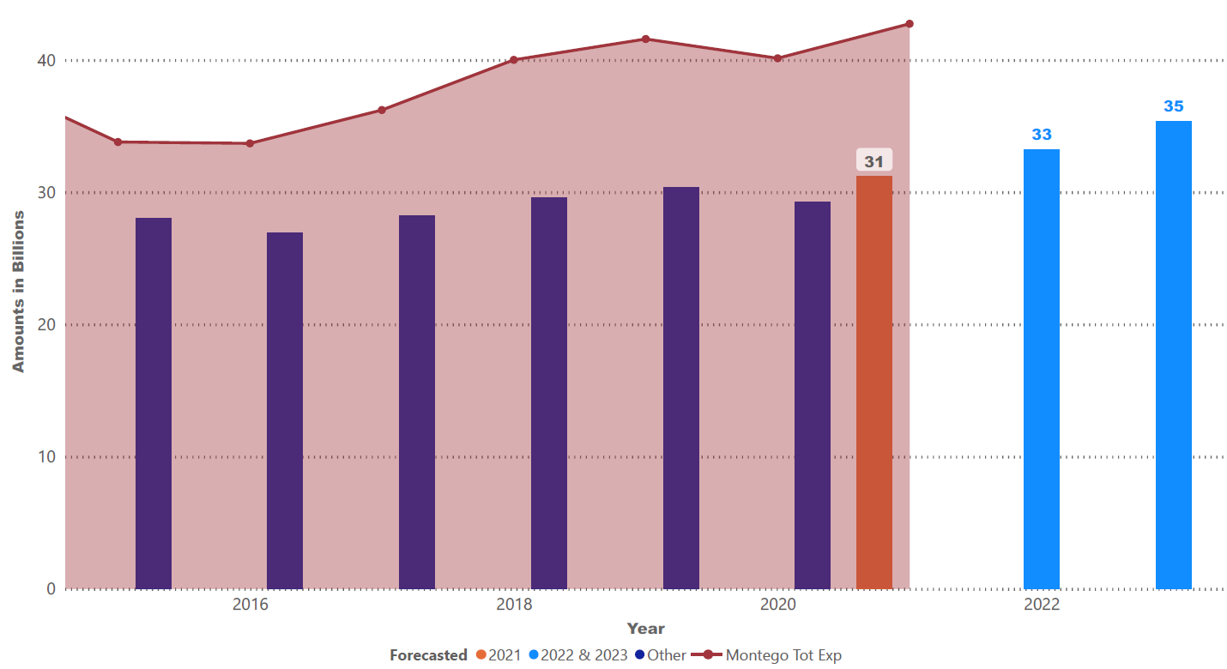
Actual Revenue, Expenses and Forecast Revenue
Revenue, Expenses and Forecast
Montego Airline
Forecasted
Expected 2021
Expenses are higher than expected
Stead Revenue growth current year 2021
Forecast growth by 5.75% year over year for 2022 - 2023

Slide 8

Montego Airline
Questions & Answers

