Slide 1
Developing deep learning models to identify emotions in human faces
Moureen Kemei
MIT Applied Data Science Program 2024

Slide 2
Importance of artificial emotional intelligence
Artificial emotional intelligence is the study and development of technologies that read human emotions by analyzing body gestures, facial expressions, voice tone and can react appropriately to them
Research shows that 55% of communication is through facial expression and visual cues. Artificial emotional intelligence is fundamental to effective human and technology interactions with applications in health care, education, service industry and others.

Slide 3




Goal: Develop a deep learning model to classify emotions in human faces
Create a computer vision model that accurately detects facial emotions
Happy
Neutral
Sad
Surprised

Slide 4
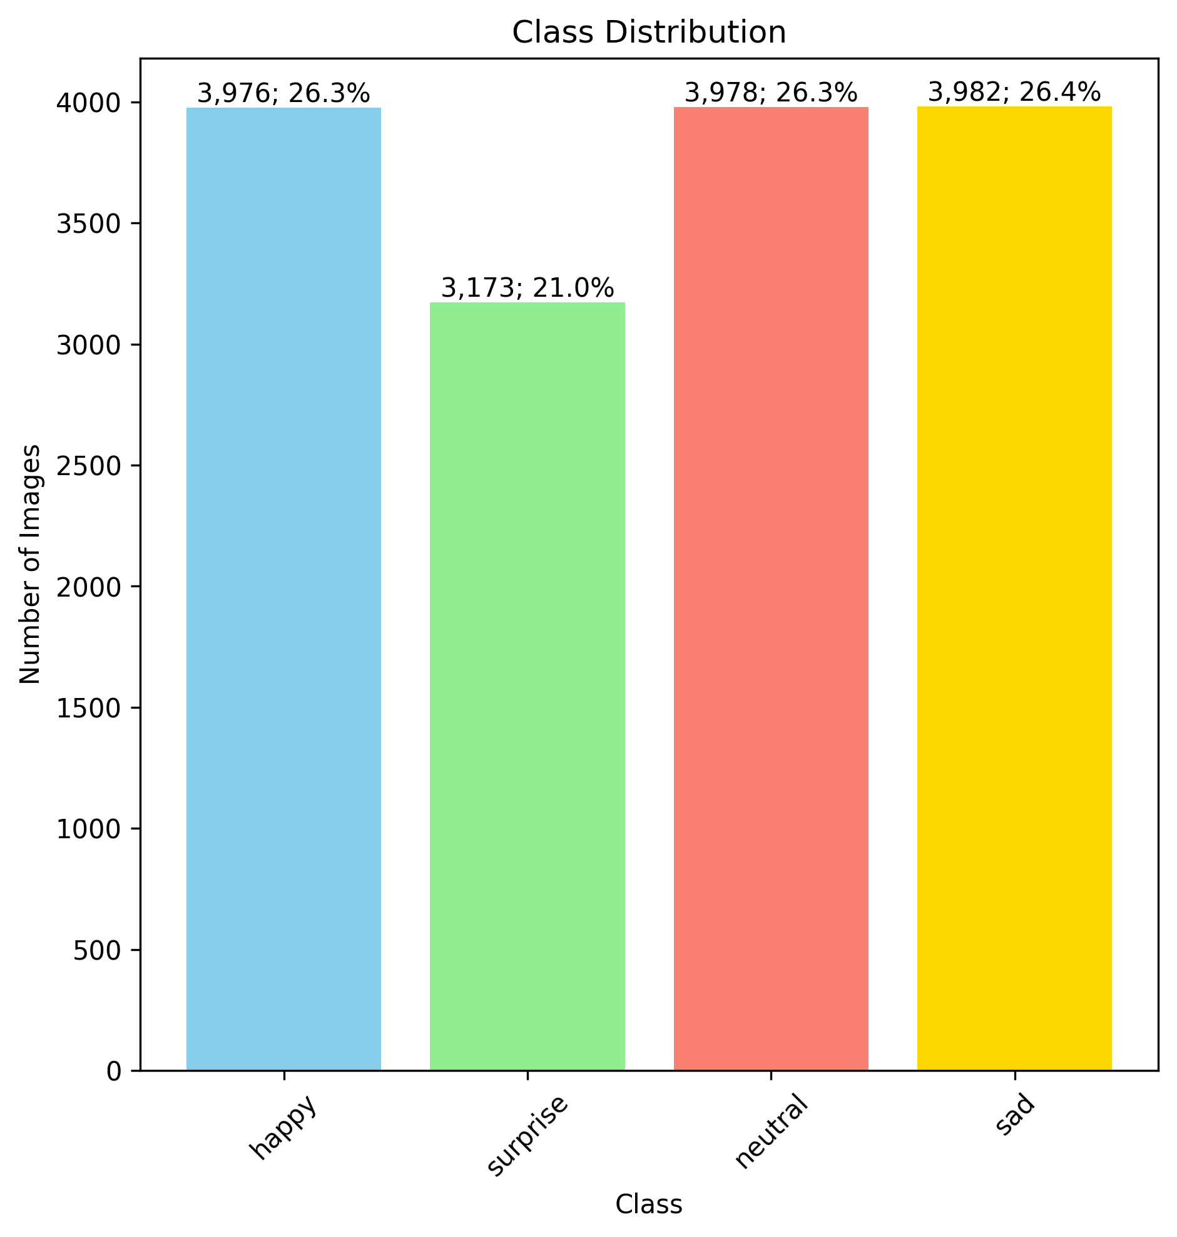

The data used to build a facial emotion detection model
48 x 48-pixel images of faces displaying emotions:
Happy
Sad
Neutral
Surprised
Training data set distribution of pictures for various emotions
Class imbalance = 3982/3173 = 1.25 (before removing duplicates)
The imbalance is not too high, we will use F1-Score to determine
model accuracy to mitigate the class imbalance concern.
F1 Score $= \frac{2 . Precision . Recall}{Precision + Recall}$
*Duplicate images were removed

Slide 5
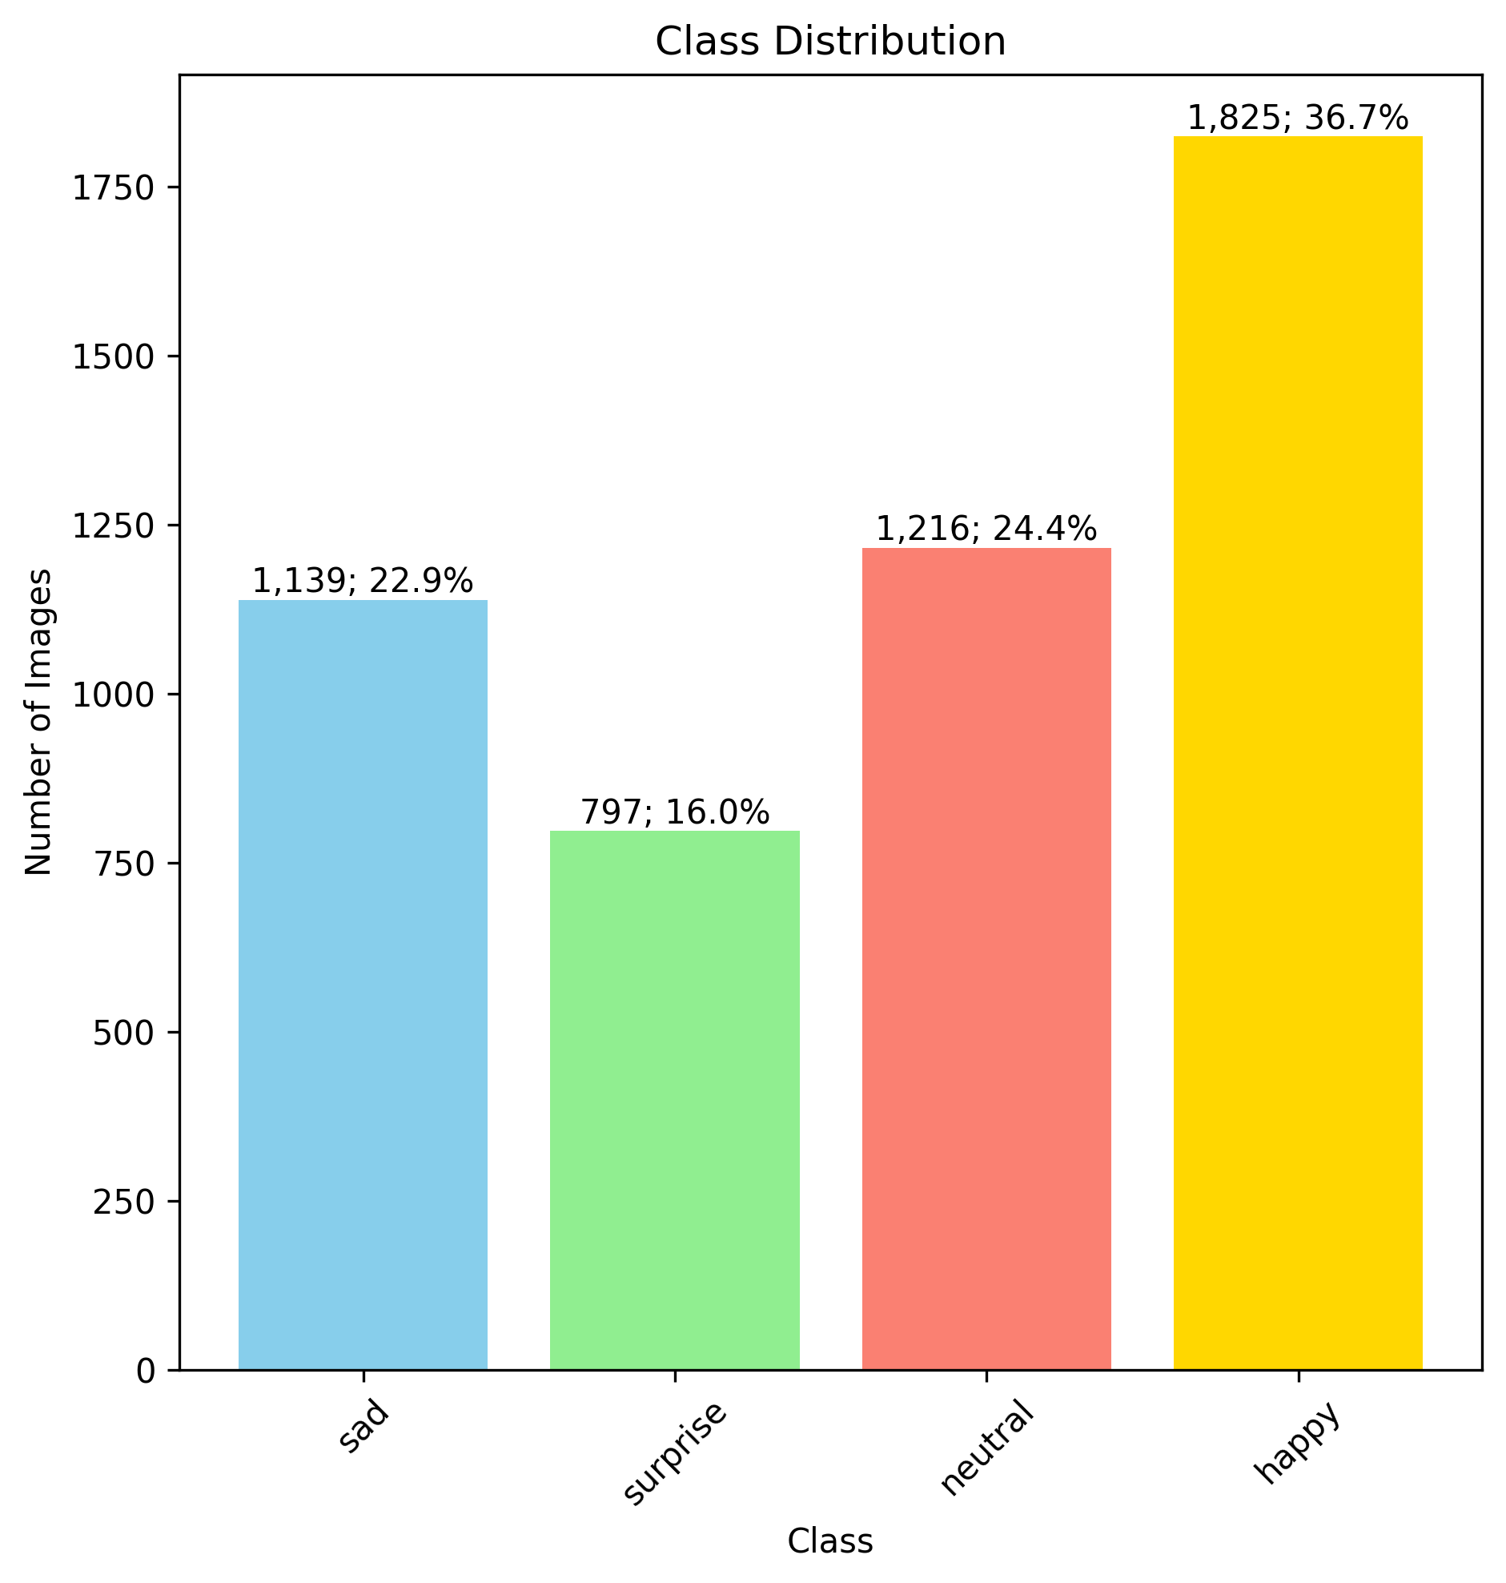
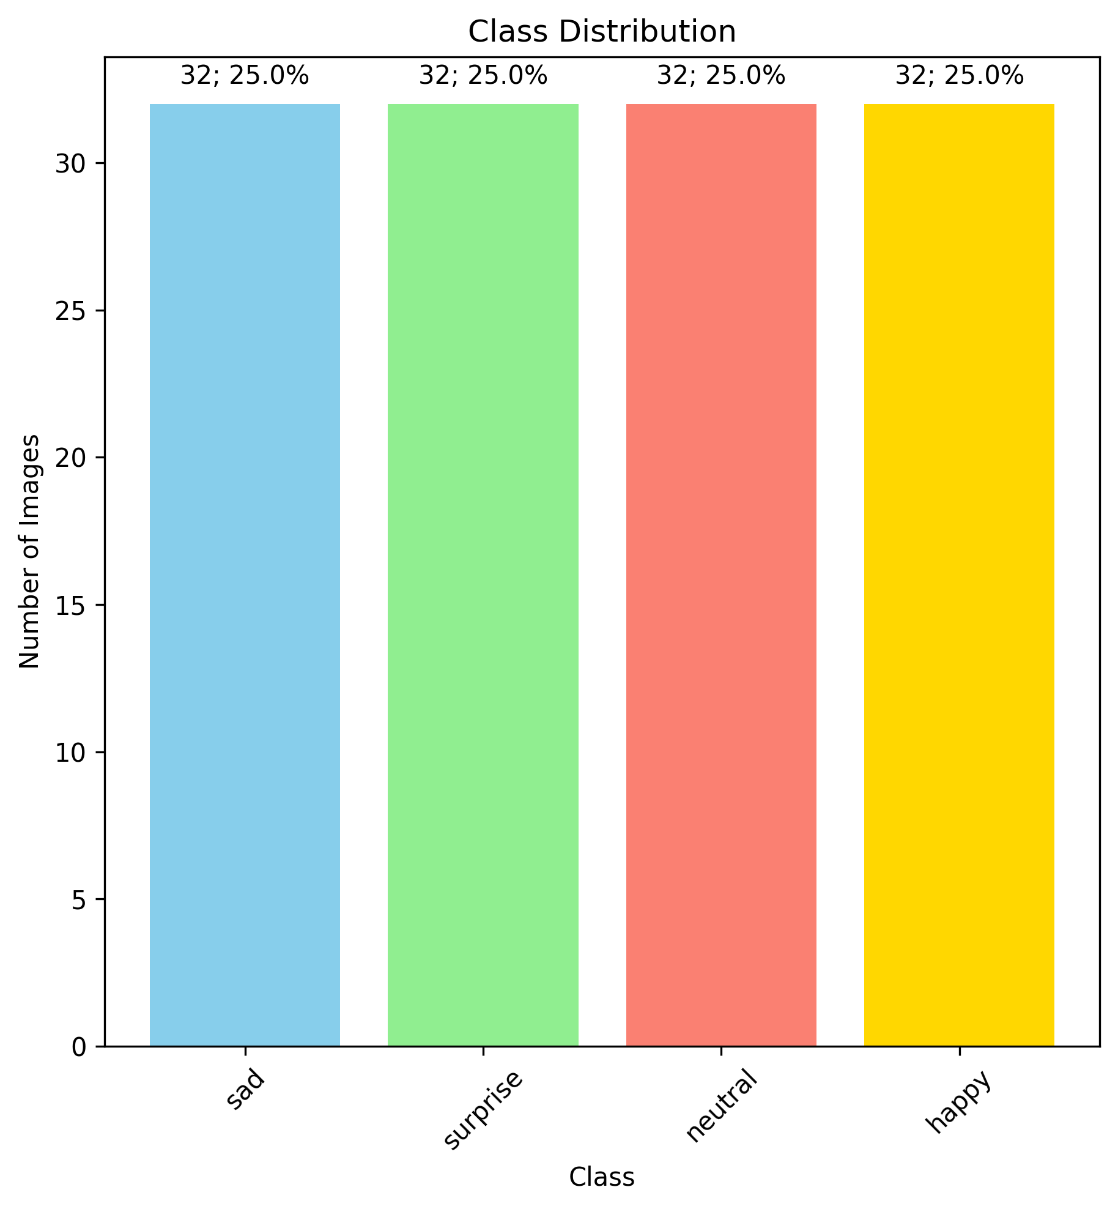
The data used to validate and test a facial emotion detection model
Validation data set distribution of pictures for various emotions before removing duplicates
Test data set distribution of pictures for various emotions

Slide 6
The CNN model architecture for facial emotion detection
Image generator: Grayscale images
Train Data augmentation: horizontal flip, brightness range (0, 0.2), rescale (1/255), shear_range (0.3)
Convolutional Neural Network 1 architecture:
Convolution + ReLu
Max Pooling (2x2)
48 x 48 x 64
24 x 24 x 64
Dropout
24 x 24 x 32
12 x 12 x 32
Softmax
0.2
12 x 12 x 32
6 x 6 x 32
0.2
0.2
Flatten (1152)
Fully Connected + Dropout
Output (4)

Slide 7
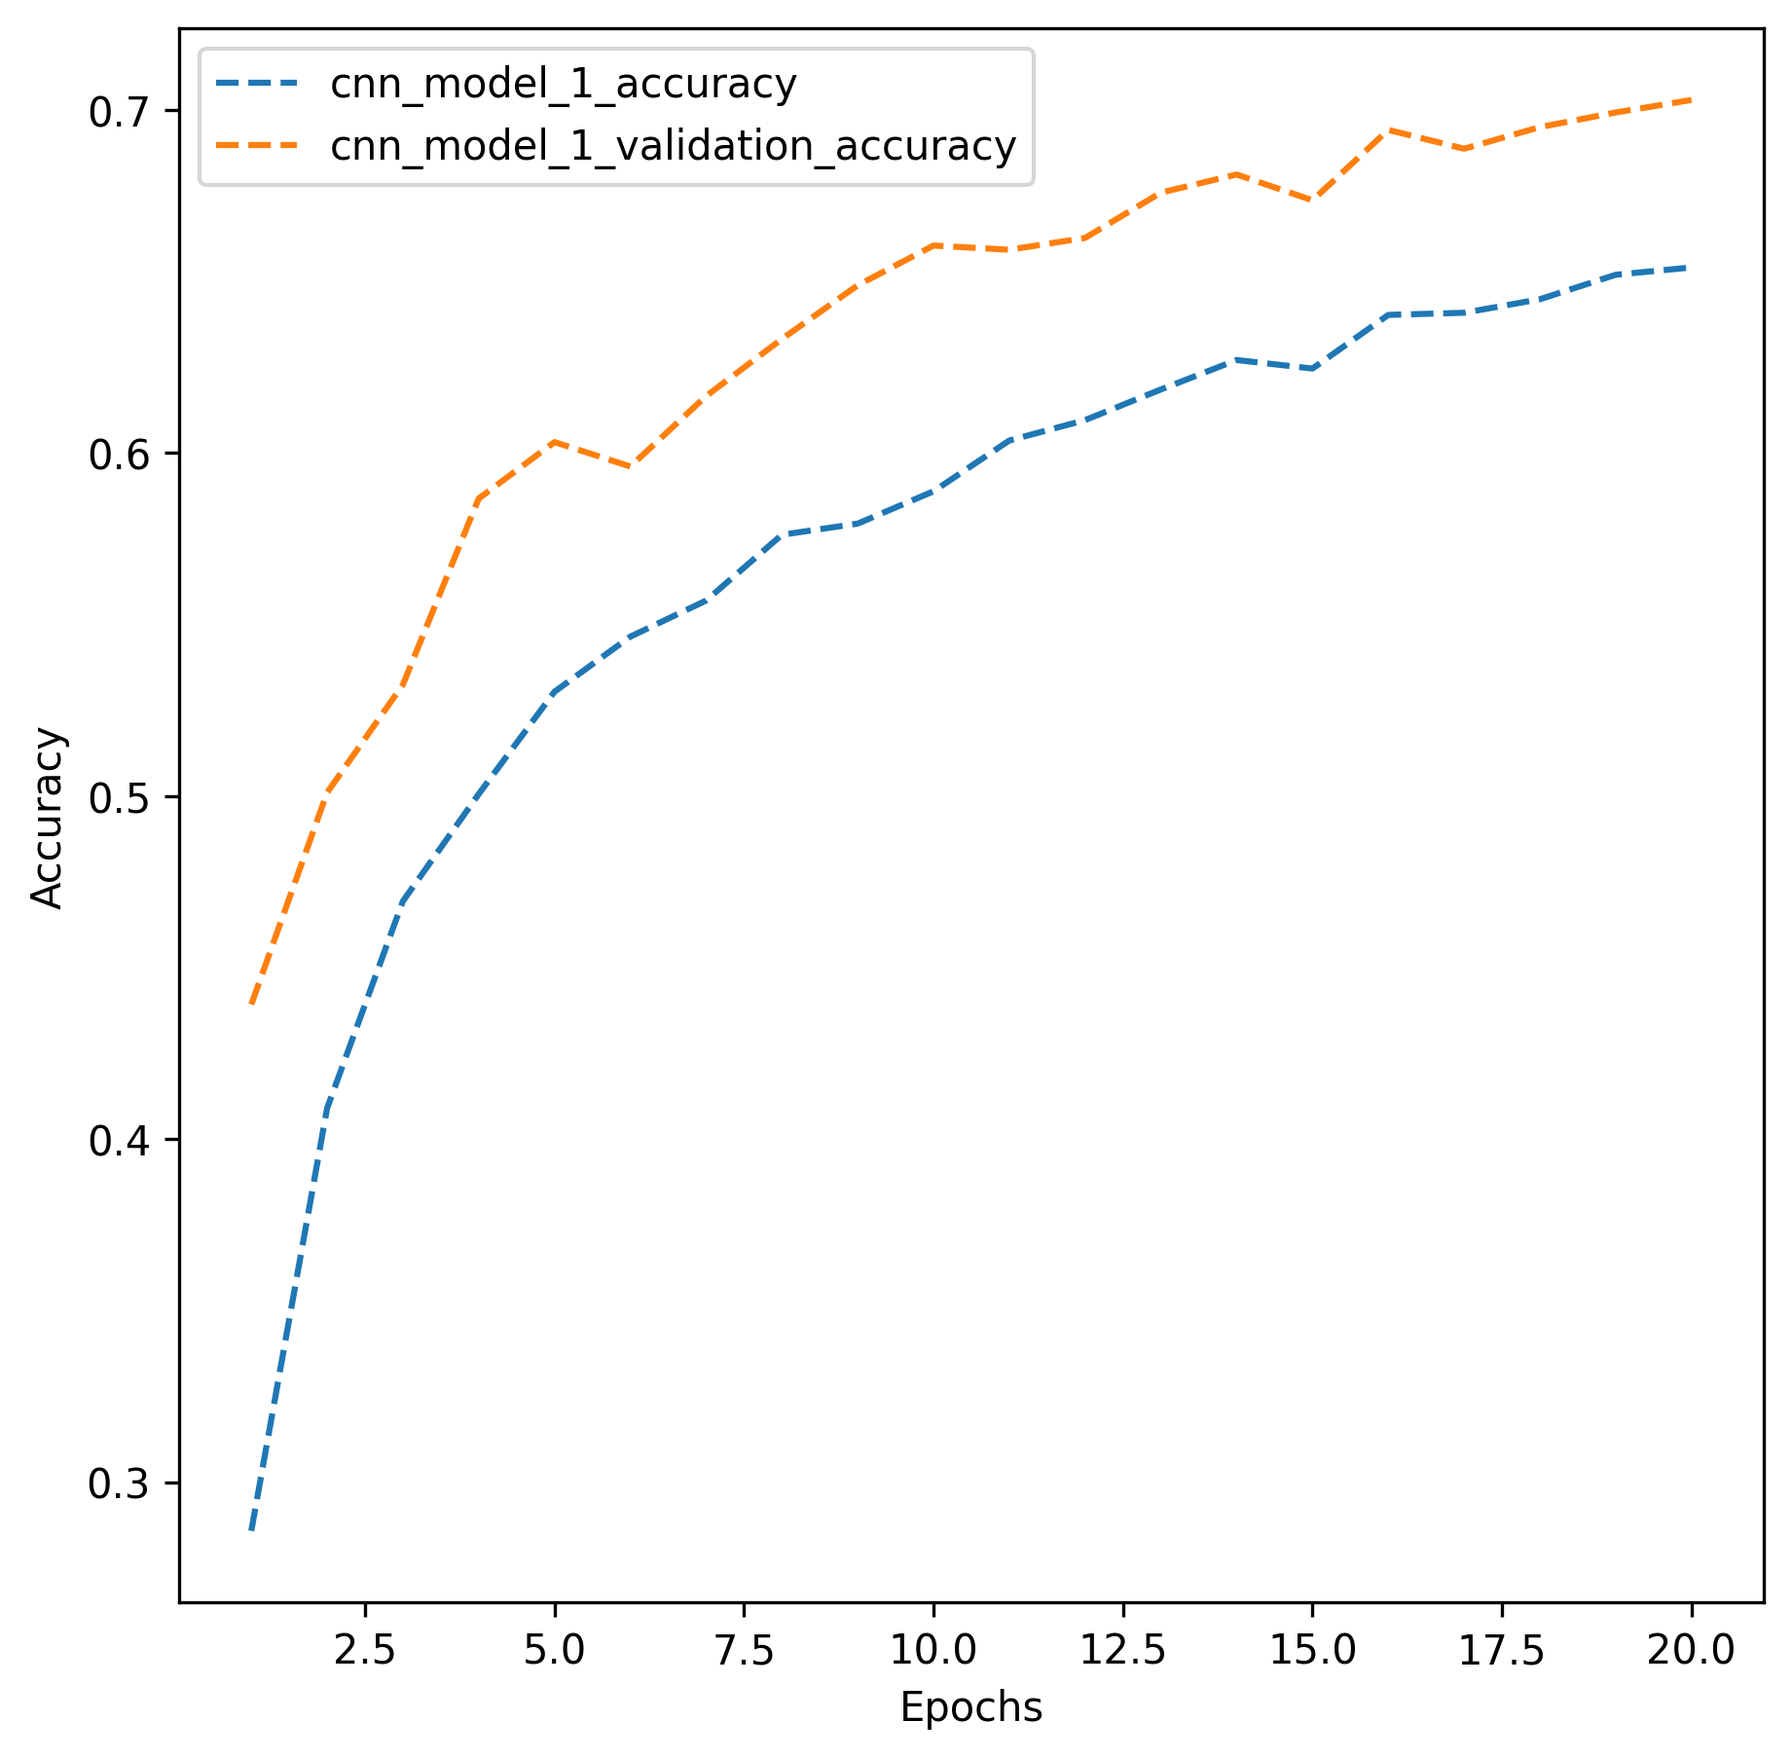
CNN model 1 accuracy:
Data set | Accuracy
Training | 65.26%
Validation | 70.3%
Test | 75.8%
Training accuracy increases with each epoch
Model generalizes well to unseen data, accuracy is higher for validation and test data sets

Slide 8
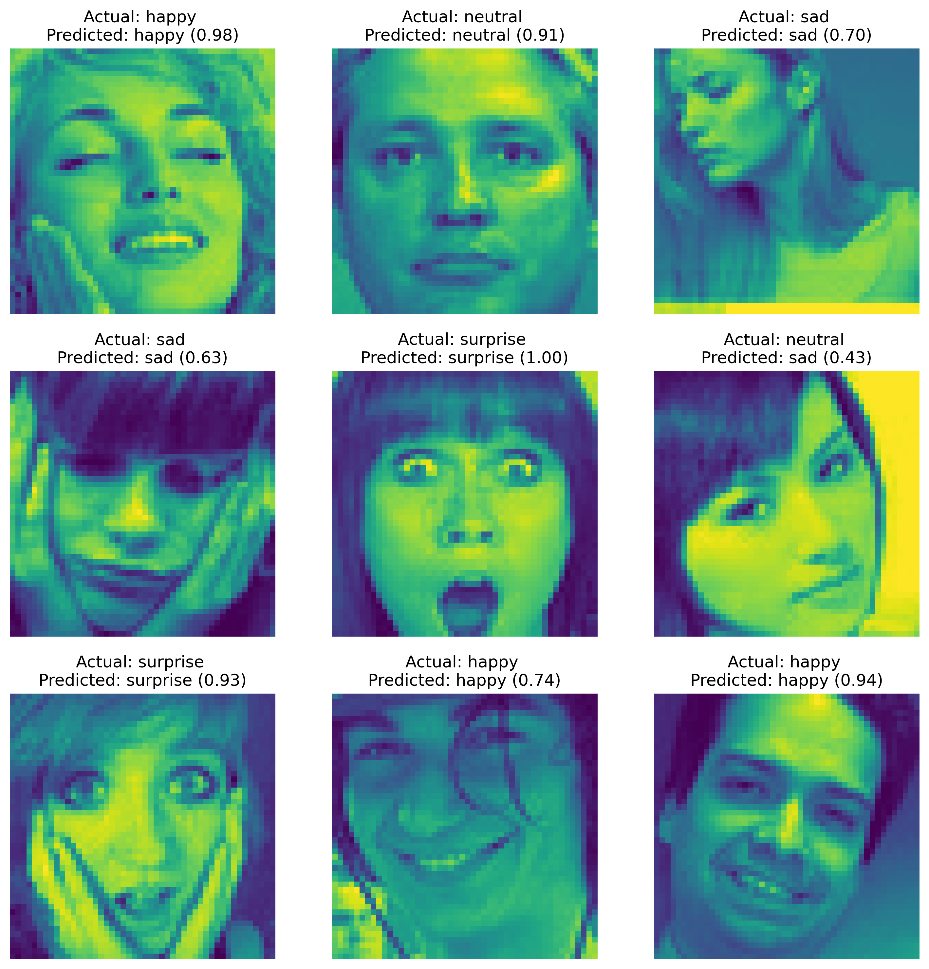
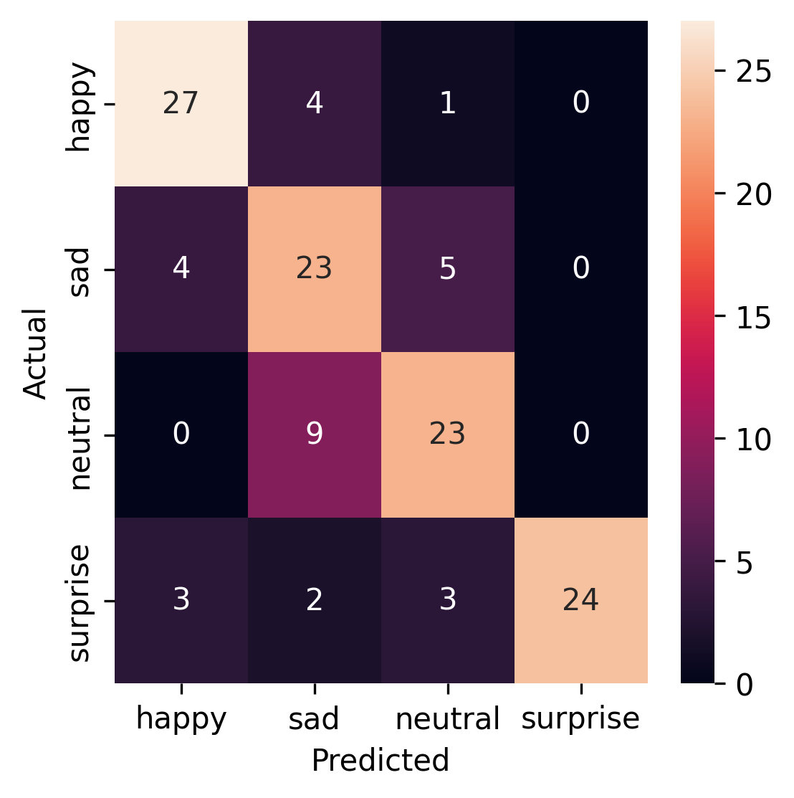
CNN model 1 accuracy and F1-Scores:
Model struggles to distinguish sad verses neutral faces
Emotion | F1-Score
Happy | 82%
Sad | 66%
Neutral | 72%
Surprise | 86%

Slide 9
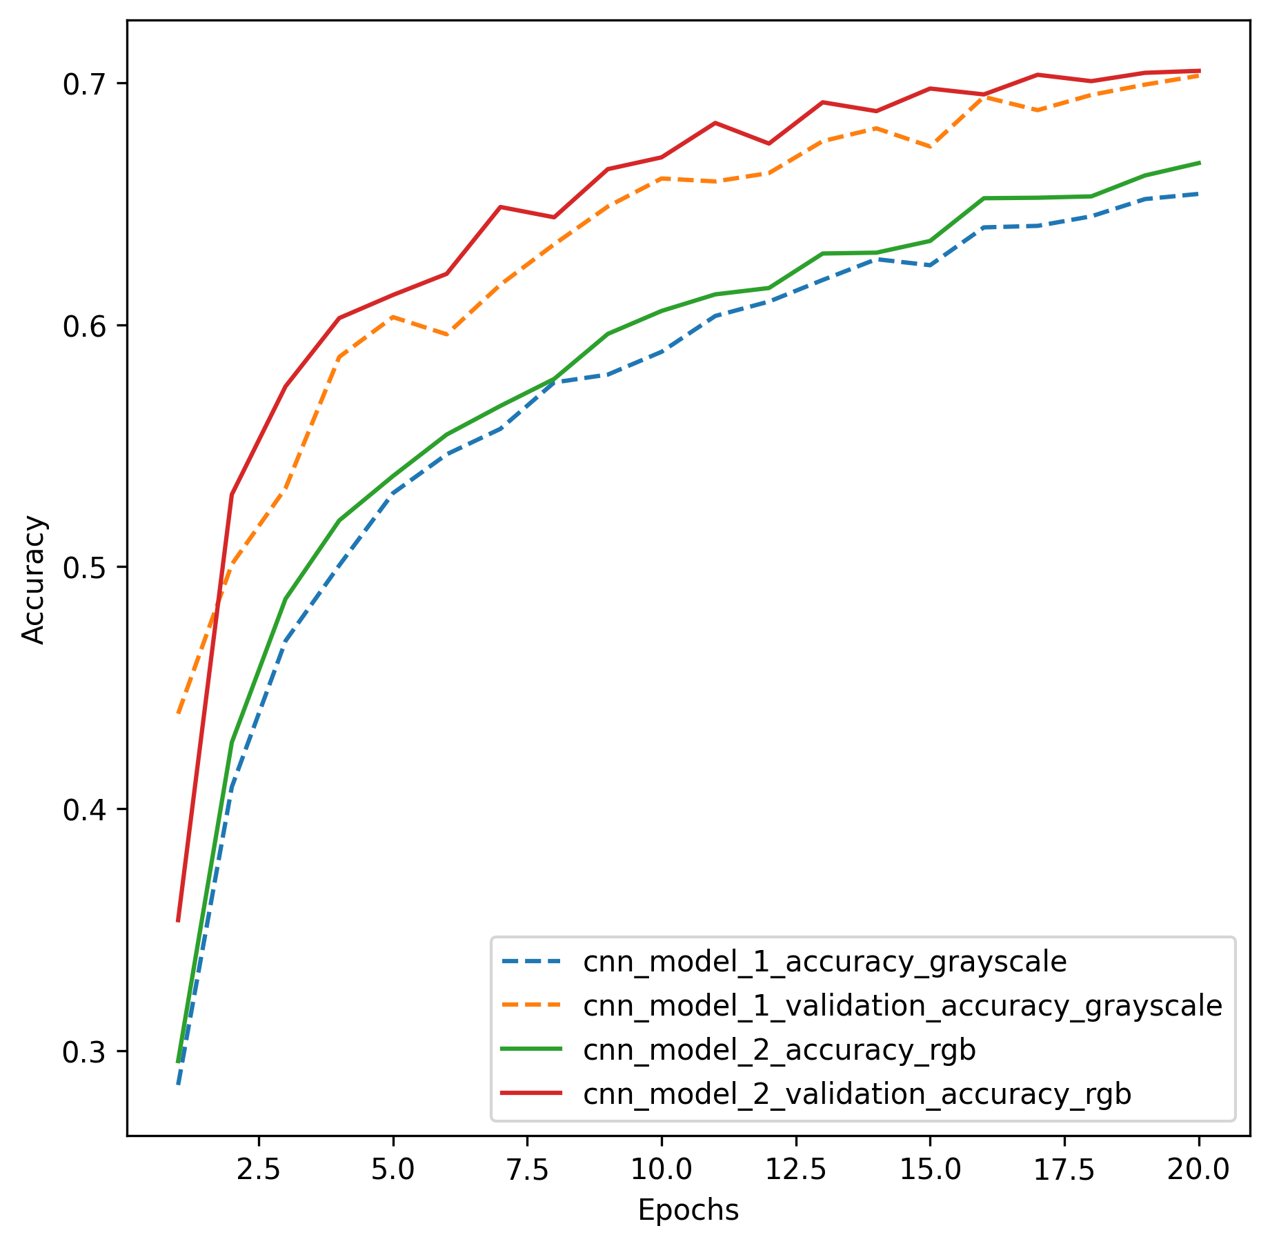
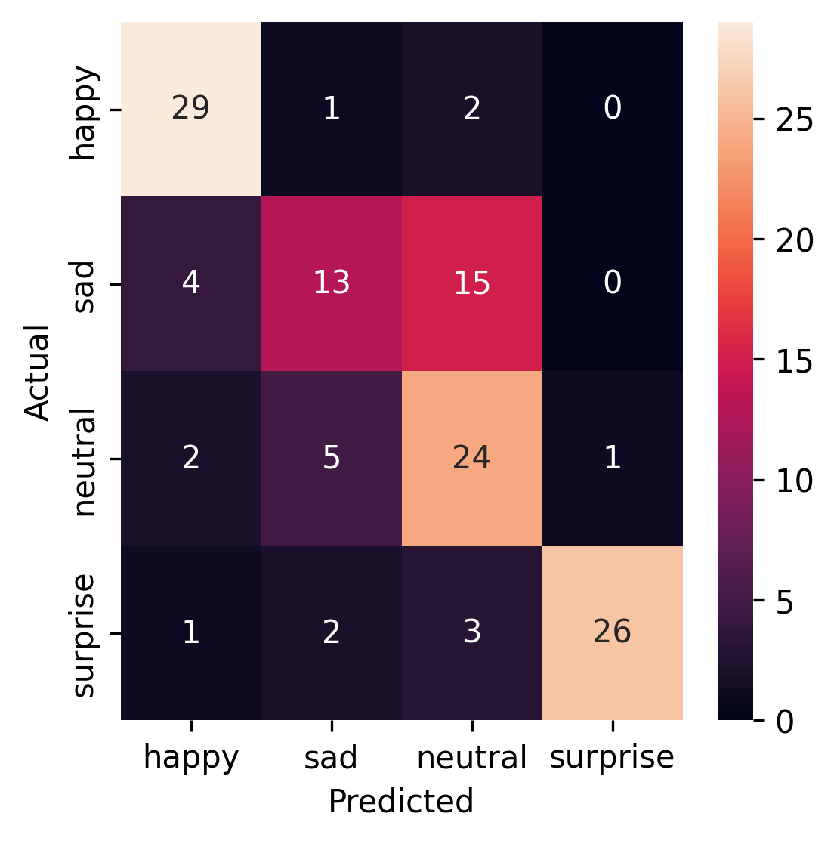
Impact of training with rgb vs gray scale images
Model accuracy is matched when training with rgb verses grayscale images.
When images are RGB, model struggles to distinguish actual sad verses neutral faces
Treat images as RGB
Treat images as Gray Scale

Slide 10
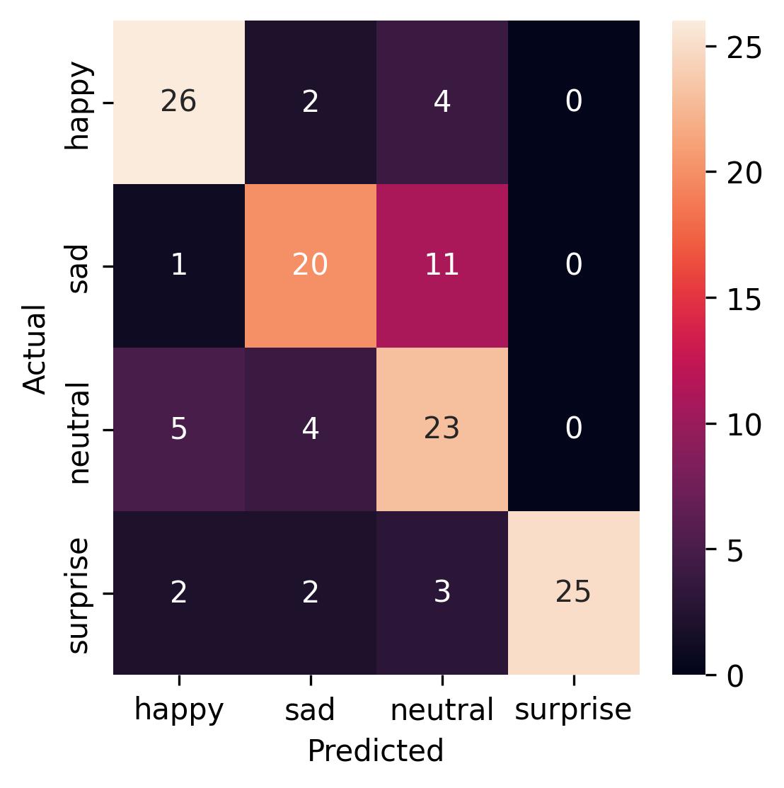
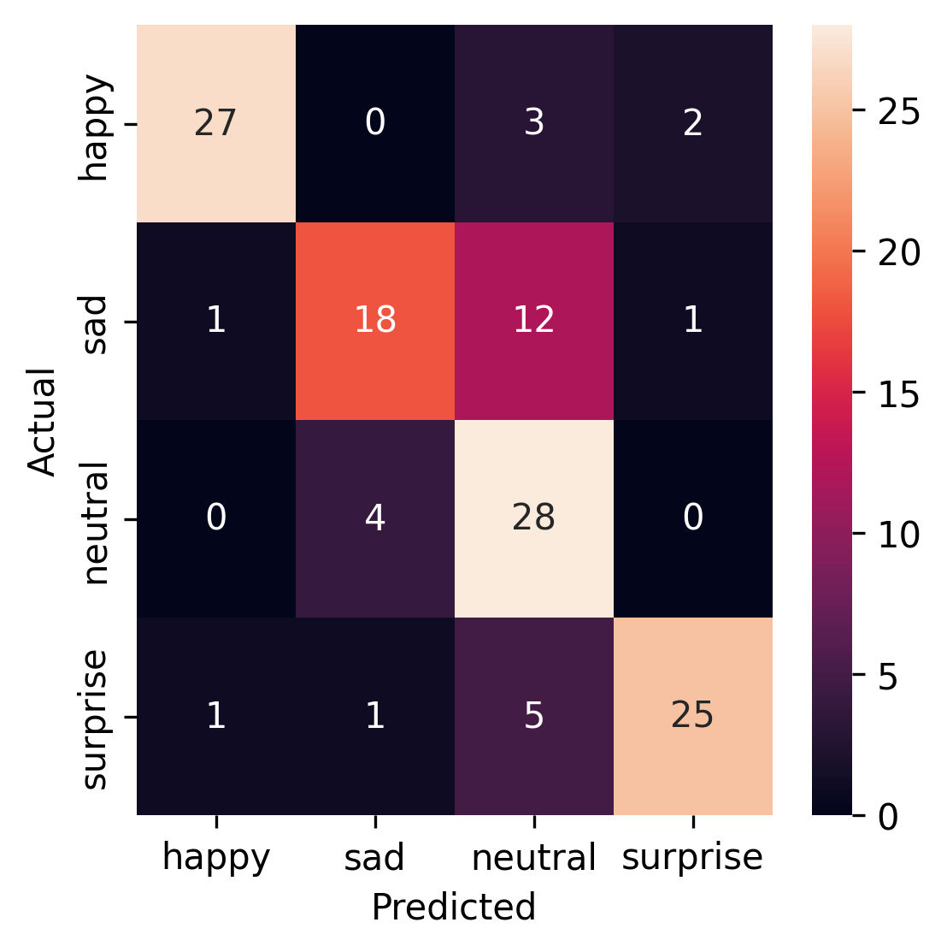
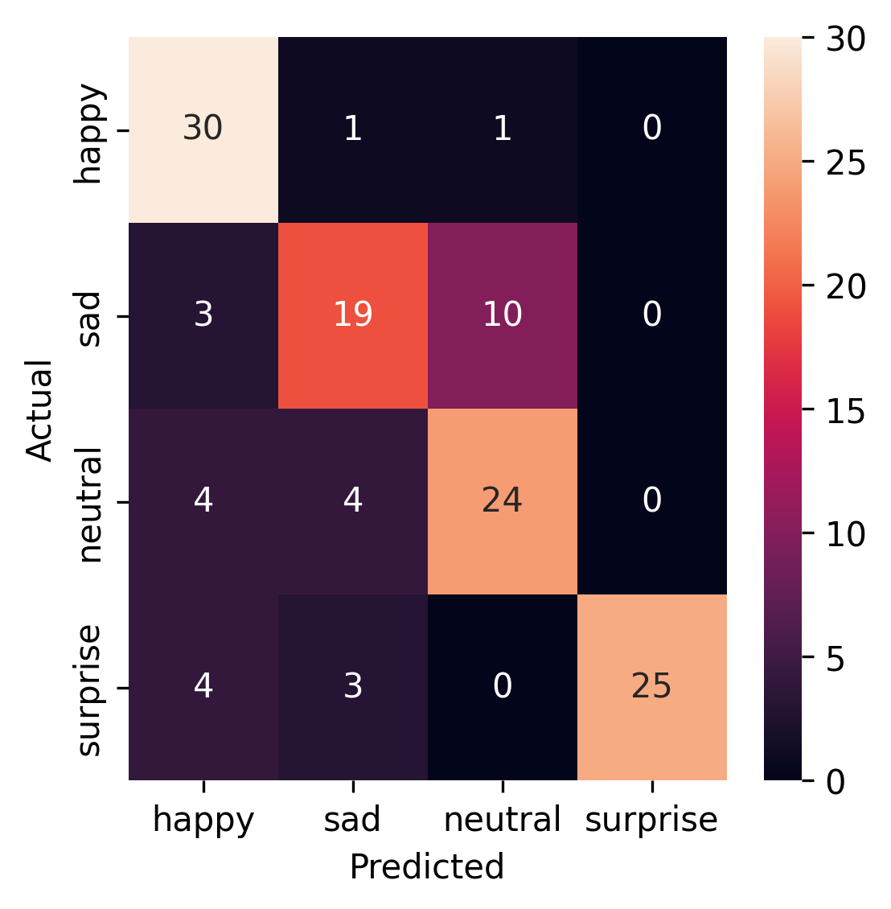
Transfer learning architectures
VGG16
ResNet V2
EfficientNet
Accuracy: 73.4%
F1-Scores
Happy: 79%
Sad: 67%
Neutral: 63%
Surprised: 88%
Accuracy: 76.5%
F1-Scores
Happy: 89%
Sad: 65%
Neutral: 70%
Surprised: 83%
Accuracy: 76.5%
F1-Scores
Happy: 82%
Sad: 64%
Neutral: 72%
Surprised: 88%

Slide 11
Optimized CNN model architecture for facial emotion detection
Image generator: RGB images
Train Data augmentation: horizontal flip, brightness range (0, 0.2), rescale (1/255), shear_range (0.3)
Improvements on Convolutional Neural Network:
Increase the depth to learn hierarchical features
Use of SiLU (Sigmoid-Weighted Linear unit) verses ReLU(Rectified Linear Unit) activation function
Use of Batch normalization to improve training stability
Model | Accuracy | F1-Score Happy | F1-Score Sad | F1-Score Neutral | F1-Score Surprise
CNN Model 2 | 71.8% | 85% | 49% | 63% | 88%
CNN Model 5 | 79.7% | 88% | 67% | 75% | 90%

Slide 12
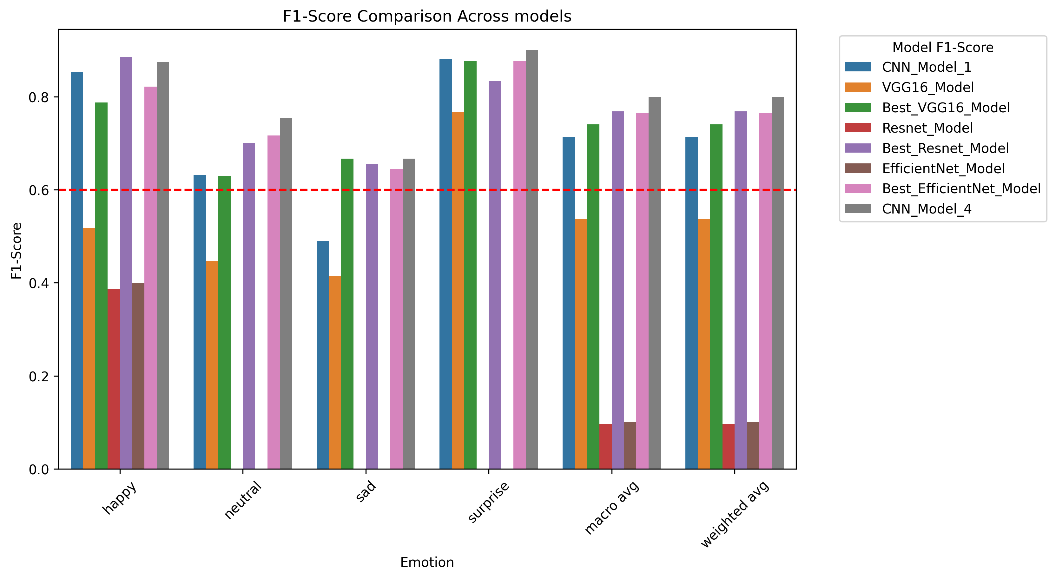
Comparison of models: CNN Model 4 is efficient and accurate
The optimized CNN model 4 matches transfer learning architecture
outcomes for accuracy and F1 score

Slide 13
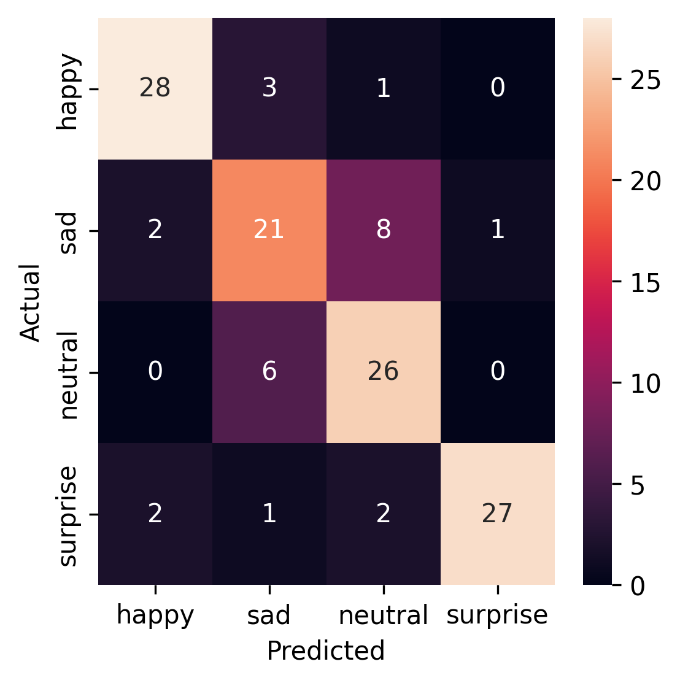
Recommendation: CNN_Model 4 is accurate and efficient
CNN model 4 is recommended for use
Simpler model which matches F1-score and accuracy performance of complex transfer learning models
Smaller and efficient (7 minute train time on GPU)

Slide 14
Paths for model improvements:
Training on large data sets
Hyper parameter tuning to optimize model settings
Use of higher resolution images
Allowing training to improve over many epochs
Building a more complex CNN model
Mitigating class imbalance during training and validation

Slide 15
Thank you

Slide 16
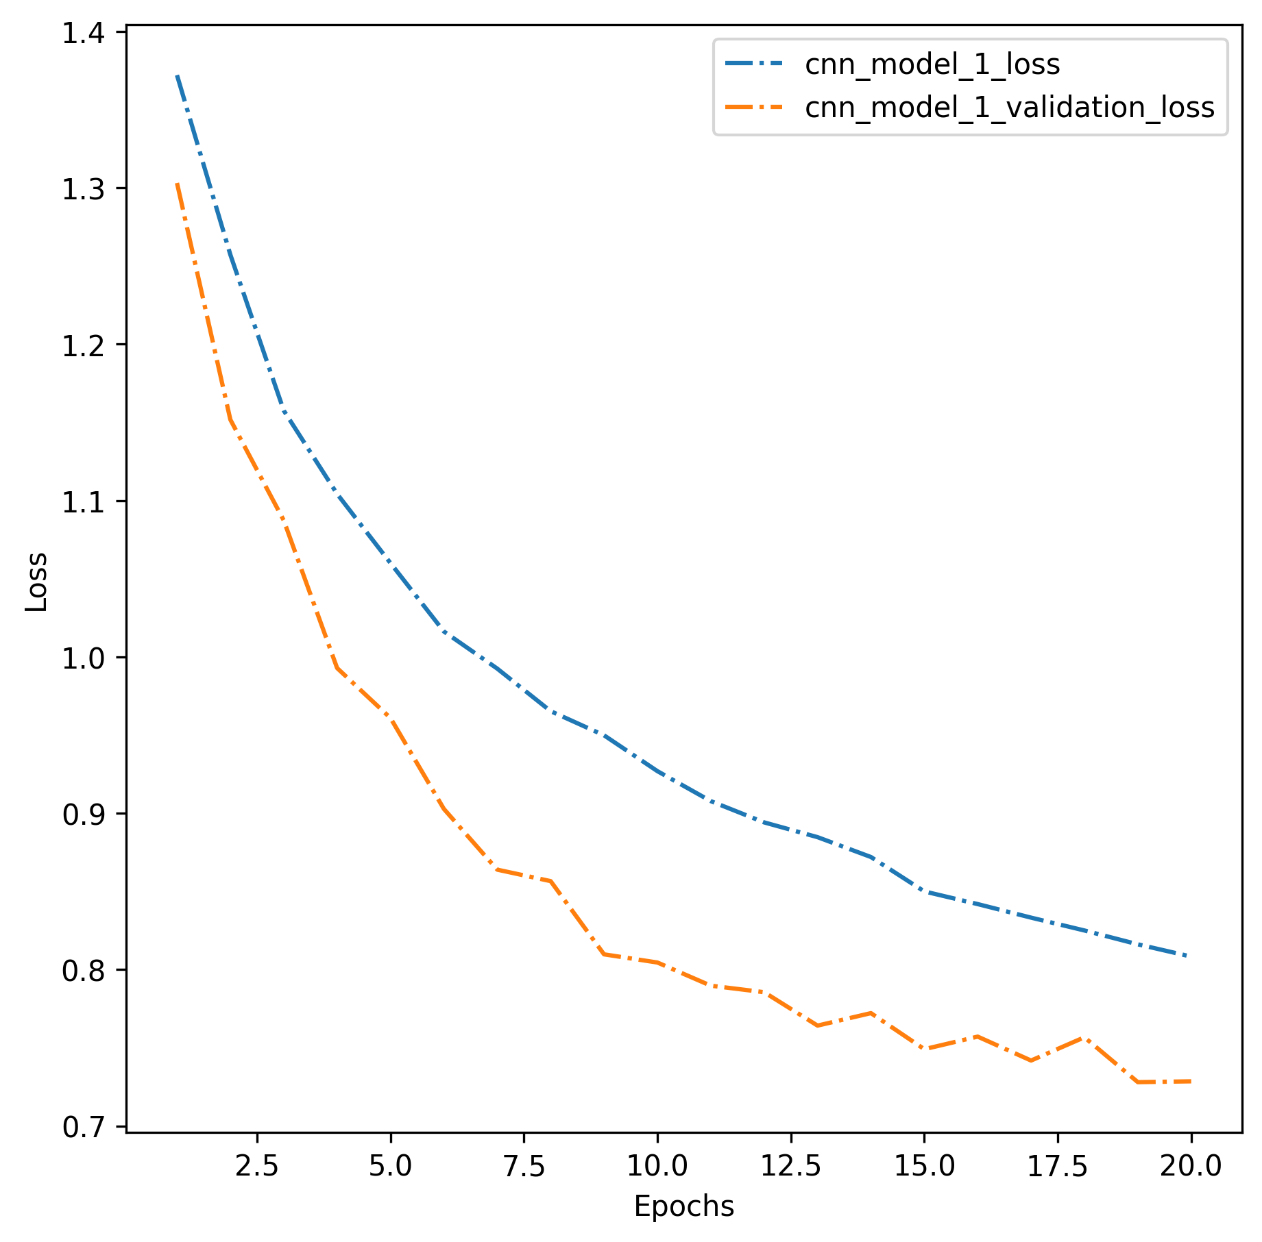
CNN model 1 loss:
Data set | Accuracy | Loss
Training | 65.64% | 82.3%
Validation | 69.71% | 73.3%
Test | 68.8% | 77.6%
Training loss decreases with each epoch
Model generalizes well to unseen data, loss is lower for validation and test data sets

Slide 17
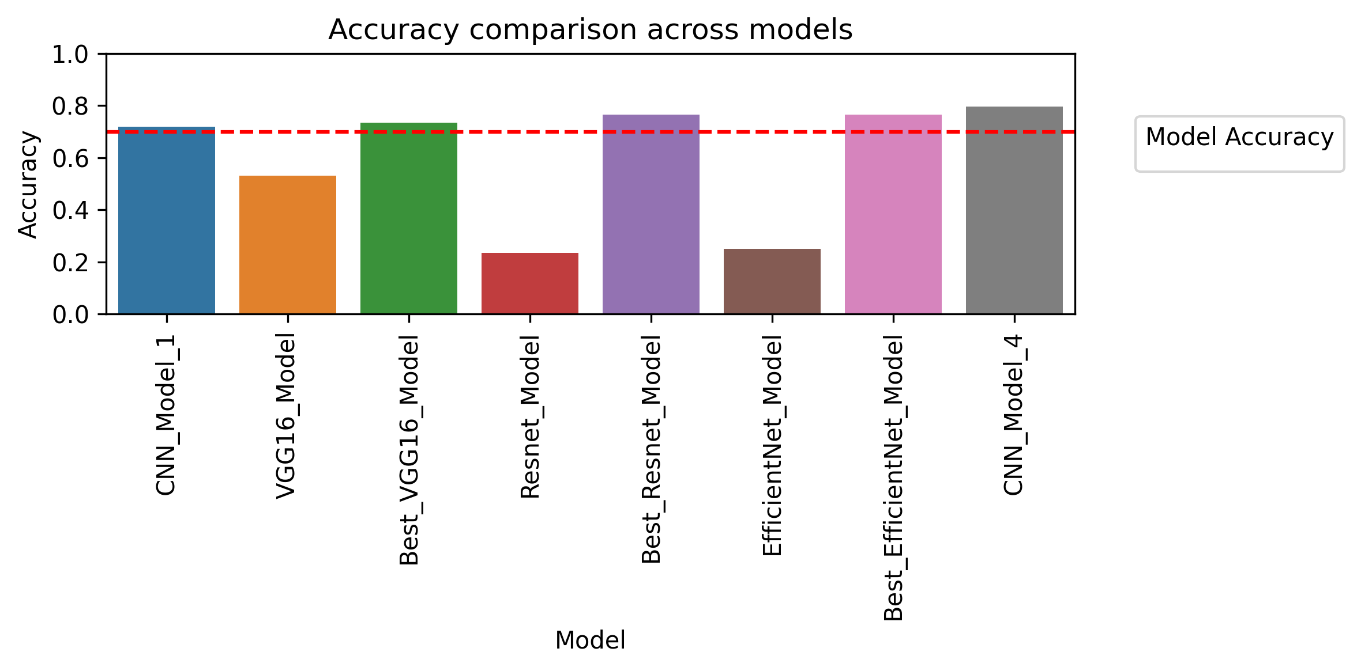
Comparison of models

