Slide 1
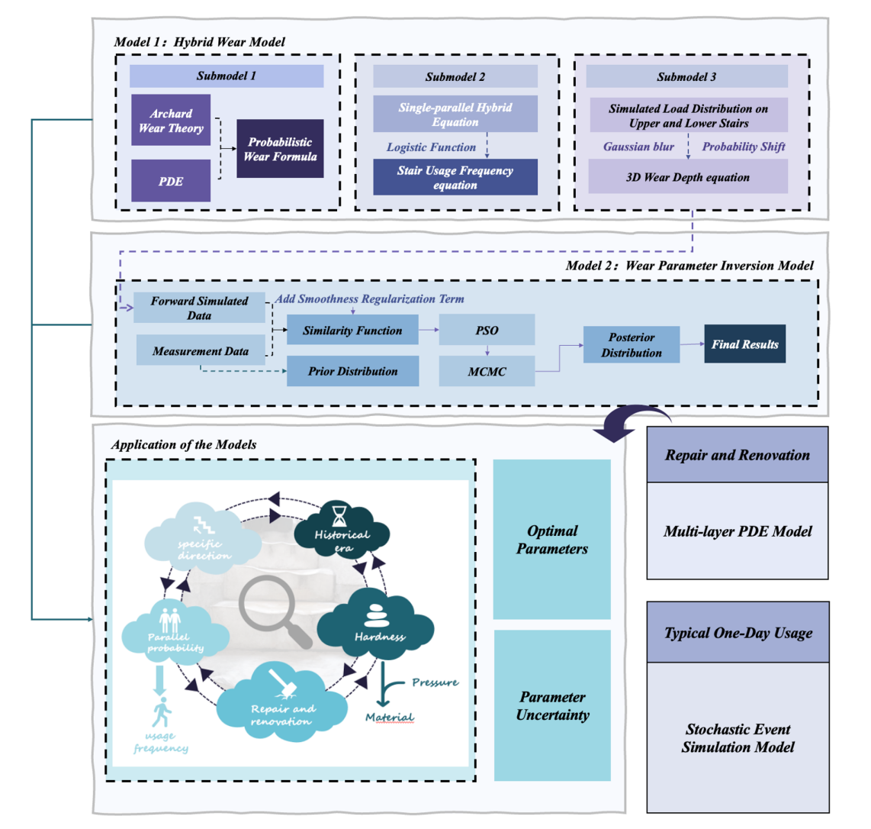

Model

Slide 2
Model

