Slide 1
Chemistry Team
What’s it all about?

Slide 2
Our Purpose
Get better at Chemistry
Believe in learning through doing
Win things
Chemistry Olympiad
Avogadro/Chem 13 exam
Have fun!
8th period shouldn’t be an 8th class
*coughcoughmath/physics/bio/computerteam*
Meetings are educational but also interesting
Notes:
No need to change

Slide 3
Typical Day at Chem Team
Lab Challenges
Chemysterie
Make My [Fara]day
Beat the Clock
Educational Games
Chemical Jeopardy - we might do some trivia today!
Molecule Structure Race
Lectures
Form on possible topics will be sent soon
Ideas?
Email us! (TJChemistryTeam@gmail.com)

Slide 4
Chemistry Olympiad (Jan-March)
About 20 people allowed to take regional test (March)
Mr. Kauffman runs selection test (Jan-Feb)
We will devote a few meetings to problem solving and practice around December

Slide 5
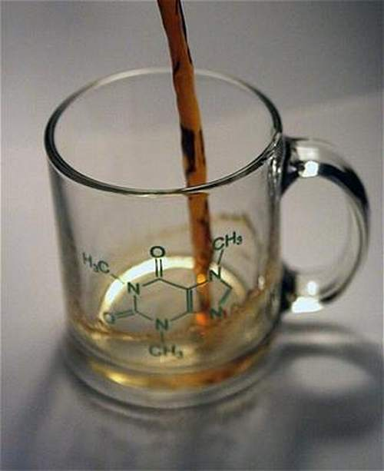
Chemathon (March-April) jk
Consists of tests + lab challenges
Hosted by University of Maryland at College Park
Two teams of 6
One for AP and Post-AP Chem students
One for Chem 1 and Pre-Chem 1 students
Placed 3rd and 6th last year
1st and 4th the year before that
Prizes
Team selection run by us
Consists of test + lab challenges
Early March
Preparation through labs
Historically we do really well on the tests

Slide 6
Chem 13/Avogadro Exams
Run by University of Waterloo
Test takes place at TJ
Anyone can take the test
Chem 13 is for AP/Post-AP students
Avogadro is for Chem 1/Pre-Chem 1
Top 5% of participants are recognized and given a prize
You are told your rank
TJ Chem Team got 1st and 2nd two years ago; almost everyone was recognized in top 5%
Questions?

Slide 7
Tutoring
We will be sending more information about tutoring in the future

Slide 8
2017-2018 Officers
Captains: John Kim (‘18), Ethan Liu (‘18)
Teaching Coordinators: Jenny Tan (‘19), Grace Qi (‘19)
Activities Coordinators: Irene Kim (‘19), Elise Ong (‘19)
Webmaster: Nikhil Sardana (‘18)
TJChemistryTeam@gmail.com
activities.tjhsst.edu/chemteam/

Slide 9
Practice
https://www.acs.org/content/dam/acsorg/education/students/highschool/olympiad/pastexams/2017-local-olympiad-exam.pdf
https://www.acs.org/content/dam/acsorg/education/students/highschool/olympiad/pastexams/2000-local-olympiad-exam.pdf

