Slide 1
Equilibrium
Me and him

Slide 2
Definition of Equilibrium
The forward and reverse reaction rates are equal
Concentrations of products and reactants are constant
Equilibrium state is dynamic and “reacts” to stresses to restore equilibrium
Only gases and ions affect the equilibrium

Slide 3
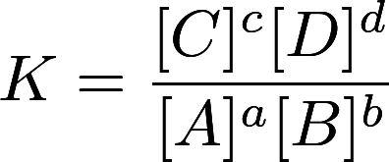
The Equilibrium Constant (K)
If all reactants are gases/aqueous…

Slide 4
The Equilibrium Constant (K)
If K >> 1?
If K << 1?
If K ≈ 1?
Note: does NOT represent speed of reactions
K for forward vs reverse reactions
Multiplying coefficients in the equation
Adding two individual chemical equations for an overall equation

Slide 5
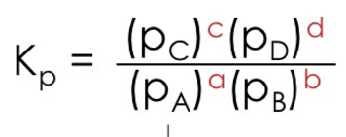
K_{c} vs. K_{p}
Equilibrium constants can be calculated with either concentrations or pressures when gases are involved
However, the two constants might not be equal
Using PV=nRT => P = (n/V)RT= CRT
We can derive, K_{p}=K_{c}(RT)^{𝚫n}
Make sure to know which one you are dealing with

Slide 6
Heterogenous Equilibrium
Equilibrium involving multiple states
CaCO₃(s) => CaO(s) + CO₂(g)
Solid and liquid concentrations do not change, therefore do not affect equilibrium
K = [CO₂]
The only instance when solids and liquids affect the concentrations of the other reactants and products are when they are limiting reactants

Slide 7
Reaction Quotient (Q_{c})
Calculated same way as K, BUT Q_{c} does not have to use equilibrium values
In a mixture with only reactants, Q_{c} = 0
In a mixture with only products, Q_{c} = ∞
If Q < K…
If Q > K…
If Q = K...

Slide 8
Finding Concentrations at Equilibrium
Often equilibrium questions involve either finding equilibrium concentrations or the equilibrium constant
H₂(g) + I₂(g) => 2HI(g)
([HI]₀+2x²)
K = ____________________
([H₂]₀-x) ([I₂]₀-x)
 | [H₂] | [I₂] | [HI]
Initial | [H₂]₀ | [I₂]₀ | [HI]₀
Change | -x | -x | +2x
Equilibrium | [H₂]₀-x | [I₂]₀-x | [HI]₀+2x

Slide 9


The 5% Rule
 | [A] | [B]
Initial | 1.0 | 0.0
Change | - x | + 2x
Equilibrium | 1.0 - x | 2x

Slide 10
Le Châtelier’s Principle
Equilibrium shifts to counteract stresses on the system
When concentration/pressure of a compound increases, equilibrium shifts to reduce the concentration/pressure
Inert gases have no effect because they do not change the partial pressures of the reactants and products
Decreasing the volume increases pressure which causes equilibrium to shift to the side with less gas molecules, hence decreasing total pressure
Increasing temperature causes equilibrium to shift in the direction that consumes energy
For these, the opposites are all true
Note: changing temperature changes the equilibrium constant. For all other changes, K remains constant

Slide 11
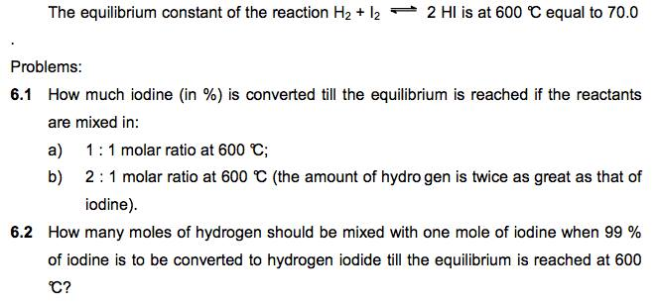
Example Problems

