Slide 1
Reaction Kinetics
By: Me and him

Slide 2
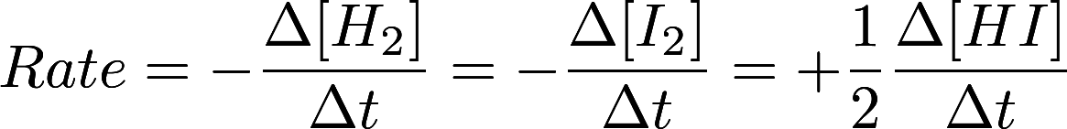
Reaction Rate
Average vs Instantaneous

Slide 3


Rate Law
Relationship between concentrations and reaction rate
Must be determined experimentally
If n = 0: zero order with respect to [A]
If n = 1: first order with respect to [A]
If n = 2: second order with respect to [A]

Slide 4
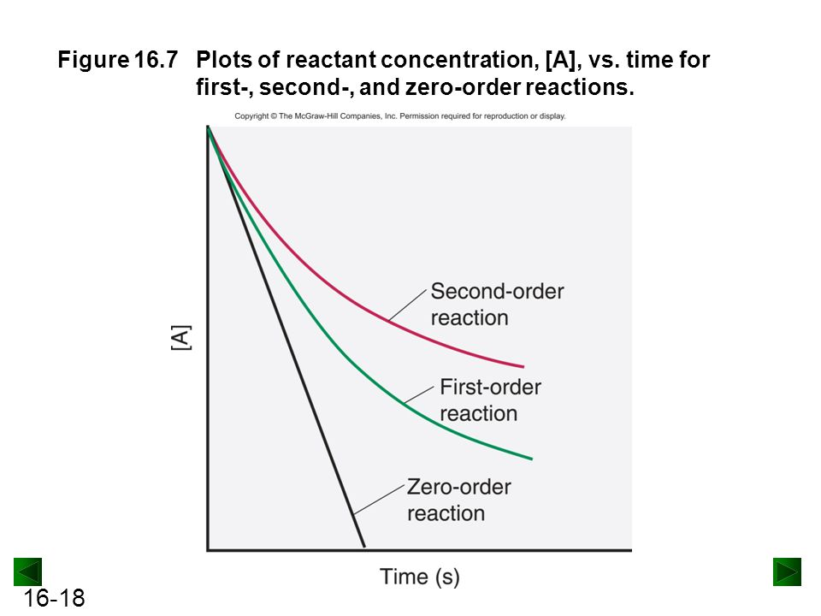
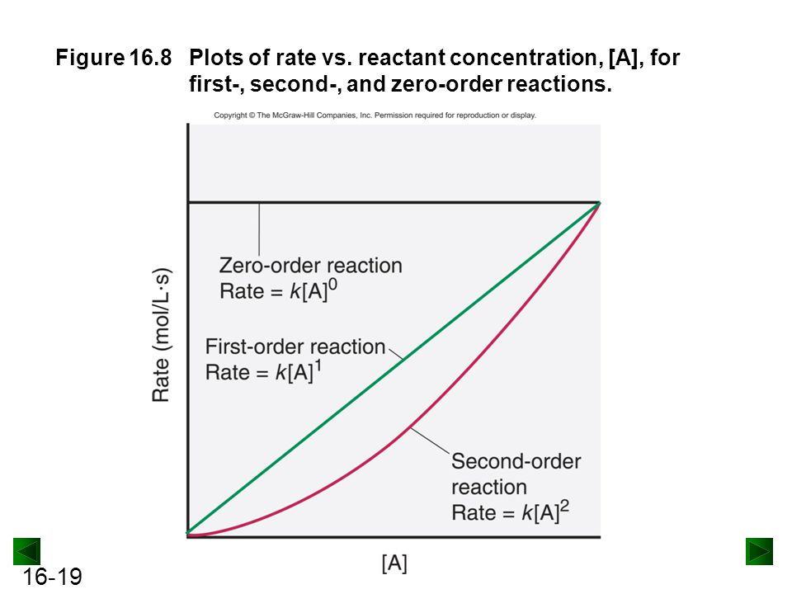
Graphs

Slide 5

Rate Law
Overall order: m + n

Slide 6
Determining Reaction Rate from Experimental Data
A + B => 2C
Find the rate law.
Experiment Number | [A] (M) | [B] (M) | Rxn Rate (M/h)
1 | 0.5 | 1 | 1.5
2 | 0.5 | 2 | 6.0
3 | 1.0 | 2 | 12.0
Rate = k [A][B]²

Slide 7
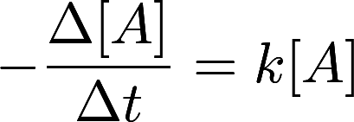

Differential and Integrated Rate Laws
First Order Differential
First Order Integrated

Slide 8
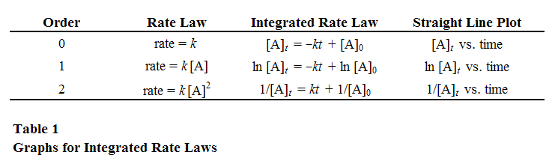
Differential and Integrated Rate Laws

Slide 9
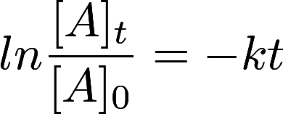
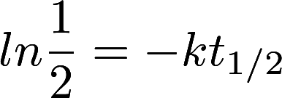
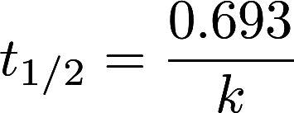
Half-Life
First Order Half-Life

Slide 10
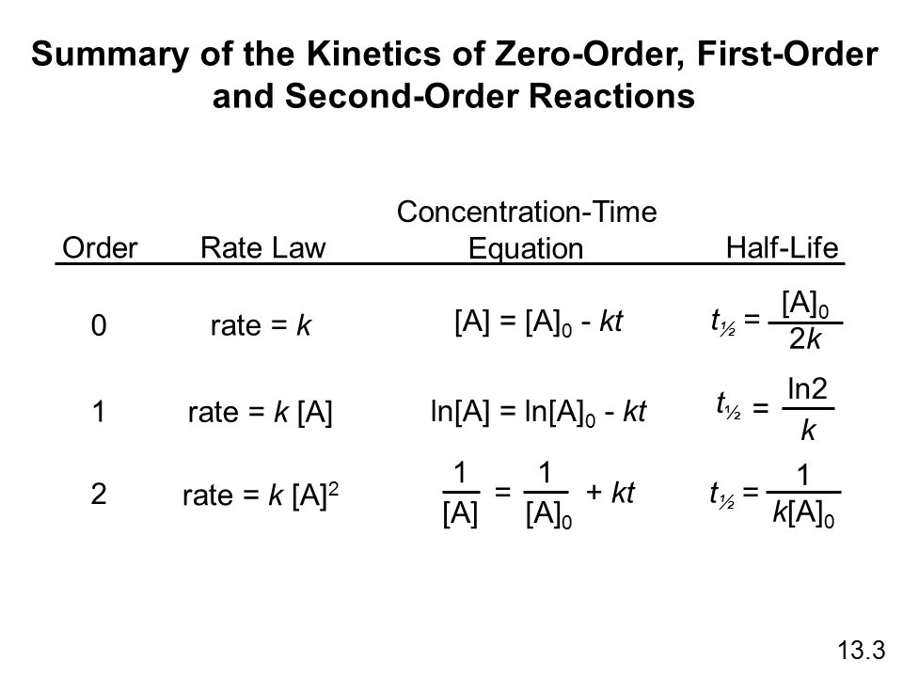
Half-Life

Slide 11
Reaction Mechanism
Many reactions happen in multiple steps; the mechanism is the way it happens
2NO => N₂O₂ (fast)
N₂O₂ + O₂=> 2NO₂ (slow)
The rate law is determined by the slowest step
Rate = k[NO]²[O₂]
Each step never has more than two particles

Slide 12
Harder Reaction Mechanism
O₃=> O₂+ O (fast) Forward is k₁; reverse is k₋₁
O₃+ O => 2O₂ (slow) k₂
Rate = k₂[O₃][O]
O is an intermediate
Since, rate of first step = k₁[O₃] = k₋₁[O₂][O]
[O] = k₁[O₃]/(k₋₁[O₂])
Substitute to get: Rate = k[O₃]²[O₂]⁻¹

Slide 13
Collision Model
Molecules need to collide in order to react
Increased temperature increases force and frequency of collisions
Collisions need to reach an activation energy to react
Particles also need to collide in a specific orientation to react
These factors lead to the Arrhenius equation

Slide 14
Arrhenius Equation
ln(k) = -E_{a}/R(1/T) + ln(A)
k = rate constant
E_{a} = activation energy (J)
R = 8.3125 J/mol K
T = temperature (K)
A = collision frequency X steric factor (fraction of collision with good orientations)

Slide 15
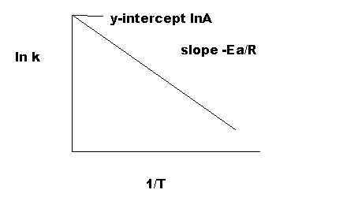
Arrhenius Equation (cont)
Graphing 1/T against ln k yields useful results
Often, the Arrhenius equation is used with multiple temperatures
Subtracting two equations for the same reaction at different temperatures yields:
ln(k₂/k₁) = E_{a}/R(1/T₁-1/T₂)
ln(A) is eliminated

Slide 16
Changing Reaction Rate
Temperature
Concentration of reactants
Introducing a catalyst
Surface area

