Slide 1


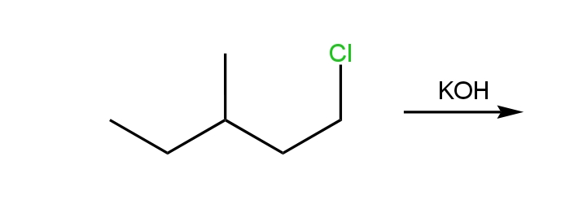

Click for Answer!
Click for question

Slide 2

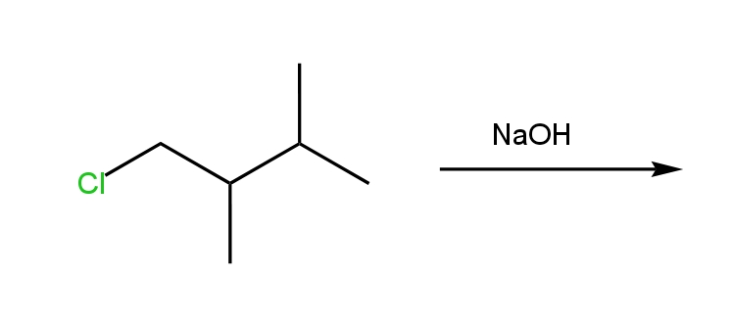

Slide 4
