Slide 1
AI in Practice: Platform Governance, Crime Prevention, and Open-Source Paradoxes
Dylan Junluo CHEN
Supervisors: Ben LIU & Xin LI

Slide 2
Study 1 (completed): Content, Position, and Source:
The Impacts of Platform-specific Internal Generative AI on Online Q&A Communities
Notes:
Here, Internal GenAI means AI bots developed by a platform and used only within this particular platform, as opposed to the general purpose GenAI like ChatGPT.

Slide 3


Online Q&A Communities
Online Q&A Communities
Supply
Supply
Questions
Answers
Questioners
Answerers
Viewers
Notes:
Important domain in IS research
3 parties: questioners ask questions in the communities, answerers supply answers, viewers read the answers and provide recognition through votes or likes.

Slide 4

Challenges: External GenAI (ChatGPT) attracts users away from online Q&A communities
Online Q&A Communities
Supply
Supply
Questions
Answers
Questioners
Answerers
Viewers
External GenAI
(e.g., ChatGPT)
Notes:
1. ChatGPT challenges. 2. Many existing studies

Slide 5
One Proactive Platform Response: Implement Internal GenAI
Online Q&A Communities
Supply
Internal GenAI
Supply
Supply
Questions
Answers
Questioners
Answerers
Viewers
External GenAI
(e.g., ChatGPT)
Notes:
1. differently, we study total different phenomenon. internal GenAI
2. What is?
3. Why do this - first, they want to keep questioners - second, platform advantage
4. why investigate - work as espected or maybe it back fiers - competing theoretical prediction on

Slide 6
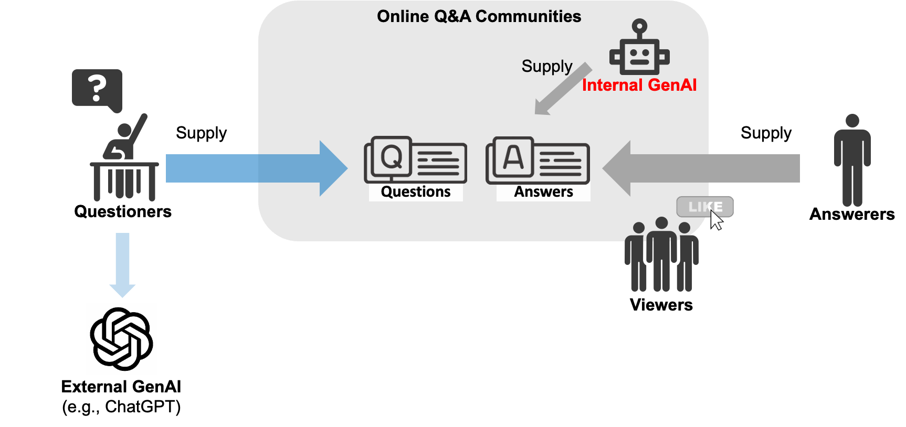
One Proactive Platform Response: Implement Internal GenAI
Our Research Question:
How does internal GenAI affect human answerers (supply) and viewers (recognition) in online Q&A communities?

Slide 7
A Randomized Experiment on SegmentFault
Platform:
A leading Chinese technical online Q&A community (7M users, 310K questions)
Experiment Design:
Random assignment at the question level
“Treated” questions: AI answer appears immediately (first position)
“Control” questions: No AI answer
Period: Sept 2023 - Feb 2024 (150 days, N=3,613 questions)
Notes:
Platform provide AI answers before any human answers
Setting Advantages:
Clean randomization
Explicit AI labeling (observable AI vs. human contributions)

Slide 8
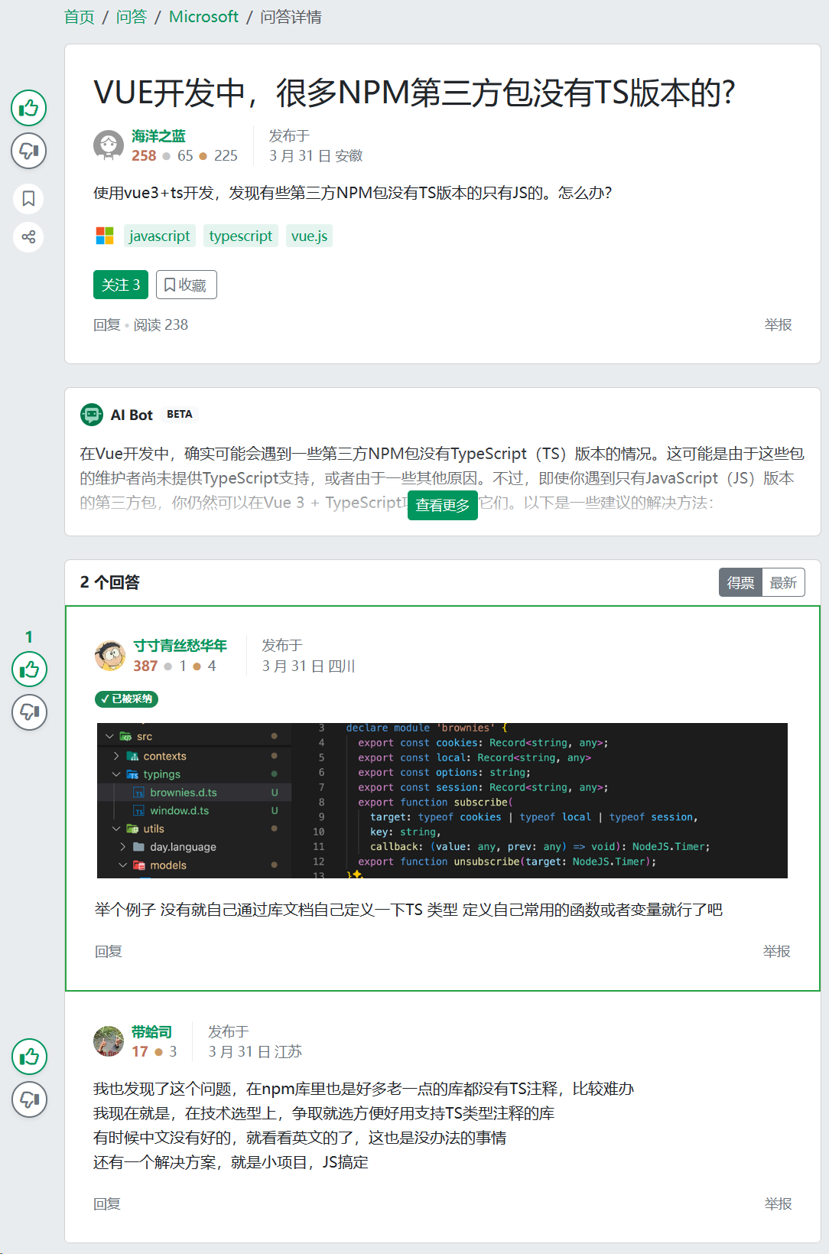
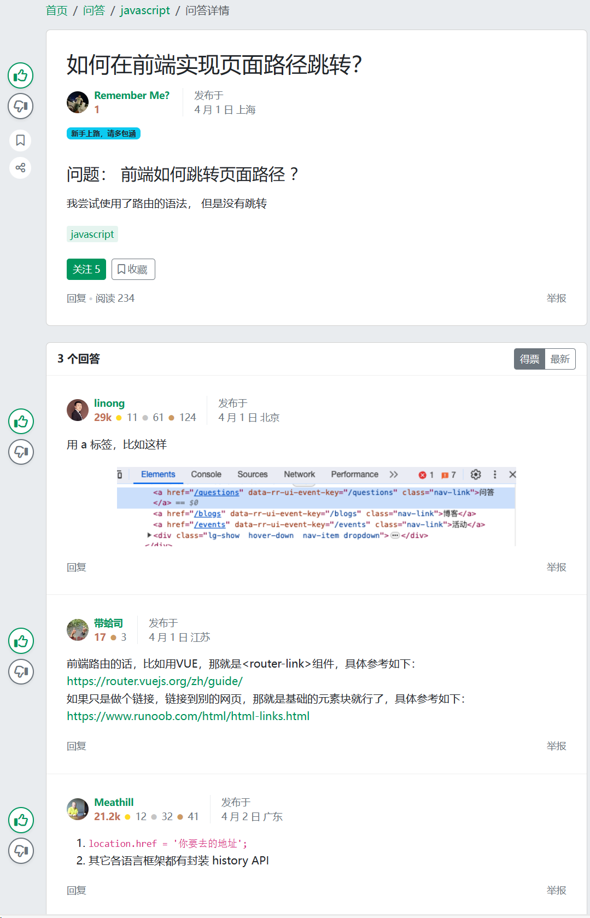
A Randomized Field Experiment on SegmentFault
Treatment
Control
Notes:
Questions
Immediately Ai answer versus no AI answers
All have human answers
advantage

Slide 9
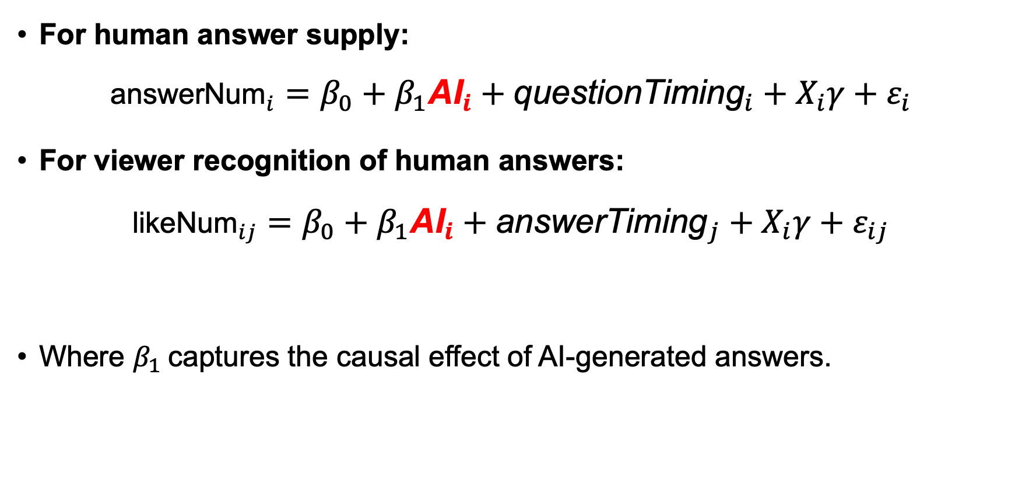
Empirical Model
For human answer supply: ${\text{answerNum}}_{i}=β_{0}+β_{1}{\text{AI}}_{i}+{\text{questionTiming}}_{i}+X_{i}γ+ε_{i}$
For viewer recognition of human answers: ${\text{likeNum}}_{ij}=β_{0}+β_{1}{\text{AI}}_{i}+{\text{answerTiming}}_{j}+X_{i}γ+ε_{ij}$
Where $β_{1}$captures the causal effect of AI-generated answers.

Slide 10
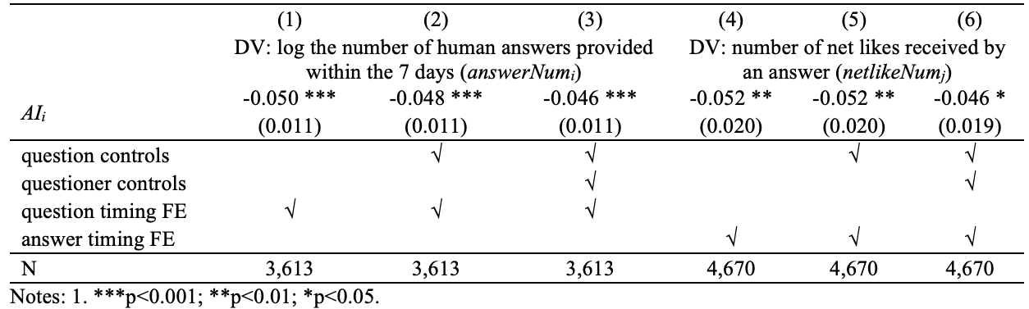
Effects of AI answers on answer supply and viewer recognition
DV: answerNum_{i}
DV: likeNum_{ij}

Slide 11
Effects of AI answers on answer supply and viewer recognition
Reduced Human Answers
-4.6% in human answers
Reduced Viewer Recognition
-14.8% in likes
Robust to
specifications with progressive controls
alternative model selection (Poisson, zero-inflated Poisson (ZIP), and zero-inflated Negative Binomial (ZINB) )
alternative time frame used in analyses (for both DV calculation and data used)
potential spillover effects
(little) potential of low quality of randomization due to unobservable omitted variables

Slide 12
Why AI Deters human answer supply? Three Theoretical Mechanisms
M: mechanisms
1. Content Effect (what AI says) > Content quality (length, readability, technical depth, …)
2. Position Effect (when/where AI arrives) > Because it is the first, no humans can be the first answerer
X: The presence of AI answers
Y: # human answers
3. Source Effect (who says it, AI versus human) > The mere fact that the answer is from AI > Perceived authority
Notes:
The source effect is a simple idea: people often trust information more just because it comes from AI, regardless of whether that answer is actually good or accurate.

Slide 13
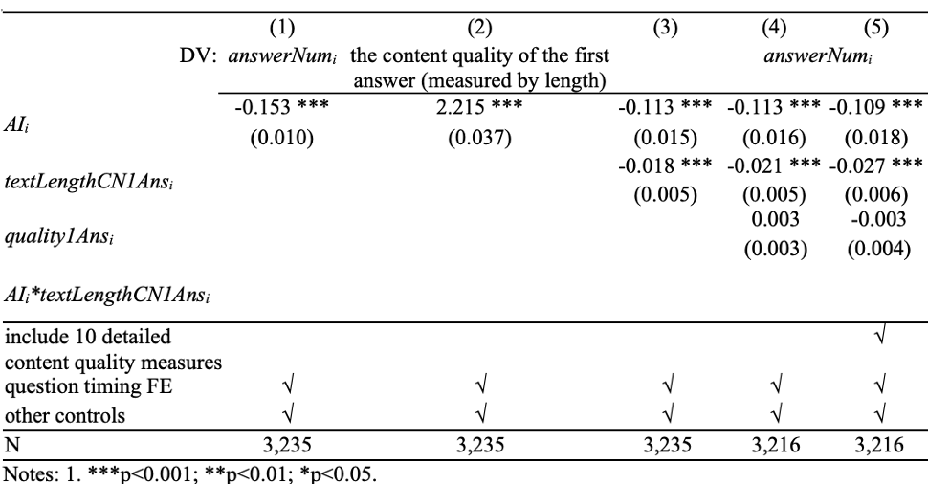
Mechanism 1 - Content Effects
X→Y
X→M
X + M →Y
Talking Point: There is a content effect, but it explains only about 1/4 of the effect

Slide 14
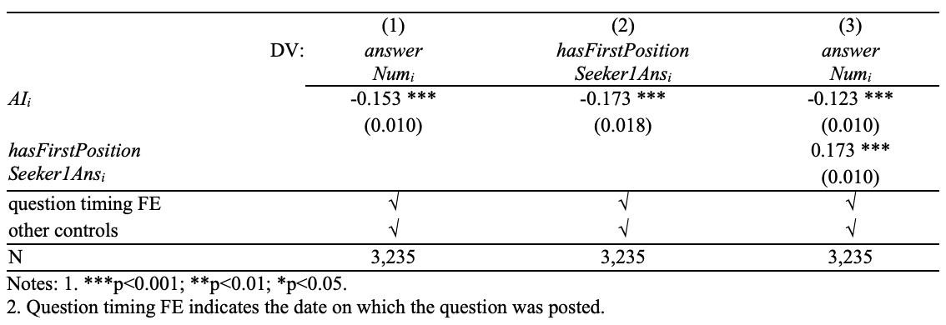
Mechanism 2 - Position Effects
X→Y
X→M
X + M →Y
Talking Point: There is a position effect - AI takes this opportunity away from users who value it most
Notes:
Strong tendency to seek first answer position -> first position seekers
M is the likelihood of XXX provide first human answer….

Slide 15
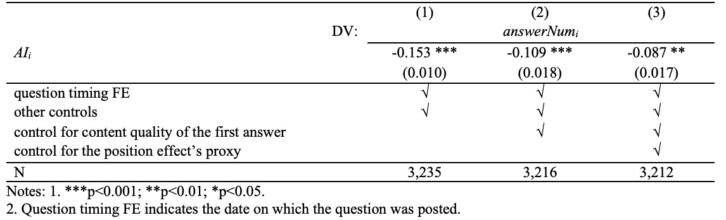
Mechanism 3 - Source Effects
Talking Point: 57% of total deterrence operates through the source effect
Notes:
Circle: old
Want you to compare, again

Slide 16
Why Viewer Recognition Decreases?
Attraction diversion
> Do not see the human answers due to attraction from AI answers
Quality degradation
> Objective quality lowers
Heightened Expectation
> Quality doesn’t change, but viewers become more picky
Talking Point:
Human answers haven’t gotten worse
Viewers’ standards have gotten higher in the presence of high-quality AI
Notes:
1. In the interest of time
2. Not because (x), or quality lower (x), but because of xxxxx
3. imporatanly, quality doesn’t beocme lower

Slide 17
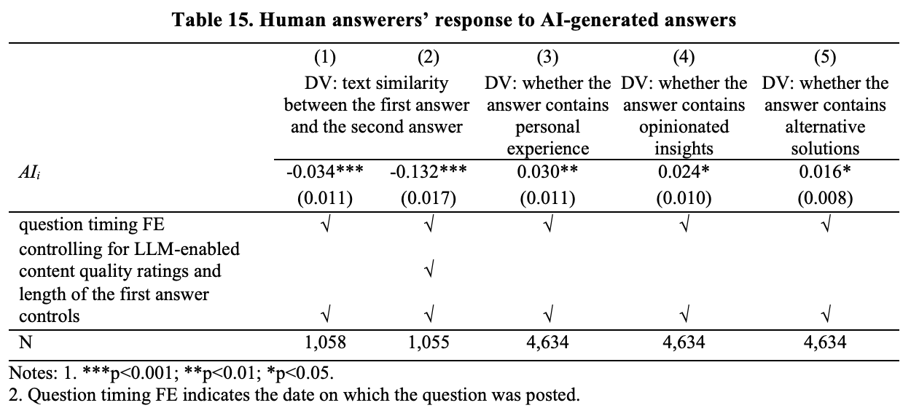
Humans Differentiate Through Unique Value
Talking Point:
There's hope - humans adapt by emphasizing their unique strengths
Notes:
Purpose
Key points. Quite different.

Slide 18
Key Takeaways
Effects of internal GenAI on human answer supply :
Internal GenAI reduces # human answers
Three mechanisms drive deterrence:
Content quality: 26%
Position advantage: 20%
AI source identity: 54% ← Largest contributor
Effects of internal GenAI on viewer recognition
Internal GenAI decreases viewer recognition of human answers
Elevated Expectations Mechanism
Recognition decreases not from quality decline but from raised expectations
Evidence of Human Adaptation
Humans differentiate through experiential, personalized insights

Slide 19
What Should Platforms and Users Do?
For Platforms:
If deploying AI, mitigation strategies:
Add disclaimers about AI limitations (counter “perceived authority”)
Introduce temporal delays in AI answers (preserve first-mover advantage for humans)
Redesign recognition systems to account for elevated expectations
Highlight human contributions that provide unique value
For Community Members:
Differentiation strategy:
Emphasize personal experiences and contextual understanding
Offer opinionated insights and alternative perspectives
Focus on what AI cannot replicate (experiential knowledge, creative problem-solving)

Slide 20
Study 2 (ongoing): Does AI save babies?
The Impacts of facial-recognition AI procurement (by Chinese governments) on crimes of child trafficking

Slide 21
Motivation: The Global Child Trafficking Crisis
The Crisis:
420,000 children trafficked annually worldwide
60% of girl victims exploited sexually
Cases tripled over 15 years
Post-pandemic detections surged 31%
Technology Limitations:
Traditional technology interventions (e.g., biometric systems, surveillance cameras) show minimal impact despite substantial investment
Two key constraints:
Scalability
Reactivity
Notes:
Child trafficking represents one of the most severe violations of human rights
Scalability: Requires extensive manual review and investment
Reactive: Only records footage after incidents occur

Slide 22
A new hope: facial-recognition AI
AI Advantages:
Scalable: Leverages existing camera infrastructure
Automated: Real-time detection without human-intensive screening
Critical Gap:
Lack of empirical evidence for AI’s effectiveness on child trafficking
Why investigating? - Practical implications:
Guide resource allocation with empirical evidence
When and why? Understand heterogeneity and mechanisms

Slide 23
The China Context
Why China?
Technology deployment:
Billions invested in comprehensive facial recognition infrastructure since 2010, with substantial variation across regions and time periods
China’s Unique Child Trafficking Challenges
Legal adoption faces numerous obstacles in China.
Massive internal migration creates vulnerable populations separated from community protection
Notes:
Legal adoption is time-consuming and costly for ordinary people
The internal migration rate is high, When you have people moving from one area to another, then child trafficking becomes more likely.

Slide 24

Empirical model
Main model (OLS)
${numAnT}_{i,t+1} =α +βnum{AI}_{it} +{county}_{i}+{year}_{t} +X_{i}γ +ε_{it}$

Slide 25
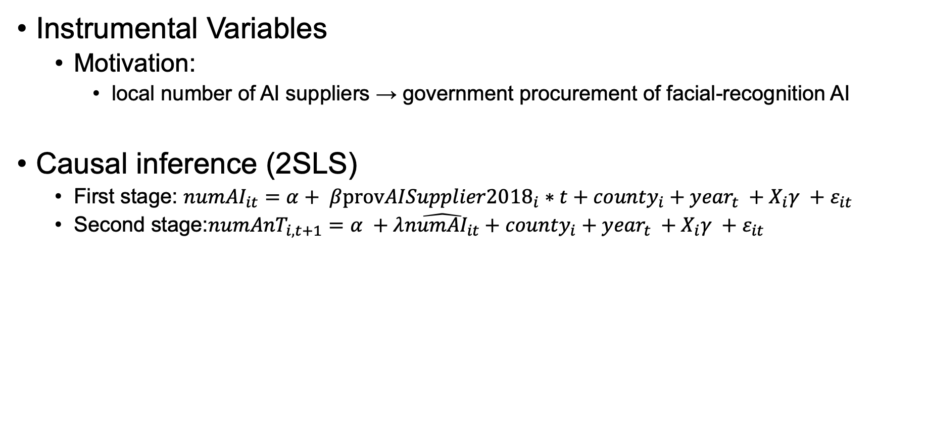
Empirical model
Instrumental Variables
Motivation:
local number of AI suppliers → government procurement of facial-recognition AI
Causal inference (2SLS)
First stage: ${numAI}_{it}=α+ β{provAISupplier2018}_{i}∗t+{county}_{i}+{year}_{t} +X_{i}γ +ε_{it}$
Second stage:${numAnT}_{i,t+1}=α +λ\hat{numAI_{it}}+{county}_{i}+{year}_{t} +X_{i}γ +ε_{it}$

Slide 26
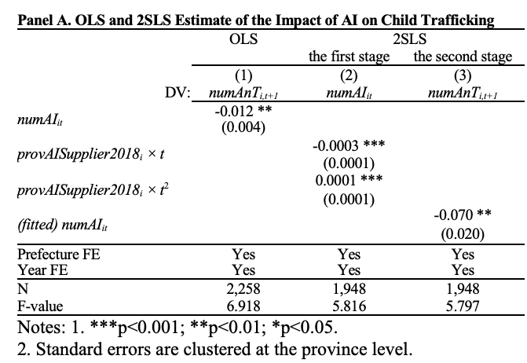
Finding 1: AI Facial Recognition Systems Reduce Child Trafficking
Talking Point: AI reduces the occurrence of child trafficking.

Slide 27
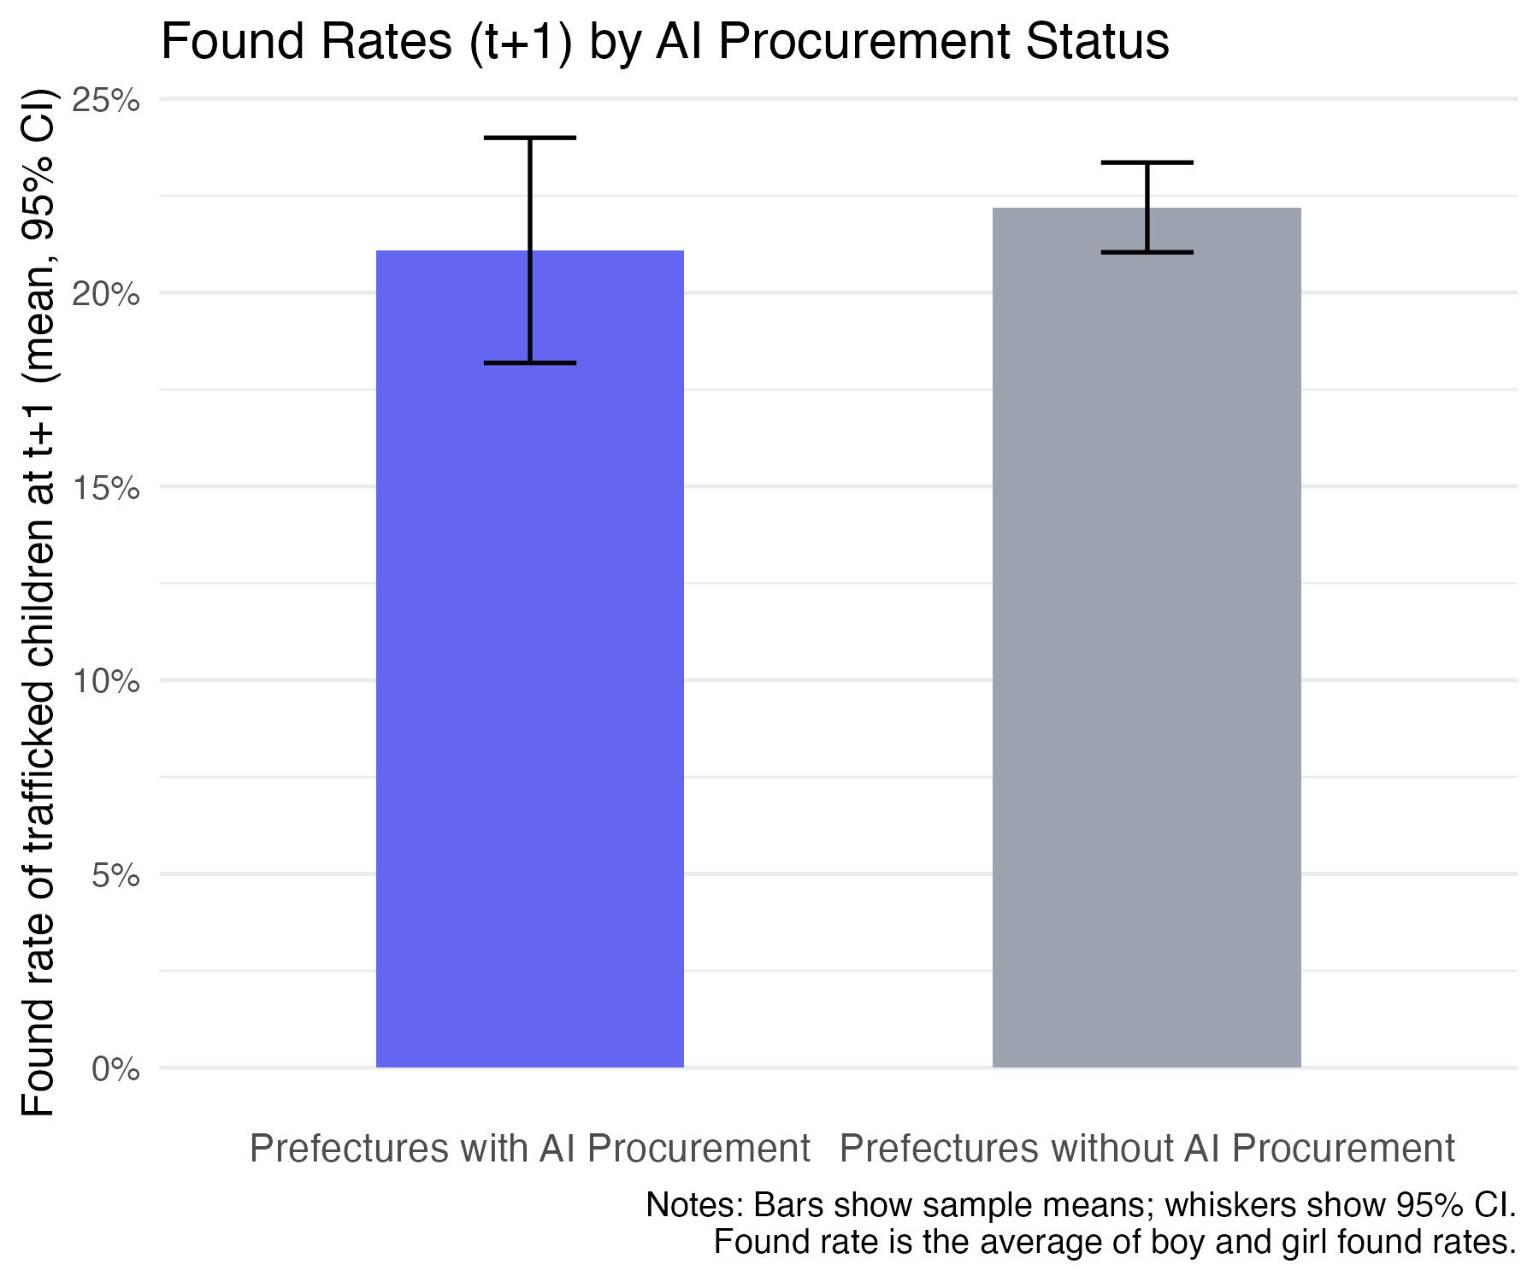
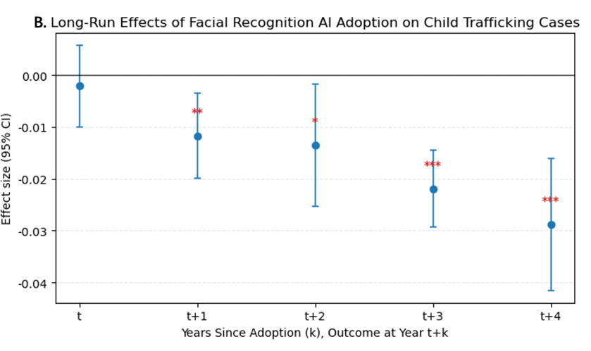
Finding 2: Additional Analyses
Talking Point:
There is a long-term protection effect, but AI has no impact on finding missing children
Notes:
The y axes shows the rate of finding missing children back
The group on the left is the prefectures with AI procurement, the group on the right is without AI procurement
We see no statistically significant difference between these two groups. So AI has no impact on finding missing children.
Figure B shows the AI effect over time
This this the confidence interval of the AI effect, which shows no effect of AI in protecting child trafficking year t.
The AI effect take some time to play out and there is a long term effect.

Slide 28
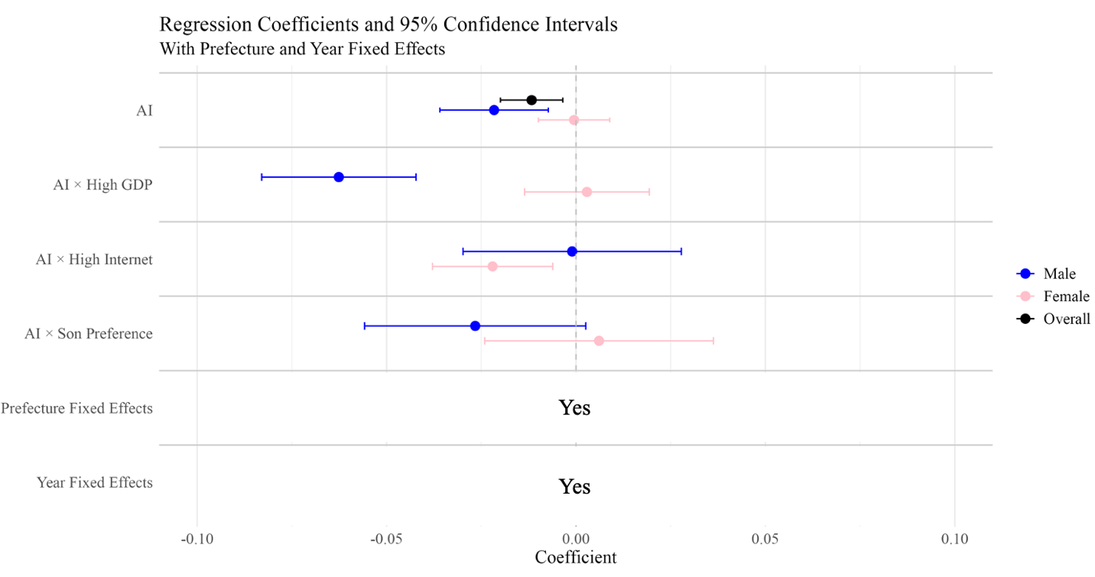
Finding 3: Heterogeneous Effects: Victim Gender and Socioeconomic Context
Talking Point:
The protection effect concentrates in boys rather than girls.
Notes:
Black represents confidence intervals of AI, it’s a overall effect
It shows that AI can only reduce the boy trafficking but has no protection on grils.

Slide 29
Study 3 (ongoing): Open but Isolated:
The Unintended Consequences of AI Model Open-Sourcing on Architecture Adoption
Notes:
Architecture is the blueprint of how a model is designed—like the floor plan of a house

Slide 30
Motivation
Model 1: GPT
Architecture: transformer
Input
Output

Slide 31
Motivation
Model 2 (image generation)
Architecture: Generative Adversarial Networks (GANs)
Input
Output

Slide 32
Motivation
Traditional Open-Source Theory:
Open-source development should enhance technology diffusion and architecture adoption
Anecdotal Evidence Challenges This:
Open-sourcing may paradoxically reduce architecture adoption
Industry concern: AI model open-sourcing enable cyber attacks and malicious applications
Academic concern: Data reliability issues may cause performance degradation and erode developer trust
The representativeness of this anecdotal evidence remains unclear
Notes:
Once you open source your model, other people will more likely adopt your model architecture.
Showing that sometimes when you open source your model, people less likely adopt your architecture, due to security concerns.

Slide 33
Motivation
Why investigating this?
For AI suppliers:
Open-sourcing represents a critical strategic choice

Slide 34
Data
Our coauthor provides this unique data.
Each model is labelled with the architecture used
754 unique tasks (e.g., facial recognition)
Variable
numSameModel_{i,t+1}
Number of models in time t+1 adopt the architecture of model i
isOpensource_{it}
Whether model i has a GitHub repo
Model specification (OLS)
numSameModel_{i,t+1} = β₀ + β₁ isOpenSource_{it} + γX_{it} + Task_{i} + Time_{t} + ε_{it}

Slide 35
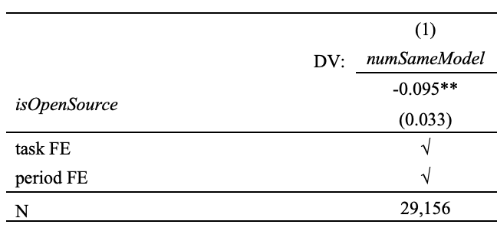
Identification and preliminary findings
Talking Point:
AI model open-sourcing may paradoxically reduce architecture adoption

Slide 36
Thank you!

