Slide 1

NQP is Average-Case Hard for $ACC^{0}$
Lijie Chen
MIT

Slide 2

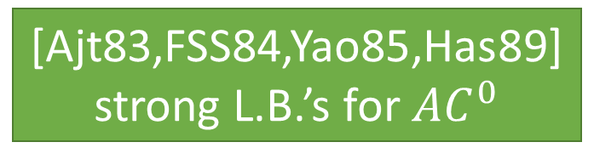

(Oversimplified) History: Part 1
People want circuit lower bounds (and show $P≠NP$), but it is HARD…
It is not the case back to the 1980s...
(at least that was most people thought at that time!)
Quest at that time: understand constant depth circuits first!
[Ajt83,FSS84,Yao85,Has89]
strong L.B.’s for $AC^{0}$
$AC^{0}$: constant depth, AND/OR/NOT circuits
The hard function: Parity!
Parity: outputs 1 $⇔$ #1 is even

Slide 3
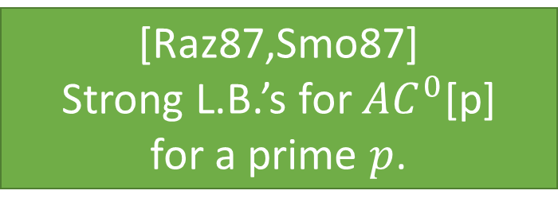
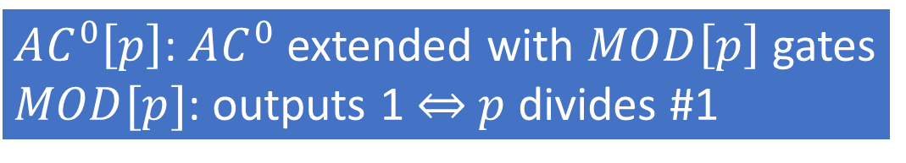
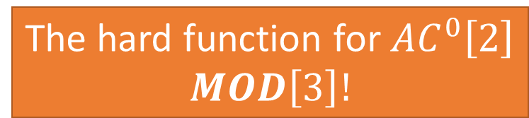
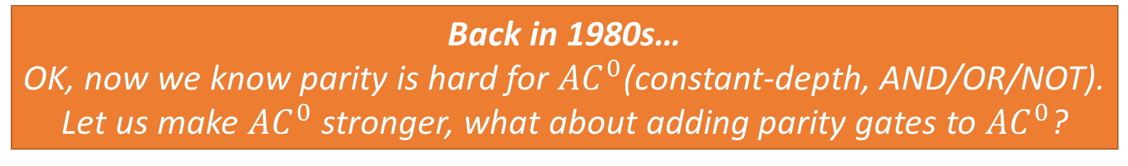
(Oversimplified) History: Part 2
Back in 1980s…
OK, now we know parity is hard for $AC^{0}$(constant-depth, AND/OR/NOT).
Let us make $AC^{0}$ stronger, what about adding parity gates to $AC^{0}$?
Philosophy: strengthen the circuit class ``just a little bit’’ by adding the most
simple function it cannot compute as available gates! Hopefully we can get
to general circuits very soon!
[Raz87,Smo87]
Strong L.B.’s for $AC^{0}$[p]
for a prime $p$.
$AC^{0}\left[p\right]$: $AC^{0}$ extended with $MOD\left[p\right]$ gates
$MOD[p]$: outputs 1 $⇔$ $p$ divides #1
The hard function for $AC^{0}\left[2\right]$
$$MOD\left[3\right]!$$

Slide 4

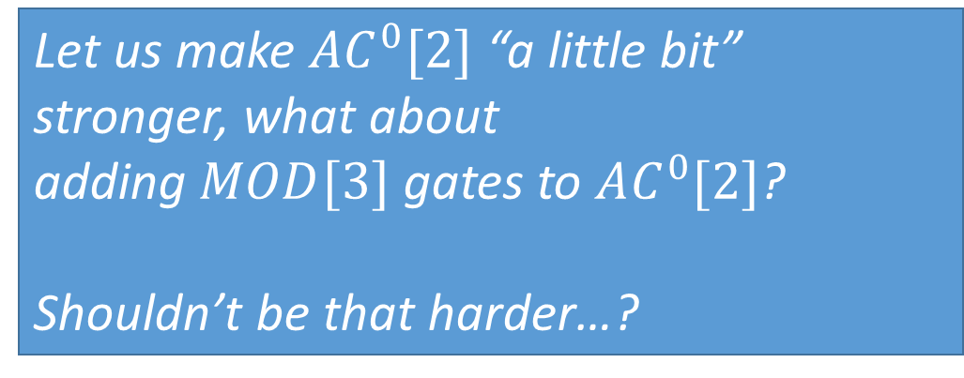
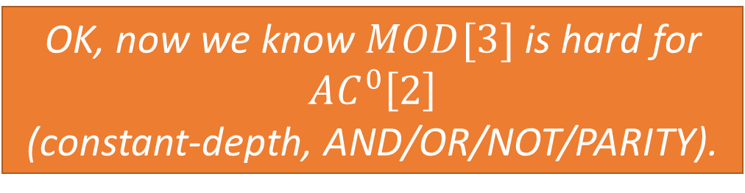



(Oversimplified) History: Part 3
Back in 1980s…
Nice, everything so far is very successful!
OK, now we know $MOD[3]$ is hard for $AC^{0}\left[2\right]$
(constant-depth, AND/OR/NOT/PARITY).
$$AC^{0}$$
add parity
$$AC^{0}[2]$$
Let us make $AC^{0}[2]$ “a little bit” stronger, what about
adding $MOD[3]$ gates to $AC^{0}[2]$?
Shouldn’t be that harder…?
add $MOD[3]$
$$AC^{0}[6]$$
Umm…

Slide 5
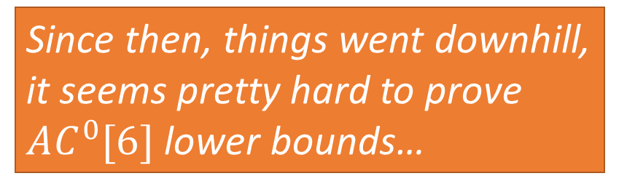
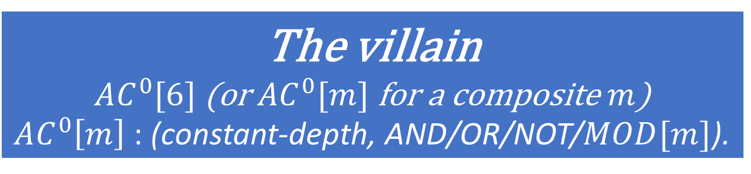
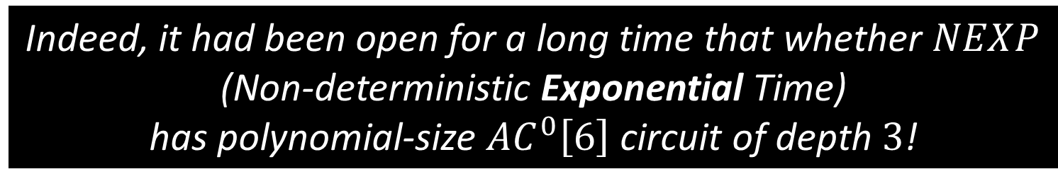
(Oversimplified) History: Part 4
The villain
$AC^{0}[6]$ (or $AC^{0}[m]$ for a composite $m$)
$AC^{0}\left[m\right]$ : (constant-depth, AND/OR/NOT/$MOD[m]$).
Since then, things went downhill,
it seems pretty hard to prove
$AC^{0}[6]$ lower bounds…
Indeed, it had been open for a long time that whether $NEXP$
(Non-deterministic Exponential Time)
has polynomial-size $AC^{0}\left[6\right]$ circuit of depth $3$!

Slide 6


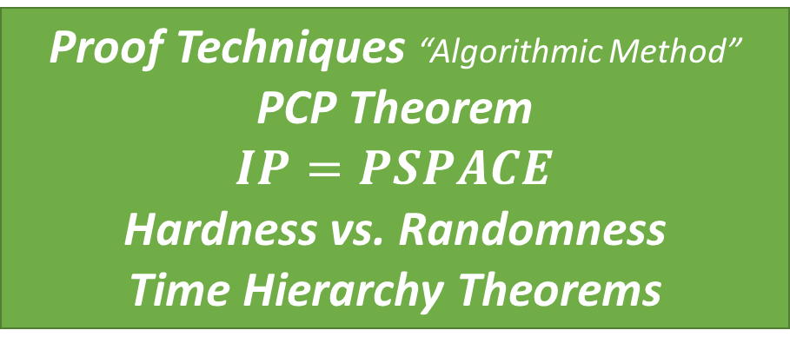
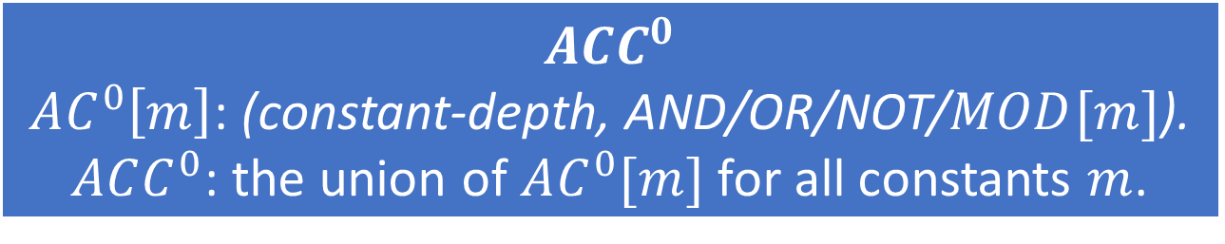
NEXP $∉$ $ACC^{0}$
$$ACC^{0}$$
$AC^{0}\left[m\right]$: (constant-depth, AND/OR/NOT/$MOD[m]$).
$ACC^{0}$: the union of $AC^{0}[m]$ for all constants $m$.
In 2011, R. Williams proved that $NEXP$
does not have polynomial-size $ACC^{0}$circuits.
Theoretical Importance of this result
Crossing all the “barriers”
Relativization
Algebrization
Natural Proofs
Proof Techniques “Algorithmic Method”
PCP Theorem
$$IP=PSPACE$$
Hardness vs. Randomness
Time Hierarchy Theorems

Slide 7

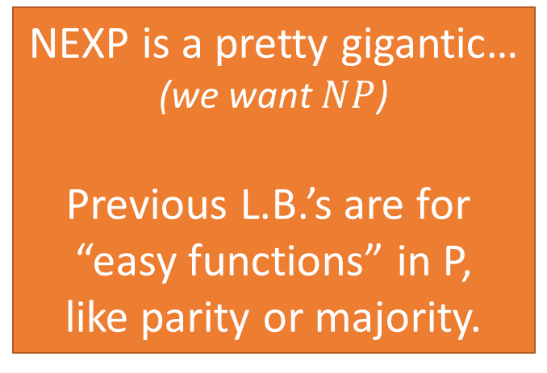
NEXP $∉$ $ACC^{0}$
In 2011, R. Williams proved that $NEXP$
does not have polynomial-size $ACC^{0}$circuits.
A Big Breakthrough
Still, it has some drawbacks comparing to previous L.B.’s
Only worst-case L.B.’s
Previous L.B.’s also worked
for average-case.
Average-case lower bounds have
more applications
NEXP is a pretty gigantic…
(we want $NP$)
Previous L.B.’s are for
“easy functions” in P,
like parity or majority.

Slide 8

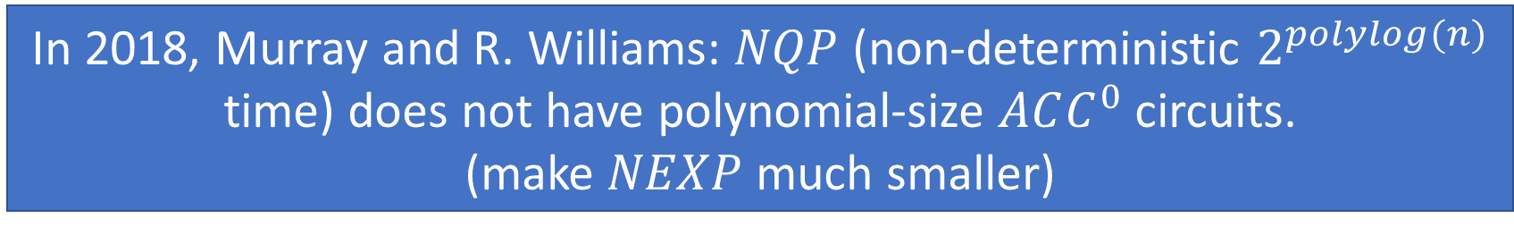
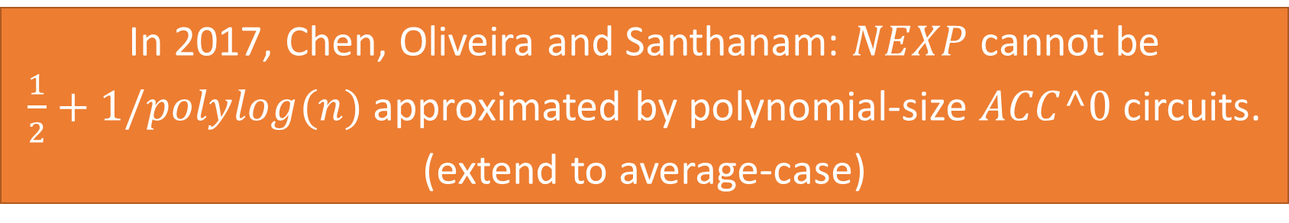
Subsequent Developments
In 2012, R. Williams: $NEXP∩coNEXP$ with 1 bit of advice
does not have polynomial-size $ACC^{0}$circuits.
(make $NEXP$ a bit smaller)
In 2017, Chen, Oliveira and Santhanam: $NEXP$ cannot be
$\frac{1}{2}+1/polylog(n)$ approximated by polynomial-size $ACC^0$ circuits.
(extend to average-case)
In 2018, Murray and R. Williams: $NQP$ (non-deterministic $2^{polylog(n)}$ time) does not have polynomial-size $ACC^{0}$ circuits.
(make $NEXP$ much smaller)
Notes:
This Chen is not me!

Slide 9
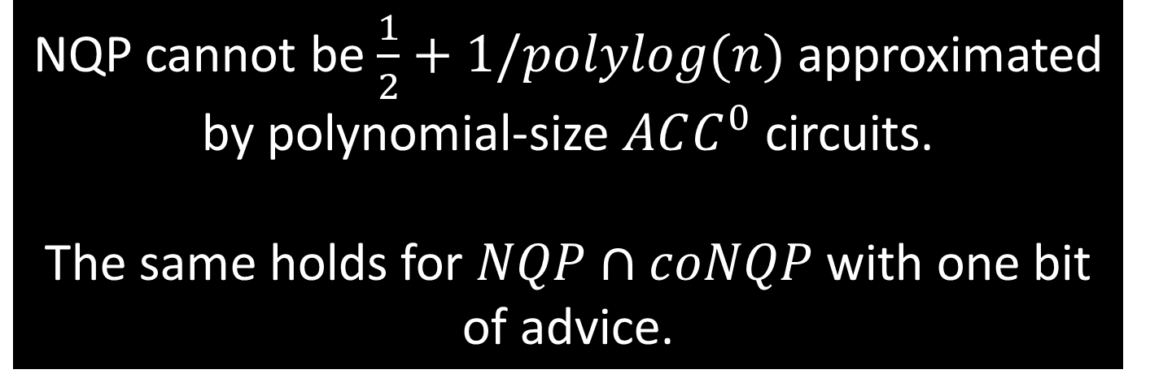
This Work
NQP cannot be $\frac{1}{2}+1/polylog(n)$ approximated by polynomial-size $ACC^{0}$ circuits.
The same holds for $NQP∩coNQP$ with one bit of advice.
Notes:
This Chen is not me!

Slide 10


Why Average-Case L.B.’s are Harder?
How previous L.B.’s worked [Wil’11]: Bird’s-Eye View
The Key Step
Assume $NQP⊆ACC^{0}$.
Apply Easy-Witness Lemma,
every $NQP$ verifiers have polynomial-size $ACC^{0}$ witness
Use that and a non-trivial algorithm to contradict non-deterministic-time hierarchy!
Notes:
This Chen is not me!

Slide 11
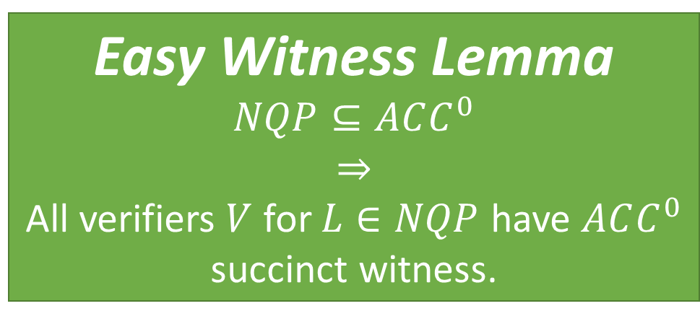
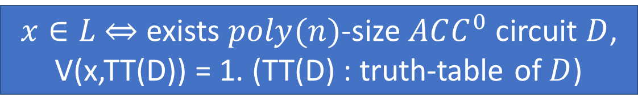
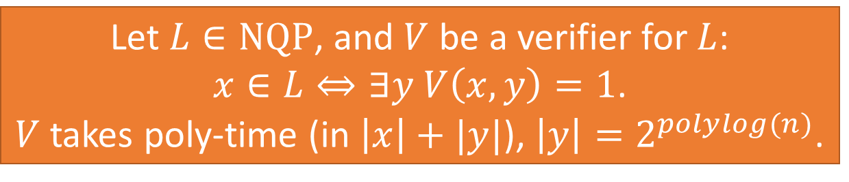
The Core: Easy Witness Lemma
Let $L∈NQP$, and $V$ be a verifier for $L$:
$x∈L⇔∃y V\left(x,y\right)=1$.
$V$ takes poly-time (in $\left|x\right|+|y|$), $\left|y\right|=2^{polylog(n)}$.
Easy Witness Lemma
$$NQP⊆ACC^{0}$$
$$⇒$$
All verifiers $V$ for $L∈NQP$ have $ACC^{0}$ succinct witness.
$x∈L$ $⇔$ exists $poly(n)$-size $ACC^{0}$ circuit $D$,
V(x,TT(D)) = 1. (TT(D) : truth-table of $D$)
Notes:
This Chen is not me!

Slide 12

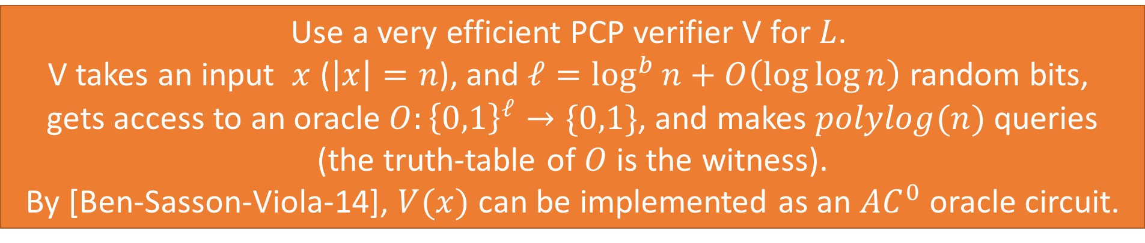
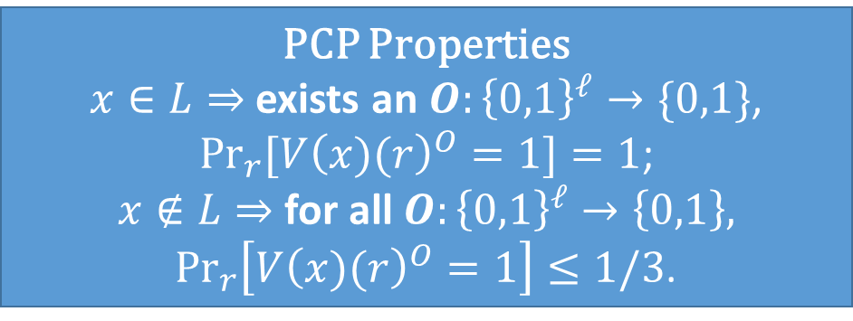
Contradicting NTIME Hierarchy via PCP
Now, assume $NQP⊆ACC^{0}$.
let $b$ be a large enough constant, and $L⊆NTIME\left[2^{\log^{b}{n}}\right]⊆NQP$.
Use a very efficient PCP verifier V for $L$.
V takes an input $x$ ($\left|x\right|=n$), and $ℓ=\log^{b}{n}+O\left(\log{\log{n}}\right)$ random bits,
gets access to an oracle $O:{\left\{0,1\right\}}^{ℓ}→\{0,1\}$, and makes $polylog(n)$ queries
(the truth-table of $O$ is the witness).
By [Ben-Sasson-Viola-14], $V(x)$ can be implemented as an $AC^{0}$ oracle circuit.
PCP Properties
$x∈L⇒$ exists an $O:{\left\{0,1\right\}}^{ℓ}→\{0,1\}$,
$\underset{r}{Pr}{[V{\left(x)(r\right)}^{O}=1]}=1$;
$x∉L⇒$ for all $O:{\left\{0,1\right\}}^{ℓ}→\left\{0,1\right\},$
$\underset{r}{Pr}\left[V{\left(x)(r\right)}^{O}=1\right]≤1/3$.
Notes:
This Chen is not me!

Slide 13
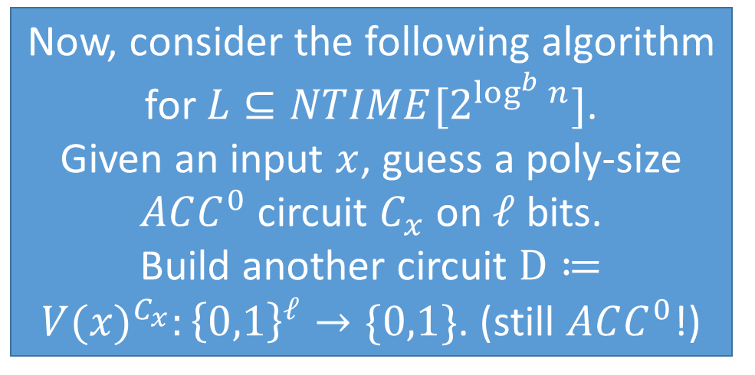
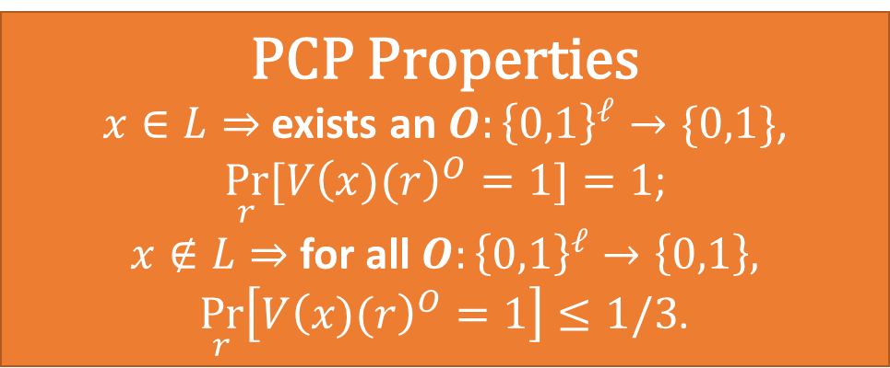
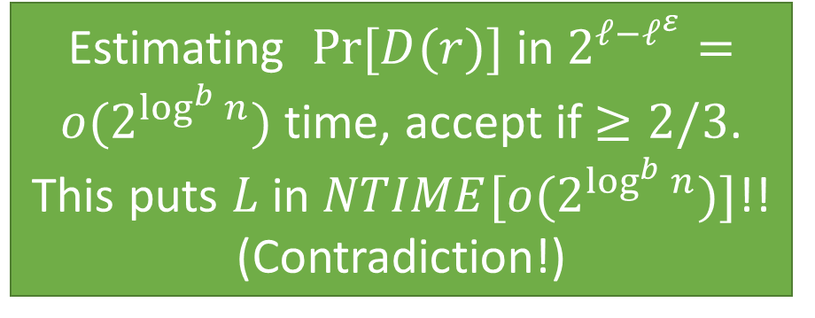
Contradicting NTIME Hierarchy via PCP
PCP Properties
$x∈L⇒$ exists an $O:{\left\{0,1\right\}}^{ℓ}→\{0,1\}$,
$\underset{r}{Pr}{[V{\left(x)(r\right)}^{O}=1]}=1$;
$x∉L⇒$ for all $O:{\left\{0,1\right\}}^{ℓ}→\left\{0,1\right\},$
$\underset{r}{Pr}\left[V{\left(x)(r\right)}^{O}=1\right]≤1/3$.
Now, consider the following algorithm for $L⊆NTIME[2^{\log^{b}{n}}]$.
Given an input $x$, guess a poly-size $ACC^{0}$ circuit $C_{x}$ on $ℓ$ bits.
Build another circuit $D≔{V(x)}^{C_{x}}:{\left\{0,1\right\}}^{ℓ}→\{0,1\}$. (still $ACC^{0}$!)
Estimating $Pr⁡[D(r)]$ in $2^{ℓ−ℓ^{ε}}=o(2^{\log^{b}{n}})$ time, accept if $≥2/3$.
This puts $L$ in $NTIME[o(2^{\log^{b}{n}})]$!! (Contradiction!)
Notes:
This Chen is not me!

Slide 14

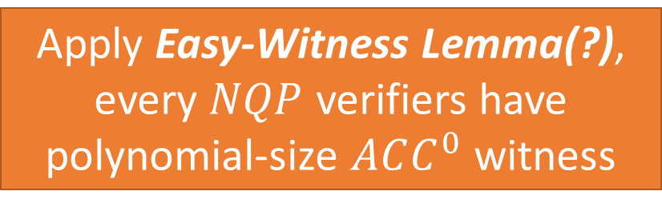
Alternative Plan?
Assume $NQP$can be approximated by $ACC^{0}$.
Problematic
Apply Easy-Witness Lemma(?),
every $NQP$ verifiers have polynomial-size $ACC^{0}$ witness
Use that and a non-trivial algorithm to contradict non-deterministic-time hierarchy!
Notes:
This Chen is not me!

Slide 15

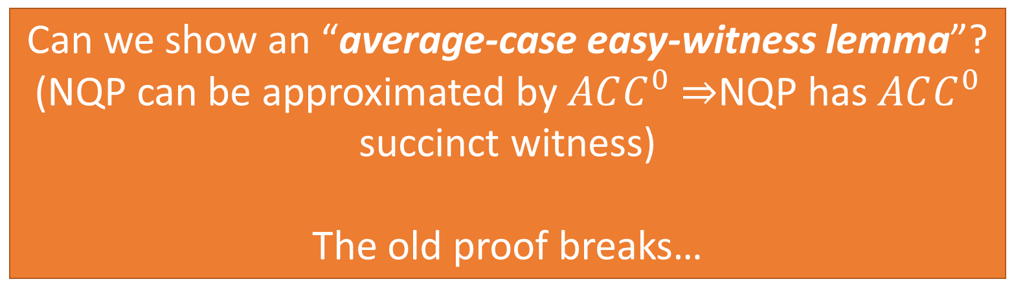

But now we can only assume $NQP$ can be approximated by $ACC^{0}$.
Can we show an “average-case easy-witness lemma”?
(NQP can be approximated by $ACC^{0}$ $⇒$NQP has $ACC^{0}$ succinct witness)
The old proof breaks…
Notes:
This Chen is not me!

Slide 16


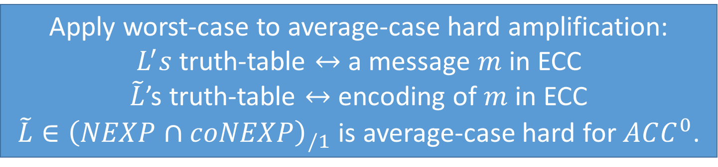
Chen-Oliveira-Santhanam’s approach:
NEXP is average-case hard for $ACC^{0}$
[COS’18]: Well, let us bypass this issue with a big weapon:
Worst-case to Average-case Hardness Amplification
Start with [Wil’14]: $L∈{\left(NEXP∩coNEXP\right)}_{/1}$ is hard for $ACC^{0}$.
Apply worst-case to average-case hard amplification:
$L^{′}s$ truth-table $↔$ a message $m$ in ECC
$\tilde{L}$’s truth-table $↔$ encoding of $m$ in ECC
$\tilde{L}∈{\left(NEXP∩coNEXP\right)}_{/1}$ is average-case hard for $ACC^{0}$.
Apply another idea to get rid of the advice to put
$\tilde{L}$ in $NEXP$.
Notes:
Say some intuition

Slide 17
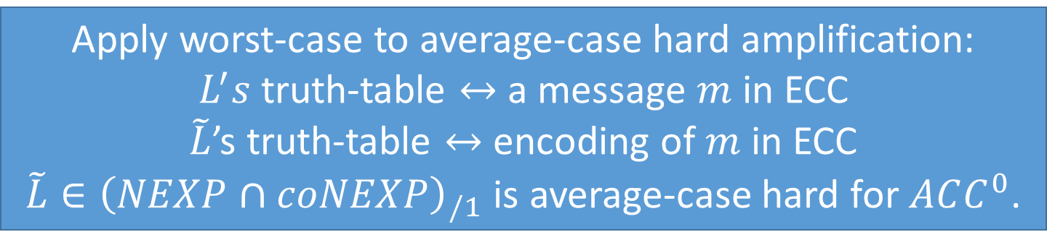
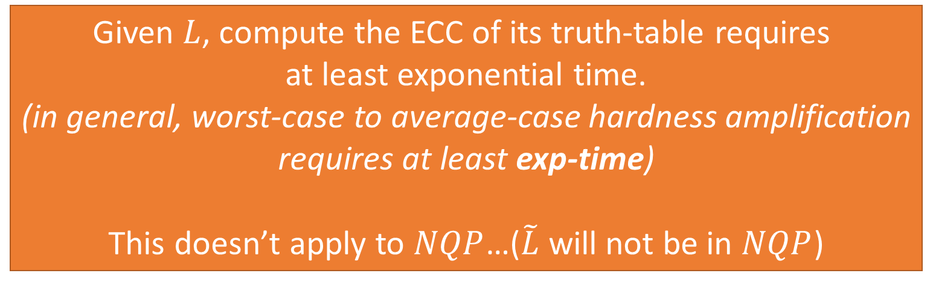
Chen-Oliveira-Santhanam’s approach:
Why it doesn’t work for NQP
Apply worst-case to average-case hard amplification:
$L^{′}s$ truth-table $↔$ a message $m$ in ECC
$\tilde{L}$’s truth-table $↔$ encoding of $m$ in ECC
$\tilde{L}∈{\left(NEXP∩coNEXP\right)}_{/1}$ is average-case hard for $ACC^{0}$.
Given $L$, compute the ECC of its truth-table requires
at least exponential time.
(in general, worst-case to average-case hardness amplification
requires at least exp-time)
This doesn’t apply to $NQP$…($\tilde{L}$ will not be in $NQP$)
Notes:
Say some intuition

Slide 18
The Difficulty
OK, we need to prove an average-case lower bound directly,
without going through either
Easy-witness Lemma (we don’t have that in average case)
Hardness Amplification (requires at least exp-time)
Umm, maybe try to start from the beginning,
and revisit how easy-witness lemma is proved?
Notes:
Say some intuition

Slide 19
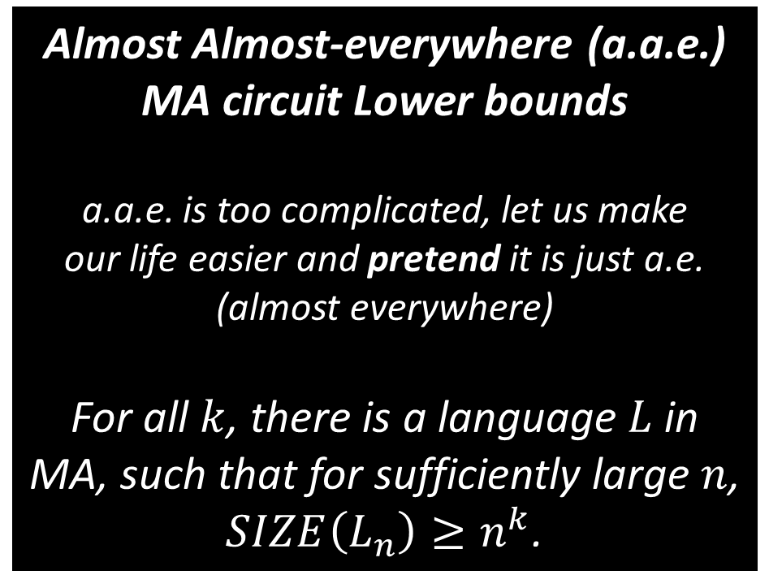
Easy-Witness Lemma
a.a.e. MA Lower Bounds vs i.o. non-deterministic PRG
Almost Almost-everywhere (a.a.e.)
MA circuit Lower bounds
a.a.e. is too complicated, let us make
our life easier and pretend it is just a.e.
(almost everywhere)
For all $k$, there is a language $L$ in MA, such that for sufficiently large $n$,
$SIZE\left(L_{n}\right)≥n^{k}$.
Infinite often (i.o.) non-deterministic PRG (NRPG)
A Non-deterministic algorithm which
either rejects, or outputs a list of inputs
which fools the target circuits.
Intuitively, can be used to i.o. derandomize an MA algorithm!
VS
Notes:
Explain what is i.o.
Explain why i.o. Non-deterministic PRG can be used to i.o. derandomize an MA algorithm

Slide 20
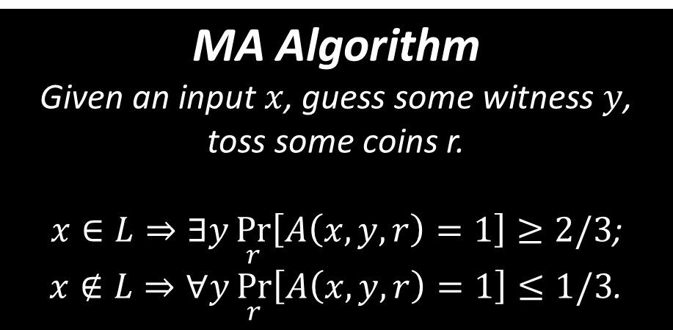
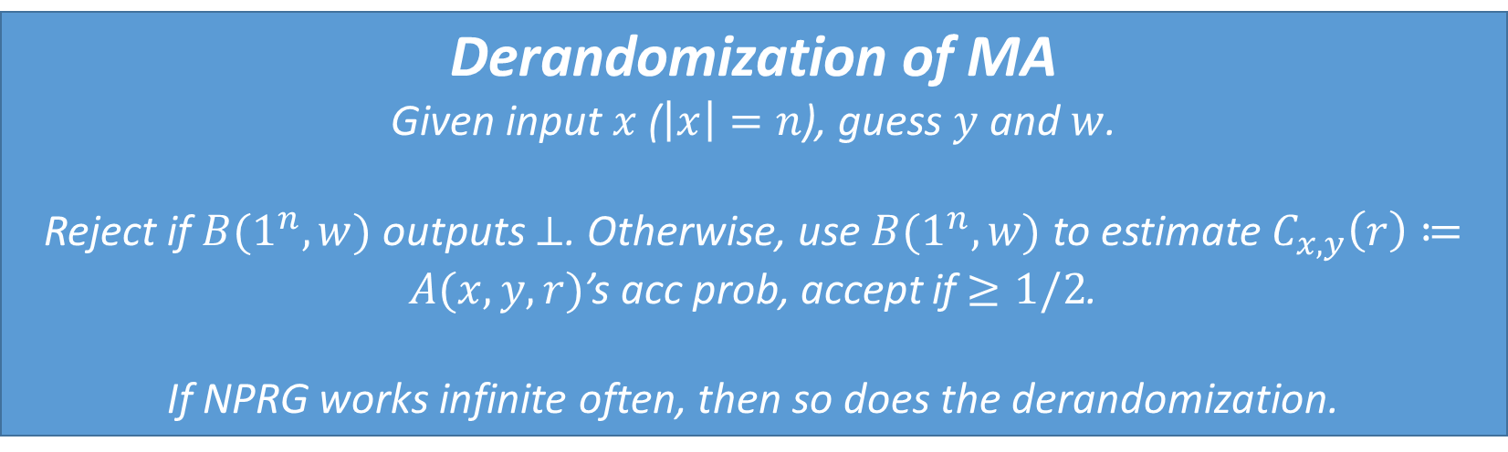
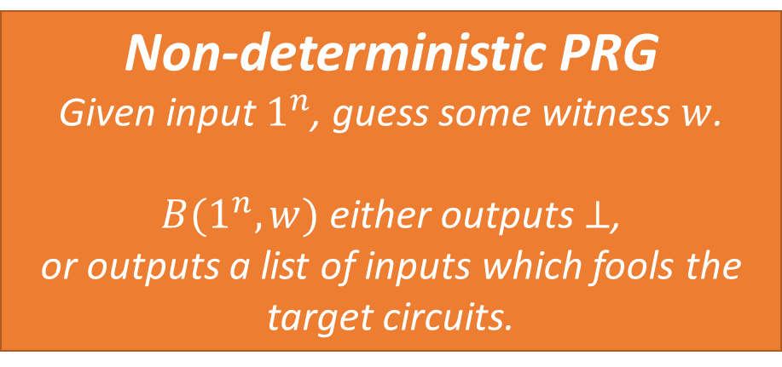
NPRG and Derandomization of MA
MA Algorithm
Given an input $x$, guess some witness $y$, toss some coins r.
$x∈L⇒∃y\underset{r}{Pr}\left[A\left(x,y,r\right)=1\right]≥2/3$;
$x∉L⇒∀y\underset{r}{Pr}\left[A\left(x,y,r\right)=1\right]≤1/3$.
Non-deterministic PRG
Given input $1^{n}$, guess some witness $w$.
$B(1^{n},w)$ either outputs $⊥$,
or outputs a list of inputs which fools the target circuits.
Derandomization of MA
Given input $x$ ($\left|x\right|=n$), guess $y$ and $w$.
Reject if $B(1^{n},w)$ outputs $⊥$. Otherwise, use $B(1^{n},w)$ to estimate $C_{x,y}\left(r\right)≔A(x,y,r)$’s acc prob, accept if $≥1/2$.
If NPRG works infinite often, then so does the derandomization.
Notes:
Explain what is i.o.
Explain why i.o. Non-deterministic PRG can be used to i.o. derandomize an MA algorithm

Slide 21
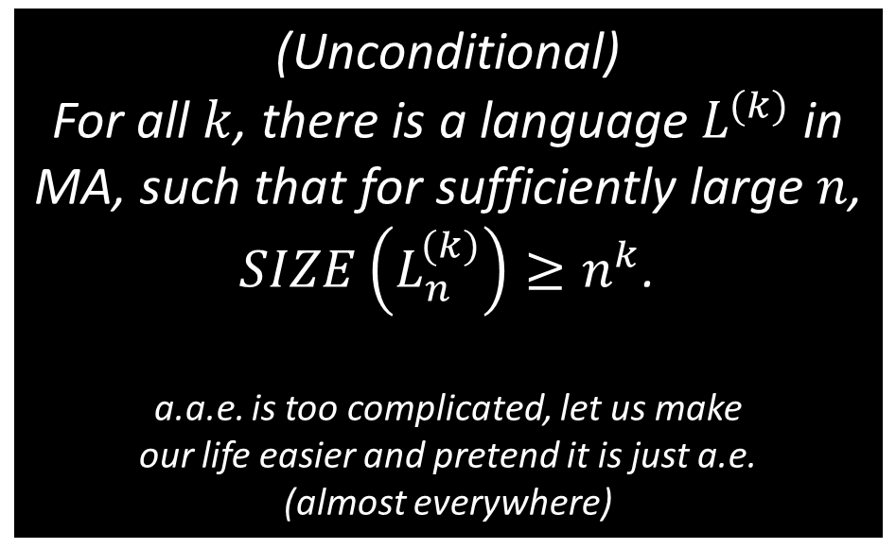
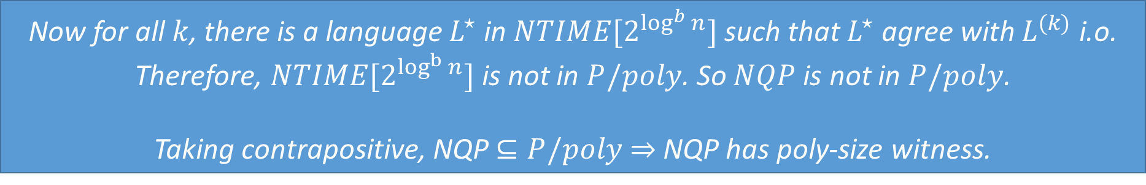
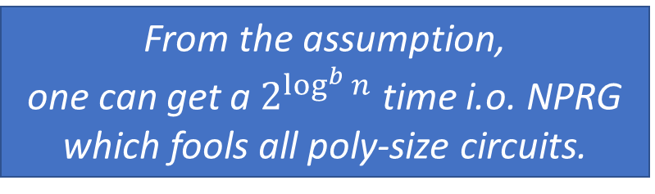
Easy-Witness Lemma
a.a.e. MA Lower Bounds vs i.o. non-deterministic PRG
(Unconditional)
For all $k$, there is a language $L^{(k)}$ in MA, such that for sufficiently large $n$,
$SIZE\left(L_{n}^{(k)}\right)≥n^{k}$.
a.a.e. is too complicated, let us make
our life easier and pretend it is just a.e.
(almost everywhere)
Assuming some NQP Verifier doesn’t have poly-size witness.
VS
From the assumption,
one can get a $2^{\log^{b}{n}}$ time i.o. NPRG which fools all poly-size circuits.
Now for all $k$, there is a language $L^{⋆}$ in $NTIME[2^{\log^{b}{n}}]$ such that $L^{⋆}$ agree with $L^{(k)}$ i.o.
Therefore, $NTIME[2^{\log^{b}{n}}]$ is not in $P/poly$. So $NQP$ is not in $P/poly$.
Taking contrapositive, NQP $⊆P/poly$ $⇒$ NQP has poly-size witness.
Notes:
Explain what is i.o.
Explain why i.o. Non-deterministic PRG can be used to i.o. derandomize an MA algorithm

Slide 22


Summary
MA a.a.e. Lower Bound and i.o. non-deterministic PRG together imply lower bound for non-deterministic time.
No succinct witness for $NQP$ implies i.o. non-deterministic PRG.
Therefore $NQP$ is not in $P/poly$.
Hence $NQP⊆$P/poly implies succinct witness for $NQP.$ (Contrapositive)
Notes:
Explain what is i.o.
Explain why i.o. Non-deterministic PRG can be used to i.o. derandomize an MA algorithm

Slide 23
The Observation
If we had an average-case a.a.e. MA circuit lower bound and an i.o. NPRG,
then we would have average-case circuit lower bounds for non-deterministic time!
Notes:
Explain what is i.o.
Explain why i.o. Non-deterministic PRG can be used to i.o. derandomize an MA algorithm

Slide 24
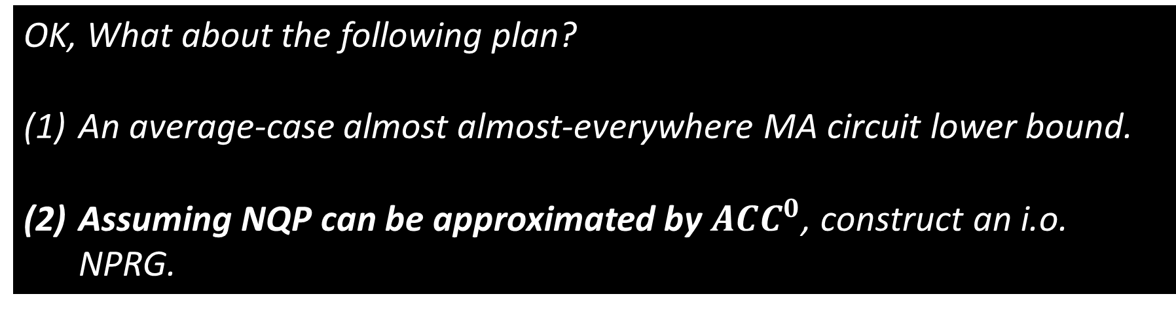
The First Attempt
OK, What about the following plan?
An average-case almost almost-everywhere MA circuit lower bound.
Assuming NQP can be approximated by $ACC^{0}$, construct an i.o. NPRG.
As it turns out, the first step is actually possible! (but still requires a technical proof)
The second step seems harder.
Notes:
Explain what is i.o.
Explain why i.o. Non-deterministic PRG can be used to i.o. derandomize an MA algorithm

Slide 25
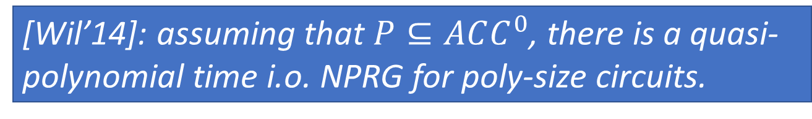
The Second Step
Assuming NQP can be approximated by $ACC^{0}$, construct an i.o. NPRG.
[Wil’14]: assuming that $P⊆ACC^{0}$, there is a quasi-polynomial time i.o. NPRG for poly-size circuits.
How is that proved?
Notes:
Explain what is i.o.
Explain why i.o. Non-deterministic PRG can be used to i.o. derandomize an MA algorithm

Slide 26
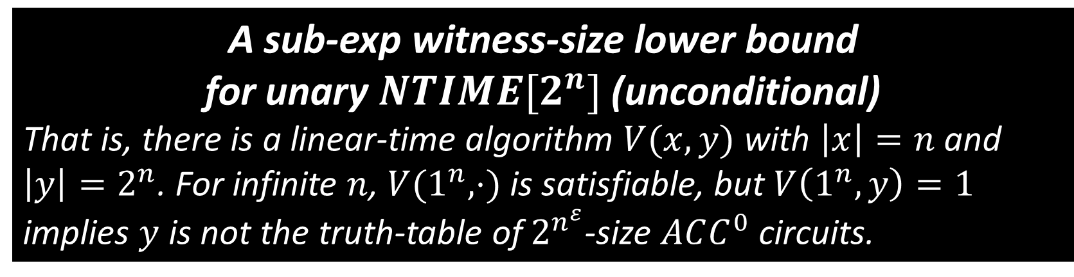


The Second Step: [Wil’14]
[Wil’14]: assuming that $P⊆ACC^{0}$, there is a quasi-polynomial time i.o. NPRG for poly-size circuits.
A sub-exp witness-size lower bound
for unary $NTIME[2^{n}]$ (unconditional)
That is, there is a linear-time algorithm $V(x,y)$ with $\left|x\right|=n$ and $\left|y\right|=2^{n}$. For infinite $n$, $V(1^{n},⋅)$ is satisfiable, but $V\left(1^{n},y\right)=1$ implies $y$ is not the truth-table of $2^{n^{ε}}$-size $ACC^{0}$ circuits.
This $V$ is a “hardness certifier” for $ACC^{0}$, under the assumption $P⊆ACC^{0}$, this is also a “hardness certifier” for general Boolean circuits.
Notes:
Because if P subseteq ACC^0, this means the general circuit-evaluation-problem is also in ACC^0. Hence, every circuit has an equivalent poly-size ACC^0!

Slide 27
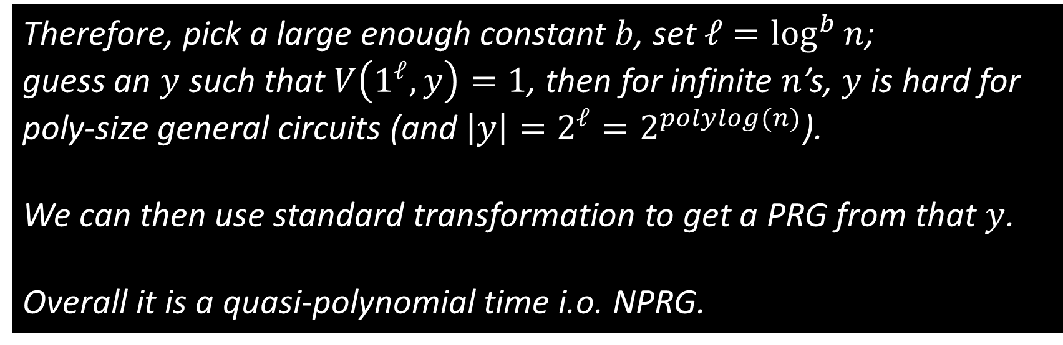
The Second Step: [Wil’14]
[Wil’14]: assuming that $P⊆ACC^{0}$, there is a quasi-polynomial time i.o. NPRG for poly-size circuits.
Therefore, pick a large enough constant $b$, set $ℓ=\log^{b}{n}$;
guess an $y$ such that $V\left(1^{ℓ},y\right)=1$, then for infinite $n$’s, $y$ is hard for poly-size general circuits (and $\left|y\right|=2^{ℓ}=2^{polylog(n)}$).
We can then use standard transformation to get a PRG from that $y$.
Overall it is a quasi-polynomial time i.o. NPRG.

Slide 28

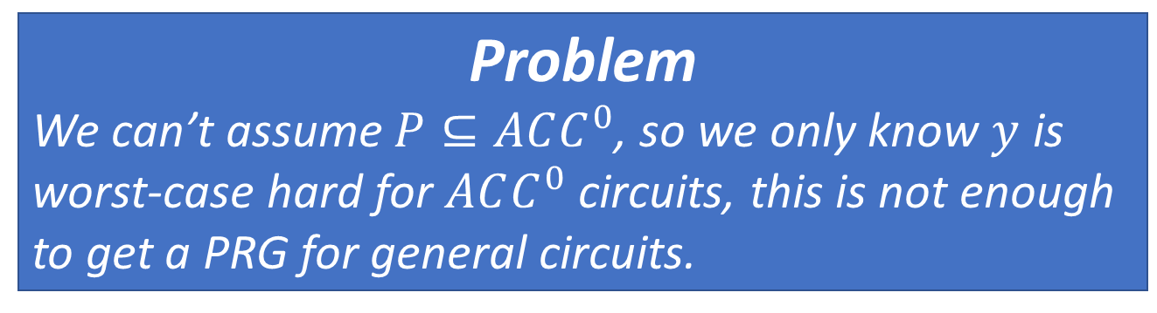
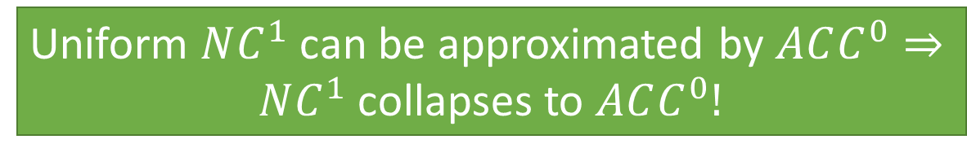

The Second Step: Our Case
Problem
We can’t assume $P⊆ACC^{0}$, so we only know $y$ is worst-case hard for $ACC^{0}$ circuits, this is not enough to get a PRG for general circuits.
OK, but at least we can get assume $NQP$ can be approximated by
$ACC^{0}$ circuits, maybe that helps?
Barrington, Kilian, Babai
There is a random self-reducible $NC^{1}$-complete problem.
Uniform $NC^{1}$ can be approximated by $ACC^{0}⇒$
$NC^{1}$ collapses to $ACC^{0}!$

Slide 29
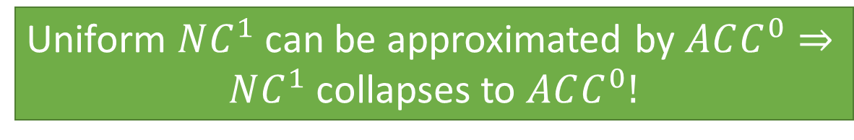
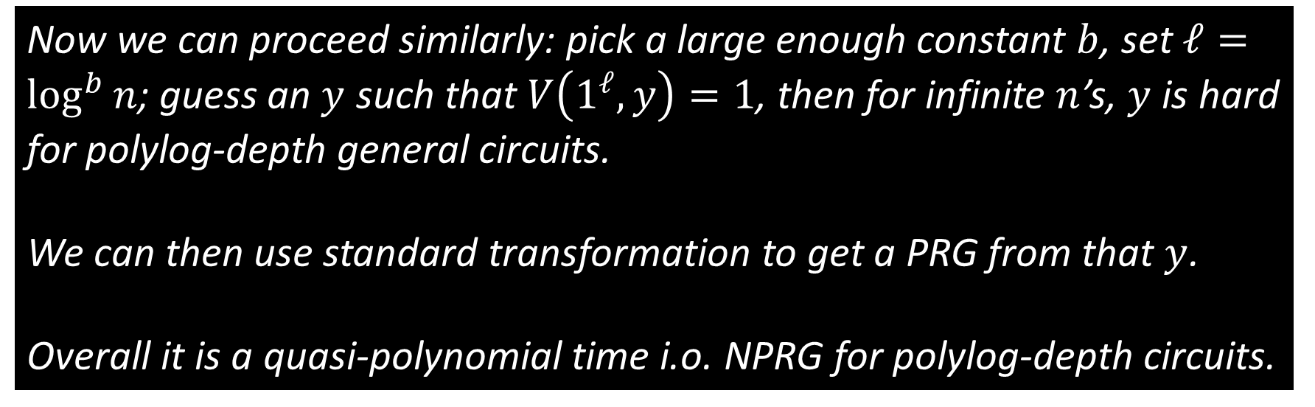
The Second Step: Our Case
Uniform $NC^{1}$ can be approximated by $ACC^{0}⇒$
$NC^{1}$ collapses to $ACC^{0}!$
Now we can proceed similarly: pick a large enough constant $b$, set $ℓ=\log^{b}{n}$; guess an $y$ such that $V\left(1^{ℓ},y\right)=1$, then for infinite $n$’s, $y$ is hard for polylog-depth general circuits.
We can then use standard transformation to get a PRG from that $y$.
Overall it is a quasi-polynomial time i.o. NPRG for polylog-depth circuits.

Slide 30
The First Attempt: Updated
OK, What about the following plan?
An average-case almost almost-everywhere MA circuit lower bound.
Assuming NQP can be approximated by $ACC^{0}$, construct an i.o. NPRG.
As it turns out, the first step is actually possible!
Under the assumption, we have an i.o. NPRG,
but only for polylog-depth circuits.
…Not enough to derandomize a general MA language…

Slide 31
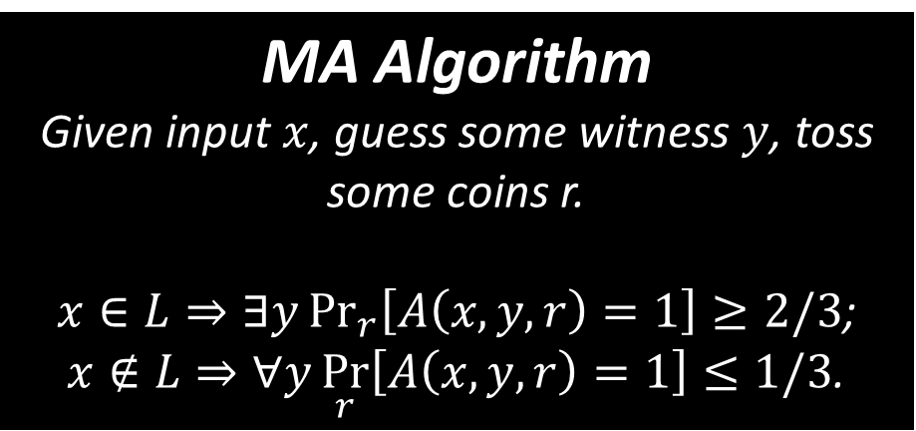
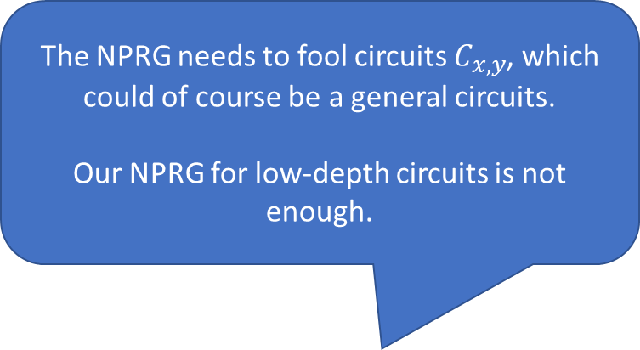
NPRG and Derandomization of MA (Recall)
MA Algorithm
Given input $x$, guess some witness $y$, toss some coins r.
$x∈L⇒∃y\underset{r}{Pr}\left[A\left(x,y,r\right)=1\right]≥2/3$;
$x∉L⇒∀y\underset{r}{Pr}\left[A\left(x,y,r\right)=1\right]≤1/3$.
Non-deterministic PRG
Given input $1^{n}$, guess some witness $w$.
$B(1^{n},w)$ either outputs $⊥$,
or outputs a list of inputs which fools the target circuits.
The NPRG needs to fool circuits $C_{x,y}$, which could of course be a general circuits.
Our NPRG for low-depth circuits is not enough.
Derandomization of MA
Given input $x$ ($\left|x\right|=n$), guess $y$ and $w$.
Reject if $B(1^{n},w)$ outputs $⊥$. Otherwise, use $B(1^{n},w)$ to estimate $C_{x,y}\left(r\right)≔A(x,y,r)$’s acc prob, accept if $≥1/2$.
If NPRG works infinite often, then so does the derandomization.

Slide 32
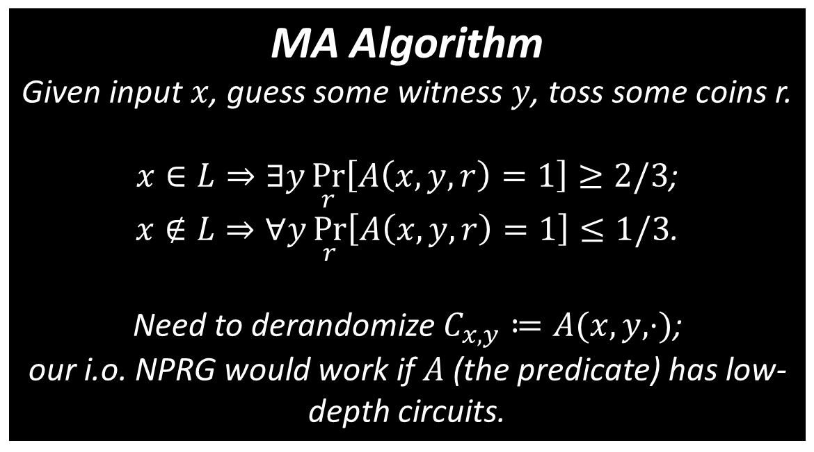
The Second Attempt
Under the assumption, we have an i.o. NPRG,
but only for polylog-depth circuits.
…Not enough to derandomize a general MA language…
MA Algorithm
Given input $x$, guess some witness $y$, toss some coins r.
$x∈L⇒∃y\underset{r}{Pr}\left[A\left(x,y,r\right)=1\right]≥2/3$;
$x∉L⇒∀y\underset{r}{Pr}\left[A\left(x,y,r\right)=1\right]≤1/3$.
Need to derandomize $C_{x,y}≔A(x,y, ⋅)$;
our i.o. NPRG would work if $A$ (the predicate) has low-depth circuits.

Slide 33
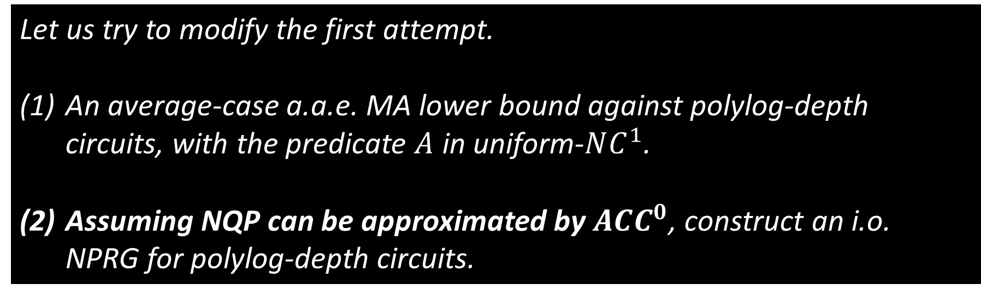
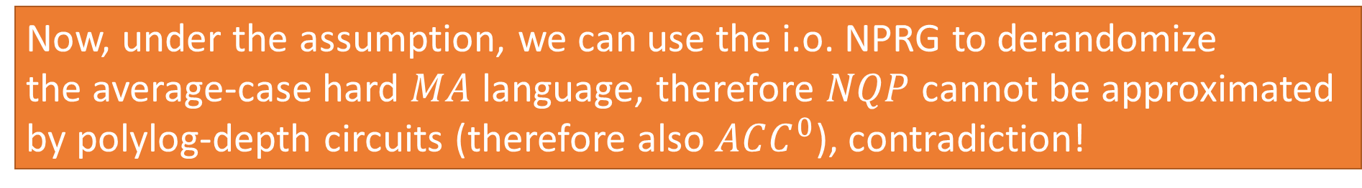
The Second Attempt
Let us try to modify the first attempt.
An average-case a.a.e. MA lower bound against polylog-depth circuits, with the predicate $A$ in uniform-$NC^{1}$.
Assuming NQP can be approximated by $ACC^{0}$, construct an i.o. NPRG for polylog-depth circuits.
Now, under the assumption, we can use the i.o. NPRG to derandomize
the average-case hard $MA$ language, therefore $NQP$ cannot be approximated
by polylog-depth circuits (therefore also $ACC^{0}$), contradiction!

Slide 34

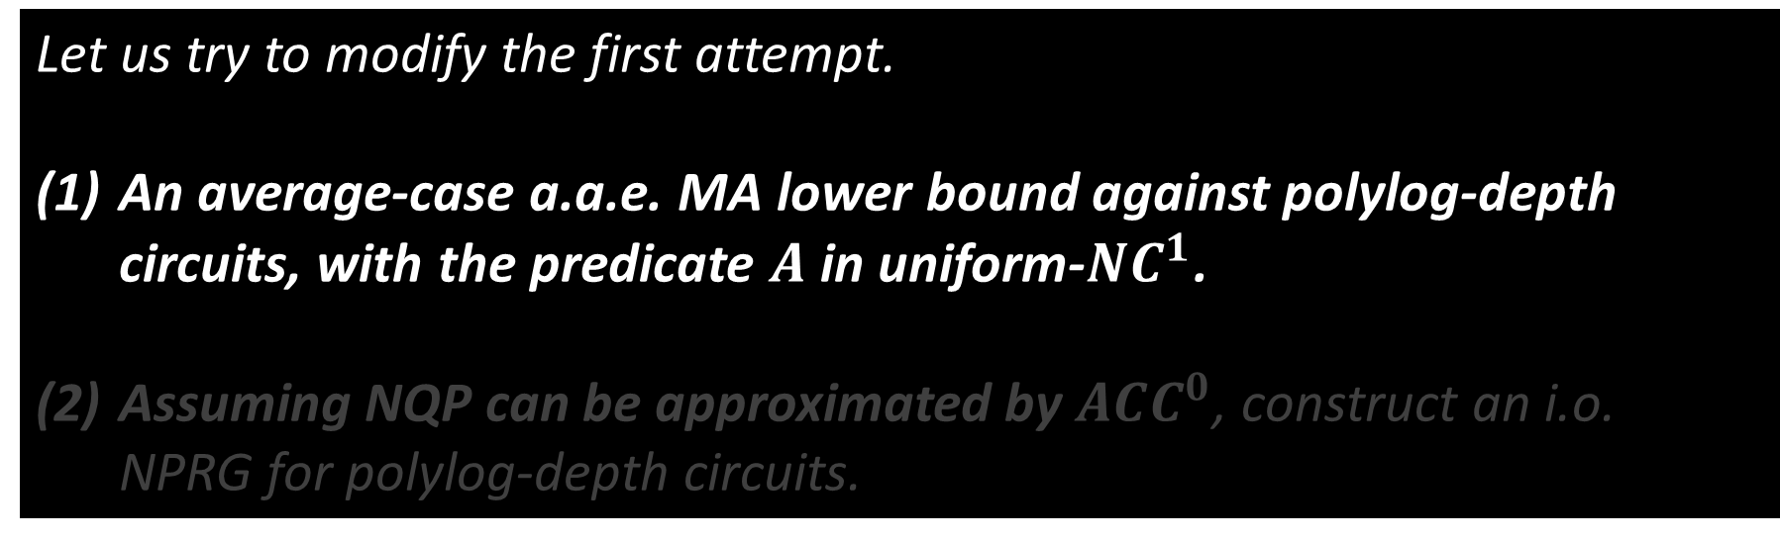
The Second Attempt
Let us try to modify the first attempt.
An average-case a.a.e. MA lower bound against polylog-depth circuits, with the predicate $A$ in uniform-$NC^{1}$.
Assuming NQP can be approximated by $ACC^{0}$, construct an i.o. NPRG for polylog-depth circuits.
In the rest of the talk, we try to outline a proof for the simpler
case without the a.a.e. requirement.

Slide 35

Average-Case MA Lower Bound
In the rest of the talk, we will try to outline a proof for the simpler case without the a.a.e. requirement.
A Baby Version
For all constants $k$, there is a language $L∈MA_{/1}$ such that
(1) $L$ has an $NC^{1}$-computable predicate $A$ ($L$ is defined by $A(x,y,z)$);
(2) $L$ cannot be $0.99$-approximated by $k\log{n}$-depth circuits.

Slide 36

Some technical details
are coming

Slide 37


Key Ingredient in [San’07]: A PSPACE-complete problem with an instance-checker
[San’07]
For all $k$, $MA_{/1}$ is average-case hard for $SIZE\left(n^{k}\right).$
We are going to build on this.
(the one-bit advice is not important for us)
[TV’02]
There is a PSPACE-complete problem $L^{PSPACE}$,
with an efficient instance checker.

Slide 38



The key ingredient: A PSPACE-complete problem
with an instance-checker
Instance-Checker $M$
Given an input $x$ and an (alleged) oracle $O$ to $L^{PSPACE}$, $M{\left(x\right)}^{O}$ tosses some coins, makes some queries to $O_{|x|}$ (!), and outputs something in $\{0,1,?\}$. ($?$ means I don’t know)
(Completeness) If $O=L^{PSPACE}$, w.h.p. $M{\left(x\right)}^{O}$ outputs $L^{PSPACE}$(x);
(Correct when given the good oracle)
(Soundness) For all $O$, $M{\left(x\right)}^{O}$ outputs something in $\{?, L^{PSPACE}(x)\}$ w.h.p.
(Make few mistakes when given the wrong oracle, can says I don’t know)

Slide 39




Why Instance-checker?
Suppose $L_{n}^{PSPACE}$ has an $S$-size circuit.
Given an input $x$;
Guess an $S$-size circuit $C_{n}$;
Toss some coins $r$;
Accept if $M{\left(x,r\right)}^{C_{n}}=1$.
An $MA$ algorithm for $L_{n}^{PSPACE}$
(indeed, $MA∩coMA$)
When $L_{n}^{PSPACE}\left(x\right)=1$, on the correct guess, we accept w.h.p.
When $L_{n}^{PSPACE}\left(x\right)=0$, we reject w.h.p. on all guesses.

Slide 40


The key ingredient: A PSPACE-complete problem
with an instance-checker
[San’07] – Two Cases
$PSPACE⊆P/poly$ ($L^{PSPACE}$ is easy).
$MA=PSPACE$, it is a folklore result that for all $k$, $PSPACE$ is average-case hard for $n^{k}$-size circuits.
(2) $PSPACE$ not in $P_{/poly}$($L^{PSPACE}$ is hard).
For all $k,$ there is an infinite sequence $\{n_{i}\}$ such that $SIZE\left(L_{n_{i}}^{PSPACE}\right)≥n_{i}^{k}$.

Slide 41



The key ingredient: A PSPACE-complete problem
with an instance-checker
(2) $PSPACE$ not in $P_{/poly}$($L^{PSPACE}$ is hard).
For all $k,$ there is an infinite sequence $\{n_{i}\}$ such that $SIZE\left(L_{n_{i}}^{PSPACE}\right)≥n_{i}^{k}$.
Let $S_{i}=SIZE(L_{n_{i}}^{PSPACE})$.
On input of length $S_{i}^{1/k}$:
Try to compute $L_{n_{i}}^{PSPACE}$ on the first $n_{i}$ bits. ($S_{i}^{1/k}≥n_{i}$)
Guess an $S_{i}$-size circuit, and check that using the instance-checker.
$L$ is in $MA. L$ is worst-case hard for $n^{k}$-size circuits.
$L^{PSPACE}$ is in fact a polynomial, with error correction.
$⇒$L is also average-case hard for $n^{Ω(k)}$-size circuits.

Slide 42


Our Adaption (For the Baby Version)
A Baby Version
For all constants $k$, there is a language $L∈MA_{/1}$ such that
(1) $L$ has an $NC^{1}$-computable predicate $A$ ($L$ is defined by $A(x,y,z)$);
(2) $L$ cannot be $0.99$-approximated by $k\log{n}$-depth circuits.
Our Two Cases
$PSPACE⊆NC^{1}$ ($L^{PSPACE}$ is easy).
$PSPACE$ not in $NC^{1}$ ($L^{PSPACE}$ is hard).

Slide 43




Key: The Complexity of the Predicate A
Suppose $L_{n}^{PSPACE}$ has a $D$-depth circuit.
Given an input $x$;
Guess a $D$-depth circuit $C_{n}$;
Toss some coins $r$;
Accept if $M{\left(x,r\right)}^{C_{n}}=1$.
An $MA$ algorithm for $L_{n}^{PSPACE}$
(indeed, $MA∩coMA$)
When $L_{n}^{PSPACE}\left(x\right)=1$, on the correct guess, we accept w.h.p.
When $L_{n}^{PSPACE}\left(x\right)=0$, we reject w.h.p. on all guesses.
Key Observation: $M$ can be implemented in $NC^{1}$!
So the whole predicate $A$ can be as well.

Slide 44



Adapted Analysis for case (2)
(2) $PSPACE$ not in $NC^{1}$($L^{PSPACE}$ is hard).
For all $k,$ there is an infinite sequence $\{n_{i}\}$ such that $DEPTH\left(L_{n_{i}}^{PSPACE}\right)≥k⋅\log{n_{i}}$.
Let $S_{i}=2^{DEPTH\left(L_{n_{i}}^{PSPACE}\right)}$.
On input of length $S_{i}^{1/k}$:
Try to compute $L_{n_{i}}^{PSPACE}$ on the first $n_{i}$ bits. ($S_{i}^{1/k}≥n_{i}$)
Guess a $DEPTH\left(L_{n_{i}}^{PSPACE}\right)$ depth circuit, and check that using the instance-checker.
$L$ is in $MA. L$ is worst-case hard for $k\log{n}$-depth circuits.
$L^{PSPACE}$ is in fact a polynomial, with error correction.
$⇒$L is also average-case hard for $Ω(k\log{n})$-depth circuits.

Slide 45


Extension to other circuit classes
The only property we used of $ACC^{0}$ circuits, is the non-trivial derandomization algorithm for this class; the lower bound can be extended to any other circuit class if we have the corresponding algorithms.
Therefore, our average-case lower bounds also work for the
$ACC^{0}∘THR$ circuits, ($ACC^{0}$ circuits with a layer of $THR$ gates at the bottom).

Slide 46


What is missing in the talk
(1) The proof still need to adapted to the “almost almost everywhere” case. (indeed this is complicated and highly non-trivial.)
(2) The original $PSPACE$-complete language is actually a bunch
of polynomials, instead of a single polynomial. Need to modify
that construction carefully. (lengthy but straightforward)
(3) Still need to do some mild hardness amplification to get
$\frac{1}{2}+1/polylog(n)$ inapproximability. (standard)

Slide 47

Open Questions
(1) (Open Ended) Any other ways to construct i.o. NPRG under some assumptions? They may lead to more circuit lower bounds.
(2) More average-case lower bounds from this paradigm?
Average-case lower bounds for neural networks (an ongoing work)
(3) Unconditional quasi-polynomial time Non-deterministic PRG for $ACC^{0}?$
[Chen-Oliveira-Santhanam]: a non-trivial NPRG. ($n−n^{1−δ}$ seed length)
Can we do better?

Slide 48
Thanks! Any Questions?

