Slide 1
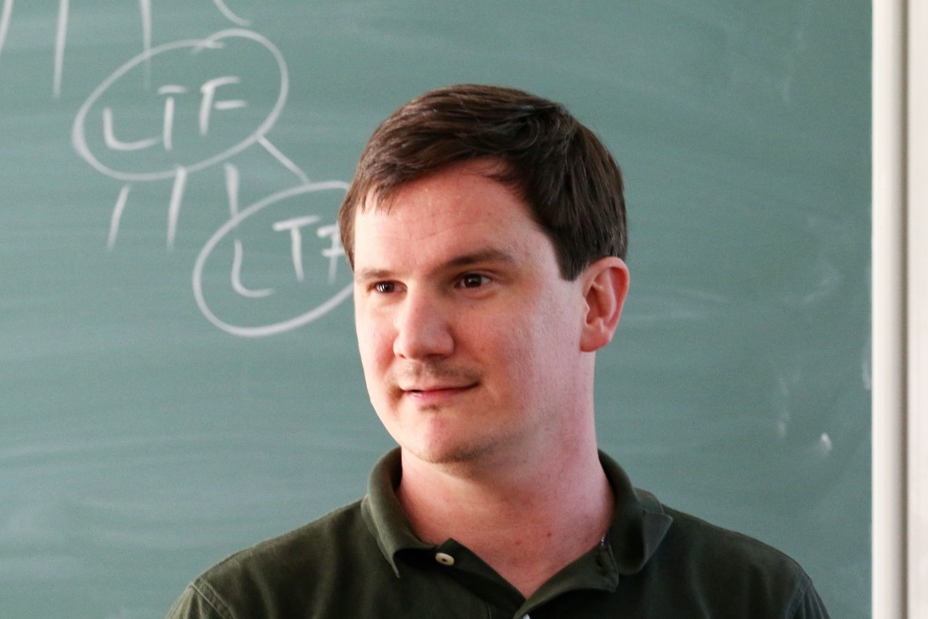

Stronger Connections Between Circuit Analysis and Circuit Lower Bounds, via PCPs of Proximity
Lijie Chen
Ryan Williams

Slide 2
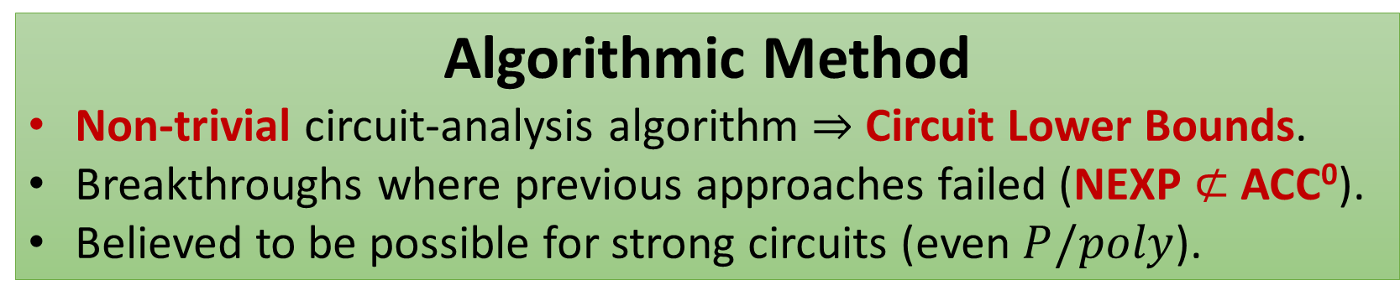
Context: The Algorithmic Method for Proving Circuit Lower Bounds
Proving limitations on non-uniform circuits is extremely hard.
Prior approaches (restrictions, polynomial approximations, etc.) face barriers (Relativization, Algebrization, Natural Proofs).
Algorithmic Method
Non-trivial circuit-analysis algorithm $⇒$ Circuit Lower Bounds.
Breakthroughs where previous approaches failed (NEXP $⊄$ ACC⁰).
Believed to be possible for strong circuits (even $P/poly$).
Notes:
Explain the green box better

Slide 3
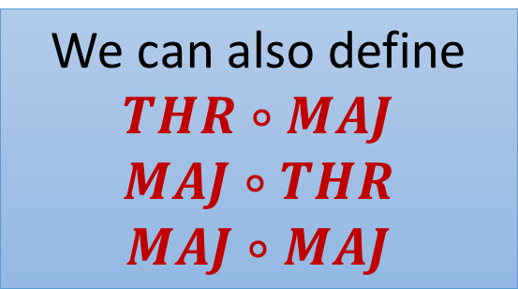

Context: A Frontier of Circuit Complexity, Depth-2 Threshold Circuits
THR gates : $f\left(x\right)=\left[w⋅x≥t\right]$ $w∈Z^{n}$, $t∈Z$.
MAJ gates : when $w_{i}$’s and $t$ are bounded by poly(n).
THR$∘$THR
We can also define
$$THR∘MAJ$$
$$MAJ∘THR$$
$$MAJ∘MAJ$$
THR
THR
THR
THR
Notes:
Don’t say too many words here..

Slide 4

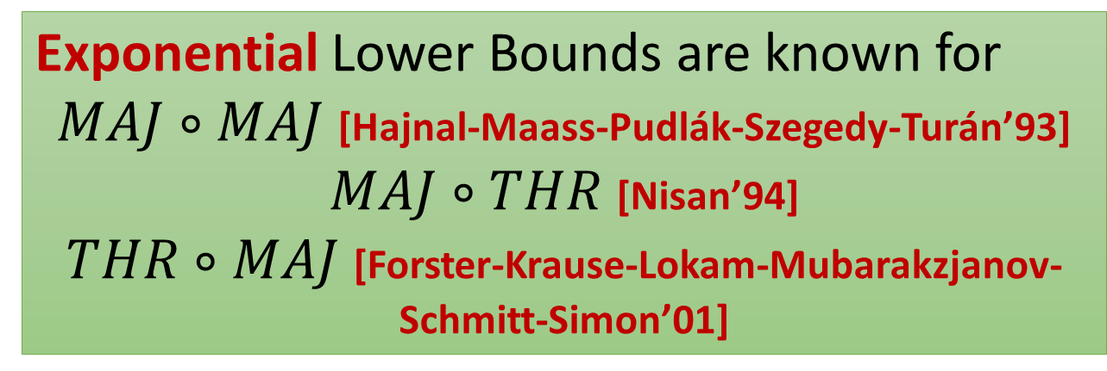
Context: A Frontier of Circuit Complexity, Depth-2 Threshold Circuits
Exponential Lower Bounds are known for
$MAJ∘MAJ$ [Hajnal-Maass-Pudlák-Szegedy-Turán’93]
$MAJ∘THR$ [Nisan’94]
$THR∘MAJ$ [Forster-Krause-Lokam-Mubarakzjanov-Schmitt-Simon’01]
NEXP
Non-deterministic
Exponential Time.
Frontier Open Question: Is NEXP $⊆THR∘THR$?
Potential Approaches in this talk.

Slide 5
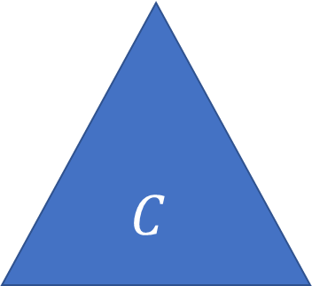
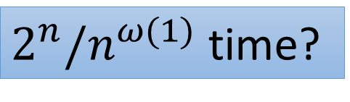


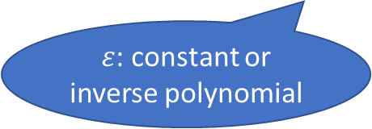
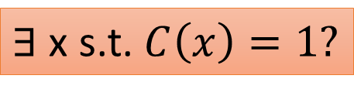
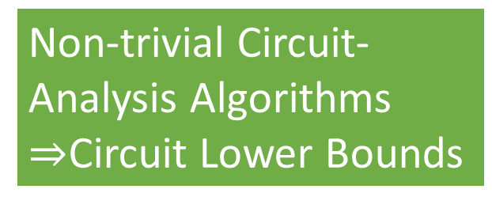
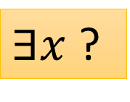

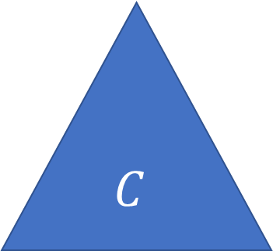
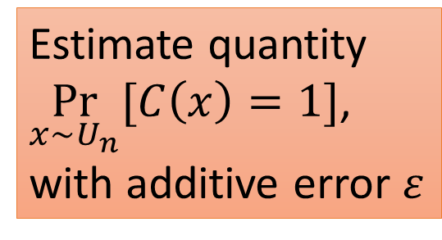
Motivation: Apply the Algorithmic Method to THR of THR?
What Circuit-Analysis Tasks?
Non-trivial Circuit-
Analysis Algorithms
$⇒$Circuit Lower Bounds
$ℭ$-SAT
$ℭ$-CAPP
Derandomization!!
$$C$$
$$C$$
Estimate quantity
$\underset{x∼U_{n}}{Pr}{[C\left(x\right)=1]}$,
with additive error $ε$
$∃$ x s.t. $C\left(x\right)=1?$
$ε$: constant or inverse polynomial
$2^{n}/n^{ω(1)}$ time?
$∃x$ ?
$$x∼U_{n}$$
Notes:
You can think about eps as a constant or inverse polynomial

Slide 6

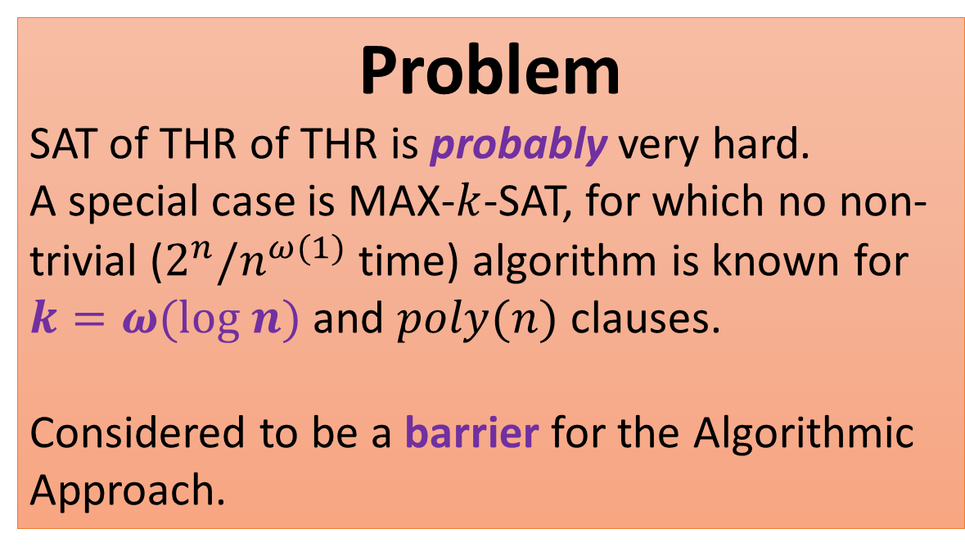


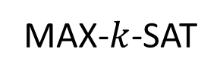

Motivation: Apply the Algorithmic Method to THR of THR?
Most previous work on the algorithmic method exploits SAT algorithms.
Problem
SAT of THR of THR is probably very hard.
A special case is MAX-$k$-SAT, for which no non-trivial ($2^{n}/n^{ω(1)}$ time) algorithm is known for $k=ω(log n)$ and $poly(n)$ clauses.
Considered to be a barrier for the Algorithmic Approach.
THR$∘$THR
THR
THR
THR
THR
MAX-$k$-SAT
MAJ
$$OR_{k}$$
$$OR_{k}$$
$$OR_{k}$$
Notes:
Put a graph here!

Slide 7
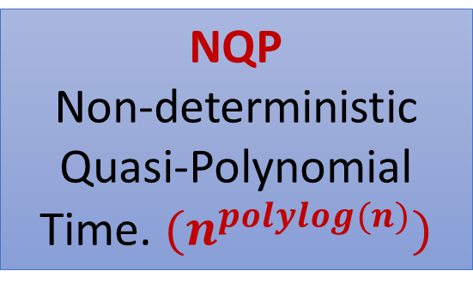
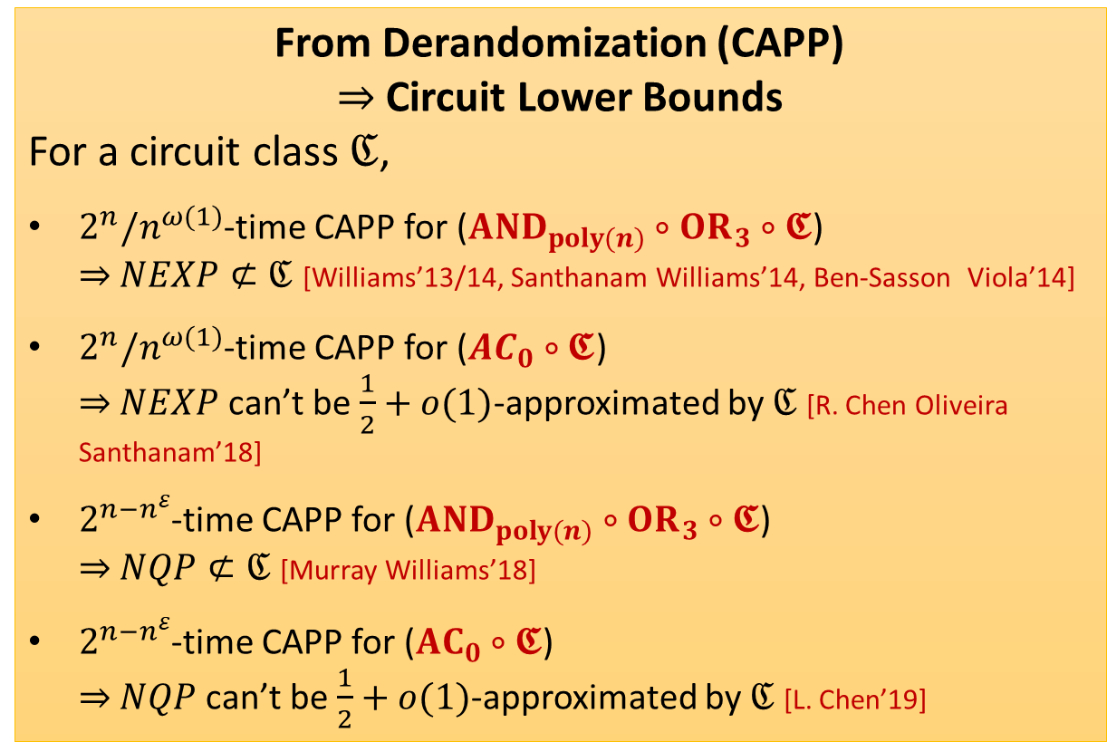
Motivation: Apply the Algorithmic Method to THR of THR?
SAT of THR of THR : probably very hard
From Derandomization (CAPP)
$⇒$ Circuit Lower Bounds
For a circuit class $ℭ$,
$2^{n}/n^{ω(1)}$-time CAPP for ($AND_{poly(n)}∘OR_{3}∘𝕮$) $⇒$ $NEXP⊄ℭ$ [Williams’13/14, Santhanam Williams’14, Ben-Sasson Viola’14]
$2^{n}/n^{ω(1)}$-time CAPP for (${AC}_{0}∘𝕮$) $⇒$ $NEXP$ can’t be $\frac{1}{2}+o(1)$-approximated by $ℭ$ [R. Chen Oliveira Santhanam’18]
$2^{n−n^{ε}}$-time CAPP for ($AND_{poly(n)}∘OR_{3}∘𝕮$) $⇒$ $NQP⊄ℭ$ [Murray Williams’18]
$2^{n−n^{ε}}$-time CAPP for (${AC}_{0}∘𝕮$) $⇒$ $NQP$ can’t be $\frac{1}{2}+o(1)$-approximated by $ℭ$ [L. Chen’19]
But derandomization is widely believed to be possible.
NQP
Non-deterministic
Quasi-Polynomial Time. $(n^{polylog(n)})$

Slide 8

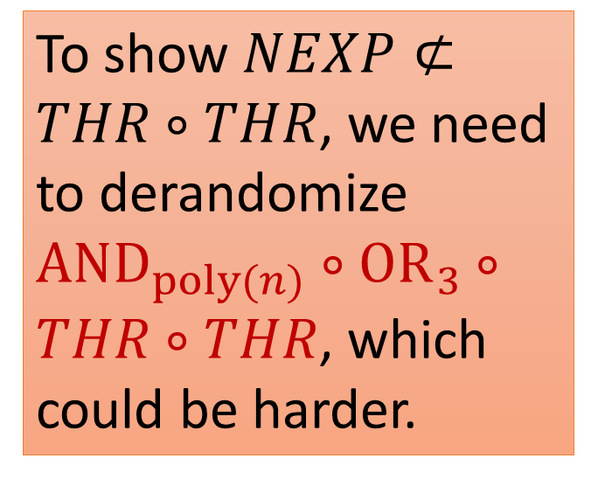
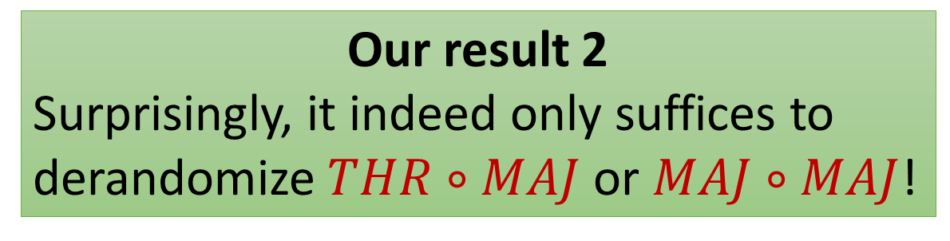
Back to THR of THR
SAT of THR of THR : probably very hard
To show $NEXP⊄THR∘THR$, we need to derandomize $AND_{poly(n)}∘OR_{3}∘THR∘THR$, which could be harder.
Our result 1
It suffices to derandomize $THR∘THR$.
Our result 2
Surprisingly, it indeed only suffices to derandomize $THR∘MAJ$ or $MAJ∘MAJ$!

Slide 9
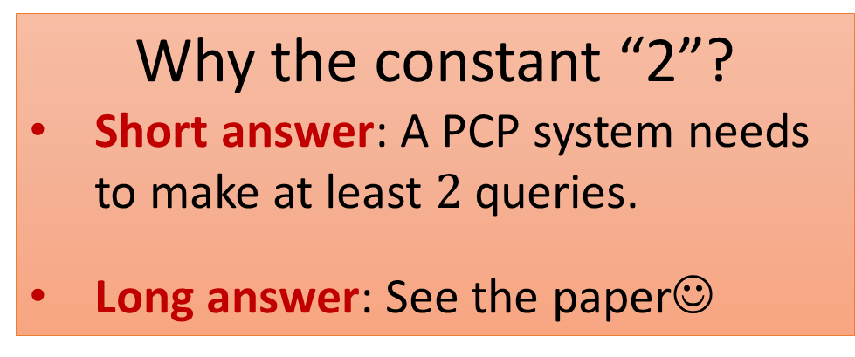
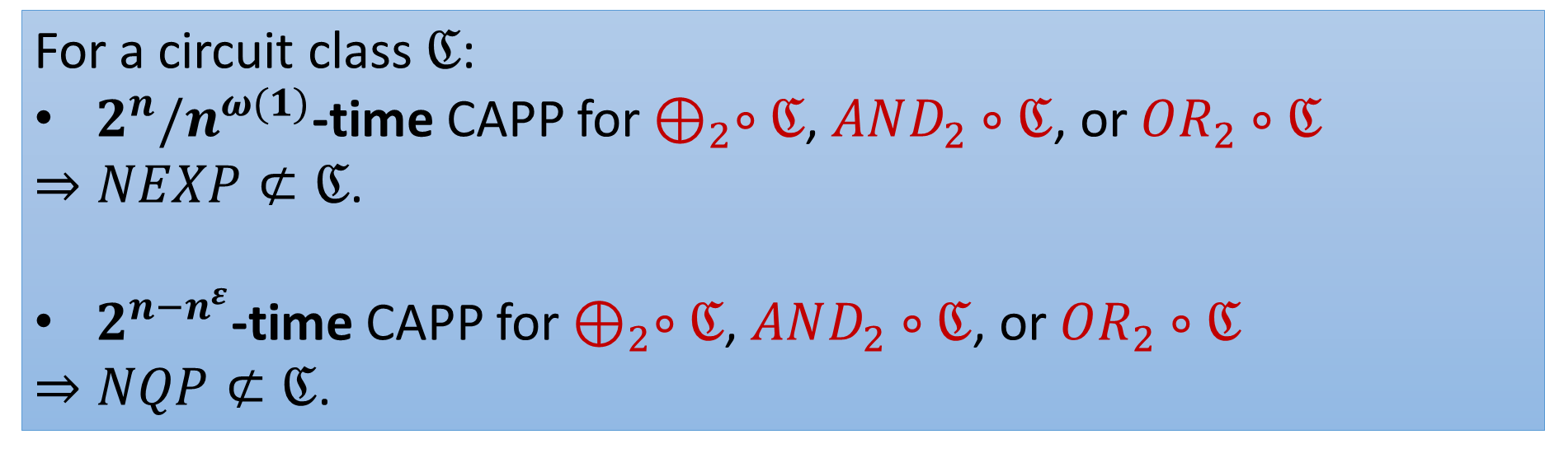
General Result: A Stronger Connection Between Circuit-Analysis Algorithms and Circuit Lower Bounds
For a circuit class $ℭ$:
$2^{n}/n^{ω(1)}$-time CAPP for $⊕_{2}∘ℭ$, $AND_{2}∘ℭ$, or $OR_{2}∘ℭ$
$⇒NEXP⊄ℭ$.
$2^{n−n^{ε}}$-time CAPP for $⊕_{2}∘ℭ$, $AND_{2}∘ℭ$, or $OR_{2}∘ℭ$
$⇒NQP⊄ℭ$.
Why the constant “2”?
Short answer: A PCP system needs to make at least $2$ queries.
Long answer: See the paper☺

Slide 10
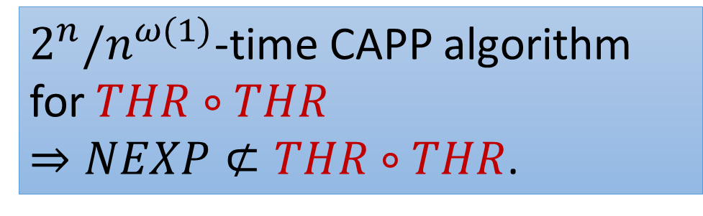
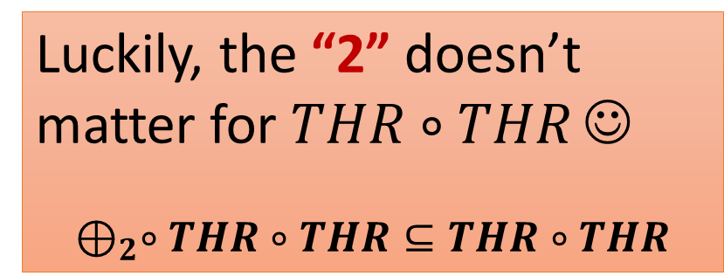
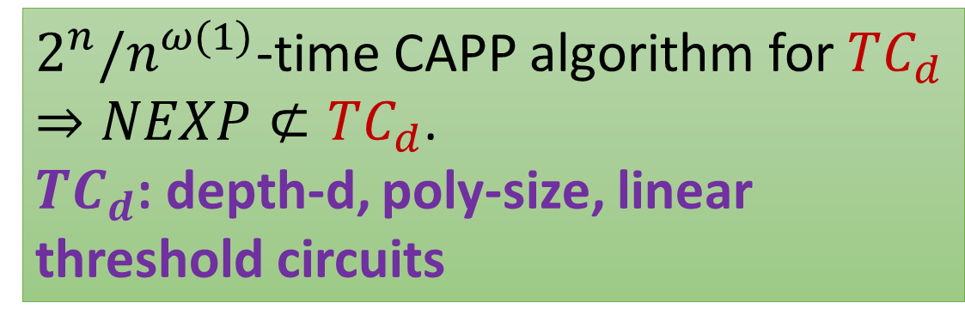
Tighter Connections for Algorithms/Lower Bounds for THR of THR
$2^{n}/n^{ω(1)}$-time CAPP algorithm for $THR∘THR$
$⇒NEXP⊄THR∘THR$.
Luckily, the “2” doesn’t matter for $THR∘THR$ ☺
$$⊕_{2}∘THR∘THR⊆THR∘THR$$
$2^{n}/n^{ω(1)}$-time CAPP algorithm for $TC_{d}$
$⇒NEXP⊄TC_{d}$.
$TC_{d}$: depth-d, poly-size, linear threshold circuits

Slide 11

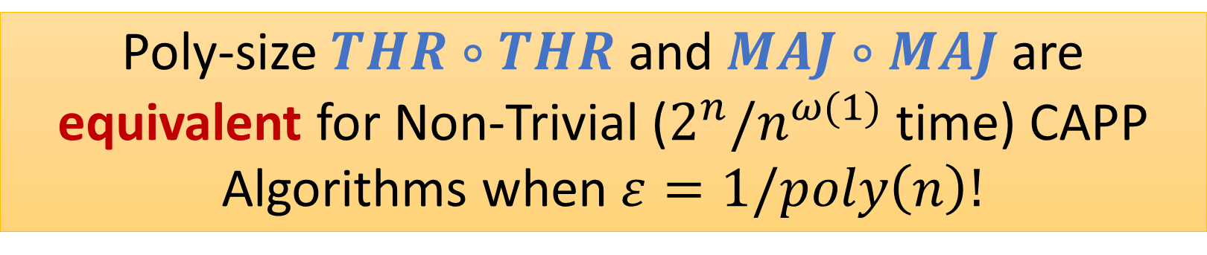
Let Us Make Our Life Even Easier
Poly-size $THR∘THR$ and $MAJ∘MAJ$ are equivalent for Non-Trivial ($2^{n}/n^{ω(1)}$ time) CAPP Algorithms when $ε=1/poly\left(n\right)!$
THR
MAJ
THR
THR
THR
MAJ
MAJ
MAJ
Proved by new structure lemmas for $THR∘THR$

Slide 12
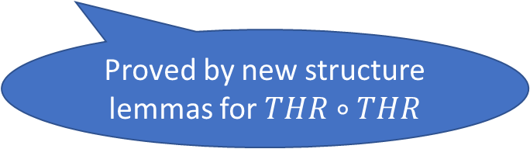
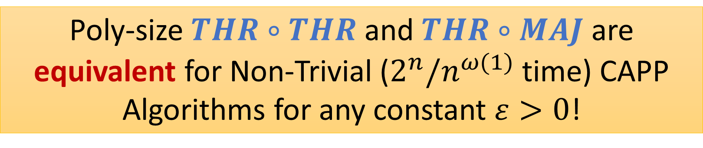
Let Us Make Our Life Even Easier
Poly-size $THR∘THR$ and $THR∘MAJ$ are equivalent for Non-Trivial ($2^{n}/n^{ω(1)}$ time) CAPP Algorithms for any constant $ε>0$!
THR
THR
THR
THR
THR
MAJ
MAJ
MAJ
Proved by new structure lemmas for $THR∘THR$

Slide 13
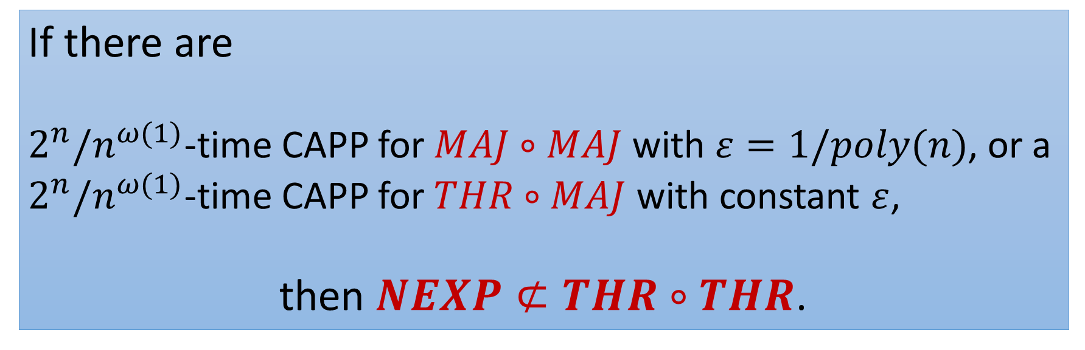
Corollary
If there are
$2^{n}/n^{ω(1)}$-time CAPP for $MAJ∘MAJ$ with $ε=1/poly(n)$, or a $2^{n}/n^{ω(1)}$-time CAPP for $THR∘MAJ$ with constant $ε$,
then $NEXP⊄THR∘THR$.

Slide 14

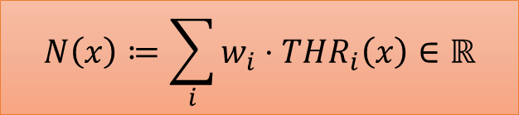


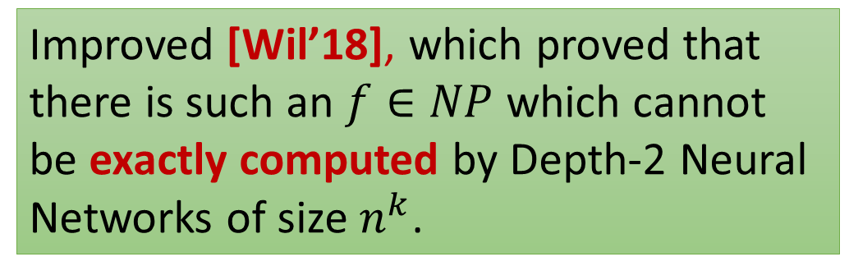

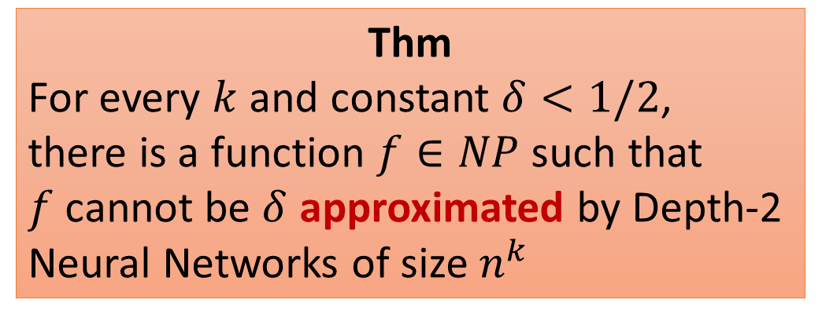




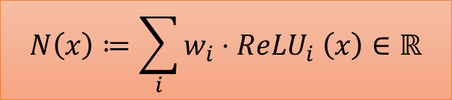
Another Application: Inapproximability by Depth-2 Neural Networks
Thm
For every $k$ and constant $δ<1/2$,
there is a function $f∈NP$ such that
$f$ cannot be $δ$ approximated by Depth-2 Neural Networks of size $n^{k}$
Depth-2 Neural Network
$$∑$$
$$N\left(x\right)≔\sum_{i}{w_{i}⋅THR_{i}\left(x\right)∈ℝ}$$
$$w_{1}$$
$$w_{3}$$
$$w_{2}$$
THR
THR
THR
Improved [Wil’18], which proved that there is such an $f∈NP$ which cannot be exactly computed by Depth-2 Neural Networks of size $n^{k}$.
$$∑$$
$$N\left(x\right)≔\sum_{i}{w_{i}⋅ReLU_{i} \left(x\right)∈ℝ}$$
$$w_{1}$$
$$w_{3}$$
$$w_{2}$$
ReLU
ReLU
ReLU
Notes:
There is no circuit that on every point outputs a value off by ½-eps to what is expected.
Say about the linear sum of ACC0 result in words.

Slide 15
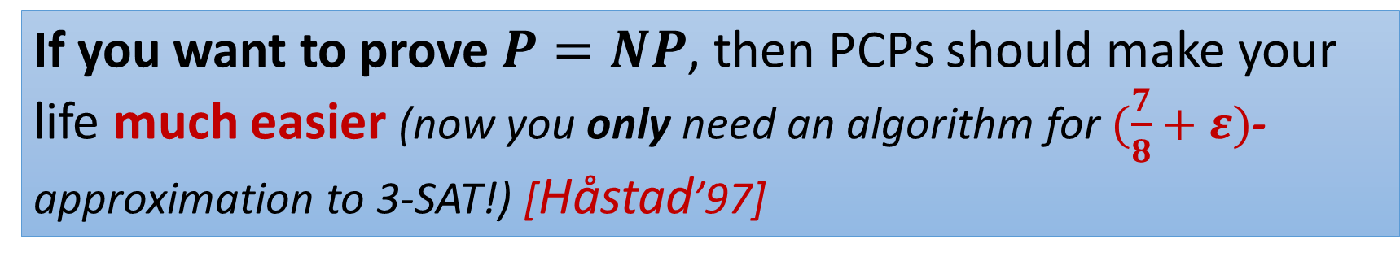
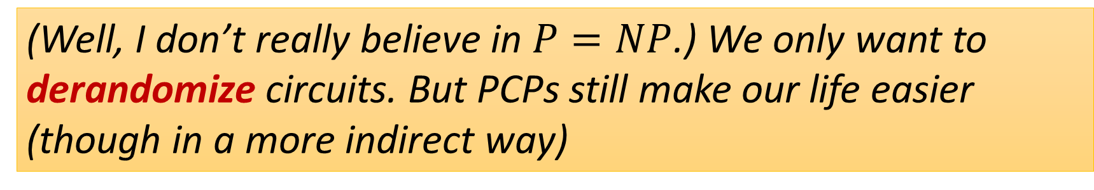
Philosophy Using PCP Algorithmically to Prove Circuit Lower Bounds (Remember: PCPs are algorithms!)
If you want to prove $P=NP$, then PCPs should make your life much easier (now you only need an algorithm for $(\frac{7}{8}+ε)$-approximation to 3-SAT!) [Håstad’97]
(Well, I don’t really believe in $P=NP$.) We only want to derandomize circuits. But PCPs still make our life easier (though in a more indirect way)
Notes:
PCPs are reductions, and reductions are algorithms!!!

Slide 16
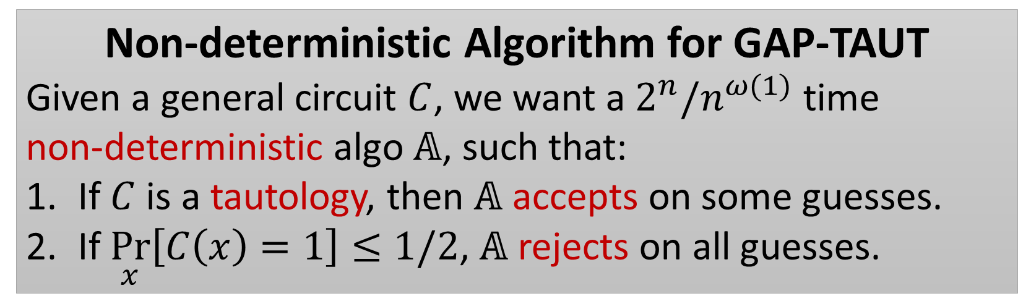
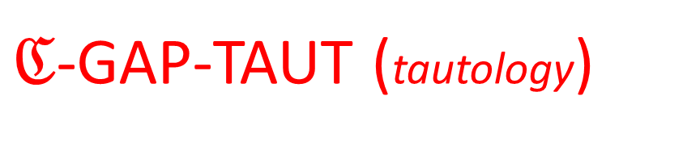
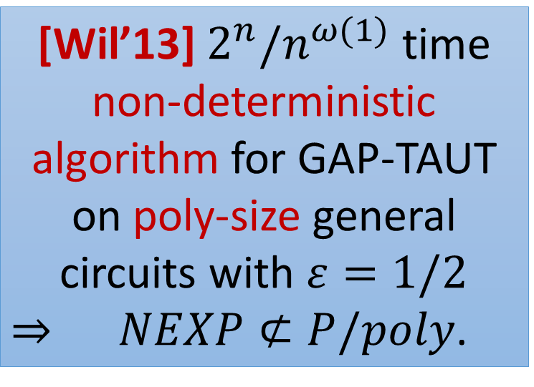



Starting Point: Non-deterministic Derandomization Suffices for Circuit Lower Bounds
$ℭ$-GAP-TAUT (tautology)
[Wil’13] $2^{n}/n^{ω(1)}$ time non-deterministic algorithm for GAP-TAUT on poly-size general circuits with $ε=1/2$
$⇒$ $NEXP⊄P/poly$.
$$C$$
Distinguish between
$\underset{x}{Pr}{[C\left(x\right)=1]}=\text{1}\text{.}$ (Yes Case)
$\underset{x}{Pr}{[C\left(x\right)=1]}≤ε$. (No Case)
Non-deterministic Algorithm for GAP-TAUT
Given a general circuit $C$, we want a $2^{n}/n^{ω(1)}$ time non-deterministic algo $𝔸$, such that:
If $C$ is a tautology, then $𝔸$ accepts on some guesses.
If $\underset{x}{Pr}\left[C\left(x\right)=1\right]≤1/2$, $𝔸$ rejects on all guesses.
$$x∼U_{n}$$

Slide 17


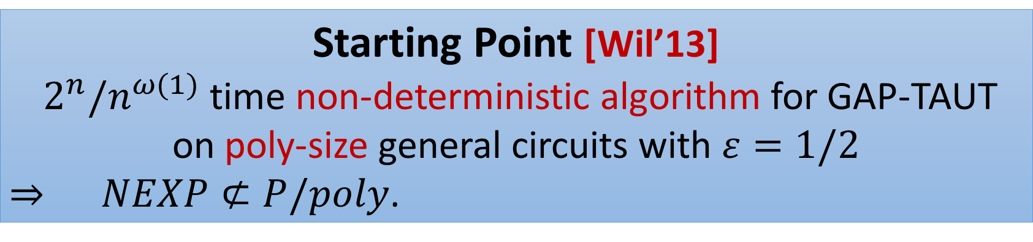
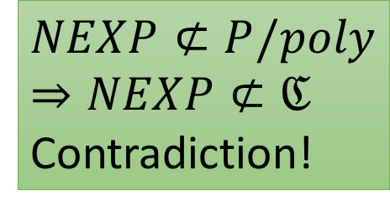
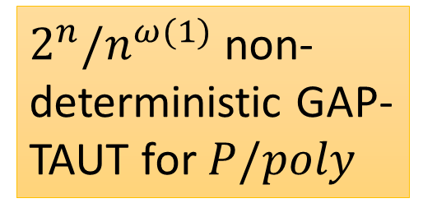
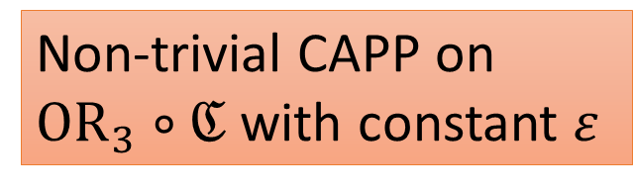
Proof Overview: Outline
Starting Point [Wil’13]
$2^{n}/n^{ω(1)}$ time non-deterministic algorithm for GAP-TAUT on poly-size general circuits with $ε=1/2$
$⇒$ $NEXP⊄P/poly$.
Key point: make use of this assumption as much as possible!
Assume $NEXP⊂ℭ$
$2^{n}/n^{ω(1)}$ non-deterministic GAP-TAUT for $P/poly$
$$NEXP⊄P/poly⇒NEXP⊄ℭ$$
Contradiction!
Think of $ℭ$ as $THR∘THR$
Non-trivial CAPP on ${OR}_{3}∘ℭ$ with constant $ε$
Notes:
One should think about this C as THR of THR

Slide 18
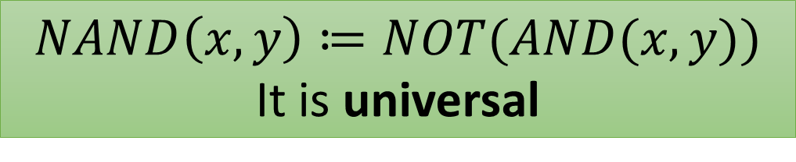

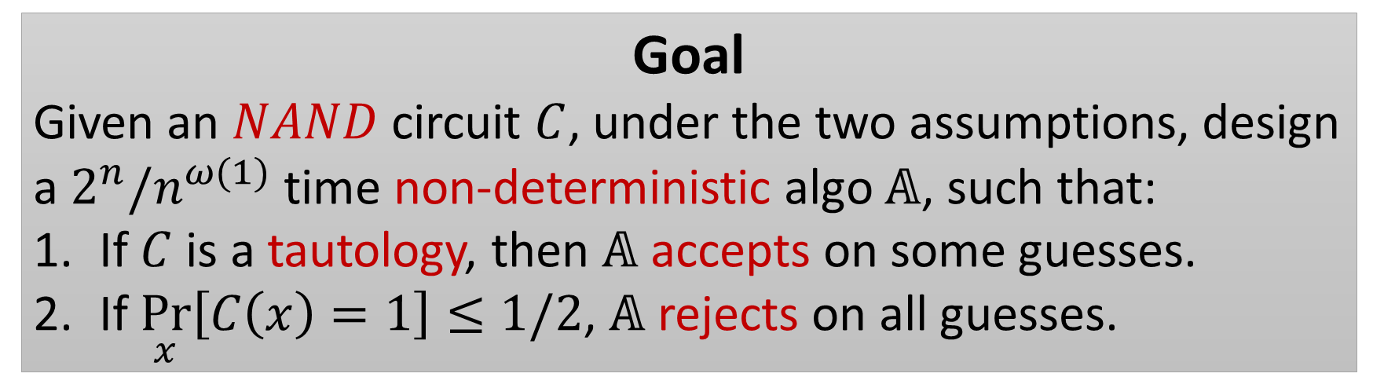
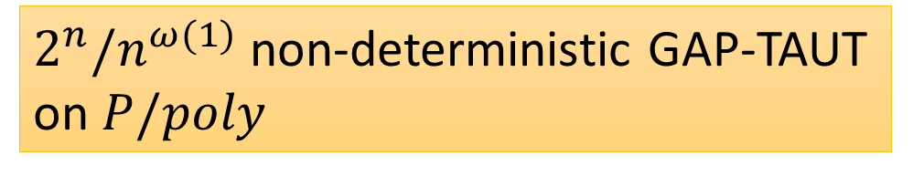
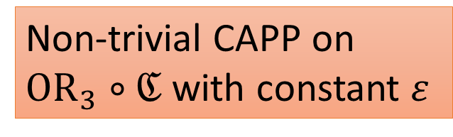

Goal: Designing the Algorithm under Assumption
Assume $NEXP⊂ℭ$
$2^{n}/n^{ω(1)}$ non-deterministic GAP-TAUT on $P/poly$
Think of $ℭ$ as $THR∘THR$
Non-trivial CAPP on ${OR}_{3}∘ℭ$ with constant $ε$
$$NAND\left(x,y\right)≔NOT(AND(x,y))$$
It is universal
Goal
Given an $NAND$ circuit $C$, under the two assumptions, design a $2^{n}/n^{ω(1)}$ time non-deterministic algo $𝔸$, such that:
If $C$ is a tautology, then $𝔸$ accepts on some guesses.
If $\underset{x}{Pr}\left[C\left(x\right)=1\right]≤1/2$, $𝔸$ rejects on all guesses.

Slide 19
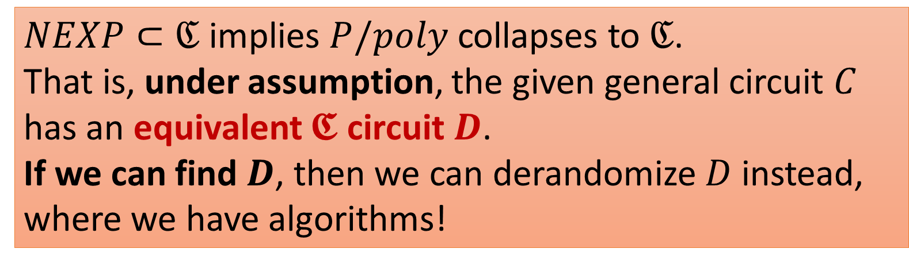
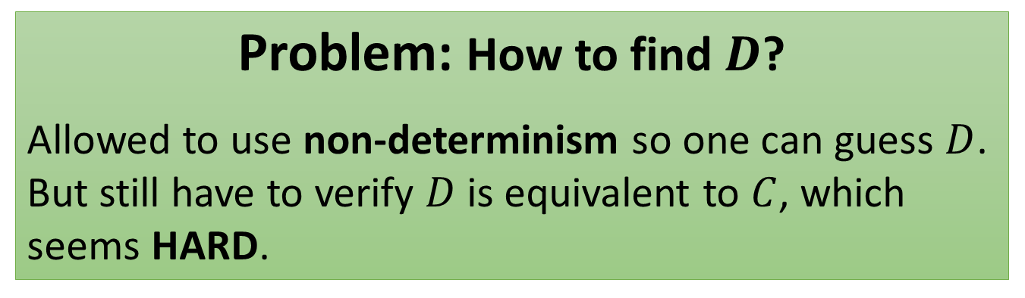
Review: Approach of [Wil’14] Guess-and-Verify-Equivalence
$NEXP⊂ℭ$ implies $P/poly$ collapses to $ℭ$.
That is, under assumption, the given general circuit $C$ has an equivalent $𝕮$ circuit $D$.
If we can find $D$, then we can derandomize $D$ instead, where we have algorithms!
Problem: How to find $D$?
Allowed to use non-determinism so one can guess $D$.
But still have to verify $D$ is equivalent to $C$, which seems HARD.
Solution
Well, just guess more circuits!
Notes:
Why we want to do this? Because we don’t have algorithm for general circuits, and only algorithm for \frakturC circuits

Slide 20
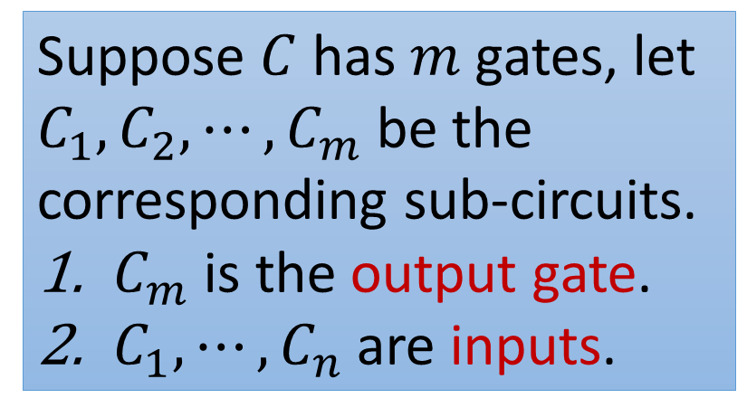
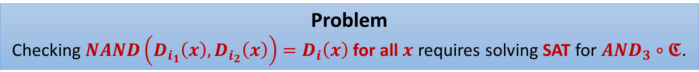
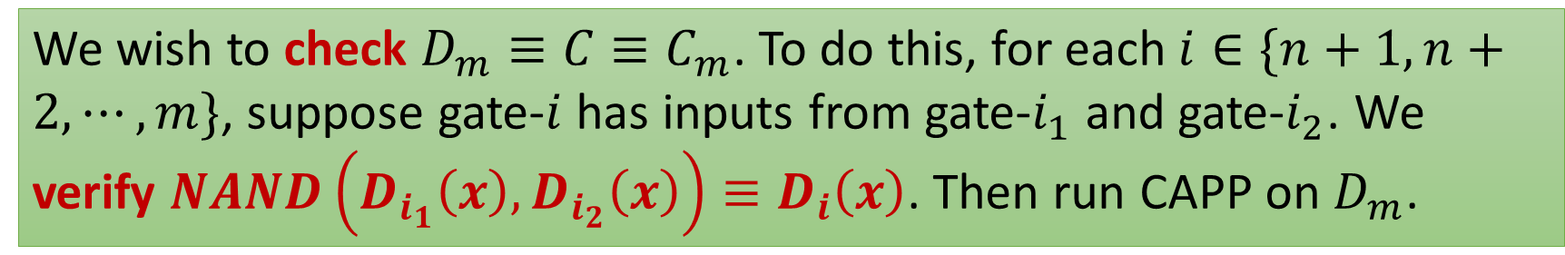

Review: Approach of [Wil’14] Guess-and-Verify-Equivalence
Suppose $C$ has $m$ gates, let $C_{1},C_{2},⋯,C_{m}$ be the corresponding sub-circuits.
$C_{m}$ is the output gate.
$C_{1},⋯,C_{n}$ are inputs.
$NEXP⊂ℭ$ implies $P/poly$ collapses to $ℭ$.
We guess $ℭ$ circuits $D_{1},D_{2},⋯,D_{m}$, hoping that $D_{i}≡C_{i}$.
We wish to check $D_{m}≡C≡C_{m}$. To do this, for each $i∈\{n+1,n+2,⋯,m\}$, suppose gate-$i$ has inputs from gate-$i_{1}$ and gate-$i_{2}$. We verify $NAND\left(D_{i_{1}}\left(x\right),D_{i_{2}}\left(x\right)\right)≡D_{i}\left(x\right)$. Then run CAPP on $D_{m}$.
Problem
Checking $NAND\left(D_{i_{1}}\left(x\right),D_{i_{2}}\left(x\right)\right)=D_{i}\left(x\right)$ for all $x$ requires solving SAT for $AND_{3}∘𝕮$.
Notes:
Why we want to do this? Because we don’t have algorithm for general circuits, and only algorithm for \frakturC circuits
A different perspective on thinking about it, introducing new variables on intermediates to get a reduction from CKT-SAT to 3-SAT.

Slide 21



A Local-checkable Proof System View
Problem: the previous approach requires solving SAT for $AND_{3}∘ℭ$.
Let $π\left(x\right)≔\left(D_{n+1}\left(x\right),D_{n+2}\left(x\right),⋯,D_{m}\left(x\right)\right).$
This is a Claimed Proof for $C_{m}\left(x\right)=1$ by giving values at all gates.
Intuitively, it is supposed to be the computation history of $C$ on input $x$.
What is so good about this proof $π(x)$?
Local checks on $x∘π(x)$
For each $i∈\{n+1,n+2,⋯,m\}$, $NAND\left(D_{i_{1}}\left(x\right),D_{i_{2}}\left(x\right)\right)=D_{i}(x)$.
$D_{m}\left(x\right)=1.$
Notes:
\pi(x) is just the computational history of C on x
This is just the Cook-Levin Theorem applied to the circuit!

Slide 22


A Local-checkable Proof System View
Let $π\left(x\right)≔\left(D_{n+1}\left(x\right),D_{n+2}\left(x\right),⋯,D_{m}\left(x\right)\right).$
A Claimed Proof for $C_{m}\left(x\right)=1$ by giving values at all gates.
One can get $ℓ=O\left(m\right)=poly(n)$ functions $F_{1},F_{2},⋯,F_{ℓ}$ on
$x∘π(x)$, such that
Each $F_{i}$ is an $OR$ of 3 bits (or their negations) from $x∘π(x)$.
If $C\left(x\right)=1,$ on the correct guesses $D_{n+1},⋯,D_{m}$, all $F_{i}$’s are satisfied by $x∘π\left(x\right)$. (Completeness)
If $C\left(x\right)=0$, for all possible $π\left(x\right),$ at least one $F_{i}$ is not satisfied by $x∘π\left(x\right)$. (Soundness)
Notes:
OR of 3, because any 3-CSP can be written as many OR_3 clauses

Slide 23


An Attempt
Guess circuits $D_{n+1},,⋯,D_{m}$, let $π\left(x\right)≔\left(D_{n+1}\left(x\right),D_{n+2}\left(x\right),⋯,D_{m}\left(x\right)\right).$
Estimate $𝔼_{i∈[ℓ]}𝔼_{x}[F_{i}(x∘π(x))]$. ($F_{i}\left(x∘π\left(x\right)\right)∈OR_{3}∘ℭ$.)
($ℓ$:number of $F_{i}$’s)
If $C$ is a tautology. Then on the correct guess, $𝔼_{i∈[ℓ]}𝔼_{x}\left[F_{i}\left(x∘π\left(x\right)\right)\right]=1.$
If $\underset{x}{Pr}\left[C\left(x\right)=1\right]≤1/2,$ then on all guesses, $𝔼_{i∈[ℓ]}𝔼_{x}\left[F_{i}\left(x∘π\left(x\right)\right)\right]≤1−\frac{1}{2ℓ}$.
To distinguish the above two cases, we need a CAPP algo with error $\frac{1}{2ℓ}=\frac{1}{poly(n)}$.
But we only assume a CAPP algo with constant error!
Notes:
Make it clear that we only assume a CAPP algo with constant error!

Slide 24


What Went Wrong?
Proof System View
$π(x)$ : a claimed proof of $C\left(x\right)=1$
$F_{i}$ : local check of the verifier
One can get $ℓ=O(m)$ functions $F_{1},F_{2},⋯,F_{ℓ}$ on $x∘π(x)$, such that
Each $F_{i}$ is an $OR$ of 3 bits (or their negations) from $x∘π(x)$.
If $C\left(x\right)=1,$ on the correct guess $D_{n+1},⋯,D_{m}$, all $F_{i}$’s are satisfied by $x∘π\left(x\right)$. (Completeness is 1)
If $C\left(x\right)=0$, for all possible $π\left(x\right),$ at least one $F_{i}$ is not satisfied by $x∘π\left(x\right)$. (Soundness is $1−1/ℓ$)
If there is a verifier who picks a random $i∈\left[ℓ\right],$ and checks whether $F_{i}\left(x∘π\left(x\right)\right)=1$.
She detects an error only with probability $1/ℓ$ when $C\left(x\right)=0$.
This is an extremely ``bad’’ PCP!
Why not just use the PCP theorem?
Notes:
From now, I probably have to assume you know some basic of PCP because I don’t really have time to define them. I hope it’s OK, you can take a nap if you are not interested in PCPs. But come on, we are complexity theorist, we doesn’t like PCP?

Slide 25










Issues When Applying PCPs Directly
Use PCPs of Proximity!
Like PCPs but both input and proof are given as oracles.
Recall that in the end we want to estimate
$$𝔼_{i∈[ℓ]}𝔼_{x}\left[F_{i}\left(x∘π\left(x\right)\right)\right].$$
Key properties being used in previous attempt:
These local checks $F_{i}$ (verifier’s queries positions) do not depend on the input $x$!
PCPs
PCPs of Proximity
$x$ (input)
$x$ (input)
Unlimited access
V
V
3 queries in total
$π(x)$ (proof)
$π(x)$ (proof)
3 queries
Now, $F_{i}(x∘π(x))$ can depend on many bits of $x$.
$$F_{i}\left(x∘π\left(x\right)\right)∈OR_{3}∘ℭ$$
Therefore, we want a proof system for verifying $C\left(x\right)=1$, such that given the random bits, verifier $V$ queries both input $x$ and proof $π(x)$.
If $C\left(x\right)=1$, exists $π(x)$, such that $V^{x∘π(x)}$ always accept.
If $C\left(x\right)=0$, for all $π(x)$,$V^{x∘π(x)}$rejects w.h.p.
Notes:
I need to re work this, maybe add a graph

Slide 26



Issues When Applying PCP Directly
Therefore, we want a proof system for verifying $C\left(x\right)=1$, such that given the random bits, verifier $V$ queries both input $x$ and proof $π(x)$.
If $C\left(x\right)=1$, $∃ π(x)$, such that $V^{x∘π(x)}$ always accept.
If $C\left(x\right)=0$, $∀ π(x)$, $V^{x∘π(x)}$rejects w.h.p.
Counter-example?
Suppose $C$ computes the parity.
Parity changes if we flip a random bit of $x$.
The verifier can’t distinguish unless she queried that bit.
Solution
Give $V$ access to an error correcting code of $x$!

Slide 27




Combing PCP of Proximity and ECCs
PCP of Proximity
Verifier $V$ is given both the input ($x$) and the proof $π(x)$ as oracles and makes $3$ queries.
$V^{x∘π(x)}$ accepts w.p. 1, when $C\left(x\right)=1$;
$V^{x∘π(x)}$accepts w.p. $δ<1$, when $x$ makes $C$ robustly output $0$ ($C$ is zero in a small hamming ball around $x$). (like property testing)
How it avoids the parity counter example?
No inputs can make parity robustly output $0$!
$x$ (input)
V
3 queries in total
$π(x)$ (proof)

Slide 28


PCP of Proximity with ECCs
Verifier $V$ is given both the encoded input ($ECC(x)$) and the proof $π(x)$ as oracles and makes $3$ queries.
$V^{ECC(x)∘π(x)}$ accepts w.p. 1, when $C\left(x\right)=1$;
$V^{ECC(x)∘π(x)}$accepts w.p. $δ<1$, when $C\left(x\right)=0$.
Use $PCP$ of Proximity for verifying $E\left(y\right)≔C\left(DEC\left(y\right)\right)=1$,
$ECC(x)$ makes $E(⋅)$ robustly output $0$ when $C\left(x\right)=0$!
DEC(corrupted $ECC(x)$) is still $x$ ☺

Slide 29



Final Algorithm
Guess circuits $D_{n+1},,⋯,D_{m}$, let $π\left(x\right)≔\left(D_{n+1}\left(x\right),D_{n+2}\left(x\right),⋯,D_{m}\left(x\right)\right).$
Fix $ECC$ to be $𝔽_{2}$-linear. That is, $ECC{\left(x\right)}_{i}$ is a parity on a subset of bits in $x$.
Suppose there is uniform parity circuit in $ℭ$ for now (this assumption can be avoided)
Now constant error CAPP algo for $OR_{3}∘ℭ$ suffices!
Estimate $𝔼_{i∈[ℓ]}𝔼_{x}[F_{i}(ECC(x)∘π(x))]$. ($F_{i}\left(x∘π\left(x\right)\right)∈OR_{3}∘ℭ$.).
If $C$ is a tautology. Then on the correct guesses, $𝔼_{i∈[ℓ]}𝔼_{x}\left[F_{i}\left(x∘π\left(x\right)\right)\right]=1.$
If $\underset{x}{Pr}\left[C\left(x\right)=1\right]≤1/2,$ then on all guesses, $𝔼_{i∈[ℓ]}𝔼_{x}\left[F_{i}\left(x∘π\left(x\right)\right)\right]≤1−δ/2$.

Slide 30



Future Work
NEW Building on the PCPP based approach, [Alman Chen’19] give a construction of Razborov-rigid matrices in $P^{NP}$.
Can we find non-trivial CAPP algorithms for $THR∘MAJ$ or $MAJ∘MAJ$ to prove circuit lower bounds for $THR∘THR$?
Recall: we know exponential lower bounds for these two models! Can we ``mine’’ some algorithms from these proofs?

Slide 31
Thank You

Slide 32
Applying to the Previous Algorithm
Guess circuits $D_{n+1},,⋯,D_{m}$, let $π\left(x\right)≔\left(D_{n+1}\left(x\right),D_{n+2}\left(x\right),⋯,D_{m}\left(x\right)\right).$
Notes:
I should take some jump here to save time

Slide 33


PCP of Proximity
Fix a circuit C. There is a PCP of Proximity system with proximity parameter $δ=1/100,$ completeness $c$, and soundness $s$ ($c>s$, both are constants), number of random bits $r=O(\log{SIZE(C)})$, satisfying the following properties:
The verifier $V$ tosses $r$ random coins, queries 2 positions of $x∘π$. ($x$ is the input, $π$ is the proof).
If $C\left(x\right)=1$, $V^{x∘π}$ accept w.p. $≥c$. (Completeness)
If $x$ is $δ$-far from $\{x:C\left(x\right)=1\}$, $V^{x∘π}$ accepts w.p. $≤s$. (Soundness when x is far from making $C$ accept).
Moreover, the correct proof $π$ can be computed from $x$ and $C$ in polynomial time.

Slide 34



Applying PCP of Proximity
Fix an $𝔽_{2}$-linear error correcting code $ENC:{\left\{0,1\right\}}^{n}→{\left\{0,1\right\}}^{cn}$,
with decoder $DEC:{\left\{0,1\right\}}^{cn}→{\left\{0,1\right\}}^{n}$,
which can recover $δ_{1}=0.1$ fraction of errors.
Given circuit $C:{\left\{0,1\right\}}^{n}→\{0,1\}$, construct $E:{\left\{0,1\right\}}^{cn}→\{0,1\}$, as $E\left(y\right)=C(DEC(y))$.
Fix the PCP of Proximity system for circuit E, guess $m$ $ℭ$ circuits $D_{1},D_{2},⋯,D_{m}$, such that $π\left(x\right)=\left(D_{n+1}\left(x\right),D_{n+2}\left(x\right),⋯,D_{m}\left(x\right)\right)$ is supposed to be the proof that $E\left(ENC\left(x\right)\right)=1.$

Slide 35




Applying PCP of Proximity
Fix the PCP of Proximity system for circuit E, guess $m$ $ℭ$ circuits $D_{1},D_{2},⋯,D_{m}$,
such that $π\left(x\right)=\left(D_{n+1}\left(x\right),D_{n+2}\left(x\right),⋯,D_{m}\left(x\right)\right)$ is supposed to be the proof that $E\left(ENC\left(x\right)\right)=1.$ (Recall $E\left(y\right)=C(DEC(y))$)
Let $F_{i}(ENC\left(x\right)∘π(x))$ be the $2$-local check corresponding to random bits $i$.
For input $x$, proof $π(x)$, $𝔼_{i}[F_{i}\left(ENC\left(x\right)∘π\left(x\right)\right)]$ is the probability that verifier accepts $ENC\left(x\right)∘π(x)$.
When $E\left(ENC\left(x\right)\right)=0$ ($C\left(x\right)=0$), $ENC(x)$ is $0.1$-far from $\{y:E\left(y\right)=1\}$.
(If $y$ is $0.1$-close to $ENC(x)$, $E\left(y\right)=C\left(DEC\left(y\right)\right)=C\left(x\right)=0$).
$∀ π(x)$ $𝔼_{i}\left[F_{i}\left(ENC\left(x\right)∘π\left(x\right)\right)\right]≤s$.
(Soundness)
When $E\left(ENC\left(x\right)\right)=1$ ($C\left(x\right)=1$), $∃$ $π(x)$ s.t. $𝔼_{i}\left[F_{i}\left(ENC\left(x\right)∘π\left(x\right)\right)\right]≥c$.
(Completeness)

Slide 36





Applying PCP of Proximity
When $E\left(ENC\left(x\right)\right)=1$ ($C\left(x\right)=1$), $∃$ $π(x)$ s.t. $𝔼_{i}\left[F_{i}\left(ENC\left(x\right)∘π\left(x\right)\right)\right]≥c$.
(Completeness)
When $E\left(ENC\left(x\right)\right)=0$ ($C\left(x\right)=0$), $∀ π(x)$ $𝔼_{i}\left[F_{i}\left(ENC\left(x\right)∘π\left(x\right)\right)\right]≤s$.
If $\underset{x}{Pr}\left[C\left(x\right)=1\right]≤n^{−10}$, on all guesses $D_{1},D_{2},⋯,D_{m}$,
$$𝔼_{i}𝔼_{x}\left[F_{i}\left(ENC\left(x\right)∘π\left(x\right)\right)\right]≤s+n^{−10}$$
If $C$ is a tautology, on certain guesses $D_{1},D_{2},⋯,D_{m}$,
$$𝔼_{i}𝔼_{x}\left[F_{i}\left(ENC\left(x\right)∘π\left(x\right)\right)\right]≥c$$
To distinguish these two cases, it suffices to estimate each $𝔼_{x}[F_{i}(ENC\left(x\right)∘π(x))]$ within $\frac{c−s}{2}$ .

Slide 37



Applying PCP of Proximity
To distinguish these two cases, it suffices to estimate each $𝔼_{x}[F_{i}(ENC\left(x\right)∘π(x))]$ within $\frac{c−s}{2}$ .
WLOG, can assume $F_{i}$ is an OR on two bits. Also assume $ℭ$ can (uniformly) compute parity.
Now it suffices to solve CAPP for $OR_{2}∘ℭ$ for a constant error.

