Slide 1

Efficient Construction of Rigid Matrices Using an NP Oracle
Josh Alman
Harvard
Lijie Chen
MIT

Slide 2
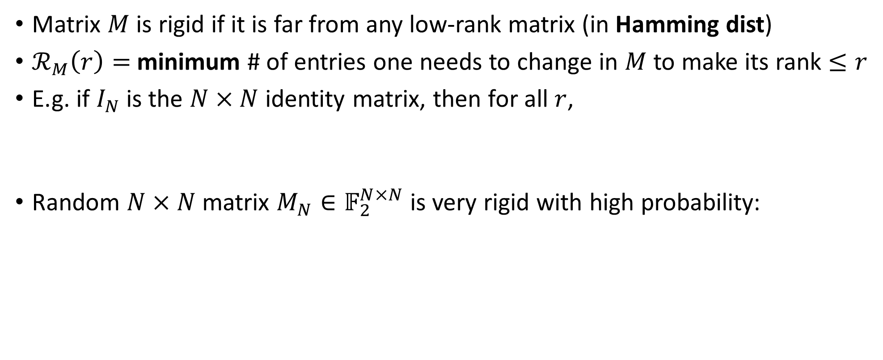


Matrix Rigidity
Matrix $M$ is rigid if it is far from any low-rank matrix (in Hamming dist)
$ℛ_{M}\left(r\right)=$minimum # of entries one needs to change in $M$ to make its rank $≤r$
E.g. if $I_{N}$ is the $N×N$ identity matrix, then for all $r$,
Random $N×N$ matrix $M_{N}∈𝔽_{2}^{N×N}$ is very rigid with high probability:
$$ℛ_{I_{N}}\left(r\right)=N−r$$
$ℛ_{M_{N}}\left(r\right)=Ω(N^{2})$ for all $r=o(N)$
Notes:
First, of course, let us recall what is a rigid matrix.
Go a bit slowly
So, the identity matrix I is not rigid, as u can change a small fraction of the whole N^2 entries to make the rank drops to even zero.
I is as not rigid as possible for a full rank matrix!
On the other hand, a random matrix is very rigid, we can prove this with a simple counting argument.

Slide 3



Matrix Rigidity
Both are notoriously hard questions open for decades
$ℛ_{M}\left(r\right)=$minimum # of entries one needs to change in $M$ to make its rank $≤r$
First introduced by [L. Valiant ‘77] to study arithmetic circuits
A random matrix is rigid w.h.p.; goal to construct without randomness Usual goal: PTIME machine $M$ such that $M(1^{N})$ outputs an $N×N$ rigid matrix
This talk: P^{NP} construction of Razborov-rigid matrices
[L. Valiant ‘77]
Every $M∈𝔽^{N×N}$ computable by $O(N)$-size $O(log N)$-depth arithmetic circuits has, for all $ε>0$,
$$ℛ_{M}\left(\frac{N}{\log{\log{N}}}\right)<N^{1+ε}.$$
[Razborov ’89, Wunderlich ‘12]
For every $f∈$ PH^{cc}$,$ the $N×N$ communication matrix $M_{f}$ has, for all $ε>0$,
$$ℛ_{M_{f}}\left(2^{{\left(\log{\log{N}}/ε\right)}^{O(1)}}\right)<ε⋅N^{2}.$$
Notes:
Proving lower bounds against linear-size log-depth circuits or PH^cc communication protocols are both notoriously hard open questions, and are open for decades
Razborov also showed that constructing rigid matrices have applications in communication complexity. Specifically, the lower bound is for the communication analogy of the polynomial hierarchy.
The random construction is not very exciting as we know random funcions require large circuits and don’t have efficient communication protocols, so the goal here is give a deterministic construction of them so we have breakthrough lower bounds for explicit functions.
It’s almost the dream goal but we need an additional NP oracle. Nonetheless, This is basically the first non-trivial construction of Rabzorov-rigid matrices and we got a few lower bounds from it, I will tell you very soon.

Slide 4
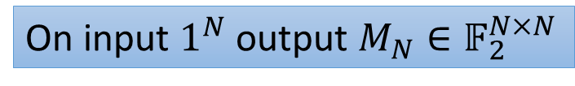
What’s Known?
Valiant-Rigid $M∈𝔽^{N×N}$:$ℛ_{M}\left(\frac{N}{\log{\log{N}}}\right)<N^{1+ε}.$
Razborov-Rigid $M∈𝔽^{N×N}$: $ℛ_{M}\left(2^{{\left(\log{\log{N}}/ε\right)}^{O(1)}}\right)<ε⋅N^{2}$
On input $1^{N}$ output $M_{N}∈𝔽_{2}^{N×N}$
Technique | $ℛ_{M}\left(r\right)$ for $N×N$ matrix $M$ | Running Time
Notes:
There are also some conditional explicit construction, and today we are going to focus on unconditional consturctions.
Display them one by one.
Go through the whole box in one sentence to save sentence (maybe make less texts)

Slide 5
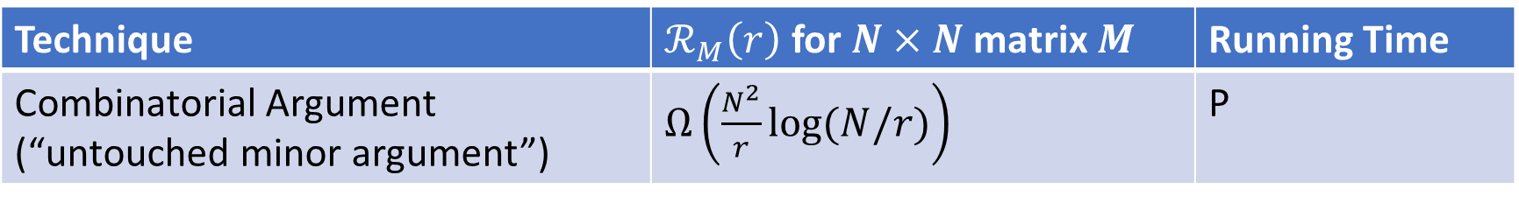
What’s Known?
Valiant-Rigid $M∈𝔽^{N×N}$:$ℛ_{M}\left(\frac{N}{\log{\log{N}}}\right)<N^{1+ε}.$
Razborov-Rigid $M∈𝔽^{N×N}$: $ℛ_{M}\left(2^{{\left(\log{\log{N}}/ε\right)}^{O(1)}}\right)<ε⋅N^{2}$
On input $1^{N}$ output $M_{N}∈𝔽_{2}^{N×N}$
Technique | $ℛ_{M}\left(r\right)$ for $N×N$ matrix $M$ | Running Time
Combinatorial Argument (“untouched minor argument”) | $Ω\left(\frac{N^{2}}{r}\log{(N/r)}\right)$ | P
Notes:
There are also some conditional explicit construction, and today we are going to focus on unconditional consturctions.
Display them one by one.
Go through the whole box in one sentence to save sentence (maybe make less texts)

Slide 6
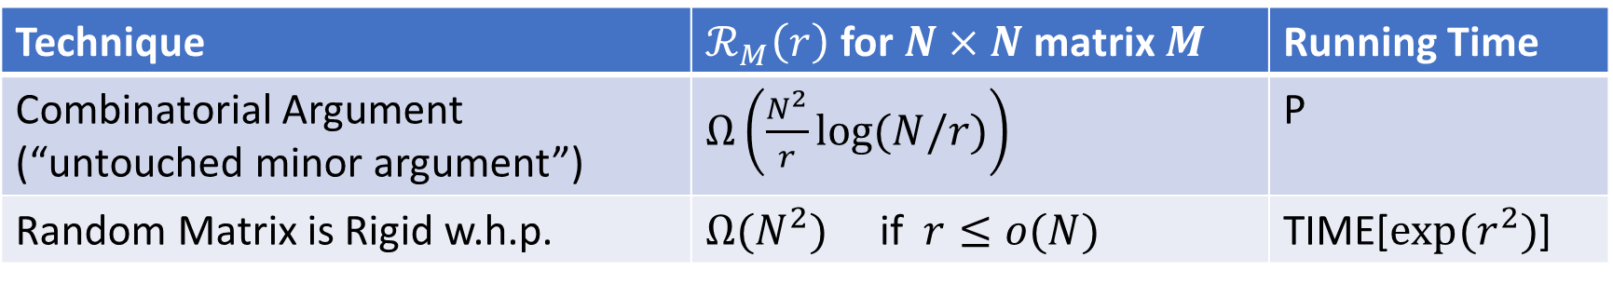
What’s Known?
Valiant-Rigid $M∈𝔽^{N×N}$:$ℛ_{M}\left(\frac{N}{\log{\log{N}}}\right)<N^{1+ε}.$
Razborov-Rigid $M∈𝔽^{N×N}$: $ℛ_{M}\left(2^{{\left(\log{\log{N}}/ε\right)}^{O(1)}}\right)<ε⋅N^{2}$
On input $1^{N}$ output $M_{N}∈𝔽_{2}^{N×N}$
Technique | $ℛ_{M}\left(r\right)$ for $N×N$ matrix $M$ | Running Time
Combinatorial Argument (“untouched minor argument”) | $Ω\left(\frac{N^{2}}{r}\log{(N/r)}\right)$ | P
Random Matrix is Rigid w.h.p. | $Ω(N^{2})$ if $r≤o(N)$ | TIME[$exp⁡(r^{2})$]
Notes:
There are also some conditional explicit construction, and today we are going to focus on unconditional consturctions.
Display them one by one.
Go through the whole box in one sentence to save sentence (maybe make less texts)

Slide 7
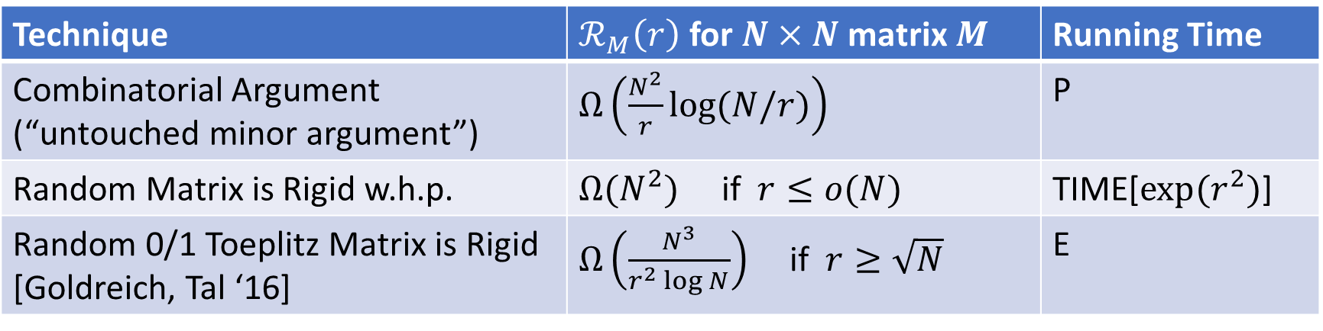
What’s Known?
Valiant-Rigid $M∈𝔽^{N×N}$:$ℛ_{M}\left(\frac{N}{\log{\log{N}}}\right)<N^{1+ε}.$
Razborov-Rigid $M∈𝔽^{N×N}$: $ℛ_{M}\left(2^{{\left(\log{\log{N}}/ε\right)}^{O(1)}}\right)<ε⋅N^{2}$
On input $1^{N}$ output $M_{N}∈𝔽_{2}^{N×N}$
Technique | $ℛ_{M}\left(r\right)$ for $N×N$ matrix $M$ | Running Time
Combinatorial Argument (“untouched minor argument”) | $Ω\left(\frac{N^{2}}{r}\log{(N/r)}\right)$ | P
Random Matrix is Rigid w.h.p. | $Ω(N^{2})$ if $r≤o(N)$ | TIME[$exp⁡(r^{2})$]
Random 0/1 Toeplitz Matrix is Rigid [Goldreich, Tal ‘16] | $Ω\left(\frac{N^{3}}{r^{2}\log{N}}\right)$ if $r≥\sqrt{N}$ | E
Notes:
There are also some conditional explicit construction, and today we are going to focus on unconditional consturctions.
Display them one by one.
Go through the whole box in one sentence to save sentence (maybe make less texts)

Slide 8
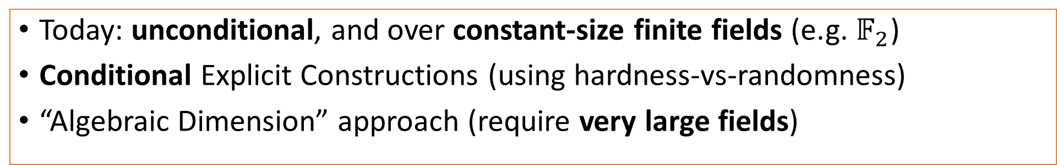
What’s Known?
Valiant-Rigid $M∈𝔽^{N×N}$:$ℛ_{M}\left(\frac{N}{\log{\log{N}}}\right)<N^{1+ε}.$
Razborov-Rigid $M∈𝔽^{N×N}$: $ℛ_{M}\left(2^{{\left(\log{\log{N}}/ε\right)}^{O(1)}}\right)<ε⋅N^{2}$
On input $1^{N}$ output $M_{N}∈𝔽_{2}^{N×N}$
Technique | $ℛ_{M}\left(r\right)$ for $N×N$ matrix $M$ | Running Time
Combinatorial Argument (“untouched minor argument”) | $Ω\left(\frac{N^{2}}{r}\log{(N/r)}\right)$ | P
Random Matrix is Rigid w.h.p. | $Ω(N^{2})$ if $r≤o(N)$ | TIME[$exp⁡(r^{2})$]
Random 0/1 Toeplitz Matrix is Rigid [Goldreich, Tal ‘16] | $Ω\left(\frac{N^{3}}{r^{2}\log{N}}\right)$ if $r≥\sqrt{N}$ | E
Today: unconditional, and over constant-size finite fields (e.g. $𝔽_{2}$)
Conditional Explicit Constructions (using hardness-vs-randomness)
“Algebraic Dimension” approach (require very large fields)
Notes:
There are also some conditional explicit construction, and today we are going to focus on unconditional consturctions.
Display them one by one.
Go through the whole box in one sentence to save sentence (maybe make less texts)

Slide 9
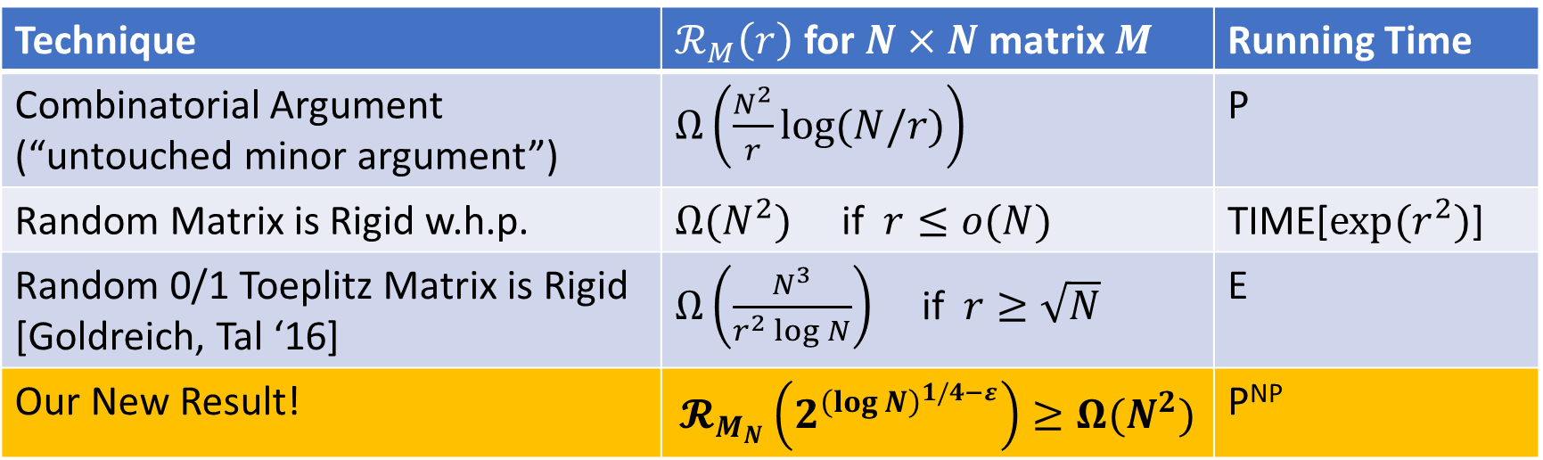
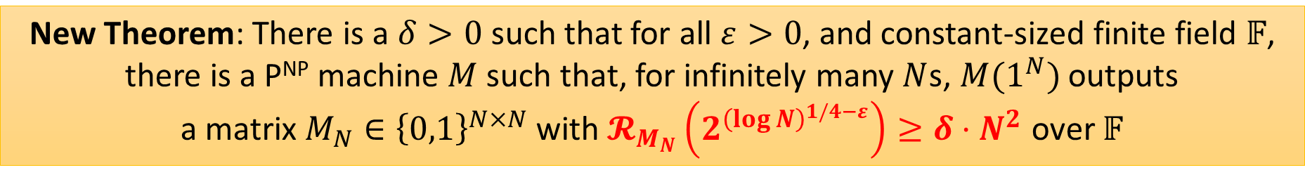
What’s Known?
Valiant-Rigid $M∈𝔽^{N×N}$:$ℛ_{M}\left(\frac{N}{\log{\log{N}}}\right)<N^{1+ε}.$
Razborov-Rigid $M∈𝔽^{N×N}$: $ℛ_{M}\left(2^{{\left(\log{\log{N}}/ε\right)}^{O(1)}}\right)<ε⋅N^{2}$
On input $1^{N}$ output $M_{N}∈𝔽_{2}^{N×N}$
Technique | $ℛ_{M}\left(r\right)$ for $N×N$ matrix $M$ | Running Time
Combinatorial Argument (“untouched minor argument”) | $Ω\left(\frac{N^{2}}{r}\log{(N/r)}\right)$ | P
Random Matrix is Rigid w.h.p. | $Ω(N^{2})$ if $r≤o(N)$ | TIME[$exp⁡(r^{2})$]
Random 0/1 Toeplitz Matrix is Rigid [Goldreich, Tal ‘16] | $Ω\left(\frac{N^{3}}{r^{2}\log{N}}\right)$ if $r≥\sqrt{N}$ | E
Our New Result! | $$𝓡_{M_{N}}\left(2^{{\left(\log{N}\right)}^{1/4−ε}}\right)≥Ω(N^{2})$$ | P^{NP}
New Theorem: There is a $δ>0$ such that for all $ε>0$, and constant-sized finite field $𝔽$, there is a P^{NP} machine $M$ such that, for infinitely many $N$s, $M(1^{N})$ outputs a matrix $M_{N}∈{\left\{0,1\right\}}^{N×N}$ with $𝓡_{M_{N}}\left(2^{{\left(\log{N}\right)}^{1/4−ε}}\right)≥δ⋅N^{2}$ over $𝔽$

Slide 10

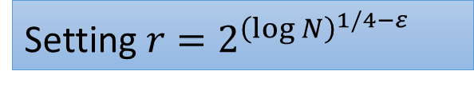
What’s Known?
Valiant-Rigid $M∈𝔽^{N×N}$:$ℛ_{M}\left(\frac{N}{\log{\log{N}}}\right)<N^{1+ε}.$
Razborov-Rigid $M∈𝔽^{N×N}$: $ℛ_{M}\left(2^{{\left(\log{\log{N}}/ε\right)}^{O(1)}}\right)<ε⋅N^{2}$
On input $1^{N}$ output $M_{N}∈𝔽_{2}^{N×N}$
Setting $r=2^{{\left(\log{N}\right)}^{1/4−ε}}$
Technique | $ℛ_{M}\left(r\right)$ for $N×N$ matrix $M$ | Running Time
Combinatorial Argument (“untouched minor argument”) | $Ω\left(\frac{N^{2}}{r}\log{(N/r)}\right)$ | P
Random Matrix is Rigid w.h.p. | $Ω(N^{2})$ if $r≤o(N)$ | TIME[$exp⁡(r^{2})$]
Random 0/1 Toeplitz Matrix is Rigid [Goldreich, Tal ‘16] | $Ω\left(\frac{N^{3}}{r^{2}\log{N}}\right)$ if $r≥\sqrt{N}$ | E
Our New Result! | $𝓡_{M_{N}}\left(2^{{\left(\log{N}\right)}^{1/4−ε}}\right)≥Ω(N^{2})$ | P^{NP}
New Theorem: There is a $δ>0$ such that for all $ε>0$, and constant-sized finite field $𝔽$, there is a P^{NP} machine $M$ such that, for infinitely many $N$s, $M(1^{N})$ outputs a matrix $M_{N}∈{\left\{0,1\right\}}^{N×N}$ with $𝓡_{M_{N}}\left(2^{{\left(\log{N}\right)}^{1/4−ε}}\right)≥δ⋅N^{2}$ over $𝔽$

Slide 11
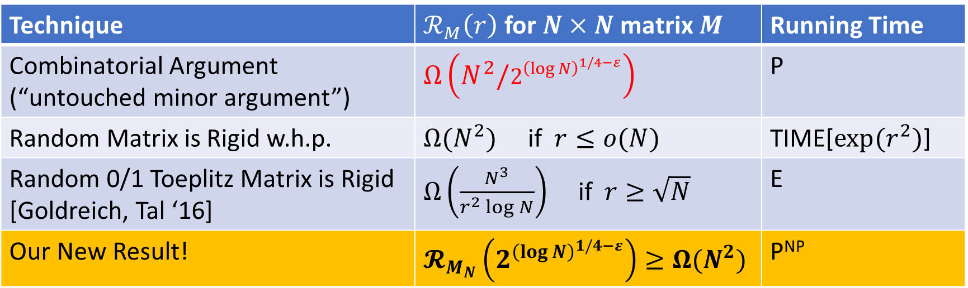
What’s Known?
Valiant-Rigid $M∈𝔽^{N×N}$:$ℛ_{M}\left(\frac{N}{\log{\log{N}}}\right)<N^{1+ε}.$
Razborov-Rigid $M∈𝔽^{N×N}$: $ℛ_{M}\left(2^{{\left(\log{\log{N}}/ε\right)}^{O(1)}}\right)<ε⋅N^{2}$
On input $1^{N}$ output $M_{N}∈𝔽_{2}^{N×N}$
Setting $r=2^{{\left(\log{N}\right)}^{1/4−ε}}$
Technique | $ℛ_{M}\left(r\right)$ for $N×N$ matrix $M$ | Running Time
Combinatorial Argument (“untouched minor argument”) | $Ω\left(N^{2}/2^{{\left(\log{N}\right)}^{1/4−ε}}\right)$ | P
Random Matrix is Rigid w.h.p. | $Ω(N^{2})$ if $r≤o(N)$ | TIME[$exp⁡(r^{2})$]
Random 0/1 Toeplitz Matrix is Rigid [Goldreich, Tal ‘16] | $Ω\left(\frac{N^{3}}{r^{2}\log{N}}\right)$ if $r≥\sqrt{N}$ | E
Our New Result! | $𝓡_{M_{N}}\left(2^{{\left(\log{N}\right)}^{1/4−ε}}\right)≥Ω(N^{2})$ | P^{NP}
New Theorem: There is a $δ>0$ such that for all $ε>0$, and constant-sized finite field $𝔽$, there is a P^{NP} machine $M$ such that, for infinitely many $N$s, $M(1^{N})$ outputs a matrix $M_{N}∈{\left\{0,1\right\}}^{N×N}$ with $𝓡_{M_{N}}\left(2^{{\left(\log{N}\right)}^{1/4−ε}}\right)≥δ⋅N^{2}$ over $𝔽$

Slide 12
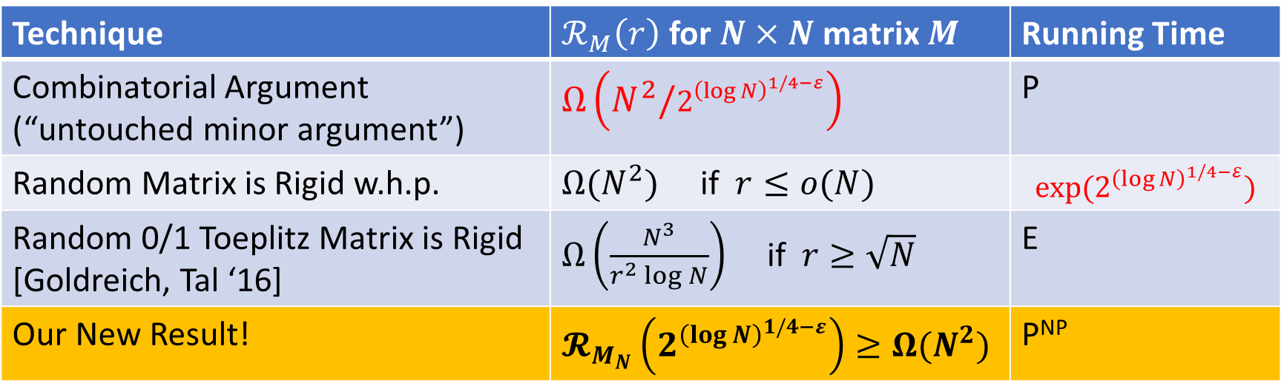
What’s Known?
Valiant-Rigid $M∈𝔽^{N×N}$:$ℛ_{M}\left(\frac{N}{\log{\log{N}}}\right)<N^{1+ε}.$
Razborov-Rigid $M∈𝔽^{N×N}$: $ℛ_{M}\left(2^{{\left(\log{\log{N}}/ε\right)}^{O(1)}}\right)<ε⋅N^{2}$
On input $1^{N}$ output $M_{N}∈𝔽_{2}^{N×N}$
Setting $r=2^{{\left(\log{N}\right)}^{1/4−ε}}$
Technique | $ℛ_{M}\left(r\right)$ for $N×N$ matrix $M$ | Running Time
Combinatorial Argument (“untouched minor argument”) | $Ω\left(N^{2}/2^{{\left(\log{N}\right)}^{1/4−ε}}\right)$ | P
Random Matrix is Rigid w.h.p. | $Ω(N^{2})$ if $r≤o(N)$ | $$exp⁡(2^{{\left(\log{N}\right)}^{1/4−ε}})$$
Random 0/1 Toeplitz Matrix is Rigid [Goldreich, Tal ‘16] | $Ω\left(\frac{N^{3}}{r^{2}\log{N}}\right)$ if $r≥\sqrt{N}$ | E
Our New Result! | $𝓡_{M_{N}}\left(2^{{\left(\log{N}\right)}^{1/4−ε}}\right)≥Ω(N^{2})$ | P^{NP}
New Theorem: There is a $δ>0$ such that for all $ε>0$, and constant-sized finite field $𝔽$, there is a P^{NP} machine $M$ such that, for infinitely many $N$s, $M(1^{N})$ outputs a matrix $M_{N}∈{\left\{0,1\right\}}^{N×N}$ with $𝓡_{M_{N}}\left(2^{{\left(\log{N}\right)}^{1/4−ε}}\right)≥δ⋅N^{2}$ over $𝔽$

Slide 13
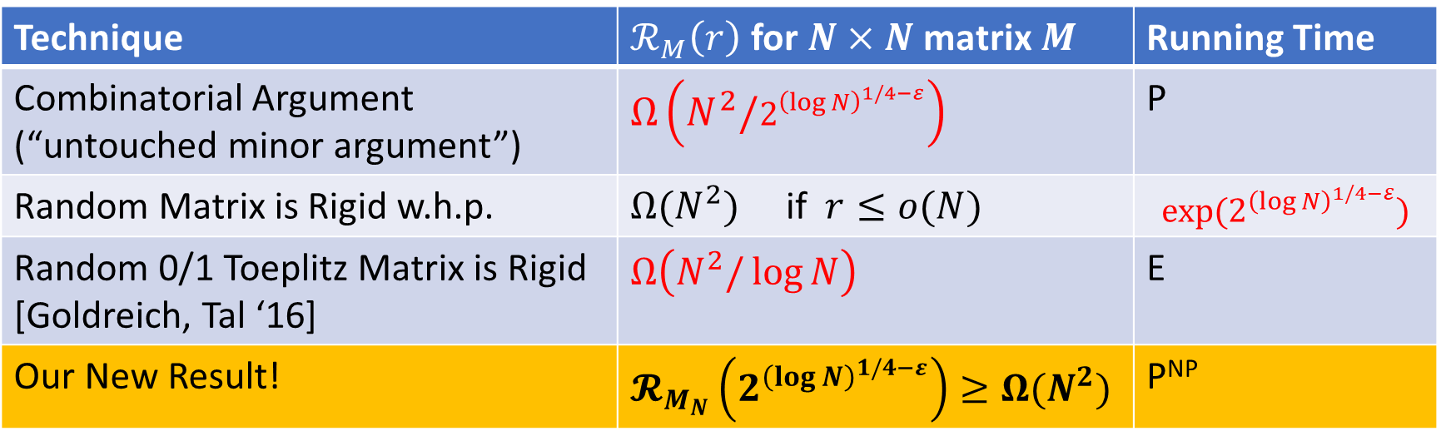
What’s Known?
Valiant-Rigid $M∈𝔽^{N×N}$:$ℛ_{M}\left(\frac{N}{\log{\log{N}}}\right)<N^{1+ε}.$
Razborov-Rigid $M∈𝔽^{N×N}$: $ℛ_{M}\left(2^{{\left(\log{\log{N}}/ε\right)}^{O(1)}}\right)<ε⋅N^{2}$
On input $1^{N}$ output $M_{N}∈𝔽_{2}^{N×N}$
Setting $r=2^{{\left(\log{N}\right)}^{1/4−ε}}$
Technique | $ℛ_{M}\left(r\right)$ for $N×N$ matrix $M$ | Running Time
Combinatorial Argument (“untouched minor argument”) | $Ω\left(N^{2}/2^{{\left(\log{N}\right)}^{1/4−ε}}\right)$ | P
Random Matrix is Rigid w.h.p. | $Ω(N^{2})$ if $r≤o(N)$ | $$exp⁡(2^{{\left(\log{N}\right)}^{1/4−ε}})$$
Random 0/1 Toeplitz Matrix is Rigid [Goldreich, Tal ‘16] | $$Ω\left(N^{2}/\log{N}\right)$$ | E
Our New Result! | $𝓡_{M_{N}}\left(2^{{\left(\log{N}\right)}^{1/4−ε}}\right)≥Ω(N^{2})$ | P^{NP}
Previous works: mostly combinational or algebraic
Our work: builds on complexity-theoretical ideas and uses PCP!
We take a very different approach!
New Theorem: There is a $δ>0$ such that for all $ε>0$, and constant-sized finite field $𝔽$, there is a P^{NP} machine $M$ such that, for infinitely many $N$s, $M(1^{N})$ outputs a matrix $M_{N}∈{\left\{0,1\right\}}^{N×N}$ with $𝓡_{M_{N}}\left(2^{{\left(\log{N}\right)}^{1/4−ε}}\right)≥δ⋅N^{2}$ over $𝔽$
Notes:
Go through them quickly
Our construction takes a very different approach: the past works usually balabal, but our work balabala

Slide 14


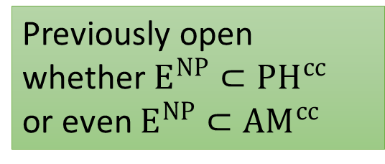
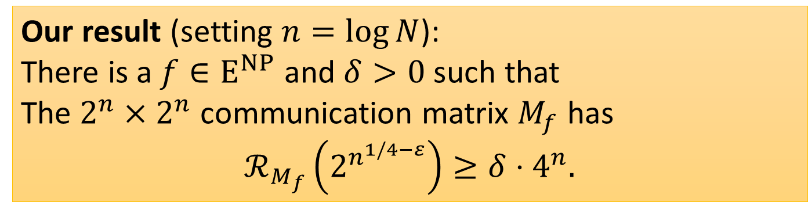
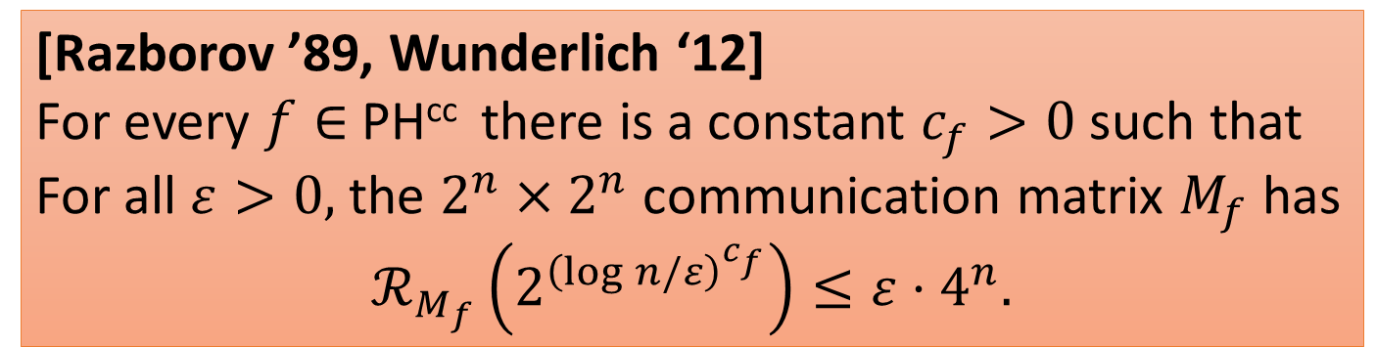
Application: Communication Complexity
[Razborov ’89, Wunderlich ‘12]
For every $f∈$ PH^{cc} there is a constant $c_{f}>0$ such that
For all $ε>0,$ the $2^{n}×2^{n}$ communication matrix $M_{f}$ has
$$ℛ_{M_{f}}\left(2^{{\left(\log{n}/ε\right)}^{c_{f}}}\right)≤ε⋅4^{n}.$$
PH^{cc} = Communication Complexity analogue of Polynomial Hierarchy
Previously open whether $E^{NP}⊂PH^{cc}$ or even $E^{NP}⊂{AM}^{cc}$
Our result (setting $n=\log{N}$):
There is a $f∈E^{NP}$ and $δ>0$such that
The $2^{n}×2^{n}$ communication matrix $M_{f}$ has
$$ℛ_{M_{f}}\left(2^{n^{1/4−ε}}\right)≥δ⋅4^{n}.$$
New Lower Bound: $E^{NP}⊄PH^{cc}$
Stronger New Lower Bound: For all $α\left(n\right)=ω\left(1\right)$,
$$TIME{\left[2^{{(\log{n)}}^{α\left(n\right)}}\right]}^{NP}⊄PH^{cc}$$
Notes:
If you haven’t seen it before, I don’t have time to define it, but …Recall that PH^cc is…
And it was a notoriously long-standing open question to prove any non-trivial lower bounds against them. Previously
You may have noticed that the rank we proved is much large than the Razborov requirement, so taking advantage of that with a padding argument we have. Instead of E^NP, we can get all the way down to slightly super quasi-polynomial to NP.
Skip through the Rabborov and Our result boxes…

Slide 15


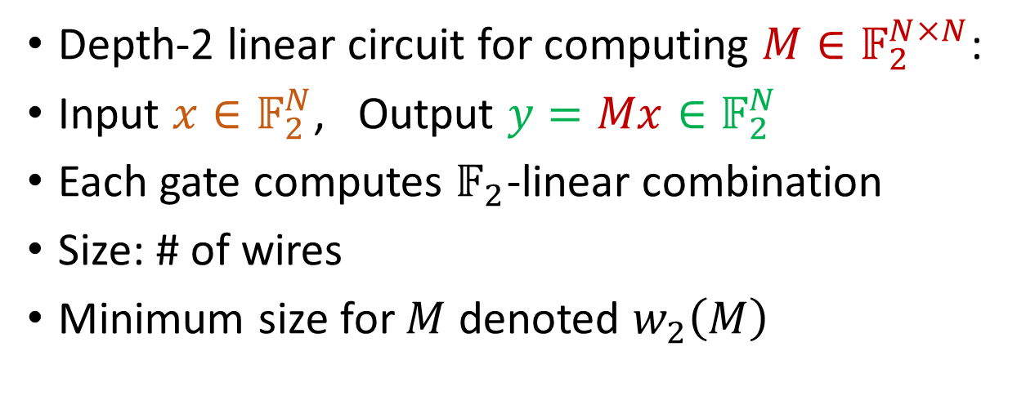


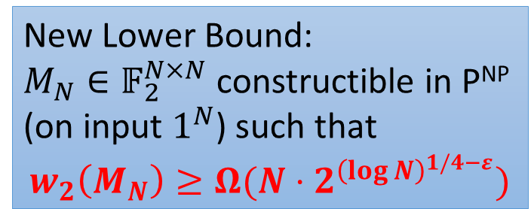
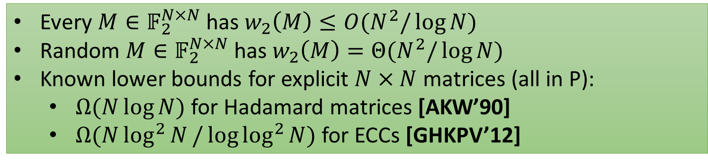








Application: Depth-2 Circuit Lower Bound
$$y_{1}$$
$$y_{2}$$
$$y_{3}$$
$$y_{N}$$
Depth-2 linear circuit for computing $M∈𝔽_{2}^{N×N}$:
Input $x∈𝔽_{2}^{N}$, Output $y=Mx∈𝔽_{2}^{N}$
Each gate computes $𝔽_{2}$-linear combination
Size: # of wires
Minimum size for $M$ denoted $w_{2}\left(M\right)$
$$+$$
$$+$$
$$+$$
$$+$$
$$+$$
$$+$$
$$+$$
$$x_{1}$$
$$x_{2}$$
$$x_{3}$$
$$x_{N}$$
Every $M∈𝔽_{2}^{N×N}$ has $w_{2}\left(M\right)≤O(N^{2}/\log{N})$
Random $M∈𝔽_{2}^{N×N}$ has $w_{2}\left(M\right)=Θ(N^{2}/\log{N})$
Known lower bounds for explicit $N×N$ matrices (all in P):
$Ω(N\log{N)}$ for Hadamard matrices [AKW’90]
$Ω(N\log^{2}{N}/\log{\log^{2}{N}})$ for ECCs [GHKPV’12]
New Lower Bound:
$M_{N}∈𝔽_{2}^{N×N}$ constructible in P^{NP} (on input $1^{N}$) such that $$w_{2}\left(M_{N}\right)≥Ω(N⋅2^{{\left(\log{N}\right)}^{1/4−ε}})$$
Notes:
We know that every linear transformation has depth-2 linear circuit of size N^2 / log N, and this is achieved by a random one.
But there are few lower bounds
Combing our new construction with the connection between rigid matrices and depth-2 linear circuit lower bounds

Slide 16
Proof Overview
Constructing rigid matrices with
Algorithms from fine-grained complexity and PCPs

Slide 17
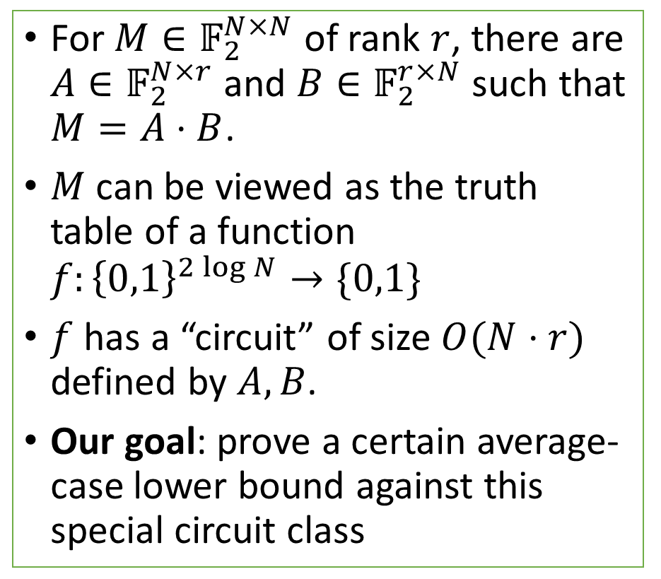
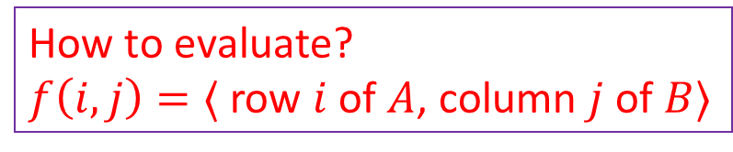



Think about Low-Rank Matrices as a Circuit Class
For $M∈𝔽_{2}^{N×N}$ of rank $r$, there are $A∈𝔽_{2}^{N×r}$ and $B∈𝔽_{2}^{r×N}$ such that $M=A⋅B$.
$M$ can be viewed as the truth table of a function $f:{\left\{0,1\right\}}^{2\log{N}}→\{0,1\}$
$f$ has a “circuit” of size $O(N⋅r)$ defined by $A,B$.
Our goal: prove a certain average-case lower bound against this special circuit class
A
Truth Table of $f$
B
$$×$$
$$=$$
How to evaluate?
$f\left(i,j\right)=⟨$ row $i$ of $A$, column $j$ of $B⟩$
Notes:
Explain, why this means this matrix is rigid

Slide 18
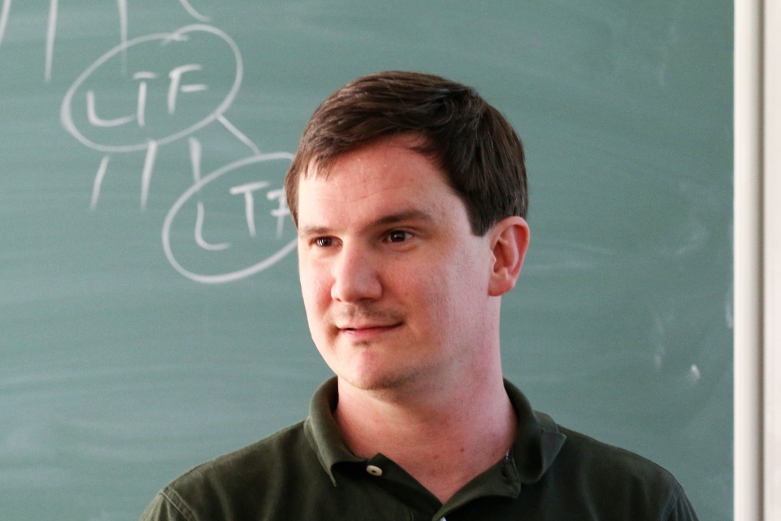
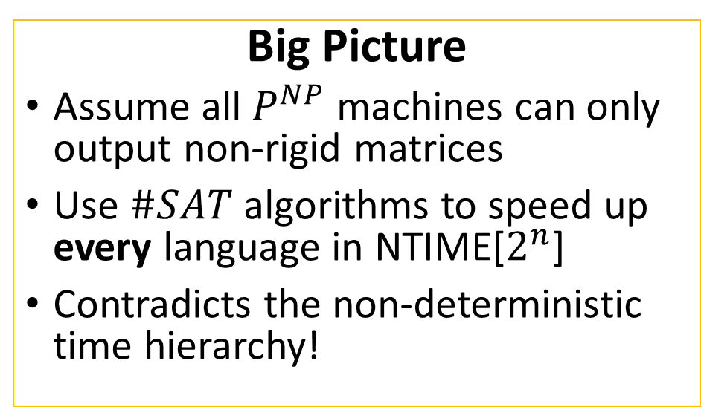
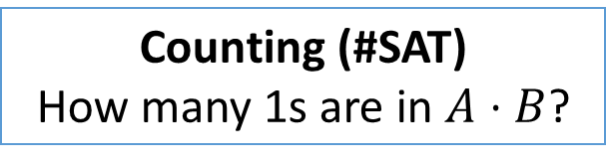

Williams’ Algorithmic Approach to Circuit LBs
Non-trivial
Circuit-Analysis
Algorithms
[Williams ‘14]
Circuit Lower
Bounds!
Give as input $A∈𝔽_{2}^{N×r}$ and $B∈𝔽_{2}^{r×N}$, the natural circuit-analysis questions:
Satisfiability (SAT)
Is $A⋅B$ the all 0s matrix?
Big Picture
Assume all $P^{NP}$ machines can only output non-rigid matrices
Use $\#SAT$ algorithms to speed up every language in NTIME[$2^{n}$]
Contradicts the non-deterministic time hierarchy!
Counting (#SAT)
How many 1s are in $A⋅B$?
[Chan, Williams ‘16] When $r≤N^{o(1)}$, #SAT can be solved in $N^{2−Ω(1/\log{r})}≪N^{2}$ deterministic time. (This is just $\#OV$ over $𝔽_{2}$!)
Idea: Use [Williams ‘14] approach to turn the above algorithm into lower bounds!
Notes:
A recent work of Chan and Williams shows that, when r is small, we do have a non-trivial #SAT algorithm
So ok, what are the circuit-analysis questions for our circuit classes?
Counting OV may be better

Slide 19
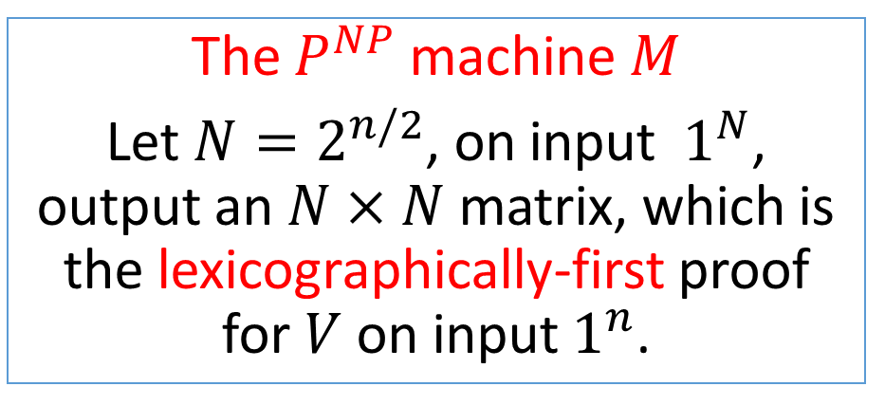
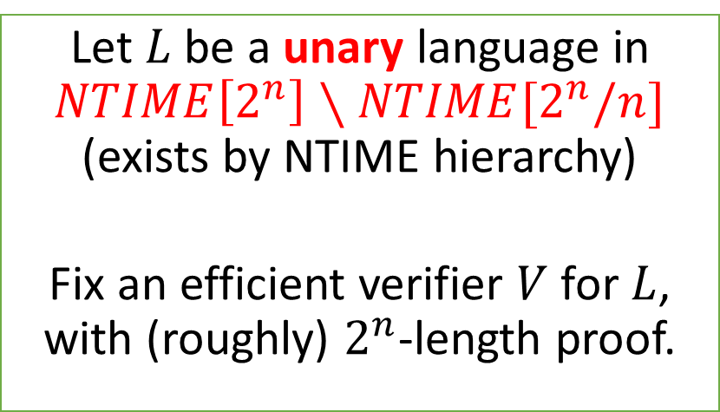
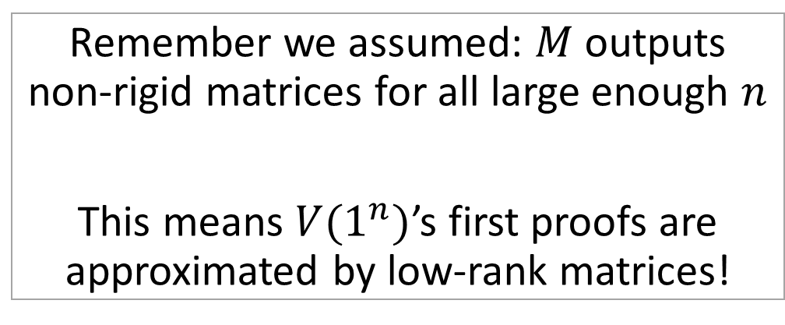
First Attempt
Let $L$ be a unary language in $NTIME\left[2^{n}\right]∖NTIME[2^{n}/n]$ (exists by NTIME hierarchy)
Fix an efficient verifier $V$ for $L$, with (roughly) $2^{n}$-length proof.
Remember we assumed: $M$ outputs non-rigid matrices for all large enough $n$
This means $V(1^{n})$’s first proofs are approximated by low-rank matrices!
The $P^{NP}$ machine $M$
Let $N=2^{n/2}$, on input $1^{N}$, output an $N×N$ matrix, which is the lexicographically-first proof for $V$ on input $1^{n}$.
do a binary search

Slide 20
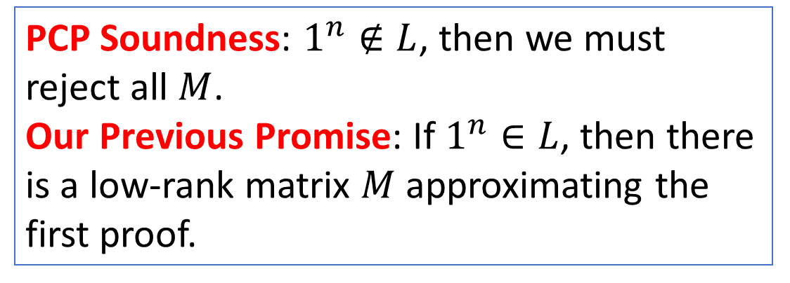
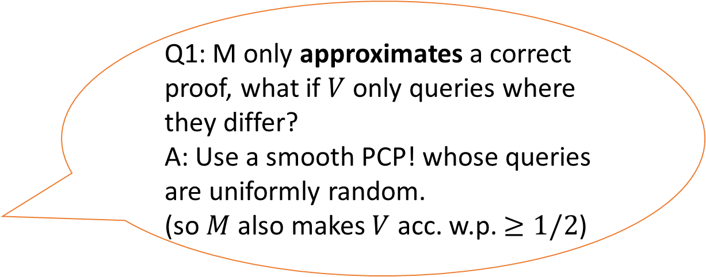
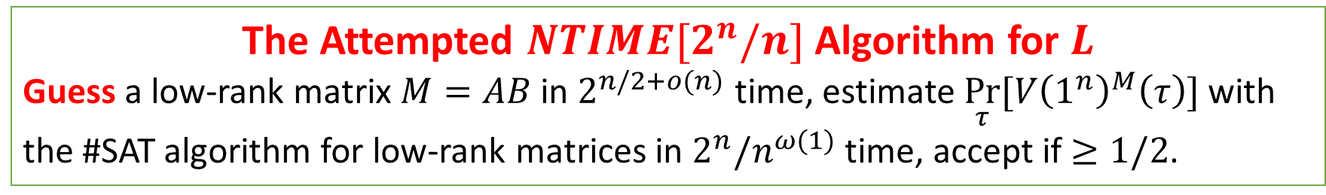
First Attempt
Use an efficient PCP verifier $V$ with $O(1)$ queries!
The Attempted $NTIME[2^{n}/n]$ Algorithm for $L$
Guess a low-rank matrix $M=AB$ in $2^{n/2+o(n)}$ time, estimate $\underset{τ}{Pr}[V{\left(1^{n}\right)}^{M}\left(τ\right)]$ with the #SAT algorithm for low-rank matrices in $2^{n}/n^{ω(1)}$ time, accept if $≥1/2$.
Q1: M only approximates a correct proof, what if $V$ only queries where they differ?
A: Use a smooth PCP! whose queries are uniformly random.
(so $M$ also makes $V$ acc. w.p. $≥1/2$)
PCP Soundness: $1^{n}∉L$, then we must reject all $M$.
Our Previous Promise: If $1^{n}∈L$, then there
is a low-rank matrix $M$ approximating the first proof.

Slide 21
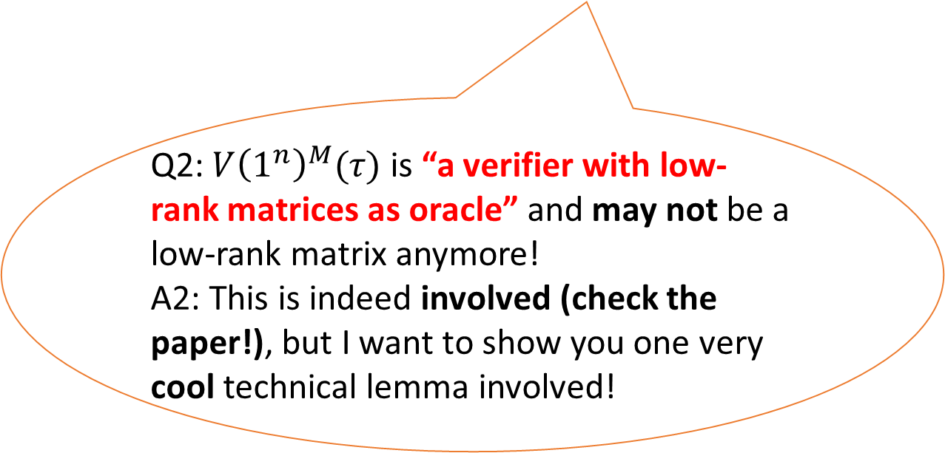
First Attempt
Use an efficient PCP verifier $V$ with $O(1)$ queries!
The Attempted $NTIME[2^{n}/n]$ Algorithm for $L$
Guess a low-rank matrix $M=AB$ in $2^{n/2+o(n)}$ time, estimate $\underset{τ}{Pr}[V{\left(1^{n}\right)}^{M}\left(τ\right)]$ with the #SAT algorithm for low-rank matrices in $2^{n}/n^{ω(1)}$ time, accept if $≥1/2$.
Q2: $V{\left(1^{n}\right)}^{M}(τ)$ is “a verifier with low-rank matrices as oracle” and may not be a low-rank matrix anymore!
A2: This is indeed involved (check the paper!), but I want to show you one very cool technical lemma involved!
PCP Soundness: $1^{n}∉L$, then we must reject all $M$.
Our Previous Promise: If $1^{n}∈L$, then there
is a low-rank matrix $M$ approximating the first proof.

Slide 22
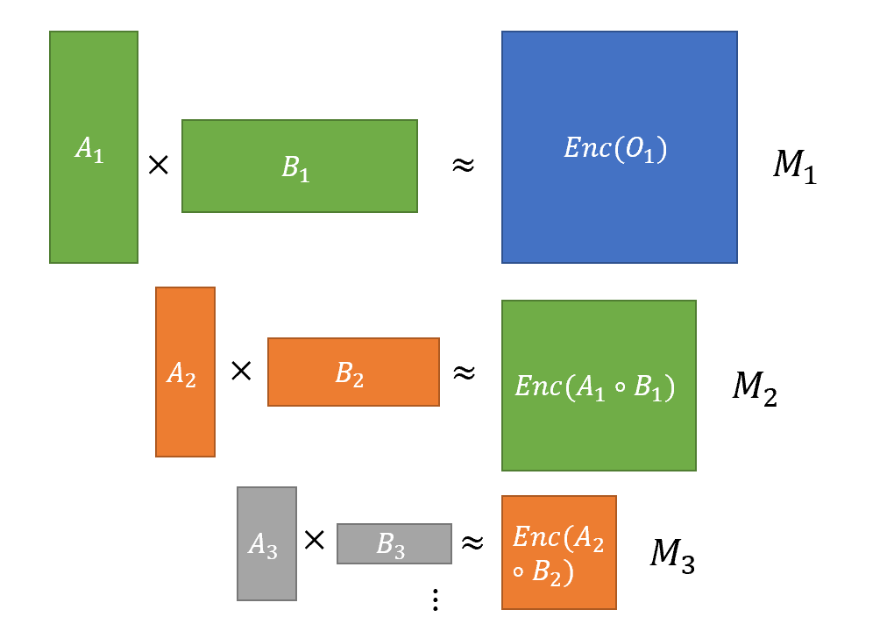
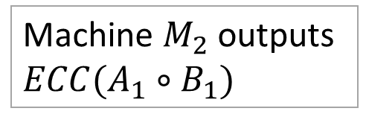
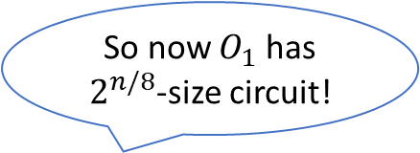

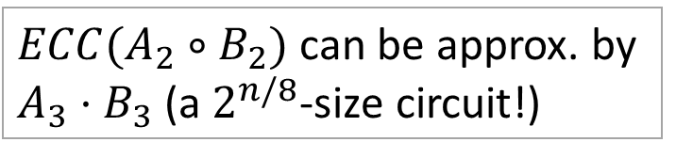
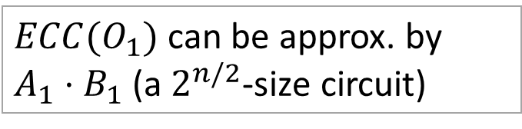
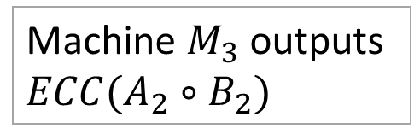
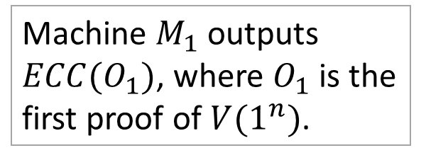

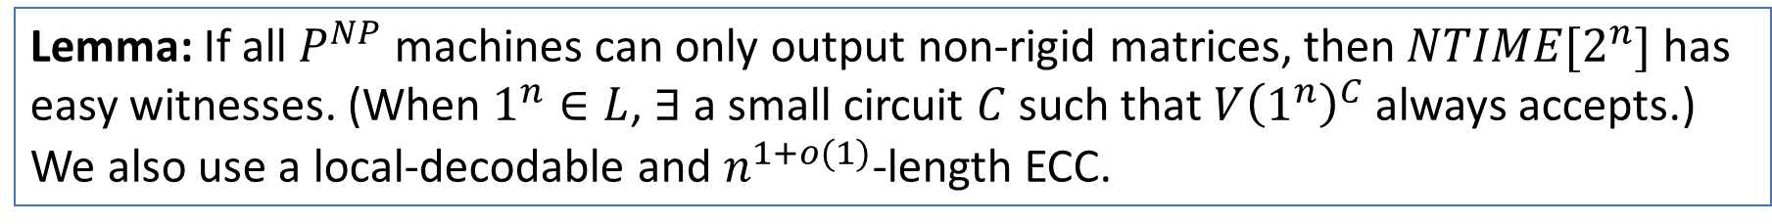
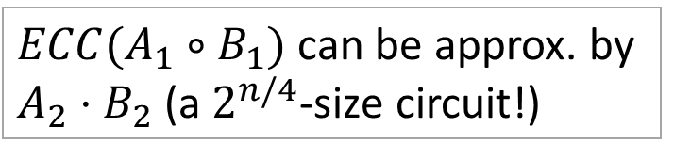
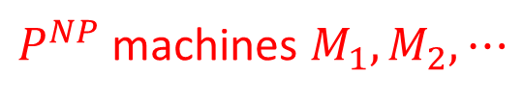
Bootstrapping Low-Rank Approximations
Lemma: If all $P^{NP}$ machines can only output non-rigid matrices, then $NTIME[2^{n}]$ has easy witnesses. (When $1^{n}∈L$, $∃$ a small circuit $C$ such that $V{\left(1^{n}\right)}^{C}$ always accepts.)
We also use a local-decodable and $n^{1+o(1)}$-length ECC.
$P^{NP}$ machines $M_{1},M_{2},⋯$
So now $O_{1}$ has $2^{n/2}$-size circuit.
Machine $M_{1}$ outputs $ECC(O_{1})$, where $O_{1}$ is the first proof of $V(1^{n})$.
$ECC(O_{1})$ can be approx. by $A_{1}⋅B_{1}$ (a $2^{n/2}$-size circuit)
So now $O_{1}$ has $2^{n/4}$-size circuit!
Machine $M_{2}$ outputs $ECC(A_{1}∘B_{1})$
$ECC(A_{1}∘B_{1})$ can be approx. by $A_{2}⋅B_{2}$ (a $2^{n/4}$-size circuit!)
So now $O_{1}$ has $2^{n/8}$-size circuit!
Machine $M_{3}$ outputs $ECC(A_{2}∘B_{2})$
$ECC(A_{2}∘B_{2})$ can be approx. by $A_{3}⋅B_{3}$ (a $2^{n/8}$-size circuit!)
Notes:
Try to make an informal lemma here
If you have seen Ryan’s approaches before you may understand why we need a lemma like this, but if you don’t see why, feel free to ask me offline.

Slide 23
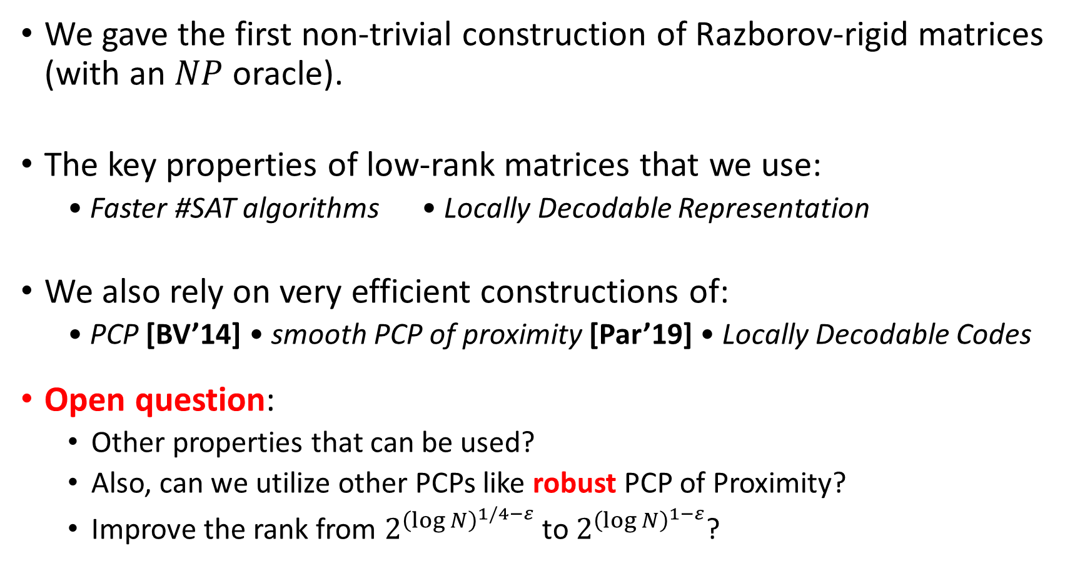
Summary
We gave the first non-trivial construction of Razborov-rigid matrices (with an $NP$ oracle).
The key properties of low-rank matrices that we use:
• Faster #SAT algorithms • Locally Decodable Representation
We also rely on very efficient constructions of:
• PCP [BV’14] • smooth PCP of proximity [Par’19] • Locally Decodable Codes
Open question:
Other properties that can be used?
Also, can we utilize other PCPs like robust PCP of Proximity?
Improve the rank from $2^{{\left(\log{N}\right)}^{1/4−ε}}$ to $2^{{\left(\log{N}\right)}^{1−ε}}$?

Slide 24
Thanks! Any Questions?

Slide 25


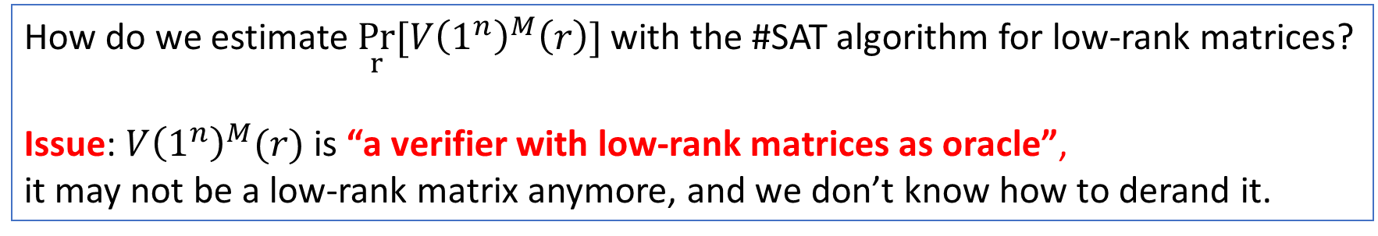

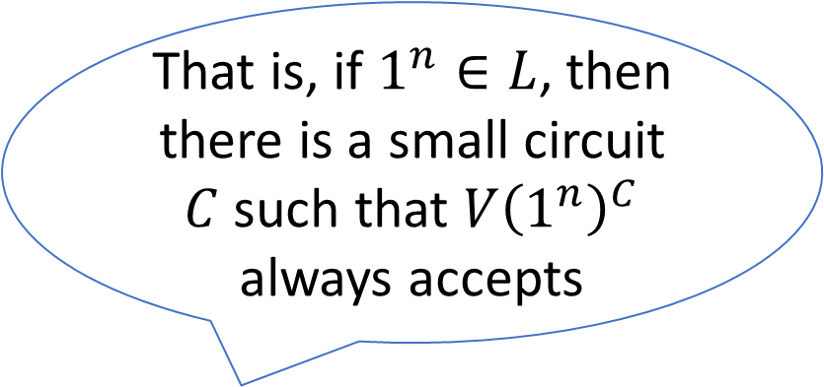
Onwards to the Real Proof
How do we estimate $\underset{r}{Pr}[V{\left(1^{n}\right)}^{M}\left(r\right)]$ with the #SAT algorithm for low-rank matrices?
Issue: $V{\left(1^{n}\right)}^{M}(r)$ is “a verifier with low-rank matrices as oracle”,
it may not be a low-rank matrix anymore, and we don’t know how to derand it.
Solution: PCP of Proximity + ECC [Chen-Williams, 2019]
(Morally Speaking), this can let us pretend that $V{\left(1^{n}\right)}^{M}(r)$ is also a low-rank matrix! so we can apply our $\#$SAT algorithm!!
New problem: for this to work, we need to assume $V(1^{n})$ has easy-witness.
That is, if $1^{n}∈L$, then there is a small circuit $C$ such that $V{\left(1^{n}\right)}^{C}$ always accepts
This is indeed involved,
Check the paper for details!
Notes:
Just say this is a very cool technical lemma we used!
If you are familiar with Ryan’s approach, then you may recognized this but otherwise don’;t worry about it ☺

Slide 26
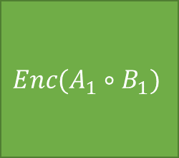
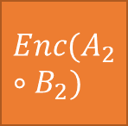

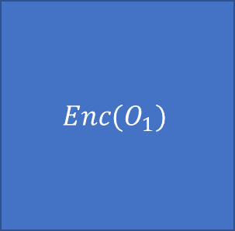















$$A_{1}$$
$$Enc(O_{1})$$
$$B_{1}$$
$$M_{1}$$
$$×$$
$$≈$$
$$A_{2}$$
$$Enc(A_{1}∘B_{1})$$
$$×$$
$$B_{2}$$
$$≈$$
$$M_{2}$$
$$A_{3}$$
$$Enc(A_{2}∘B_{2})$$
$$×$$
$$B_{3}$$
$$≈$$
$$M_{3}$$
$$⋮$$

