Slide 1
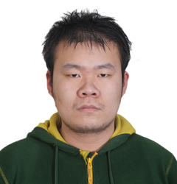
Classical Algorithms from Quantum and Arthur-Merlin Communication Protocols
Lijie Chen
MIT
Ruosong Wang
CMU

Slide 2
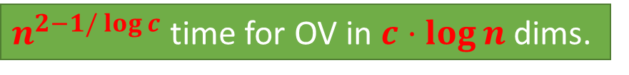
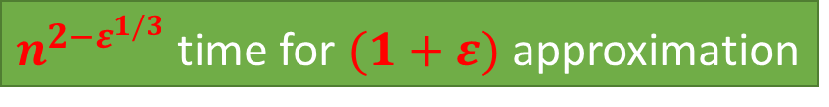
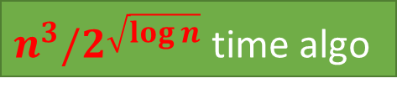
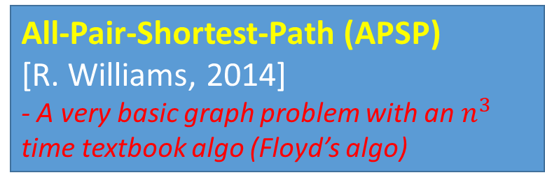
The Polynomial Method - A gift from circuit complexity to algorithm
Orthogonal Vectors (OV)
[Abboud-R. Williams-Yu, 2015]
- One of the most important problems in fine-grained complexity
$n^{2−1/\log{c}}$ time for OV in $c⋅\log{n}$ dims.
All-Pair-Shortest-Path (APSP)
[R. Williams, 2014]
- A very basic graph problem with an $n^{3}$ time textbook algo (Floyd’s algo)
$n^{3}/2^{\sqrt{\log{n}}}$ time algo
Approx.-Bichrom.-Closest-Pair
[Alman-R. Williams-Chan, 2016]
- A Fundamental Problem in Computational Geometry
$n^{2−ε^{1/3}}$ time for $(1+ε)$ approximation

Slide 3
How does Polynomial Method Work?
An Algorithm Task A
Find A Key Subroutine S of A
approx
Batch Evaluation for
Multi-Variable Polynomials
Subroutine S
A Sparse Polynomial
P
Fast Rectangle Matrix Multiplication

Slide 4
Observation [Alman-R.Williams, 2017]
In fact, it ultimately relies on
“low-rank decomposition” of the
Subroutine S!
An Algorithm Task A
Find A Key Subroutine S of A
approx
Batch Evaluation for
Multi-Variable Polynomials
Subroutine S
A Sparse Polynomial
P
Fast Rectangle Matrix Multiplication

Slide 5
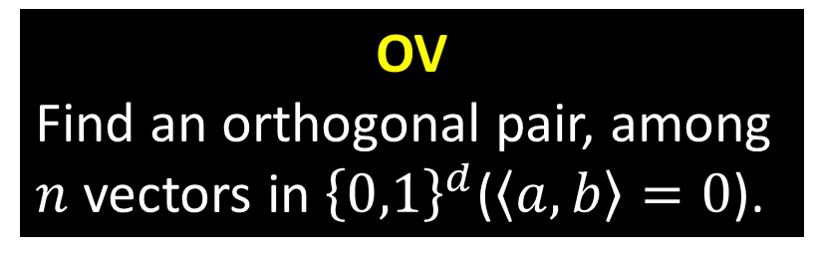
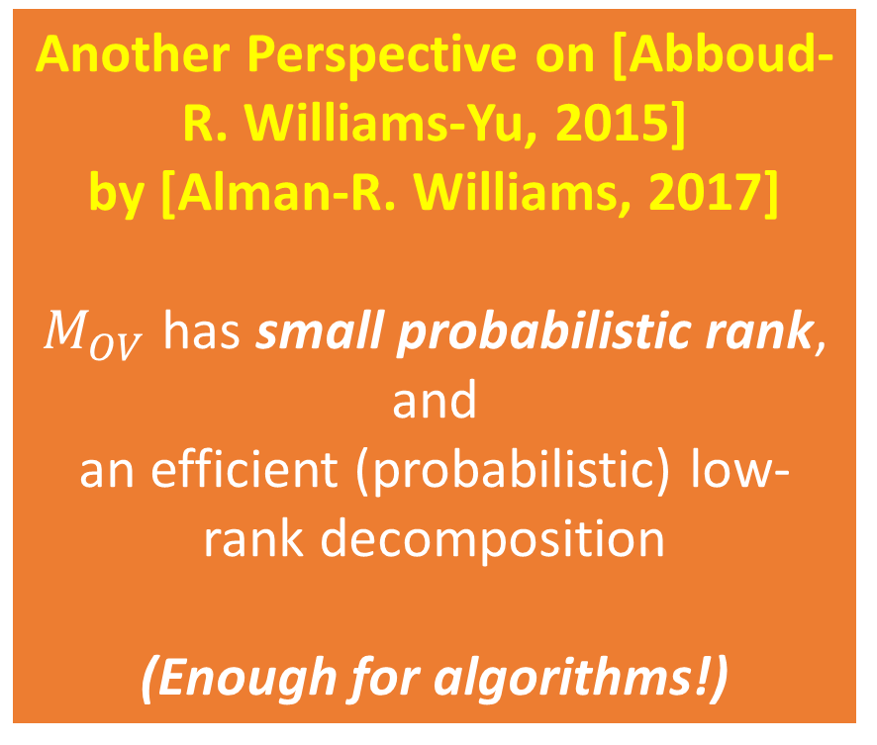


Example : Orthogonal Vectors (OV)
OV
Find an orthogonal pair, among $n$ vectors in ${\left\{0,1\right\}}^{d}$($\left\langle a,b\right\rangle =0$).
Another Perspective on [Abboud-R. Williams-Yu, 2015]
by [Alman-R. Williams, 2017]
$M_{OV}$ has small probabilistic rank, and
an efficient (probabilistic) low-rank decomposition
(Enough for algorithms!)
Key Subroutine S
$$F_{OV}\left(a,b\right)≔[\left\langle a,b\right\rangle =0?]$$
Corresponding Matrix $M_{OV}$
$M_{OV}$ : a $2^{d}×2^{d}$ matrix

Slide 6

Motivation : Other ways to construct these low-rank decomposition?
Communication Protocols!
Deterministic Communication Protocols
Rank
Quantum Communication Protocols
$≥$ log of
Approximate Rank
Unbounded Error Communication Protocols
Sign Rank

Slide 7
Connections between Communication Protocols and different rank measures
rank
Original Perspective
Approach to prove communication complexity lower bounds
CC
This Work
Approach to Systematically Construct Efficient Low-Rank Decomposition
(to get algorithms)
rank
CC

Slide 8
This Work : Two Generic Connections
(Classical) Approximate Counting Algorithms from Quantum Communication Protocols
2. (Classical) Satisfying Pair Algorithms from
Arthur-Merlin or PH Communication Protocols

Slide 9
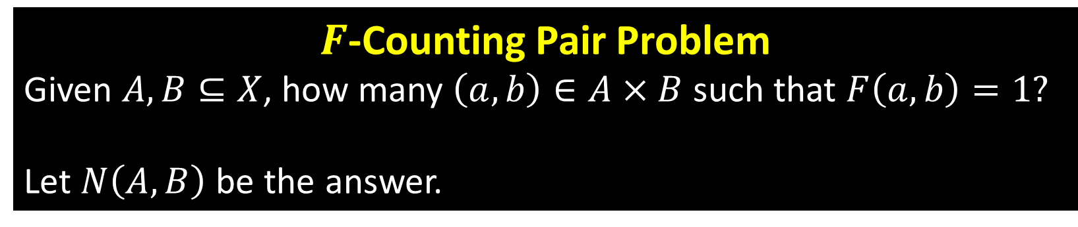
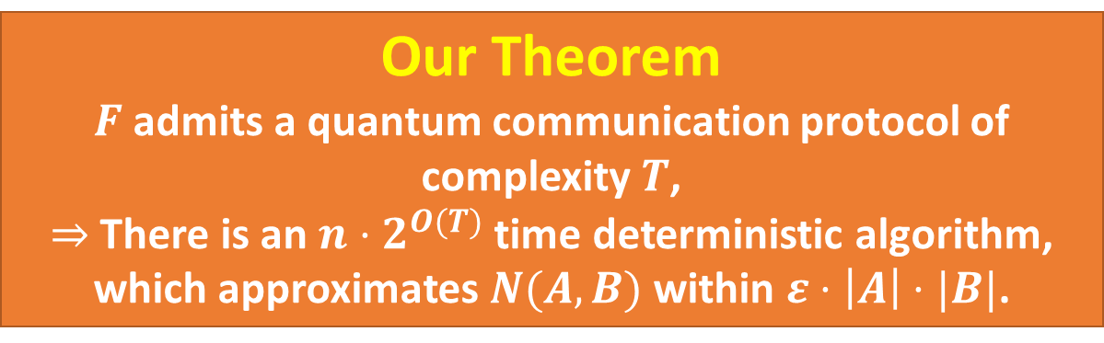
Approximate Counting Algorithms from Quantum Communication Protocols
$F$-Counting Pair Problem
Given $A,B⊆X$, how many $\left(a,b\right)∈A×B$ such that $F\left(a,b\right)=1?$
Let $N\left(A,B\right)$ be the answer.
Our Theorem
$F$ admits a quantum communication protocol of complexity $T$,
$⇒$ There is an $n⋅2^{O(T)}$ time deterministic algorithm, which approximates $N(A,B)$ within $ε⋅\left|A\right|⋅|B|$.

Slide 10
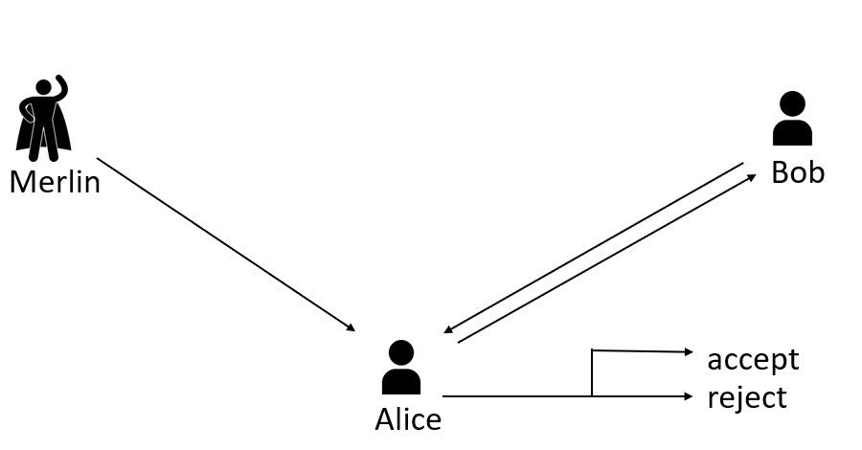
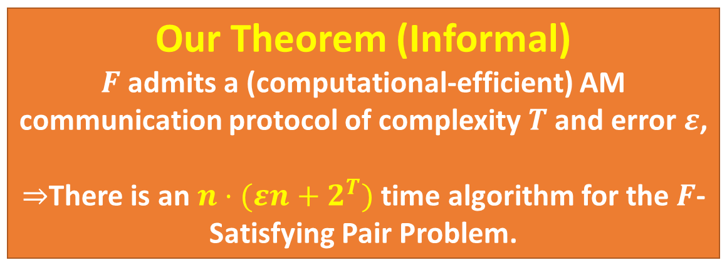
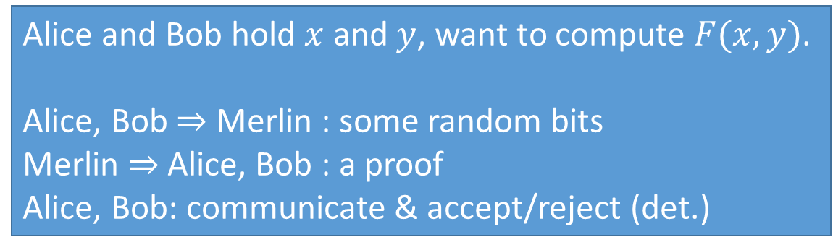
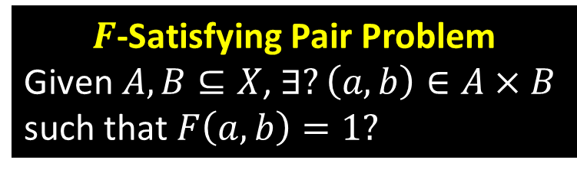
Satisfying Pair Algorithms from Arthur-Merlin (AM) or PH Communication Protocols
$F$-Satisfying Pair Problem
Given $A,B⊆X$, $∃?\left(a,b\right)∈A×B$ such that $F\left(a,b\right)=1?$
Alice and Bob hold $x$ and $y$, want to compute $F(x,y)$.
Alice, Bob $⇒$ Merlin : some random bits
Merlin $⇒$ Alice, Bob : a proof
Alice, Bob: communicate & accept/reject (det.)
AM Communication Protocols
Our Theorem (Informal)
$F$ admits a (computational-efficient) AM communication protocol of complexity $T$ and error $ε$,
$⇒$There is an $n⋅(εn+2^{T})$ time algorithm for the $F$-Satisfying Pair Problem.

Slide 11
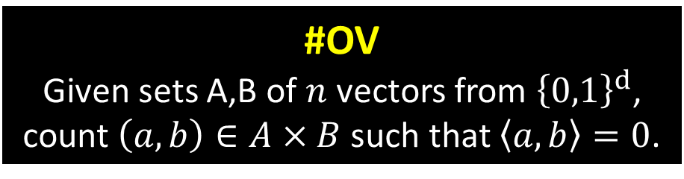
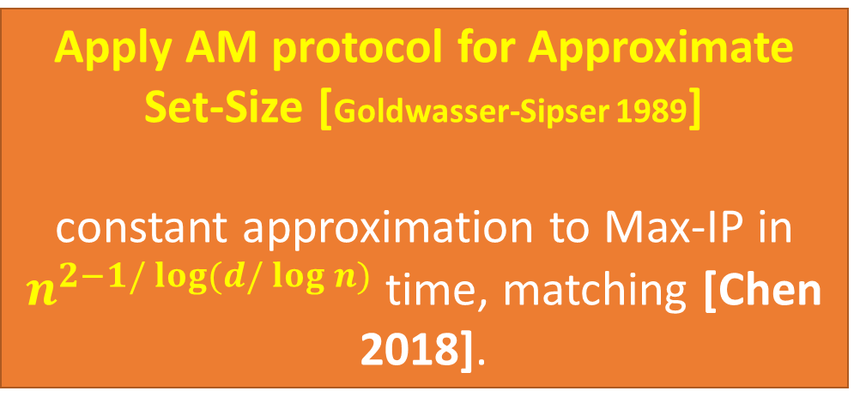
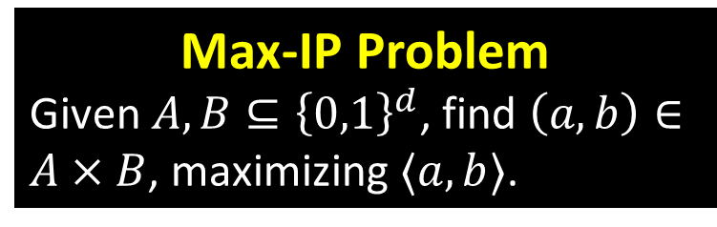
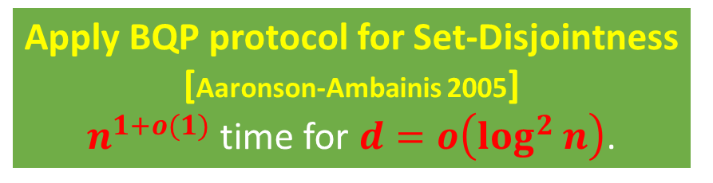
Immediate Applications
#OV
Given sets A,B of $n$ vectors from ${\left\{0,1\right\}}^{d}$,
count $\left(a,b\right)∈A×B$ such that $\left\langle a,b\right\rangle =0$.
Max-IP Problem
Given $A,B⊆{\left\{0,1\right\}}^{d}$, find $\left(a,b\right)∈A×B$, maximizing $⟨a,b⟩$.
Constant additive error approximation
Apply BQP protocol for Set-Disjointness [Aaronson-Ambainis 2005]
$n^{1+o(1)}$ time for $d=o\left(\log^{2}{n}\right)$.
Apply AM protocol for Approximate Set-Size [Goldwasser-Sipser 1989]
constant approximation to Max-IP in $n^{2−1/\log{(d/\log{n})}}$ time, matching [Chen 2018].
Other applications from BQP protocol for Element-Distinctness [Ambainis 2007], and BQP protocol Formula-Evaluation [Ambainis et al. 2010].

Slide 12
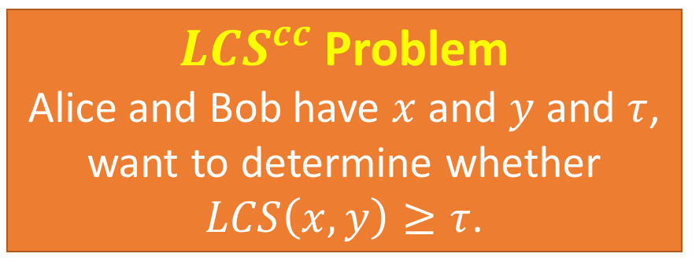
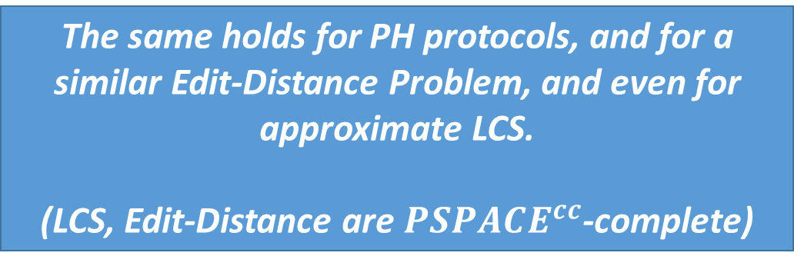
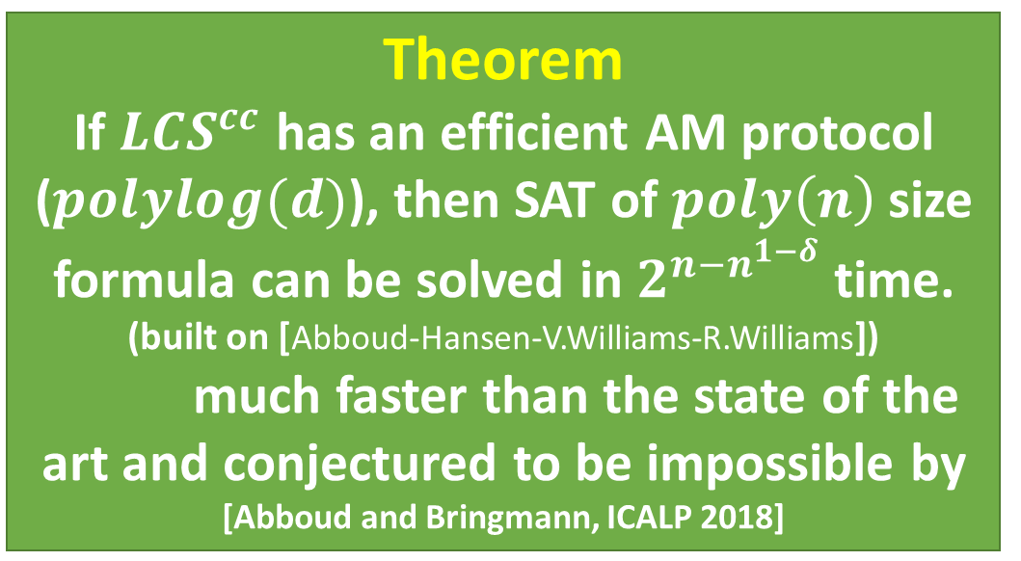
Applications in Computation Complexity
Theorem
If $LCS^{cc}$ has an efficient AM protocol ($polylog(d)$), then SAT of $poly\left(n\right)$size formula can be solved in $2^{n−n^{1−δ}}$ time.
(built on [Abboud-Hansen-V.Williams-R.Williams])
much faster than the state of the art and conjectured to be impossible by [Abboud and Bringmann, ICALP 2018]
Big Open Question in CC
Prove a non-trivial lower bound on the AM communication complexity of an explicit function
$LCS^{cc}$ Problem
Alice and Bob have $x$ and $y$ and $τ$, want to determine whether $LCS\left(x,y\right)≥τ$.
The same holds for PH protocols, and for a similar Edit-Distance Problem, and even for approximate LCS.
(LCS, Edit-Distance are $PSPACE^{cc}$-complete)

Slide 13
Thanks! Questions?

Slide 14
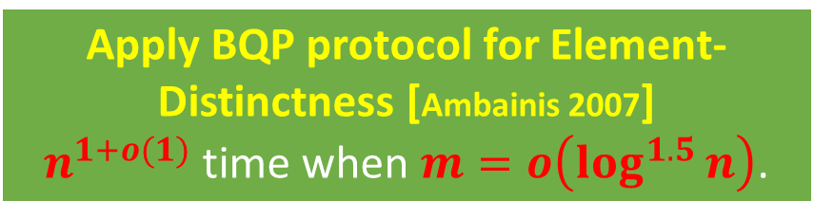
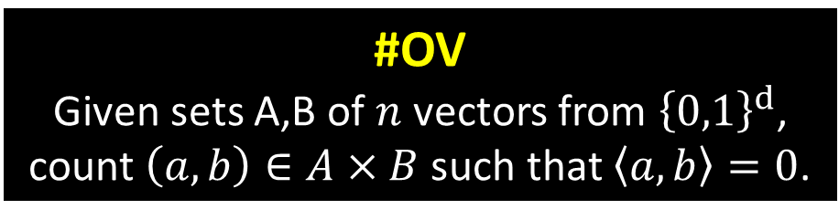
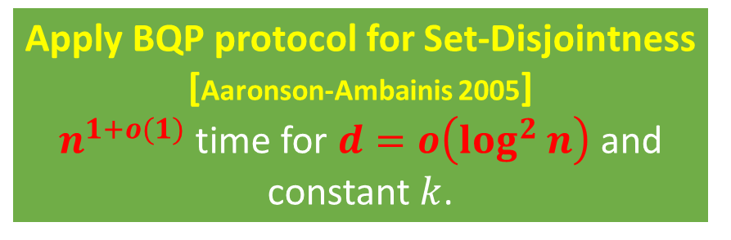
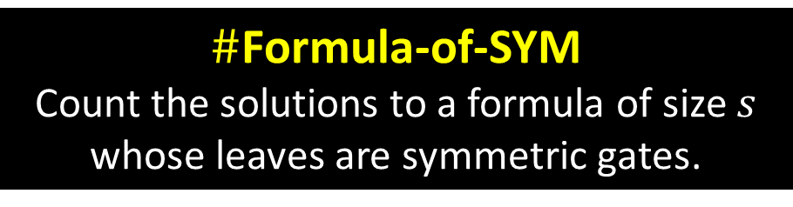


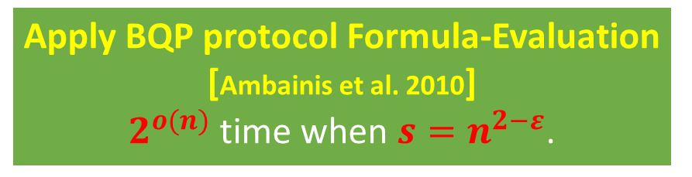
Applications
Constant additive error approximation
#OV
Given sets A,B of $n$ vectors from ${\left\{0,1\right\}}^{d}$,
count $\left(a,b\right)∈A×B$ such that $\left\langle a,b\right\rangle =0$.
Apply BQP protocol for Set-Disjointness [Aaronson-Ambainis 2005]
$n^{1+o(1)}$ time for $d=o\left(\log^{2}{n}\right)$ and constant $k$.
#$k$-OV
A similar problem defines on $k$ sets.
$\#$Sparse-OV
#OV but now all vectors have hamming weight at most $m$
Apply BQP protocol for Element-Distinctness [Ambainis 2007]
$n^{1+o(1)}$ time when $m=o\left(\log^{1.5}{n}\right)$.
$\#$Formula-of-SYM
Count the solutions to a formula of size $s$ whose leaves are symmetric gates.
Apply BQP protocol Formula-Evaluation [Ambainis et al. 2010]
$2^{o(n)}$ time when $s=n^{2−ε}$.

