Slide 1

An Equivalence Class for Orthogonal Vectors
Lijie Chen
MIT
Ryan Williams
MIT

Slide 2
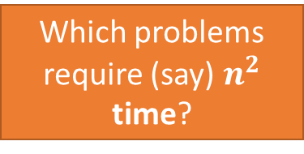
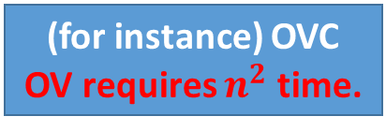

Fine-Grained Complexity: “Modern” NP-completeness
Many Conceptual Similarities
NP-Completeness
Fine-Grained Complexity
Basic Questions
Which problems require super-poly time?
Which problems require (say) $n^{2}$ time?
$P≠NP$
SAT requires $n^{ω(1)}$ time.
(for instance) OVC
OV requires $n^{2}$ time.
Basic Assumptions
Weapons (Reductions)
Karp-reduction
Fine-Grained Reduction

Slide 3
The Key Conceptual Difference
NP-completeness
Fine-Grained Complexity
Hamiltonian Path
Orthogonal Vectors
Approx. Bichrom.
Closest Pair
Vertex Cover
Max-Clique
Edit Distance
Backurs and Indyk 2015
Sparse-Graph-Diameter
Rubinstein 2018
Thousands of NP-complete problems
form an equivalence class
Roditty and V.Williams 2013
Few Problems are known
To be Equivalent to OV
Except for the APSP
equivalence class

Slide 4


Why we want an Equivalence Class? I
What does an equivalence class mean?
A super strong understanding
of the natural of computation!
All problems are essentially the same problem!
We cannot say “Edit Distance is just OV in disguise”
Hamiltonian Path
Max-Clique
These NP-complete problems
are just SAT “in disguise”!
Vertex Cover

Slide 5
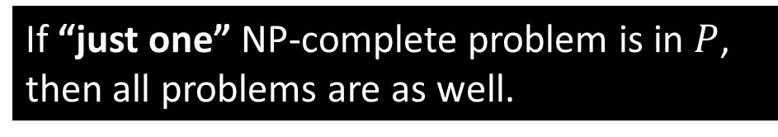
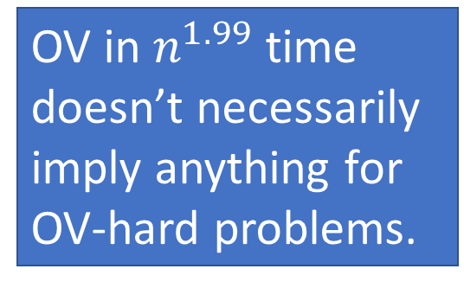
Why we want an Equivalence Class? II
Consequence of an equivalence class
OV in $n^{1.99}$ time doesn’t necessarily imply anything for
OV-hard problems.
If “just one” NP-complete problem requires super-poly time, then all of them do
If “just one” NP-complete problem is in $P$, then all problems are as well.
Orthogonal Vectors
Hamiltonian Cycle
Approx. Bichrom.
Closest Pair
Edit Distance
Vertex Cover
Max-Clique
Sparse-Graph-Diameter

Slide 6
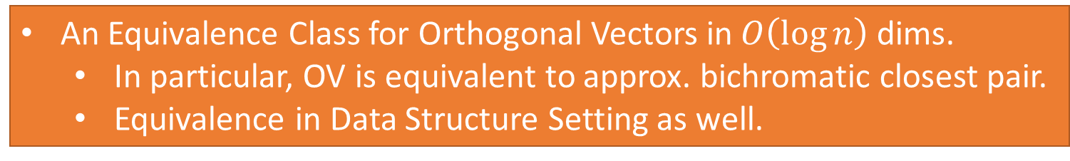
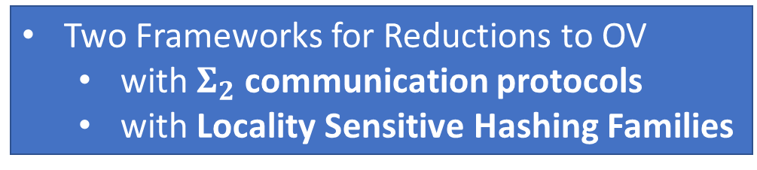
This Work
An Equivalence Class for Orthogonal Vectors in $O\left(\log{n}\right)$ dims.
In particular, OV is equivalent to approx. bichromatic closest pair.
Equivalence in Data Structure Setting as well.
Two Frameworks for Reductions to OV
with $Σ_{2}$ communication protocols
with Locality Sensitive Hashing Families
Other related results (See the paper!)
A new algorithm for approximate Min-IP.
Some tighter reductions.
Some equivalence results in “moderate” dimensions.
A (sub-optimal) reduction from 3-SUM to 3-OV.

Slide 7
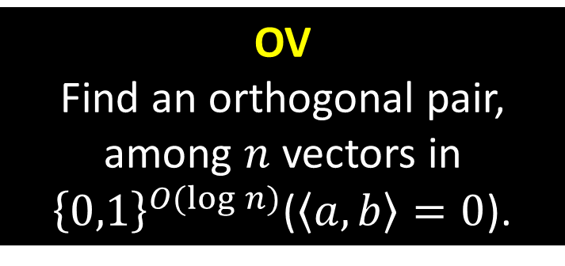
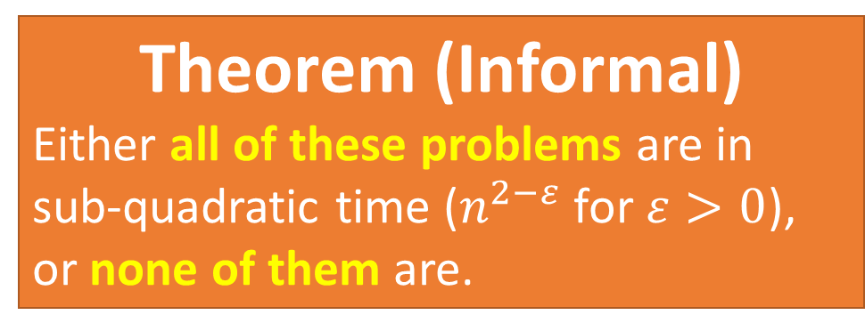

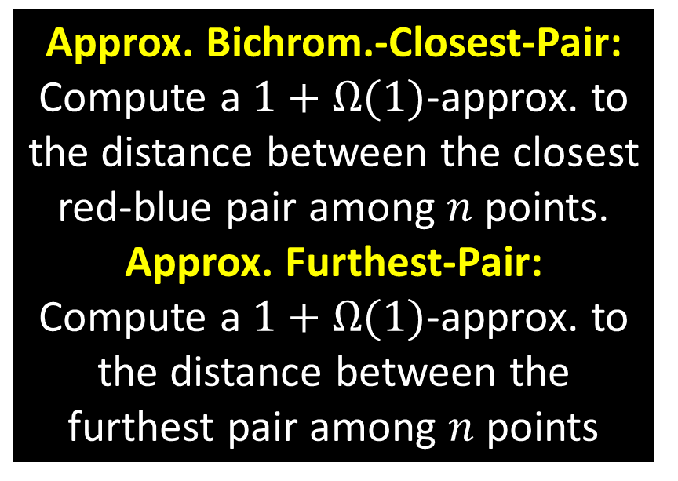
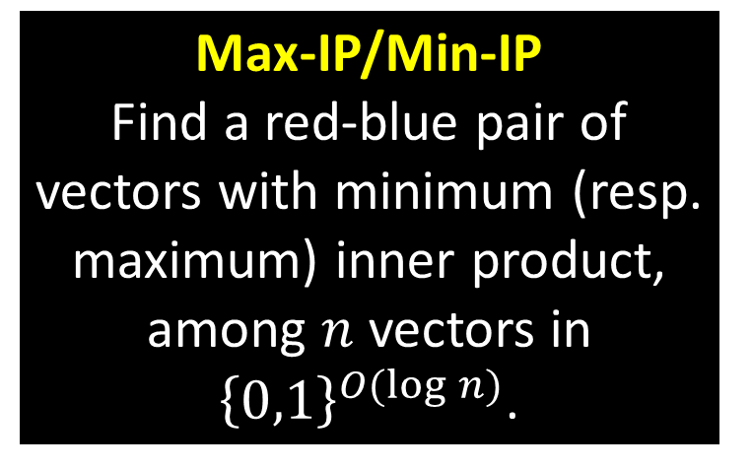
A New Equivalence Class for OV
OV
Find an orthogonal pair, among $n$ vectors in ${\left\{0,1\right\}}^{O(\log{n})}$($\left\langle a,b\right\rangle =0$).
Approx. Bichrom.-Closest-Pair: Compute a $1+Ω(1)$-approx. to the distance between the closest red-blue pair among $n$ points.
Approx. Furthest-Pair:
Compute a $1+Ω(1)$-approx. to the distance between the furthest pair among $n$ points
Theorem (Informal)
Either all of these problems are in sub-quadratic time ($n^{2−ε}$ for $ε>0$),
or none of them are.
Max-IP/Min-IP
Find a red-blue pair of vectors with minimum (resp. maximum) inner product, among $n$ vectors in ${\left\{0,1\right\}}^{O(\log{n})}$.
Apx-Min-IP/-Max-IP
Compute a $100$ approximation to Max-IP/Min-IP.

Slide 8
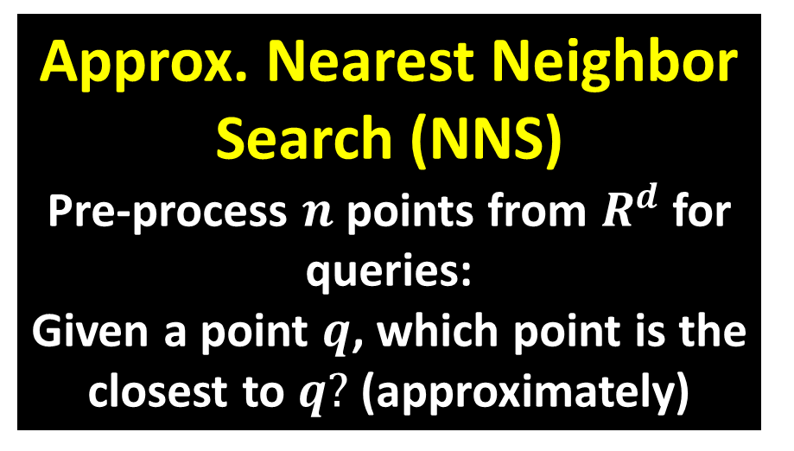
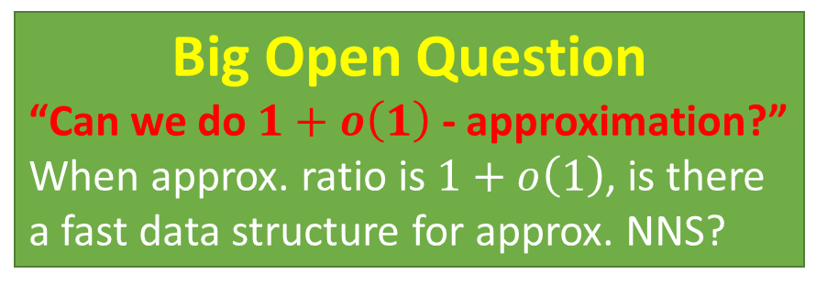
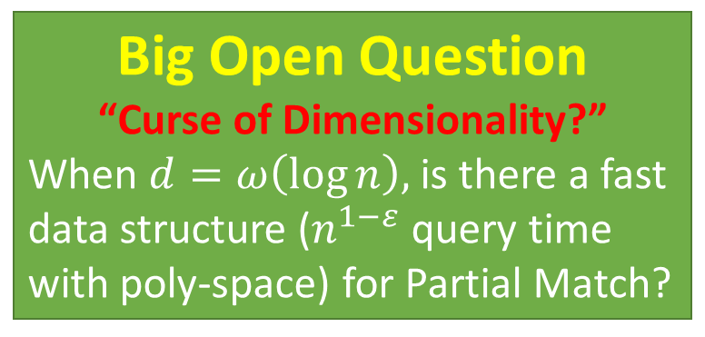
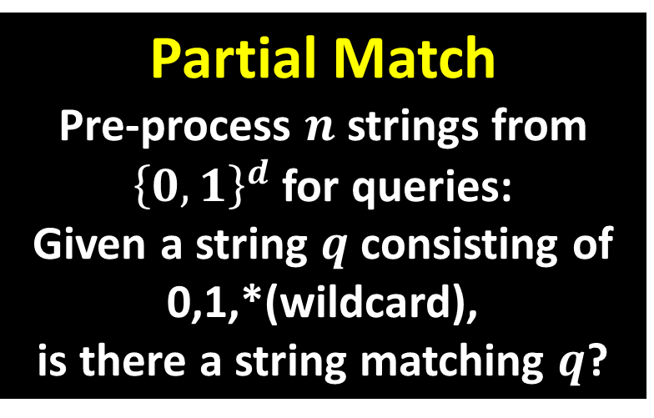
Equivalence in Data Structure Setting
Partial Match
Pre-process $n$ strings from ${\left\{0,1\right\}}^{d}$ for queries:
Given a string $q$ consisting of
0,1,*(wildcard),
is there a string matching $q$?
Approx. Nearest Neighbor Search (NNS)
Pre-process $n$ points from $R^{d}$ for queries:
Given a point $q$, which point is the closest to $q?$ (approximately)
Theorem (Informal)
Such a fast DS exists for Partial Match if and only if such a fast DS exists for approx. NNS
Big Open Question
“Curse of Dimensionality?”
When $d=ω\left(\log{n}\right),$ is there a fast data structure ($n^{1−ε}$ query time with poly-space) for Partial Match?
Big Open Question
“Can we do $1+o\left(1\right)$ - approximation?”
When approx. ratio is $1+o\left(1\right)$, is there a fast data structure for approx. NNS?

Slide 9
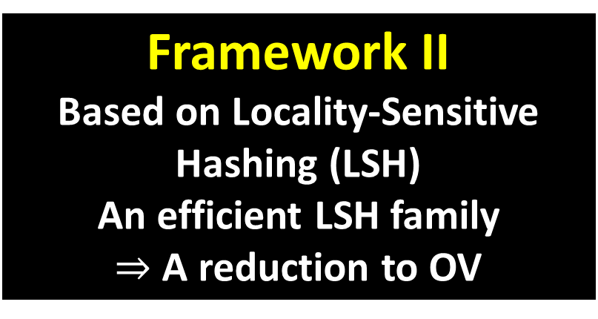
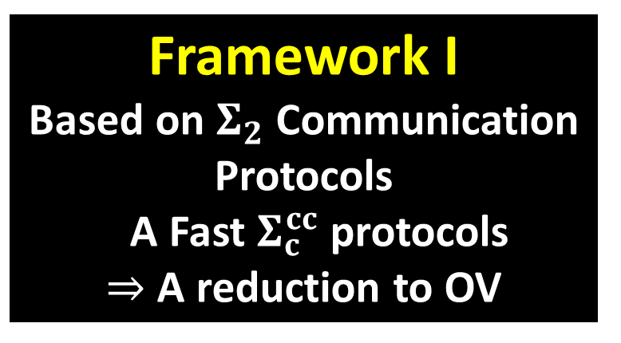
Technique: Two Reduction Frameworks
Known Directions [R. Williams 05, Rubinstein 18]: OV $⇒$ Other Problems
This work: Other Problems $⇒$ OV via two reduction frameworks
Framework I
Based on $Σ_{2}$ Communication Protocols
A Fast $Σ_{c}^{cc}$ protocols
$⇒$ A reduction to OV
Framework II
Based on Locality-Sensitive Hashing (LSH)
An efficient LSH family
$⇒$ A reduction to OV

Slide 10
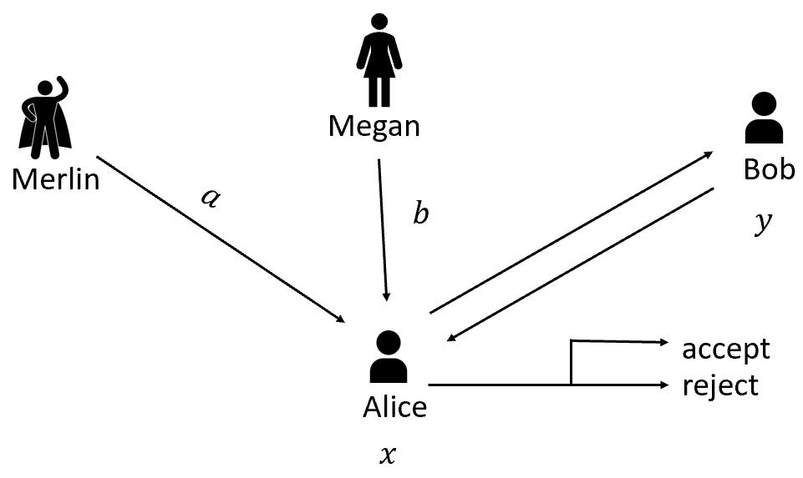

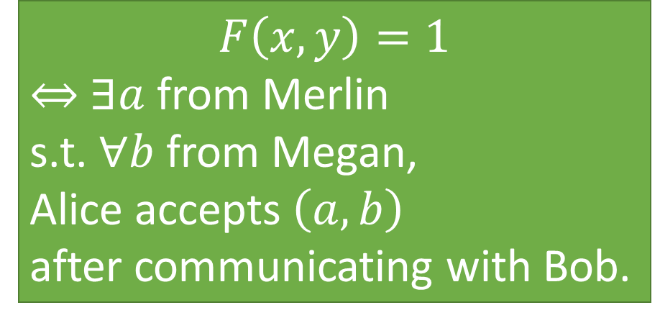
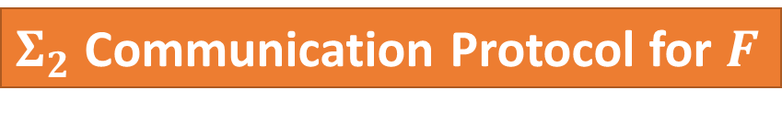
Framework I : $Σ_{2}$ communication protocols
$Σ_{2}$ Communication Protocol for $F$
$$F\left(x,y\right)=1$$
$⇔$ $∃a$ from Merlin
s.t. $∀b$ from Megan,
Alice accepts $\left(a,b\right)$
after communicating with Bob.
Notes:
Redo the graph

Slide 11
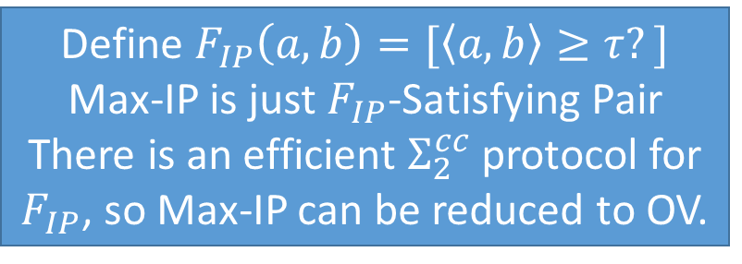
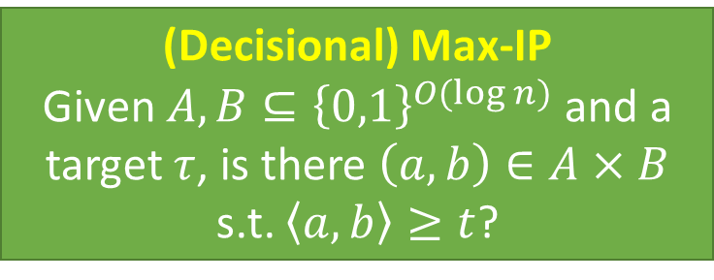
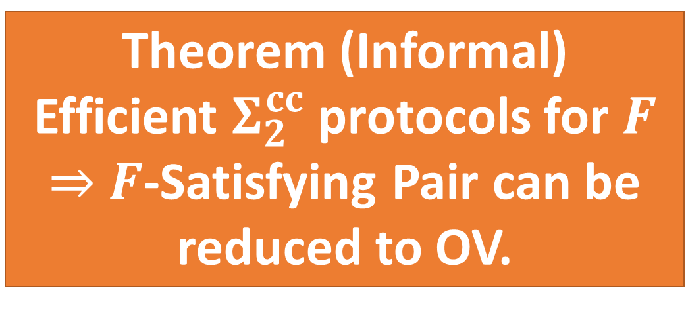
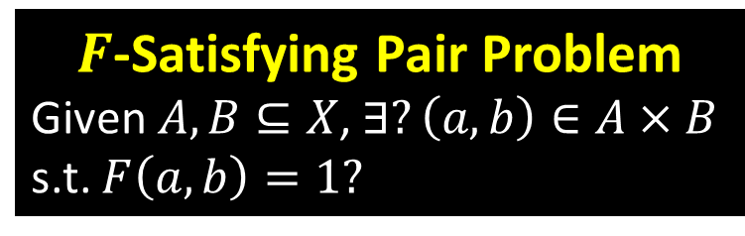
Framework I : $Σ_{2}$ communication protocols
$F$-Satisfying Pair Problem
Given $A,B⊆X$, $∃?\left(a,b\right)∈A×B$ s.t. $F\left(a,b\right)=1?$
Application
(Decisional) Max-IP
Given $A,B⊆{\left\{0,1\right\}}^{O(\log{n})}$ and a target $τ$, is there $\left(a,b\right)∈A×B$ s.t. $\left\langle a,b\right\rangle ≥t$?
Theorem (Informal)
Efficient $Σ_{2}^{cc}$ protocols for $F$
$⇒$ $F$-Satisfying Pair can be reduced to OV.
Define $F_{IP}\left(a,b\right)=[\left\langle a,b\right\rangle ≥τ?]$
Max-IP is just $F_{IP}$-Satisfying Pair
There is an efficient $Σ_{2}^{cc}$ protocol for $F_{IP}$, so Max-IP can be reduced to OV.
Notes:
Discuss why Sigma_2 may be more compelling than MA

Slide 12
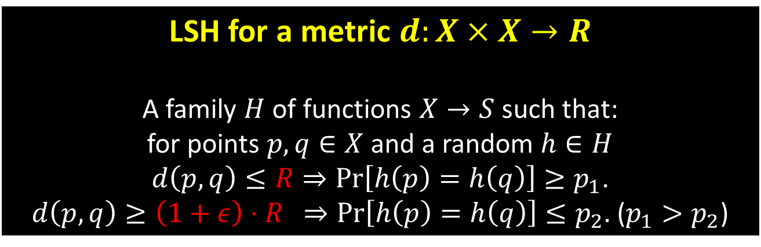
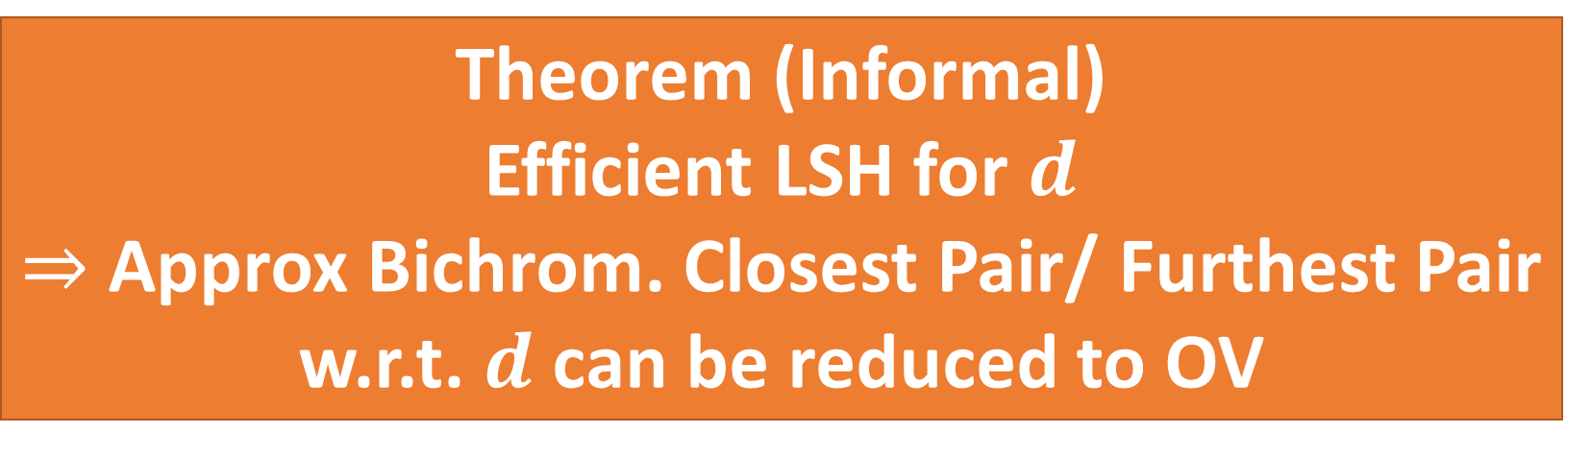
Framework II : Locality-Sensitive Hashing
LSH for a metric $d:X×X→R$
A family $H$ of functions $X→S$ such that:
for points $p,q∈X$ and a random $h∈H$
$d\left(p,q\right)≤R⇒Pr\left[h\left(p\right)=h\left(q\right)\right]≥p_{1}$.
$d\left(p,q\right)≥\left(1+ε\right)⋅R$ $⇒Pr\left[h\left(p\right)=h\left(q\right)\right]≤p_{2}$. ($p_{1}>p_{2}$)
Theorem (Informal)
Efficient LSH for $d$
$⇒$ Approx Bichrom. Closest Pair/ Furthest Pair
w.r.t. $d$ can be reduced to OV
Notes:
Polish this

Slide 13
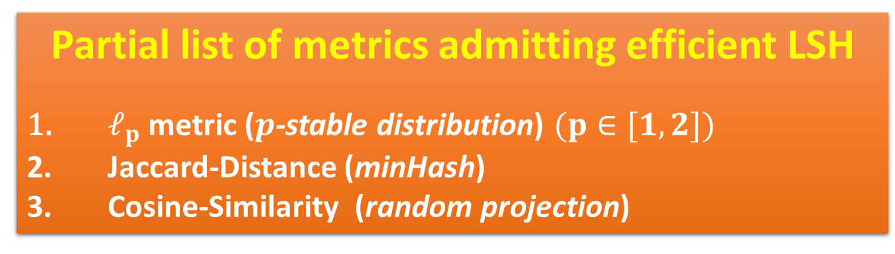
Framework II : Locality-Sensitive Hashing
Partial list of metrics admitting efficient LSH
$ℓ_{p}$ metric ($p$-stable distribution) $(p∈[1,2])$
Jaccard-Distance (minHash)
Cosine-Similarity (random projection)
Applications
Approx Bichrom. Closest Pair/ Furthest Pair
w.r.t. all the above metrices are equivalent to
OV

Slide 14
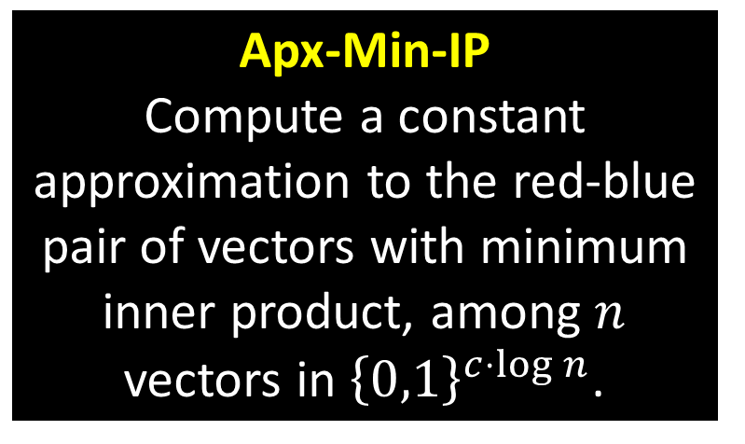
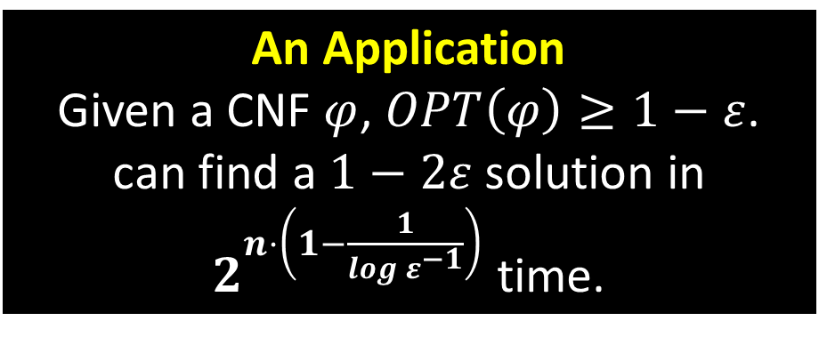
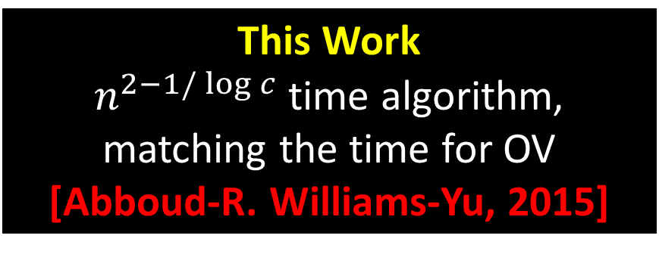
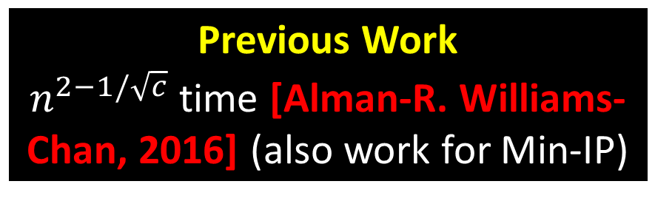
A New Algorithm for Approximate Min-IP
Apx-Min-IP
Compute a constant approximation to the red-blue pair of vectors with minimum inner product, among $n$ vectors in ${\left\{0,1\right\}}^{c⋅\log{n}}$.
This Work
$n^{2−1/\log{c}}$ time algorithm,
matching the time for OV [Abboud-R. Williams-Yu, 2015]
An Application
Given a CNF $φ$, $OPT\left(φ\right)≥1−ε$.
can find a $1−2ε$ solution in
$2^{n⋅\left(1−\frac{1}{log ε^{−1}}\right)}$ time.
Previous Work
$n^{2−1/\sqrt{c}}$ time [Alman-R. Williams-Chan, 2016] (also work for Min-IP)

Slide 15
Open Problems
Find More Problems Equivalent to OV
Unequivalence Results?

Slide 16
Thank you! Questions?

