Slide 1
Recent Structure Lemmas for Depth-Two Threshold Circuits
Lijie Chen
MIT

Slide 2

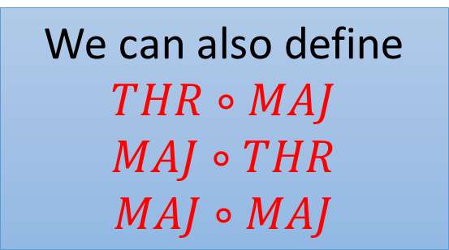

THR$∘$THR Circuits
THR gates : $f\left(x\right)=\left[w⋅x≥t\right]$ $w∈Z^{n}$, $t∈Z$.
MAJ gates : when $w_{i}$’s and $t$ are bounded by poly(n).
THR$∘$THR:
We can also define
$$THR∘MAJ$$
$$MAJ∘THR$$
$$MAJ∘MAJ$$
THR
THR
THR
THR
Notes:
Always mean polynomial-size circuits

Slide 3


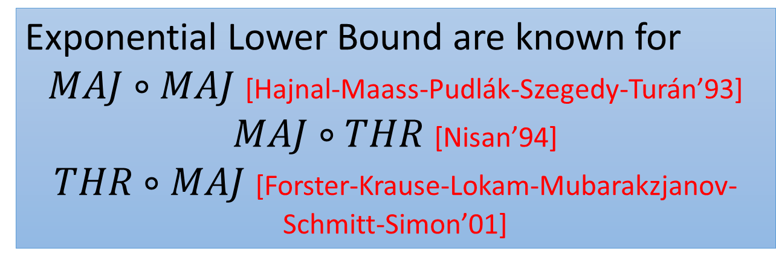
THR$∘$THR Circuits
Exponential Lower Bound are known for
$MAJ∘MAJ$ [Hajnal-Maass-Pudlák-Szegedy-Turán’93]
$MAJ∘THR$ [Nisan’94]
$THR∘MAJ$ [Forster-Krause-Lokam-Mubarakzjanov-Schmitt-Simon’01]
NEXP:
Non-deterministic
Exponential Time.
Frontier Open Question: Is NEXP $⊆THR∘THR$?
Potential Approaches in this talk.
Notes:
THR gate is just a half-space

Slide 4
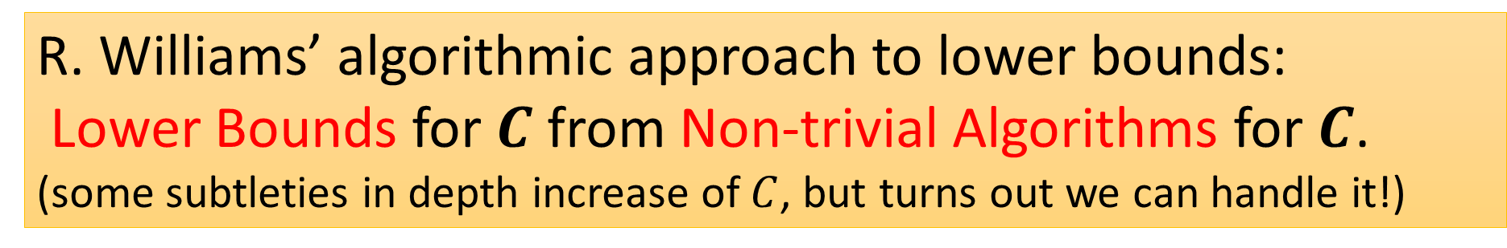
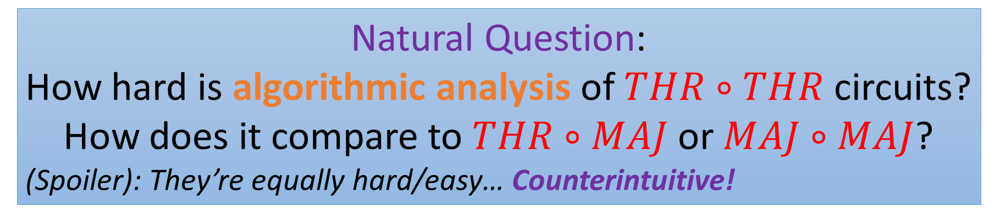
Motivation
R. Williams’ algorithmic approach to lower bounds:
Lower Bounds for $C$ from Non-trivial Algorithms for $C$.
(some subtleties in depth increase of $C$, but turns out we can handle it!)
Natural Question:
How hard is algorithmic analysis of $THR∘THR$ circuits?
How does it compare to $THR∘MAJ$ or $MAJ∘MAJ$?
(Spoiler): They’re equally hard/easy… Counterintuitive!
Notes:
THR gate is just a half-space
We know THR of THR is strictly stronger than THR of MAJ which is in turn strictly stronger than MAJ of MAJ

Slide 5
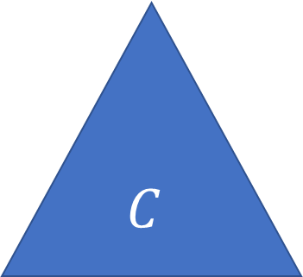


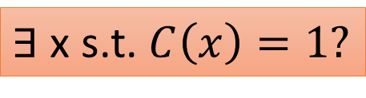
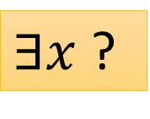


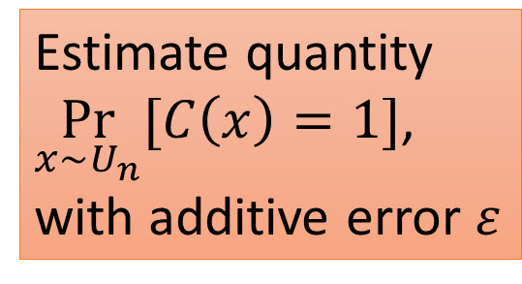
Algorithmic Questions
$C$-SAT
$C$-CAPP
$$C$$
$$C$$
Estimate quantity
$\underset{x∼U_{n}}{Pr}{[C\left(x\right)=1]}$,
with additive error $ε$
$∃$ x s.t. $C\left(x\right)=1?$
$∃x$ ?
$$x∼U_{n}$$
Notes:
Our notion for Non-trivial CAPP is slightly restrictive more several technical reasons…
Because we don’t want to afford a loss of the depth in the construction

Slide 6
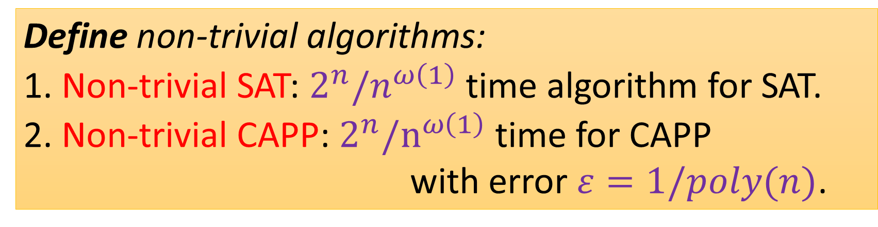
Algorithmic Questions
$C$-SAT
$C$-CAPP
Define non-trivial algorithms:
1. Non-trivial SAT: $2^{n}/n^{ω\left(1\right)}$ time algorithm for SAT.
2. Non-trivial CAPP: $2^{n}/n^{ω\left(1\right)}$ time for CAPP with error $ε=1/poly(n)$.
$$C$$
$$C$$
Estimate quantity
$\underset{x∼U_{n}}{Pr}{[C\left(x\right)=1]}$,
with additive error $ε$
$∃$ x s.t. $C\left(x\right)=1?$
$∃x$ ?
$$x∼U_{n}$$
Notes:
Our notion for Non-trivial CAPP is slightly restrictive more several technical reasons…
Because we don’t want to afford a loss of the depth in the construction

Slide 7

Algorithmic Equivalence I
Poly-size $THR∘THR$ and $THR∘MAJ$ are equivalent for Non-Trivial SAT Algorithms!
THR
THR
THR
THR
THR
MAJ
MAJ
MAJ
Notes:
In terms of non-trivial SAT algorithms, $THR∘THR$ and $THR∘MAJ$ are the same.
In terms of non-trivial CAPP algorithms (a.k.a. derandomization), $THR∘THR$ and $MAJ∘MAJ$ are the same.

Slide 8

Algorithmic Equivalence II
Poly-size $THR∘THR$ and $MAJ∘MAJ$ are equivalent for Non-Trivial CAPP Algorithms!
THR
MAJ
THR
THR
THR
MAJ
MAJ
MAJ
Notes:
That is, from an algorithmic perspective,
$THR∘THR$ (we only have super-weak lower bound) is basically the same as $THR∘MAJ$ or $MAJ∘MAJ$ (we have the strongest possible lower bound)

Slide 9


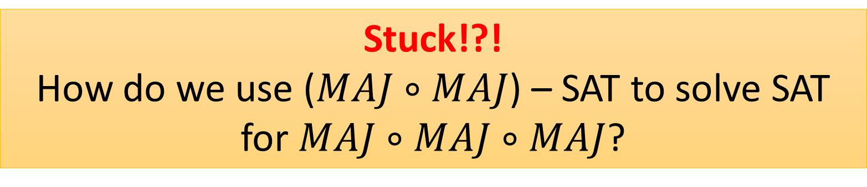
Motivation: New Structure Lemmas
[Goldmann-Hastad-Razborov’92]:
$$THR∘THR⊆MAJ∘MAJ∘MAJ$$
MAJ
THR
MAJ
MAJ
THR
THR
THR
MAJ
MAJ
MAJ
Stuck!?!
How do we use ($MAJ∘MAJ$) – SAT to solve SAT for $MAJ∘MAJ∘MAJ$?
Notes:
Explain

Slide 10

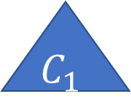

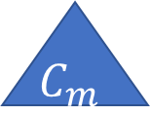

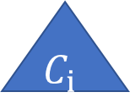
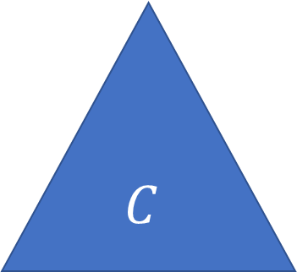

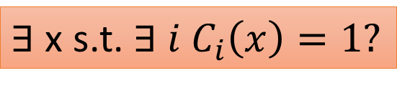


Motivation: New Structure Lemmas
What if we had a top $OR$ gate? e.g., $OR∘MAJ∘MAJ$
$C$-SAT
$(OR∘C)$-SAT
$$C$$
$∃$ x s.t. $∃ i$ $C_{i}\left(x\right)=1?$
$∃$ x s.t. $C\left(x\right)=1?$
OR
poly(n)
$$C_{1}$$
$$C_{i}$$
$$C_{m}$$
$∃$ x ?
$∃$ x ?

Slide 11

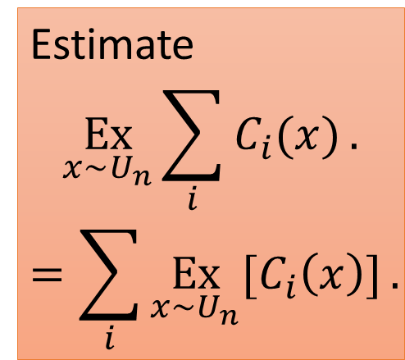

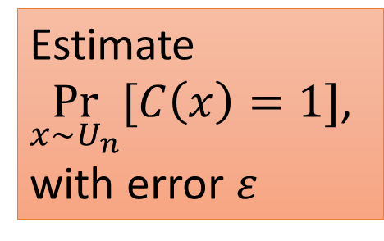




Motivation: New Structure Lemmas
DOR: Disjoint-OR
(at most one input is ever true)
What if we had a top $DOR$ gate?
$C$-CAPP
$(DOR∘C)$-CAPP
Estimate
$\underset{x∼U_{n}}{Pr}{[C\left(x\right)=1]}$,
with error $ε$
$$C$$
Estimate
$$\underset{x∼U_{n}}{Ex}{\sum_{i}{C_{i}(x)}}.$$
$$=\sum_{i}{\underset{x∼U_{n}}{Ex}{[C_{i}\left(x\right)]}}.$$
DOR
poly(n)
$$C_{1}$$
$$C_{i}$$
$$C_{m}$$
$$x∼U_{n}$$
$$x∼U_{n}$$
Notes:
If, furthermore, we can get a top Disjoint OR gate, then we can even preserve the CAPP algorithms.
Actually also preserve the counting algorithms.

Slide 12
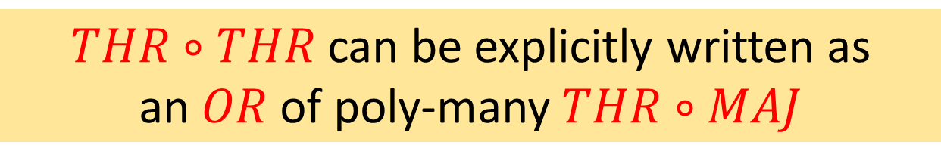
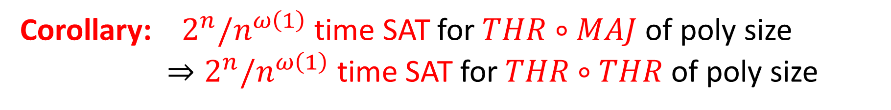
Structure Lemma I
$THR∘THR$ can be explicitly written as an $OR$ of poly-many $THR∘MAJ$
OR
poly(n)
THR
THR
THR
THR
THR
THR
MAJ
MAJ
MAJ
Corollary: $2^{n}/n^{ω\left(1\right)}$ time SAT for $THR∘MAJ$ of poly size
$⇒2^{n}/n^{ω\left(1\right)}$ time SAT for $THR∘THR$ of poly size
Notes:
ETHR gate is just a slice of Boolean cube

Slide 13
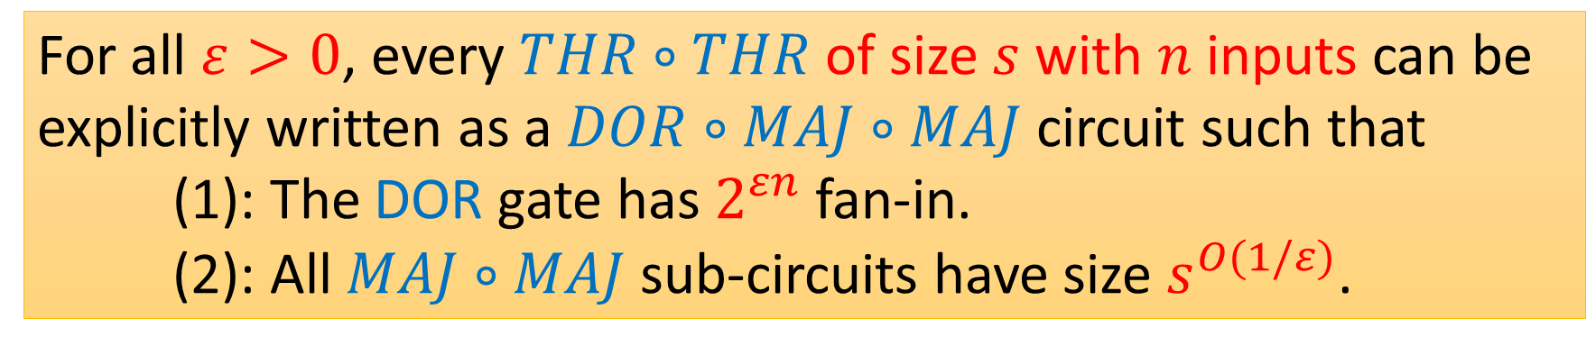
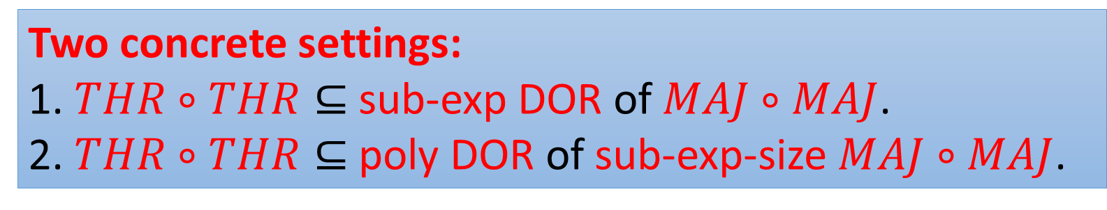
Structure Lemma II
For all $ε>0$, every $THR∘THR$ of size $s$ with $n$ inputs can be explicitly written as a $DOR∘MAJ∘MAJ$ circuit such that
(1): The DOR gate has $2^{εn}$ fan-in.
(2): All $MAJ∘MAJ$ sub-circuits have size $s^{O(1/ε)}$.
Two concrete settings:
1. $THR∘THR⊆$ sub-exp DOR of $MAJ∘MAJ$.
2. $THR∘THR⊆$ poly DOR of sub-exp-size $MAJ∘MAJ$.
Notes:
The second structure Lemma, is a little more complicated, …, …

Slide 14
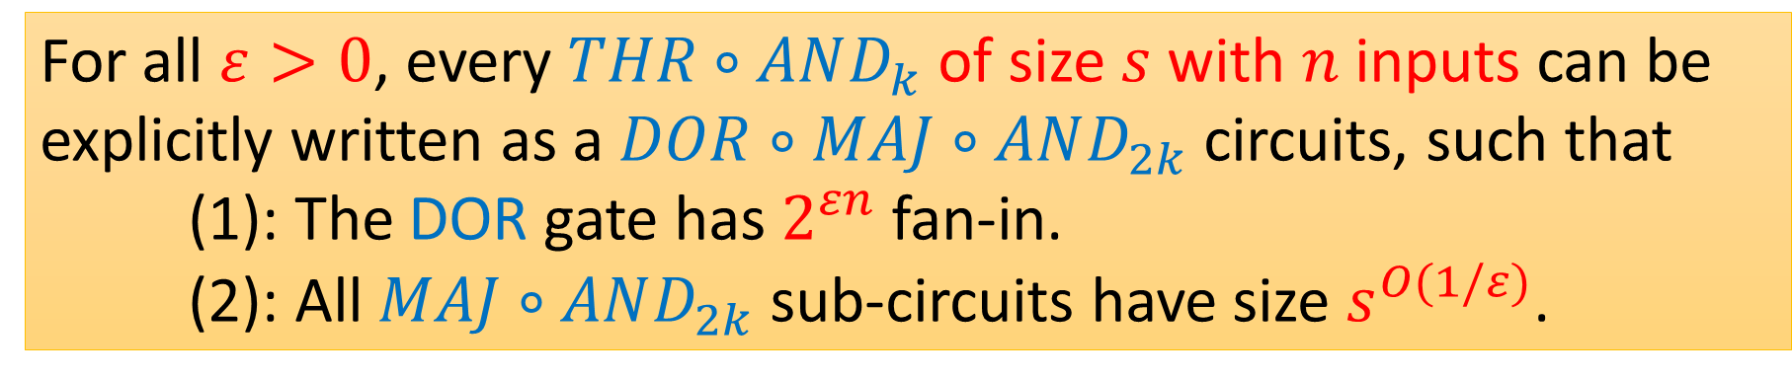
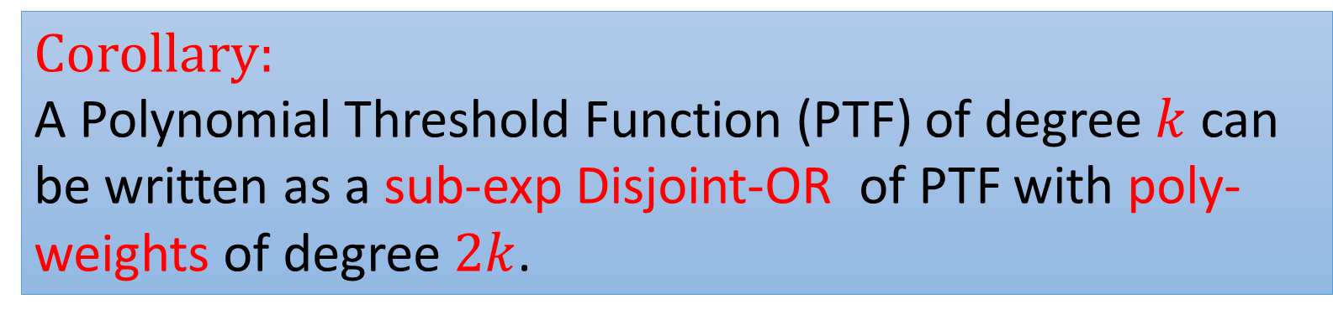
Other Applications
For all $ε>0$, every $THR∘AND_{k}$ of size $s$ with $n$ inputs can be explicitly written as a $DOR∘MAJ∘AND_{2k}$ circuits, such that
(1): The DOR gate has $2^{εn}$ fan-in.
(2): All $MAJ∘AND_{2k}$ sub-circuits have size $s^{O(1/ε)}$.
Corollary:
A Polynomial Threshold Function (PTF) of degree $k$ can be written as a sub-exp Disjoint-OR of PTF with poly-weights of degree $2k$.
Notes:
PTF is just the sign of a polynomial

Slide 15
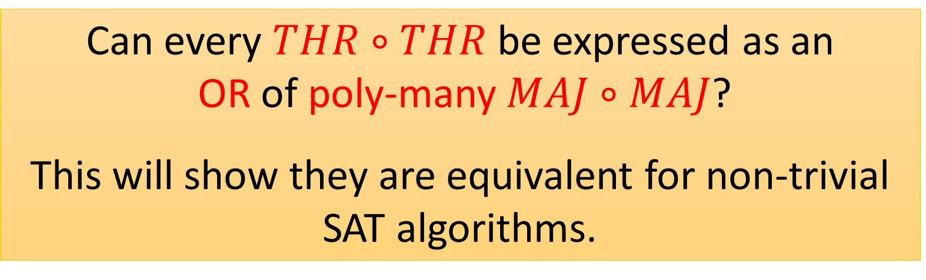
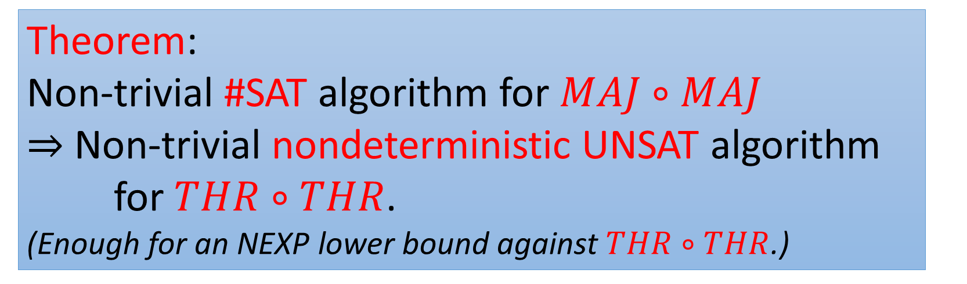
Open Question 1
Can every $THR∘THR$ be expressed as an OR of poly-many $MAJ∘MAJ$?
This will show they are equivalent for non-trivial SAT algorithms.
Theorem: Non-trivial #SAT algorithm for $MAJ∘MAJ$
$⇒$ Non-trivial nondeterministic UNSAT algorithm for $THR∘THR$. (Enough for an NEXP lower bound against $THR∘THR$.)

Slide 16
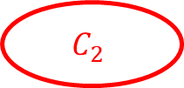



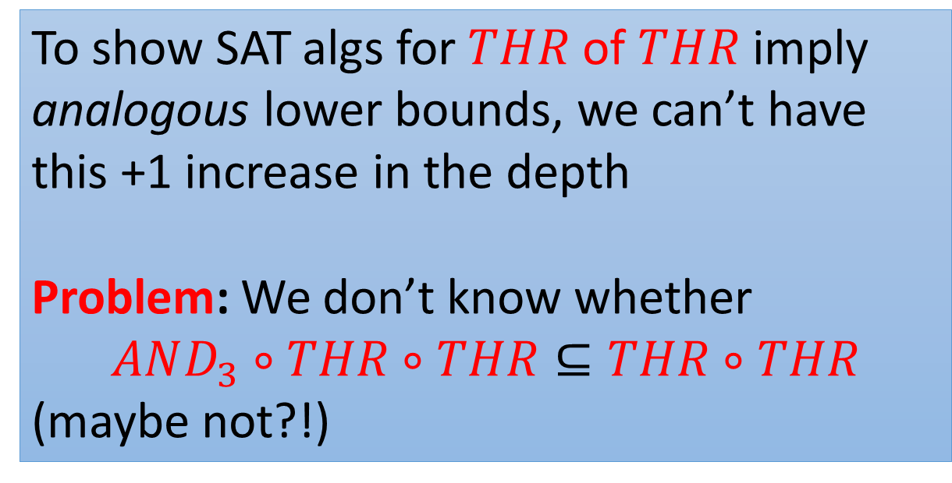
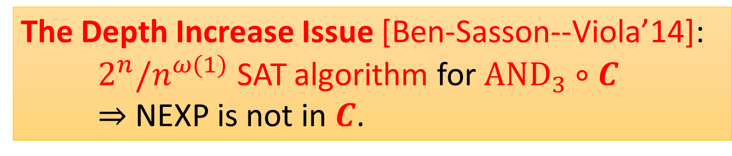
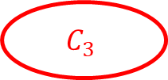
SAT for Depth-d THR $⇒$ Depth-d Lower Bounds
The Depth Increase Issue [Ben-Sasson--Viola’14]: $2^{n}/n^{ω(1)}$ SAT algorithm for ${AND}_{3}∘C$ $⇒$ NEXP is not in $C$.
To show SAT algs for $THR$ of $THR$ imply analogous lower bounds, we can’t have this +1 increase in the depth
Problem: We don’t know whether
$$AND_{3}∘THR∘THR⊆THR∘THR$$
(maybe not?!)
$$AND_{3}$$
$$C_{1}$$
$$C_{2}$$
$$C_{3}$$
Notes:
THR gate is just a half-space
Another result we have proved exploits THR properties to show that non-trivial SAT solving for depth-d threshold circuits actually implies lower bounds for depth-d. But this is not obvious, because there is a depth increase issue in the usual way we think about this.

Slide 17
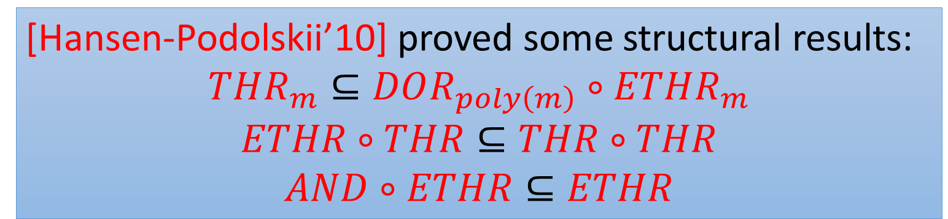
Dealing With Depth Increase
We can use ETHR gates
ETHR gates : $f\left(x\right)=\left[w⋅x=t\right]$, for some $w∈Z^{n}$, $t∈Z$.
[Hansen-Podolskii’10] proved some structural results:
$$THR_{m}⊆DOR_{poly\left(m\right)}∘ETHR_{m}$$
$$ETHR∘THR⊆THR∘THR$$
$$AND∘ETHR⊆ETHR$$
Notes:
Explain these old results

Slide 18
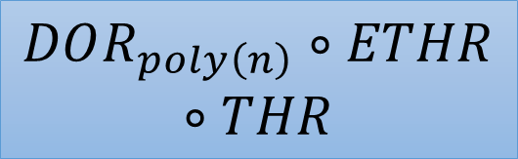


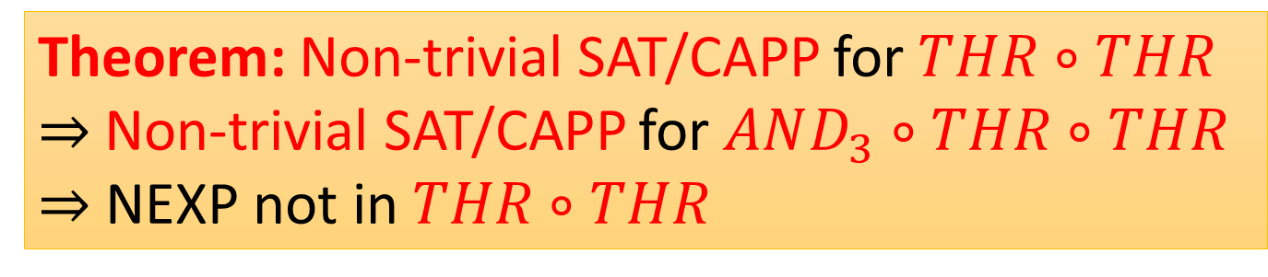
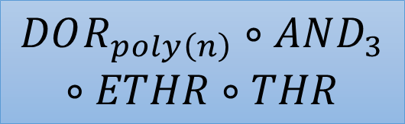

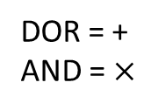

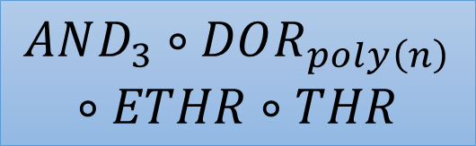

Dealing With Depth Increase
$$THR_{m}⊆DOR_{poly\left(m\right)}∘ETHR_{m}$$
$$AND_{3}∘THR∘THR$$
$$AND_{3}∘DOR_{poly\left(n\right)}∘ETHR∘THR$$
DOR = +
AND = $×$
Theorem: Non-trivial SAT/CAPP for $THR∘THR$
$⇒$Non-trivial SAT/CAPP for $AND_{3}∘THR∘THR$
$⇒$ NEXP not in $THR∘THR$
$$DOR_{poly\left(n\right)}∘AND_{3}∘ETHR∘THR$$
$$ETHR∘THR⊆THR∘THR$$
$$AND∘ETHR⊆ETHR$$
$$DOR_{poly\left(n\right)}∘THR∘THR$$
$$DOR_{poly\left(n\right)}∘ETHR∘THR$$
Notes:
ETHR gate is just a slice of Boolean cube

Slide 19
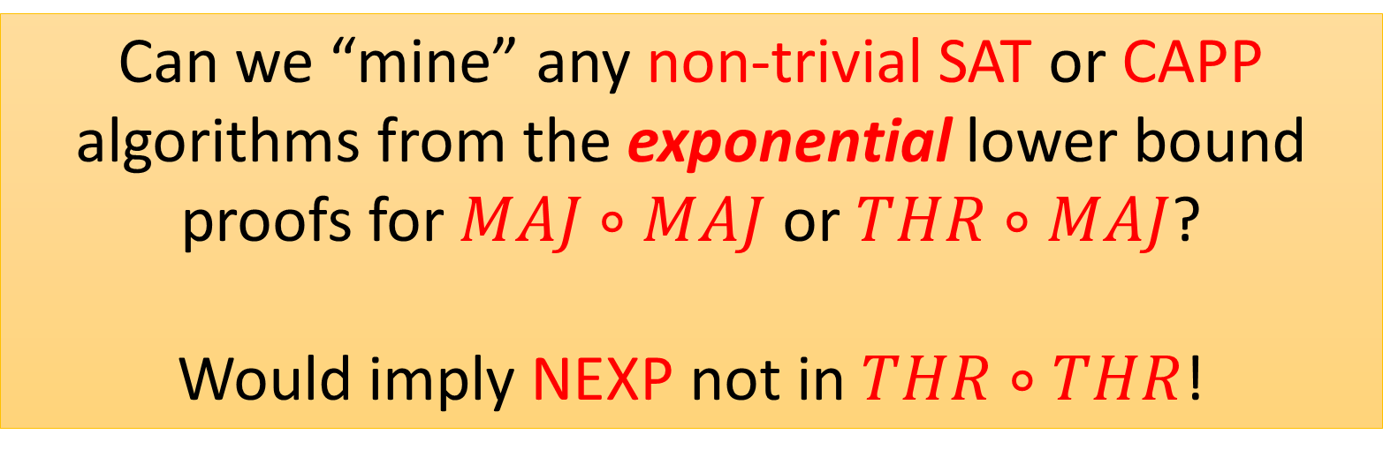
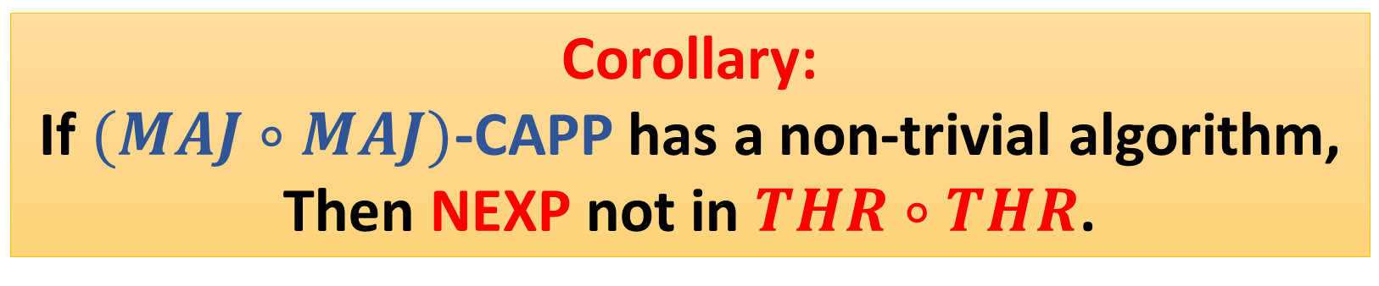
Open Question 2
Corollary: If $(MAJ∘MAJ)$-CAPP has a non-trivial algorithm,
Then NEXP not in $THR∘THR$.
Can we “mine” any non-trivial SAT or CAPP algorithms from the exponential lower bound proofs for $MAJ∘MAJ$ or $THR∘MAJ$?
Would imply NEXP not in $THR∘THR$!
Notes:
That is, from an algorithmic perspective,
$THR∘THR$ (we only have super-weak lower bound) is basically the same as $THR∘MAJ$ or $MAJ∘MAJ$ (we have the strongest possible lower bound)

Slide 20
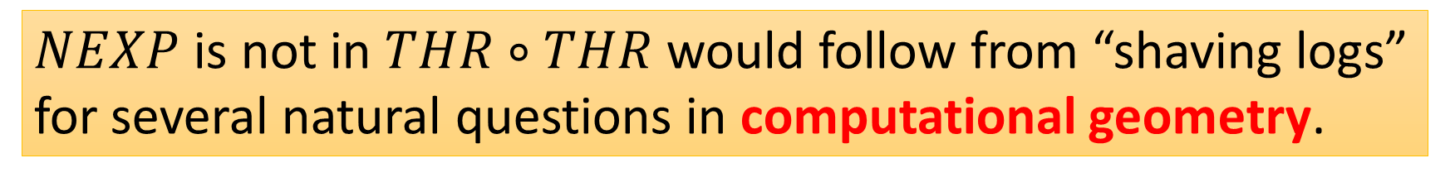
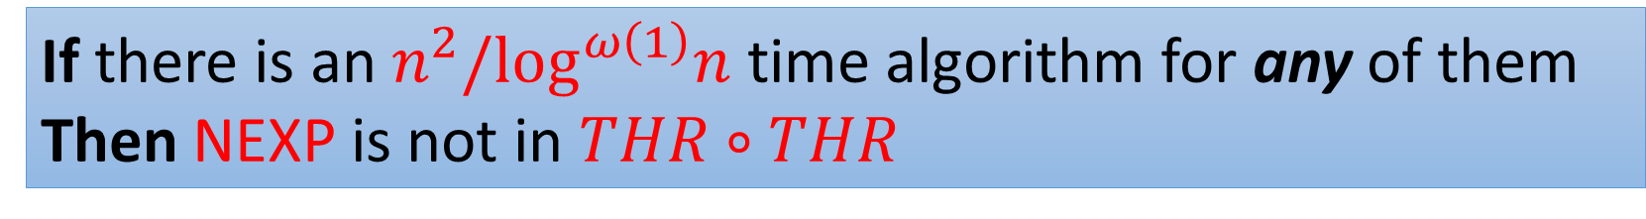
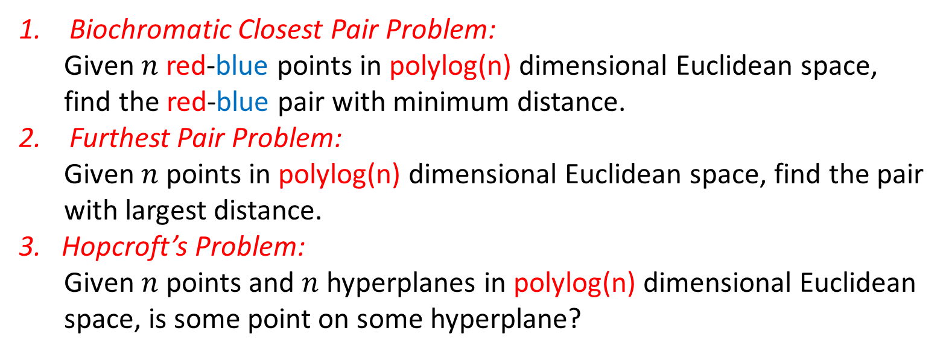
Connection to Fine-Grained Complexity
$NEXP$ is not in $THR∘THR$ would follow from “shaving logs” for several natural questions in computational geometry.
Biochromatic Closest Pair Problem:
Given $n$ red-blue points in polylog(n) dimensional Euclidean space,
find the red-blue pair with minimum distance.
Furthest Pair Problem:
Given $n$ points in polylog(n) dimensional Euclidean space, find the pair with largest distance.
3. Hopcroft’s Problem:
Given $n$ points and $n$ hyperplanes in polylog(n) dimensional Euclidean space, is some point on some hyperplane?
If there is an $n^{2}/\log^{ω\left(1\right)}n$ time algorithm for any of them Then NEXP is not in $THR∘THR$
Notes:
Hopcroft’s problem is the problem that you are given n points and n plane

Slide 21
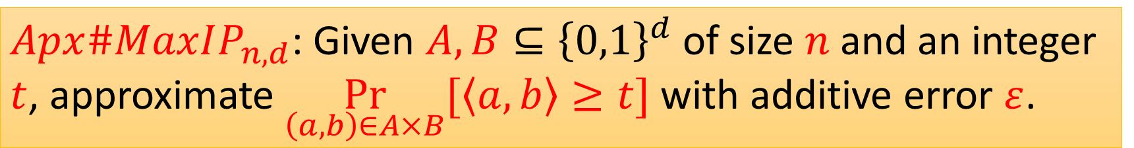
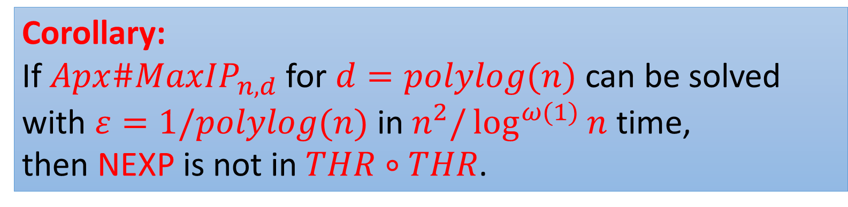
A Simple CAPP-like Problem
$Apx\#MaxIP_{n,d}$: Given $A,B⊆{\left\{0,1\right\}}^{d}$ of size $n$ and an integer $t$, approximate $\underset{\left(a,b\right)∈A×B}{Pr}{[\left\langle a,b\right\rangle ≥t]}$ with additive error $ε$.
By a simple reduction
Corollary:
If $Apx\#MaxIP_{n,d}$for $d=polylog(n)$ can be solved with $ε=1/polylog(n)$ in $n^{2}/\log^{ω(1)}{n}$ time, then NEXP is not in $THR∘THR$.
Notes:
ETHR gate is just a slice of Boolean cube

Slide 22
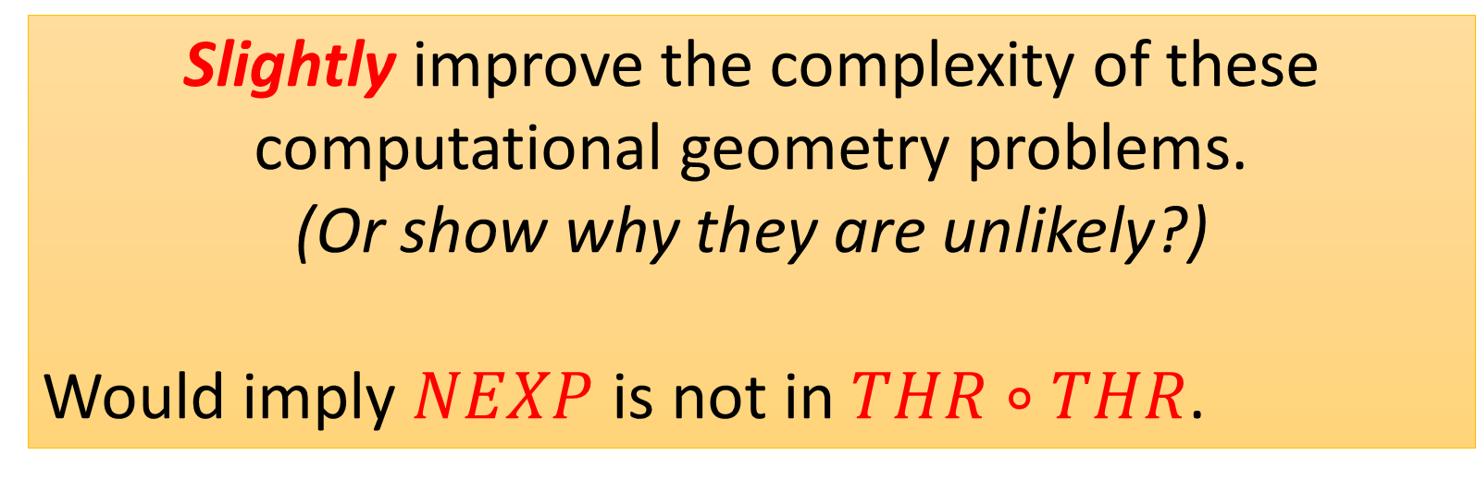
Open Question 3
Slightly improve the complexity of these computational geometry problems.
(Or show why they are unlikely?)
Would imply $NEXP$ is not in $THR∘THR$.
Notes:
That is, from an algorithmic perspective,
$THR∘THR$ (we only have super-weak lower bound) is basically the same as $THR∘MAJ$ or $MAJ∘MAJ$ (we have the strongest possible lower bound)

Slide 23

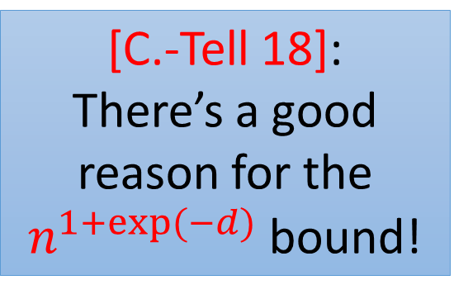
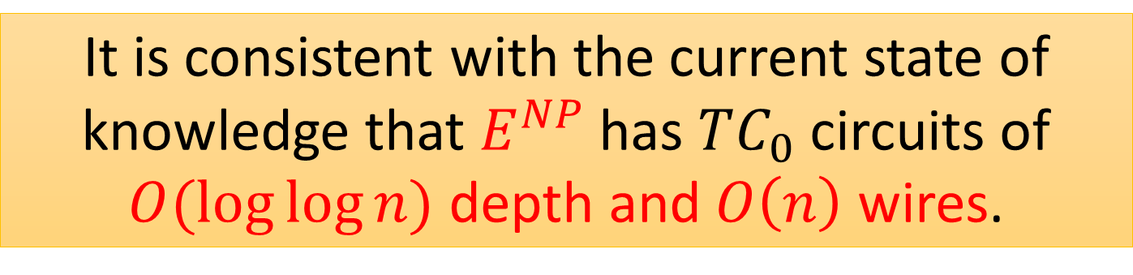
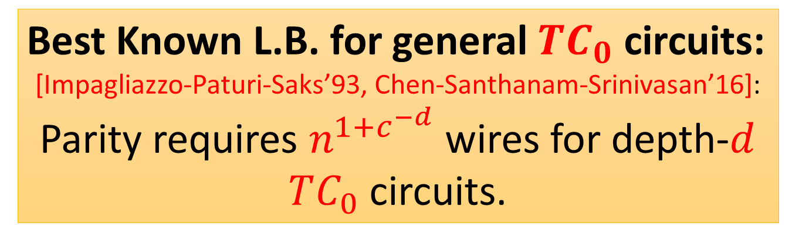
Another Interesting Connection
$k$-SAT: Best Running Time is $2^{n(1−1/Θ(k))}$.
Best Known L.B. for general $TC_{0}$ circuits:
[Impagliazzo-Paturi-Saks’93, Chen-Santhanam-Srinivasan’16]: Parity requires $n^{1+c^{−d}}$ wires for depth-$d$ $TC_{0}$ circuits.
[C.-Tell 18]: There’s a good reason for the $n^{1+exp⁡(−d)}$ bound!
It is consistent with the current state of knowledge that $E^{NP}$ has $TC_{0}$ circuits of $O(\log{\log{n}})$ depth and $O\left(n\right)$ wires.
Notes:
$n^{1+exp⁡(−o(d))}$-wire lower bound for some $NC^{1}$-complete problem like Boolean Formula Evalaution
$$⇒NC^{1}≠TC_{0}$$

Slide 24
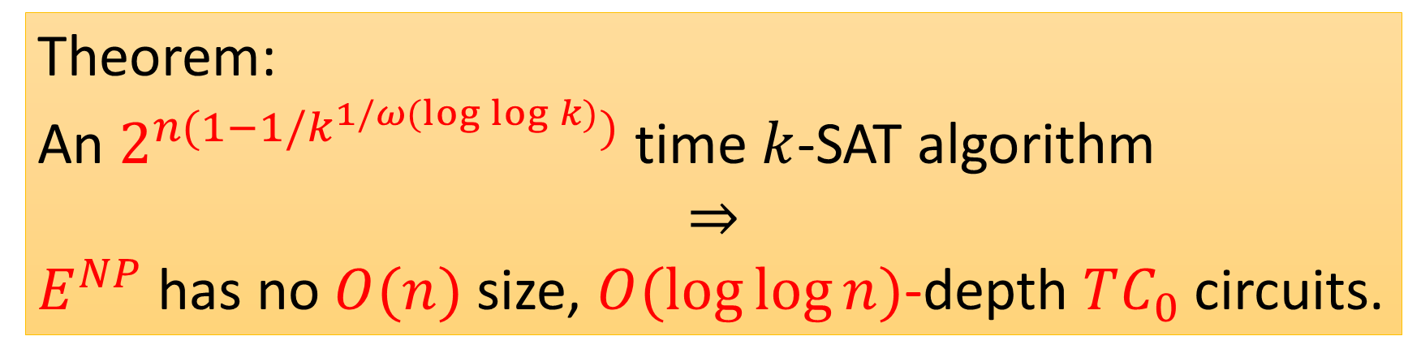
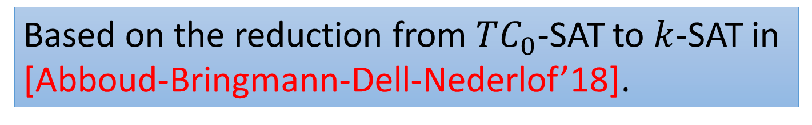
Another Interesting Connection
Theorem:
An $2^{n(1−1/k^{1/ω(\log{\log{k}})})}$ time $k$-SAT algorithm
$$⇒$$
$E^{NP}$ has no $O(n)$ size, $O(\log{\log{n}})$-depth $TC_{0}$ circuits.
Based on the reduction from $TC_{0}$-SAT to $k$-SAT in [Abboud-Bringmann-Dell-Nederlof’18].
Notes:
That is, from an algorithmic perspective,
$THR∘THR$ (we only have super-weak lower bound) is basically the same as $THR∘MAJ$ or $MAJ∘MAJ$ (we have the strongest possible lower bound)

Slide 25
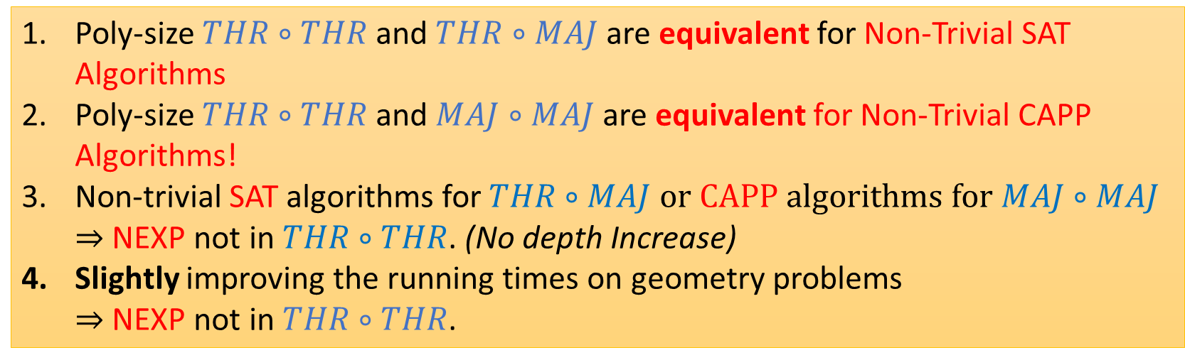
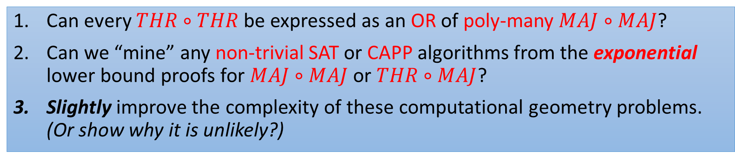
Conclusion
Poly-size $THR∘THR$ and $THR∘MAJ$ are equivalent for Non-Trivial SAT Algorithms
Poly-size $THR∘THR$ and $MAJ∘MAJ$ are equivalent for Non-Trivial CAPP Algorithms!
Non-trivial SAT algorithms for $THR∘MAJ$ or CAPP algorithms for $MAJ∘MAJ$ $⇒$ NEXP not in $THR∘THR$. (No depth Increase)
Slightly improving the running times on geometry problems $⇒$ NEXP not in $THR∘THR$.
Open Question
Can every $THR∘THR$ be expressed as an OR of poly-many $MAJ∘MAJ$?
Can we “mine” any non-trivial SAT or CAPP algorithms from the exponential lower bound proofs for $MAJ∘MAJ$ or $THR∘MAJ$?
Slightly improve the complexity of these computational geometry problems. (Or show why it is unlikely?)

Slide 26
Thanks
Notes:
That is, from an algorithmic perspective,
$THR∘THR$ (we only have super-weak lower bound) is basically the same as $THR∘MAJ$ or $MAJ∘MAJ$ (we have the strongest possible lower bound)

Slide 27



Connection to Fine-Grained Complexity
Tighter Connection for $E^{NP}$ and $SYM∘SYM$ circuits.
Best Known L.B.
$E^{NP}$ has no $n^{2−o(1)}$
$SYM∘SYM$ circuits
Approx. Biochromatic Closest Pair Problem:
Given $n$ red-blue points in dimensional Euclidean space,
approximate the red-blue pair with minimum distance.
$\left(1+\frac{1}{\log^{k}{n}}\right)$ approximation to the above problem in $n^{2}/\log^{ ω(1) }{n}$ time $⇒$ $E^{NP}$ has no $n^{(k−2)/2}$ size $SYM∘SYM$ circuits.
Current Best Algorithm works for $k<3$. [Alman-Chan-Williams’16]
Notes:
Hopcroft’s problem is the problem that you are given n points and n plane

Slide 28

Proof Sketch
$THR∘THR$: $F\left(x\right)=[\sum_{i}{w_{i}⋅G_{i}\left(x\right)≤T]}$. $G_{i}{\left(x\right)}^{′}s$ are THR gates.
Negate $G_{i}(x)$’s when $w_{i}<0$. One can assume $w_{i}≥0$.
$G_{i}\left(x\right)=\sum_{j}{E_{i,j}(x)}$, $E_{i,j}(x)$’s are ETHR gates. ($THR⊆DOR∘ETHR$).
$F\left(x\right)=\left[\sum_{i}^{S}{w_{i}⋅E_{i}\left(x\right)}≤T\right]$, $E_{i}\left(x\right)=[L_{i}\left(x\right)=0]$.
$E_{i}(x)$ has weights $≤2^{W}$.
Pick a prime p $≤poly(S,W)$.
Set $E_{i}^{p}\left(x\right)=[L_{i}\left(x\right)≡0(mod p)]$.
Notes:
ETHR gate is just a slice of Boolean cube

Slide 29

Proof Sketch
$F\left(x\right)=\left[\sum_{i}^{S}{w_{i}⋅E_{i}\left(x\right)}≤T\right]$, $E_{i}\left(x\right)=[L_{i}\left(x\right)=0]$.
One can assume $w_{i}≥0$. Pick a prime p $≤poly(S,W)$.
Set $E_{i}^{p}\left(x\right)=[L_{i}\left(x\right)≡0(mod p)]$.
and $F^{p}\left(x\right)=[\sum_{i}{w_{i}⋅E_{i}^{p}\left(x\right)≤T}]$.
(1): $F^{p}\left(x\right)$ is in $THR∘MAJ$. ($E_{i}^{p}(x)$ has poly-weights)
(2): $F\left(x\right)=OR_{p} F^{p}\left(x\right).$
If $\sum_{i}{w_{i}⋅E_{i}^{p}\left(x\right)≤T}$, then $\sum_{i}{w_{i}⋅E_{i}\left(x\right)≤T}$ $E_{i}^{p}(x)$ is always $≥$ $E_{i}\left(x\right)$
If p is a random prime, w.h.p., $E_{i}^{p}\left(x\right)=E_{i}\left(x\right)$for all $i.$
Notes:
ETHR gate is just a slice of Boolean cube

Slide 30

What About Derandomization?
Maybe $THR∘MAJ$ circuits are super hard that even no $2^{n}/n^{ω\left(1\right)}$ SAT exist? Then this approach is doomed to fail.
(Personal Belief: the algorithm exists, we just need one really good algorithmic idea)
Ryan’s program: Non-trivial Derandomization is enough.
CAPP: Given C, estimate $\underset{x}{Pr}{[C\left[x\right]=1]}.$
Notes:
ETHR gate is just a slice of Boolean cube

Slide 31

What About Derandomization?
Ryan’s program: Non-trivial Derandomization is enough.
CAPP: Given C, estimate $\underset{x}{Pr}{[C\left[x\right]=1]}$ with error $ε$.
Focus on $2^{n}/n^{ω(1)}$ CAPP algorithm works for all $ε=1/poly(n)$. We call it good CAPP.
[Implicit in BV’14,…]: good CAPP for $AND_{3}∘C$ $⇒$ NEXP is not in $C$.
Notes:
ETHR gate is just a slice of Boolean cube

Slide 32

Observation
[GHR’96]: $THR∘THR⊆MAJ∘MAJ∘MAJ$
$THR∘THR⊆DOR∘ETHR∘THR$.
$C\left(x\right)=\sum_{i}{E_{i}(x)}$. $E_{i}{\left(x\right)}^{′}s$ are $ETHR∘THR$ circuits.
$\operatorname{Pr}\left[C\right]=\sum_{i}{Pr⁡[E_i]}$.
Good CAPP for $ETHR∘THR$ implies good CAPP
for $THR∘THR.$
Notes:
ETHR gate is just a slice of Boolean cube

Slide 33

Observation
$ETHR∘THR$: $F\left(x\right)=[\sum_{i}{w_{i}⋅G_{i}\left(x\right)}=T]$. $G_{i}$’s : THR gates.
Let $p$ be a prime $≤$ poly(n).
$F^{p}\left(x\right)=\left[\sum_{i}{w_{i}⋅G_{i}\left(x\right)≡T\left(mod p\right)}\right]$.
$F^{p}(x)$ is in $MAJ∘THR=MAJ∘MAJ$.
$\operatorname{Pr}\left[F\right]≈\min_{p}{Pr⁡[F^{p}(x)]}$.
Good CAPP for $MAJ∘MAJ$ $⇒$ Good CAPP for $THR∘THR‼$
Notes:
ETHR gate is just a slice of Boolean cube

Slide 34

Observation
Good CAPP for $MAJ∘MAJ$ $⇒$ Good CAPP for $THR∘THR$
Recall that $AND_{3}∘THR∘THR⊆DOR_{poly\left(n\right)}∘THR∘THR$.
Good CAPP for $THR∘THR$ $⇒$ Good CAPP for ${AND}_{3}∘THR∘THR⇒$ NEXP is not in $THR∘THR$.
Notes:
ETHR gate is just a slice of Boolean cube

Slide 35

Talk Overview
Examine the algorithmic hardness of $THR∘THR$
Technique: new structure lemmas of $THR∘THR$.
Introduce some natural problems that, “shaving logs” on them would imply NEXP is not in $THR∘THR$.
Some open problems.

