Slide 1
Recent Developments in Fine-Grained Complexity via Communication Complexity
Lijie Chen
MIT

Slide 2
Today’s Topic
Background
What is Fine-Grained Complexity?
The Methodology of Fine-Grained Complexity
Frontier: Fine-Grained Hardness for Approximation Problems
The Connection
[ARW’17]: Connection between Fine-Grained Complexity and Communication Protocols. ([Rub’18, CLM’18]: Further developments.)
Our Results
[Chen’18]: Hardness for Furthest Pair
[CW’19]: A New Equivalence Class in Fine-Grained Complexity
[CGLRR’19]: Fine-Grained Complexity Meets IP = PSPACE

Slide 3
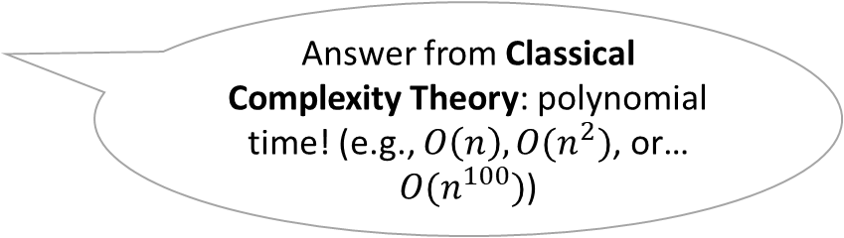
What is Fine-Grained Complexity Theory?
The goal of algorithm design and complexity theory
What problems are efficiently solvable?
What is “efficiently solvable”?
Answer from Classical Complexity Theory: polynomial time! (e.g., $O\left(n\right),O(n^{2})$, or… $O(n^{100})$)
If yes, find a fast algorithm!(algorithm designer’s job)
If no, prove there are no fast algorithms! (complexity theorist’s job)

Slide 4





Classical Complexity Theory Poly-Time vs. Super-Poly-Time
Efficient algorithms
Inefficient algorithms
Polynomial-time
Super-polynomial-time
Shortest Path
$$O(N log N)$$
SAT
$$O(2^{N})$$
Edit Distance
$$O(N^{2})$$
Hamiltonian Path
Recognizing Map Graphs
$$O(N^{120})$$
Approximate Nash Equilibrium
$$O(N^{log N})$$

Slide 5
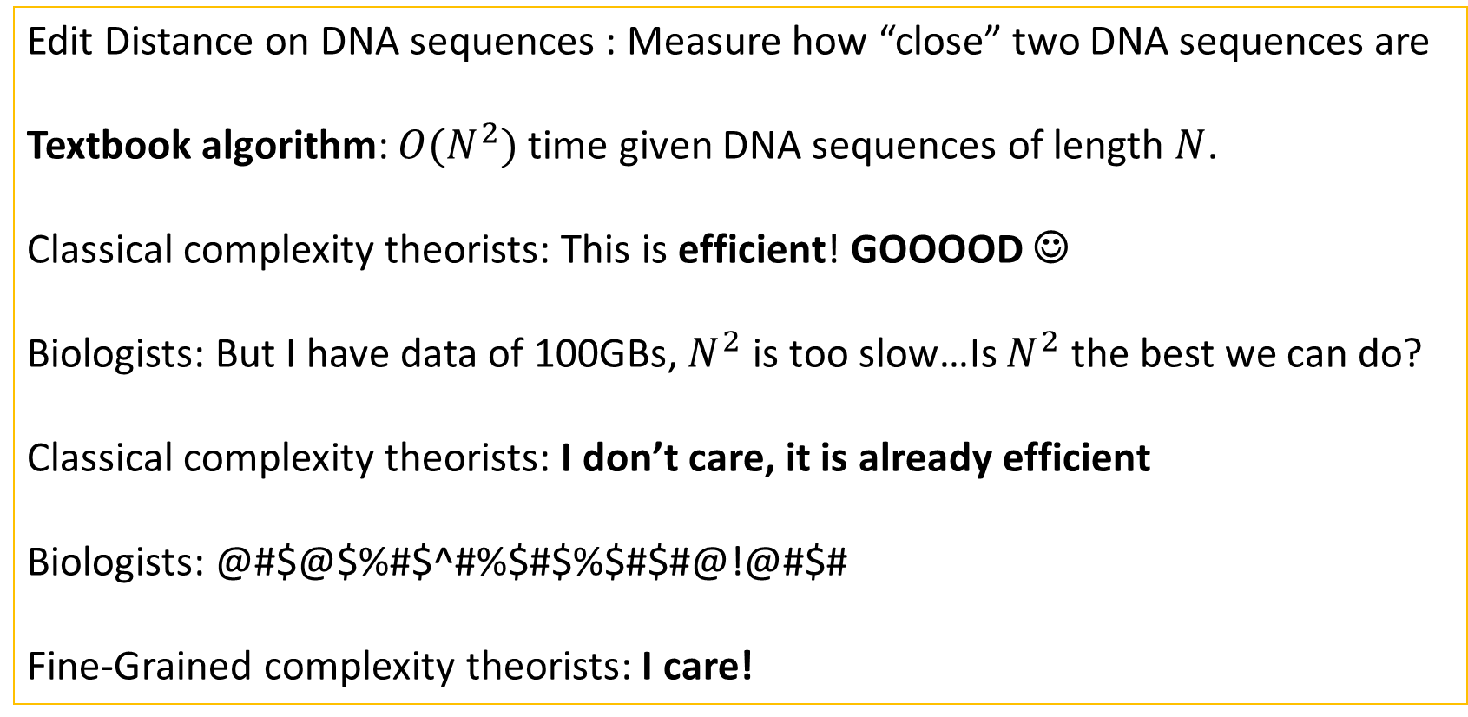
Why Poly-Time is not Always “Efficient” Case Study: Edit Distance
Edit Distance on DNA sequences : Measure how “close” two DNA sequences are
Textbook algorithm: $O(N^{2})$ time given DNA sequences of length $N$.
Classical complexity theorists: This is efficient! GOOOOD ☺
Biologists: But I have data of 100GBs, $N^{2}$ is too slow…Is $N^{2}$ the best we can do?
Classical complexity theorists: I don’t care, it is already efficient
Biologists: @#$@$%#$^#%$#$%$#$#@!@#$#
Fine-Grained complexity theorists: I care!
Notes:
This famous heuristic for edit distance is cited nearly 70k times.

Slide 6
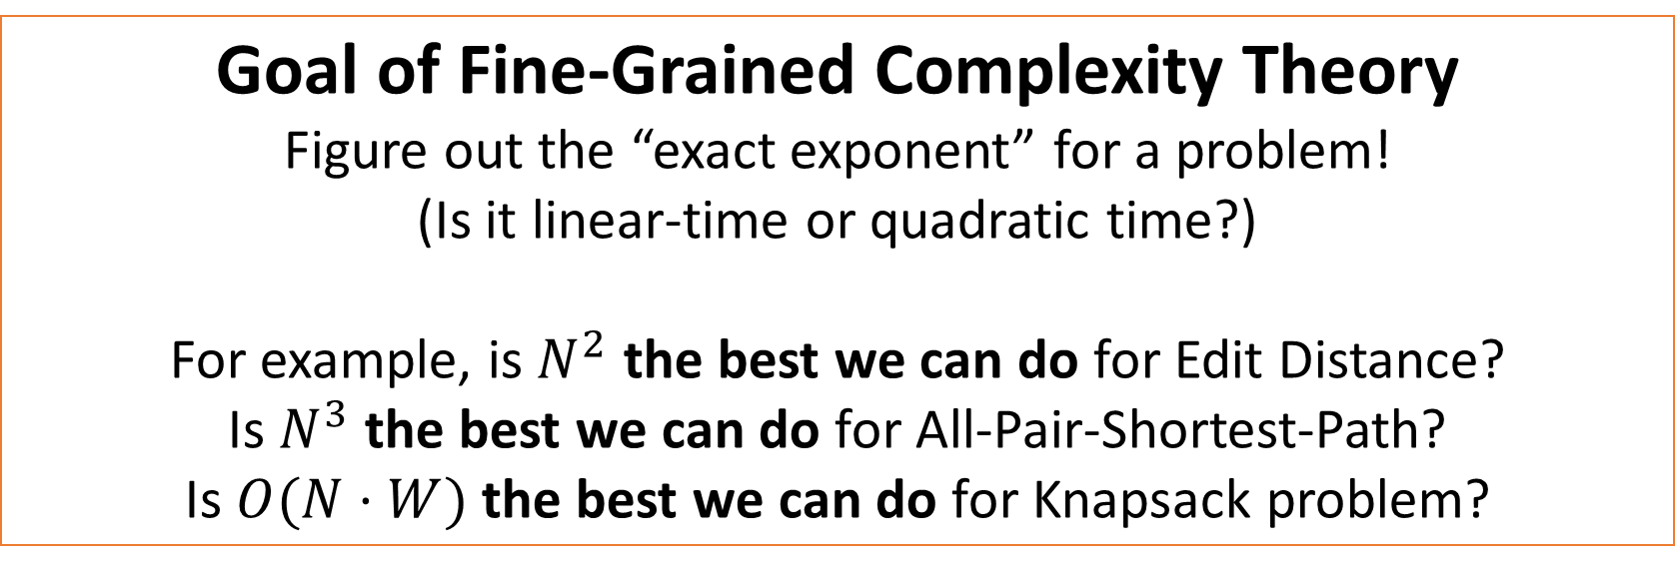
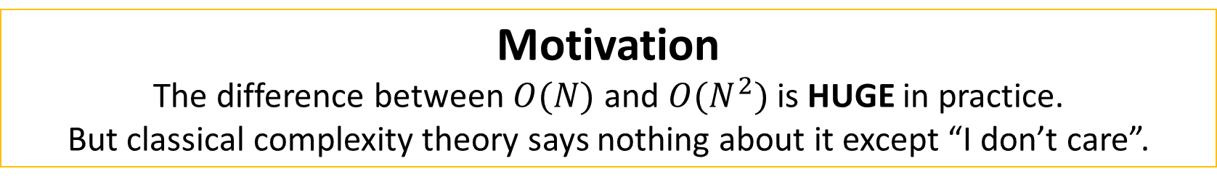
Fine-Grained Complexity
Motivation
The difference between $O(N)$ and $O(N^{2})$ is HUGE in practice.
But classical complexity theory says nothing about it except “I don’t care”.
Accepted
vs.
Time limit exceeded on test 27
Goal of Fine-Grained Complexity Theory
Figure out the “exact exponent” for a problem!
(Is it linear-time or quadratic time?)
For example, is $N^{2}$ the best we can do for Edit Distance?
Is $N^{3}$ the best we can do for All-Pair-Shortest-Path?
Is $O(N⋅W)$ the best we can do for Knapsack problem?

Slide 7
Methodology of Fine-Grained Complexity Theory
How does Fine-Grained Complexity Theory work?

Slide 8
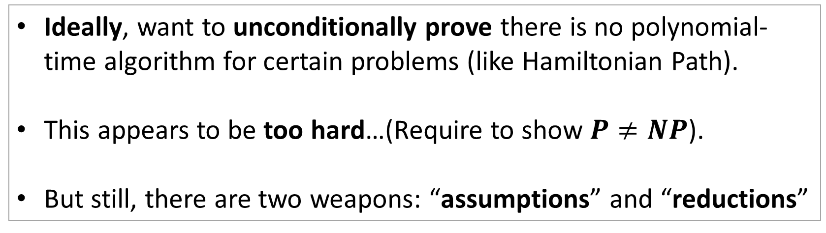
How does Classical Complexity Work?
Ideally, want to unconditionally prove there is no polynomial-time algorithm for certain problems (like Hamiltonian Path).
This appears to be too hard…(Require to show $P≠NP$).
But still, there are two weapons: “assumptions” and “reductions”

Slide 9


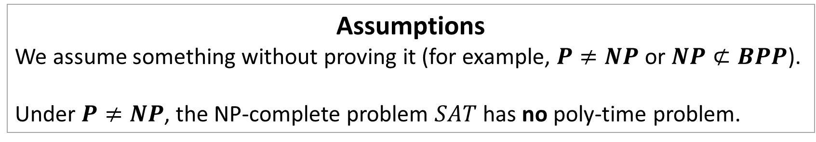
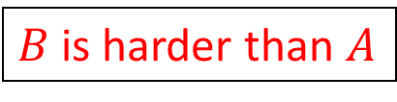
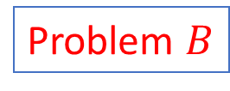
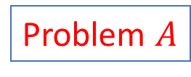
Two Weapons of Complexity Theorist
Assumptions
We assume something without proving it (for example, $P≠NP$ or $NP⊄BPP$).
Under $P≠NP$, the NP-complete problem $SAT$ has no poly-time problem.
Reductions
$B$ is harder than $A$
reduction
Problem $A$
Problem $B$
$$B∉P$$
$$A∉P$$
The surprising part is how much we get from a single assumption $P≠NP$.

Slide 10
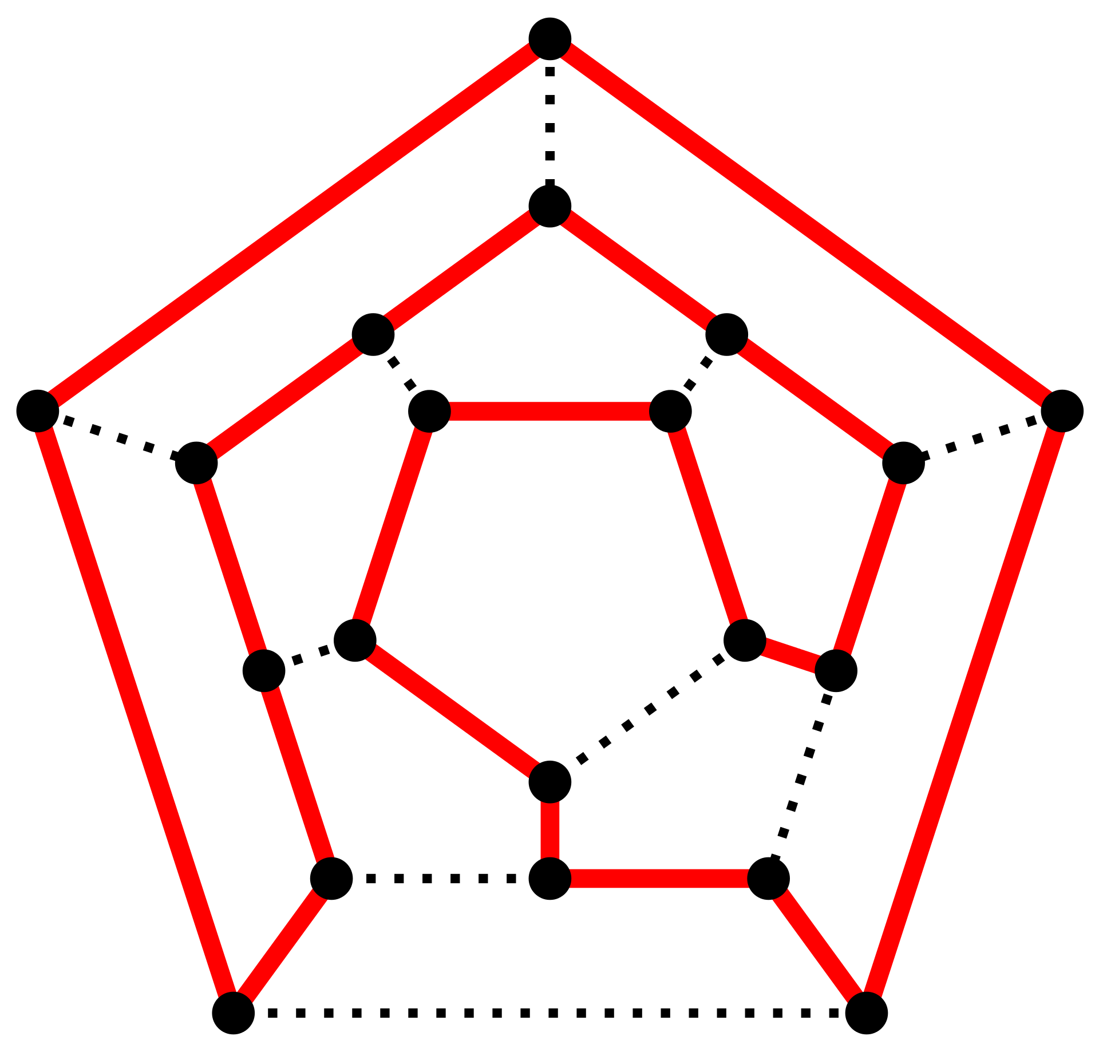

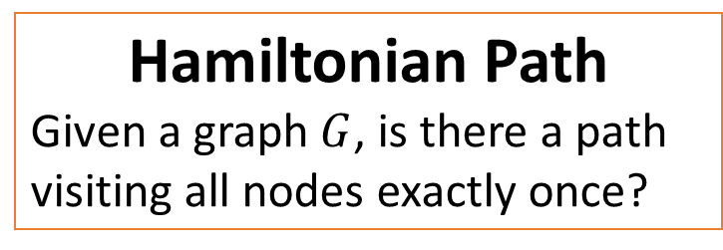
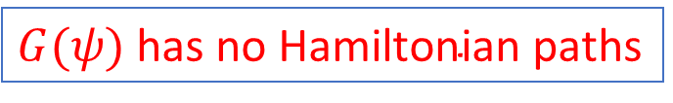
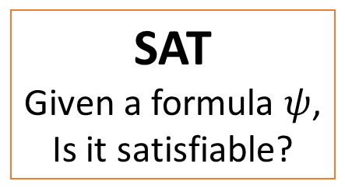

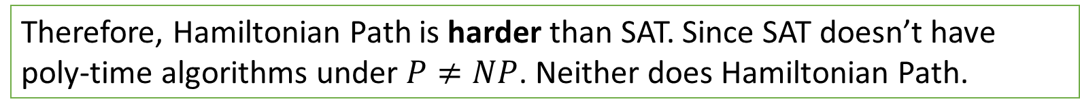
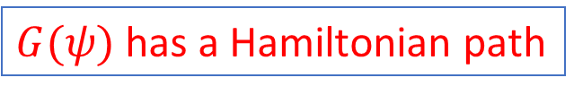
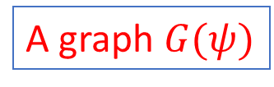
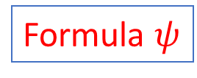
Hardness via Reduction
SAT
Given a formula $ψ$,
Is it satisfiable?
Hamiltonian Path
Given a graph $G$, is there a path visiting all nodes exactly once?
Formula $ψ$
A graph $G(ψ)$
$ψ$ is satisfiable
$G(ψ)$ has a Hamiltonian path
$ψ$ is not satisfiable
$G(ψ)$ $\text{has} \text{no} \text{Hamiltonian} \text{path}$s
Therefore, Hamiltonian Path is harder than SAT. Since SAT doesn’t have poly-time algorithms under $P≠NP$. Neither does Hamiltonian Path.

Slide 11
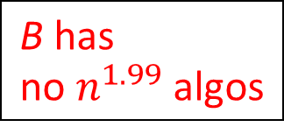
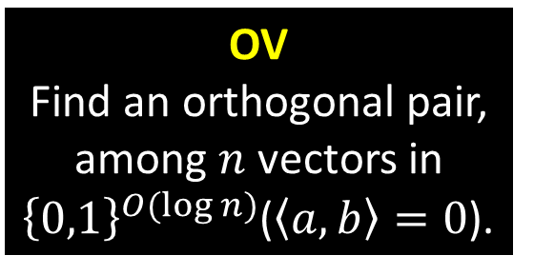
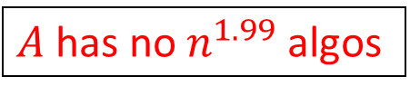
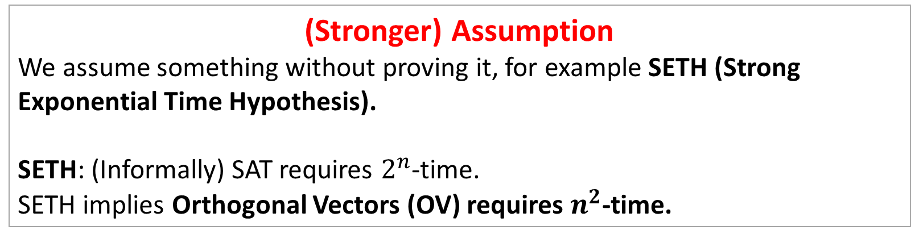
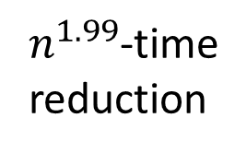


Two Weapons of Fine-Grained Complexity Theorist
(Stronger) Assumption
We assume something without proving it, for example SETH (Strong Exponential Time Hypothesis).
SETH: (Informally) SAT requires $2^{n}$-time.
SETH implies Orthogonal Vectors (OV) requires $n^{2}$-time.
OV
Find an orthogonal pair, among $n$ vectors in ${\left\{0,1\right\}}^{O(\log{n})}$($\left\langle a,b\right\rangle =0$).
Fine-Grained Reductions
$n^{1.99}$-time
reduction
$$\text{B} \text{has} \text{no} n^{1.99} \text{algos}$$
Problem $A$
Problem $B$
$A$ has no$n^{1.99}$ algos

Slide 12
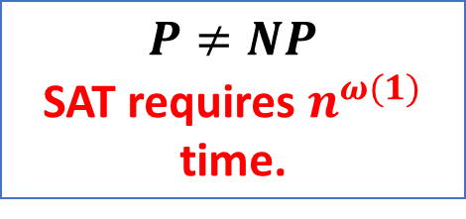
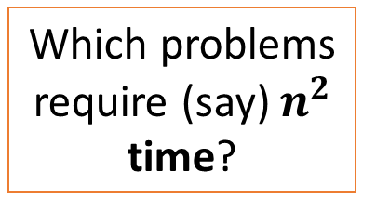
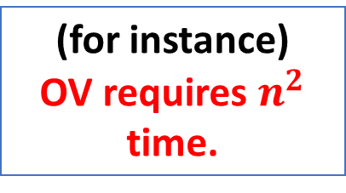
Summary
In short, Fine-Grained Complexity studied “more fine-grained” questions, with “more fine-grained” assumptions and reductions
Classical Complexity
Fine-Grained Complexity
Which problems require super-poly time?
Which problems require (say) $n^{2}$ time?
Basic Questions
$P≠NP$
SAT requires $n^{ω(1)}$ time.
(for instance)
OV requires $n^{2}$ time.
Assumptions
Reductions
Karp-reduction
Fine-Grained Reduction

Slide 13
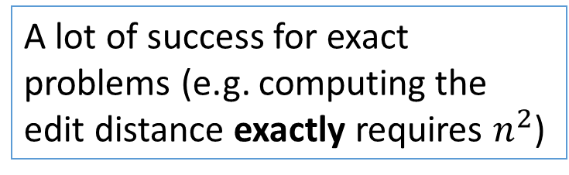
The Success of Fine-Grained Complexity for Exact Problems
A lot of success for exact problems (e.g. computing the edit distance exactly requires $n^{2}$)
SETH
dynamic data structures [Pat10, AV14, AW14, HKNS15, KPP16, AD16, HLNW17, GKLP17]
computational geometry
[Bri14,Wil18, DKL16]
pattern matching [AVW14,
BI15, BI16, BGL16,BK18]
graph algorithms [RV13,
GIKW17, AVY15, KT17]

Slide 14
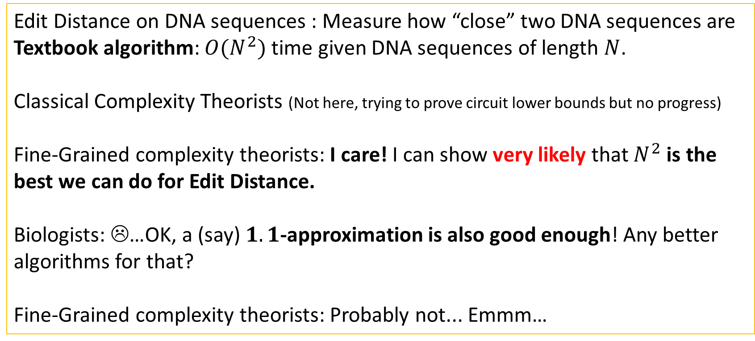
Dialogue Continued
Edit Distance on DNA sequences : Measure how “close” two DNA sequences are
Textbook algorithm: $O(N^{2})$ time given DNA sequences of length $N$.
Classical Complexity Theorists (Not here, trying to prove circuit lower bounds but no progress)
Fine-Grained complexity theorists: I care! I can show very likely that $N^{2}$ is the best we can do for Edit Distance.
Biologists: ☹…OK, a (say) $1.1$-approximation is also good enough! Any better algorithms for that?
Fine-Grained complexity theorists: Probably not... Emmm…

Slide 15
Frontier: Fine-Grained Complexity for Approximation Hardness
For many natural problems, a good enough approximation is as good as an exact solution.
Can we figure out the best exact exponent on those approximation algorithms?
Example
What is the best algorithm for 1.1-approximation to Edit Distance?

Slide 16





Challenge: How to Show Approximate Hardness?
Exact Case
SETH
OV
Edit Distance
Approximation Case
$$I$$
$$S,T$$
SETH
OV
1.1-approx. to Edit Distance
?
OV
Find an orthogonal pair, among $n$ vectors in ${\left\{0,1\right\}}^{O(\log{n})}$($\left\langle a,b\right\rangle =0$).
Yes
$$ED\left(S,T\right)≥1.1⋅α$$
No
$$ED\left(S,T\right)≤1⋅α$$

Slide 17

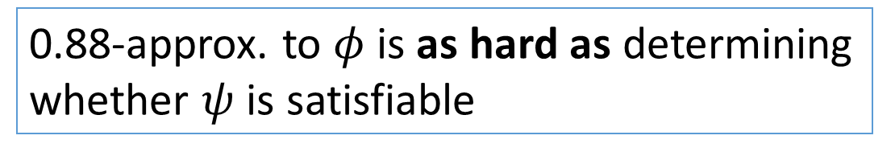



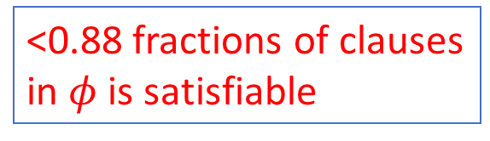
Classical Solution: The PCP Theorem
PCPs
$$ψ$$
$$φ$$
$$P≠NP$$
SAT
0.88-approx. to 3-SAT
Yes
$φ$ is satisfiable
<0.88 fractions of clauses
in $φ$ is satisfiable
No
0.88-approx. to $φ$ is as hard as determining whether $ψ$ is satisfiable

Slide 18
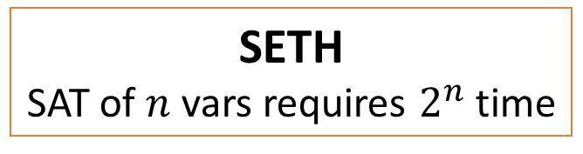
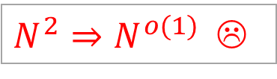
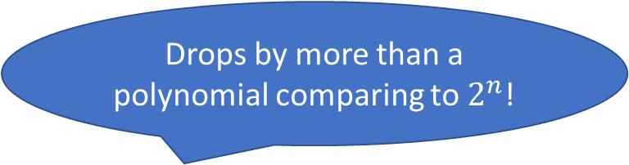
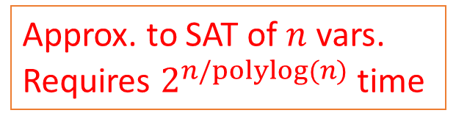
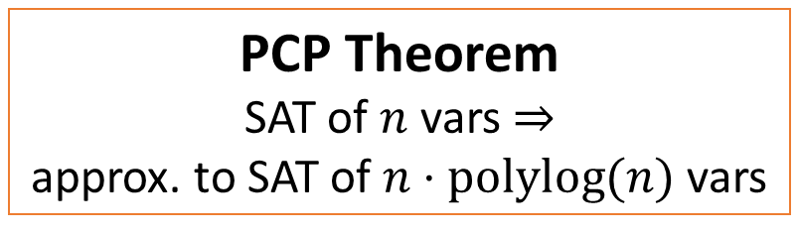
Major Challenge: How to Show Approximation Hardness in Fine-Grained Setting?
The PCP theorem is too “coarse” to be applied in the fine-grained setting.
Drops by more than a polynomial comparing to $2^{n}$!
SETH
SAT of $n$ vars requires $2^{n}$ time
Approx. to SAT of $n$ vars.
Requires $2^{n/polylog(n)}$ time
PCP Theorem
SAT of $n$ vars $⇒$
approx. to SAT of $n⋅polylog(n)$ vars
$N^{2}⇒N^{o(1)}$ ☹
OV
Notes:
Maybe explain that?

Slide 19
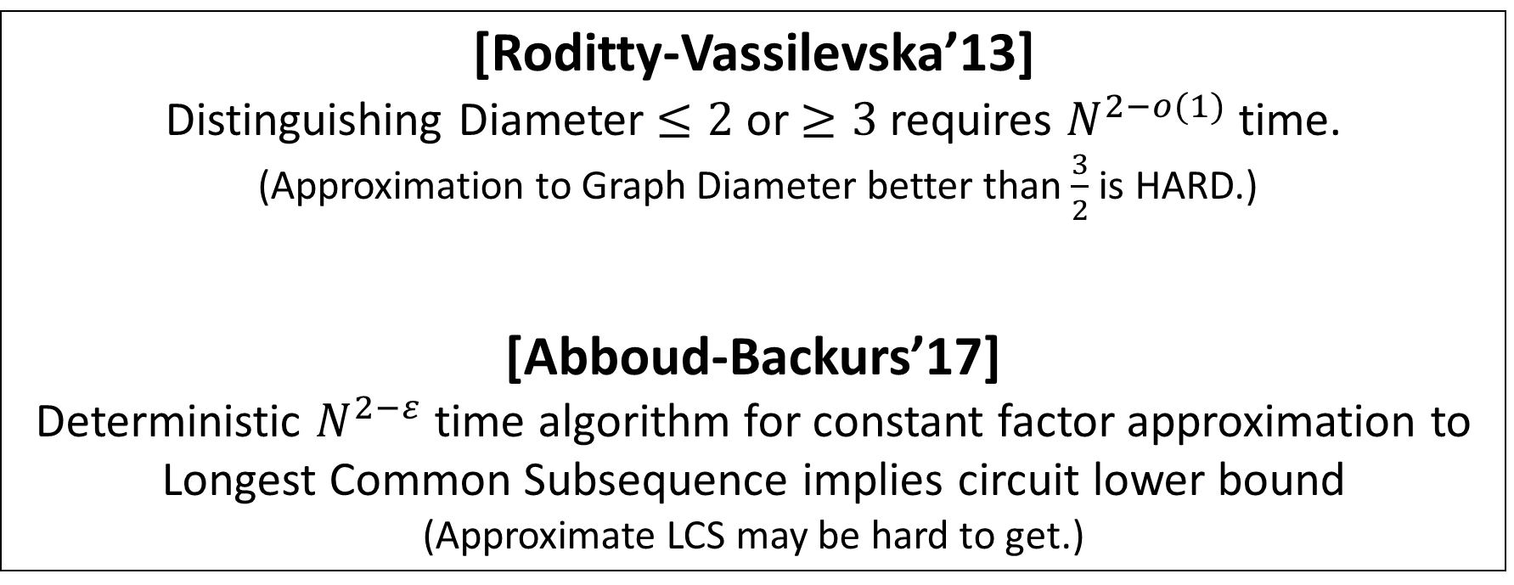
Some Earlier Works
[Roditty-Vassilevska’13]
Distinguishing Diameter $≤2$ or $≥3$ requires $N^{2−o(1)}$ time.
(Approximation to Graph Diameter better than $\frac{3}{2}$ is HARD.)
[Abboud-Backurs’17]
Deterministic $N^{2−ε}$ time algorithm for constant factor approximation to Longest Common Subsequence implies circuit lower bound
(Approximate LCS may be hard to get.)

Slide 20
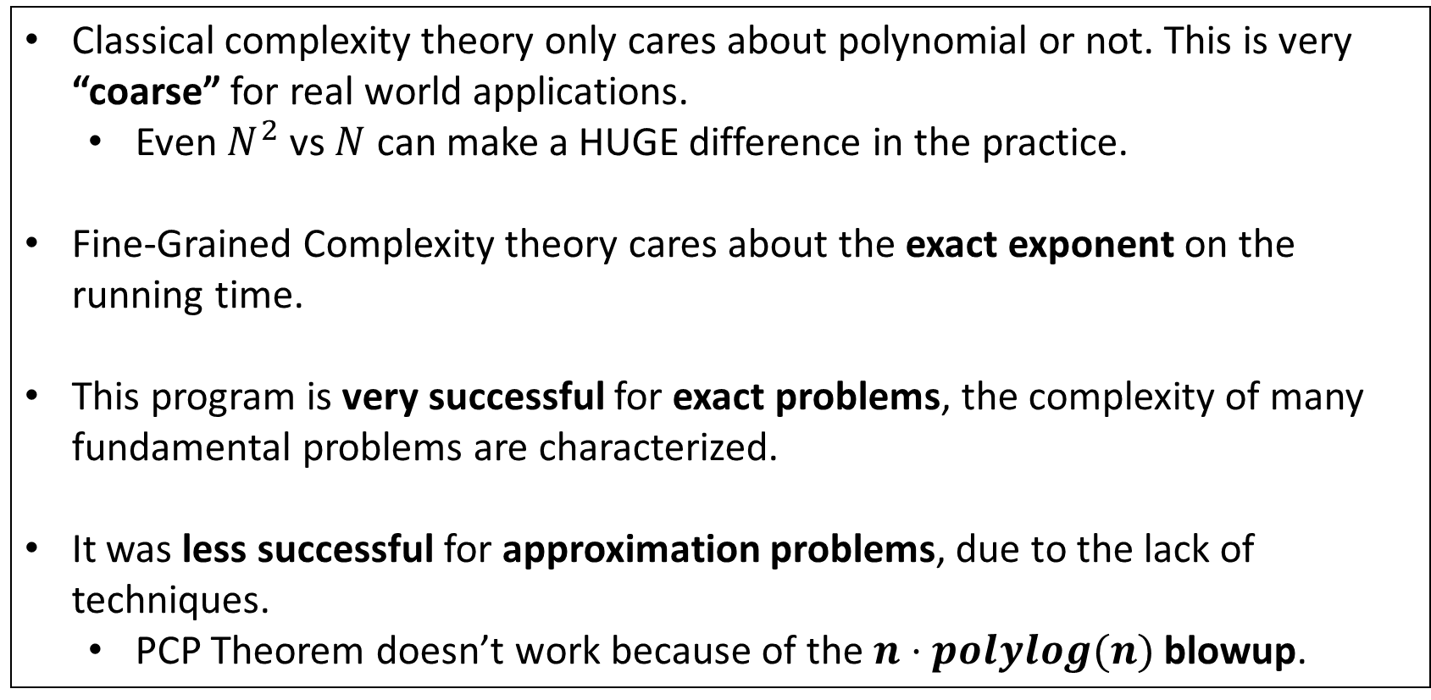
Summary
Classical complexity theory only cares about polynomial or not. This is very “coarse” for real world applications.
Even $N^{2}$ vs $N$ can make a HUGE difference in the practice.
Fine-Grained Complexity theory cares about the exact exponent on the running time.
This program is very successful for exact problems, the complexity of many fundamental problems are characterized.
It was less successful for approximation problems, due to the lack of techniques.
PCP Theorem doesn’t work because of the $n⋅polylog(n)$ blowup.

Slide 21
Today’s Topic
Background
What is Fine-Grained Complexity?
The Methodology of Fine-Grained Complexity
Frontier: Fine-Grained Hardness for Approximation Problems
The Connection
[ARW’17]: Connection between Fine-Grained Complexity and Communication Protocols.
[Rub’18, CLM’18]: Further developments.
Our Results
[Chen’18]: Hardness for Furthest Pair
[CW’19]: A New Equivalence Class in Fine-Grained Complexity
[CGLRR’19]: Fine-Grained Complexity Meets IP = PSPACE

Slide 22
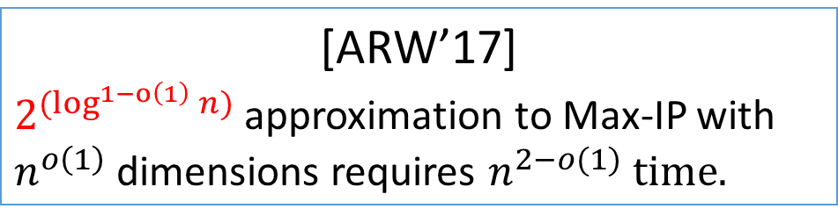
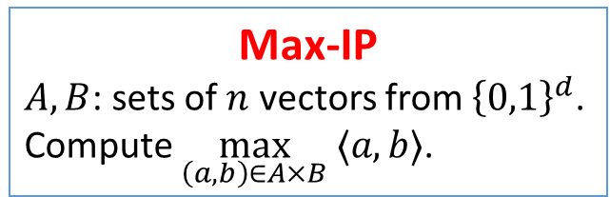
[ARW’17]: Hardness of Approximation in P Via Communication Protocols!
Max-IP
$A,B$: sets of $n$ vectors from ${\left\{0,1\right\}}^{d}$.
Compute $\max_{\left(a,b\right)∈A×B} ⟨a,b⟩$.
[ARW’17]
$2^{(\log^{1−o\left(1\right)}{n})}$ approximation to Max-IP with $n^{o\left(1\right)}$ dimensions requires $n^{2−o(1)} time.$
Hardness for many other problems [ARW’17]
Bichromatic LCS Closest Pair Over Permutations,
Approximate Regular Expression Matching,
and Diameter in Product Metrics
Key Contribution of [ARW’17]
There is a framework to show fine-grained approximation result!
The key: Communication Protocols!

Slide 23
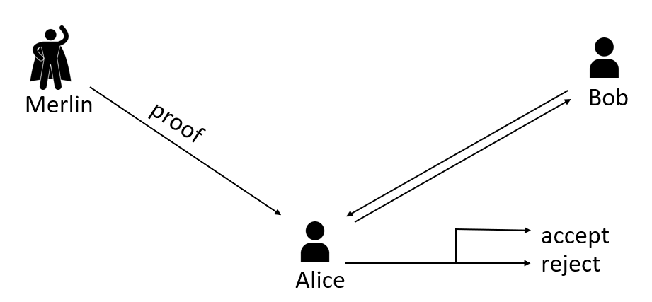
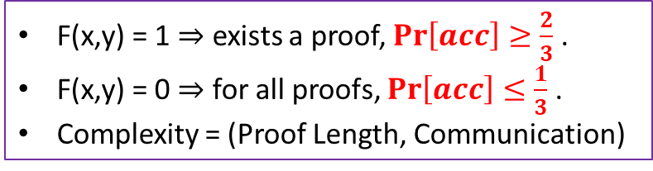
Merlin-Arthur(MA) Protocols
Alice holds $x$, Bob holds $y$, want to compute $F(x,y)$
F(x,y) = 1 $⇒$ exists a proof, $\operatorname{Pr}\left[acc\right]≥\frac{2}{3}$ .
F(x,y) = 0 $⇒$ for all proofs, $\operatorname{Pr}\left[acc\right]≤\frac{1}{3}$ .
Complexity = (Proof Length, Communication)
MA Communication Protocol
Notes:
Pause here and stay longer to make sure people understand

Slide 24
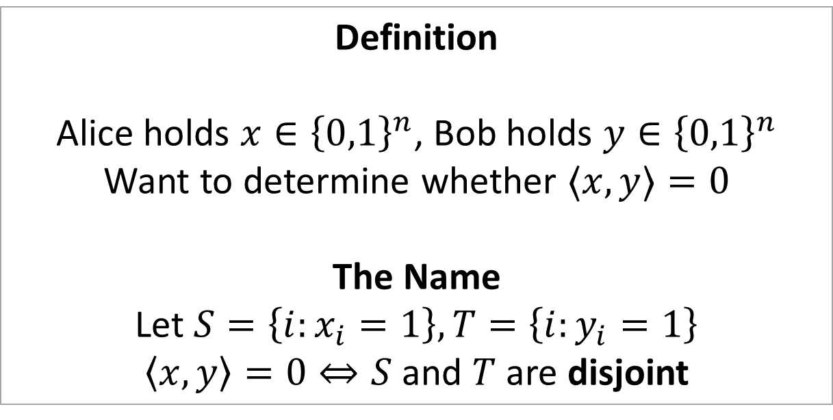
Set-Disjointness
Definition
Alice holds $x∈{\left\{0,1\right\}}^{n}$, Bob holds $y∈{\left\{0,1\right\}}^{n}$
Want to determine whether $⟨x,y⟩=0$
The Name
Let $S=\left\{i:x_{i}=1\right\},T=\left\{i:y_{i}=1\right\}$
$\left\langle x,y\right\rangle =0⇔S$ and $T$ are disjoint

Slide 25
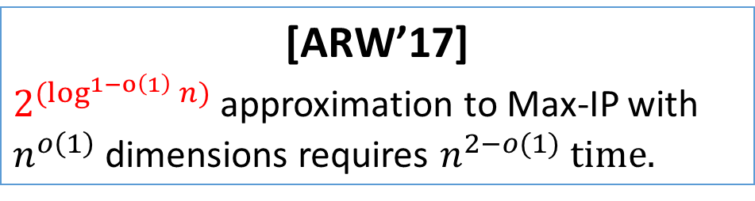
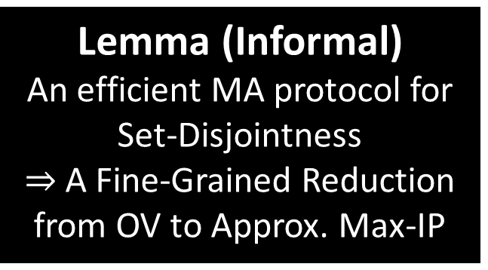
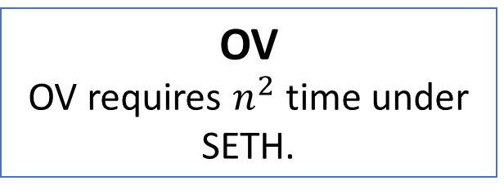
Merlin-Arthur Protocols Implies Reduction to Approx. Max-IP
[AW’09]
There is a good MA protocol for Set-Disjointness
Lemma (Informal)
An efficient MA protocol for Set-Disjointness
$⇒$ A Fine-Grained Reduction from OV to Approx. Max-IP
OV
OV requires $n^{2}$ time under SETH.
[ARW’17]
$2^{(\log^{1−o\left(1\right)}{n})}$ approximation to Max-IP with $n^{o\left(1\right)}$ dimensions requires $n^{2−o(1)} time.$

Slide 26
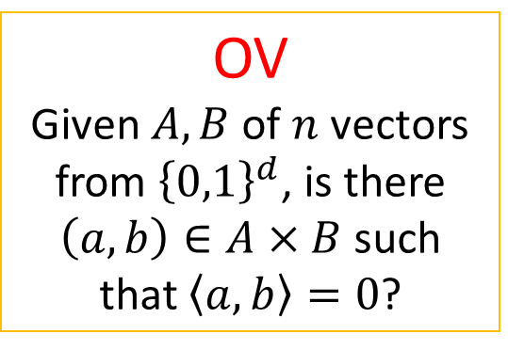

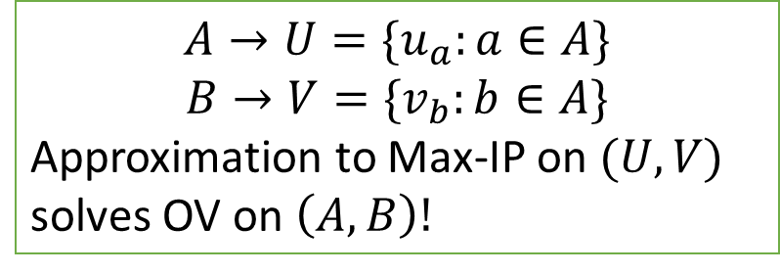
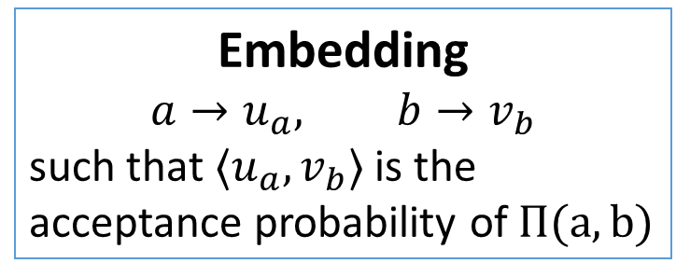
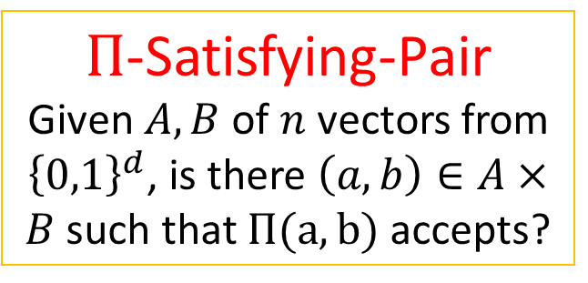
The High-Level idea
Let $Π$ be an MA protocol for Set-Disjointness.
OV
Given $A,B$ of $n$ vectors from ${\left\{0,1\right\}}^{d}$, is there $\left(a,b\right)∈A×B$ such that $\left\langle a,b\right\rangle =0$?
$Π$-Satisfying-Pair
Given $A,B$ of $n$ vectors from ${\left\{0,1\right\}}^{d}$, is there $\left(a,b\right)∈A×B$ such that $Π(a,b)$ accepts?
Approximate Max-IP
Embedding
$$a→u_{a}, b→v_{b}$$
such that $⟨u_{a},v_{b}⟩$ is the acceptance probability of $Π(a,b)$
$$A→U=\{u_{a}:a∈A\}$$
$$B→V=\{v_{b}:b∈A\}$$
Approximation to Max-IP on $(U,V)$ solves OV on $\left(A,B\right)!$

Slide 27
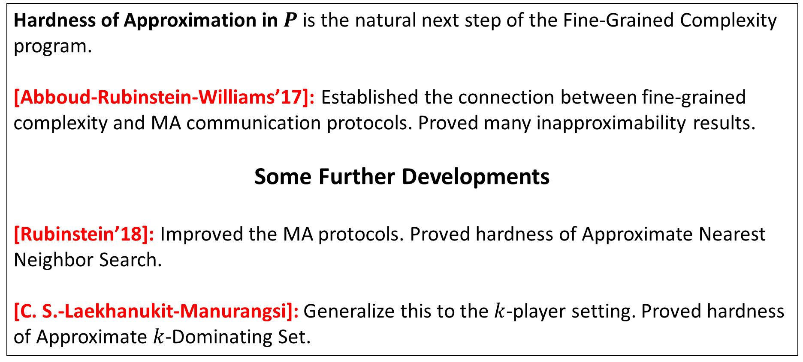
Summary
Hardness of Approximation in $P$ is the natural next step of the Fine-Grained Complexity program.
[Abboud-Rubinstein-Williams’17]: Established the connection between fine-grained complexity and MA communication protocols. Proved many inapproximability results.
Some Further Developments
[Rubinstein’18]: Improved the MA protocols. Proved hardness of Approximate Nearest Neighbor Search.
[C. S.-Laekhanukit-Manurangsi]: Generalize this to the $k$-player setting. Proved hardness of Approximate $k$-Dominating Set.

Slide 28
Motivation of Our Works
Explore More on connection between Fine-Grained Complexity and Communication Protocols
Communication protocols other than Merlin-Arthur protocols?

Slide 29
Today’s Topic
Background
What is Fine-Grained Complexity?
The Methodology of Fine-Grained Complexity
Frontier: Fine-Grained Hardness for Approximation Problems
The Connection
[ARW’17]: Connection between Fine-Grained Complexity and Communication Protocols.
[Rub’18, CLM’18]: Further developments.
Our Results
[Chen’18]: Hardness for Furthest Pair
[CW’19]: A New Equivalence Class in Fine-Grained Complexity
[CGLRR’19]: Fine-Grained Complexity Meets IP = PSPACE

Slide 30

[Chen’18] $NP⋅UPP$ Protocols and Hardness of Furthest Pair

Slide 31

Closest Pair vs. Furthest Pair
Given $n$ points in $ℝ^{d}$
Closest Pair
Furthest Pair
Find the pair with minimum distance
Find the pair with maximum distance

Slide 32



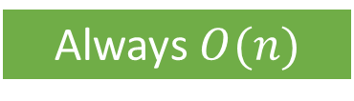

Closest Pair vs. Furthest Pair
Closest Pair
Furthest Pair
Best Algorithms
$$2^{O(d)}⋅n$$
$$n^{2−2/d}$$
Is Furthest Pair “Far Harder” Than Closest Pair?
When $d=O(1)$
Always $O(n)$
Goes to $n^{2}$
EASY
HARD

Slide 33




Closest Pair vs. Furthest Pair
Theorem
Under SETH, Furthest Pair in $2^{\log^{⋆}n}$ dimensions requires $n^{2}$ time
$$log\left({10000}^{{10000}^{10000}}\right)≈13⋅{10000}^{10000}$$
$$log\left(13⋅{10000}^{10000}\right)≈13⋅10000$$
$log\left(13⋅10000\right)≈$17
$$log\left(17\right)≈4$$
$$log\left(4\right)=2$$
$$log\left(2\right)=1$$
$$log\left(1\right)=0$$
$\log^{ ⋆ }(n)$ grows extremely slowly!
$$\log^{∗}\left({10000}^{{10000}^{10000}}\right)≤8.$$
$2^{\log^{⋆}n}$ is effectively a constant ☺

Slide 34


Comparing to [Wil’18]
[Wil’18]
Under SETH, Furthest Pair in ${\left(log log n\right)}^{2}$ dimensions
$2^{\log^{⋆}n}$ (ours)
requires $n^{2}$ time
$${\left(log log n\right)}^{2}≥log log log n≥\log^{\left(4\right)}n≥\log^{\left(5\right)}n≥…≥ \\ \log^{(10000)}n≥…≥2^{\log^{⋆}n}$$
An “infinite” improvement ☺

Slide 35








Closest Pair vs. Furthest Pair: Updated
Closest Pair
Furthest Pair
Best Algorithms
$$2^{O(d)}⋅n$$
$$n^{2−2/d}$$
$$d=O(1)$$
$$O(n)$$
Goes to $n^{2}$
$$d=2^{\log^{⋆}n}$$
$$O(n log n)$$
Requires $n^{2}$
Furthest Pair is “Far Harder” Than Closest Pair!

Slide 36




Technique: $NP⋅UPP$ Protocols
Alice holds $x$, Bob holds $y$, want to compute $F(x,y)$
F(x,y) = 1 $⇒$ exists a proof, $\operatorname{Pr}\left[acc\right]≥\frac{2}{3}$ .
F(x,y) = 0 $⇒$ for all proofs, $\operatorname{Pr}\left[acc\right]≤\frac{1}{3}$ .
Complexity = (Proof Length, Communication)
MA Communication Protocol
F(x,y) = 1 $⇒$ exists a proof, $\operatorname{Pr}\left[acc\right]>\frac{1}{2}$ .
F(x,y) = 0 $⇒$ for all proofs, $\operatorname{Pr}\left[acc\right]<\frac{1}{2}$ .
Complexity = (Proof Length, Communication)
$NP⋅UPP$ Communication Protocol

Slide 37


Technique: $NP⋅UPP$ Protocols Implies SETH-Hardness
Lemma
An $NP⋅UPP$ protocol for Set-Disjointness with proof length $o\left(n\right),$ communication complexity $α(n)$
$⇒$ under SETH, Furthest Pair in $2^{α(n)}$ dimensions requires $n^{2}$ time

Slide 38


Technique: $NP⋅UPP$ Protocols Via Recursive Chinese Remainder Theorem
Theorem
There is an $NP⋅UPP$ protocol for Set-Disjointness with proof length $o\left(n\right),$ communication complexity $\log^{⋆}n$
Proved by an involved recursive application of
Chinese Remainder Theorem
(See the paper ☺)

Slide 39

Open Question
Can we show that Furthest Pair in $α(n)$ dimensions for any $α\left(n\right)=ω(1)$ requires $n^{2−o(1)}$ time?

Slide 40

Summary
Furthest Pair/ Closest Pair look similar. But we show that Furthest Pair is “far harder than” Closest Pair.
In $2^{\log^{∗}n}$ dimensions, closest pair is in$n log n$ time, furthest pair requires $n^{2}$ time under SETH
$NP⋅UPP$ protocols are natural relaxation of MA protocols.
Fast $NP⋅UPP$ protocols for Set-Disjointness $⇒$ Hardness for Furthest Pair.
We construct an $NP⋅UPP$ protocols with sub-linear proof complexity and $O(\log^{⋆}n)$ communication complexity.

Slide 41

[CW’19] $Σ_{2}$ Communication Protocols and An Equivalence Class for OV

Slide 42




Fine-Grained Complexity: “Modern” NP-completeness
Many Conceptual Similarities
NP-Completeness
Fine-Grained Complexity
Basic Questions
Which problems require super-poly time?
Which problems require (say) $n^{2}$ time?
$P≠NP$
SAT requires $n^{ω(1)}$ time.
(for instance)
OV requires $n^{2}$ time.
Basic Assumptions
Preserve being in P
Preserve less-than-$n^{2}$
Weapons (Reductions)
Karp-reduction
Fine-Grained Reduction

Slide 43
The Key Conceptual Difference
NP-completeness
Fine-Grained Complexity
Hamiltonian Path
Orthogonal Vectors
Approx. Bichrom.
Closest Pair
Vertex Cover
Max-Clique
Edit Distance
Backurs and Indyk 2015
Sparse-Graph-Diameter
Rubinstein 2018
Thousands of NP-complete problems
form an equivalence class
Roditty and V.Williams 2013
Few Problems are known
To be Equivalent to OV
Except for the APSP
equivalence class

Slide 44


Why we want an Equivalence Class? I
What does an equivalence class mean?
A super strong understanding
of the nature of computation!
All problems are essentially the same problem!
We cannot say “Edit Distance is just OV in disguise”
Hamiltonian Path
Max-Clique
These NP-complete problems
are just SAT “in disguise”!
Vertex Cover

Slide 45


Why we want an Equivalence Class? II
Consequence of an equivalence class
OV in $n^{1.99}$ time doesn’t necessarily imply anything for
OV-hard problems.
If “just one” NP-complete problem requires super-poly time, then all of them do
If “just one” NP-complete problem is in $P$, then all problems are as well.
Orthogonal Vectors
Hamiltonian Cycle
Approx. Bichrom.
Closest Pair
Edit Distance
Vertex Cover
Max-Clique
Sparse-Graph-Diameter

Slide 46


This Work
An Equivalence Class for Orthogonal Vectors in $O\left(\log{n}\right)$ dims.
In particular, OV is equivalent to approx. bichromatic closest pair.
Two Frameworks for Reductions to OV
with $Σ_{2}$ communication protocols (this talk)
with Locality Sensitive Hashing Families (see the paper)

Slide 47





A New Equivalence Class for OV
OV
Find an orthogonal pair, among $n$ vectors in ${\left\{0,1\right\}}^{O(\log{n})}$($\left\langle a,b\right\rangle =0$).
Approx. Bichrom.-Closest-Pair: Compute a $1+Ω(1)$-approx. to the distance between the closest red-blue pair among $n$ points.
Approx. Furthest-Pair:
Compute a $1+Ω(1)$-approx. to the distance between the furthest pair among $n$ points
Theorem (Informal)
Either all of these problems are in sub-quadratic time ($n^{2−ε}$ for $ε>0$),
or none of them are.
Max-IP/Min-IP
Find a red-blue pair of vectors with minimum (resp. maximum) inner product, among $n$ vectors in ${\left\{0,1\right\}}^{O(\log{n})}$.
Apx-Min-IP/-Max-IP
Compute a $100$ approximation to Max-IP/Min-IP.

Slide 48


Technique: Two Reduction Frameworks
Known Directions [R. Williams 05, Rubinstein 18]: OV $⇒$ Other Problems
This work: Other Problems $⇒$ OV via two reduction frameworks
Framework I (this talk)
Based on $Σ_{2}$ Communication Protocols
A Fast $Σ_{c}^{cc}$ protocols
$⇒$ A reduction to OV
Framework II (see the paper)
Based on Locality-Sensitive Hashing (LSH)
An efficient LSH family
$⇒$ A reduction to OV

Slide 49




Framework : $Σ_{2}$ communication protocols
$Σ_{2}$ Communication Protocol for $F$
$$F\left(x,y\right)=1$$
$⇔$ $∃a$ from Merlin
s.t. $∀b$ from Megan,
Alice accepts $\left(a,b\right)$
after communicating with Bob.
Notes:
Redo the graph

Slide 50




Framework : $Σ_{2}$ communication protocols
$F$-Satisfying Pair Problem
Given $A,B⊆X$, $∃?\left(a,b\right)∈A×B$ s.t. $F\left(a,b\right)=1?$
Application
(Decisional) Max-IP
Given $A,B⊆{\left\{0,1\right\}}^{O(\log{n})}$ and a target $τ$, is there $\left(a,b\right)∈A×B$ s.t. $\left\langle a,b\right\rangle ≥t$?
Theorem (Informal)
Efficient $Σ_{2}^{cc}$ protocols for $F$
$⇒$ $F$-Satisfying Pair can be reduced to OV.
Define $F_{IP}\left(a,b\right)=[\left\langle a,b\right\rangle ≥τ?]$
Max-IP is just $F_{IP}$-Satisfying Pair
There is an efficient $Σ_{2}^{cc}$ protocol for $F_{IP}$, so Max-IP can be reduced to OV.
Notes:
Discuss why Sigma_2 may be more compelling than MA

Slide 51
Open Problems
Find More Problems Equivalent to OV
Unequivalence Results?

Slide 52

Summary
Fine-Grained Complexity Mimics The Theory of NP-completeness and is very successful.
One Important difference is that Fine-Grained Complexity lacks equivalence class for OV.
$Σ_{2}$ protocols are analogy of $Σ_{2}P$ in communication complexity.
Efficient $Σ_{2}$ protocols implies fine-grained reductions to Orthogonal Vectors (OV).
We construct efficient $Σ_{2}$ protocols and show an equivalence class for OV.
In particular, OV is equivalent to Approximate Bichromatic Closest Pair.

Slide 53
[CGLRR’19] Fine-Grained Complexity Meets IP = PSPACE

Slide 54

IP Protocols
Alice holds $x$, Bob holds $y$, want to compute $F(x,y)$
F(x,y) = 1 $⇒$ exists a proof, $\operatorname{Pr}\left[acc\right]≥\frac{2}{3}$ .
F(x,y) = 0 $⇒$ for all proofs, $\operatorname{Pr}\left[acc\right]≤\frac{1}{3}$ .
Complexity = (Proof Length, Communication)
MA Communication Protocol
IP Communication Protocol
Alice and Merlin now interact in several rounds.
Complexity = (Total Proof Length, Communication)

Slide 55



IP = PSPACE and Communication Complexity
Closest-LCS-Pair
Input: Two sets $A,B$ of strings with max length $D=2^{{\left(log N\right)}^{o\left(1\right)}}$
Output: $\max_{\left(a,b\right)∈A×B} LCS\left(a,b\right)$
Theorem (Informal)
efficient IP protocols for $F(x,y)$.
$⇒$ Closest-$F$-Pair can be reduced to approx. Closest-LCS-Pair
[AW’09] (Informal)
$polylog(n)$ space algorithm for $F(x,y)$
$⇒$ efficient IP protocols for $F(x,y)$.
Closest-LCS-Pair can be reduced to approx. Closest-LCS-Pair. (That is, it is equivalent to its approximation version.)

Slide 56
Summary
IP protocols are generalization of Merlin-Arthur protocols where Merlin and Arthur interact for more than one round.
Utilizing IP protocols, we show an equivalence between exact closest-LCS-pair and approximate closest-LCS-pair.
There are many other results in the paper.

Slide 57

Conclusion
Fine-Grained Complexity want to understand the exact running time for problems in P.
Still old weapons: assumptions and reductions
The frontier: hardness for approximation algorithms
[ARW’17]: Connect fine-grained complexity to communication complexity to show approximation hardness.
Our work: Further explore this direction.
[Chen’18]: Hardness for Furthest Pair with $NP⋅UPP$ protocols
[CW’19]: Equivalence Class for OV with $Σ_{2}$ protocols
[CGLRR’19]: Applying IP = PSPACE to Fine-Grained Complexity

