Slide 1


On Distributed Differential Privacy and Counting Distinct Elements
Lijie Chen
Badih Ghazi
Ravi Kumar
Pasin Manurangsi

Slide 2
Today’s Plan
Part I (Introduction)
The Shuffle Model of Differential Privacy
The Count Distinct Problem and Our Results for it
Lower Bounds for Selection and Learning Parity in the Shuffle Model
Part II (Techniques)
Lower Bounds via Dominated Protocols
Lower Bounds via Moment-Matching
Conclusion and Open Problems

Slide 3
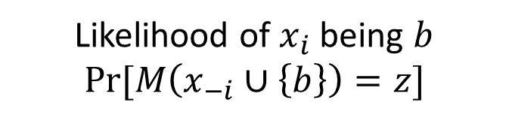
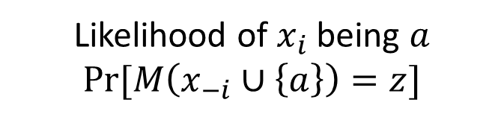
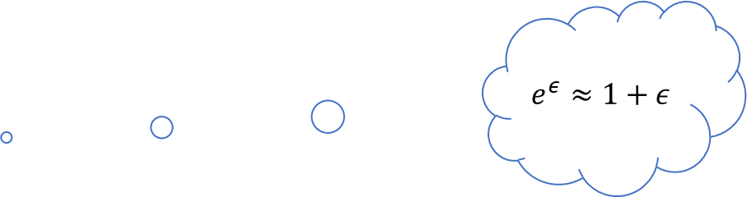
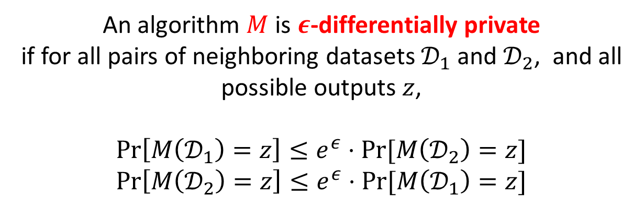
Differential Privacy: Definition
An algorithm $M$ runs on a data set $𝒟={\left\{x_{i}\right\}}_{i∈[n]}$, produces a probabilistic output $M(𝓓)$
{3,5,7,9,11}
{3,5,7,13,11}
We say two datasets are neighboring, if they differ by at most one element
An algorithm $M$ is $ε$-differentially private
if for all pairs of neighboring datasets $𝒟_{1}$ and $𝒟_{2}$, and all possible outputs $z$,
$$\operatorname{Pr}\left[M\left(𝒟_{1}\right)=z\right]≤e^{ε}⋅Pr⁡[M\left(𝒟_{2}\right)=z]$$
$$\operatorname{Pr}\left[M\left(𝒟_{2}\right)=z\right]≤e^{ε}⋅Pr⁡[M\left(𝒟_{1}\right)=z]$$
$$e^{ε}≈1+ε$$
Attacker knows $x_{−i}={\left\{x_{j}\right\}}_{j≠i}$ and an output $z$ from $M(𝒟)$
Likelihood of $x_{i}$ being $a$
$Pr⁡[M\left(x_{−i}∪\left\{a\right\}\right)=z]$
Likelihood of $x_{i}$ being $b$
$Pr⁡[M\left(x_{−i}∪\left\{b\right\}\right)=z]$
Neighboring!

Slide 4
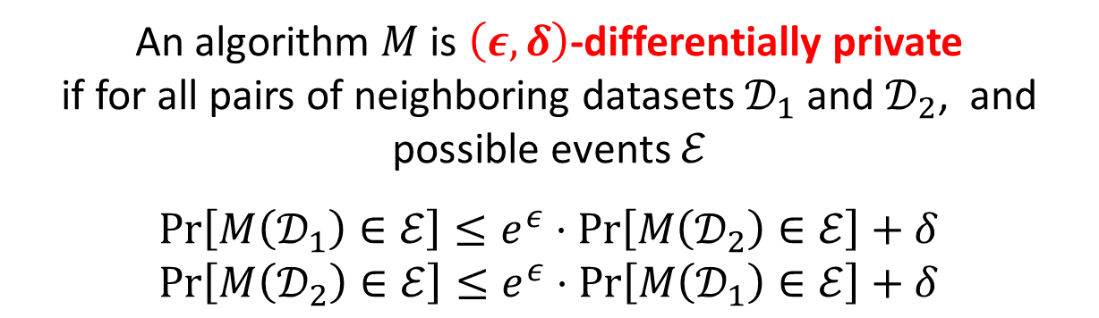
Differential Privacy: Definition
An algorithm $M$ runs on a data set $𝒟={\left\{x_{i}\right\}}_{i∈[n]}$, produces a probabilistic output $M(𝓓)$
{3,5,7,9,11}
{3,5,7,13,11}
We say two datasets are neighboring, if they differ by at most one element
An algorithm $M$ is $\left(ε,δ\right)$-differentially private
if for all pairs of neighboring datasets $𝒟_{1}$ and $𝒟_{2}$, and possible events $ℰ$
$$\operatorname{Pr}\left[M\left(𝒟_{1}\right)∈ℰ\right]≤e^{ε}⋅\operatorname{Pr}\left[M\left(𝒟_{2}\right)∈ℰ\right]+δ$$
$$\operatorname{Pr}\left[M\left(𝒟_{2}\right)∈ℰ\right]≤e^{ε}⋅\operatorname{Pr}\left[M\left(𝒟_{1}\right)∈ℰ\right]+δ$$

Slide 5

Differential Privacy in the Distributed Setting
Imagine each user holds their own data $x_{i}$ initially
An algorithm $M$ runs on a dataset $𝒟={\left\{x_{i}\right\}}_{i∈[n]}$, produces a probabilistic output $M(𝓓)$
How do we ensure the privacy of each user?
Trust
How much should the user trust the curator?
Three
Important
Dimensions
Utility
How useful is the algorithm?
Privacy
How private is the algorithm?

Slide 6
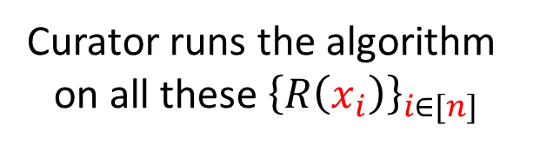
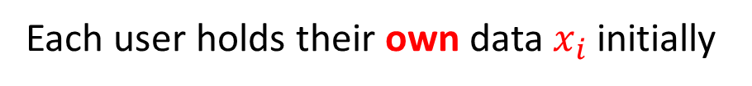
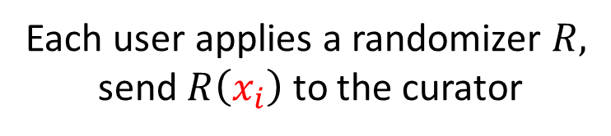

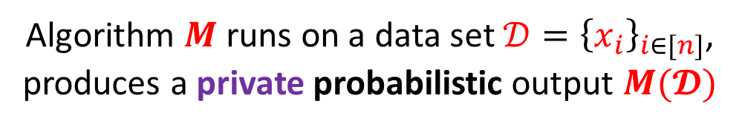
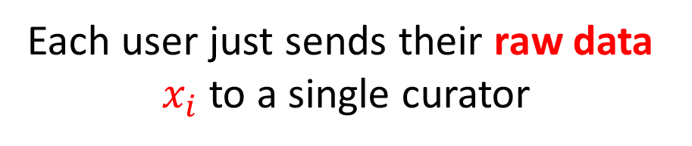
Central Model vs (Non-interactive) Local Model
Each user holds their own data $x_{i}$ initially
Each user holds their own data $x_{i}$ initially
After sending you raw data to the curator, you must trust their integrity for the rest of your life
It’s probabilistic
Each user just sends their raw data
$x_{i}$ to a single curator
Each user applies a randomizer $R,$
send $R\left(x_{i}\right)$ to the curator
Algorithm $M$ runs on a data set $𝒟={\left\{x_{i}\right\}}_{i∈[n]}$,
produces a private probabilistic output $M(𝓓)$
Curator runs the algorithm
on all these ${\left\{R\left(x_{i}\right)\right\}}_{i∈[n]}$

Slide 7
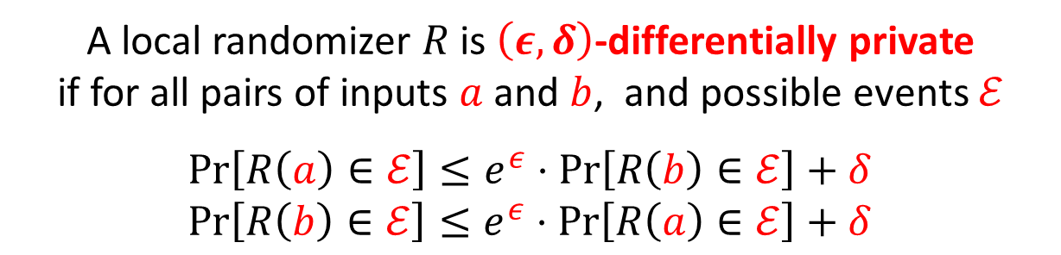
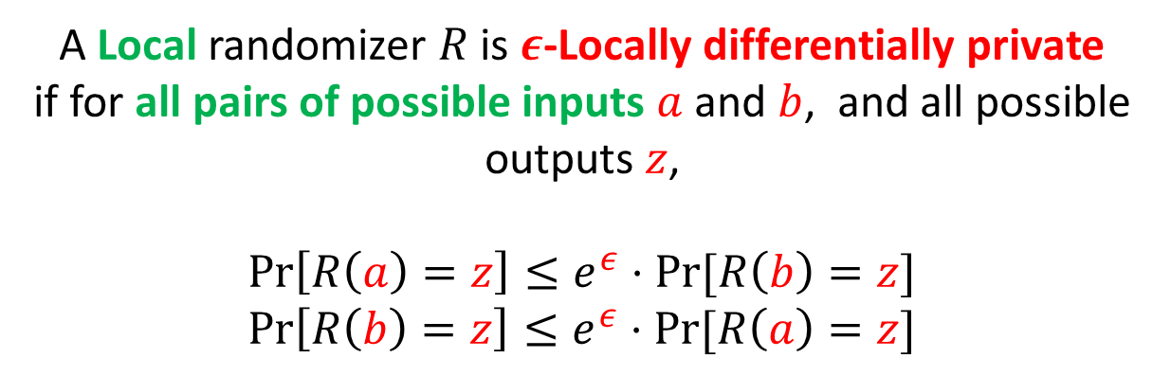
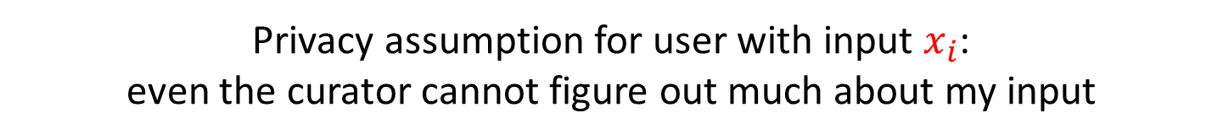
Differential Privacy: Local Model
Imagine each user holds their own data $x_{i}$ initially
It’s probabilistic
Each user applies a randomizer $R,$ sends $R\left(x_{i}\right)$ to the curator
Privacy assumption for user with input $x_{i}$:
even the curator cannot figure out much about my input
A Local randomizer $R$ is $ε$-Locally differentially private
if for all pairs of possible inputs $a$ and $b$, and all possible outputs $z$,
$$\operatorname{Pr}\left[R\left(a\right)=z\right]≤e^{ε}⋅Pr⁡[R\left(b\right)=z]$$
$$\operatorname{Pr}\left[R\left(b\right)=z\right]≤e^{ε}⋅Pr⁡[R\left(a\right)=z]$$
A local randomizer $R$ is $\left(ε,δ\right)$-differentially private
if for all pairs of inputs $a$ and $b$, and possible events $ℰ$
$$\operatorname{Pr}\left[R\left(a\right)∈ℰ\right]≤e^{ε}⋅\operatorname{Pr}\left[R\left(b\right)∈ℰ\right]+δ$$
$$\operatorname{Pr}\left[R\left(b\right)∈ℰ\right]≤e^{ε}⋅\operatorname{Pr}\left[R\left(a\right)∈ℰ\right]+δ$$
Curator runs the algorithm on all these ${\left\{R\left(x_{i}\right)\right\}}_{i∈[n]}$

Slide 8
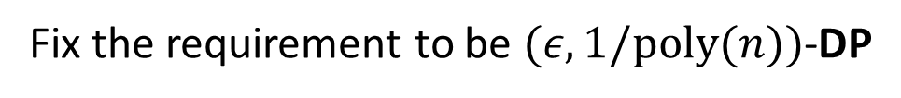


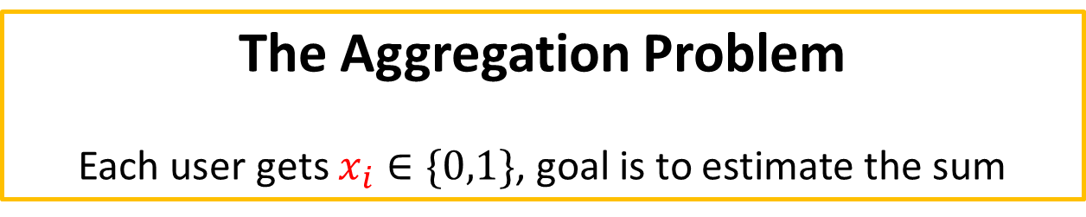
Differential Privacy: Central vs Local
Privacy
How private is the algorithm?
Fix the requirement to be $(ε,1/poly(n))$-DP
The Aggregation Problem
Each user gets $x_{i}∈\{0,1\}$, goal is to estimate the sum
Trust
Utility
Central
Complete Trust in the Curator
$Θ(ε^{−1})$ error
Local
$Θ(ε^{−1}⋅\sqrt{n})$ error
Only Trust myself

Slide 9




Differential Privacy: Shuffle Model
Complete Trust in the Curator
Only Trust myself
Spectrum of Trust
Local
Central
Shuffle Model
[IKOS06, BEM+17,CSU+18,EFM+19]
Spectrum of Utility
$Θ(ε^{−1})$ error
$Θ(ε^{−1}⋅\sqrt{n})$ error
Local
Central

Slide 10
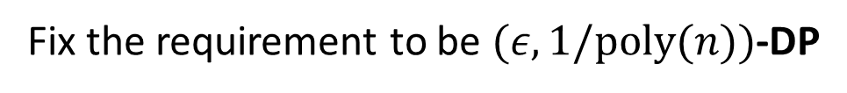
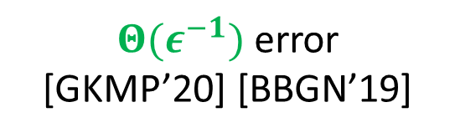
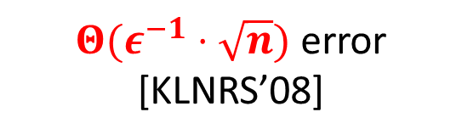

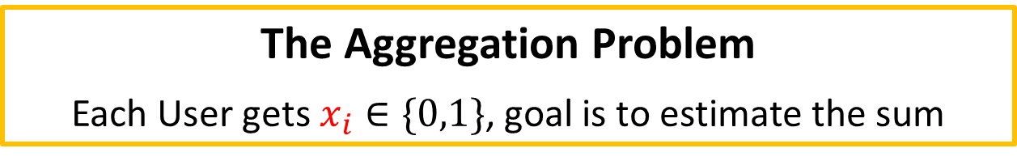
Differential Privacy: Central vs Local vs Shuffle
Privacy
How private is the algorithm?
Fix the requirement to be $(ε,1/poly(n))$-DP
The Aggregation Problem
Each User gets $x_{i}∈\{0,1\}$, goal is to estimate the sum
Trust
Utility
Central
Complete Trust in the Curator
$Θ(ε^{−1})$ error
Local
$Θ(ε^{−1}⋅\sqrt{n})$ error [KLNRS’08]
Only Trust myself
Shuffle
Only Trust the Shuffler
$Θ(ε^{−1})$ error
[GKMP’20] [BBGN’19]

Slide 11
Local Model
Shuffle Model
Imagine each user holds their own data $x_{i}$ initially
It’s probabilistic
Each user applies a randomizer $R,$ sends $R\left(x_{i}\right)$ to the curator
There exists a shuffler $S$, which applies a random permutation on all $\{R(x_{i})\}$
Curator runs the algorithm on all these ${\left\{R\left(x_{i}\right)\right\}}_{i∈[n]}$

Slide 12
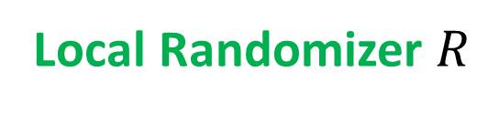
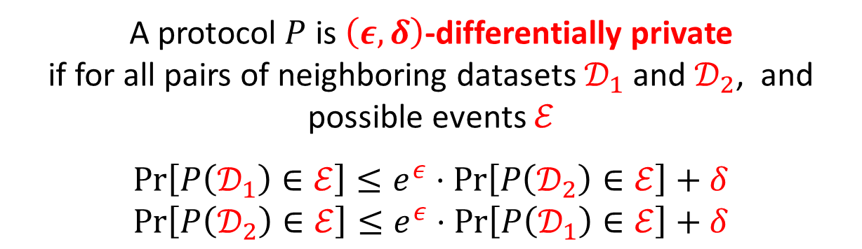
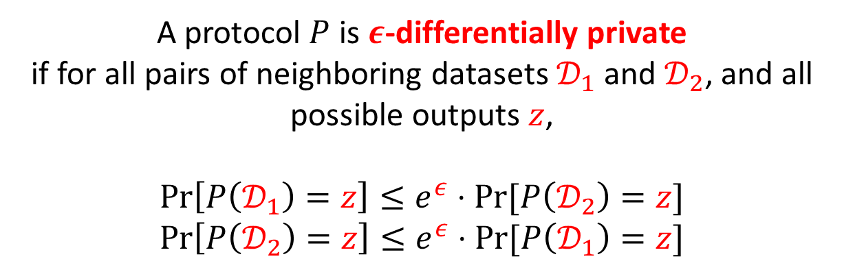

Shuffle Model: Formal Definition
Local Randomizer $R$
Message Complexity
How many messages one user sends in the worst case
Shuffler S
Transcript with Dataset $𝒟=\{x_{i}\}$
$$P\left(𝒟\right)=S(R\left(x_{1}\right),R\left(x_{2}\right),R\left(x_{3}\right),…,R(x_{n}))$$
A protocol $P$ is $ε$-differentially private
if for all pairs of neighboring datasets $𝒟_{1}$ and $𝒟_{2}$, and all possible outputs $z$,
$$\operatorname{Pr}\left[P\left(𝒟_{1}\right)=z\right]≤e^{ε}⋅Pr⁡[P\left(𝒟_{2}\right)=z]$$
$$\operatorname{Pr}\left[P\left(𝒟_{2}\right)=z\right]≤e^{ε}⋅Pr⁡[P\left(𝒟_{1}\right)=z]$$
A protocol $P$ is $\left(ε,δ\right)$-differentially private
if for all pairs of neighboring datasets $𝒟_{1}$ and $𝒟_{2}$, and possible events $ℰ$
$$\operatorname{Pr}\left[P\left(𝒟_{1}\right)∈ℰ\right]≤e^{ε}⋅\operatorname{Pr}\left[P\left(𝒟_{2}\right)∈ℰ\right]+δ$$
$$\operatorname{Pr}\left[P\left(𝒟_{2}\right)∈ℰ\right]≤e^{ε}⋅\operatorname{Pr}\left[P\left(𝒟_{1}\right)∈ℰ\right]+δ$$

Slide 13
Today’s Plan
Part I (Introduction)
The Shuffle Model of Differential Privacy
The Count Distinct Problem and Our Results for it
Lower Bounds for Selection and Learning Parity in the Shuffle Model
Part II (Techniques)
Lower Bounds via Moment-Matching
Lower Bounds via Dominated Protocols
Conclusion and Open Problems

Slide 14

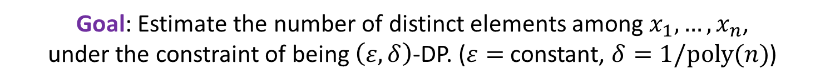
The Count Distinct Problem
Convention
Green for Local Model
Purple for Shuffle Model
Red for Central Model
Input: $n$ users, each holds their own data $x_{i}$
Central Model:
O(1) error
Goal: Estimate the number of distinct elements among $x_{1},…,x_{n}$,
under the constraint of being $\left(ε,δ\right)$-DP. ($ε=$ constant, $δ=1/poly(n)$)
Lower Bound in Local-DP
It is maximally hard in the local model (i.e., error $=\tilde{Ω}(n)$)
Lower Bound in Shuffle-DP
It is still maximally hard in the single-message (worst-case) shuffle model
Upper Bound in Shuffle-DP
It is much easier in the shuffle model if each user sends at most one message in expectation

Slide 15

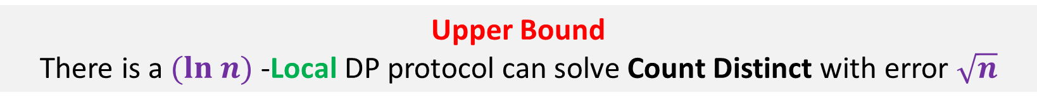
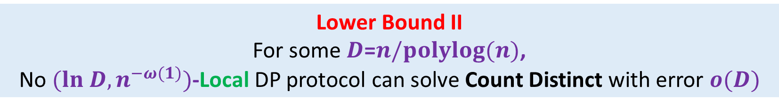
Count Distinct in (Non-Interactive) Local Model
Input: $n$ users, each holds their own data $x_{i}$
Goal: Estimate the number of distinct elements among $x_{1},…,x_{n}$,
under the constraint of being $\left(ε,δ\right)$-DP. ($ε=$ constant, $δ=1/poly(n)$)
Lower Bound I
No $(O\left(1\right),o(1/n))$-Local DP protocol can solve Count Distinct with error $o(n)$
Via Dominated Protocols
Lower Bound II
For some $D$=$n/polylog(n)$,
No $(ln D,n^{−ω(1)})$-Local DP protocol can solve Count Distinct with error $o(D)$
Via Moment Matching
Upper Bound
There is a $(ln n)$-Local DP protocol can solve Count Distinct with error $\sqrt{n}$

Slide 16
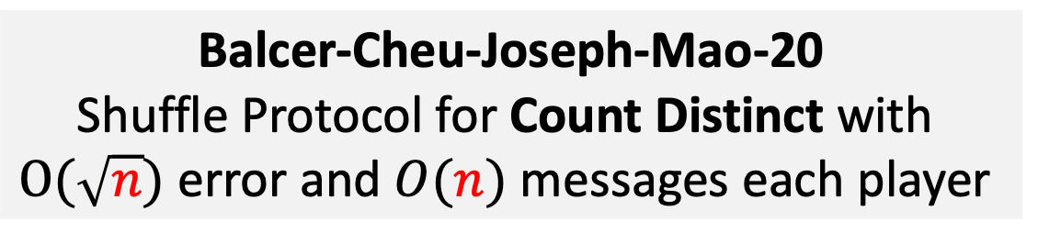
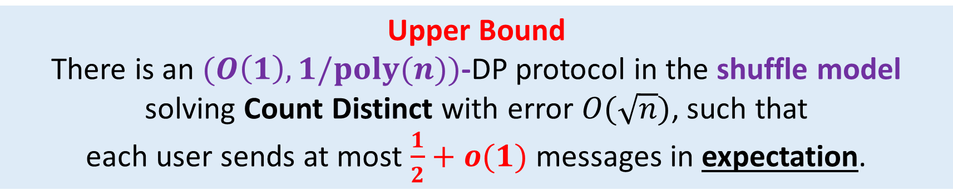
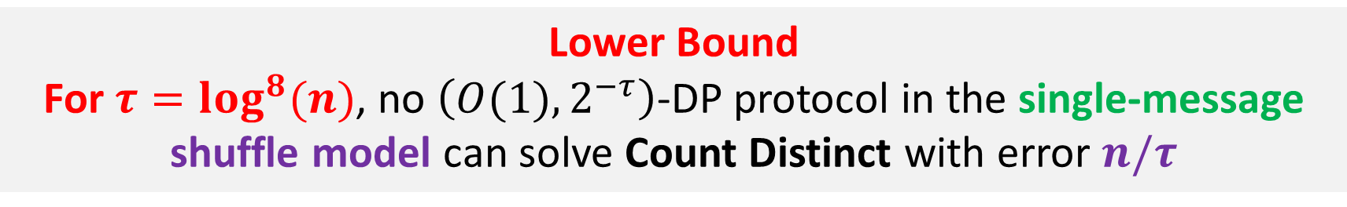

Count Distinct in the Shuffle Model
Input: $n$ users, each holds their own data $x_{i}$
Balcer-Cheu-Joseph-Mao-20
Shuffle Protocol for Count Distinct with
$O(\sqrt{n})$ error and $O(n)$ messages each player
Goal: Estimate the number of distinct elements among $x_{1},…,x_{n}$,
under the constraint of being $\left(ε,δ\right)$-DP.
Lower Bound
For $τ=log^{8}(n)$, no $\left(O(1),2^{−τ}\right)$-DP protocol in the single-message shuffle model can solve Count Distinct with error $n/τ$
Upper Bound
There is an $(O\left(1\right),1/poly(n))$-DP protocol in the shuffle model solving Count Distinct with error $O(\sqrt{n})$, such that
each user sends at most $\frac{1}{2}+o(1)$ messages in expectation.

Slide 17
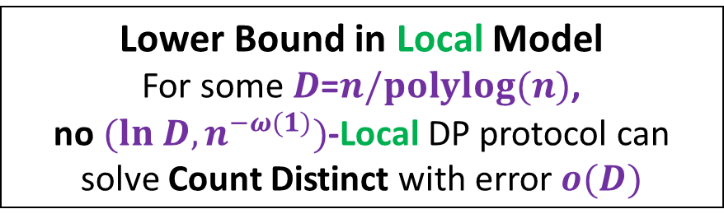
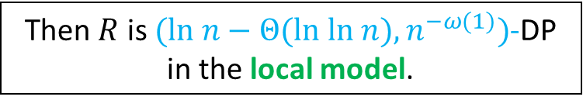
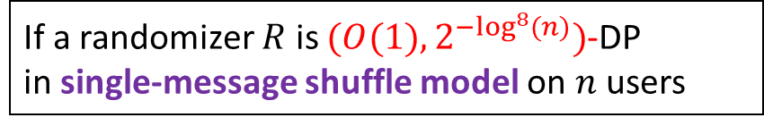
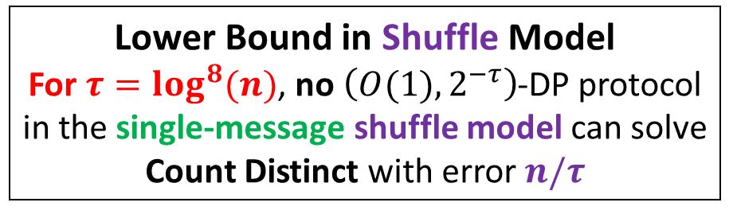
Count Distinct in the Shuffle Model
Lower Bound in Local Model
For some $D$=$n/polylog(n)$,
no $(ln D,n^{−ω(1)})$-Local DP protocol can solve Count Distinct with error $o(D)$
Lemma (Informal)
New connection between Local and Single-Message Shuffle Model
If a randomizer $R$ is $(O(1),2^{−\log^{8}(n)})$-DP
in single-message shuffle model on $n$ users
Lower Bound in Shuffle Model
For $τ=log^{8}(n)$, no $\left(O(1),2^{−τ}\right)$-DP protocol in the single-message shuffle model can solve Count Distinct with error $n/τ$
Then $R$ is $(ln n−Θ(ln ln n),n^{−ω(1)})$-DP
in the local model.

Slide 18
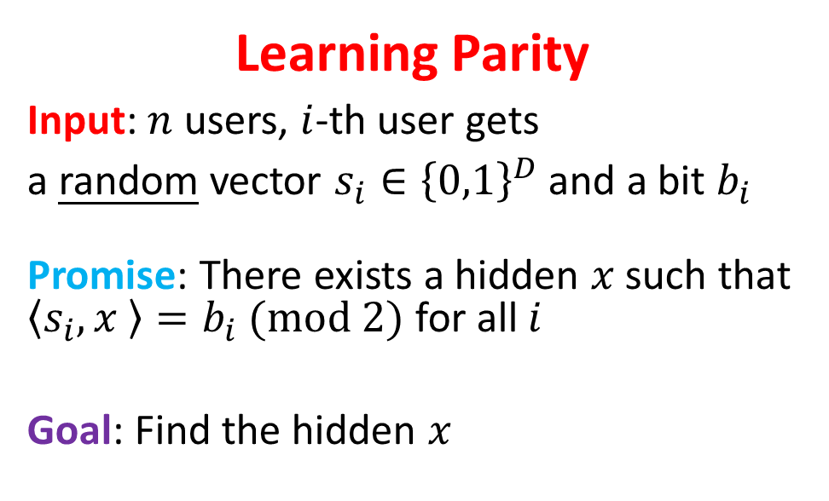
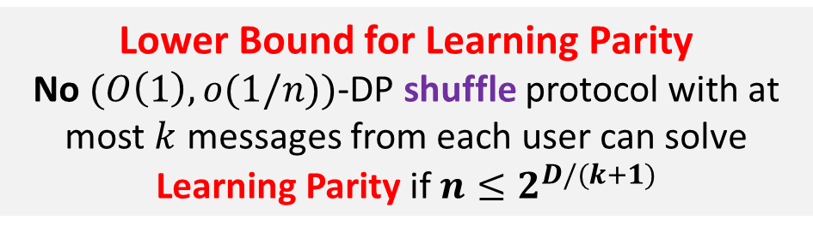
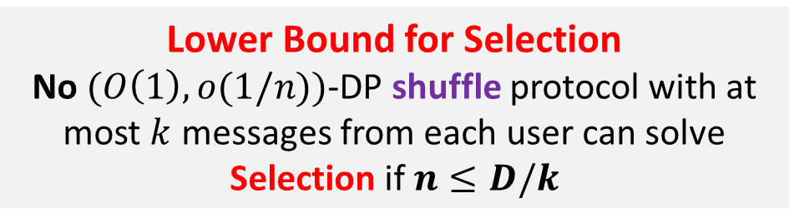
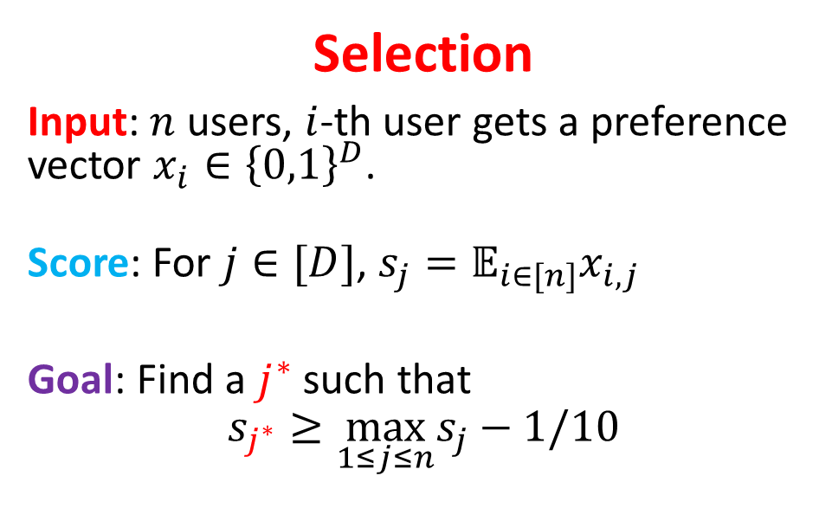
Other Lower Bounds in the Shuffle Model
Selection
Input: $n$ users, $i$-th user gets a preference vector $x_{i}∈{\left\{0,1\right\}}^{D}$.
Score: For $j∈[D]$, $s_{j}=𝔼_{i∈[n]}x_{i,j }$
Goal: Find a $j^{∗}$ such that
$$s_{j^{∗}}≥\max_{1≤j≤n}s_{j}−1/10$$
Learning Parity
Input: $n$ users, $i$-th user gets
a random vector $s_{i}∈{\left\{0,1\right\}}^{D}$ and a bit $b_{i}$
Promise: There exists a hidden $x$ such that $\left\langle s_{i},x \right\rangle =b_{i} (mod 2)$ for all $i$
Goal: Find the hidden $x$
Lower Bound for Selection
No $(O\left(1\right),o(1/n))$-DP shuffle protocol with at most $k$ messages from each user can solve Selection if $n≤D/k$
Lower Bound for Learning Parity
No $(O\left(1\right),o(1/n))$-DP shuffle protocol with at most $k$ messages from each user can solve Learning Parity if $n≤2^{D/(k+1)}$
Via Dominated Protocols

Slide 19
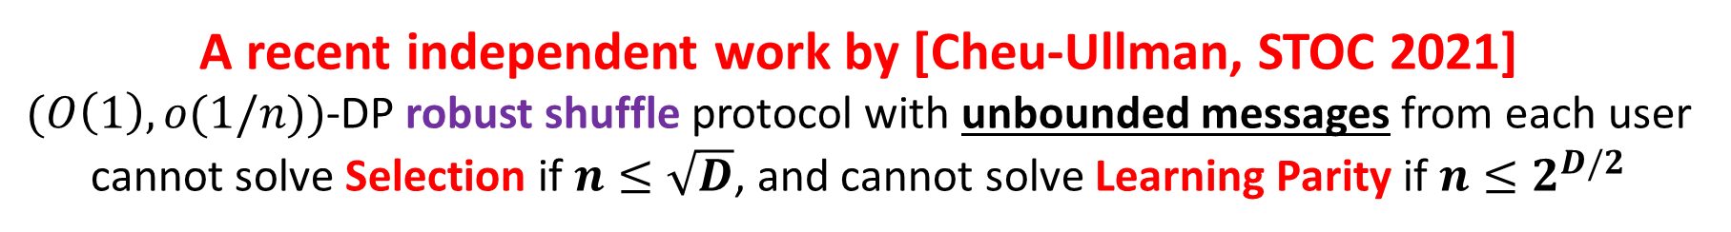
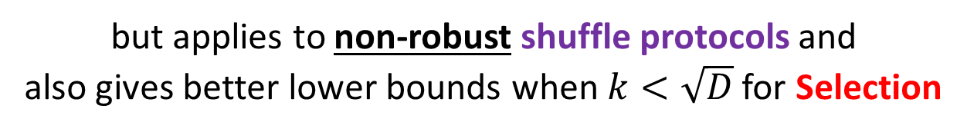
Comparison with [Cheu-Ullman’2020]
Robust Shuffle Model
(Robustness condition.) The protocol should still be private, even if a small constant fraction of users dropped out. A very desirable property in practice
A recent independent work by [Cheu-Ullman, STOC 2021]
$(O\left(1\right),o(1/n))$-DP robust shuffle protocol with unbounded messages from each user
cannot solve Selection if $n≤\sqrt{D}$, and cannot solve Learning Parity if $n≤2^{D/2}$
Our result does not work for the unbounded message case
but applies to non-robust shuffle protocols and
also gives better lower bounds when $k<\sqrt{D}$ for Selection

Slide 20
Today’s Plan
Part I (Introduction)
The Shuffle Model of Differential Privacy
The Count Distinct Problem and Our Results for it
Lower Bounds for Selection and Learning Parity in the Shuffle Model
Part II (Techniques)
Lower Bounds via Dominated Protocols
Lower Bounds via Moment-Matching
Conclusion and Open Problems

Slide 21
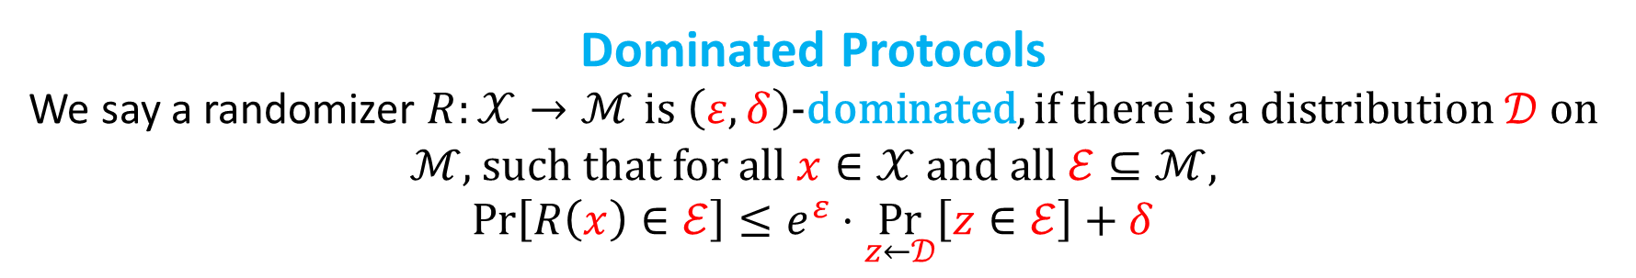
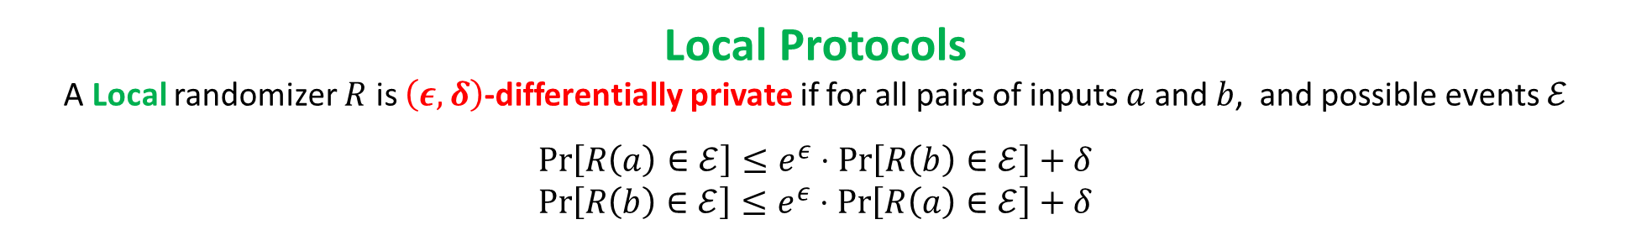
Lower Bounds in Shuffle Model via Dominated Protocols
Convention
Green for Local Model
Purple for Shuffle Model
Blue for Dominated Protocols
Local Protocols
A Local randomizer $R$ is $\left(ε,δ\right)$-differentially private if for all pairs of inputs $a$ and $b$, and possible events $ℰ$
$$\operatorname{Pr}\left[R\left(a\right)∈ℰ\right]≤e^{ε}⋅\operatorname{Pr}\left[R\left(b\right)∈ℰ\right]+δ$$
$$\operatorname{Pr}\left[R\left(b\right)∈ℰ\right]≤e^{ε}⋅\operatorname{Pr}\left[R\left(a\right)∈ℰ\right]+δ$$
It is proved that some Multi-Message Shuffle Protocols are not Local DP for any non-trivial parameters
Dominated Protocols
We say a randomizer $R:𝒳→ℳ$ is $\left(ε,δ\right)$-dominated, if there is a distribution $𝒟$ on $ℳ$, such that for all $x∈𝒳$ and all $ℰ⊆ℳ$,
$$\operatorname{Pr}\left[R\left(x\right)∈ℰ\right]≤e^{ε}⋅\underset{z←𝒟}{Pr}\left[z∈ℰ\right]+δ$$
$\left(ε,δ\right)$-Local Protocols are $\left(ε,δ\right)$-Dominated! (Set $𝒟=R(x_{0})$ for a fixed $x_{0}∈𝒳$. )

Slide 22
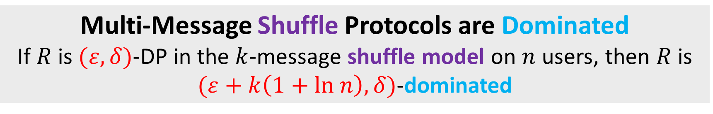

Lower Bounds in Shuffle Model via Dominated Protocols
Convention
Green for Local Model
Purple for Shuffle Model
Blue for Dominated Protocols
Dominated Protocols
We say a randomizer $R:𝒳→ℳ$ is $\left(ε,δ\right)$-dominated, if there is a distribution $𝒟$ on $ℳ$, such that for all $x∈𝒳$ and all $ℰ⊆ℳ$,
$$\operatorname{Pr}\left[R\left(x\right)∈ℰ\right]≤e^{ε}⋅\underset{z←𝒟}{Pr}\left[z∈ℰ\right]+δ$$
It is proved that some Multi-Message Shuffle Protocols are not Local DP for any non-trivial parameters
Multi-Message Shuffle Protocols are Dominated
If $R$ is $(ε,δ)$-DP in the $k$-message shuffle model on $n$ users, then $R$ is $(ε+k\left(1+ln n\right),δ)$-dominated

Slide 23
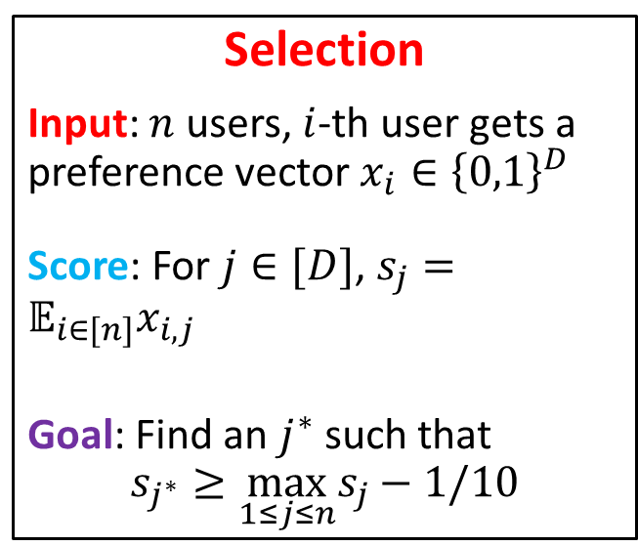
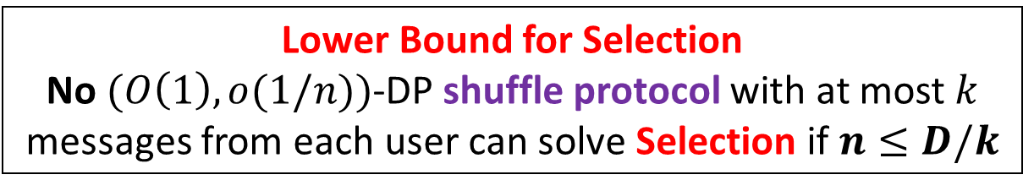
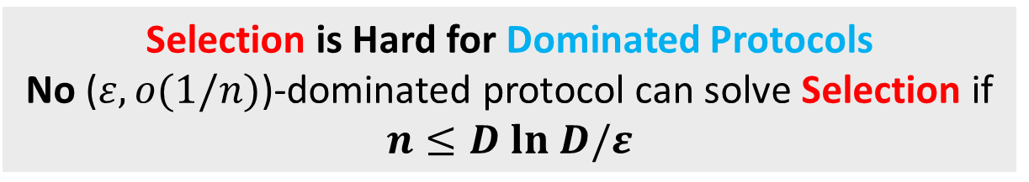
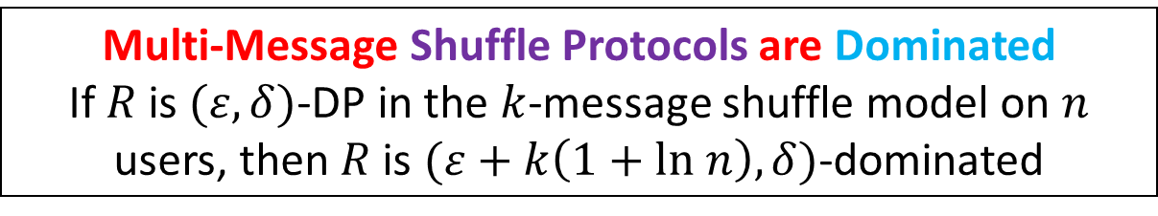
Lower Bounds for Count Distinct via Dominated Protocols
Multi-Message Shuffle Protocols are Dominated
If $R$ is $(ε,δ)$-DP in the $k$-message shuffle model on $n$ users, then $R$ is $(ε+k\left(1+ln n\right),δ)$-dominated
Selection
Input: $n$ users, $i$-th user gets a preference vector $x_{i}∈{\left\{0,1\right\}}^{D}$
Score: For $j∈[D]$, $s_{j}=𝔼_{i∈[n]}x_{i,j }$
Goal: Find an $j^{∗}$ such that
$$s_{j^{∗}}≥\max_{1≤j≤n}s_{j}−1/10$$
Selection is Hard for Dominated Protocols
No ($ε,o(1/n)$)-dominated protocol can solve Selection if $n≤D ln D/ε$
Lower Bound for Selection
No $(O\left(1\right),o(1/n))$-DP shuffle protocol with at most $k$ messages from each user can solve Selection if $n≤D/k$

Slide 24
Today’s Plan
Part I (Introduction)
The Shuffle Model of Differential Privacy
The Count Distinct Problem and Our Results for it
Lower Bounds for Selection and Learning Parity in the Shuffle Model
Part II (Techniques)
Lower Bounds via Dominated Protocols
Lower Bounds via Moment-Matching
Conclusion and Open Problems

Slide 25
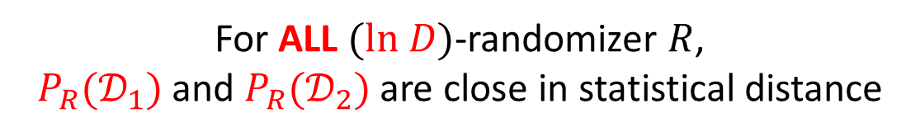
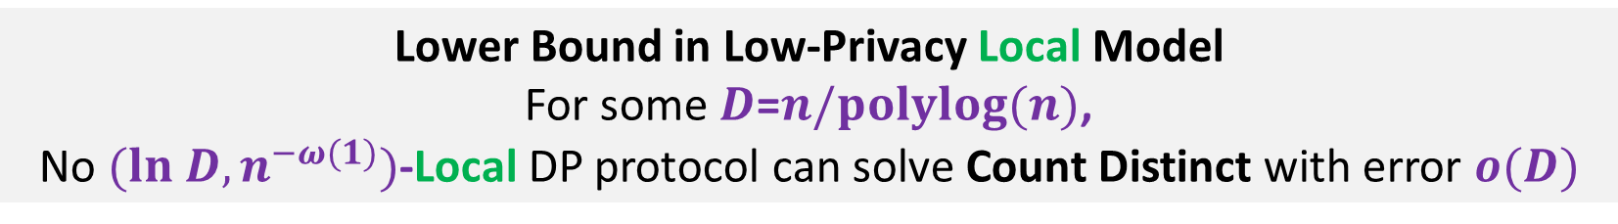
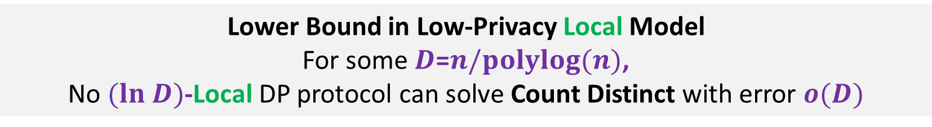
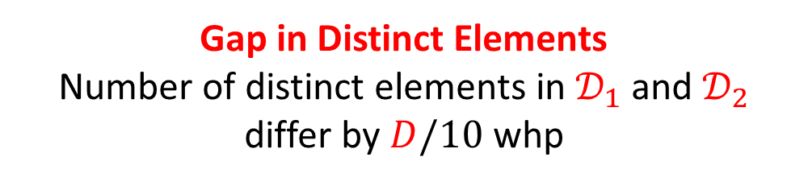

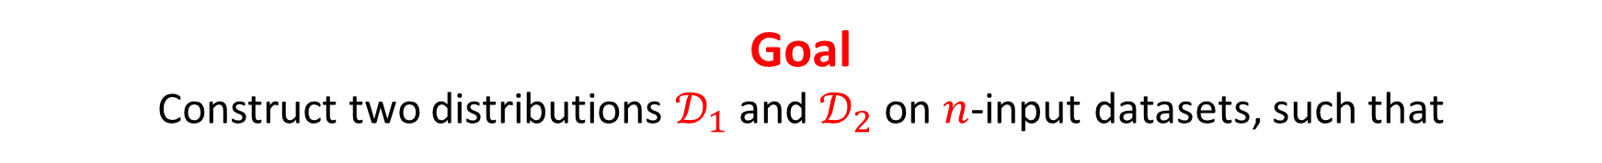

Constructing the Hard Distribution
Lower Bound in Low-Privacy Local Model
For some $D$=$n/polylog(n)$,
No $(ln D)$-Local DP protocol can solve Count Distinct with error $o(D)$
Lower Bound in Low-Privacy Local Model
For some $D$=$n/polylog(n)$,
No $(ln D,n^{−ω(1)})$-Local DP protocol can solve Count Distinct with error $o(D)$
Goal
Construct two distributions $𝒟_{1}$ and $𝒟_{2}$ on $n$-input datasets, such that
Indistinguishability
NO ($ln D$)-Local DP protocol
can distinguish $𝒟_{1}$ and $𝒟_{2}$
Gap in Distinct Elements
Number of distinct elements in $𝒟_{1}$ and $𝒟_{2}$
differ by $D/10$ whp
$P_{R}(𝒟)$ is the distribution of the transcript, when running randomizer $R$ on a dataset.
$P_{R}(𝒟)$: Draw $\left(x_{1},…,x_{n}\right)←𝒟$
Output ($R\left(x_{1}\right),…,R(x_{n})$)
For ALL $(ln D)$-randomizer $R$,
$P_{R}(𝒟_{1})$ and $P_{R}(𝒟_{2})$ are close in statistical distance

Slide 26





Histogram Suffices
Due to symmetry, only the histogram of $P_{R}(𝒟_{1})$ and $P_{R}(𝒟_{2})$ matters!
Goal
Construct two distributions $𝒟_{1}$ and $𝒟_{2}$ on $n$-input datasets, such that
Indistinguishability
NO ($ln D$)-Local DP protocol
can distinguish $𝒟_{1}$ and $𝒟_{2}$
$Hist_{R}\left(𝒟\right)$is the distribution of histogram of the transcript, when running randomizer $R$ on a dataset.
$Hist_{R}\left(𝒟\right):$ Draw $\left(x_{1},…,x_{n}\right)←𝒟$
Output the histogram of ($R\left(x_{1}\right),…,R(x_{n})$)
For ALL $(ln D)$-randomizer $R$,
$P_{R}(𝒟_{1})$ and $P_{R}(𝒟_{2})$ are close in statistical distance
For ALL $(ln D)$-randomizer $R$,
${Hist}_{R}(𝒟_{1})$ and ${Hist}_{R}(𝒟_{2})$ are close in statistical distance

Slide 27

Overview of Proof
Two Ideas Behind The Estimate the Unseen Problem:
Poissonization and Moment-Matching
Construction of Hard Distributions:
We construct $𝒟_{1}$ and $𝒟_{2}$ from two Moment-Matching random variables $U$ and $V$
Analyzing ${Hist}_{R}\left(𝒟_{1}\right)$ and ${Hist}_{R}\left(𝒟_{2}\right)$
${Hist}_{R}\left(𝒟_{1}\right)$ and ${Hist}_{R}\left(𝒟_{2}\right)$ are the histogram r.v. obtained by applying $R$ on $𝒟_{1}$ and $𝒟_{2}$
Express them elegantly with sums of Mixtures of Multi-Dimensional Poisson distributions (Poissonization)
Need to bound statistical distance between two Mixtures of Multi-Dimensional Poisson distributions
Moment-Matching Techniques:
Bounding the statistical distance with (a multi-dimensional generalization of) Moment-Matching Lemma for Poisson distributions and Charlier Polynomials
$(ln (n/polylog(n)))$-randomizer $R$
Very general, potentially applicable to many other problems
First application of such techniques in privacy

Slide 28



Lower Bounds for Count Distinct via Moment-Matching
Lower Bound in Low-Privacy Local Model
For some $D$=$n/polylog(n)$,
No $(ln D)$-Local DP protocol can solve Count Distinct with error $o(D)$
Estimate the Unseen
Input: Given access to a list ($a_{1},a_{2},…,a_{n}$)
Problem: Estimate the number of Distinct Elements in the list within an additive error $n/10$ and with probability $0.99$
Model: Can pick some uniformly random locations to query; wish to minimize the number of locations picked
[Valiant-Valiant’13] and [Wu-Yang’16]
$Ω\left(\frac{n}{log n}\right)$-queries are required!

Slide 29


Key Ideas Behind the Lower Bounds for Estimate the Unseen
Poissonization
A standard tool in property testing literature
for breaking the correlation in histogram
Moment-Matching Random Variables
A very elegant way to bound statistical distance!
https://theinformaticists.com/category/blog/online-lectures/
Yanjun Han

Slide 30





Constructing the Hard Distribution
In Estimate the Unseen?
Given A population random variable $W$ on non-negative integers with unit mean ($𝔼\left[W\right]=1$)
Analysis: # of users
Let $I←𝒟_{EU}^{W}$. $I$ has roughly $𝔼\left[W\right]⋅n=n$ users whp
Dataset $𝒟_{EU}^{W}$
For each $i∈[n]$, we
(1) draw $n_{i}←W$
(2) add $n_{i}$ users with input $i$.
Analysis: # of distinct elements
Let $I←𝒟_{EU}^{W}$. $I$ has roughly $n⋅Pr[W>0]$ distinct elements whp
The Key idea
Construct two unit mean population r.v. $U$ and $V$ such that
Moment Matching!
(1) $Pr⁡[U>0]$ and $Pr⁡[V>0]$ differ by a constant
(2) $U$ and $V$ “looks” very similar
# distinct elements in $𝒟_{EU}^{U}$and $𝒟_{EU}^{V}$ differ by $Ω(n)$

Slide 31







Lower Bounds for Count Distinct via Moment-Matching
Key idea in [Wu-Yang’16]: Moment-Matching Random Variables
Let $L=\log{n}$ and $Λ=Θ(L^{2})$. There are two random variables $U$ and $V$ such that:
(Unit Mean) $𝔼\left[U\right]=𝔼\left[V\right]=1$
(Matching Moments) $𝔼\left[U^{j}\right]=𝔼[V^{j}]$ For $1≤j≤L$
(Bounded Domain) Both $U$ and $V$ are supported on $\left\{0\right\}∪[1,Λ]$
(Mostly zero vs. Mostly non-zero) $\operatorname{Pr}\left[U=0\right]≥0.9$ and $\operatorname{Pr}\left[V=0\right]≤0.1$.
Let $I←𝒟_{EU}^{W}$. $I$ has roughly $n⋅Pr[W>0]$ distinct elements whp.
[Wu-Yang’16] (informal)
(1) $𝒟_{EU}^{U}$and $𝒟_{EU}^{V}$are indistinguishable if one only looks at $o(n/\log{n})$ random positions;
(2) # distinct elements in $𝒟_{EU}^{U}$and $𝒟_{EU}^{V}$ differ by $Ω(n)$
Dataset $𝒟_{EU}^{W}$
For each $i∈[n]$, we
(1) draw $n_{i}←W$
(2) add $n_{i}$ users with input $i$.
Hope
Can we use${ 𝒟}_{EU}^{U}$ and $𝒟_{EU}^{V}$to prove lower bounds in the local model?
Not clear how to do it
Key Problem
How do we analyze the histogram distributions${Hist}_{R}(𝒟_{EU}^{U})$ and ${Hist}_{R}(𝒟_{EU}^{V})$?

Slide 32







Hard Distribution: Signal/Noise Decomposition
Setting: $n$ users. Each user gets an input from [D], for some $D=n/polylog(n)$.
Parameters: $W:$ a random variable over $\left\{0\right\}∪\left[1,Λ\right]$; $E$: a random subset of $[D]$ such that $\left|E\right|≤D/100$.
Same as $𝒟_{EU}^{W}$, but for $[D]$ instead of $[n]$
Signal Part $𝒟_{signal}^{W}$
For each $i∈[D]$, we
(1) draw $n_{i}←W$;
(2) add $n_{i}$ users with input $i$.
Noise Part $𝒟_{noise}^{E}$
For each $i∈E$, we
set $n_{i}←(n−D)/|E|$
(2) add $n_{i}$ users with input $i$.
Hard Distribution$𝒟^{W}$
Draw two datasets $D_{1}←𝒟_{signal}^{W}$
and $D_{2}←𝒟_{noise}^{E}$.
Output their union (as a multi-set).
Let $I←𝒟_{signal}^{W}$. $I$ has roughly $D⋅Pr[W>0]$ distinct elements whp.
(Mostly zero vs. Mostly non-zero)
$\operatorname{Pr}\left[U=0\right]≥0.9$ and $\operatorname{Pr}\left[V=0\right]≤0.1$.
# distinct elements in $𝒟_{signal}^{U}$and $𝒟_{signal}^{V}$ differ by $D/2$ whp
Datasets from $𝒟_{noise}^{E}$ has at most $D/100$ distinct elements
Gap in Distinct Elements
Number of distinct elements in $𝒟^{U}$ and $𝒟^{V}$ differ by $D/10$ whp

Slide 33

Overview of Proof
Two Ideas Behind The Estimate the Unseen Problem:
Poissonization and Moment-Matching
Construction of Hard Distribution:
We construct $𝒟^{U}$ and $𝒟^{V}$ from two Moment-Matching random variables $U$ and $V$
Analyzing ${Hist}_{R}\left(𝒟^{U}\right)$ and ${Hist}_{R}\left(𝒟^{V}\right)$
${Hist}_{R}\left(𝒟^{U}\right)$ and ${Hist}_{R}\left(𝒟^{V}\right)$ are the histogram r.v. obtained by applying $R$ on $𝒟^{U}$and $𝒟^{V}$
Express them elegantly with sums of Mixtures of Multi-Dimensional Poisson distributions (Poissonization)
Now need to bound statistical distance between two Mixtures of Multi-Dimensional Poisson distributions
Moment-Matching Techniques:
Bounding the statistical distance with (a multi-dimensional generalization of) Moment-Matching Lemma for Poisson distributions and the Charlier Polynomials
$(ln (n/polylog(n)))$-randomizer $R$

Slide 34





The Magic of Poissonization
Poisson Distribution
Parameter: $λ$
Support: non-negative integers
Specification: $\operatorname{Pr}\left[Poi\left(λ\right)=k\right]=\frac{λ^{k}e^{−λ}}{k!}$
Mean: $𝔼\left[Poi\left(λ\right)\right]=λ$
Key fact: $Poi\left(α\right)+Poi\left(β\right)=Poi(α+β)$
Distribution $𝒟$ on $\left[m\right]=\{1,…,m\}$
Take (roughly) $n$ samples from $𝒟$
Analyze the histogram of the $n$ samples
$$X∼Poi\left(α\right),Y∼Poi\left(β\right)⇒X+Y∼Poi(α+β)$$
Poisson Sampling
Draw $n′←Poi(n)$ first.
Take $n′$ samples from $𝒟$, and consider the histogram random variables $N_{1},…,N_{m}$,
$N_{i}$ indicates how many times $i$ occurs in the $n′$ samples.
Now all the $N_{i}$’s are independent!
Moreover, $N_{i}$ distributes as $Poi(Pr\left[𝒟=i\right]⋅n)$
Usual Sampling
Take $n$ samples from $𝒟;$ consider the histogram random variables $N_{1},…,N_{m}$,
$N_{i}$ indicates how many times $i$ occurs in the $n$ samples.
Clearly these $N_{1},…,N_{m}$ are correlated

Slide 35







Poissonization in Local Model
Poisson Distribution
Parameter: $λ$
Support: non-negative integers
Specification: $\operatorname{Pr}\left[Poi\left(λ\right)=k\right]=\frac{λ^{k}e^{−λ}}{k!}$
Mean: $𝔼\left[Poi\left(λ\right)\right]=λ$
Key fact: $Poi\left(α\right)+Poi\left(β\right)=Poi(α+β)$
A randomizer $R:𝒳→[m]$
Generate (roughly) $n$ users with the same input $x_{0}∈𝒳$ and
Analyze the output histogram of $R$ on all these users
Lemma
The histogram of randomizer $R$ with $Poi(n)$ users with input $x_{0}$ is $\vec{Poi}(R\left(x_{0}\right)⋅n)$
$$X∼Poi\left(α\right),Y∼Poi\left(β\right)⇒X+Y∼Poi(α+β)$$
Poisson Sampling
Draw $n′←Poi(n)$ first.
Take $n′$ samples from $R(x_{0})$; consider the histogram random variables $N_{1},…,N_{m}$,
$N_{i}$ indicates how many times $i$ occurs in the $n′$ samples.
Now all the $N_{i}$’s are independent!
Moreover, $N_{i}$ distributes as $Poi(Pr\left[R(x_{0})=i\right]⋅n)$
Usual Sampling
Take $n$ samples from $R(x_{0});$ consider the histogram random variables $N_{1},…,N_{m}$,
$N_{i}$ indicates how many times $i$ occurs in the $n$ samples.
Clearly these $N_{1},…,N_{m}$ are correlated
Poisson Sampling
Draw $n′←Poi(n)$ first
Take $n′$ samples from $R(x_{0})$; consider the histogram random variables vector $\vec{N}=(N_{1},…,N_{m})$.
$N_{i}$ indicates how many times $i$ occurs in the $n′$ samples.
$\vec{N}$ distributes as $\vec{Poi}(R\left(x_{0}\right)⋅n)$
Multi-dimensional Poisson distribution
Parameter: $\vec{λ}∈ℝ^{m}$
Support: non-negative integers vectors
Specification: $\vec{Poi}(\vec{λ})$ is a vector of $m$ independent Poisson distribution, such that the $i$-th distributes as $Poi(\vec{λ_{i}})$
Mean: $𝔼\left[\vec{Poi}(\vec{λ})\right]=\vec{λ}$
Key fact: $Poi(\vec{α}) +Poi(\vec{β})=Poi(\vec{α}+\vec{β})$

Slide 36





Poissonization in our Hard Distributions
Setting: $n$ users. Each user gets an input from [D], for some $D=n/polylog(n)$.
Parameters: $W:$ a distribution over $\left\{0\right\}∪\left[1,Λ\right]$; $E$: a random subset of $[D]$ such that $\left|E\right|≤|D|/100$.
Noise Part $𝒟_{noise}^{E}$
For each $i∈E$, we
set $n_{i}←(n−D)/|E|$
(2) add $n_{i}$ users with input $i$.
Signal Part $𝒟_{signal}^{W}$
For each $i∈[D]$, we
draw $λ_{i}←W$;
draw $n_{i}←Poi(λ_{i})$
(3) add $n_{i}$ users with input $i$.
Noise Part $𝒟_{noise}^{E}$
For each $i∈E$, we
(1) draw $n_{i}←Poi(\frac{n−D}{\left|E\right|})$
(2) add $n_{i}$ users with input $i$.
Signal Part $𝒟_{signal}^{W}$
For each $i∈[D]$, we
(1) draw $n_{i}←W$;
(2) add $n_{i}$ users with input $i$.
Hard Distribution$𝒟^{W}$
Draw two datasets $D_{1}←𝒟_{signal}^{W}$
and $D_{2}←𝒟_{noise}^{E}$.
Output their union (as a multi-set).

Slide 37







Expressing the Histogram
Signal Part $𝒟_{signal}^{W}$
For each $i∈[D]$, we
draw $λ_{i}←W$;
Draw $n_{i}←Poi(λ_{i})$
(3) add $n_{i}$ users with input $i$.
Lemma
The histogram of randomizer $R$ with $Poi(n)$ users with input $x_{0}$ is $\vec{Poi}(R\left(x_{0}\right)⋅n)$
Construction of the Data set $𝒟_{EU}^{W}$
For each $i∈[n]$, we
(1) draw $n_{i}←W$
(2) add $n_{i}$ users with input $i$.
Corollary
The histogram of $R$ with $Poi(W)$ users with input $x_{0}$ is exactly $\vec{Poi}(R\left(x_{0}\right)⋅W)$
In short
For each $i∈[D]$, add $Poi(W)$ users with input $i$
Mixture of Multi-dimensional Poisson Distributions
For a random variable $U$ on $ℝ_{≥0}^{m}$
$\vec{Poi}(U)$: draw $\vec{λ}←U$ and output a sample from $\vec{Poi}(\vec{λ})$
Theorem
The histogram of $R$ on $𝒟_{signal}^{W}$distributes as
$$\sum_{i=1}^{D}{\vec{Poi}(R\left(i\right)⋅W_{i})}$$
Where $W_{1},…,W_{D}$ are $D$ independent random variables identical to $W$

Slide 38






Expressing the Histogram II
Signal Part $𝒟_{signal}^{W}$
For each $i∈[D]$, we
draw $λ_{i}←W$;
Draw $n_{i}←Poi(λ_{i})$
(3) add $n_{i}$ users with input $i$.
The histogram of $R$ on $𝒟_{signal}^{W}$distributes as
$$\sum_{i=1}^{D}{\vec{Poi}(R\left(i\right)⋅W_{i})}$$
Where $W_{1},…,W_{D}$ are $D$ independent random variables identical to $W$
Key fact:$Poi(\vec{α}) +Poi(\vec{β})=Poi(\vec{α}+\vec{β})$
Noise Part $𝒟_{noise}^{E}$
For each $i∈E$, we
(1) draw $n_{i}←Poi(\frac{n−D}{\left|E\right|})$
(2) add $n_{i}$ users with input $i$.
The histogram of $R$ on $𝒟_{noise}^{E}$ distributes as
$$\sum_{i∈E}{\vec{Poi}(R\left(i\right)⋅(n−D)/|E|)}$$
Let ${\vec{ν}}_{E}=\frac{n−D}{\left|E\right|}⋅\sum_{i∈E}{R\left(i\right)}$, the above is simply $\vec{Poi}({\vec{ν}}_{E})$!
Theorem
The histogram of $R$ on $𝒟^{W}$ distributes as
where $W_{1},…,W_{D}$ are $D$ independent random variables identical to $W$

Slide 39










Key Insight: Decomposition
Show that the histogram of $R$ on $𝒟^{U}$ and $𝒟^{V}$ are close
$$\vec{Poi}({\vec{μ}}_{E})+\sum_{i=1}^{D}{\vec{Poi}(R\left(i\right)⋅V_{i})}$$
Where $V_{1},…,V_{D}$ are $D$ independent random variables identical to $V$
Where $U_{1},…,U_{D}$ are $D$ independent random variables identical to $U$
Where $V_{1},…,V_{D}$ are $D$ independent random variables identical to $V$
$$\vec{Poi}({\vec{μ}}_{E})+\sum_{i=1}^{D}{\vec{Poi}(R\left(i\right)⋅U_{i})}$$
Where $U_{1},…,U_{D}$ are $D$ independent random variables identical to $U$
Key Insight
Decompose ${\vec{μ}}_{E}$ into $D+1$ non-negative vectors ${\vec{ν}}^{(0)},{\vec{ν}}^{(1)},…,{\vec{ν}}^{(D)}$ such that
$${\vec{μ}}_{E}=\sum_{i=0}^{D}{{\vec{ν}}^{(i)}}$$
$$\vec{Poi}\left({\vec{μ}}_{E}\right)=\sum_{i=0}^{D}{{\vec{Poi}(\vec{ν}}^{(i)})}$$
and hence
Pick ${\vec{ν}}^{(0)},{\vec{ν}}^{(1)},…,{\vec{ν}}^{(D)}$ carefully so that each of the $D$ terms can be bounded!

Slide 40

Overview of Proof
Two Ideas Behind The Estimate the Unseen Problem:
Poissonization and Moment-Matching
Construction of Hard Distribution:
We construct $𝒟^{U}$ and $𝒟^{V}$ from two Moment-Matching random variables $U$ and $V$
Analyzing ${Hist}_{R}\left(𝒟^{U}\right)$ and ${Hist}_{R}\left(𝒟^{V}\right)$
${Hist}_{R}\left(𝒟^{U}\right)$ and ${Hist}_{R}\left(𝒟^{V}\right)$ are the histogram r.v. obtained by applying $R$ on $𝒟^{U}$and $𝒟^{V}$
Express them elegantly with sums of Mixtures of Multi-Dimensional Poisson distributions (Poissonization)
Now need to bound statistical distance between two Mixtures of Multi-Dimensional Poisson distributions
Moment-Matching Techniques:
Bounding the statistical distance with (a multi-dimensional generalization of) Moment-Matching Lemma for Poisson distributions and the Charlier Polynomials
$(ln (n/polylog(n)))$-randomizer $R$

Slide 41




Bounding Statistical Distance Between Mixtures of Multi-Dimensional Poisson Distributions
where $U_{1},…,U_{D}$ are $D$ independent random variables identical to $U$
where $V_{1},…,V_{D}$ are $D$ independent random variables identical to $V$
Moment-Matching Random Variables
Let $L=\log{n}$ and $Λ=Θ(L^{2})$. There are two random variables $U$ and $V$ such that:
(Unit Mean) $𝔼\left[U\right]=𝔼\left[V\right]=1$
(Matching Moments) $𝔼\left[U^{j}\right]=𝔼[V^{j}]$ For $1≤j≤L$
(Bounded Domain) Both $U$ and $V$ are supported on $\left\{0\right\}∪[1,Λ]$
(Mostly zero vs. Mostly non-zero) $\operatorname{Pr}\left[U=0\right]≥0.9$ and $\operatorname{Pr}\left[V=0\right]≤0.1$.

Slide 42





Bounding Statistical Distance Between Mixtures of Multi-Dimensional Poisson Distributions
Have ${\vec{ν}}^{(0)},{\vec{ν}}^{(1)},…,{\vec{ν}}^{(D)}$ such that
$${\vec{μ}}_{E}=\sum_{i=0}^{D}{{\vec{ν}}^{(i)}}$$
Setting $\vec{λ}={\vec{ν}}^{(i)}$ requires
${\vec{ν}}_{z}^{\left(i\right)}≥R{\left(i\right)}_{z}$ for all possible output $z$
Such a decomposition exists
if ${\vec{ν}}_{E}≥2Λ^{2}⋅\sum_{i}{R(i)}$!
Key Lemma
For all $ln\left(D\right)$-randomizer $R$, a random subset $E$ satisfies
${\vec{ν}}_{E}≥2Λ^{2}⋅\sum_{i}{R(i)}$ whp!

Slide 43



Wrapping up
Lower Bound in Low-Privacy Local Model
For some $D$=$n/polylog(n)$,
No $(ln D)$-Local DP protocol can solve Count Distinct with error $o(D)$
We have two distributions $𝒟^{U}$ and $𝒟^{W}$ on (roughly) $n$-input datasets
Indistinguishability
NO ($ln D$)-Local DP protocol
can distinguish $𝒟_{1}$ and $𝒟_{2}$
Gap in Distinct Elements
Number of distinct elements in $𝒟_{1}$ and $𝒟_{2}$
differ by $D/10$ whp
For ALL $(ln D)$-randomizer $R$,

Slide 44

Conclusion and Open Problems
Lower Bounds for unbounded messages in the Shuffle Model without robustness constraints?
Extend the Single-Message Shuffle Model Lower Bound for Count Distinct to the regime that $δ=1/poly(n)$? (Currently it requires $δ=2^{−polylog(n)}$).
Thank you!

Slide 45



Maximal Separation Between Global Sensitivity and Two-Party DP
That is, changing one input bit of $f$ can make the value of $f$ changes by at most $1$
There is a function $f:{\left\{0,1\right\}}^{n }×{\left\{0,1\right\}}^{n}→ℝ$ whose global sensitivity is one, yet no (O(1),$o(1/n)$)-DP protocol for $f$ in the two-party model can achieve error $o(n/log n)$.
Check our paper for more details!
Improved the previous $1$ vs. $Ω(\sqrt{n})$ separation,
and answered an Open Question by
[McGregor-Mironov-Pitassi-Reingold-Talwar-Vadhan FOCS 2010]

Slide 46




Lower Bounds in Shuffle Model via Dominated Protocols
Multi-Message Shuffle Protocols are Dominated
If $R$ is $(ε,δ)$-DP in the $k$-message shuffle model on $n$ users, then $R$ is $(ε+k\left(1+ln n\right),δ)$-dominated
Dominated Protocols
We say a randomizer $R:𝒳→ℳ$ is $\left(ε,δ\right)$-dominated, if there is a distribution $𝒟$ on $ℳ$, such that for all $x∈𝒳$ and all $ℰ⊆ℳ$,
$$\operatorname{Pr}\left[R\left(x\right)∈ℰ\right]≤e^{ε}⋅\underset{z←𝓓}{Pr}\left[z∈ℰ\right]+δ$$
It is proved that some Multi-Message Shuffle Protocols are not Local DP for any non-trivial parameters
Selection is Hard for Dominated Protocols
No ($ε,o(1/n)$)-dominated protocol can solve Selection if $n≤D ln D/ε$
Lower Bound for Selection
No $(O\left(1\right),o(1/n))$-DP shuffle protocol with at most $k$ messages from each user can solve Selection if $n≤D/k$

Slide 47



A few Words About Proof Techniques
Multi-Message Shuffle Protocols are Dominated
If $R$ is $(ε,δ)$-DP in the $k$-message shuffle model on $n$ users, then $R$ is $(ε+k\left(1+ln n\right),δ)$-dominated
The argument fails to connect two-message shuffle DP and local DP.
[Cheu-Smith-Ullman-Zeber-Zhilyaev’18]
If R is $(ε,δ)$-DP in single-message shuffle, then $R$ is ($ε+ln n,δ$)-local DP.
[Balcer-Cheu’20]
There are $\left(ε,δ\right)$-DP $O\left(1\right)$-message protocol in shuffle model which is not Local-DP for meaningful parameters
Our Key Observation
One can still establish connection between multi-message shuffle DP and dominated DP!

Slide 48





A few Words About Proof Techniques
Selection is Hard for Dominated Protocols
No ($ε,o(1/n)$)-dominated protocol can solve Selection if $n≤D ln D/ε$
[Ullman’18]
Selection is hard for ($ε,1/poly(n)$)-Local DP
[Ghazi-Golowich-Kumar-Pagh-Velingker’19]
Selection is hard for single-message Shuffle DP
(indeed, Selection is hard for $(ε+ln n,δ)$ Local DP)
Boolean Fourier Analysis
and $Χ^{2}$-Divergence
Level-1 Inequality
Our Lower Bound
We (very non-trivially) generalize their proof techniques to show Selection is indeed hard for Dominated DP.

Slide 49





Hard Distribution: Signal/Noise Decomposition
Setting: $n$ users. Each user gets an input from [D], for some $D=n/polylog(n)$.
Parameters: $W:$ a distribution over $\left\{0\right\}∪\left[1,Λ\right]$; $E$: a random subset of $[D]$ such that $\left|E\right|≤|D|/100$.
Construction of the Signal Part $𝒟_{signal}^{W}$
For each $i∈[D]$, we
(1) draw $λ_{i}←W$;
(2) set $n_{i}←λ_{i}$
(3) add $n_{i}$ users with input $i$.
Construction of the
Hard Distribution $𝒟^{W}$
Draw two datasets $D_{1}←𝒟_{signal}^{W}$
and $D_{2}←𝒟_{noise}^{W}$.
Output their union (as a multi-set).
Construction of the Noise Part $𝒟_{noise}^{W}$
For each $i∈E$, we
set $n_{i}←(n−D)/|E|$
(2) add $n_{i}$ users with input $i$.
Since $𝔼\left[U\right]=1$
$𝒟_{signal}^{U}$ has $𝔼\left[U\right]⋅D=D$ inputs in expectation.
So $𝒟^{U}$ (and $𝒟^{V}$) has roughly $n$ inputs.
Goal:
No $(ln D)$-Local DP protocol can distinguish between
$𝒟^{U}$ and $𝒟^{V}$.

Slide 50








Hard Distribution: Signal/Noise Decomposition
Setting: $n$ users. Each user gets an input from [D], for some $D=n/polylog(n)$.
Parameters: $W:$ a distribution over $\left\{0\right\}∪\left[1,Λ\right]$; $E$: a random subset of $[D]$ such that $\left|E\right|≤|D|/100$.
Construction of the Signal Part $𝒟_{signal}^{W}$
For each $i∈[D]$, we
(1) draw $λ_{i}←W$;
(2) draw $n_{i}←λ_{i}$;
(3) add $n_{i}$ users with input $i$.
Construction of the Noise Part $𝒟_{noise}^{W}$
For each $i∈E$, we
(1) draw $n_{i}←(n−D)/|E|$
(2) add $n_{i}$ users with input $i$.
Construction of the
Hard Distribution $𝒟^{W}$
Draw two datasets $D_{1}←𝒟_{signal}^{W}$
and $D_{2}←𝒟_{noise}^{W}$.
Output their union (as a multi-set).
$𝒟_{signal}^{W}$ provides signal
W.h.p. for $I←𝒟_{signal}^{U}$, #DE($I$)$≤0.1|D|$
W.h.p. for $I←𝒟_{signal}^{V}$, #DE($I$)$≥0.5|D|$
(Mostly zero vs. Mostly non-zero)
$\operatorname{Pr}\left[U=0\right]≥0.9$ and $\operatorname{Pr}\left[V=0\right]≤0.1$.
(1) no ($ln D,n^{−ω(1)}$)-Local DP protocol can distinguish them
(2) #distinct elements in $𝒟^{U}$ and $𝒟^{V}$ differ by $D/10$
$$𝒟_{noise}^{W} does not make a difference$$
For $I←𝒟_{noise}^{W}$ $\#DE(I)≤\left|E\right|≤0.01|D|$

Slide 51



Why revisit Estimate the Unseen?
Lower Bound in Low-Privacy Local Model
For some $D$=$n/polylog(n)$,
No $(ln D)$-Local DP protocol can solve Count Distinct with error $o(D)$
(1) Estimate the Unseen is the same problem as Count Distinct, just in a different model!
Could be relevant!
(2) Estimate the Unseen is very well-studied, and tight lower bounds are known.
Rich ideas behind the proofs too!
Can we use ideas
behind these proofs?

Slide 52




Recap
Moment-Matching Random Variables
Let $L=\log{n}$ and $Λ=Θ(L^{2})$. There are two random variables $U$ and $V$ s.t.:
(Unit Mean) $𝔼\left[U\right]=𝔼\left[V\right]=1$
(Matching Moments) $𝔼\left[U^{j}\right]=𝔼[V^{j}]$ For $1≤j≤L$
(Bounded Domain) Both $U$ and $V$ are supported on $\left\{0\right\}∪[1,Λ]$
(Mostly zero vs. Mostly non-zero) $\operatorname{Pr}\left[U=0\right]≥0.9$ and $\operatorname{Pr}\left[V=0\right]≤0.1$.
Theorem
The histogram of $R$ on $𝒟_{EU}^{W}$ distributes as
$$\sum_{i=1}^{n}{\vec{Poi}(R\left(i\right)⋅W_{i})}$$
Where $W_{1},…,W_{n}$ are $n$ independent random variables identical to $W$
Construction of the Data set $𝒟_{EU}^{W}$
For each $i∈[n]$, we
(1) draw $n_{i}←W$
(2) add $n_{i}$ users with input $i$.
Can we show that the histogram of $R$ on $𝒟_{EU}^{U}$ and $𝒟_{EU}^{V}$ are close?
$${H_{R}(𝒟}_{EU}^{U})=\sum_{i=1}^{n}{\vec{Poi}(R\left(i\right)⋅U_{i})}$$
Where $U_{1},…,U_{n}$ are $n$ independent random variables identical to $U$
$${H_{R}(𝒟}_{EU}^{U})= \sum_{i=1}^{n}{\vec{Poi}(R\left(i\right)⋅V_{i})}$$
Where $V_{1},…,V_{n}$ are $n$ independent random variables identical to $V$
Not clear how to bound the distance

