Slide 1
On Distributed Differential Privacy and Counting Distinct Elements
Edit 1/1
Lijie Chen
Badih Ghazi
Ravi Kumar
Pasin Manurangsi
Google Research
MIT

Slide 2
Today’s Plan
Part I (Introduction)
The Shuffle Model of Differential Privacy
The Count Distinct Problem and Our Results for it
Lower Bounds for Selection and Learning Parity in the Shuffle Model
Part II (Techniques)
Lower Bounds via Moment-Matching
Lower Bounds via Dominated Protocols
Conclusion and Open Problems

Slide 3
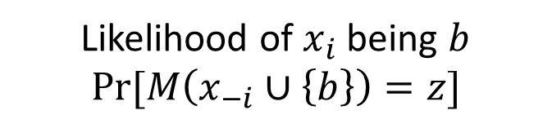
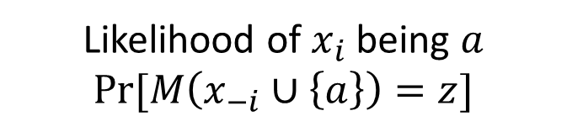
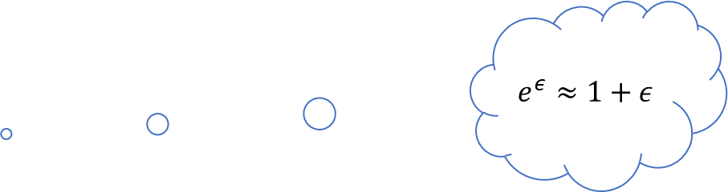
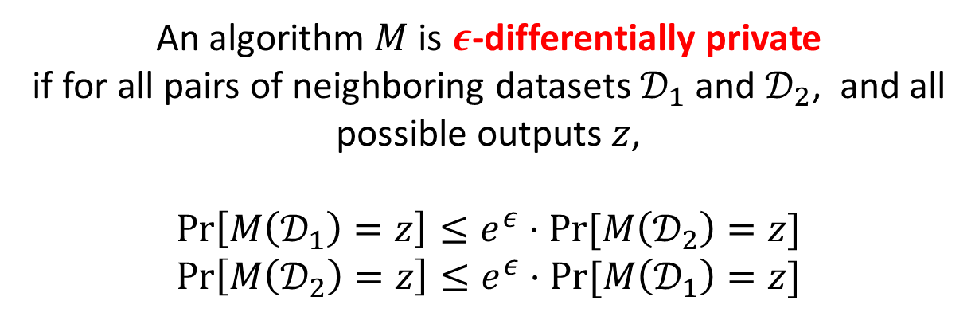
Differential Privacy: Definition
An algorithm $M$ runs on a data set $𝒟={\left\{x_{i}\right\}}_{i∈[n]}$, produces a probabilistic output $M(𝓓)$
{3,5,7,9,11}
{3,5,7,13,11}
We say two datasets are neighboring, if they differ by at most one element
An algorithm $M$ is $ε$-differentially private
if for all pairs of neighboring datasets $𝒟_{1}$ and $𝒟_{2}$, and all possible outputs $z$,
$$\operatorname{Pr}\left[M\left(𝒟_{1}\right)=z\right]≤e^{ε}⋅Pr⁡[M\left(𝒟_{2}\right)=z]$$
$$\operatorname{Pr}\left[M\left(𝒟_{2}\right)=z\right]≤e^{ε}⋅Pr⁡[M\left(𝒟_{1}\right)=z]$$
$$e^{ε}≈1+ε$$
Attacker knows $x_{−i}={\left\{x_{j}\right\}}_{j≠i}$ and an output $z$ from $M(𝒟)$
Likelihood of $x_{i}$ being $a$
$Pr⁡[M\left(x_{−i}∪\left\{a\right\}\right)=z]$
Likelihood of $x_{i}$ being $b$
$Pr⁡[M\left(x_{−i}∪\left\{b\right\}\right)=z]$
Neighboring!

Slide 4
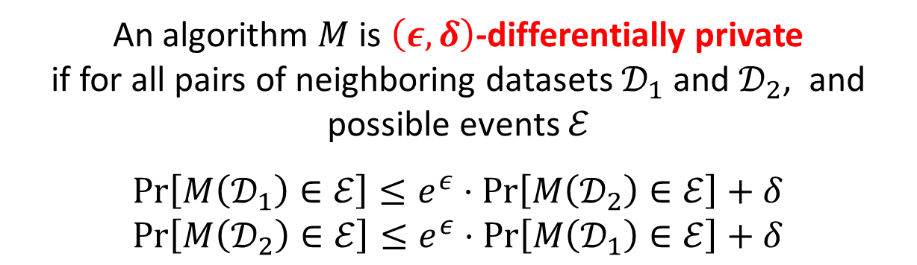
Differential Privacy: Definition
An algorithm $M$ runs on a data set $𝒟={\left\{x_{i}\right\}}_{i∈[n]}$, produces a probabilistic output $M(𝓓)$
{3,5,7,9,11}
{3,5,7,13,11}
We say two datasets are neighboring, if they differ by at most one element
An algorithm $M$ is $\left(ε,δ\right)$-differentially private
if for all pairs of neighboring datasets $𝒟_{1}$ and $𝒟_{2}$, and possible events $ℰ$
$$\operatorname{Pr}\left[M\left(𝒟_{1}\right)∈ℰ\right]≤e^{ε}⋅\operatorname{Pr}\left[M\left(𝒟_{2}\right)∈ℰ\right]+δ$$
$$\operatorname{Pr}\left[M\left(𝒟_{2}\right)∈ℰ\right]≤e^{ε}⋅\operatorname{Pr}\left[M\left(𝒟_{1}\right)∈ℰ\right]+δ$$

Slide 5
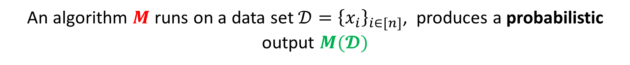
Differential Privacy in the Distributed Setting
Imagine each user holds their own data $x_{i}$ initially
An algorithm $M$ runs on a data set $𝒟={\left\{x_{i}\right\}}_{i∈[n]}$, produces a probabilistic output $M(𝓓)$
How do we ensure the privacy of each user?
Trust
How much should the user trust the curator?
Three
Important
Dimensions
Utility
How useful is the algorithm?
Privacy
How private is the algorithm?

Slide 6
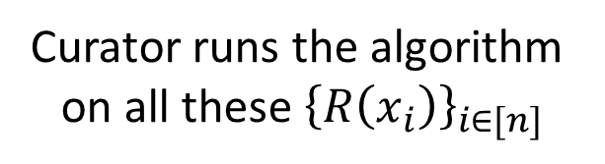
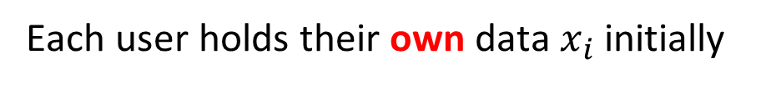
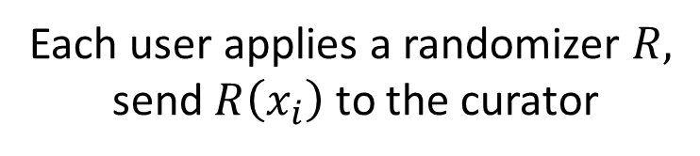

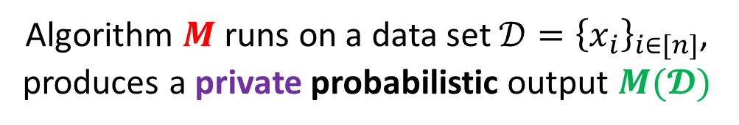
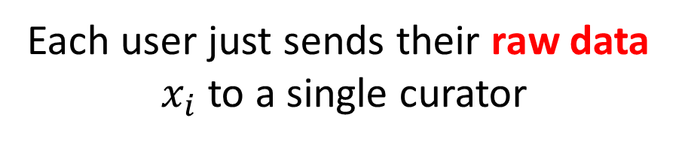
Central Model vs (Non-interactive) Local Model
Each user holds their own data $x_{i}$ initially
Each user holds their own data $x_{i}$ initially
After sending you raw data to the curator, you must trust their integrity for the rest of your life
It’s probabilistic
Each user just sends their raw data
$x_{i}$ to a single curator
Each user applies a randomizer $R,$
send $R\left(x_{i}\right)$ to the curator
Algorithm $M$ runs on a data set $𝒟={\left\{x_{i}\right\}}_{i∈[n]}$,
produces a private probabilistic output $M(𝓓)$
Curator runs the algorithm
on all these ${\left\{R\left(x_{i}\right)\right\}}_{i∈[n]}$

Slide 7
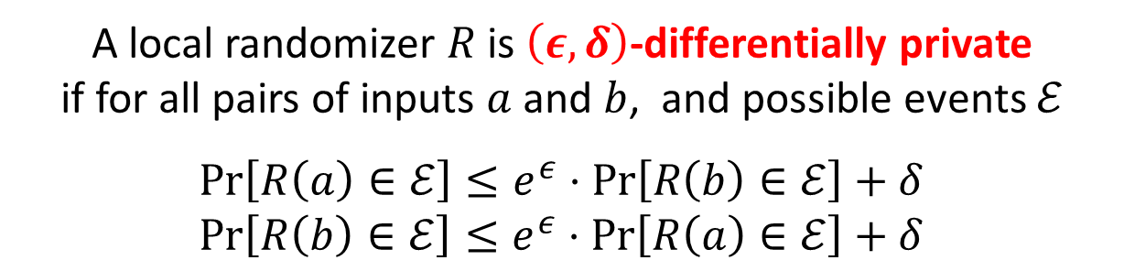
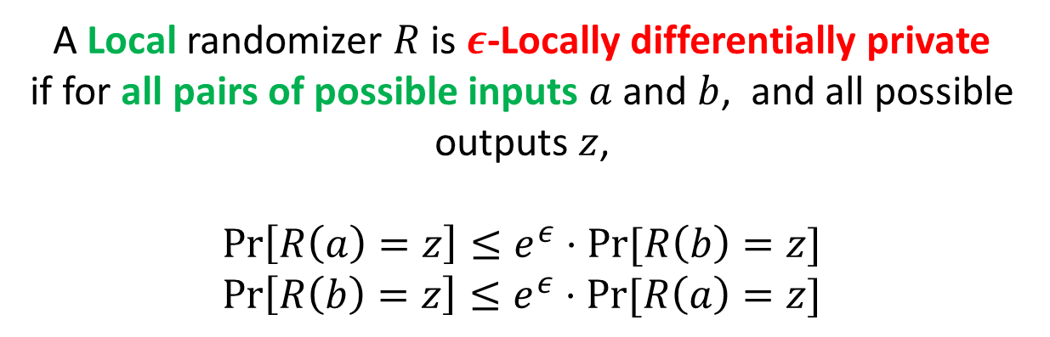
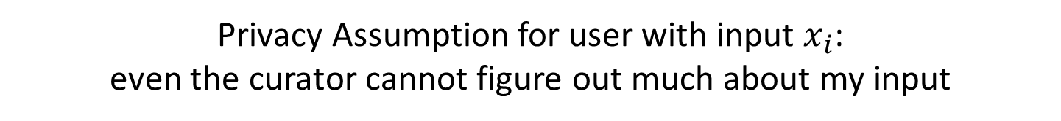
Differential Privacy: Local Model
Imagine each user holds their own data $x_{i}$ initially
It’s probabilistic
Each user applies a randomizer $R,$ sends $R\left(x_{i}\right)$ to the curator
Privacy Assumption for user with input $x_{i}$:
even the curator cannot figure out much about my input
A Local randomizer $R$ is $ε$-Locally differentially private
if for all pairs of possible inputs $a$ and $b$, and all possible outputs $z$,
$$\operatorname{Pr}\left[R\left(a\right)=z\right]≤e^{ε}⋅Pr⁡[R\left(b\right)=z]$$
$$\operatorname{Pr}\left[R\left(b\right)=z\right]≤e^{ε}⋅Pr⁡[R\left(a\right)=z]$$
A local randomizer $R$ is $\left(ε,δ\right)$-differentially private
if for all pairs of inputs $a$ and $b$, and possible events $ℰ$
$$\operatorname{Pr}\left[R\left(a\right)∈ℰ\right]≤e^{ε}⋅\operatorname{Pr}\left[R\left(b\right)∈ℰ\right]+δ$$
$$\operatorname{Pr}\left[R\left(b\right)∈ℰ\right]≤e^{ε}⋅\operatorname{Pr}\left[R\left(a\right)∈ℰ\right]+δ$$
Curator runs the algorithm on all these ${\left\{R\left(x_{i}\right)\right\}}_{i∈[n]}$

Slide 8
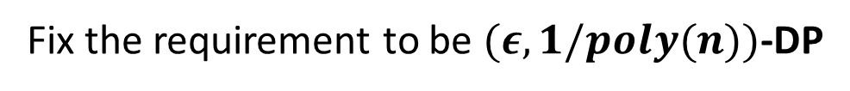


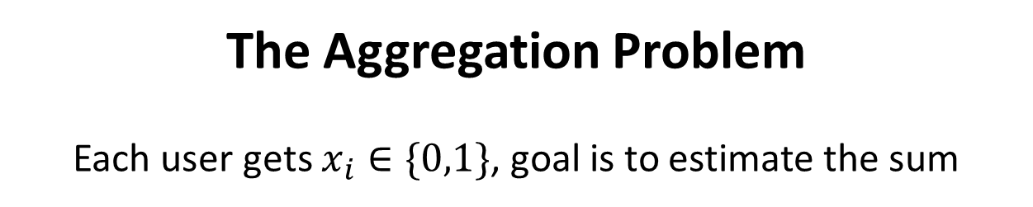
Differential Privacy: Central vs Local
Privacy
How private is the algorithm?
Fix the requirement to be $(ε,1/poly(n))$-DP
The Aggregation Problem
Each user gets $x_{i}∈\{0,1\}$, goal is to estimate the sum
Trust
Utility
Central
Complete Trust in the Curator
$Θ(ε^{−1})$ error
Local
$Θ(ε^{−1}⋅\sqrt{n})$ error
Only Trust myself

Slide 9




Differential Privacy: Shuffle Model
Complete Trust in the Curator
Only Trust myself
Spectrum of Trust
Local
Central
Shuffle Model
[IKOS06, BEM+17,CSU+18,EFM+19]
Spectrum of Utility
$Θ(ε^{−1})$ error
$Θ(ε^{−1}⋅\sqrt{n})$ error
Local
Central

Slide 10
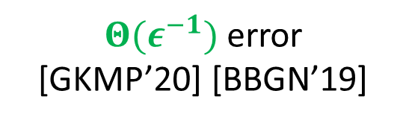
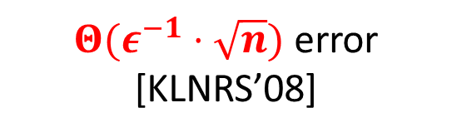

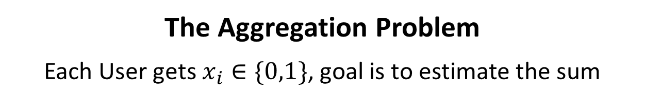
Differential Privacy: Central vs Local vs Shuffle
Privacy
How private is the algorithm?
Fix the requirement to be $(ε,1/poly(n))$-DP
The Aggregation Problem
Each User gets $x_{i}∈\{0,1\}$, goal is to estimate the sum
Trust
Utility
Central
Complete Trust in the Curator
$Θ(ε^{−1})$ error
Local
$Θ(ε^{−1}⋅\sqrt{n})$ error [KLNRS’08]
Only Trust myself
Shuffle
Only Trust the Shuffler
$Θ(ε^{−1})$ error
[GKMP’20] [BBGN’19]

Slide 11
Shuffle Model
Imagine each user holds their own data $x_{i}$ initially
It’s probabilistic
Each user applies a randomizer $R,$ sends $R\left(x_{i}\right)$ to the curator
There exists a shuffler $S$, which applies a random permutation on all $\{R(x_{i})\}$
Curator runs the algorithm on all these ${\left\{R\left(x_{i}\right)\right\}}_{i∈[n]}$

Slide 12
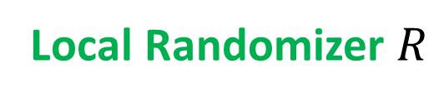
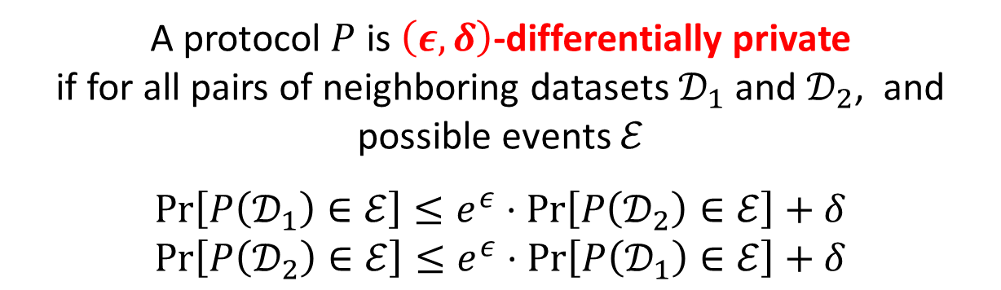
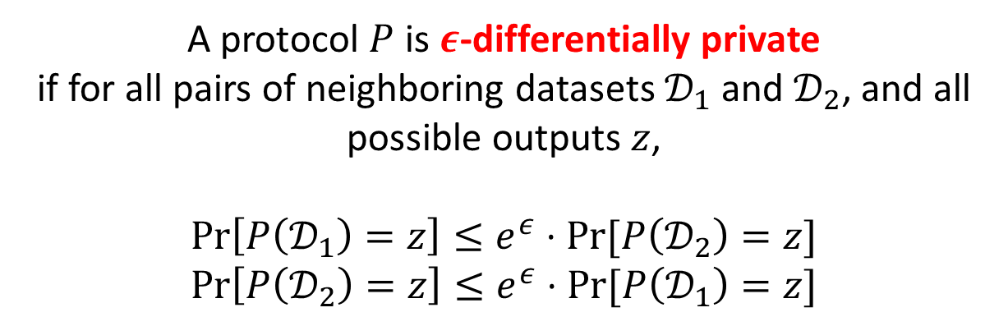
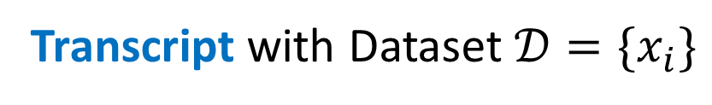
Shuffle Model: Definition
Local Randomizer $R$
Message Complexity
How many messages one user sends in the worst case
Shuffler S
Transcript with Dataset $𝒟=\{x_{i}\}$
$$P\left(𝒟\right)=S(R\left(x_{1}\right),R\left(x_{2}\right),R\left(x_{3}\right),…,R(x_{n}))$$
A protocol $P$ is $ε$-differentially private
if for all pairs of neighboring datasets $𝒟_{1}$ and $𝒟_{2}$, and all possible outputs $z$,
$$\operatorname{Pr}\left[P\left(𝒟_{1}\right)=z\right]≤e^{ε}⋅Pr⁡[P\left(𝒟_{2}\right)=z]$$
$$\operatorname{Pr}\left[P\left(𝒟_{2}\right)=z\right]≤e^{ε}⋅Pr⁡[P\left(𝒟_{1}\right)=z]$$
A protocol $P$ is $\left(ε,δ\right)$-differentially private
if for all pairs of neighboring datasets $𝒟_{1}$ and $𝒟_{2}$, and possible events $ℰ$
$$\operatorname{Pr}\left[P\left(𝒟_{1}\right)∈ℰ\right]≤e^{ε}⋅\operatorname{Pr}\left[P\left(𝒟_{2}\right)∈ℰ\right]+δ$$
$$\operatorname{Pr}\left[P\left(𝒟_{2}\right)∈ℰ\right]≤e^{ε}⋅\operatorname{Pr}\left[P\left(𝒟_{1}\right)∈ℰ\right]+δ$$

Slide 13
Today’s Plan
Part I (Introduction)
The Shuffle Model of Differential Privacy
The Count Distinct Problem and Our Results for it
Lower Bounds for Selection and Learning Parity in the Shuffle Model
Part II (Techniques)
Lower Bounds via Moment-Matching
Lower Bounds via Dominated Protocols
Conclusion and Open Problems

Slide 14
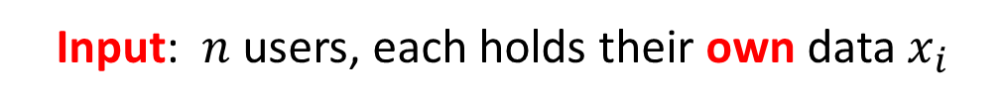
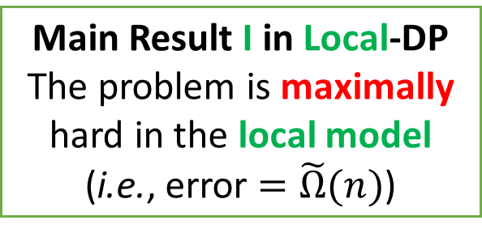
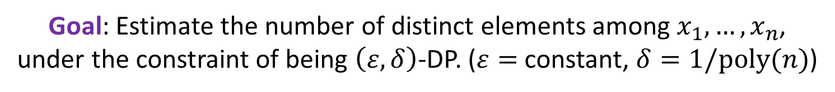
The Count Distinct Problem
Input: $n$ users, each holds their own data $x_{i}$
Goal: Estimate the number of distinct elements among $x_{1},…,x_{n}$,
under the constraint of being $\left(ε,δ\right)$-DP. ($ε=$ constant, $δ=1/poly(n)$)
Convention
Green for Local Model
Purple for Shuffle Model
Red for Central Model
Central Model:
Constant-error is possible
Main Result II in Shuffle-DP
The problem is still maximally hard in the
single-message (worst-case) shuffle model
Main Result III in Shuffle-DP
The problem is much easier in the shuffle model if each user sends at most one message in expectation
Main Result I in Local-DP
The problem is maximally hard in the local model (i.e., error $=\tilde{Ω}(n)$)

Slide 15

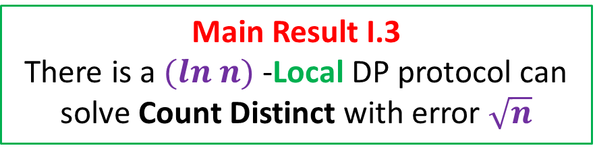
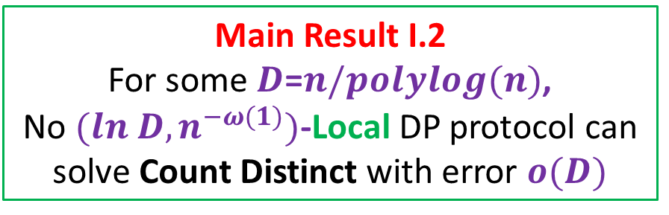
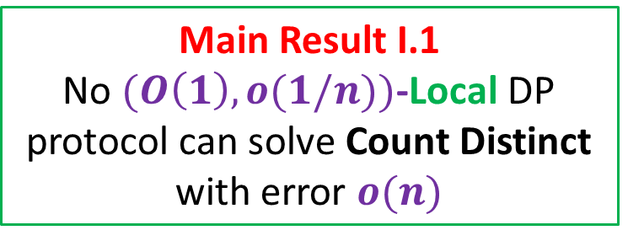
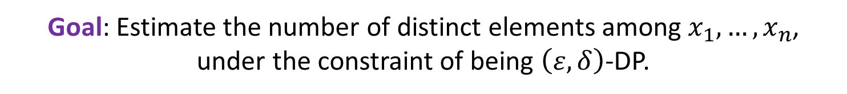
Count Distinct in (Non-Interactive) Local Model
Input: $n$ users, each holds their own data $x_{i}$
Goal: Estimate the number of distinct elements among $x_{1},…,x_{n}$,
under the constraint of being $\left(ε,δ\right)$-DP.
Main Result I.3
There is a $(ln n)$-Local DP protocol can solve Count Distinct with error $\sqrt{n}$
Main Result I.1
No $(O\left(1\right),o(1/n))$-Local DP protocol can solve Count Distinct with error $o(n)$
Main Result I.2
For some $D$=$n/polylog(n)$,
No $(ln D,n^{−ω(1)})$-Local DP protocol can solve Count Distinct with error $o(D)$
Via Dominated Protocols
Via Moment Matching

Slide 16
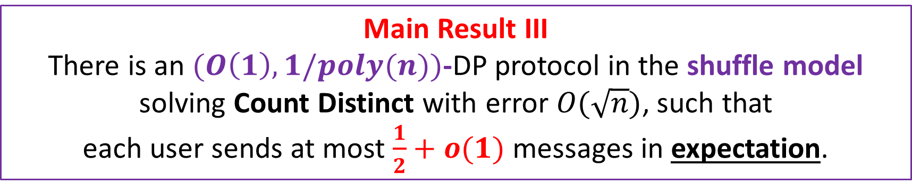
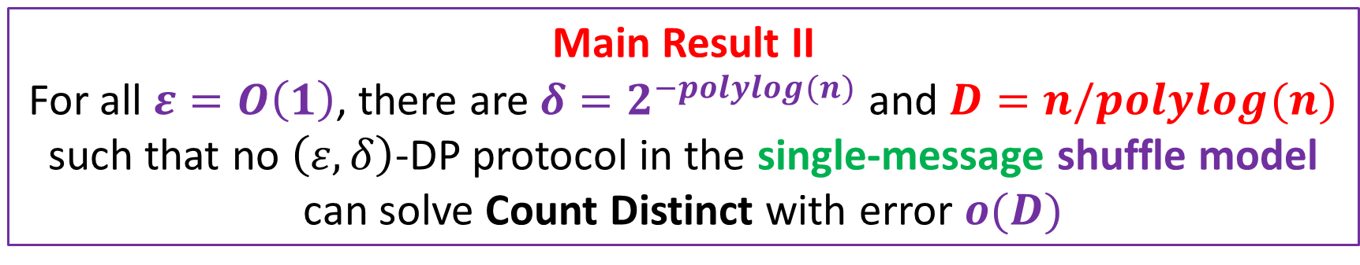
Count Distinct in the Shuffle Model
Input: $n$ users, each holds their own data $x_{i}$
Goal: Estimate the number of distinct elements among $x_{1},…,x_{n}$,
under the constraint of being $\left(ε,δ\right)$-DP.
Main Result II
For all $ε=O\left(1\right)$, there are $δ=2^{−polylog(n)}$ and $D=n/polylog(n)$ such that no $\left(ε,δ\right)$-DP protocol in the single-message shuffle model can solve Count Distinct with error $o(D)$
Main Result III
There is an $(O\left(1\right),1/poly(n))$-DP protocol in the shuffle model solving Count Distinct with error $O(\sqrt{n})$, such that
each user sends at most $\frac{1}{2}+o(1)$ messages in expectation.

Slide 17
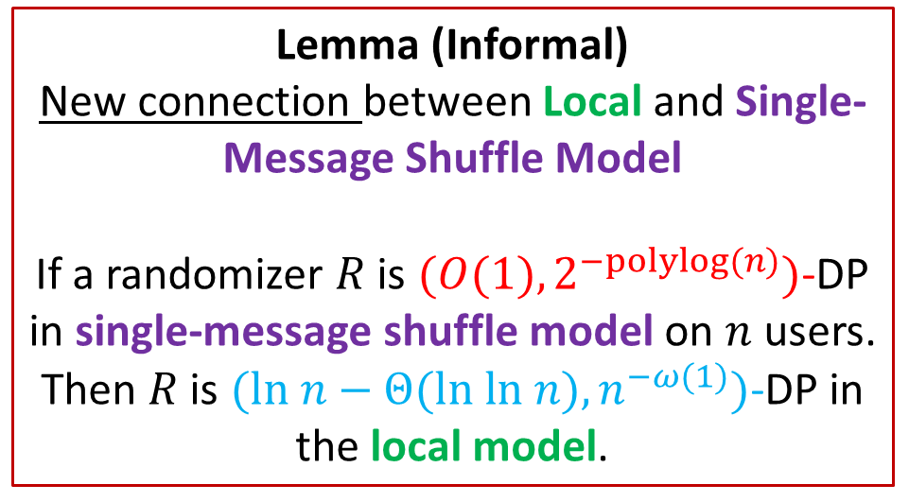
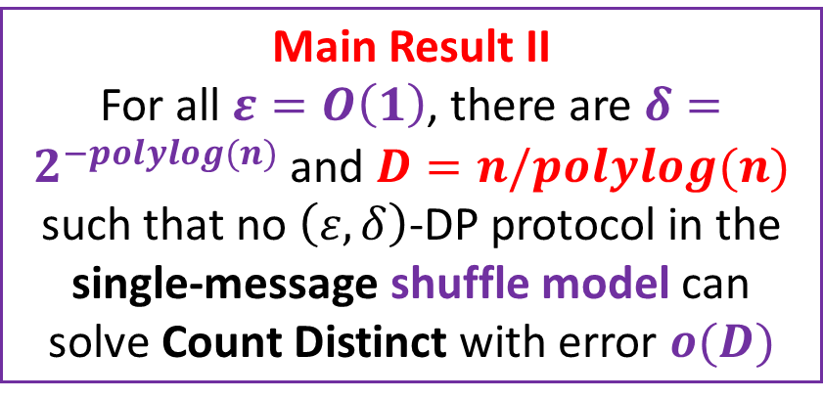
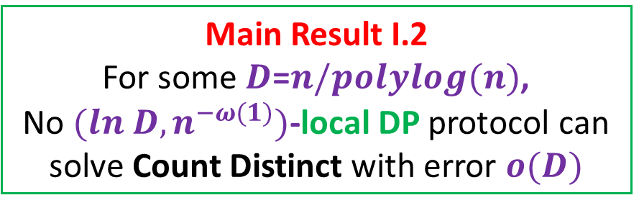
Count Distinct in the Shuffle Model
Main Result I.2
For some $D$=$n/polylog(n)$,
No $(ln D,n^{−ω(1)})$-local DP protocol can solve Count Distinct with error $o(D)$
Lemma (Informal)
New connection between Local and Single-Message Shuffle Model
If a randomizer $R$ is $(O(1),2^{−polylog(n)})$-DP in single-message shuffle model on $n$ users.
Then $R$ is $(ln n−Θ(ln ln n),n^{−ω(1)})$-DP in the local model.
Main Result II
For all $ε=O\left(1\right)$, there are $δ=2^{−polylog(n)}$ and $D=n/polylog(n)$ such that no $\left(ε,δ\right)$-DP protocol in the single-message shuffle model can solve Count Distinct with error $o(D)$

Slide 18
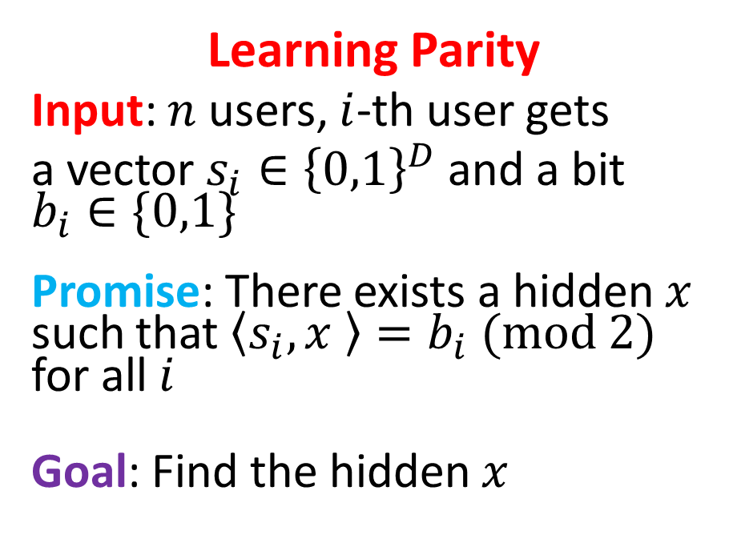
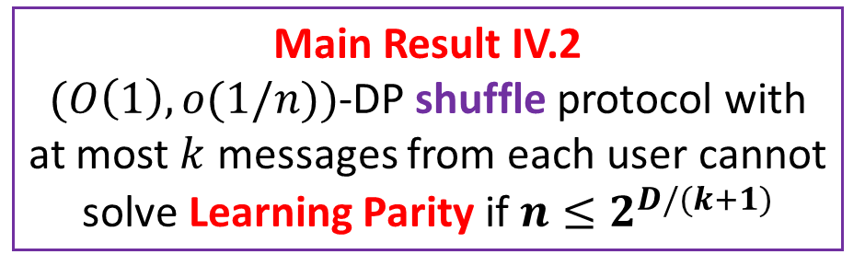
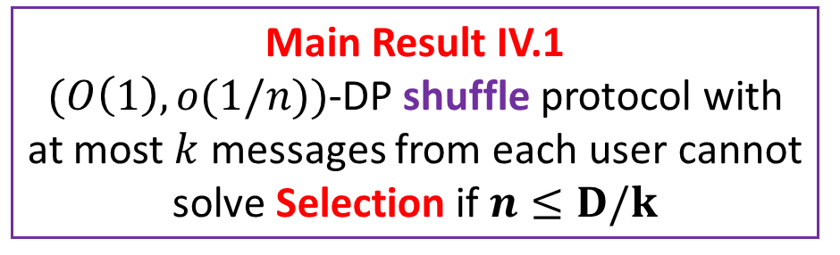
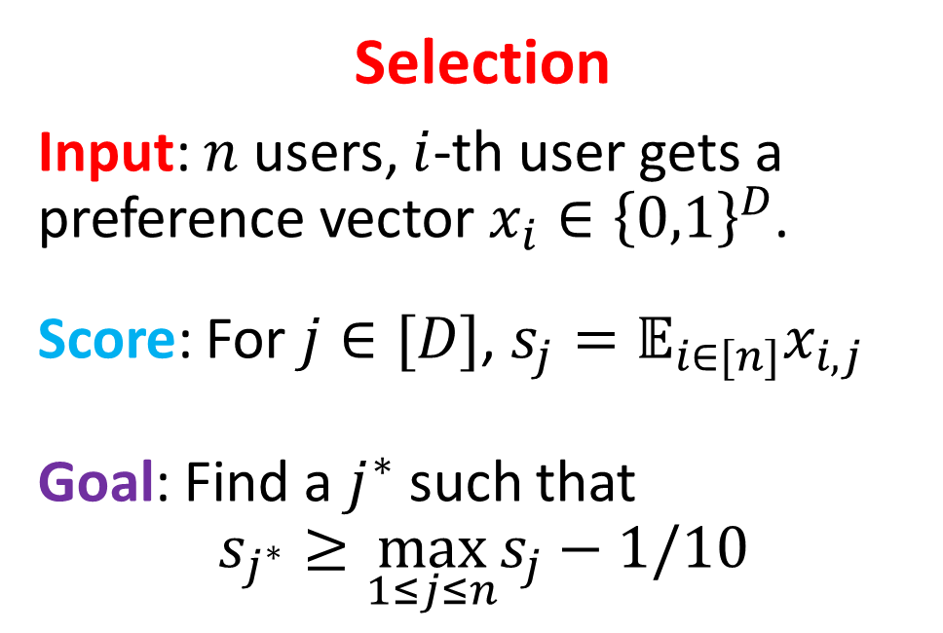
Other Lower Bounds in the Shuffle Model
Selection
Input: $n$ users, $i$-th user gets a preference vector $x_{i}∈{\left\{0,1\right\}}^{D}$.
Score: For $j∈[D]$, $s_{j}=𝔼_{i∈[n]}x_{i,j }$
Goal: Find a $j^{∗}$ such that
$$s_{j^{∗}}≥\max_{1≤j≤n}s_{j}−1/10$$
Learning Parity
Input: $n$ users, $i$-th user gets
a vector $s_{i}∈{\left\{0,1\right\}}^{D}$ and a bit $b_{i}∈\{0,1\}$
Promise: There exists a hidden $x$ such that $\left\langle s_{i},x \right\rangle =b_{i} (mod 2)$ for all $i$
Goal: Find the hidden $x$
Main Result IV.1
$(O\left(1\right),o(1/n))$-DP shuffle protocol with at most $k$ messages from each user cannot solve Selection if $n≤D/k$
Main Result IV.2
$(O\left(1\right),o(1/n))$-DP shuffle protocol with at most $k$ messages from each user cannot solve Learning Parity if $n≤2^{D/(k+1)}$

Slide 19
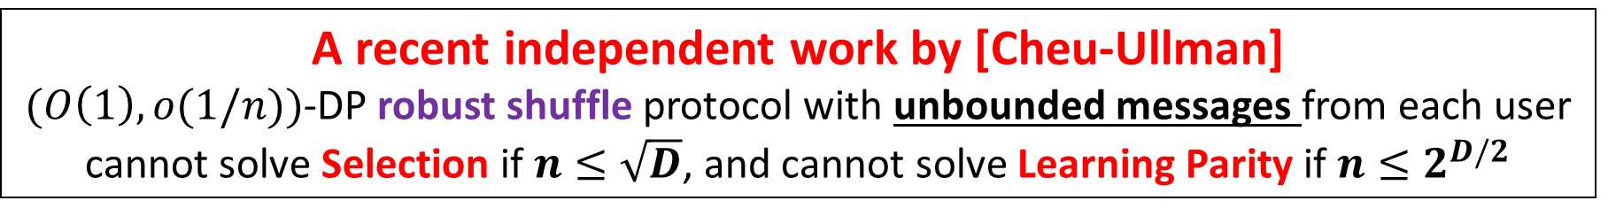
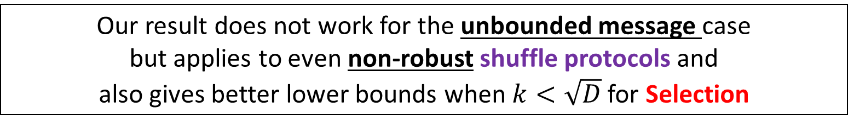
Comparison with [Cheu-Ullman’2020]
Robust Shuffle Model
(Robustness condition.) The protocol should still be private, even if a small constant fraction of users dropped out. A very desirable property in practice
A recent independent work by [Cheu-Ullman]
$(O\left(1\right),o(1/n))$-DP robust shuffle protocol with unbounded messages from each user
cannot solve Selection if $n≤\sqrt{D}$, and cannot solve Learning Parity if $n≤2^{D/2}$
Our result does not work for the unbounded message case
but applies to even non-robust shuffle protocols and
also gives better lower bounds when $k<\sqrt{D}$ for Selection

Slide 20
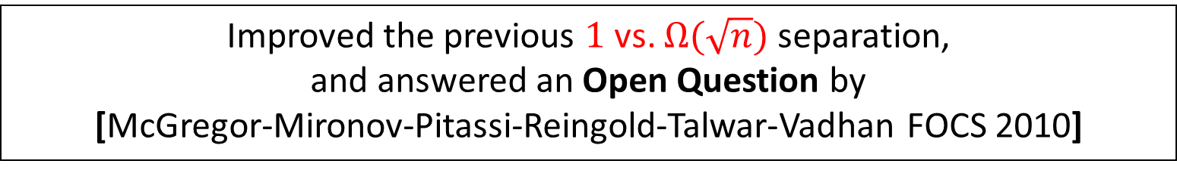
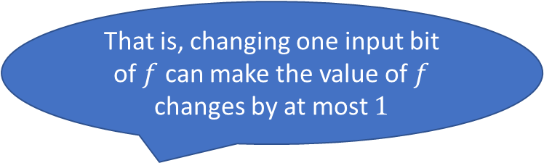
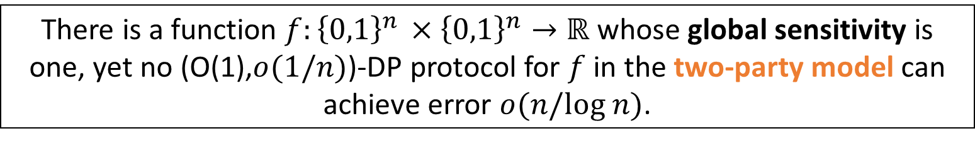
Maximal Separation Between Global Sensitivity and Two-Party DP
That is, changing one input bit of $f$ can make the value of $f$ changes by at most $1$
There is a function $f:{\left\{0,1\right\}}^{n }×{\left\{0,1\right\}}^{n}→ℝ$ whose global sensitivity is one, yet no (O(1),$o(1/n)$)-DP protocol for $f$ in the two-party model can achieve error $o(n/log n)$.
Check our paper for more details!
Improved the previous $1$ vs. $Ω(\sqrt{n})$ separation,
and answered an Open Question by
[McGregor-Mironov-Pitassi-Reingold-Talwar-Vadhan FOCS 2010]

Slide 21
Today’s Plan
Part I (Introduction)
The Shuffle Model of Differential Privacy
The Count Distinct Problem and Our Results for it
Lower Bounds for Selection and Learning Parity in the Shuffle Model
Part II (Techniques)
Lower Bounds via Moment-Matching
Lower Bounds via Dominated Protocols
Conclusion and Open Problems
The proof is very technical,
I will only give the construction of hard instances,
and some intuitions on why the lower bounds hold

Slide 22
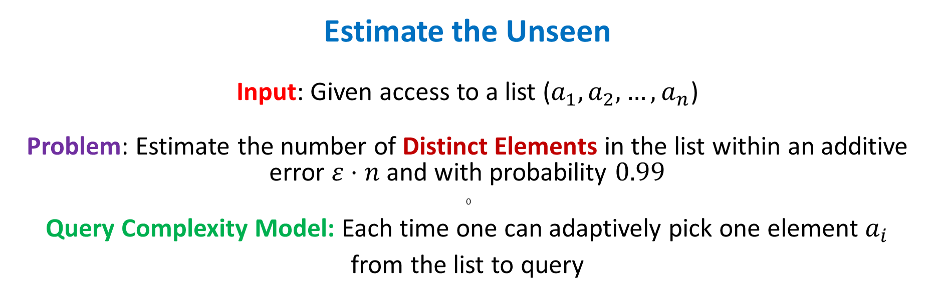
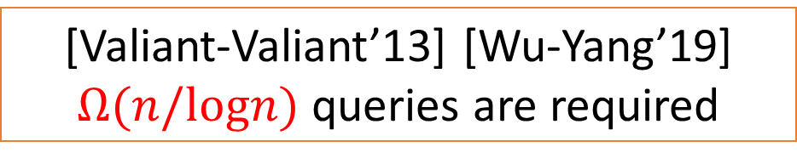
Lower Bounds for Count Distinct via Moment-Matching
Estimate the Unseen
Input: Given access to a list ($a_{1},a_{2},…,a_{n}$)
Problem: Estimate the number of Distinct Elements in the list within an additive error $ε⋅n$ and with probability $0.99$
0
Query Complexity Model: Each time one can adaptively pick one element $a_{i}$
from the list to query
[Valiant-Valiant’13] [Wu-Yang’19]
$Ω(n/logn)$ queries are required

Slide 23
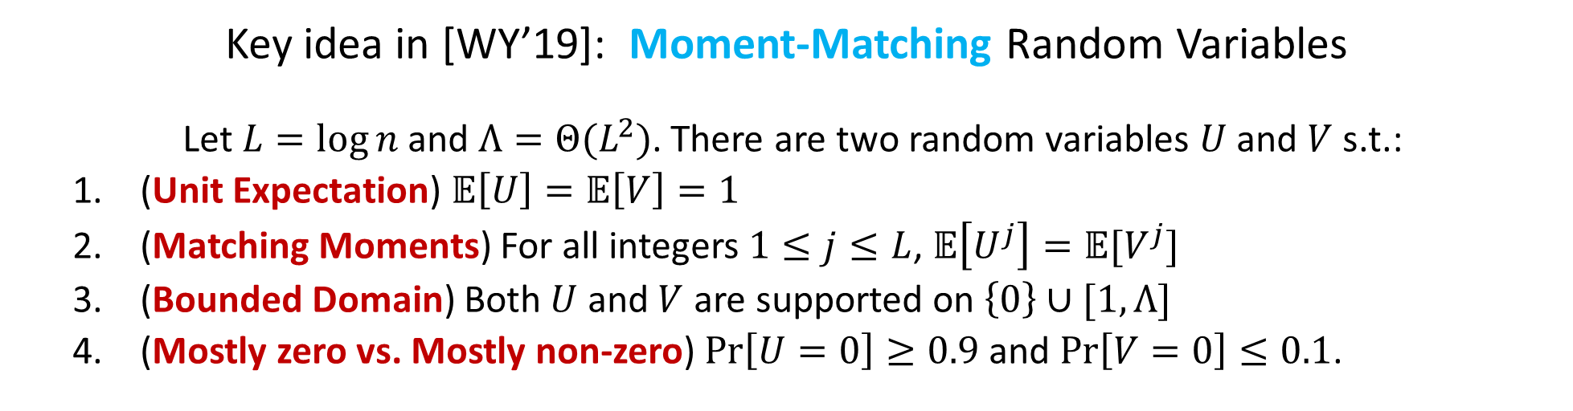
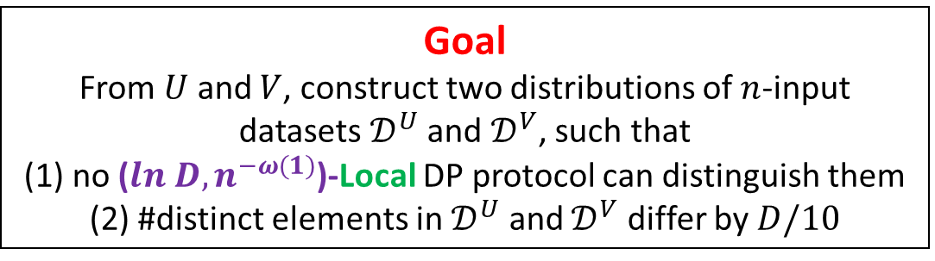
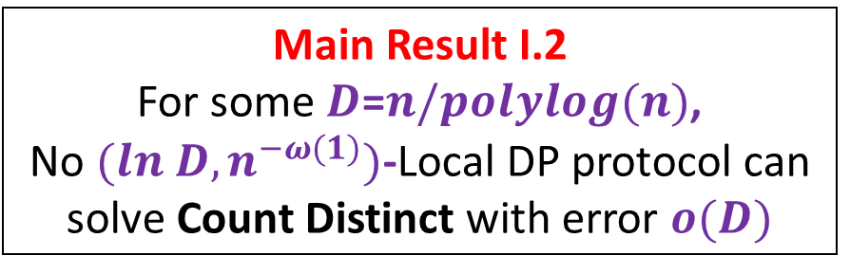
Lower Bounds for Count Distinct via Moment-Matching
Key idea in [WY’19]: Moment-Matching Random Variables
Let $L=\log{n}$ and $Λ=Θ(L^{2})$. There are two random variables $U$ and $V$ s.t.:
(Unit Expectation) $𝔼\left[U\right]=𝔼\left[V\right]=1$
(Matching Moments) For all integers $1≤j≤L$, $𝔼\left[U^{j}\right]=𝔼[V^{j}]$
(Bounded Domain) Both $U$ and $V$ are supported on $\left\{0\right\}∪[1,Λ]$
(Mostly zero vs. Mostly non-zero) $\operatorname{Pr}\left[U=0\right]≥0.9$ and $\operatorname{Pr}\left[V=0\right]≤0.1$.
Main Result I.2
For some $D$=$n/polylog(n)$,
No $(ln D,n^{−ω(1)})$-Local DP protocol can solve Count Distinct with error $o(D)$
Goal
From $U$ and $V$, construct two distributions of $n$-input datasets $𝒟^{U}$ and $𝒟^{V}$, such that
(1) no ($ln D,n^{−ω(1)}$)-Local DP protocol can distinguish them
(2) #distinct elements in $𝒟^{U}$ and $𝒟^{V}$ differ by $D/10$

Slide 24
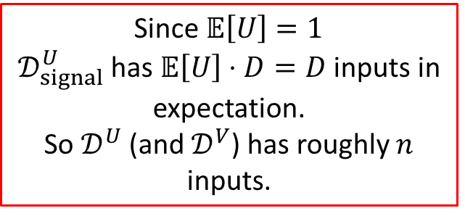




Hard Distribution: Signal/Noise Decomposition
Setting: $n$ users. Each user gets an input from [D], for some $D=n/polylog(n)$.
Parameters: $W:$ a distribution over $\left\{0\right\}∪\left[1,Λ\right]$; $E$: a random subset of $[D]$ such that $\left|E\right|≤|D|/100$.
Construction of the Signal Part $𝒟_{signal}^{W}$
For each $i∈[D]$, we
(1) draw $λ_{i}←W$;
(2) set $n_{i}←λ_{i}$
(3) add $n_{i}$ users with input $i$.
Construction of the
Hard Distribution $𝒟^{W}$
Draw two datasets $D_{1}←𝒟_{signal}^{W}$
and $D_{2}←𝒟_{noise}^{W}$.
Output their union (as a multi-set).
Construction of the Noise Part $𝒟_{noise}^{W}$
For each $i∈E$, we
set $n_{i}←(n−D)/|E|$
(2) add $n_{i}$ users with input $i$.
Since $𝔼\left[U\right]=1$
$𝒟_{signal}^{U}$ has $𝔼\left[U\right]⋅D=D$ inputs in expectation.
So $𝒟^{U}$ (and $𝒟^{V}$) has roughly $n$ inputs.
Goal:
No $(ln D,n^{−ω(1)})$-Local DP protocol can distinguish between
$𝒟^{U}$ and $𝒟^{V}$.

Slide 25








Hard Distribution: Signal/Noise Decomposition
Setting: $n$ users. Each user gets an input from [D], for some $D=n/polylog(n)$.
Parameters: $W:$ a distribution over $\left\{0\right\}∪\left[1,Λ\right]$; $E$: a random subset of $[D]$ such that $\left|E\right|≤|D|/100$.
Construction of the Signal Part $𝒟_{signal}^{W}$
For each $i∈[D]$, we
(1) draw $λ_{i}←W$;
(2) draw $n_{i}←λ_{i}$;
(3) add $n_{i}$ users with input $i$.
Construction of the Noise Part $𝒟_{noise}^{W}$
For each $i∈E$, we
(1) draw $n_{i}←(n−D)/|E|$
(2) add $n_{i}$ users with input $i$.
Construction of the
Hard Distribution $𝒟^{W}$
Draw two datasets $D_{1}←𝒟_{signal}^{W}$
and $D_{2}←𝒟_{noise}^{W}$.
Output their union (as a multi-set).
$𝒟_{signal}^{W}$ provides signal
W.h.p. for $I←𝒟_{signal}^{U}$, #DE($I$)$≤0.1|D|$
W.h.p. for $I←𝒟_{signal}^{V}$, #DE($I$)$≥0.5|D|$
(Mostly zero vs. Mostly non-zero)
$\operatorname{Pr}\left[U=0\right]≥0.9$ and $\operatorname{Pr}\left[V=0\right]≤0.1$.
(1) no ($ln D,n^{−ω(1)}$)-Local DP protocol can distinguish them
(2) #distinct elements in $𝒟^{U}$ and $𝒟^{V}$ differ by $D/10$
$$𝒟_{noise}^{W} does not make a difference$$
For $I←𝒟_{noise}^{W}$ $\#DE(I)≤\left|E\right|≤0.01|D|$

Slide 26





Hard Distribution: Poissonization Trick
Setting: $n$ users. Each user gets an input from [D], for some $D=n/polylog(n)$.
Parameters: $W:$ a distribution over $\left\{0\right\}∪\left[1,Λ\right]$; $E$: a random subset of $[D]$ such that $\left|E\right|≤|D|/100$.
Construction of the Signal Part $𝒟_{signal}^{W}$
For each $i∈[D]$, we
(1) draw $λ_{i}←W$;
(2) set $n_{i}←λ_{i}$
(3) add $n_{i}$ users with input $i$.
Construction of the Signal Part $𝒟_{signal}^{W}$
For each $i∈[D]$, we
(1) draw $λ_{i}←W$;
(2) draw $n_{i}←Poi\left(λ_{i}\right)$;
(3) add $n_{i}$ users with input $i$.
Construction of the
Hard Distribution $𝒟^{W}$
Draw two datasets $D_{1}←𝒟_{signal}^{W}$
and $D_{2}←𝒟_{noise}^{W}$.
Output their union (as a multi-set).
Construction of the Noise Part $𝒟_{noise}^{W}$
For each $i∈E$, we
set $n_{i}←(n−D)/|E|$
(2) add $n_{i}$ users with input $i$.
Construction of the Noise Part $𝒟_{noise}^{W}$
For each $i∈E$, we
draw $n_{i}←Poi((n−D)/|E|)$
(2) add $n_{i}$ users with input $i$.
Poisson Distribution
Parameter: $λ$
Support: non-negative integers
Specification: $\operatorname{Pr}\left[Poi\left(λ\right)=k\right]=\frac{λ^{k}e^{−λ}}{k!}$
Mean: $𝔼\left[Poi\left(λ\right)\right]=λ$
Goal:
No $(ln D,n^{−ω(1)})$-Local DP protocol can distinguish between
$𝒟^{U}$ and $𝒟^{V}$.

Slide 27






Hard Distribution: Signal/Noise Decomposition
Setting: $n$ users. Each user gets an input from [D], for some $D=n/polylog(n)$.
Parameters: $W:$ a distribution over $\left\{0\right\}∪\left[1,Λ\right]$; $E$: a random subset of $[D]$ such that $\left|E\right|≤|D|/100$.
Construction of the Noise Part $𝒟_{noise}^{W}$
For each $i∈E$, we
draw $n_{i}←Poi((n−D)/|E|)$
(2) add $n_{i}$ users with input $i$.
Construction of the Signal Part $𝒟_{signal}^{W}$
For each $i∈[D]$, we
(1) draw $λ_{i}←W$;
(2) draw $n_{i}←Poi\left(λ_{i}\right)$;
(3) add $n_{i}$ users with input $i$.
Construction of the
Hard Distribution $𝒟^{W}$
Draw two datasets $D_{1}←𝒟_{signal}^{W}$
and $D_{2}←𝒟_{noise}^{W}$.
Output their union (as a multi-set).
(Matching Moments)
For all integers $1≤j≤L$, $𝔼\left[U^{j}\right]=𝔼[V^{j}]$
$𝒟_{noise}^{W}$ provides noise
No $(ln D,n^{−ω(1)})$-Local DP protocol
can distinguish between
$𝒟^{U}$ and $𝒟^{V}$.
(1) no ($ln D,n^{−ω(1)}$)-Local DP protocol can distinguish them
(2) #distinct elements in $𝒟^{U}$ and $𝒟^{V}$ differ by $D/10$

Slide 28



Lower Bounds in Shuffle Model via Dominated Protocols
Convention
Green for Local Model
Purple for Shuffle Model
Blue for Dominated Protocols
Local Protocols
A Local randomizer $R$ is $\left(ε,δ\right)$-differentially private
if for all pairs of inputs $a$ and $b$, and possible events $ℰ$
$$\operatorname{Pr}\left[R\left(a\right)∈ℰ\right]≤e^{ε}⋅\operatorname{Pr}\left[R\left(b\right)∈ℰ\right]+δ$$
$$\operatorname{Pr}\left[R\left(b\right)∈ℰ\right]≤e^{ε}⋅\operatorname{Pr}\left[R\left(a\right)∈ℰ\right]+δ$$
Dominated Protocols
We say a randomizer $R:𝒳→ℳ$ is $\left(ε,δ\right)$-dominated, if there exists a distribution $𝒟$ on $ℳ$, such that for all $x∈𝒳$ and all $E⊆ℳ$,
$$\operatorname{Pr}\left[R\left(x\right)∈E\right]≤e^{ε}⋅\underset{𝓓}{Pr}\left[E\right]+δ$$
Set $𝒟=R(x_{0})$ for a fixed $x_{0}∈𝒳$. Then Local Protocols are Dominated.
Multi-Message Shuffle Protocols are Dominated
If $R$ is $(ε,δ)$-DP in the $k$-message shuffle model on $n$ users, then $R$ is $(ε+k\left(1+ln n\right),δ)$-dominated

Slide 29




Lower Bounds for Count Distinct via Dominated Protocols
Multi-Message Shuffle Protocols are Dominated
If $R$ is $(ε,δ)$-DP in the $k$-message shuffle model on $n$ users, then $R$ is $(ε+k\left(1+ln n\right),δ)$-dominated
Selection
Input: $n$ users, $i$-th user gets a preference vector $x_{i}∈{\left\{0,1\right\}}^{D}$
Score: For $j∈[D]$, $s_{j}=𝔼_{i∈[n]}x_{i,j }$
Goal: Find an $j^{∗}$ such that
$$s_{j^{∗}}≥\max_{1≤j≤n}s_{j}−1/10$$
Selection is Hard for Dominated Protocols
($ε,o(1/n)$)-dominated protocol cannot solve Selection if $n≤D ln D/ε$
Main Result IV.1
$(O\left(1\right),o(1/n))$-DP shuffle protocol with at most $k$ messages from each user cannot solve Selection if $n≤n/k$

Slide 30

Conclusion and Open Problems
Lower Bounds for unbounded messages in the Shuffle Model without robustness constraints?
Extend the Single-Message Shuffle Model Lower Bound for Count Distinct to the regime that $δ=1/poly(n)$? (Currently it requires $δ=2^{−polylog(n)}$).
Thank you!

