Slide 1
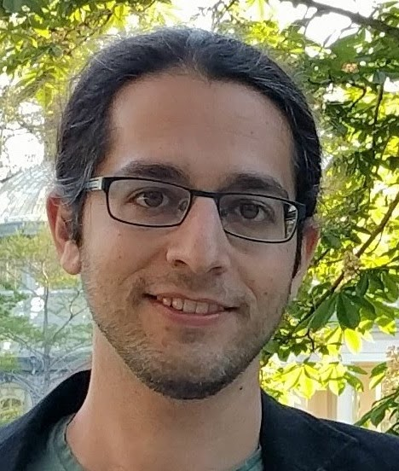
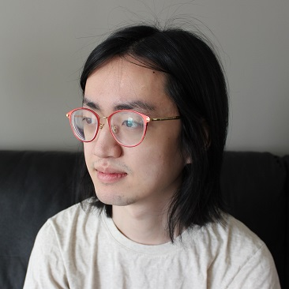
Hardness vs Randomness, Revised: Uniform, Non-Black-Box, and Instance-Wise
Lijie Chen
MIT
Roei Tell
MIT

Slide 2
Today’s Plan
Part I (An Overview of Conceptual Messages)
Part II (Motivation and Results)
The right assumptions for derandomization
Randomness might be indistinguishable from useless
Part III (Techniques)
Instance-wise reconstructive targeted PRGs/HSGs
Derandomization via GKR interactive proof systems
Open Problems

Slide 3
Conceptual Messages: The RIGHT Assumptions for Derandomization
A new Hardness-to-Randomness framework for non-black-box derandomization
based on new uniform hardness assumptions
New type of uniform hardness assumptions which is both necessary and sufficient for derandomization
New uniform assumptions
prBPP = prP

Slide 4
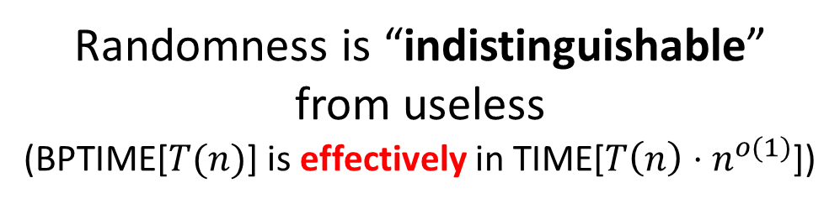
Conceptual Messages: Super-fast Derandomization
A new Hardness-to-Randomness framework for non-black-box derandomization
based on new uniform hardness assumptions
A more flexible framework enables extremely fast derandomization
Provably unachievable by PRGs!
New uniform assumptions
Randomness is “indistinguishable”
from useless
(BPTIME[$T(n)$] is effectively in TIME[$T\left(n\right)⋅n^{o(1)}$])

Slide 5
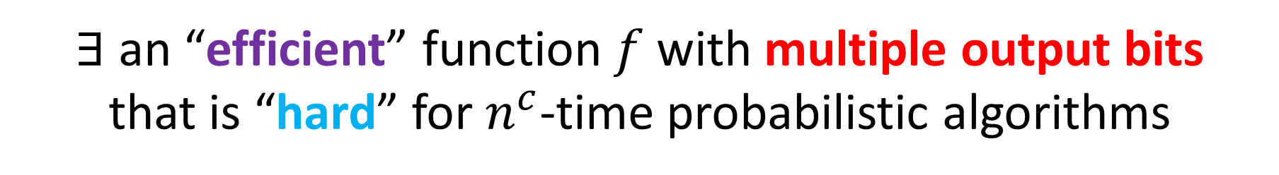
New Hardness Assumptions: A Template
$∃$ an “efficient” function $f$ with multiple output bits
that is “hard” for $n^{c}$-time probabilistic algorithms

Slide 6

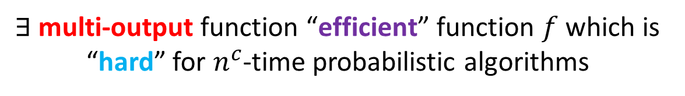
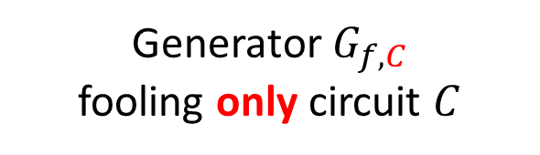
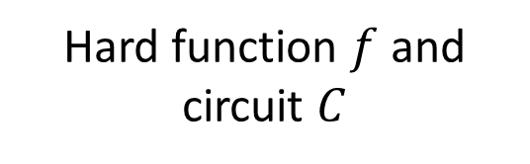
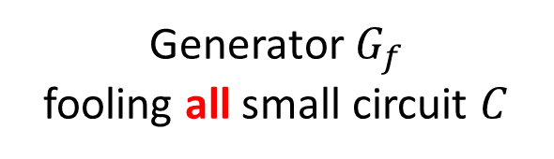

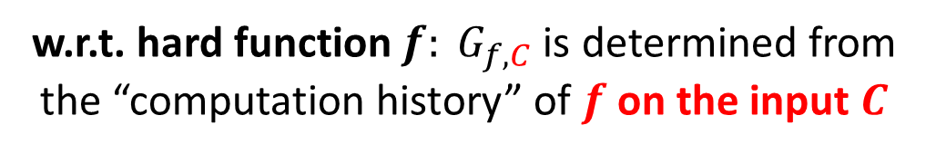
Uniform, Non-Black-Box, Instance-Wise : Explained
Does NOT depend on C
PRGs
Generator $G_{f}$
fooling all small circuit $C$
Hard function $f$
Targeted PRGs
Generator $G_{f,C}$
fooling only circuit $C$
Hard function $f$ and
circuit $C$
Non-Black-Box
w.r.t. input$: G_{f,C}$ depends on $C$ (unlike PRG)
w.r.t. hard function $f: G_{f,C}$is determined from the “computation history” of $f$ on the input $C$
New Hardness Assumptions:
A Template
$∃$ multi-output function “efficient” function $f$ which is “hard” for $n^{c}$-time probabilistic algorithms

Slide 7
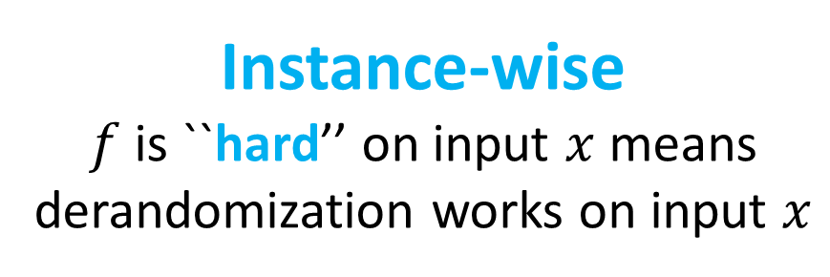

Uniform, Non-Black-Box, and Instance-Wise: Explained
$∃$ an “efficient” function $f$ with multiple output bits
that is “hard” for $n^{c}$-time probabilistic algorithms
Uniform
Only assume hardness against uniform probabilistic algorithms
(NOT circuits).
Instance-wise
$f$ is ``hard’’ on input $x$ means derandomization works on input $x$
This avoids the hard question of
proving circuit lower bounds

Slide 8
Today’s Plan
Part I (An Overview of Conceptual Messages)
Part II (Motivation and Results)
The right assumptions for derandomization
Randomness might be indistinguishable from useless
Part III (Techniques)
Instance-wise reconstructive targeted PRGs/HSGs
Derandomization via GKR interactive proof systems
Open Problems

Slide 9
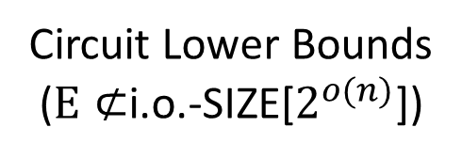
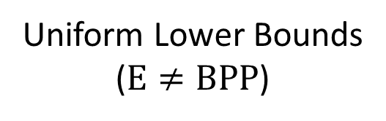
Previous Hardness-to-Randomness frameworks are based on PRGs
Circuit Lower Bounds
($E⊄$i.o.-SIZE[$2^{o(n)}$])
Log-seed PRGs
[Yao82; BM84; Nis91; NW94; IW99]
Assumptions are too strong?
?
prP = prBPP
[IW98; TV07;…]
?
Uniform Lower Bounds
($E≠BPP$)
PRGs that work on “average”
Assumptions are too weak?
Remark: Circuit Lower Bounds for E vs. for NE

Slide 10
New Hardness-to-Randomness framework based on Targeted PRGs
Circuit Lower Bounds
($E⊄$i.o.-SIZE[$2^{o(n)}$])
Log-seed PRGs
?
New type of Hardness Assumptions
prP = prBPP
?
Uniform Lower Bounds
($E≠BPP$)
PRGs that work on “average”

Slide 11

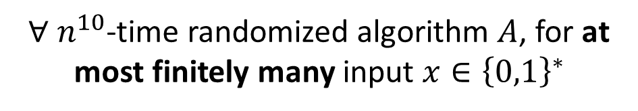
The RIGHT Assumptions for Derandomization
Assumption
$∃$ poly-time $f:{\left\{0,1\right\}}^{n}→{\left\{0,1\right\}}^{n}$ that is almost-all-input-hard against all $n^{10}$-time randomized algorithms
$∀$ $n^{10}$-time randomized algorithm $A$, for at most finitely many input $x∈{\left\{0,1\right\}}^{∗}$
$$\underset{internal coins of A}{Pr}\left[A\left(x\right)=f\left(x\right)\right]≥2/3$$
Claim
Take-away
Almost-all-input hardness
is necessary for derandomization
Proved by simple diagonalization
prP = prBPP
Assumption

Slide 12
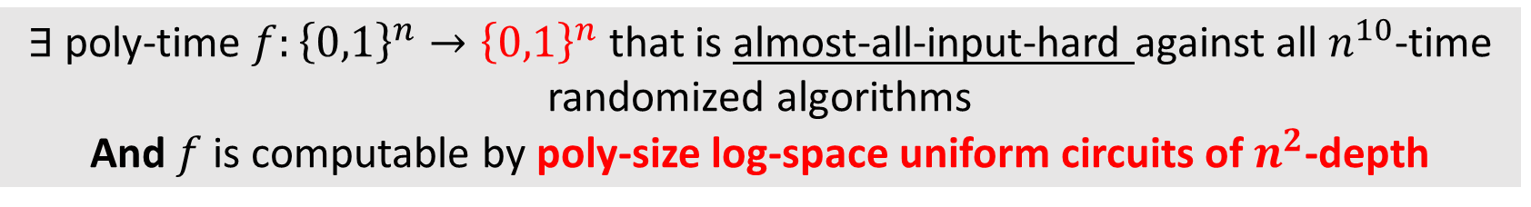
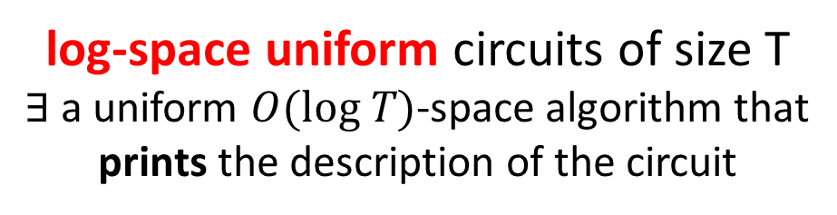
The RIGHT Assumptions for Derandomization
Assumption_{low-depth}
$∃$ poly-time $f:{\left\{0,1\right\}}^{n}→{\left\{0,1\right\}}^{n}$ that is almost-all-input-hard against all $n^{10}$-time randomized algorithms And $f$ is computable by poly-size log-space uniform circuits of $n^{2}$-depth
prP = prBPP
Take-away
Almost-all-input hardness is
sufficient for derandomization
log-space uniform circuits of size T
$∃$ a uniform $O(log T)$-space algorithm that
prints the description of the circuit

Slide 13
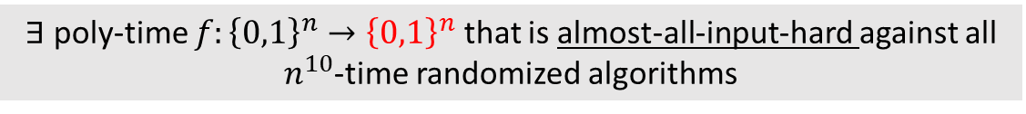
The RIGHT Assumptions for Derandomization
Main Result
Assumption_{low-depth}
$∃$ poly-time $f:{\left\{0,1\right\}}^{n}→{\left\{0,1\right\}}^{n}$ that is almost-all-input-hard against all $n^{10}$-time randomized algorithms And $f$ is computable by poly-size log-space uniform circuits of $n^{2}$-depth
prP = prBPP
Assumption
$∃$ poly-time $f:{\left\{0,1\right\}}^{n}→{\left\{0,1\right\}}^{n}$ that is almost-all-input-hard against all
$n^{10}$-time randomized algorithms
Take-away
Almost-all-input hardness is
sufficient and necessary for derandomization

Slide 14
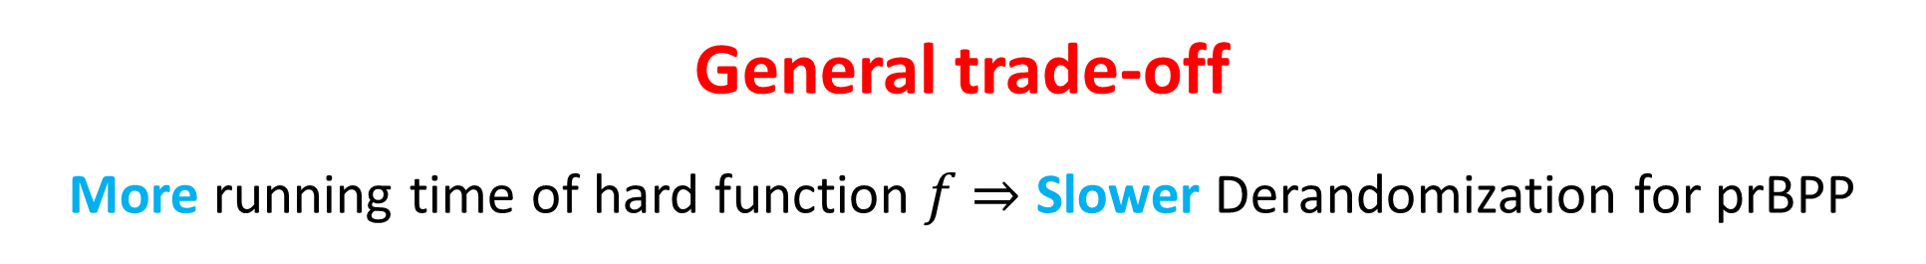
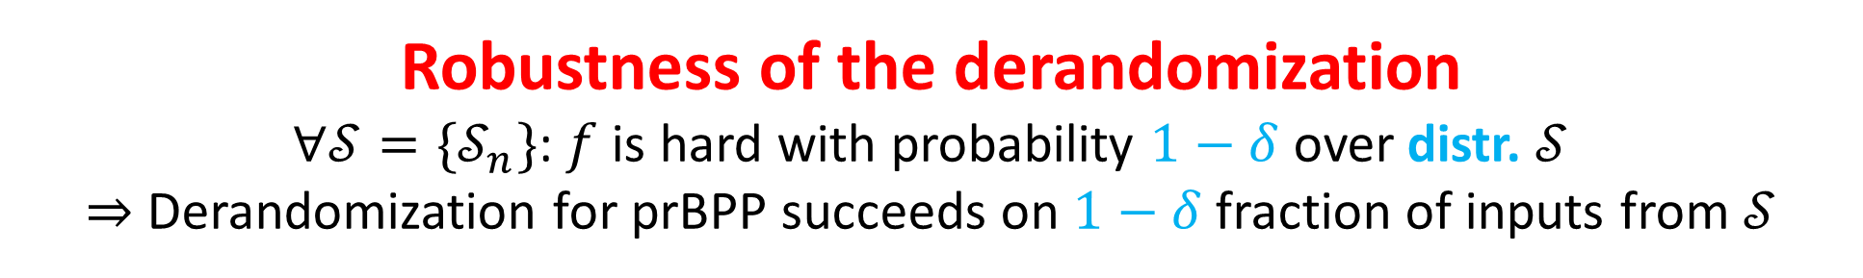
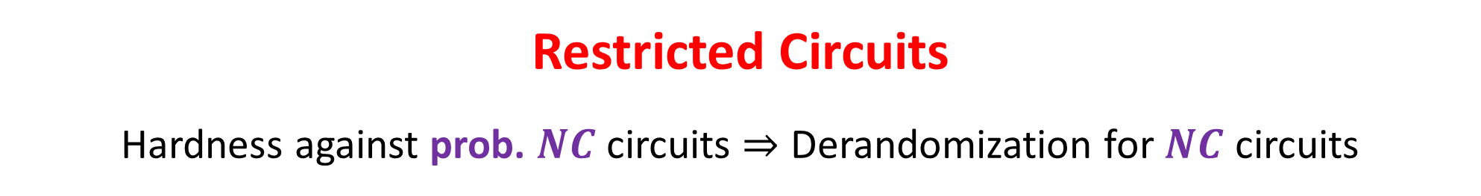
Generality and robustness
Robustness of the derandomization
$∀𝒮=\{𝒮_{n}\}$: $f$ is hard with probability $1−δ$ over distr. $𝒮$ $⇒$ Derandomization for prBPP succeeds on $1−δ$ fraction of inputs from $𝒮$
General trade-off
More running time of hard function $f$ $⇒$ Slower Derandomization for prBPP
Restricted Circuits
Hardness against prob. $NC$ circuits $⇒$ Derandomization for $NC$ circuits

Slide 15
Today’s Plan
Part I (An Overview of Conceptual Messages)
Part II (Motivation and Results)
The right assumptions for derandomization
Randomness might be indistinguishable from useless
Part III (Techniques)
Instance-wise reconstructive targeted PRGs/HSGs
Derandomization via GKR interactive proof systems
Open Problems

Slide 16
Quest for faster derandomization or: Is randomness useless?
 | Assumptions | Derandomization

Slide 17
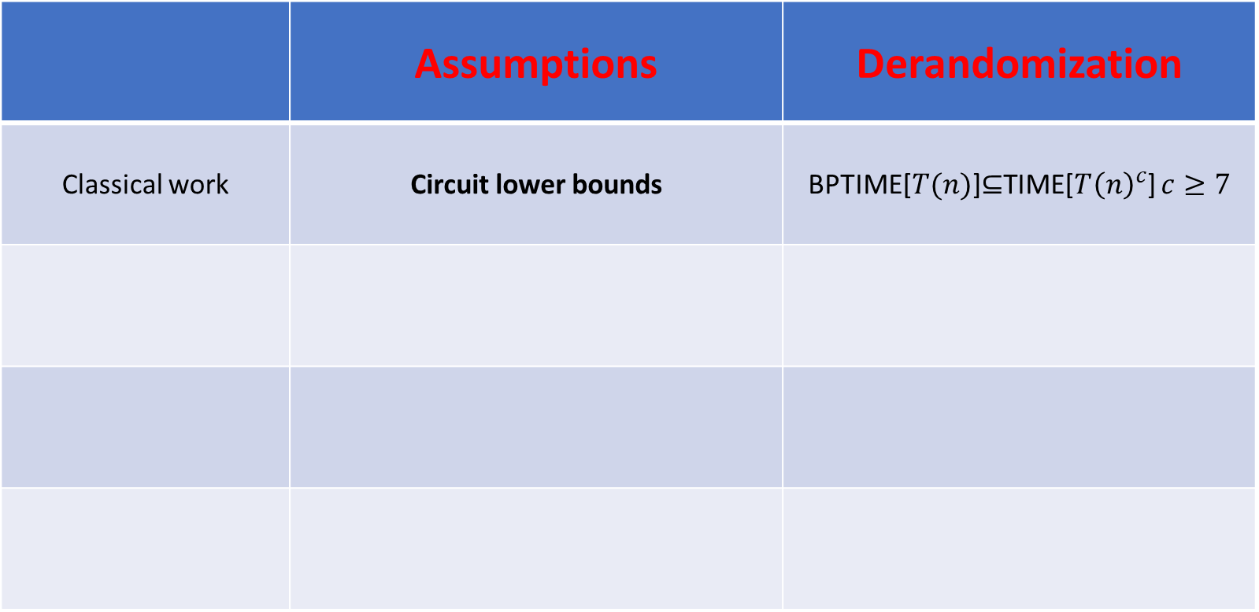
Quest for faster derandomization or: Is randomness useless?
Caution: From now on, will use BPTIME instead of prBPTIME
 | Assumptions | Derandomization
Classical work | Circuit lower bounds | BPTIME[$T(n)$]$⊆$TIME[$T{\left(n\right)}^{c}$] $c≥7$

Slide 18
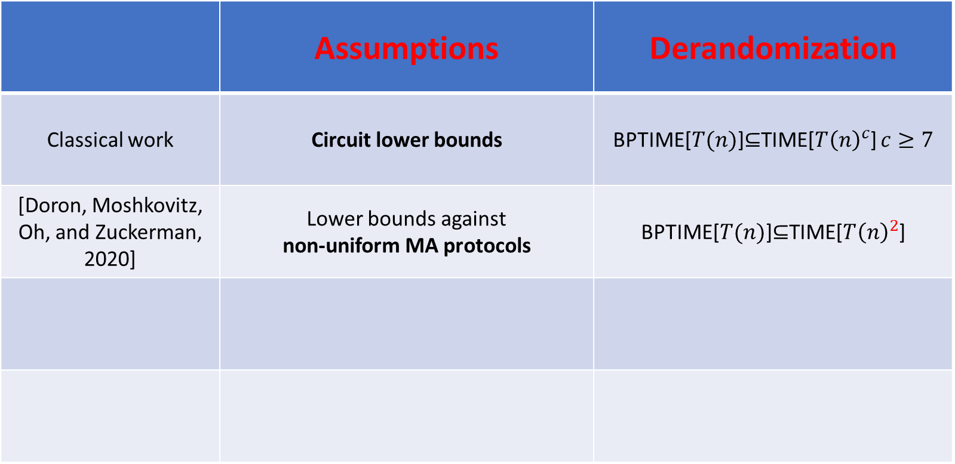
Quest for faster derandomization or: Is randomness useless?
Caution: From now on, will use BPTIME instead of prBPTIME
 | Assumptions | Derandomization
Classical work | Circuit lower bounds | BPTIME[$T(n)$]$⊆$TIME[$T{\left(n\right)}^{c}$] $c≥7$
[Doron, Moshkovitz, Oh, and Zuckerman, 2020] | Lower bounds against non-uniform MA protocols | BPTIME[$T(n)$]$⊆$TIME[$T{\left(n\right)}^{2}$]

Slide 19
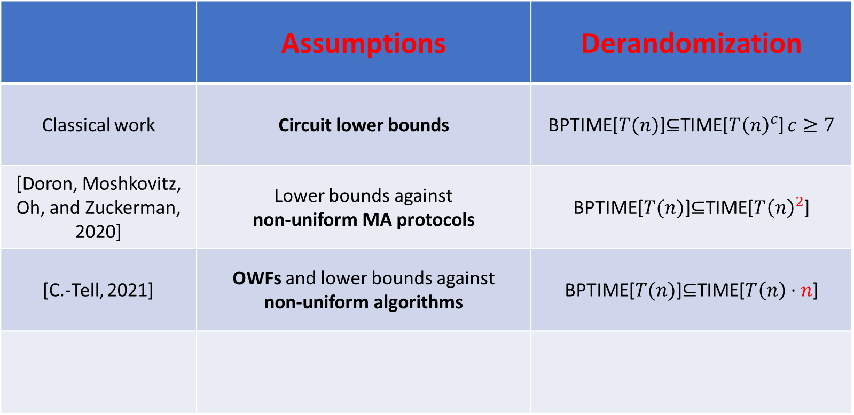
Quest for faster derandomization or: Is randomness useless?
Caution: From now on, will use BPTIME instead of prBPTIME
 | Assumptions | Derandomization
Classical work | Circuit lower bounds | BPTIME[$T(n)$]$⊆$TIME[$T{\left(n\right)}^{c}$] $c≥7$
[Doron, Moshkovitz, Oh, and Zuckerman, 2020] | Lower bounds against non-uniform MA protocols | BPTIME[$T(n)$]$⊆$TIME[$T{\left(n\right)}^{2}$]
[C.-Tell, 2021] | OWFs and lower bounds against non-uniform algorithms | BPTIME[$T(n)$]$⊆$TIME[$T\left(n\right)⋅n$]

Slide 20
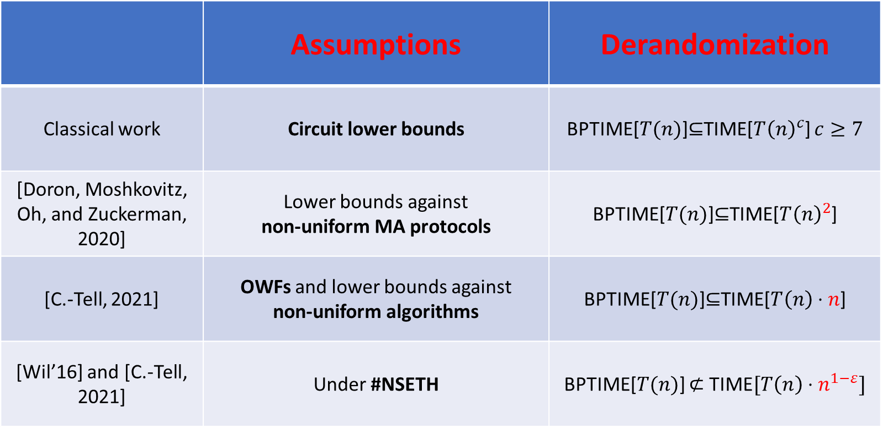
Quest for faster derandomization or: Is randomness useless?
Caution: From now on, will use BPTIME instead of prBPTIME
 | Assumptions | Derandomization
Classical work | Circuit lower bounds | BPTIME[$T(n)$]$⊆$TIME[$T{\left(n\right)}^{c}$] $c≥7$
[Doron, Moshkovitz, Oh, and Zuckerman, 2020] | Lower bounds against non-uniform MA protocols | BPTIME[$T(n)$]$⊆$TIME[$T{\left(n\right)}^{2}$]
[C.-Tell, 2021] | OWFs and lower bounds against non-uniform algorithms | BPTIME[$T(n)$]$⊆$TIME[$T\left(n\right)⋅n$]
[Wil’16] and [C.-Tell, 2021] | Under #NSETH | BPTIME[$T(n)$] $⊄$ TIME$[T\left(n\right)⋅n^{1−ε}]$
A barrier for faster derandomization

Slide 21

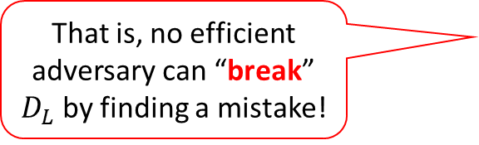


How to overcome the #NSETH-barrier?
A Lesson from Crypto
If two things are “indistinguishable” by poly-time algorithms, then they are practically the same
Can we show randomness is “indistinguishable” from useless?
i.e., BPTIME$\left[T\left(n\right)\right]⊆$ Effective-TIME[$T\left(n\right)⋅n^{o(1)}$]
For every $L∈prBPTIME[T(n)]$, find a $T\left(n\right)⋅n^{o(1)}$-time deterministic algorithm $D_{L}$ such that:
Goal
That is, no efficient adversary can “break” $D_{L}$ by finding a mistake!
for every poly-time sampleable distribution $\{𝒮_{n}\}_{n∈ℕ}$, $\underset{x←𝒮_{n}}{Pr}\left[L\left(x\right)≠D_{L}\left(x\right)\right]≤n^{−ω(1)}$

Slide 22
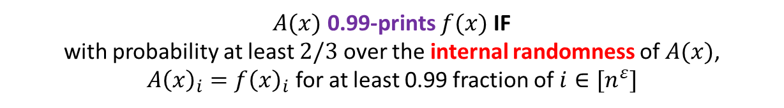
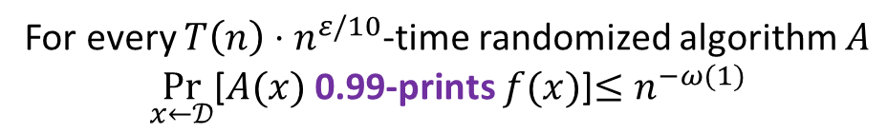
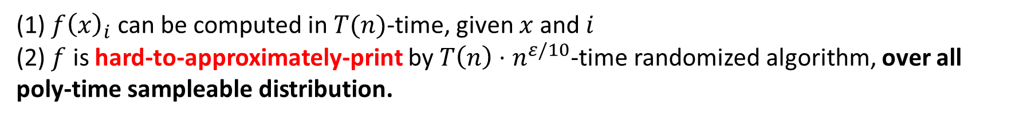
Derandomization from non-batch-computable functions: Randomness is “indistinguishable” from useless
Assume OWFs exists and $∃f:{\left\{0,1\right\}}^{n}→{\left\{0,1\right\}}^{n^{ε}}$ s.t.
(1) $f{\left(x\right)}_{i}$ can be computed in $T(n)$-time, given $x$ and $i$
(2) $f$ is hard-to-approximately-print by $T\left(n\right)⋅n^{ε/10}$-time randomized algorithm, over all poly-time sampleable distribution.
Then $BPTIME\left[T\left(n\right)\right]⊆$ Effective-TIME[$T\left(n\right)⋅n^{O(ε)}$]
Hard-to-approximately-print with respect to a distribution $𝒟$
For every $T\left(n\right)⋅n^{ε/10}$-time randomized algorithm $A$
$\underset{x←𝒟}{Pr}$[$A(x)$ 0.99-prints $f(x)$]$≤n^{−ω(1)}$
$A(x)$ 0.99-prints $f(x)$ IF with probability at least $2/3$ over the internal randomness of $A(x)$,
$A{\left(x\right)}_{i}=f{\left(x\right)}_{i}$ for at least 0.99 fraction of $i∈[n^{ε}]$

Slide 23
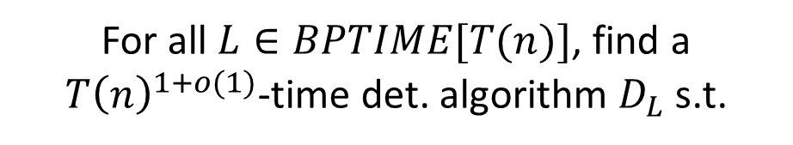
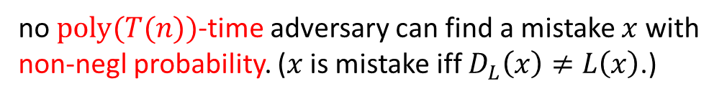
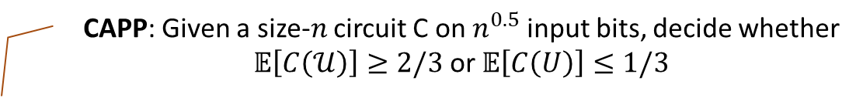
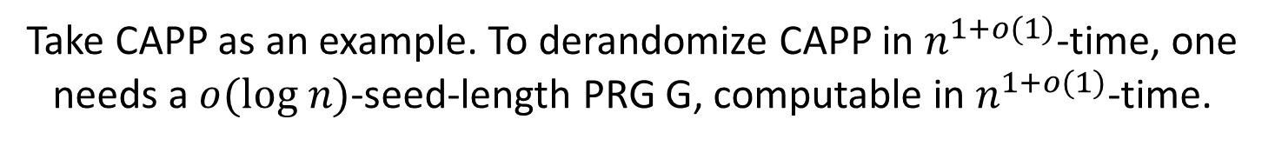
Randomness is “indistinguishable” from useless? The need for non-black-box derandomization
Goal
Indistinguishable from being correct
For all $L∈BPTIME[T(n)]$, find a $T{\left(n\right)}^{1+o(1)}$-time det. algorithm $D_{L}$ s.t.
no $poly(T(n))$-time adversary can find a mistake $x$ with non-negl probability. ($x$ is mistake iff $D_{L}\left(x\right)≠L\left(x\right)$.)
Theorem
No PRGs or black-box derandomization can achieve this goal
That is, only non-black-box derandomization can get superfast derandomization!
CAPP: Given a size-$n$ circuit C on $n^{0.5}$ input bits, decide whether $𝔼\left[C\left(𝒰\right)\right]≥2/3$ or $𝔼\left[C\left(U\right)\right]≤1/3$
Take CAPP as an example. To derandomize CAPP in $n^{1+o(1)}$-time, one needs a $o(log n)$-seed-length PRG G, computable in $n^{1+o(1)}$-time.
Adversary: run $G$ to get $n^{o(1)}$ outputs $\{x_{i}\}$, output a circuit $C$ which only accepts those $x_{i}$’s

Slide 24
Today’s Plan
Part I (An Overview of Conceptual Messages)
Part II (Motivation and Results)
The right assumptions for derandomization
Randomness might be indistinguishable from useless
Part III (Techniques)
Instance-wise reconstructive targeted PRGs/HSGs
Derandomization via GKR interactive proof systems
Open Problems

Slide 25
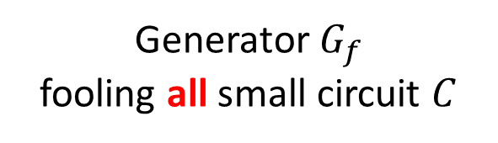


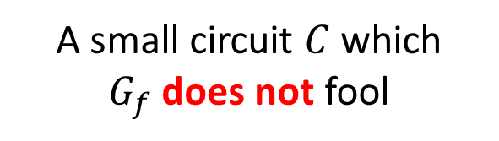
Review: Hardness-to-Randomness via Reconstructive PRGs
PRGs
Generator $G_{f}$
fooling all small circuit $C$
Hard function $f$
Reconstructive PRGs
A small circuit $C$ which
$G_{f}$ does not fool
a small circuit for $f$

Slide 26
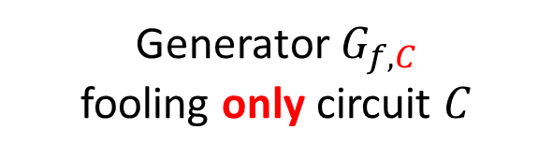
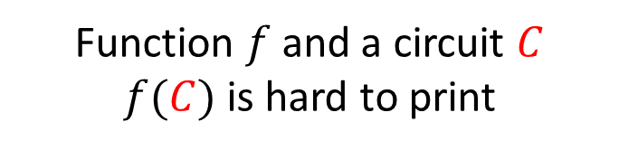
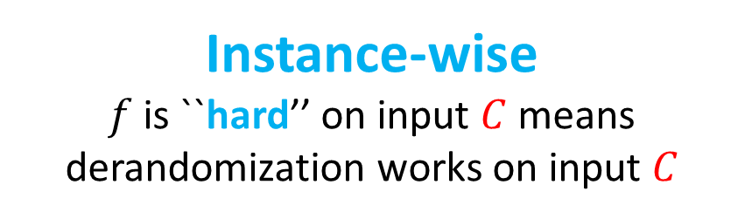
Revision: uniform Hardness-to-Randomness via Instance-wise Reconstructive Targeted PRGs
Targeted PRGs
Function $f$ and a circuit $C$
$f(C)$ is hard to print
Generator $G_{f,C}$
fooling only circuit $C$
Instance-wise
$f$ is ``hard’’ on input $C$ means derandomization works on input $C$

Slide 27
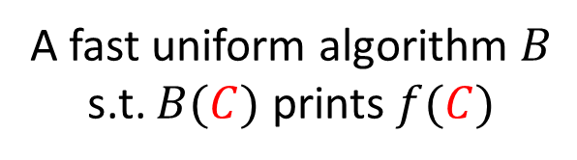
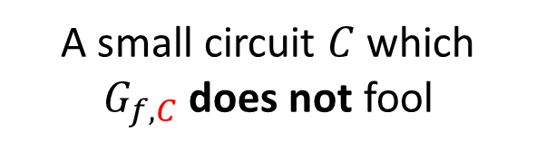
Revision: uniform Hardness-to-Randomness via Instance-wise Reconstructive Targeted PRGs
Targeted PRGs
Function $f$ and a circuit $C$
$f(C)$ is hard to print
Generator $G_{f,C}$
fooling only circuit $C$
Instance-wise
$f$ is ``hard’’ on input $C$ means derandomization works on input $C$
Reconstructive Targeted PRGs
A fast uniform algorithm $B$
s.t. $B(C)$ prints $f(C)$
A small circuit $C$ which
$G_{f,C}$ does not fool

Slide 28

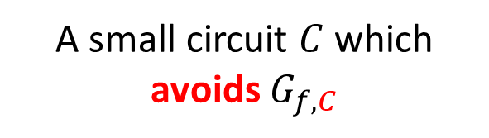
Revision: uniform Hardness-to-Randomness via Instance-wise Reconstructive Targeted HSGs
Targeted HSGs
Function $f$ and a circuit $C$
$f(C)$ is hard to print
Generator $G_{f,C}$
hitting only circuit $C$
Instance-wise
$f$ is ``hard’’ on input $C$ means derandomization works on input $C$
Reconstructive Targeted HSGs
A fast uniform algorithm $B$
s.t. $B(C)$ prints $f(C)$
A small circuit $C$ which
avoids $G_{f,C}$

Slide 29
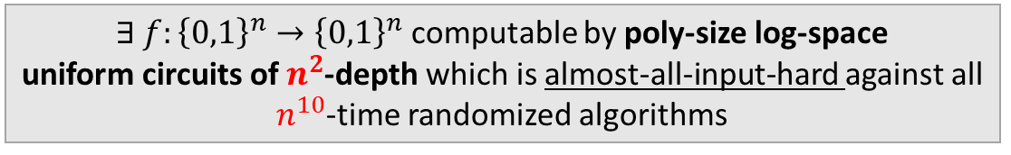
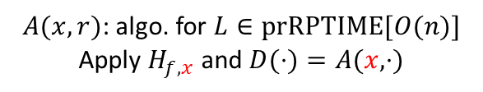
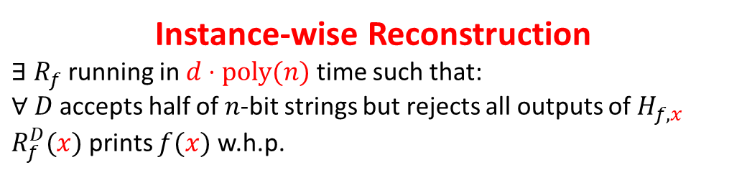
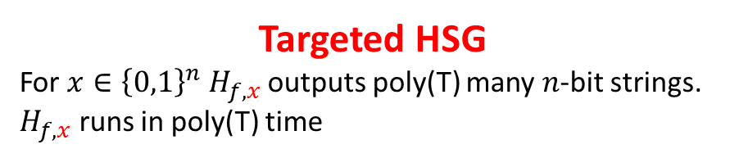
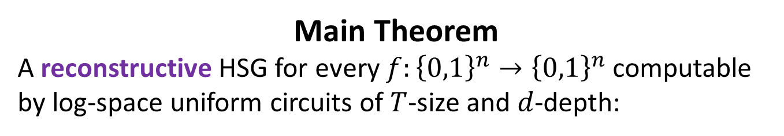
A Construction of Reconstructive HSGs
Main Theorem
A reconstructive HSG for every $f:{\left\{0,1\right\}}^{n}→{\left\{0,1\right\}}^{n}$ computable by log-space uniform circuits of $T$-size and $d$-depth:
Instance-wise Reconstruction
$∃$ $R_{f}$ running in $d⋅poly(n)$ time such that:
$∀$ $D$ accepts half of $n$-bit strings but rejects all outputs of $H_{f,x}$
$R_{f}^{D}(x)$ prints $f(x)$ w.h.p.
Targeted HSG
For $x∈{\left\{0,1\right\}}^{n}$ $H_{f,x}$ outputs poly(T) many $n$-bit strings. $H_{f,x}$ runs in poly(T) time
$A(x,r)$: algo. for $L∈prRPTIME[O(n)]$
Apply $H_{f,x}$ and $D(⋅)=A(x,⋅)$
$∃ f:{\left\{0,1\right\}}^{n}→{\left\{0,1\right\}}^{n}$ computable by poly-size log-space
uniform circuits of $n^{2}$-depth which is almost-all-input-hard against all
$n^{10}$-time randomized algorithms
prP = prRP
prBPP = prRP^{prRP}
prP = prBPP

Slide 30
Today’s Plan
Part I (An Overview of Conceptual Messages)
Part II (Motivation and Results)
The right assumptions for derandomization
Randomness might be indistinguishable from useless
Part III (Techniques)
Instance-wise reconstructive targeted PRGs/HSGs
Derandomization via GKR interactive proof systems
Open Problems

Slide 31

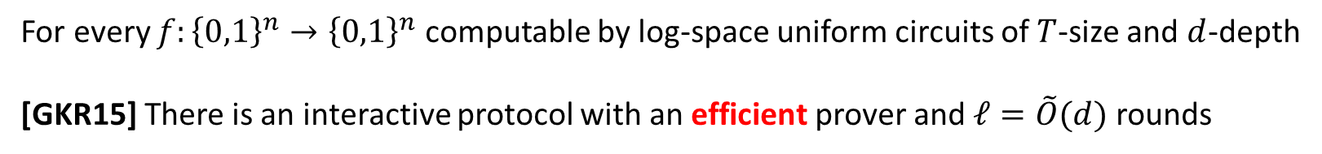

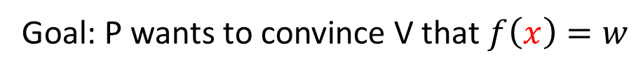


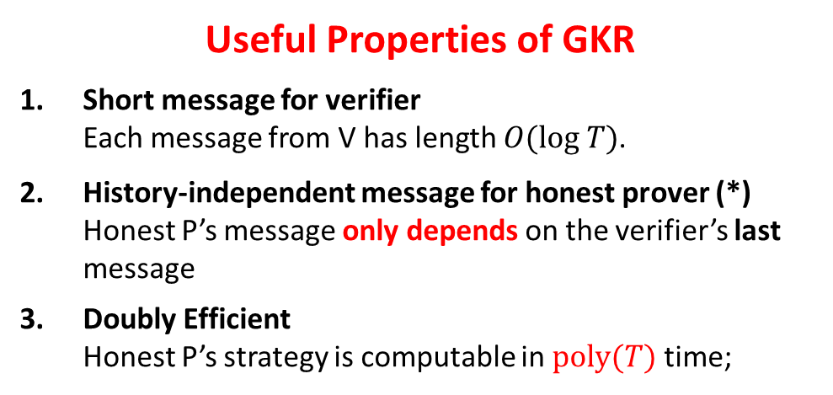
The GKR interactive proof protocol
For every $f:{\left\{0,1\right\}}^{n}→{\left\{0,1\right\}}^{n}$ computable by log-space uniform circuits of $T$-size and $d$-depth
[GKR15] There is an interactive protocol with an efficient prover and $ℓ=\tilde{O}(d)$ rounds
Useful Properties of GKR
Short message for verifier Each message from V has length $O(log T)$.
History-independent message for honest prover (*) Honest P’s message only depends on the verifier’s last message
Doubly Efficient Honest P’s strategy is computable in $poly(T)$ time;
Goal: P wants to convince V that $f\left(x\right)=w$
$x$, w
$x$, w
Prover (P)
Verifier (V)
$$⋮$$
$ℓ$-round

Slide 32
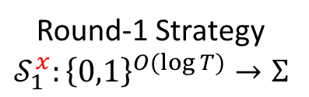
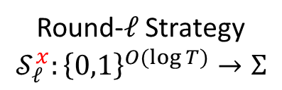
The GKR interactive proof protocol
For every $f:{\left\{0,1\right\}}^{n}→{\left\{0,1\right\}}^{n}$ computable by log-space uniform circuits of $T$-size and $d$-depth
[GKR15] There is an interactive protocol with an efficient prover and $ℓ=\tilde{O}(d)$ rounds
Useful Properties of GKR
Short message for verifier Each message from V has length $O(log T)$.
History-independent message for honest prover (*) Honest P’s message only depends on the verifier’s last message
Doubly Efficient Honest P’s strategy is computable in $poly(T)$ time;
Goal: P wants to convince V that $f\left(x\right)=w$
Honest Prover Strategy
Round-1 Strategy
$$𝒮_{1}^{x}:{\left\{0,1\right\}}^{O(\log{T})}→Σ$$
Verifier (V)
$$⋮$$
$ℓ$-round
Round-$ℓ$ Strategy
$$𝒮_{ℓ}^{x}:{\left\{0,1\right\}}^{O(\log{T})}→Σ$$

Slide 33
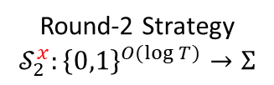













The GKR interactive proof protocol: Reductive
Truth-tables of honest prover strategies
Round-1 Strategy
$$𝒮_{1}^{x}:{\left\{0,1\right\}}^{O(\log{T})}→Σ$$
From which one can compute $f(x)$
Round-2 Strategy
$$𝒮_{2}^{x}:{\left\{0,1\right\}}^{O(\log{T})}→Σ$$
Reductive
For all $i≤ℓ−1$
$∃$ $n^{ε}$-time $R_{x,i}$ such that
$$R_{x,i}^{S_{i+1}^{x}}=S_{i}^{x}$$
Round-3 Strategy
$$𝒮_{3}^{x}:{\left\{0,1\right\}}^{O(\log{T})}→Σ$$
$$⋮$$
$$⋮$$
each entry is computable in $n^{ε}$ time
from $x$ and next row
$$⋮$$
$$⋮$$
Round-$ℓ$ Strategy
$$𝒮_{ℓ}^{x}:{\left\{0,1\right\}}^{O(\log{T})}→Σ$$
$$⋮$$
Base case
$∃$ $n^{ε}$-time $R_{x,ℓ }$ such that $R_{x,ℓ }=S_{ℓ}^{x}$
each entry is computable in $n^{ε}$ time from $x$

Slide 34








The Targeted HSG $H_{f,x}$
Truth-tables of honest prover strategies
NW PRG
Round-1 Strategy
$$𝒮_{1}^{x}:{\left\{0,1\right\}}^{O(\log{T})}→Σ$$
$${NW}_{S_{1}^{x}}$$
Round-2 Strategy
$$𝒮_{2}^{x}:{\left\{0,1\right\}}^{O(\log{T})}→Σ$$
$${NW}_{S_{2}^{x}}$$
Round-3 Strategy
$$𝒮_{3}^{x}:{\left\{0,1\right\}}^{O(\log{T})}→Σ$$
$${NW}_{S_{3}^{x}}$$
$$⋮$$
$$⋮$$
union
$$H_{f,x}$$
$$⋮$$
$${NW}_{S_{ℓ−2}^{x}}$$
$$⋮$$
$${NW}_{S_{ℓ−1}^{x}}$$
Round-$ℓ$ Strategy
$$𝒮_{ℓ}^{x}:{\left\{0,1\right\}}^{O(\log{T})}→Σ$$
$$⋮$$
$${NW}_{S_{ℓ}^{x}}$$

Slide 35













Overview of the Reconstruction Algorithm
NW PRG
$${NW}_{S_{1}^{x}}$$
$D_{x}(⋅)≔A(x,⋅)$ avoids $H_{f,x}$ ($D_{x}$ accepts half of the inputs; but reject all outputs of $H_{f,x}$)
$${NW}_{S_{2}^{x}}$$
$${NW}_{S_{3}^{x}}$$
$$⋮$$
union
$$H_{f,x}$$
$D_{x}$ avoids every ${NW}_{S_{i}^{x}}$
$$⋮$$
$${NW}_{S_{ℓ−2}^{x}}$$
$${NW}_{S_{ℓ−1}^{x}}$$
$D_{x}$ is a distinguisher for every ${NW}_{S_{i}^{x}}$
$$⋮$$
$${NW}_{S_{ℓ}^{x}}$$

Slide 36










Overview of the Reconstruction Algorithm
NW PRG
$${NW}_{S_{1}^{x}}$$
a small circuit for $S_{1}^{x}$
$${NW}_{S_{2}^{x}}$$
a small circuit for $S_{2}^{x}$
$${NW}_{S_{3}^{x}}$$
a small circuit for $S_{3}^{x}$
$$⋮$$
Reconstruction
$D_{x}$
$$⋮$$
$${NW}_{S_{ℓ−2}^{x}}$$
a small circuit for $S_{ℓ−2}^{x}$
$${NW}_{S_{ℓ−1}^{x}}$$
a small circuit for $S_{ℓ−1}^{x}$
$$⋮$$
a small circuit for $S_{ℓ}^{x}$
$${NW}_{S_{ℓ}^{x}}$$
$D_{x}$ is a distinguisher for every ${NW}_{S_{i}^{x}}$
A small circuit $C$ which
$G_{h}$ does not fool
a small circuit for $h$

Slide 37



Review: Reconstruction as Learning
Reconstructive PRGs
The small circuit $C$ which
${NW}_{f}$ does not fool
a small circuit for $f$
[IW’98]
The Nisan-Wigderson PRG gives a uniform learning procedure
Reconstruction via uniform Learning
A uniform learner $ℒ^{f}(C)$: Given $C$ that distinguishes ${NW}_{f}$, makes a small number of queries to $f$, output a small circuit for $f$ w.h.p.

Slide 38
The GKR interactive proof protocol: Reminder
Truth-tables of honest prover strategies
Round-1 Strategy
$$𝒮_{1}^{x}:{\left\{0,1\right\}}^{O(\log{T})}→Σ$$
From which one can compute $f(x)$
Round-2 Strategy
$$𝒮_{2}^{x}:{\left\{0,1\right\}}^{O(\log{T})}→Σ$$
Reductive
For all $i≤ℓ−1$
$∃$ $n^{ε}$-time $R_{x,i}$ such that
$$R_{x,i}^{S_{i+1}^{x}}=S_{i}^{x}$$
Round-3 Strategy
$$𝒮_{3}^{x}:{\left\{0,1\right\}}^{O(\log{T})}→Σ$$
$$⋮$$
$$⋮$$
each entry is computable in $n^{ε}$ time
from $x$ and next row
$$⋮$$
$$⋮$$
Round-$ℓ$ Strategy
$$𝒮_{ℓ}^{x}:{\left\{0,1\right\}}^{O(\log{T})}→Σ$$
$$⋮$$
Base case
$∃$ $n^{ε}$-time $R_{x,ℓ }$ such that $R_{x,ℓ }=S_{ℓ}^{x}$
each entry is computable in $n^{ε}$ time from $x$

Slide 39























$${NW}_{S_{1}^{x}}$$
a small circuit $E_{1}$ for $S_{1}^{x}$
$$f(x)$$
$${NW}_{S_{2}^{x}}$$
Reductive
For all $i≤ℓ−1$
$∃$ $n^{ε}$-time $R_{x,i}$ such that
$$R_{x,i}^{S_{i+1}^{x}}=S_{i}^{x}$$
One Step
a small circuit $E_{2}$ for $S_{2}^{x}$
$${NW}_{S_{3}^{x}}$$
a small circuit $E_{i+1}$ for $S_{i+1}^{x}$
a small circuit $E_{3}$ for $S_{3}^{x}$
Run the learning algorithm $ℒ^{S_{i}^{x}}(D_{x})$:
$D_{x}$
use $R_{x, i}^{E_{i+1}}$ to answer queries to $S_{i}^{x}$!
uniform Learning
$ℒ^{S_{i}^{x}}(D_{x})$: Given $D_{x}$, makes a small number of queries to $S_{i}^{x}$, output
a small circuit for $S_{i}^{x}$w.h.p.
$${NW}_{S_{ℓ−2}^{x}}$$
a small circuit $E_{i}$ for $S_{i}^{x}$
a small circuit $E_{ℓ−2}$ for $S_{ℓ−2}^{x}$
$${NW}_{S_{ℓ−1}^{x}}$$
a small circuit $E_{ℓ−1}$ for $S_{ℓ−1}^{x}$
$${NW}_{S_{ℓ}^{x}}$$
a small circuit $E_{ℓ}$ for $S_{ℓ}^{x}$
Base case: $E_{ℓ}=R_{x,ℓ}$
$D_{x}$ is a distinguisher for every ${NW}_{S_{i}^{x}}$
Overall Running time: $ℓ⋅poly\left(n\right)=d⋅poly(n)$

Slide 40


A Construction of Reconstructive HSGs
Main Theorem
A reconstructive HSG for every $f:{\left\{0,1\right\}}^{n}→{\left\{0,1\right\}}^{n}$ computable by log-space uniform circuits of $T$-size and $d$-depth:
Instance-wise Reconstruction
$∃$ $R_{f}$ running in $d⋅poly(n)$ time such that:
$∀$ $D$ accepts half of $n$-bit strings but rejects all outputs of $H_{f,x}$
$R_{f}^{D}(x)$ prints $f(x)$ w.h.p.
Targeted HSG
For $x∈{\left\{0,1\right\}}^{n}$ $H_{f,x}$ outputs poly(T) many $n$-bit strings. $H_{f,x}$ runs in poly(T) time

Slide 41
Conclusion
We provide a new hardness-to-randomness framework that constructs targeted PRGs/HSGs from almost-all-input hardness (aai-hardness)
aai-hardness is probably the right hardness assumption for prP = prBPP.
enables superfast derandomization
Our proof builds on the doubly efficient delegation system of Goldwasser, Kalai, and Rothblum

Slide 42
New directions to explore
Almost-all-input hardness
Can we prove the required almost-all-input lower bounds?
Can we study this in different settings?
Will it lead to new developments?
More connections between proof system to derandomization
Can we apply the doubly efficient delegation system for low-space computation by Reingold, Rothblum, and Rothblum?
A more general connection?

Slide 43

Open Problems: Full Equivalence?
$∃$ poly-time $f:{\left\{0,1\right\}}^{n}→{\left\{0,1\right\}}^{n}$ that is almost-all-input-hard against all $n^{10}$-time randomized algorithms And $f$ is computable by poly-size log-space uniform circuits of $n^{2}$-depth
prP = prBPP
?
$∃$ poly-time $f:{\left\{0,1\right\}}^{n}→{\left\{0,1\right\}}^{n}$ that is almost-all-input-hard against all $n^{10}$-time randomized algorithms

Slide 44
Open Problems: low-space?
$∃$ $f:{\left\{0,1\right\}}^{n}→{\left\{0,1\right\}}^{n}$ computable in $n^{2}$-space and poly-time which is almost-all-input-hard against all $n^{10}$-time randomized algorithms
?
prP = prBPP

Slide 45
Thanks!

