Slide 1
Simple and fast derandomization from very hard functions Eliminating randomness at almost no cost
Lijie Chen
Roei Tell
MIT
MIT

Slide 2
Today’s Plan
Part I (Introduction)
Previous results on Derandomization, the PRG approach
The work of [DMOZ’ 2020]
Our Results
Part II (Taste of Techniques)
Lower Bound
Optimal Derandomization

Slide 3
Today’s Plan
Part I (Introduction)
Previous results on Derandomization, the PRG approach
The work of [DMOZ’ 2020]
Our Results
Part II (Taste of Techniques)
Lower Bound
Optimal Derandomization

Slide 4
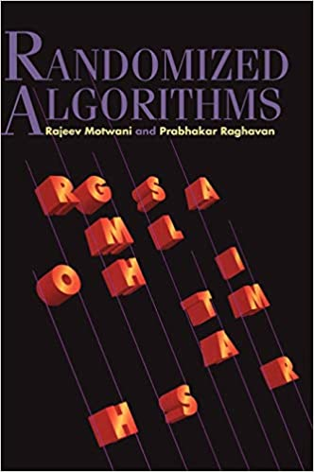
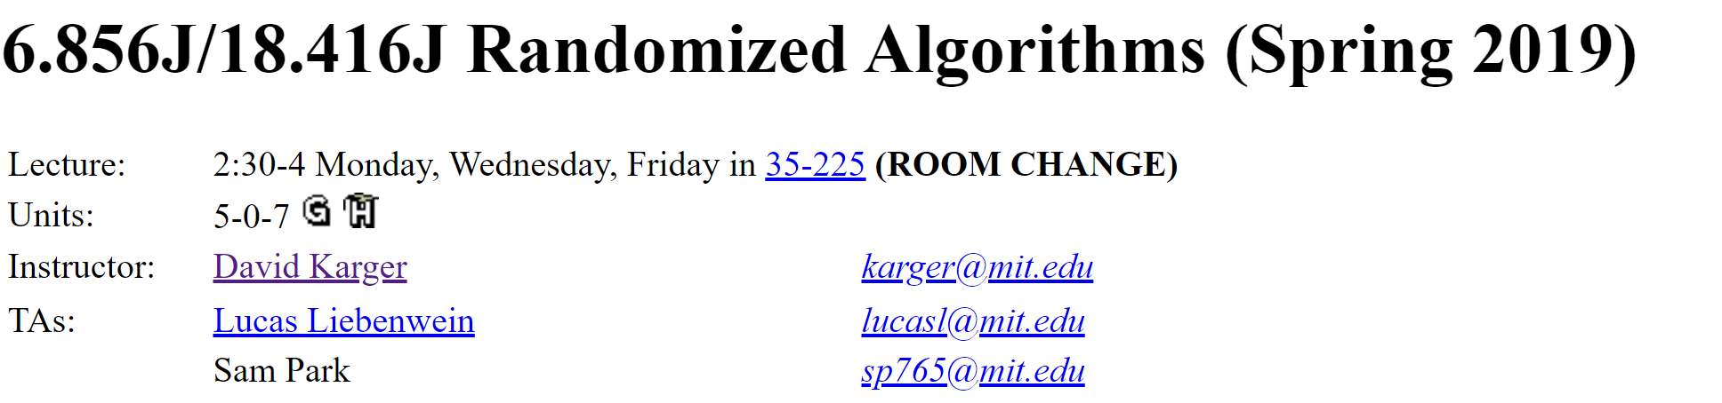
Randomized Algorithms
Algorithms making coin tosses during computation,
and are expected to be correct with high probability
Randomized Algorithms are everywhere and very useful.
Quicksort
Miller-Rabin primality test

Slide 5
Derandomization: Motivation
Derandomization
Randomized Algorithms
Deterministic Algorithms
Practical Concern
Randomized Algorithm usually require access to high-quality random bits, which could be a scarce resource.
randomized algorithms running on them do not have a correctness guarantee
In practice, randomness are usually ``generated’’ by deterministic procedure with a short seed.

Slide 6
Derandomization: Motivation
Theoretical Concern I
Theoretical Computer Science treats randomness as an important computational resource as well. Like computational time and space.
Time vs Randomness
Given two fundamental resource (time and randomness). The natural theoretical question would be to study the trade off between these two.
Notes:
Note: discuss the connection with lower bounds; also mention that in the later slides

Slide 7
Derandomization: Motivation
Theoretical Concern II
Derandomization is also closely connected to the task of proving circuit lower bounds, another fundamental problem in Theoretical Computer Science
[IW’04], [Wil’11]
Derandomization
Circuit Lower Bounds
[NW’94], [IW’99]
Notes:
Note: discuss the connection with lower bounds; also mention that in the later slides

Slide 8
Derandomization: Central Question
To what extend can we reduce randomness requirement by allowing the algorithm more running time?
BPP
all problems solvable in probabilistic polynomial time
P
all problems solvable in deterministic polynomial time
Central Question
Is BPP = P?

Slide 9
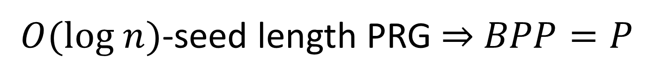
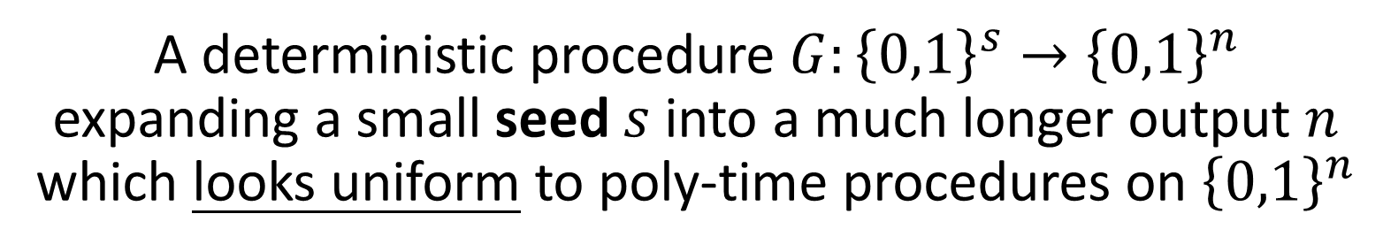
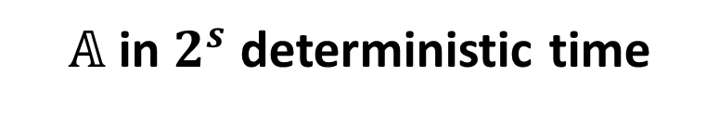
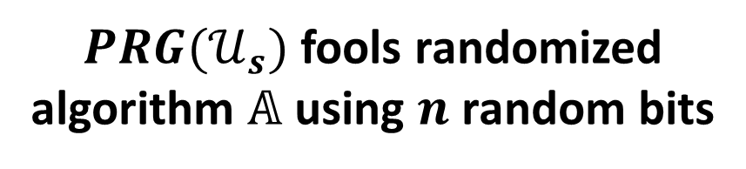
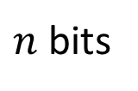
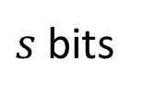
Pseudorandom Generator (PRG)
A deterministic procedure $G:{\left\{0,1\right\}}^{s}→{\left\{0,1\right\}}^{n}$ expanding a small seed $s$ into a much longer output $n$ which looks uniform to poly-time procedures on ${\left\{0,1\right\}}^{n}$
$PRG(𝒰_{s})$ fools randomized algorithm $𝔸$ using $n$ random bits
PRG
$s$ bits
$n$ bits
$𝔸$ in $2^{s}$ deterministic time
$O(log n)$-seed length PRG $⇒$ $BPP=P$

Slide 10
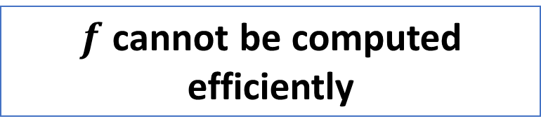
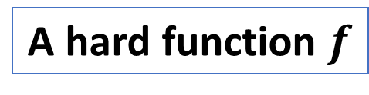
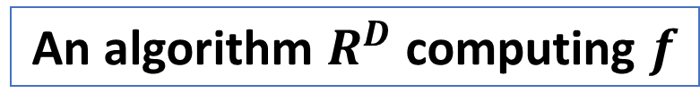
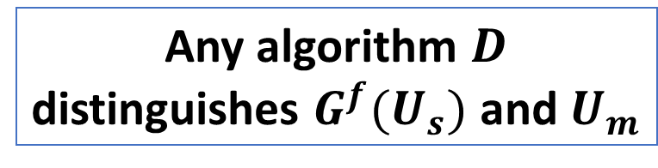
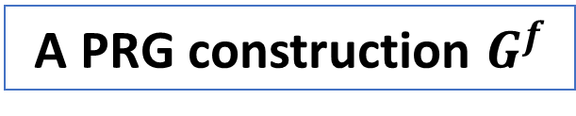
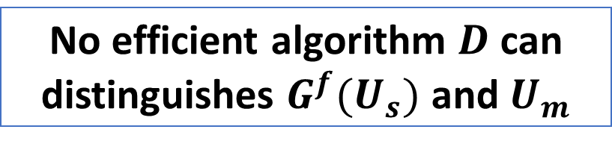
“Hardness-to-Randomness” Paradigm
Initiated and developed in classical work of [Yao82; BM84; NW94; IW99]
Randomness can be extracted from very hard functions!
A hard function $f$
A PRG construction $G^{f}$
How to show $G^{f}$ looks random to an efficient procedure?
Efficient reduction!
Any algorithm $D$ distinguishes $G^{f}(U_{s})$ and $U_{m}$
An algorithm $R^{D}$ computing $f$
Hardness
Randomness
Implies
$f$ cannot be computed efficiently
No efficient algorithm $D$ can distinguishes $G^{f}(U_{s})$ and $U_{m}$
Notes:
Explain this slowly

Slide 11
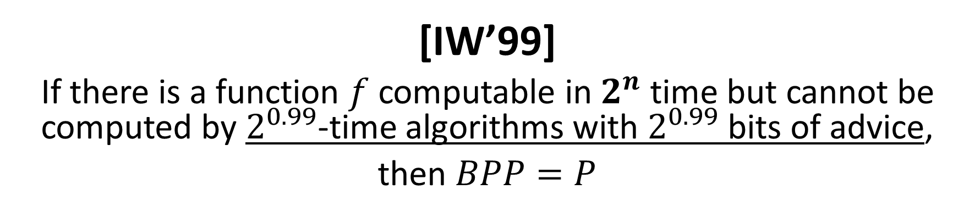
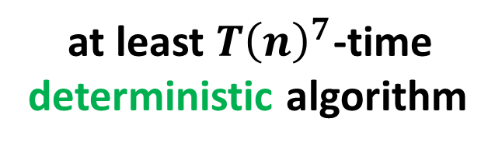

Classic Work
[IW’99]
If there is a function $f$ computable in $2^{n}$ time but cannot be computed by $2^{0.99}$-time algorithms with $2^{0.99}$ bits of advice,
then $BPP=P$
a $T(n)$-time randomized algorithm
at least $T{\left(n\right)}^{7}$-time
deterministic algorithm
Still a bit slow? Can we do faster?
Problem solved?
if we only care about polynomial time or not.
Notes:
Just state time / advice

Slide 12

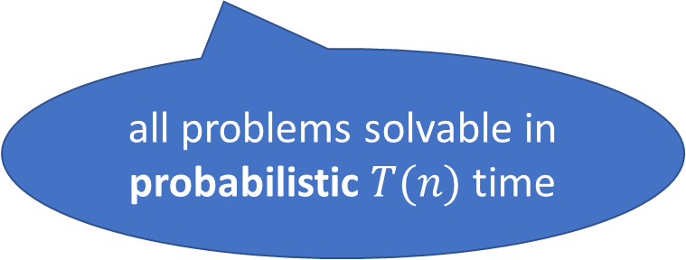
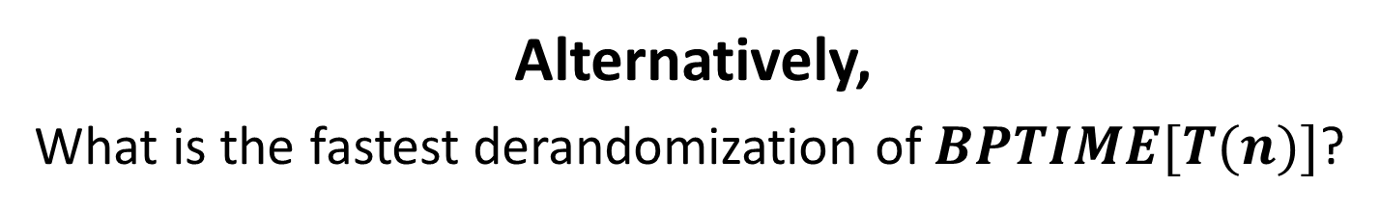


More Fine-Grained Understanding?
$$?$$
a $T(n)$-time randomized algorithm
$T(n)$-time
deterministic algorithm
Alternatively,
What is the fastest derandomization of $BPTIME[T(n)]$?
all problems solvable in probabilistic $T(n)$ time

Slide 13
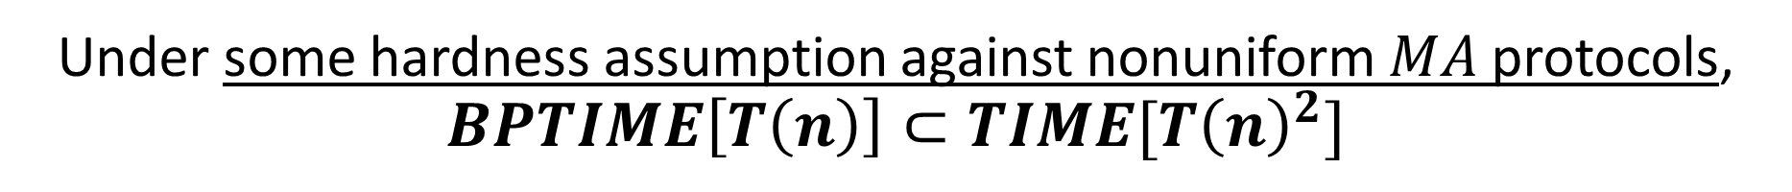
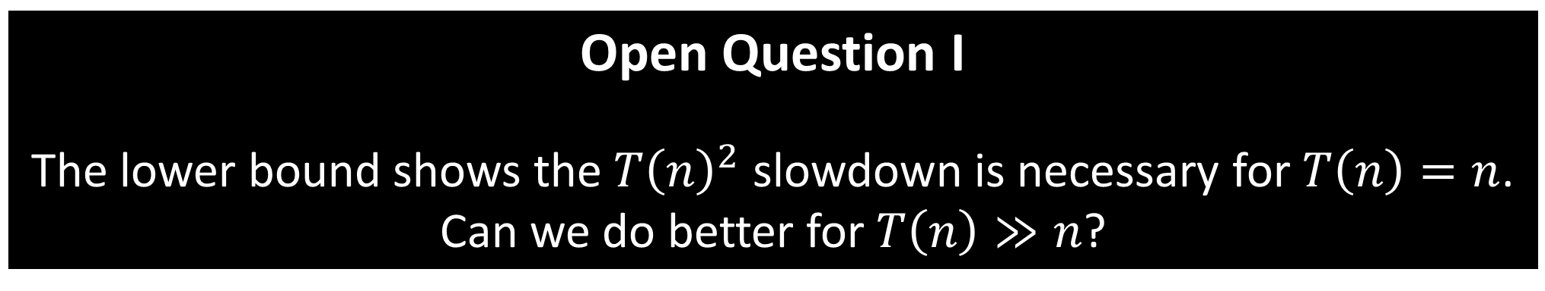
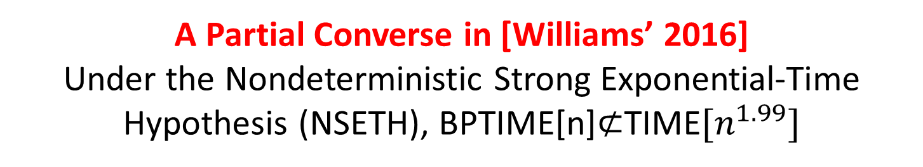
[Doron, Moshkovitz, Oh, and Zuckerman, 2020]
Under some hardness assumption against nonuniform $MA$ protocols, $BPTIME\left[T\left(n\right)\right]⊂TIME[T{\left(n\right)}^{2}]$
See next slide
Open Question I
The lower bound shows the $T{\left(n\right)}^{2}$ slowdown is necessary for $T\left(n\right)=n$.
Can we do better for $T\left(n\right)≫n$?
Derandomization with a Quadratic Slowdown
A Partial Converse in [Williams’ 2016]
Under the Nondeterministic Strong Exponential-Time Hypothesis (NSETH), BPTIME[n]$⊄$TIME$[n^{1.99}]$
See later slide
Notes:
Less focus on the assumption; instead
Why 2 is not good enough, add some discussion
Split this into two and give more discussion, make sure the lower bound

Slide 14
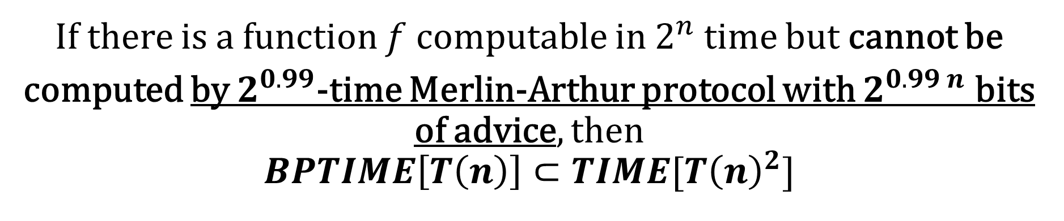
[Doron, Moshkovitz, Oh, and Zuckerman, 2020]
some hardness assumption against nonuniform $MA$ protocols
If there is a function $f$ computable in $2^{n}$ time but cannot be
computed by $2^{0.99}$-time Merlin-Arthur protocol with $2^{0.99 n}$ bits of advice, then
$$BPTIME\left[T\left(n\right)\right]⊂TIME[T{\left(n\right)}^{2}]$$
Their power is less understood
Nonstandard Assumption
Assumed hardness against
exponential-time nonuniform Merlin-Arthur protocols
Open Question II
Can we obtain similar results under standard assumptions like [IW’99]?
Notes:
Less focus on the assumption; instead
Why 2 is not good enough, add some discussion
Split this into two and give more discussion, make sure the lower bound

Slide 15
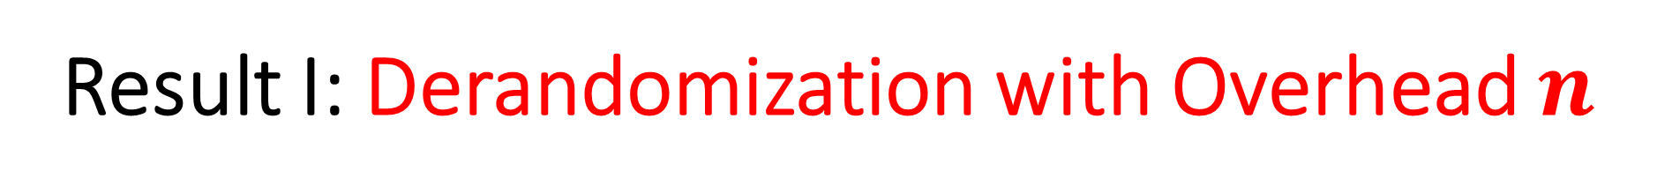
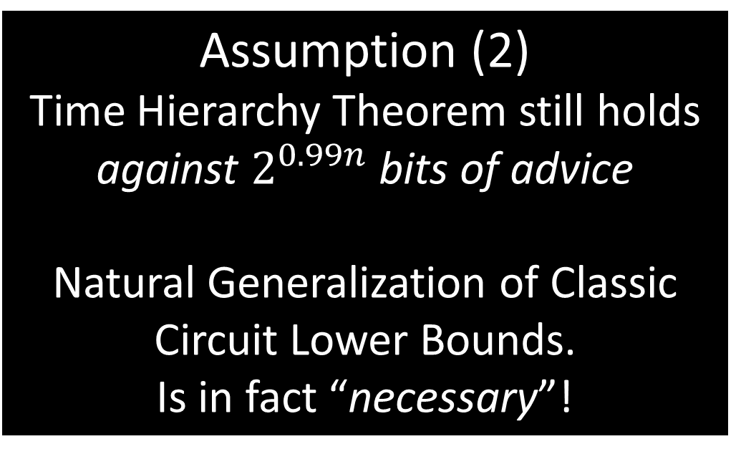

Result I: Derandomization with Overhead $n$
For every $k≥1$. If the following two assumptions hold, then $BPTIME\left[n^{k}\right]⊂TIME[n^{k+1}]$
Assumption (1) One-Way Functions Exist
The Standard and Minimum Assumption
in Cryptography
Assumption (2) Time Hierarchy Theorem still holds against $2^{0.99n}$ bits of advice
Natural Generalization of Classic Circuit Lower Bounds.
Is in fact “necessary”!
Against poly-size circuits

Slide 16




Result I: Derandomization with Overhead $n$
For every $k≥1$. If the following two assumptions holds, then $BPTIME\left[n^{k}\right]⊂TIME[n^{k+1}]$
Assumption (2) Time Hierarchy Theorem still holds against $2^{0.99n}$ bits of advice
Assumption (1) One-Way Functions Exist
Time Hierarchy Theorem
There is a function $f$ computable in $2^{kn}$ time but cannot be computed by $2^{\left(k−0.01\right)n}$-time algorithms.
Our Assumption (2)
There is a function $f$ computable in $2^{kn}$ time but cannot be computed by $2^{\left(k−0.01\right)n}$-time algorithms with $2^{0.99n}$ bits of advice.

Slide 17
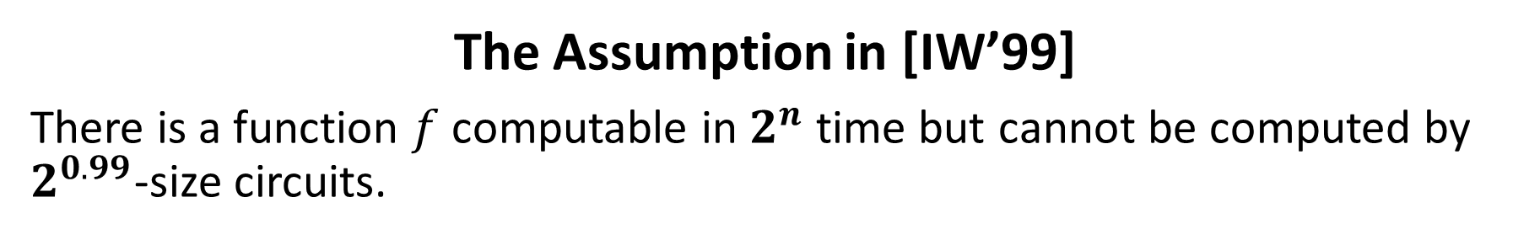
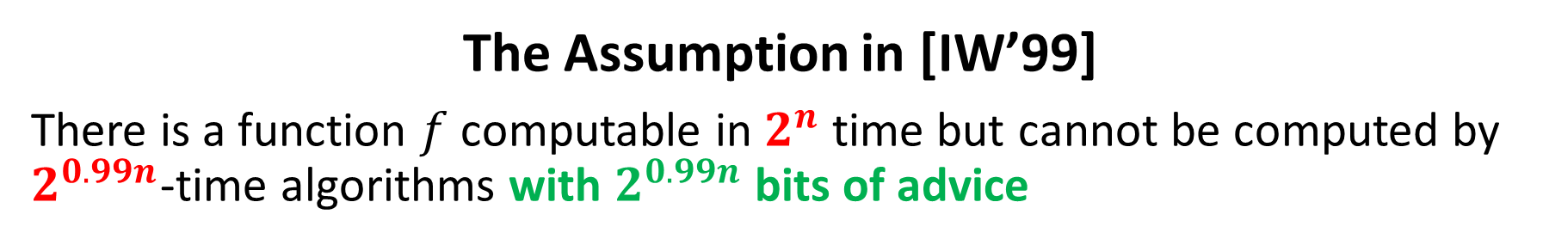

Result I: Derandomization with Overhead $n$
Compare with the Assumption in [IW’99]
The Assumption in [IW’99]
There is a function $f$ computable in $2^{n}$ time but cannot be computed by $2^{0.99n}$-time algorithms with $2^{0.99n}$ bits of advice
The Assumption in [IW’99]
There is a function $f$ computable in $2^{n}$ time but cannot be computed by $2^{0.99}$-size circuits.
The Common Philosophy
Nonuniform advice cannot significantly speed up generic computation
Our Assumption (2)
There is a function $f$ computable in $2^{kn}$ time but cannot be computed by $2^{\left(k−0.01\right)n}$-time algorithms with $2^{0.99n}$ bits of advice.

Slide 18

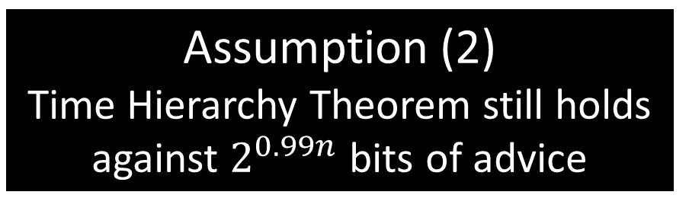
Assumption (2) is Necessary for PRGs
PRG Approach to Derandomization with Overhead $n$
Needs a $log n$-seed length PRG against $n^{k}$-time algorithms
unconditional
Equivalent?
under OWFs
Assumption (2) Time Hierarchy Theorem still holds against $2^{0.99n}$ bits of advice
Notes:
Under OWFs, it’s equivalent

Slide 19
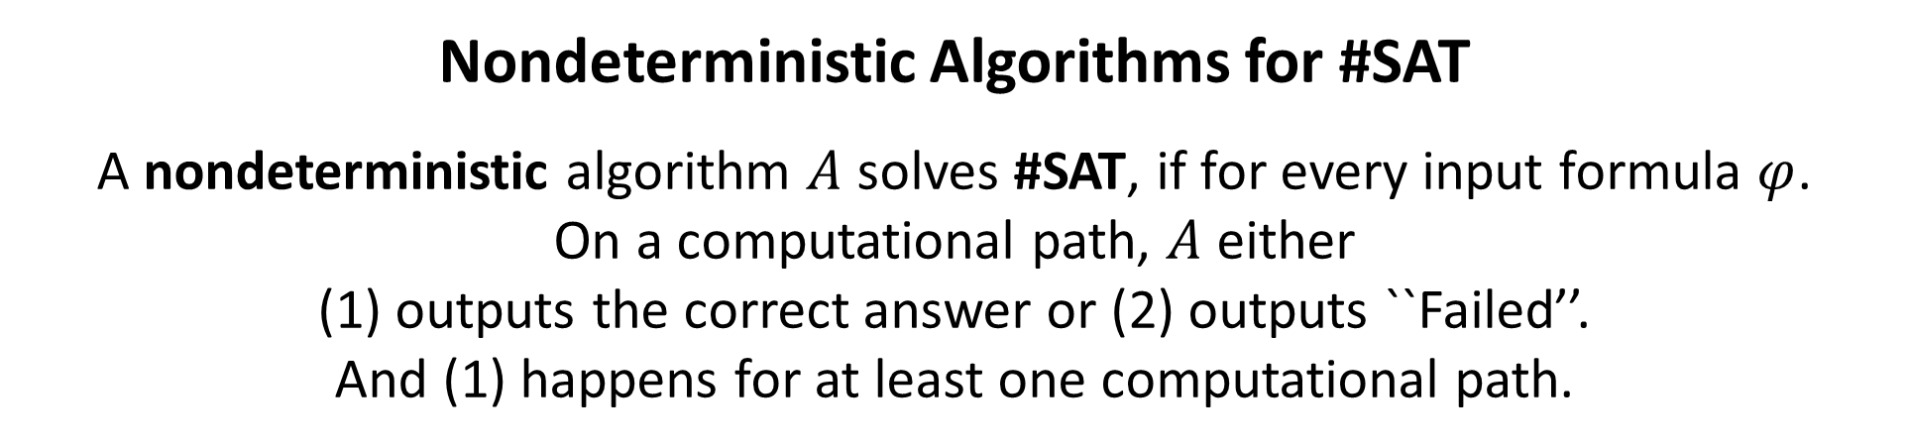
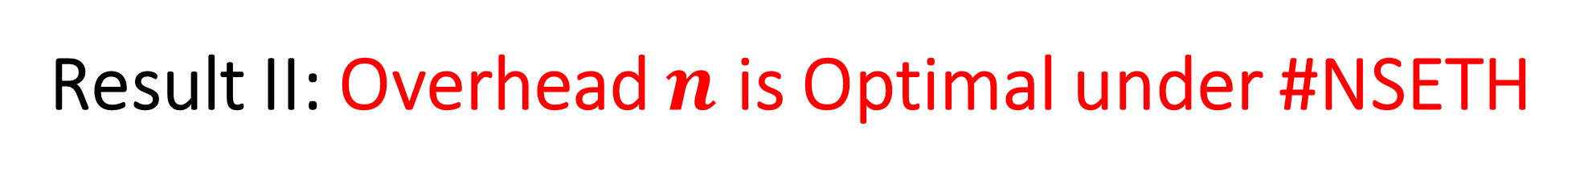

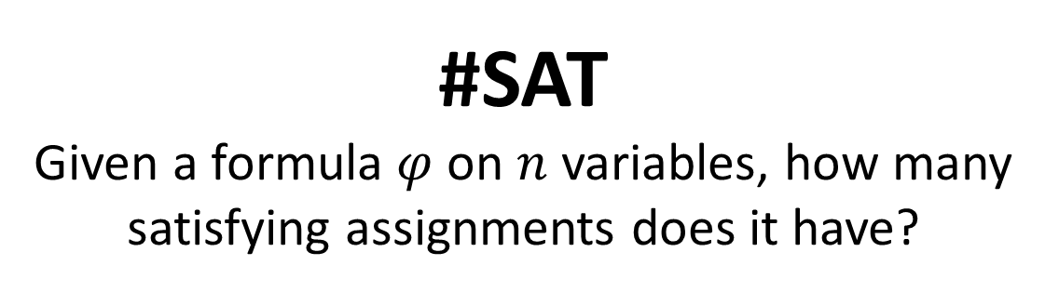
Result II: Overhead $n$ is Optimal under #NSETH
#SAT
Given a formula $φ$ on $n$ variables, how many satisfying assignments does it have?
What is #NSETH?
#NSETH
No $2^{0.99}$-time nondeterministic algorithm can solve $\#SAT$.
Nondeterministic Algorithms for #SAT
A nondeterministic algorithm $A$ solves #SAT, if for every input formula $φ$.
On a computational path, $A$ either (1) outputs the correct answer or (2) outputs ``Failed’’.
And (1) happens for at least one computational path.

Slide 20
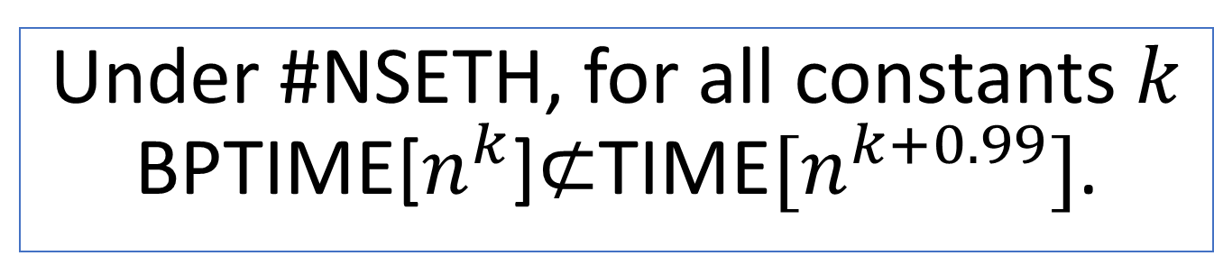
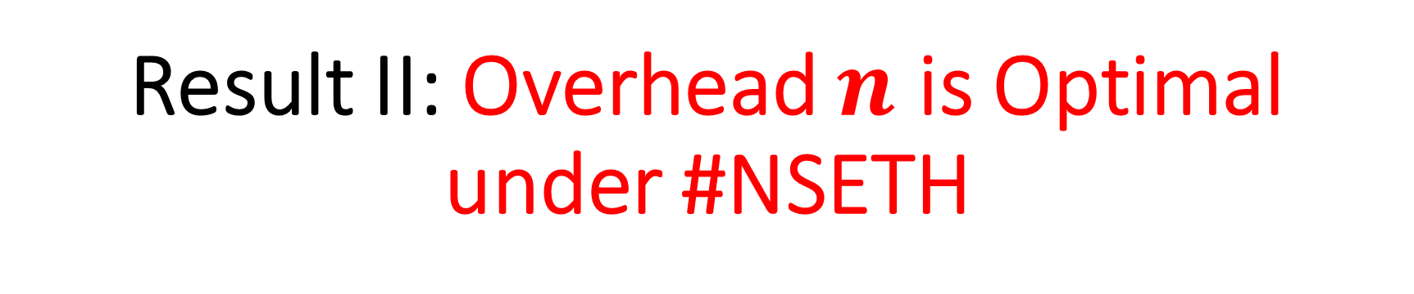

Result II: Overhead $n$ is Optimal under #NSETH
#NSETH
No $2^{0.99}$-time nondeterministic algorithm can solve $\#SAT$.
Under #NSETH, for all constants $k$ BPTIME[$n^{k}$]$⊄$TIME$[n^{k+0.99}]$.

Slide 21
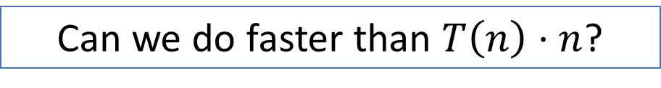
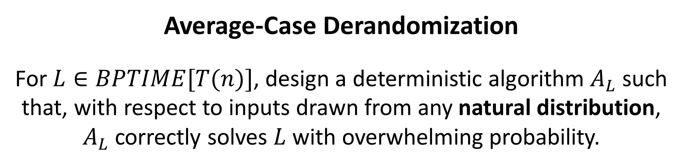

Result III: Better Derandomization for Average-Case
Can we do faster than $T\left(n\right)⋅n$?
Under similar assumptions as in our first result.
For every $L∈BPTIME[T(n)]$, there exists a deterministic algorithm $A_{L}$ running in time $T\left(n\right)⋅n^{0.01}$, such that for every $T(n)$-time sampleable distribution $𝒮$,
$\underset{x∼𝓢}{Pr}\left[A_{L}\left(x\right)≠L\left(x\right)\right]≤n^{−ω(1)}$.
Average-Case Derandomization
For $L∈BPTIME[T(n)]$, design a deterministic algorithm $A_{L}$ such that, with respect to inputs drawn from any natural distribution, $A_{L}$ correctly solves $L$ with overwhelming probability.

Slide 22
Today’s Plan
Part I (Introduction)
Previous results on Derandomization, the PRG approach
The work of [DMOZ’ 2020]
Our Results
Part II (Taste of Techniques)
Lower Bound
Optimal Derandomization

Slide 23
Result II: Overhead $n$ is Optimal under #NSETH
#NSETH
No $2^{0.99}$-time nondeterministic algorithm can solve $\#SAT$.
Under #NSETH, for all constants $k$ BPTIME[$n^{k}$]$⊄$TIME$[n^{k+0.99}]$.

Slide 24
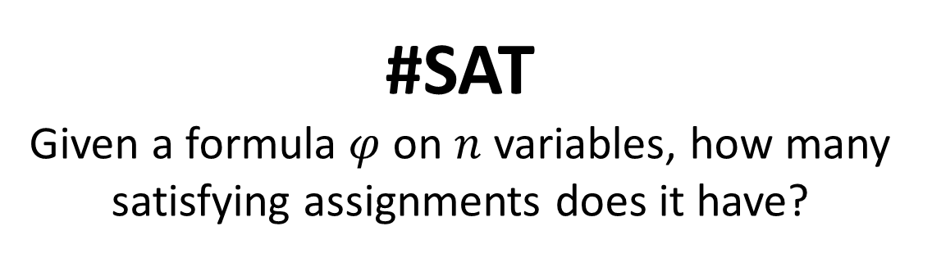
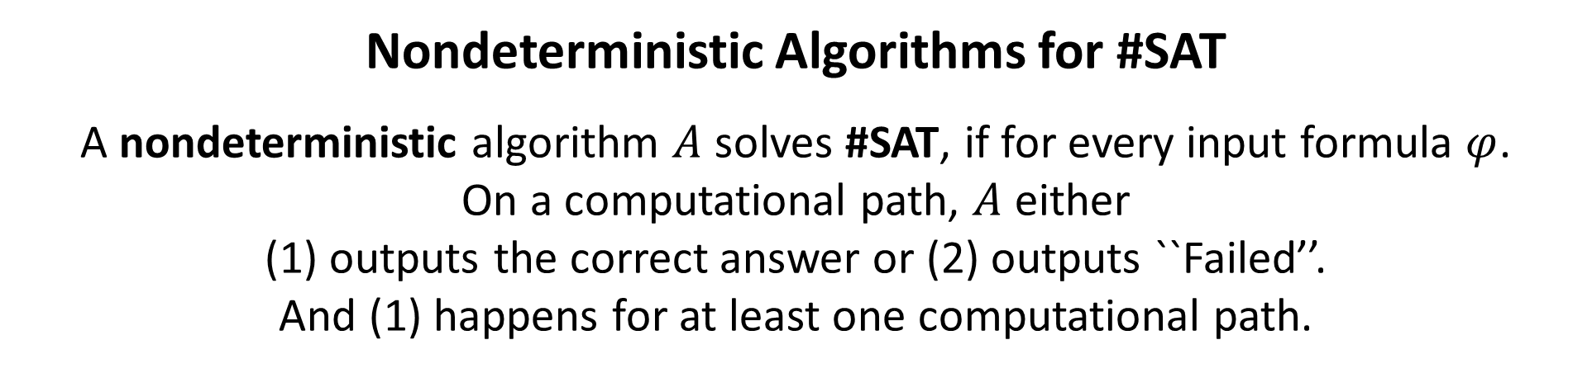
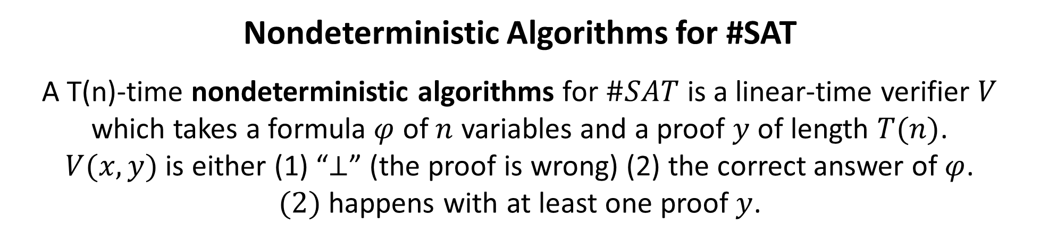
Proof System View of Nondeterministic Algorithms
#SAT
Given a formula $φ$ on $n$ variables, how many satisfying assignments does it have?
Nondeterministic Algorithms for #SAT
A nondeterministic algorithm $A$ solves #SAT, if for every input formula $φ$.
On a computational path, $A$ either (1) outputs the correct answer or (2) outputs ``Failed’’.
And (1) happens for at least one computational path.
Nondeterministic Algorithms for #SAT
A T(n)-time nondeterministic algorithms for $\#SAT$ is a linear-time verifier $V$ which takes a formula $φ$ of $n$ variables and a proof $y$ of length $T(n)$.
$V(x,y)$ is either (1) “$⊥$” (the proof is wrong) (2) the correct answer of $φ$.
$(2)$ happens with at least one proof $y$.

Slide 25
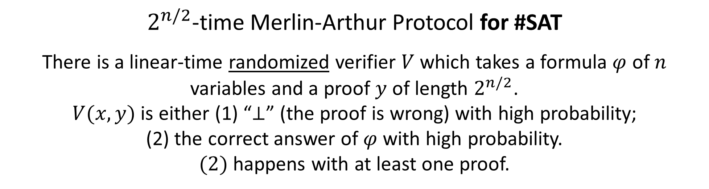
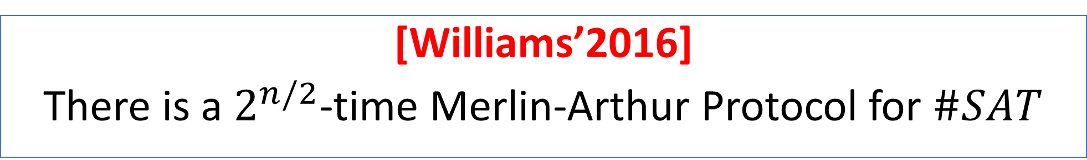
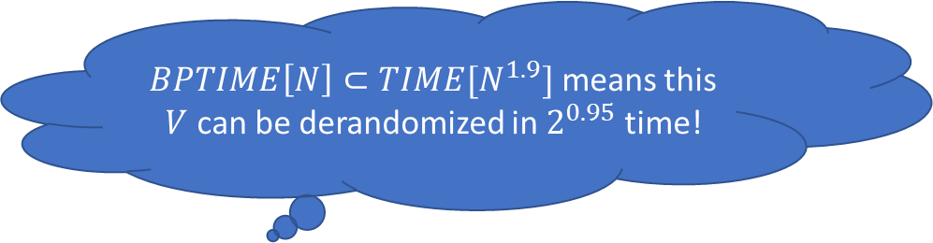
Proof Idea
[Williams’2016]
There is a $2^{n/2}$-time Merlin-Arthur Protocol for $\#SAT$
$BPTIME\left[N\right]⊂TIME[N^{1.9}]$ means this $V$ can be derandomized in $2^{0.95}$ time!
$2^{n/2}$-time Merlin-Arthur Protocol for #SAT
There is a linear-time randomized verifier $V$ which takes a formula $φ$ of $n$ variables and a proof $y$ of length $2^{n/2}$.
$V(x,y)$ is either (1) “$⊥$” (the proof is wrong) with high probability;
(2) the correct answer of $φ$ with high probability.
$(2)$ happens with at least one proof.

Slide 26
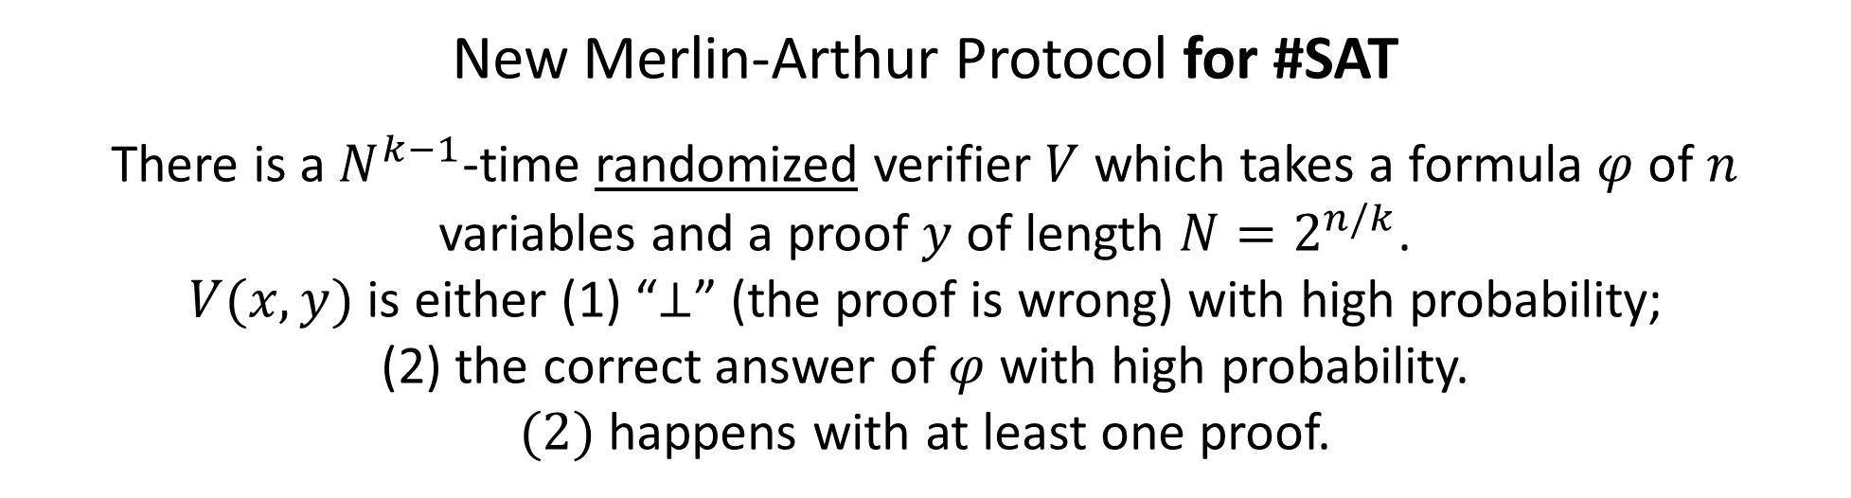
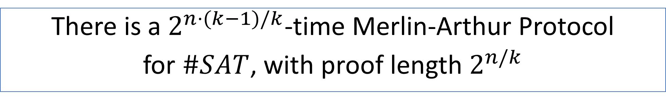
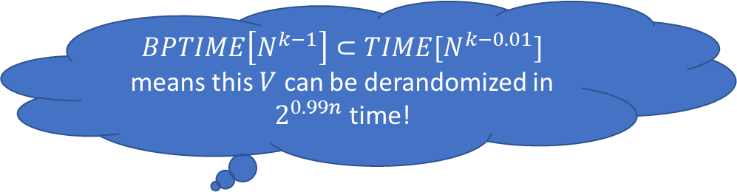
Improvement
There is a $2^{n⋅(k−1)/k}$-time Merlin-Arthur Protocol
for $\#SAT$, with proof length $2^{n/k}$
$BPTIME\left[N^{k−1}\right]⊂TIME[N^{k−0.01}]$ means this $V$ can be derandomized in $2^{0.99n}$ time!
New Merlin-Arthur Protocol for #SAT
There is a $N^{k−1}$-time randomized verifier $V$ which takes a formula $φ$ of $n$ variables and a proof $y$ of length ${N=2}^{n/k}$.
$V(x,y)$ is either (1) “$⊥$” (the proof is wrong) with high probability;
(2) the correct answer of $φ$ with high probability.
$(2)$ happens with at least one proof.

Slide 27
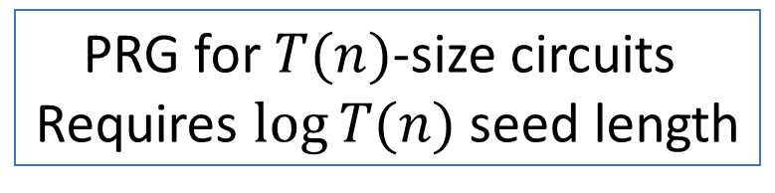
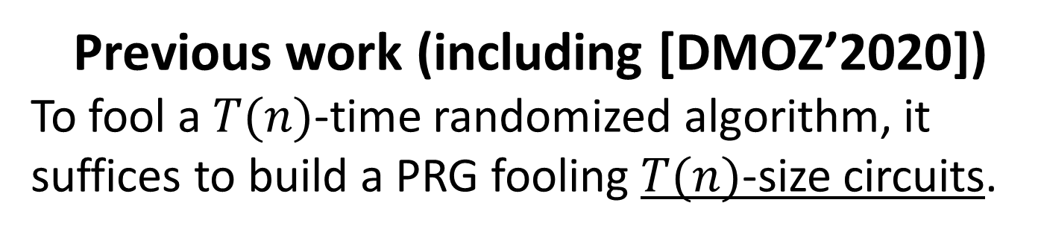
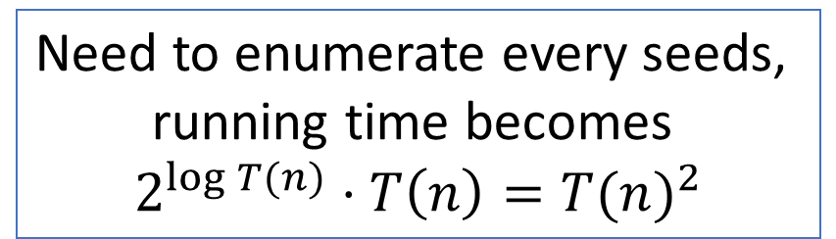
Bottleneck of the PRG Approach: Seed Length
Previous work (including [DMOZ’2020])
To fool a $T(n)$-time randomized algorithm, it suffices to build a PRG fooling $T(n)$-size circuits.
Need to enumerate every seeds,
running time becomes
$$2^{\log{T(n)}}⋅T\left(n\right)={T(n)}^{2}$$
PRG for $T(n)$-size circuits
Requires $\log{T(n)}$ seed length
How do we get faster-than-quadratic derandomization?
We need a PRG with seed length $log n$ instead of$log T(n)$

Slide 28
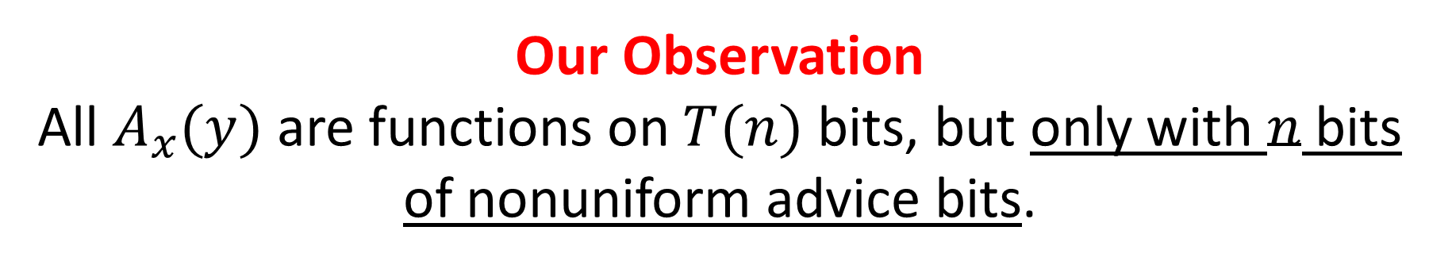
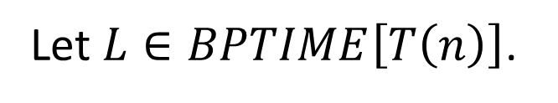
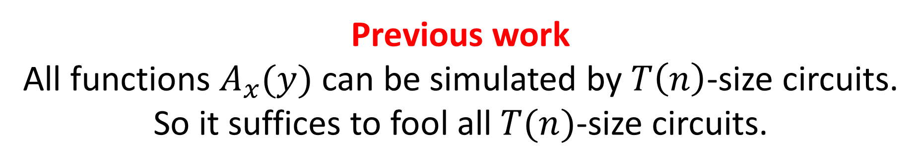



A Closer Look at the PRG Approach
There is a linear-time algorithm $A(x,y)$ such that $x∈{\left\{0,1\right\}}^{n}$, $y∈{\left\{0,1\right\}}^{T(n)}$.
Let $L∈BPTIME\left[T\left(n\right)\right]$.
$$x∈L⇒\underset{y}{Pr}\left[A\left(x,y\right)=1\right]≥2/3$$
$$x∈L⇒\underset{y}{Pr}\left[A\left(x,y\right)=1\right]≤1/3$$
Let $A_{x}\left(y\right)≔A(x,y)$.
We need a PRG to fool all the functions $A_{x}(y)$
Previous work
All functions $A_{x}(y)$ can be simulated by $T\left(n\right)$-size circuits.
So it suffices to fool all $T(n)$-size circuits.
Our Observation
All $A_{x}(y)$ are functions on $T(n)$ bits, but only with $n$ bits of nonuniform advice bits.

Slide 29



Optimal Derandomization: A More Sophisticated PRG Approach
Let $A_{x}\left(y\right)≔A(x,y)$.
We need a PRG to fool all functions $A_{x}(y)$
Our Observation
All $A_{x}(y)$ are linear-time functions on $T(n)$ bits, but only with $n$ bits of nonuniform advice bits.
That is, it suffices to construct a PRG to fool linear-time function on $N=T(n)$ bits, with $T^{−1}\left(N\right)=n$ bits of advice
Notes:
The seed length correspond to advice!!
Forget about TIME[N]_{T^{-1}(n)}

Slide 30


Our Results in More Detail
For every $k≥1$. If the following assumptions hold, then there is a $\frac{1}{k}⋅log{N}$ seed length PRG $G$ fooling linear-time functions with $N^{1/k}$ bits of advice
Assumption (2) There is a function $f$ computable in $2^{kn}$ time but cannot be computed by $2^{\left(k−0.01\right)n}$-time algorithms with $2^{0.99n}$ bits of advice.
Assumption (1) One-Way Functions Exist
Notes:
Explain more here

Slide 31







Bottleneck of the PRG Approach: Reduction Overhead
a $T(n)$-time randomized algorithm
at least $T{\left(n\right)}^{7}$-time
deterministic algorithm
Why such a big blowup?
A hard function $f$
A PRG construction $G^{f}$
Issue
Hardness against $T^{c}$-time algorithms only translates to pseudo randomness against $T$-time algorithms
To fool $T$-time algo, $f$ needs at least $T^{c}$ time, so $G^{f}$ also takes $T^{c}$ time!
How to show $G^{f}$ looks random to a uniform procedure?
Efficient Reduction
Any T-time algorithm $D$ distinguishes $G^{f}(U_{s})$ and $U_{m}$
An algorithm $R^{D}$ computing $f$
in $T^{c}$ time
Implies
$f$ cannot be computed efficiently in $T^{c}$ time
No efficient $T$-algorithm $D$ can distinguishes $G^{f}(U_{s})$ and $U_{m}$

Slide 32






Key Ingredient Super Efficient Reduction Assuming OWFs
A hard function $f$
A PRG construction $G^{f}$
Improvement
Hardness against $T$-time algorithms translates to pseudo randomness against T-time algorithms with no loss
How to show $G^{f}$ looks random to a uniform procedure?
Efficient Reduction
Any T-time algorithm $D$ distinguishes $G^{f}(U_{s})$ and $U_{m}$
An algorithm $R^{D}$ computing $f$
in $T$ time
Implies
$f$ cannot be computed efficiently in $T$ time
No efficient $T$-algorithm $D$ can distinguishes $G^{f}(U_{s})$ and $U_{m}$

Slide 33

Conclusion
We proved that under hardness assumption against deterministic computation with advice,
$BPTIME\left[T\left(n\right)\right]⊂TIME[n⋅T(n)]$
The $n$ overhead is optimal under $\#NSETH$.
For average-case derandomization, nearly $T(n)$-time derandomization is possible.

Slide 34
Thanks you! Any Questions?

