Slide 1
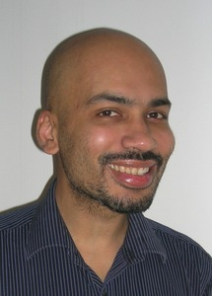
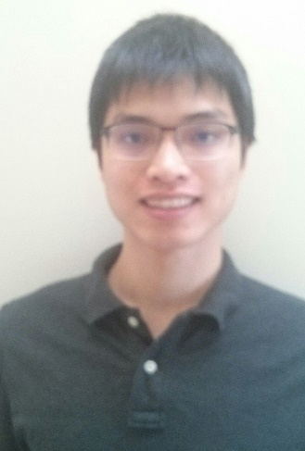
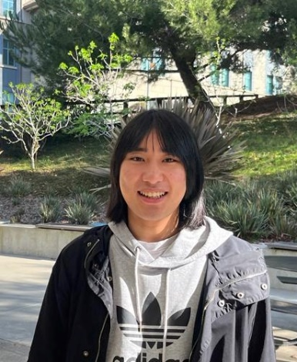
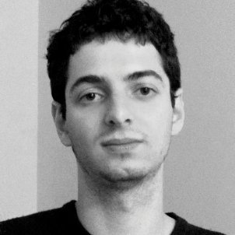
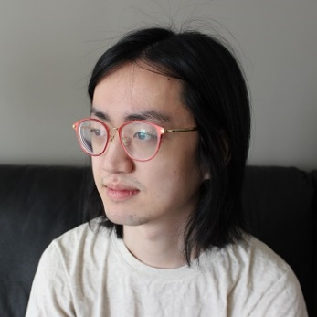
Polynomial-time Pseudodeterministic Construction of Primes
Lijie Chen
UC Berkeley
Zhenjian Lu
University of Oxford
Igor C. Oliveira
University of Warwick
Hanlin Ren
University of Oxford
Rahul Santhanam
University of Oxford

Slide 2

Today’s Plan
Our Result:
Motivation
Construction of Primes, and all easy and dense P-property
Proof Overview
Review of the previous approach
A ``${win}^{log n}$’’ approach

Slide 3
Today’s Plan
Our Result:
Motivation
Construction of Primes, and all easy and dense P-property
Proof Overview
Review of the previous approach
A ``${win}^{log n}$’’ approach

Slide 4
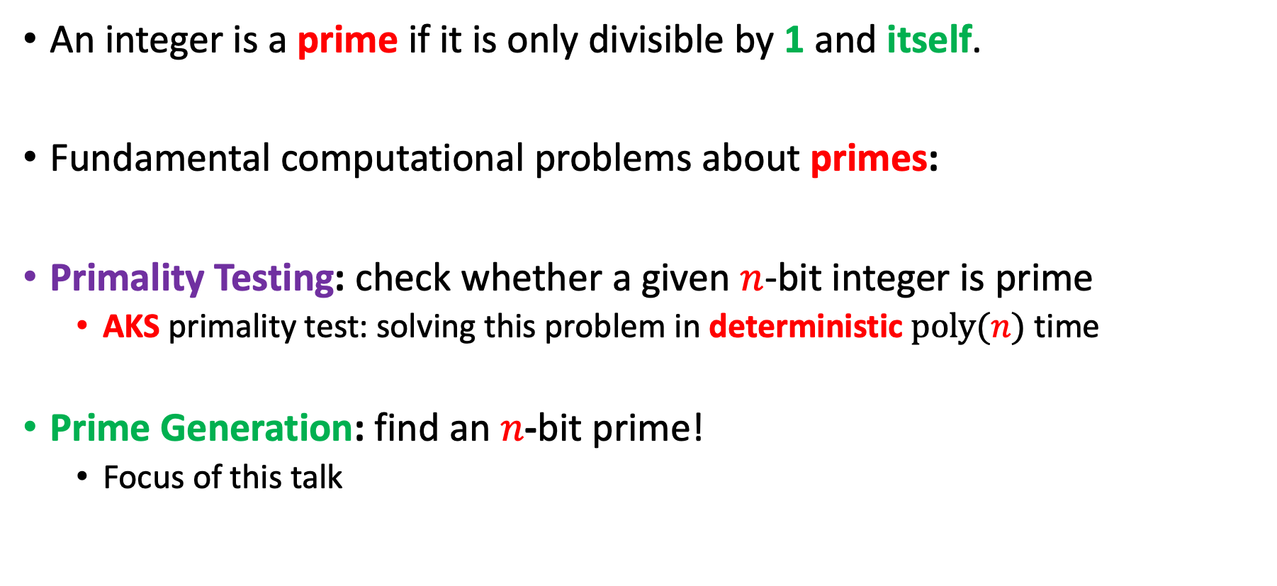
Primes
An integer is a prime if it is only divisible by 1 and itself.
Fundamental computational problems about primes:
Primality Testing: check whether a given $n$-bit integer is prime
AKS primality test: solving this problem in deterministic $poly(n)$ time
Prime Generation: find an $n$-bit prime!
Focus of this talk

Slide 5
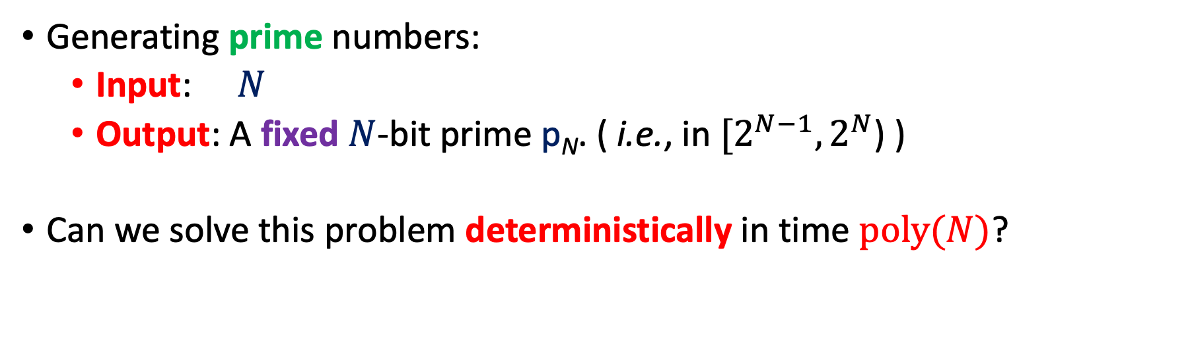
Motivational Problem
Generating prime numbers:
Input: $N$
Output: A fixed $N$-bit prime p_{N}. ( i.e., in $[2^{N−1},2^{N}$) )
Can we solve this problem deterministically in time $poly(N)$?

Slide 6
A Simple Algorithm
Enumerate N-bit integers in sequence, testing each one for primality using the AKS Algorithm.
Strong number-theoretic conjectures (Cramér’s conjecture) imply this algorithm halts in poly(N) time, but they seem beyond the power of current techniques.
Best provable guarantee on running time for this algorithm is
2^{0.525 N}, due to [BHP2001].

Slide 7
Attempts at Improvements
Best known algorithm is due to [LO87].
It proceeds via approximate computation of the zeta function and has running time guarantee 2^{N/2+o(N)}.
The Polymath 4 Project (2009) attempted to improve the state of the art but succeeded only in giving conditional improvements [TCH12].

Slide 8
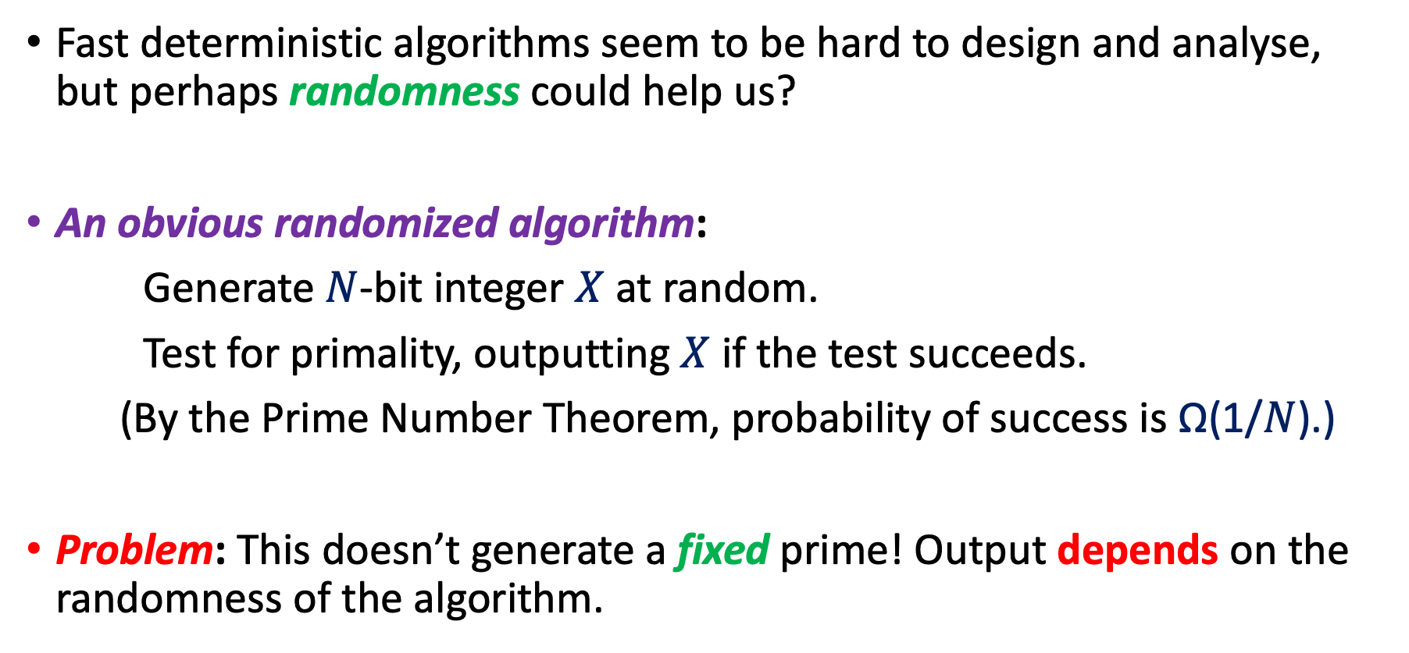
A Relaxed Requirement
Fast deterministic algorithms seem to be hard to design and analyse, but perhaps randomness could help us?
An obvious randomized algorithm:
Generate $N$-bit integer $X$ at random.
Test for primality, outputting $X$ if the test succeeds.
(By the Prime Number Theorem, probability of success is Ω(1/$N$).)
Problem: This doesn’t generate a fixed prime! Output depends on the randomness of the algorithm.

Slide 9
It is not so clear how to obtain a fast deterministic algorithm.
On the other hand, randomized generation is easy, but does not produce a fixed prime number.
Is there an intermediate notion that could perhaps be useful?

Slide 10
Deterministic, Randomized
Fix a property Q, such as Primes.
Given N (in unary),
Find an element/string y_{N} in Q such that |y_{N}| = N.
1^{N}
1^{N}
Computation paths of the Algorithm
y_{N} = f(1^{N})
y¹
y²
y³
y¹
y⁴
⊥
⊥
…
Deterministic
(output in Q)
Randomized
(w.h.p., output in Q)

Slide 11
Pseudodeterministic
Pseudodeterministic Algorithm:
A canonical solution is outputed with high probability.
1^{N}
1^{N}
1^{N}
y²
⊥
f(1^{N})
…
y_{N} = f(1^{N})
f(1^{N})
⊥
f(1^{N})
f(1^{N})
y¹
y²
y³
y¹
y⁴
⊥
⊥
…
Deterministic
(output in Q)
Pseudodeterministic
(w.h.p., fixed output in Q)
Randomized
(w.h.p., output in Q)

Slide 12
Pseudodeterministic Algorithms
By standard amplification, we can assume the canonical solution is outputed with probability at least 1 – exp(-N).
Viewed as a black-box, the output of the algorithm is deterministic to any computationally bounded observer.

Slide 13
Literature on pseudodeterminism
Pseudodeterminism was first defined and studied in:
Eran Gat and Shafi Goldwasser [GG11]:
“Probabilistic search algorithms with unique answers and their cryptographic applications”.
Further investigated in [GGR13], [GG15], [Gro15], [GGH17], [OS17].
Some of these works developed algorithms for specific problems such as finding a bipartite matching (in parallel), a non-zero of a polynomial, etc.
TODO: add more

Slide 14
Questions
Gat-Goldwasser (2011):
Is there an efficient pseudodeterministic algorithm
for generating prime numbers?
More generally,
Is it the case that the generation problem
for every dense and easy property Q can be solved pseudodeterministically in polynomial time?

Slide 15
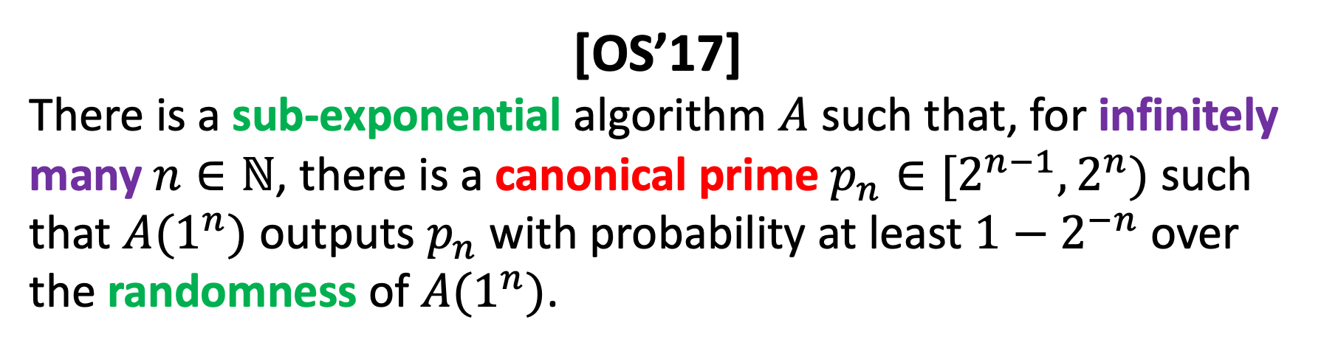
Previous work
[OS’17]
There is a sub-exponential algorithm $A$ such that, for infinitely many $n∈ℕ$, there is a canonical prime $p_{n}∈[2^{n−1},2^{n})$ such that $A(1^{n})$ outputs $p_{n}$ with probability at least $1−2^{−n}$ over the randomness of $A(1^{n})$.

Slide 16
Today’s Plan
Our Result:
Motivation
Construction of Primes, and all easy and dense P-property
Proof Overview
Review of the previous approach
A ``${win}^{log n}$’’ approach

Slide 17
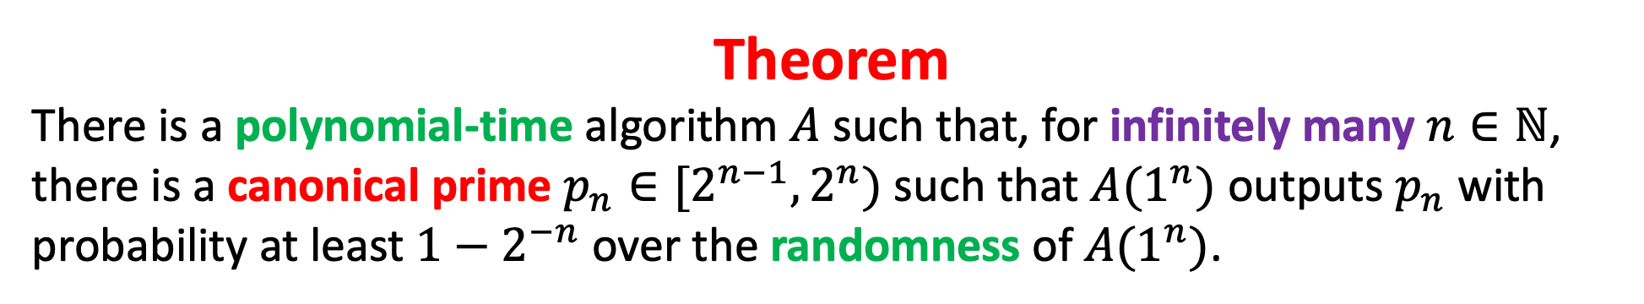
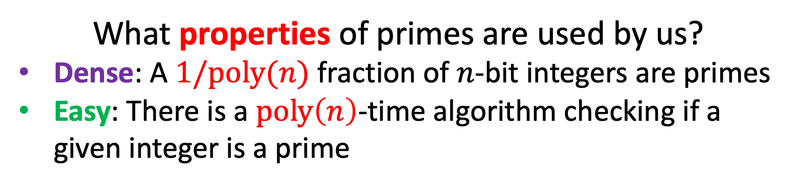
Our Result: Pseudodeterministic Construction of infinitely many primes
Theorem
There is a polynomial-time algorithm $A$ such that, for infinitely many $n∈ℕ$, there is a canonical prime $p_{n}∈[2^{n−1},2^{n})$ such that $A(1^{n})$ outputs $p_{n}$ with probability at least $1−2^{−n}$ over the randomness of $A(1^{n})$.
What properties of primes are used by us?
Dense: A $1/poly(n)$ fraction of $n$-bit integers are primes
Easy: There is a $poly\left(n\right)$-time algorithm checking if a given integer is a prime

Slide 18
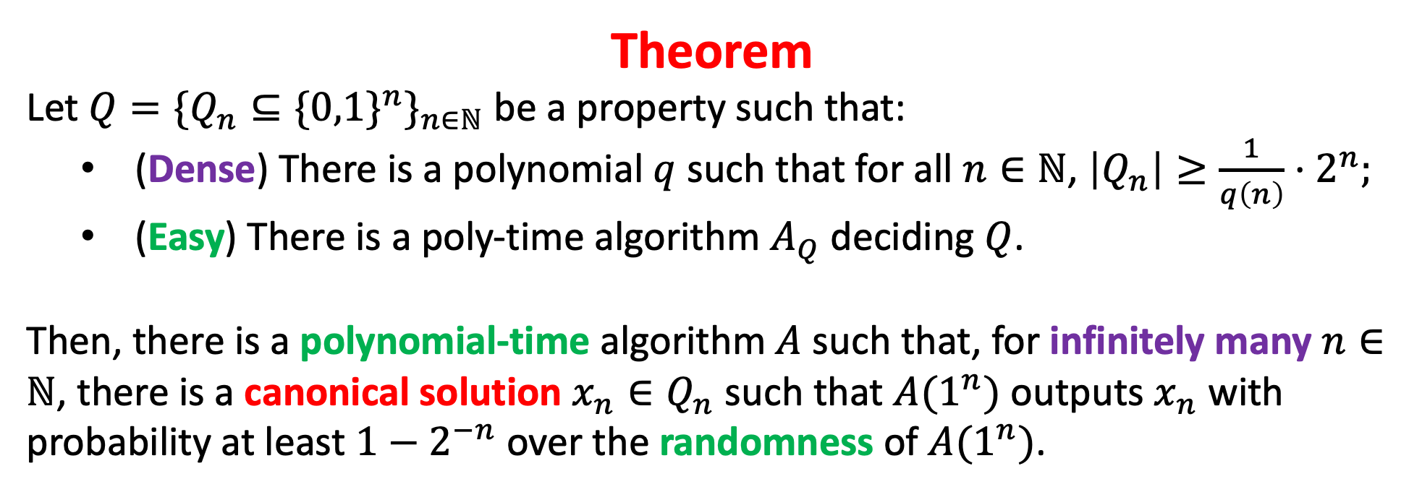
Our Result: Pseudodeterministic Construction of dense and easy properties
Theorem
Let $Q=\{Q_{n}⊆\{0,1{\}^{n}\}}_{n∈ℕ}$ be a property such that:
(Dense) There is a polynomial $q$ such that for all $n∈ℕ$, $\left|Q_{n}\right|≥{\frac{1}{q\left(n\right)}⋅2}^{n};$
(Easy) There is a poly-time algorithm $A_{Q}$ deciding $Q$.
Then, there is a polynomial-time algorithm $A$ such that, for infinitely many $n∈ℕ$, there is a canonical solution $x_{n}∈Q_{n}$ such that $A(1^{n})$ outputs $x_{n}$ with probability at least $1−2^{−n}$ over the randomness of $A(1^{n})$.
[OS’17] also works for all easy and dense properties

Slide 19
Today’s Plan
Our Result:
Motivation
Construction of Primes, and all easy and dense P-property
Proof Overview
Review of the previous approach
A ``${win}^{log n}$’’ approach

Slide 20

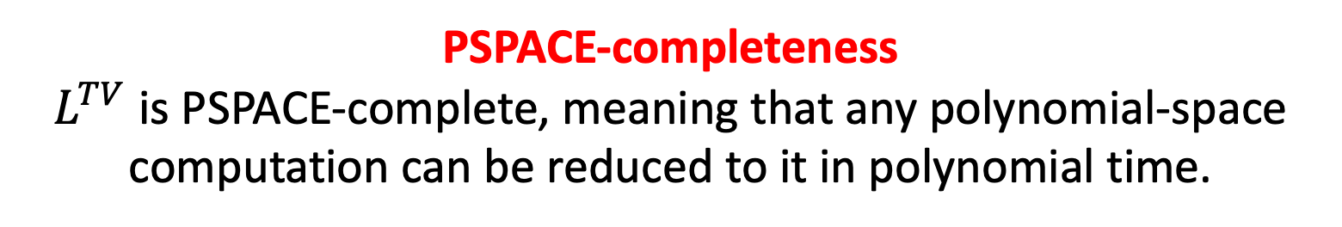
Review of the previous approach [OS’17]
A win-win argument from Hardness vs. Randomness (Our presentation is somewhat different from the original paper)
Uniform Hardness vs. Randomness via Reconstruction [IW’01], [TV’07], [CRTY’20]
There is a language $L^{TV}$ such that
PSPACE-completeness
$L^{TV}$ is PSPACE-complete, meaning that any polynomial-space computation can be reduced to it in polynomial time.

Slide 21
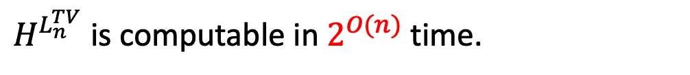

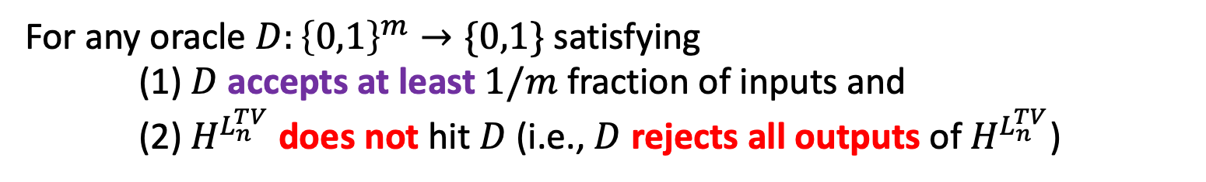
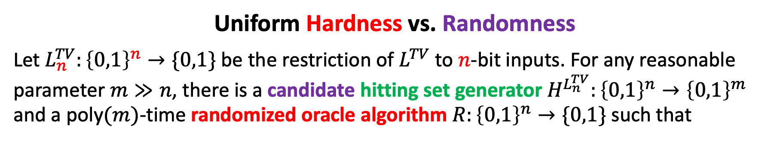
Review of the previous approach [OS’17]
There is a PSPACE-complete language $L^{TV}$ such that
Uniform Hardness vs. Randomness
Let $L_{n}^{TV}:{\left\{0,1\right\}}^{n}→\{0,1\}$ be the restriction of $L^{TV}$ to $n$-bit inputs. For any reasonable parameter $m≫n$, there is a candidate hitting set generator $H^{L_{n}^{TV}}:{\left\{0,1\right\}}^{n}→{\left\{0,1\right\}}^{m}$ and a poly$(m)$-time randomized oracle algorithm $R:{\left\{0,1\right\}}^{n}→\{0,1\}$ such that
$H^{L_{n}^{TV}}$ is computable in $2^{O(n)}$ time.
For any oracle $D:{\left\{0,1\right\}}^{m}→\{0,1\}$ satisfying (1) $D$ accepts at least $1/m$ fraction of inputs and (2) $H^{L_{n}^{TV}}$ does not hit $D$ (i.e., $D$ rejects all outputs of $H^{L_{n}^{TV}}$)
We have that $R^{D}$ computes $L_{n}^{TV}$

Slide 22
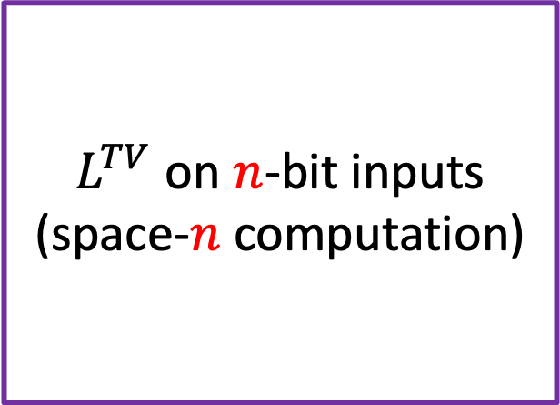
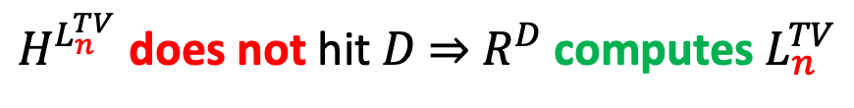
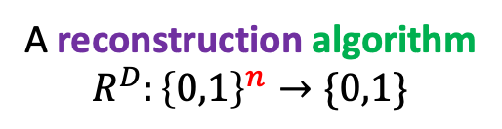
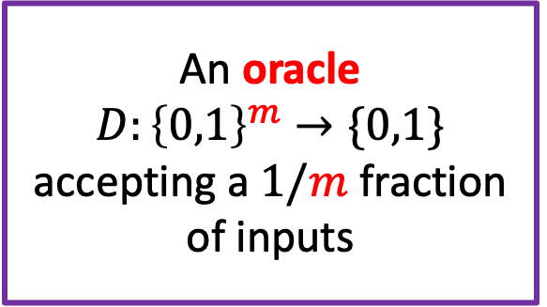
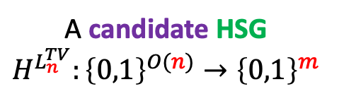
Review of the previous approach [OS’17]
$L^{TV}$ on $n$-bit inputs
(space-$n$ computation)
A candidate HSG
$$H^{L_{n}^{TV}}:{\left\{0,1\right\}}^{O(n)}→{\left\{0,1\right\}}^{m}$$
An oracle
$$D:{\left\{0,1\right\}}^{m}→\{0,1\}$$
accepting a $1/m$ fraction of inputs
A reconstruction algorithm
$$R^{D}:{\left\{0,1\right\}}^{n}→\{0,1\}$$
$H^{L_{n}^{TV}}$ does not hit $D$ $⇒$ $R^{D}$ computes $L_{n}^{TV}$

Slide 23
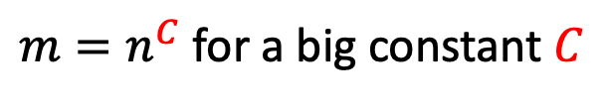
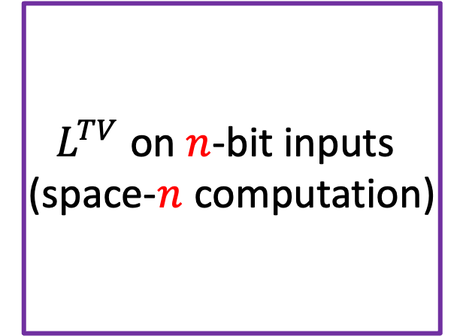
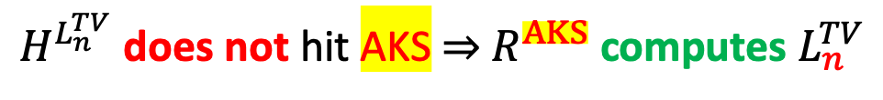
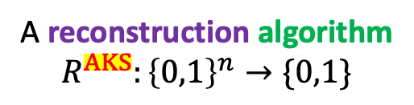
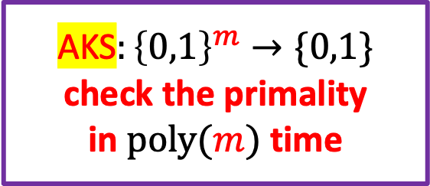
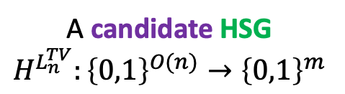
Review of the previous approach [OS’17]
$m=n^{C}$ for a big constant $C$
$L^{TV}$ on $n$-bit inputs
(space-$n$ computation)
A candidate HSG
$$H^{L_{n}^{TV}}:{\left\{0,1\right\}}^{O(n)}→{\left\{0,1\right\}}^{m}$$
AKS$:{\left\{0,1\right\}}^{m}→\{0,1\}$
check the primality
in $poly(m)$ time
A reconstruction algorithm
$$R^{AKS}:{\left\{0,1\right\}}^{n}→\{0,1\}$$
$H^{L_{n}^{TV}}$ does not hit AKS $⇒$ $R^{AKS}$ computes $L_{n}^{TV}$

Slide 24
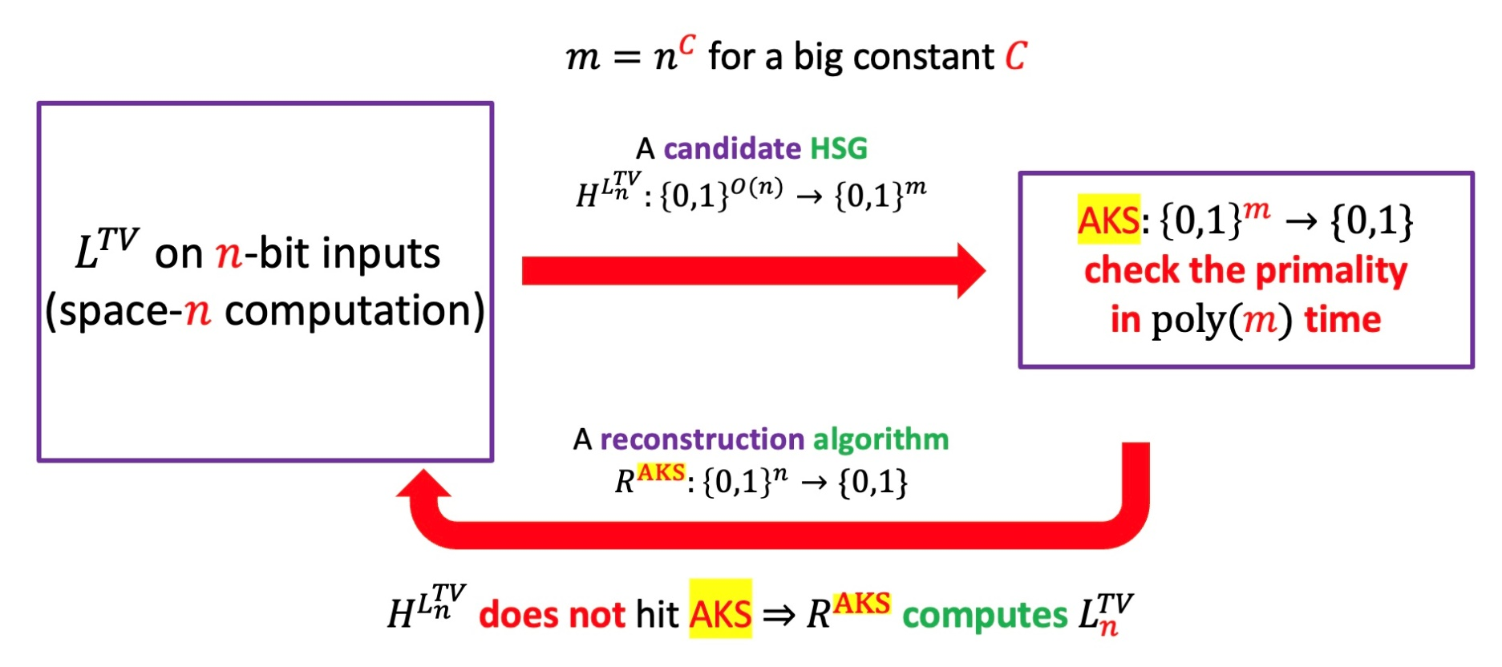
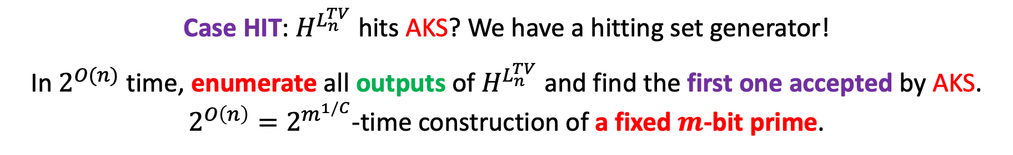
Review of the previous approach [OS’17]
A win-win argument from
Hardness vs. Randomness
Case HIT: $H^{L_{n}^{TV}}$ hits AKS? We have a hitting set generator!
In $2^{O(n)}$ time, enumerate all outputs of $H^{L_{n}^{TV}}$ and find the first one accepted by AKS. $2^{O\left(n\right)}=2^{m^{1/C}}$-time construction of a fixed $m$-bit prime.

Slide 25
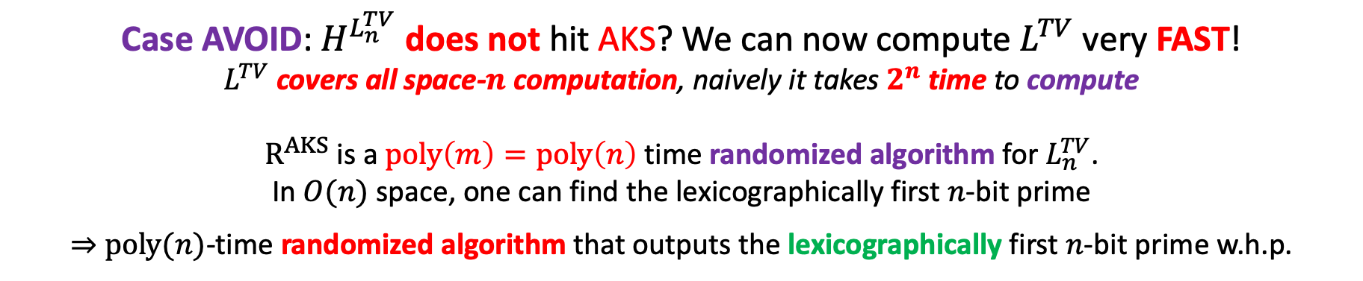
Review of the previous approach [OS’17]
A win-win argument from
Hardness vs. Randomness
Case AVOID: $H^{L_{n}^{TV}}$ does not hit AKS? We can now compute $L^{TV}$ very FAST! $L^{TV}$ covers all space-$n$ computation, naively it takes $2^{n}$ time to compute
$R^{AKS}$ is a $poly\left(m\right)=poly\left(n\right)$ time randomized algorithm for $L_{n}^{TV}$.
In $O(n)$ space, one can find the lexicographically first $n$-bit prime
$⇒$ $poly(n)$-time randomized algorithm that outputs the lexicographically first $n$-bit prime w.h.p.

Slide 26
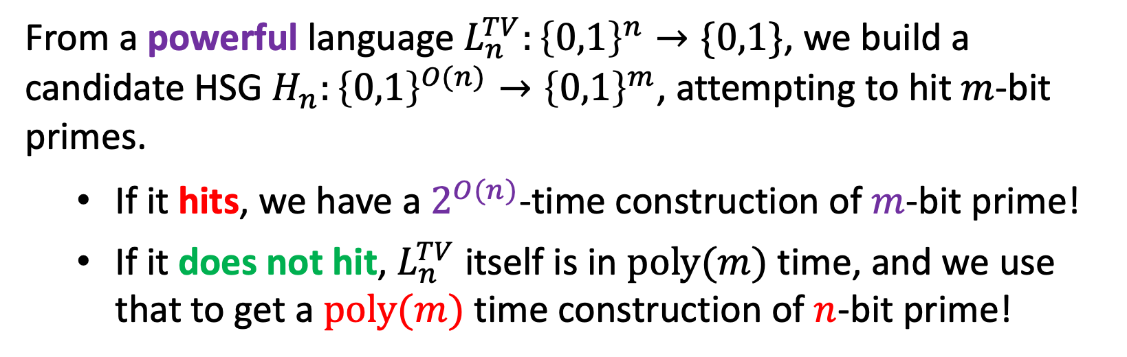
Digest: How does it work?
From a powerful language $L_{n}^{TV}:{\left\{0,1\right\}}^{n}→\{0,1\}$, we build a candidate HSG $H_{n}:{\left\{0,1\right\}}^{O(n)}→{\left\{0,1\right\}}^{m}$, attempting to hit $m$-bit primes.
If it hits, we have a $2^{O(n)}$-time construction of $m$-bit prime!
If it does not hit, $L_{n}^{TV}$ itself is in $poly(m)$ time, and we use that to get a $poly(m)$ time construction of $n$-bit prime!
Why can’t we get polynomial time?
The second case is fine, but the first case is TOO SLOW
Key idea: keep recursing on the first case!

Slide 27
Today’s Plan
Our Result:
Motivation
Construction of Primes, and all easy and dense P-property
Proof Overview
Review of the previous approach
A ``${win}^{log n}$’’ approach

Slide 28
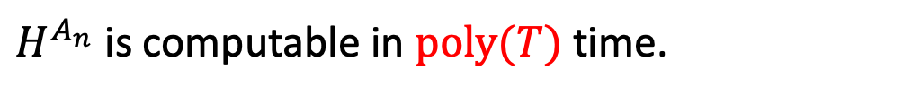

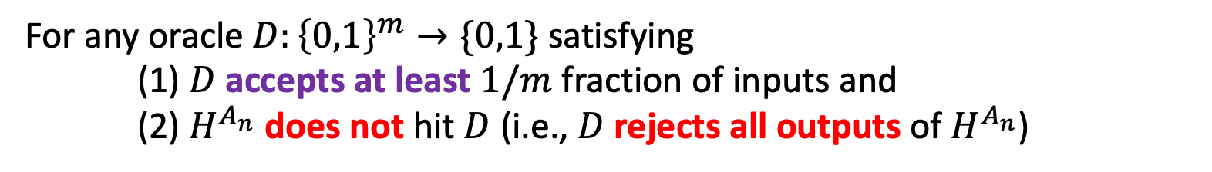
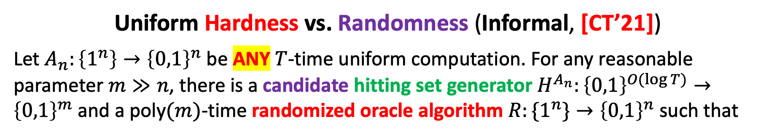
Key technique tool: Chen-Tell Generator
Uniform Hardness vs. Randomness FOR ALL COMPUTATION*
Previously, the hardness vs. randomness trade-off only works for some PSPACE-complete language $L^{TV}$
Uniform Hardness vs. Randomness (Informal, [CT’21])
Let $A_{n}:\left\{1^{n}\right\}→{\left\{0,1\right\}}^{n}$ be ANY $T$-time uniform computation. For any reasonable parameter $m≫n$, there is a candidate hitting set generator $H^{A_{n}}:{\left\{0,1\right\}}^{O(log T)}→{\left\{0,1\right\}}^{m}$ and a poly$(m)$-time randomized oracle algorithm $R:\{1^{n}\}→{\left\{0,1\right\}}^{n}$ such that
$H^{A_{n}}$ is computable in $poly(T)$ time.
For any oracle $D:{\left\{0,1\right\}}^{m}→\{0,1\}$ satisfying (1) $D$ accepts at least $1/m$ fraction of inputs and (2) $H^{A_{n}}$ does not hit $D$ (i.e., $D$ rejects all outputs of $H^{A_{n}}$)
We have that $R^{D}\left(1^{n}\right)=A(1^{n})$ w.h.p.

Slide 29
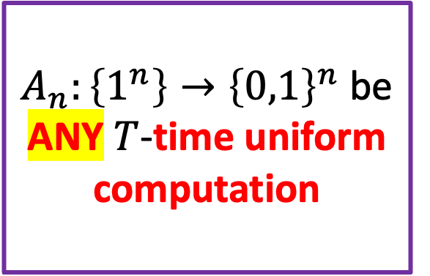
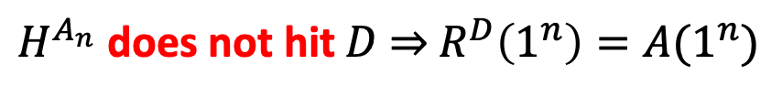
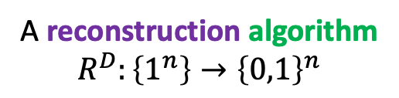

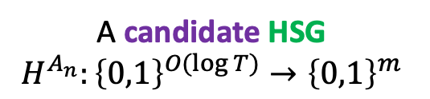
Key technique tool: Chen-Tell Generator
$A_{n}:\left\{1^{n}\right\}→{\left\{0,1\right\}}^{n}$ be ANY $T$-time uniform computation
A candidate HSG
$$H^{A_{n}}:{\left\{0,1\right\}}^{O(log T)}→{\left\{0,1\right\}}^{m}$$
An oracle
$$D:{\left\{0,1\right\}}^{m}→\{0,1\}$$
accepting a $1/m$ fraction of inputs
A reconstruction algorithm
$$R^{D}:\left\{1^{n}\right\}→{\left\{0,1\right\}}^{n}$$
$H^{A_{n}}$ does not hit $D$ $⇒$ $R^{D}\left(1^{n}\right)=A(1^{n})$

Slide 30
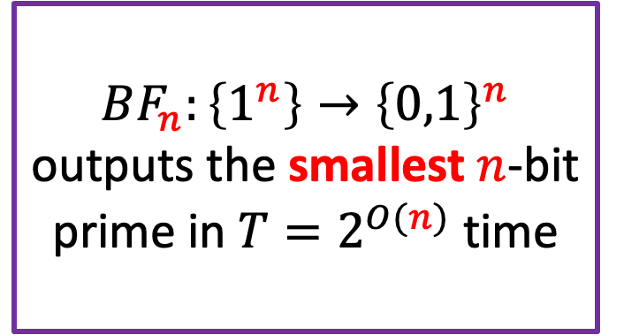
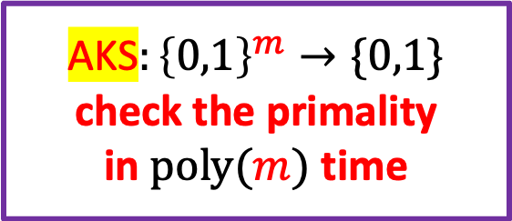
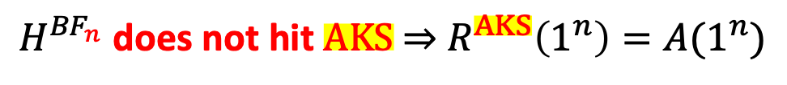
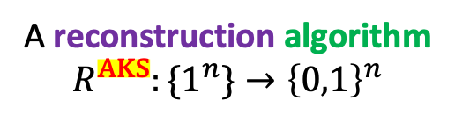
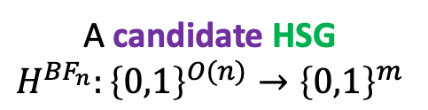

Instantiate the New HSG: Case AVOID
$m=n^{C}$ for a big constant $C$
$BF_{n}:\left\{1^{n}\right\}→{\left\{0,1\right\}}^{n}$ outputs the smallest $n$-bit prime in $T=2^{O(n)}$ time
A candidate HSG
$$H^{{BF}_{n}}:{\left\{0,1\right\}}^{O(n)}→{\left\{0,1\right\}}^{m}$$
AKS$:{\left\{0,1\right\}}^{m}→\{0,1\}$
check the primality
in $poly(m)$ time
A reconstruction algorithm
$$R^{AKS}:\{1^{n}\}→{\left\{0,1\right\}}^{n}$$
$H^{{BF}_{n}}$ does not hit $AKS$ $⇒$ $R^{AKS}\left(1^{n}\right)=A(1^{n})$
Case AVOID: $H^{BF_{n}}$ does not hit AKS? $R^{AKS}\left(1^{n}\right)$ outputs the smallest $n$-bit prime in randomized $poly\left(m\right)=poly(n)$ time.

Slide 31
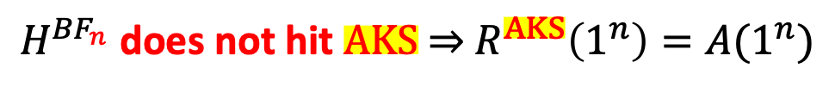

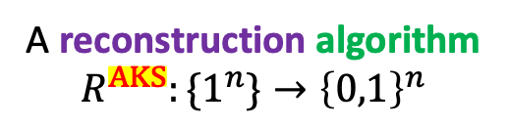

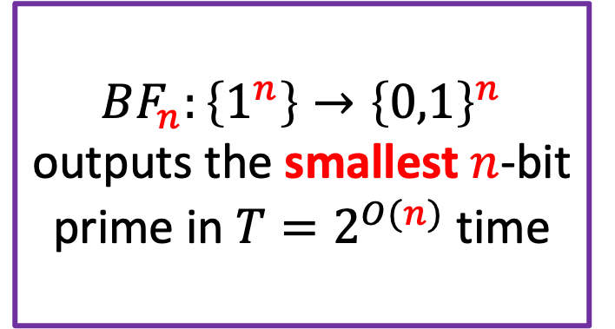
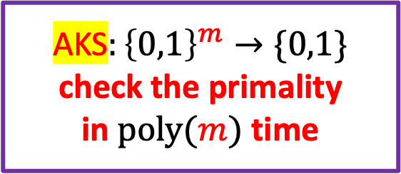
Instantiate the New HSG: Case HIT
$m=n^{C}$ for a big constant $C$
$BF_{n}:\left\{1^{n}\right\}→{\left\{0,1\right\}}^{n}$ outputs the smallest $n$-bit prime in $T=2^{O(n)}$ time
A candidate HSG
$$H^{{BF}_{n}}:{\left\{0,1\right\}}^{O(n)}→{\left\{0,1\right\}}^{m}$$
AKS$:{\left\{0,1\right\}}^{m}→\{0,1\}$
check the primality
in $poly(m)$ time
A reconstruction algorithm
$$R^{AKS}:\{1^{n}\}→{\left\{0,1\right\}}^{n}$$
$H^{{BF}_{n}}$ does not hit $AKS$ $⇒$ $R^{AKS}\left(1^{n}\right)=A(1^{n})$
Case HIT: $H^{BF_{n}}$HITS AKS?
By enumerating all outputs of $H^{BF_{n}}$ and check, we have a $2^{O(n)}$-time deterministic algorithm that outputs a fixed $m$-bit prime. (Not fast enough!)

Slide 32
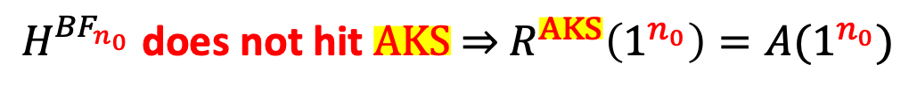

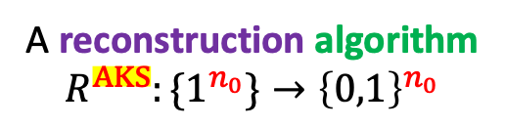




Instantiate the New HSG: Case HIT
$n_{1}={n_{0}}^{C}$ for a big constant $C$
$BF_{n_{0}}:\left\{1^{n_{0}}\right\}→{\left\{0,1\right\}}^{n_{0}}$ outputs the smallest $n_{0}$-bit prime in $T=2^{O(n_{0})}$ time
A candidate HSG
$$H^{{BF}_{n_{0}}}:{\left\{0,1\right\}}^{O(n_{0})}→{\left\{0,1\right\}}^{n_{1}}$$
AKS$:{\left\{0,1\right\}}^{n_{1}}→\{0,1\}$
check the primality
in $poly(n_{1})$ time
A reconstruction algorithm
$$R^{AKS}:\{1^{n_{0}}\}→{\left\{0,1\right\}}^{n_{0}}$$
$H^{{BF}_{n_{0}}}$ does not hit $AKS$ $⇒$ $R^{AKS}\left(1^{n_{0}}\right)=A(1^{n_{0}})$
Case HIT: $H^{BF_{n_{0}}}$HITS AKS?
By enumerating all outputs of $H^{BF_{n_{0}}}$ and check, we have a $2^{O(n_{0})}$-time deterministic algorithm that outputs a fixed $n_{1}$-bit prime. (Not fast enough!)

Slide 33







Why do we stop here?
$n_{1}=n_{0}^{C}$ for a big constant $C$
Case HIT: $H^{BF_{n_{0}}}$ HITS ${AKS}_{n_{1}}$
A candidate HSG
$$H^{{BF}_{n_{0}}}:{\left\{0,1\right\}}^{O(n_{0})}→{\left\{0,1\right\}}^{n_{1}}$$
$BF_{n_{1}}:\left\{1^{n_{1}}\right\}→{\left\{0,1\right\}}^{n_{1}}$: enumerating all outputs of $H^{BF_{n_{0}}}$ and output the first prime; a ${T_{1}=2}^{O(n_{0})}$ time deterministic algorithm outputting a fixed $n_{1}$-bit prime
$BF_{n_{0}}:\left\{1^{n_{0}}\right\}→{\left\{0,1\right\}}^{n_{0}}$ outputs the smallest $n_{0}$-bit prime in $T_{0}=2^{O(n_{0})}$ time
Case AVOID: $H^{BF_{n_{0}}}$DOES NOT HITS ${AKS}_{n_{1}}$
poly$(n_{0})$-time construction of fixed $n_{0}$-bit prime!

Slide 34







Why do we stop here?
$n_{1}=n_{0}^{C}$ for a big constant $C$; $n_{2}=n_{1}^{C}$
Case HIT: $H^{BF_{n_{1}}}$ HITS ${AKS}_{n_{2}}$
$BF_{n_{2}}:\left\{1^{n_{2}}\right\}→{\left\{0,1\right\}}^{n_{2}}$: enumerating all outputs of $H^{BF_{n_{1}}}$ and output the first prime; a $T_{2}=poly(T_{1})$ time deterministic algorithm outputting a fixed $n_{2}$-bit prime
A candidate HSG
$$H^{{BF}_{n_{1}}}:{\left\{0,1\right\}}^{O(log T_{1})}→{\left\{0,1\right\}}^{n_{2}}$$
$BF_{n_{1}}:\left\{1^{n_{1}}\right\}→{\left\{0,1\right\}}^{n_{1}}$: a ${T_{1}=2}^{O(n_{0})}$ time deterministic algorithm outputting a fixed $n_{1}$-bit prime
Case AVOID:
$H^{BF_{n_{1}}}$ DOES NOT HITS ${AKS}_{n_{2}}$
poly$(n_{1})$-time construction of fixed $n_{1}$-bit prime!

Slide 35














A $Win^{log n}$ Argument
$$n_{i}=n_{i−1}^{C}$$
A candidate HSG
$$H^{{BF}_{n_{0}}}:{\left\{0,1\right\}}^{O(log T_{0})}→{\left\{0,1\right\}}^{n_{1}}$$
A candidate HSG
$$H^{{BF}_{n_{1}}}:{\left\{0,1\right\}}^{O(log T_{1})}→{\left\{0,1\right\}}^{n_{2}}$$
$BF_{n_{0}}:\left\{1^{n_{0}}\right\}→{\left\{0,1\right\}}^{n_{0}}$ outputs the smallest $n_{0}$-bit prime in $T_{0}=2^{O(n_{0})}$ time
Case HIT $H^{BF_{n_{0}}}$ HITS ${AKS}_{n_{1}}$
$BF_{n_{1}}:\left\{1^{n_{1}}\right\}→{\left\{0,1\right\}}^{n_{1}}$ outputs a fixed $n_{1}$-bit prime in $T_{1}=poly(T_{0})$time
Case HIT $H^{BF_{n_{1}}}$ HITS ${AKS}_{n_{2}}$
$BF_{n_{2}}:\left\{1^{n_{2}}\right\}→{\left\{0,1\right\}}^{n_{2}}$ outputs a fixed $n_{2}$-bit prime in $T_{2}=poly(T_{1})$ time
Case AVOID:
$H^{BF_{n_{0}}}$DOES NOT HITS ${AKS}_{n_{1}}$
Case AVOID: $H^{BF_{n_{1}}}$DOES NOT HITS ${AKS}_{n_{2}}$
Case AVOID: $H^{BF_{n_{2}}}$
DOES NOT HITS ${AKS}_{n_{3}}$
poly$(n_{0})$-time construction of fixed $n_{0}$-bit prime!
poly$(n_{1})$-time construction of fixed $n_{1}$-bit prime!
poly$(n_{2})$-time construction of fixed $n_{2}$-bit prime!

Slide 36









When do we stop?
$n_{i}=n_{i−1}^{C}$;
pick $C$ large enough so that $n_{i}$ grows faster than $T_{i}$!
A candidate HSG
$$H^{{BF}_{n_{i}}}:{\left\{0,1\right\}}^{O(log T_{i})}→{\left\{0,1\right\}}^{n_{i+1}}$$
Case HIT $H^{BF_{n_{i}}}$ HITS ${AKS}_{n_{i+1}}$
$BF_{n_{i}}:\left\{1^{n_{i}}\right\}→{\left\{0,1\right\}}^{n_{i}}$ outputs a fixed $n_{i}$-bit prime in $T_{i}=poly(T_{i−1})$ time
$BF_{n_{i+1}}:\left\{1^{n_{i+1}}\right\}→{\left\{0,1\right\}}^{n_{i+1}}$ outputs a fixed $n_{i+1}$-bit prime in $T_{i+1}=poly(T_{i})$ time
Case AVOID: $H^{BF_{n_{i}}}$
DOES NOT HITS ${AKS}_{n_{i+1}}$
Case AVOID: $H^{BF_{n_{i+1}}}$
DOES NOT HITS ${AKS}_{n_{i+2}}$
poly$(n_{i})$-time construction of fixed $n_{i}$-bit prime!
poly$(n_{i+1})$-time construction of fixed $n_{i+1}$-bit prime!
For some $t=O(log n_{0})$, $BF_{n_{t}}:\left\{1^{n_{t}}\right\}→{\left\{0,1\right\}}^{n_{t}}$ runs in $poly(n_{t})$ time, and we stop there.

Slide 37

Summary
Given a $T(n)$-time algorithm $A_{n}$ that constructs an $n$-bit prime, we build a HSG $H^{A_{n}}$ attempting to hit $m$-bit primes, for $m=n^{C}$.
If it hits, we have $poly\left(T\left(n\right)\right)=poly(T(m^{1/C}))$-time construction of $m$-bit prime. (Now a better algorithm!)
If it does not hit, we immediately get a $poly(m)$-time construction of $n$-bit prime. (DONE)
In the first case, we iterate the same argument again on the new and better algorithm that constructs $m$-bit prime. Until the running time becomes polynomial.
At the end of the day, we have several input lengths $n_{0},…,n_{t}$, and we know that on at least one of them we have poly-time pseudodeterministic construction of primes.

Slide 38

Omitted Technical Details
Unfortunately, the HSG of Chen-Tell does not apply to all uniform computation; but only low-depth uniform circuits. Luckily, all the algorithms $BF_{n_{i}}$ we constructed can be implemented by low-depth circuits.
The original Chen-Tell paper gives you a HSG with $O(\log^{2} T)$ seed length instead of $O(log T)$; Doing the math, this only gives a quasi-poly time construction of fixed prime instead of poly-time.
We improve the original Chen-Tell by combining it with the Shaltiel-Umans generator.
Need to work much harder, new ideas include a clever use of the construction of a cryptographic PRG from one-way permutation.

Slide 39

Problems and Future Directions
Infinitely often deterministic generation of an n-bit prime in time 2^{o(n)}?
Make our result work on all input lengths?
[OS’17] indeed achieved zero-error (the algorithm either outputs the canonical prime, or ``FAILURE’’). Can our algorithm be made zero-error too?
More applications of our techniques?
${WIN}^{log n}$ Argument
Improved Chen-Tell generator

Slide 40
Thanks!

