Slide 1
Sharp Threshold Results for Computational Complexity
Lijie Chen
MIT
Ce Jin
Tsinghua U.
Ryan Williams
MIT
Made most of the slides!

Slide 2
Today’s Plan
Part I (Introduction)
Hardness Magnification and its connections to Barriers
Our new sharp threshold results
Hardness Magnification
Quantified Derandomization
Explicit Obstruction
Part II (Techniques)
The key tool: Derandomized Shrinkage Theorem for De-Morgan Formulas
How does this tool imply our results
Proof ideas of the key tool
Open Problems

Slide 3
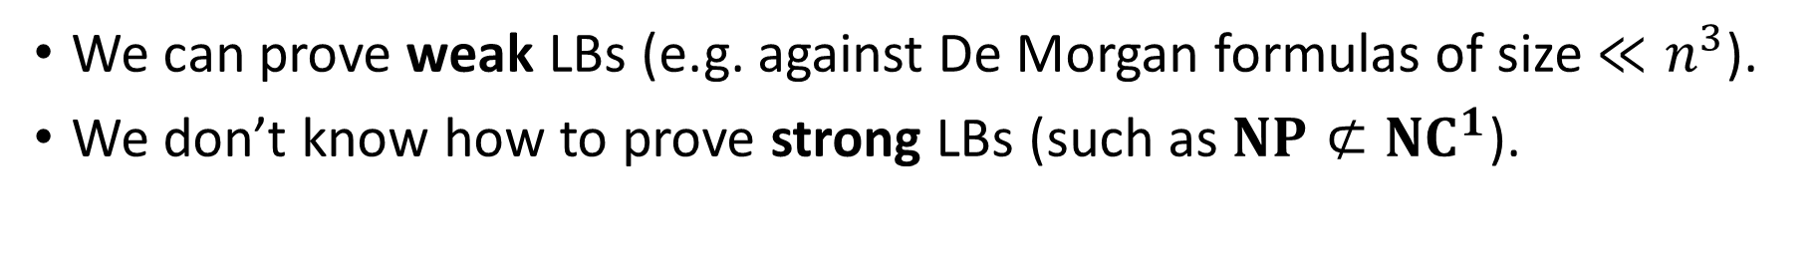
How far are we from proving major lower bounds?
We can prove weak LBs (e.g. against De Morgan formulas of size $≪n^{3}$).
We don’t know how to prove strong LBs (such as $NP⊄{NC}^{1}$).
Can we quantify “how far” we are from various open lower bounds?
Heuristically, we are closer to an $n^{3.01}$ formula LB than $NP⊄{NC}^{1}$…
This intuition can be wrong!
“Hardness Magnification” [OS’18, OPS’19, MMW’19, CJW’19, …] shows that:
Some weak LBs are as hard to prove as strong LBs!
In this paper, we show more extreme magnification theorems, which we call “sharp thresholds for complexity”.
Notes:
And there are some barriers to proving them
Try to measure it by looking at existing results
close
Recent results show it’s hard to measure ..
Such judgements can be misleading

Slide 4
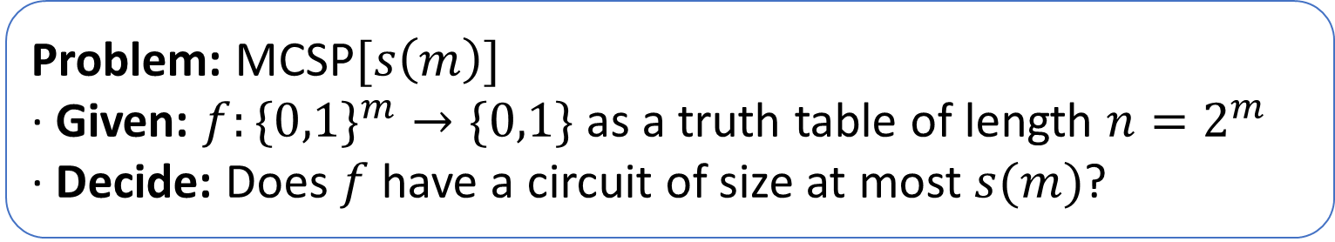
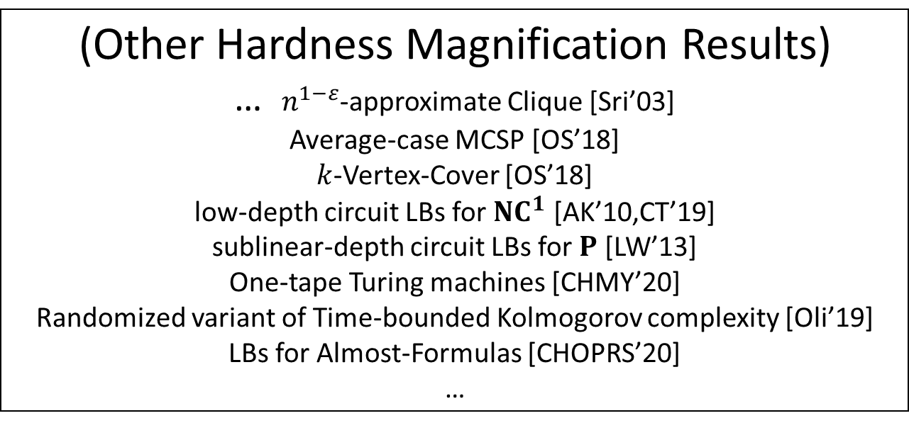
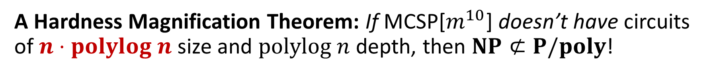
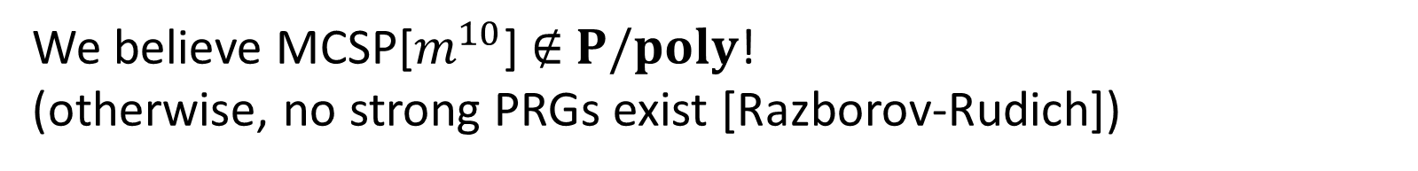
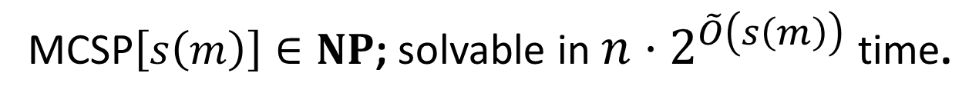
Hardness Magnification and Minimum Circuit Size Problem (MCSP)
Problem: MCSP$[s\left(m\right)]$
· Given: $f:\{0,1\}^{m}→\{0,1\}$ as a truth table of length $n=2^{m}$
· Decide: Does $f$have a circuit of size at most $s(m)$?
(Other Hardness Magnification Results)
… $n^{1−ε}$-approximate Clique [Sri’03]
Average-case MCSP [OS’18]
$k$-Vertex-Cover [OS’18]
low-depth circuit LBs for $NC^{1}$ [AK’10,CT’19]
sublinear-depth circuit LBs for $P$ [LW’13]
One-tape Turing machines [CHMY’20]
Randomized variant of Time-bounded Kolmogorov complexity [Oli’19]
LBs for Almost-Formulas [CHOPRS’20]
…
MCSP$\left[s\left(m\right)\right]∈NP$; solvable in ${n⋅2}^{\tilde{O}\left(s\left(m\right)\right)}$ time.
We believe MCSP[$m^{10}$] $∉$ $P/poly$! (otherwise, no strong PRGs exist [Razborov-Rudich])
A Hardness Magnification Theorem: If MCSP[$m^{10}$] doesn’t have circuits of $n⋅polylog n$ size and $polylog n$ depth, then $NP⊄P/poly$!
[McKay-Murray-Williams’19]
Notes:
Approximate max clique requires super linear circuits -> NP not in p/poly
K-vertex cover not solvable in near-linear time and small space, P is not equal to NP ( k=n^(o1))

Slide 5
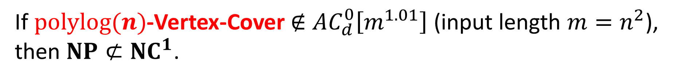
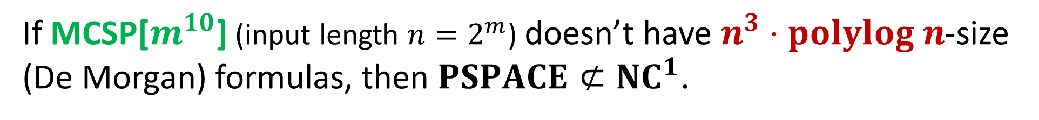
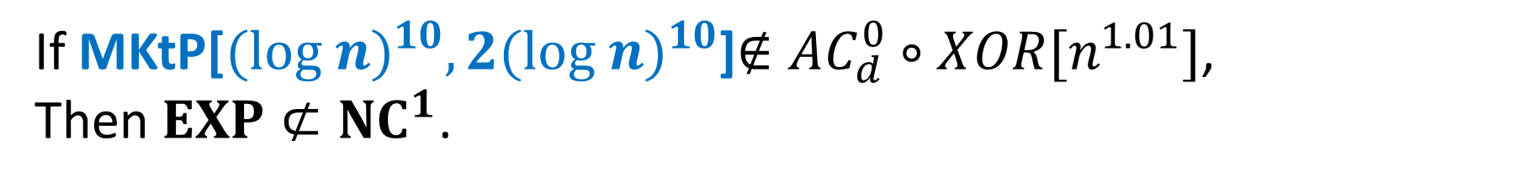
More Hardness Magnification Theorems
If $polylog(n)$-Vertex-Cover $∉$ $AC_{d}^{0}\left[m^{1.01}\right]$ (input length $m=n^{2}$),
then $NP⊄NC^{1}$.
[Oliveira-Santhanam’18]
Just a hard function in E
If MKtP[${(log n)}^{10},2{(log n)}^{10}$]$∉AC_{d}^{0}∘XOR[n^{1.01}]$,
Then $EXP⊄{NC}^{1}$.
[Oliveira-Pich-Santhanam’19]
If MCSP[$m^{10}$] (input length $n=2^{m}$) doesn’t have $n^{3}⋅polylog n$-size (De Morgan) formulas, then $PSPACE⊄{NC}^{1}$.
[C.-Jin-Williams’19]

Slide 6
How to view Hardness Magnification?
Indicates proving “weak” lower bounds is even harder than previously thought?
Weak LB
Suggests new approaches to proving strong lower bounds?
Magnification
Strong LB
It is argued that Hardness Magnification can bypass the Natural Proof Barrier by Razborov-Rudich. [AK’10, OS’18, CHOPRS’20]
But [CHOPRS, ITCS’20] recently formulated a new Locality Barrier of Hardness Magnification…
Notes:
A heuristic argument : HM seems to yield strong LBs only for certain functions, not for most of them (violating the “largeness” condition of Natural Proofs)
A real theorem In some cases, the required weak LB actually implies the non-existence of natural proofs
Proving almost-linear size lower bounds is already as hard as proving super-polynomial lower bounds…
TODO: here, add one ore two more slides on discussion about Natural Proof Barrier

Slide 7
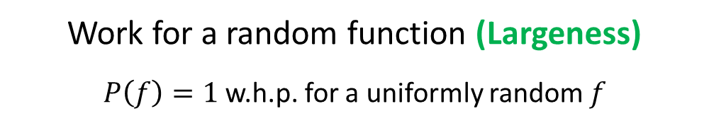
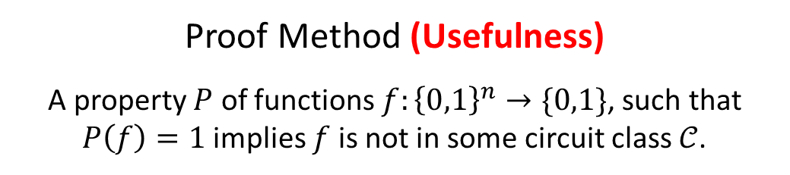

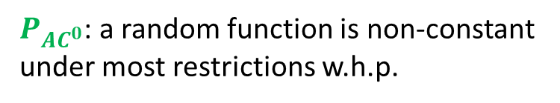
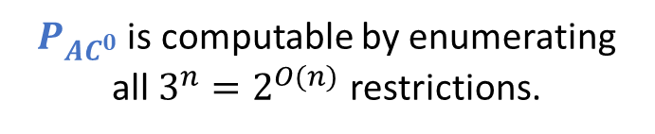
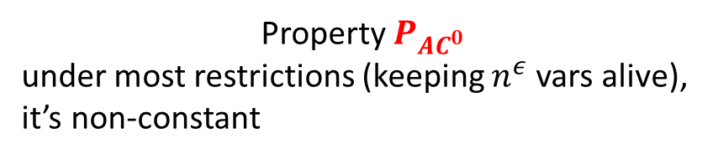

Hardness Magnification and Natural Proofs
Natural Proofs in One Sentence
If your proof method is both efficient and works for a random function, then it can’t prove lower bounds for strong circuit classes
Hardness Magnification
HM theorems make use of special structures of the function, which does not hold for random functions
$$TC^{0},NC^{1},P/poly$$
Proof Method (Usefulness)
A property $P$ of functions $f:{\left\{0,1\right\}}^{n}→\{0,1\}$, such that $P\left(f\right)=1$ implies $f$ is not in some circuit class $𝒞$.
Property $P_{AC^{0}}$
under most restrictions (keeping $n^{ε}$ vars alive), it’s non-constant
Conclusion
Random restriction (alone) can’t prove lower bounds for strong circuit classes
Being efficient (Constructive)
$P(f)$ can be computed in $2^{O(n)}$ time
$P_{AC^{0}}$ is computable by enumerating
all $3^{n}=2^{O(n)}$ restrictions.
Work for a random function (Largeness)
$P\left(f\right)=1$ w.h.p. for a uniformly random $f$
$P_{AC^{0}}$: a random function is non-constant under most restrictions w.h.p.
Notes:
Talk about HM and the Natural Proof Barrier

Slide 8
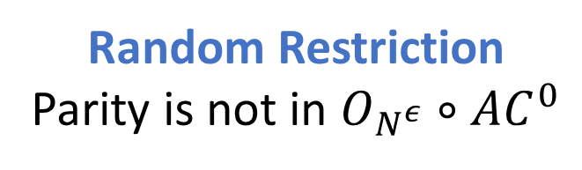
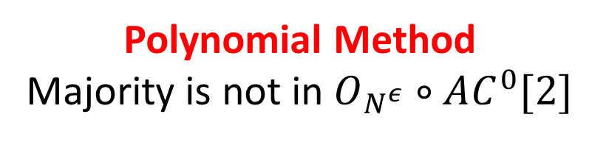
Hardness Magnification and the Locality Barrier
Motivating Question
Are current proof techniques strong enough to show the lower bounds required by Hardness Magnification?
Locality Barrier in One Sentence
If your proof method is robust enough to handle circuits with (arbitrary) small-fan-in oracles, then it can’t prove the lower bounds required by HM
Check [CHOPRS’20] for
MORE discussions on this!!
Standard Proof techniques do extend to circuits with small-fan-in oracles
Random Restriction
Parity is not in $O_{N^{ε}}∘AC^{0}$
Polynomial Method
Majority is not in $O_{N^{ε}}∘AC^{0}[2]$
Notes:
Talk about HM and the Locality Barrier

Slide 9
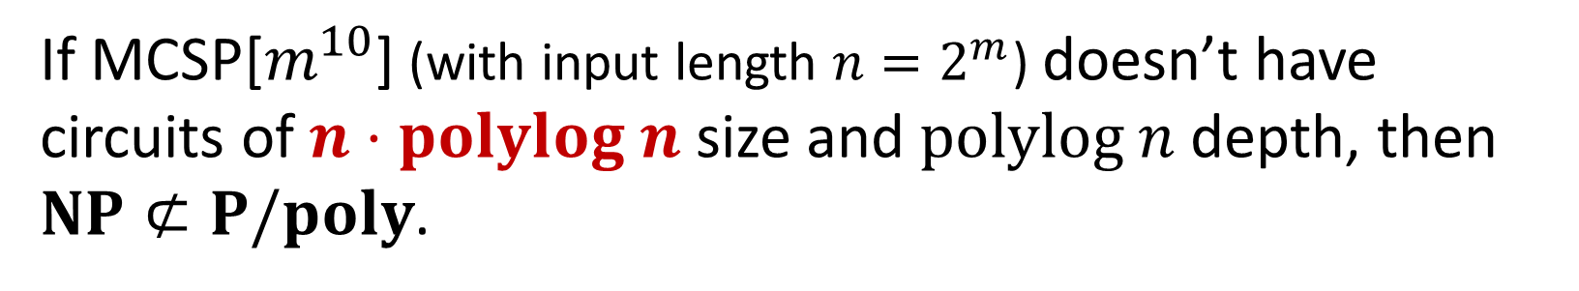
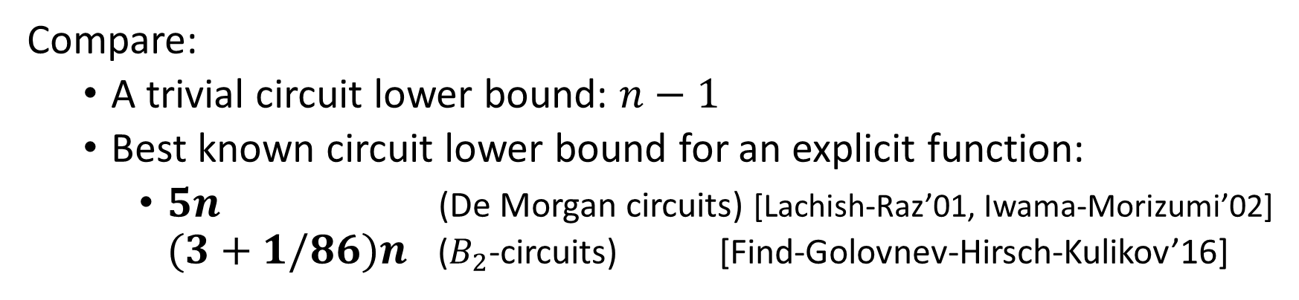
Gap in Hardness Magnification theorems
If MCSP[$m^{10}$] (with input length $n=2^{m}$) doesn’t have circuits of $n⋅polylog n$ size and $polylog n$ depth, then $NP⊄P/poly$.
[McKay-Murray-Williams’19]
Compare:
A trivial circuit lower bound: $n−1$
Best known circuit lower bound for an explicit function:
$5n$ (De Morgan circuits) [Lachish-Raz’01, Iwama-Morizumi’02] $(3+1/86)n$ ($B_{2}$-circuits) [Find-Golovnev-Hirsch-Kulikov’16]
We are relatively far away from proving $n⋅polylog n$ circuit lower bounds…

Slide 10
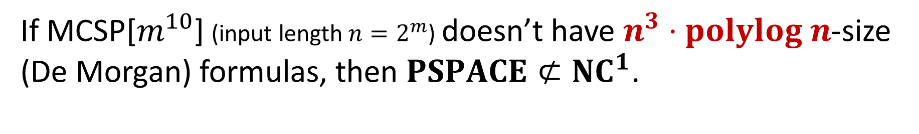
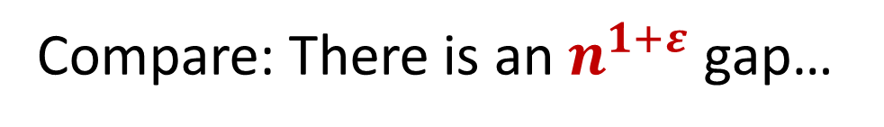
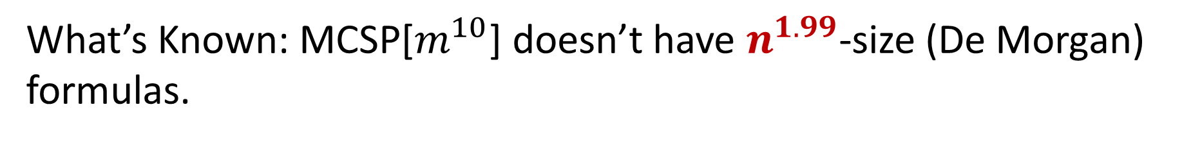
Gap in Hardness Magnification theorems
If MCSP[$m^{10}$] (input length $n=2^{m}$) doesn’t have $n^{3}⋅polylog n$-size (De Morgan) formulas, then $PSPACE⊄{NC}^{1}$.
[C.-Jin-Williams’19]
What’s Known: MCSP[$m^{10}$] doesn’t have $n^{1.99}$-size (De Morgan) formulas.
[Hirahara-Santhanam’17,
Oliveira-Pich-Santhanam’19]
Compare: There is an $n^{1+ε}$ gap…

Slide 11
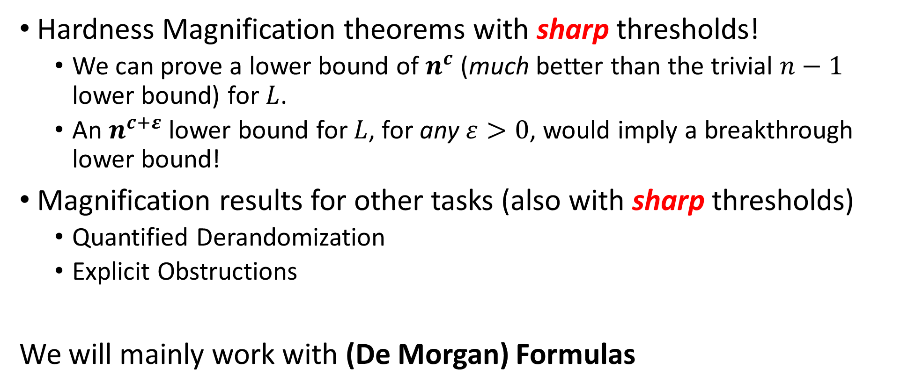
Our new results
Hardness Magnification theorems with sharp thresholds!
We can prove a lower bound of $n^{c}$ (much better than the trivial $n−1$ lower bound) for $L$.
An $n^{c+ε}$ lower bound for $L$, for any $ε>0$, would imply a breakthrough lower bound!
Magnification results for other tasks (also with sharp thresholds)
Quantified Derandomization
Explicit Obstructions
We will mainly work with (De Morgan) Formulas
Unlike HM, they are not subject to the recent “Locality Barrier” [CHOPRS’20].

Slide 12
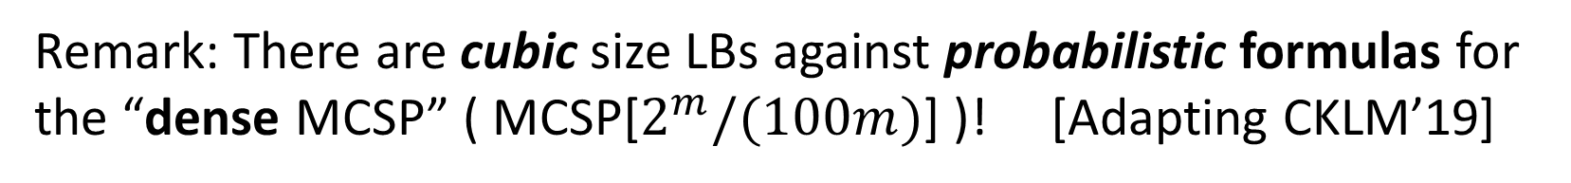
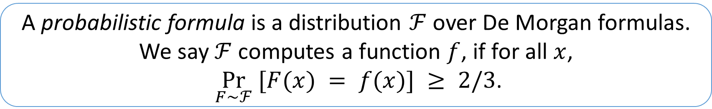
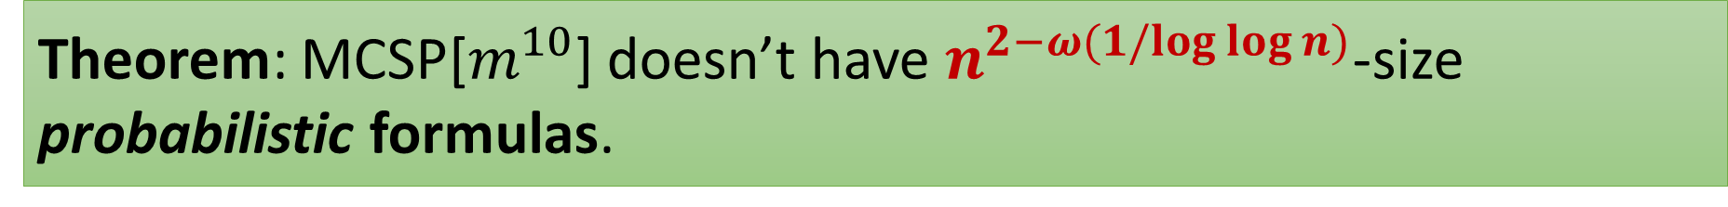
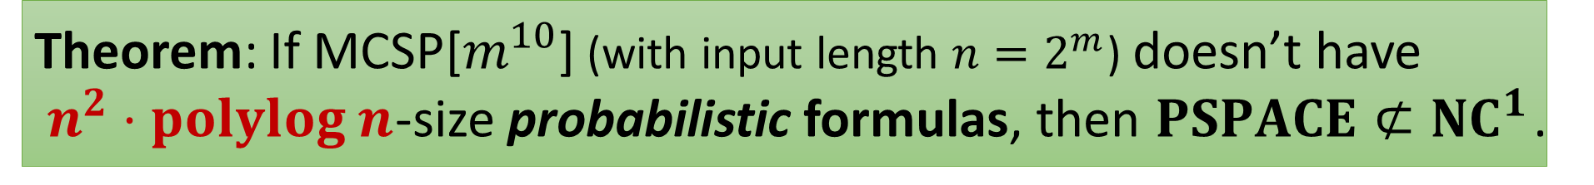
Hardness Magnification with Sharp Thresholds
A probabilistic formula is a distribution $ℱ$ over De Morgan formulas. We say $ℱ$ computes a function $f$, if for all $x$,
$\underset{F∼ℱ}{Pr} [F(x) = f(x)] ≥ 2/3$.
Theorem: If MCSP[$m^{10}$] (with input length $n=2^{m}$) doesn’t have
$n^{2}⋅polylog n$-size probabilistic formulas, then $PSPACE⊄{NC}^{1}$.
Theorem: MCSP[$m^{10}$] doesn’t have $n^{2−ω(1/log{\log{n)}}}$-size probabilistic formulas.
Remark: There are cubic size LBs against probabilistic formulas for the “dense MCSP” ( MCSP[$2^{m}/(100m)$] )! [Adapting CKLM’19]
Notes:
TODO: talk about the trade-off?

Slide 13
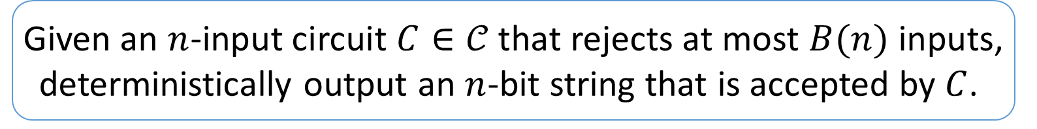

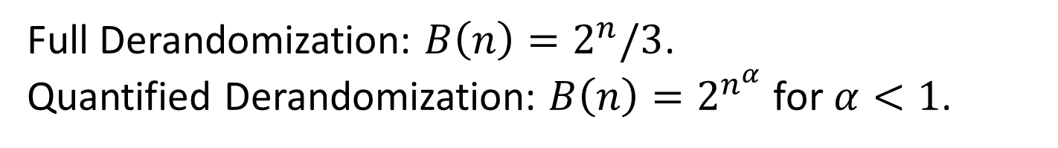
Quantified Derandomization
The Quantified Derandomization problem [Goldreich-Widgerson’14]:
Given an $n$-input circuit $C∈𝒞$ that rejects at most $B(n)$ inputs, deterministically output an $n$-bit string that is accepted by $C$.
Full Derandomization: $B\left(n\right)=2^{n}/3$.
Quantified Derandomization: $B\left(n\right)=2^{n^{α}}$ for $α<1$.
Studied by [GW’14, Tell’18, Tell’19, C.-Tell’19] for $𝒞=AC^{0},TC^{0}, AC^{0}\left[2\right],⋯$
We consider $𝒞=$ probabilistic formulas

Slide 14
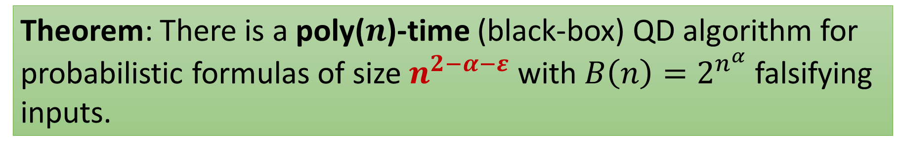

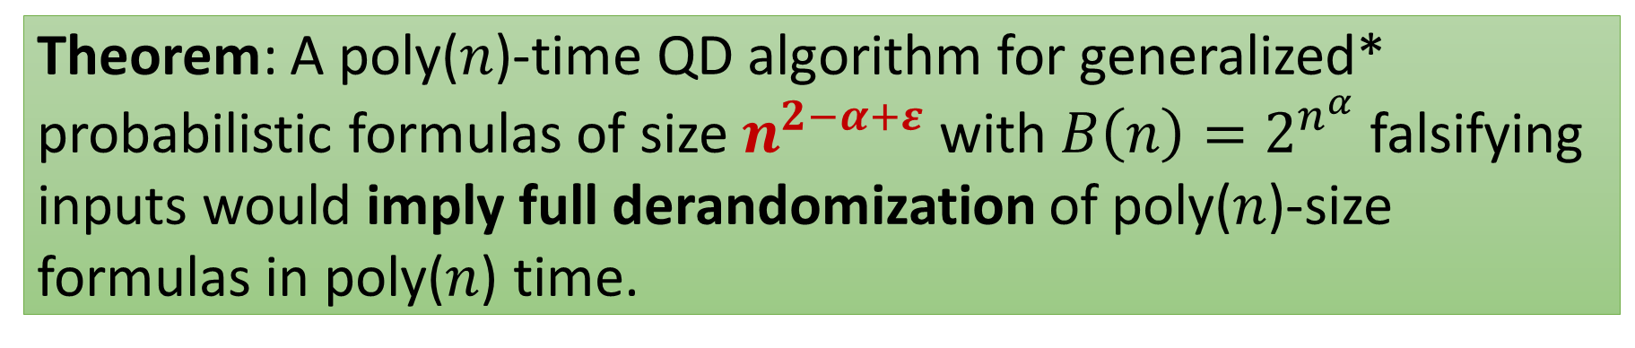
Quantified Derandomization (QD) with Sharp Thresholds
Theorem: There is a poly($n$)-time (black-box) QD algorithm for probabilistic formulas of size $n^{2−α−ε}$ with $B\left(n\right)=2^{n^{α}}$ falsifying inputs.
(We can achieve $n^{2−2α−ε}$ for generalized* probabilistic formulas.)
Theorem: A poly($n$)-time QD algorithm for generalized* probabilistic formulas of size $n^{2−α+ε}$ with $B\left(n\right)=2^{n^{α}}$ falsifying inputs would imply full derandomization of poly($n$)-size formulas in poly($n$) time.
*may not have bounded probability gap. See paper for precise definition.
Notes:
(Theorem: There is a poly($n$)-time black-box QD algorithm for generalized* probabilistic formulas of size $n^{2−2α−ε}$ with $B\left(n\right)=2^{n^{α}}$ falsifying inputs.)

Slide 15
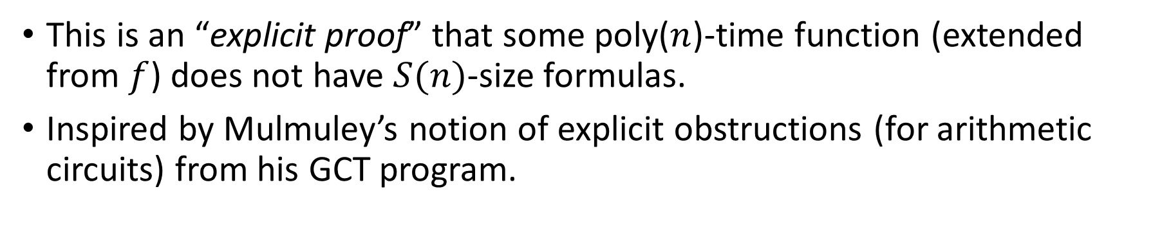
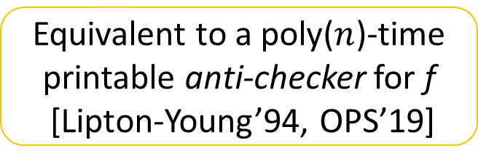
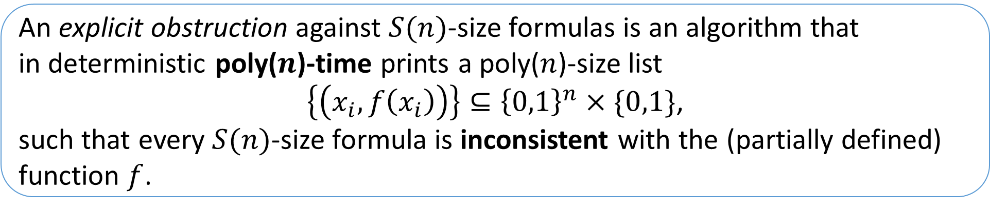
“Explicit proofs” of formula lower bounds
An explicit obstruction against $S(n)$-size formulas is an algorithm that
in deterministic poly($n$)-time prints a poly($n$)-size list
$\left\{\left(x_{i},f\left(x_{i}\right)\right)\right\}⊆{\left\{0,1\right\}}^{n}×\{0,1\}$,
such that every $S(n)$-size formula is inconsistent with the (partially defined) function $f$.
Equivalent to a poly($n$)-time printable anti-checker for f
[Lipton-Young’94, OPS’19]
This is an “explicit proof” that some poly($n$)-time function (extended from $f$) does not have $S(n)$-size formulas.
Inspired by Mulmuley’s notion of explicit obstructions (for arithmetic circuits) from his GCT program.
Notes:
Mulmuley [Mul11] argues philosophically that, in order to prove results such as NP 6⊂ P /poly , we should strive to construct explicit obstructions against small circuits. His Geometric Complexity Theory program is rooted in the idea
that this task may be more feasible to achieve for arithmetic circuits

Slide 16
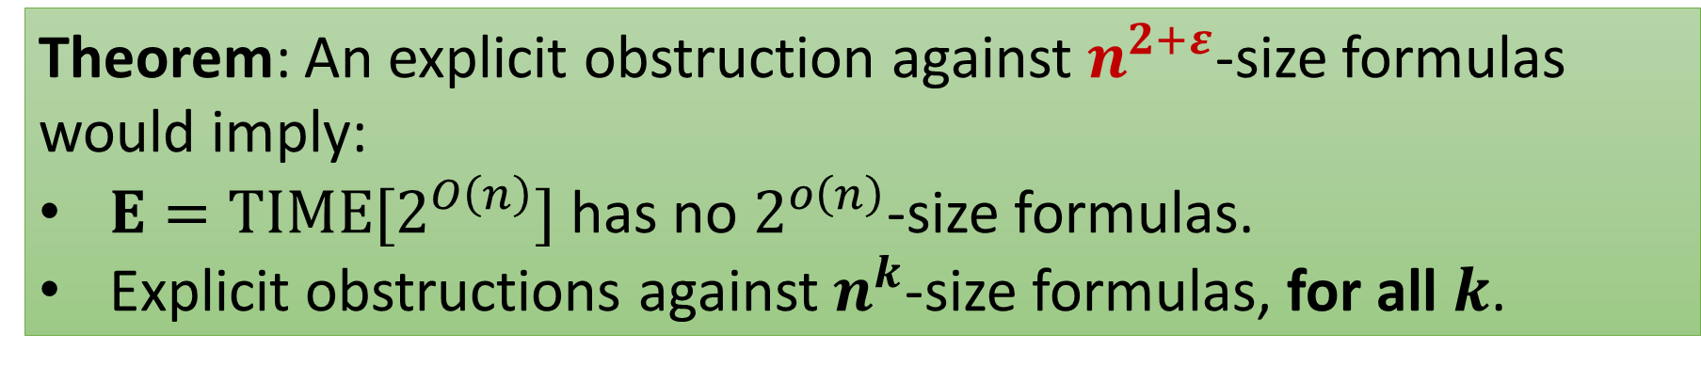
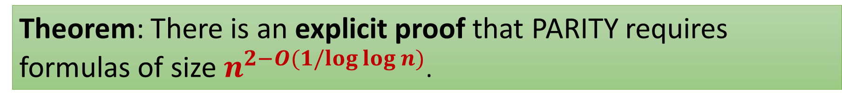
“Explicit proofs” of formula lower bounds
The PARITY function requires formulas of size $Ω(n^{2})$. [Krapchenko’71]
Theorem: There is an explicit proof that PARITY requires formulas of size$n^{2−O(1/log{\log{n})}}$.
Best known formula lower bound: nearly cubic [Håstad’98, Tal’17].
Can we make the proof explicit?
Theorem: An explicit obstruction against $n^{2+ε}$-size formulas would imply:
$E=TIME[2^{O\left(n\right)}]$ has no $2^{o\left(n\right)}$-size formulas.
Explicit obstructions against $n^{k}$-size formulas, for all $k$.
In fact, they are equivalent!
Notes:
There is an $ε>0$and an explicit obstruction against formulas of size $n^{2+ε}$ .
For all $k$, there is an explicit obstruction against formulas of size $n^{k}$.
There is an $α>0$ and a function in $E=TIME[2^{O\left(n\right)}]$ that does not have $2^{αn}$-size formulas, even infinitely often.

Slide 17
Today’s Plan
Part I (Introduction)
Hardness Magnification and its connection to Barriers
Our new sharp threshold results
Hardness Magnification
Quantified Derandomization
Explicit Obstruction
Part II (Techniques)
The key tool: Derandomized Shrinkage Theorem for De-Morgan Formulas
How does this tool imply our results
Proof ideas of the key tool
Open Problems

Slide 18

Our Techniques
 | Sparse MCSP, MKtP Lower Bounds against prob. formulas | Quantified Derandomization of (generalized) prob. formulas | Explicit Obstructions against formulas
Sharp Magnification theorems | Adapting C.-Jin-Williams’19 | Adapting Goldreich-Wigderson ’14 | Efficient linear hashing
Slightly sub-quadratic results

Slide 19
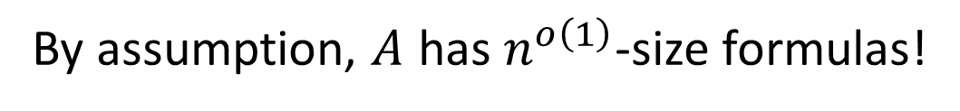
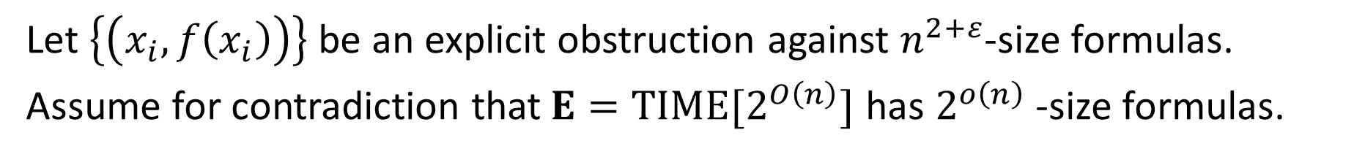
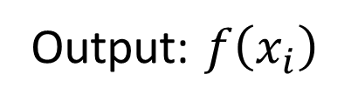
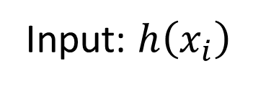
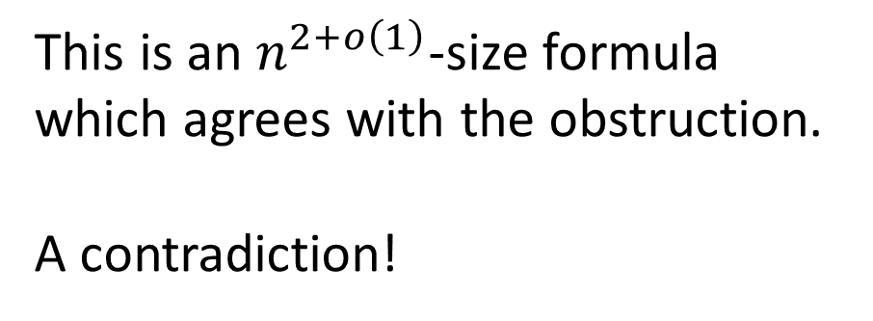
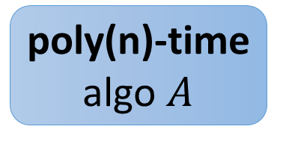

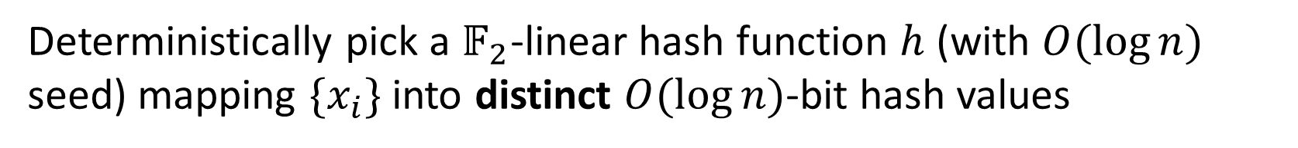
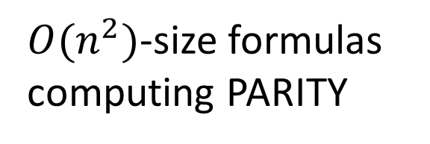
Better Explicit Obstructions Imply Breakthrough Lower Bounds: Proof Sketch
Let $\left\{\left(x_{i},f\left(x_{i}\right)\right)\right\}$ be an explicit obstruction against $n^{2+ε}$-size formulas.
Assume for contradiction that$E=TIME[2^{O\left(n\right)}]$ has $2^{o\left(n\right)}$ -size formulas.
Deterministically pick a $𝔽_{2}$-linear hash function $h$ (with $O(\log{n)}$ seed) mapping ${\{x}_{i}\}$ into distinct $O(\log{n)}$-bit hash values
Output: $f\left(x_{i}\right)$
poly(n)-time
algo $A$
By assumption, $A$ has $n^{o\left(1\right)}$-size formulas!
This is an $n^{2+o\left(1\right)}$-size formula which agrees with the obstruction.
A contradiction!
Input: $h\left(x_{i}\right)$
$O(n^{2})$-size formulas computing PARITY
$$x_{i}$$
Notes:
We have an algorithm $A$ that: receives $h(x_{i})$ as input, finds $x_{i}$ and returns $f(x_{i})$ in $poly\left(n\right)$-time.
Then, use $O(n^{2})$-size PARITY formulas to construct a formula $A(h\left(x\right))$ of size $n^{2+o\left(1\right)}$ which agrees with the obstruction, a contradiction.

Slide 20
Our Techniques
 | Sparse MCSP, MKtP Lower Bounds against prob. formulas | Quantified Derandomization of (generalized) prob. formulas | Explicit Obstructions against formulas
Sharp Magnification theorems | Adapting C.-Jin-Williams’19 | Adapting Goldreich-Wigderson’14 | Efficient linear hashing
Slightly sub-quadratic results | Derandomized Håstad’s Shrinkage Theorem

Slide 21

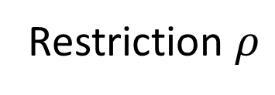
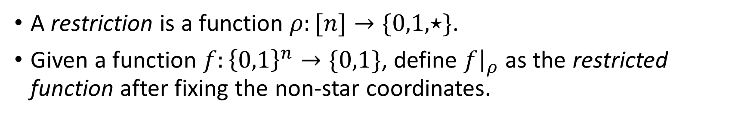

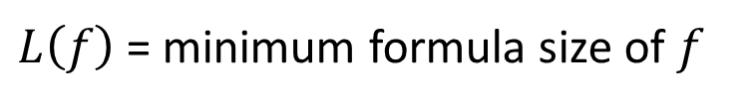






Restrictions
A restriction is a function $ρ:[n]→\{0,1,⋆\}$.
Given a function $f:{\left\{0,1\right\}}^{n}→\{0,1\}$, define $f{\left.​\right|}_{ρ}$ as the restricted function after fixing the non-star coordinates.
Formulas shrink under restrictions:
OR
$$L(f)=4$$
Restriction $ρ$
$$L(f|_{ρ})=1$$
AND
AND
$$ρ\left(1\right)=0, ρ\left(2\right)=ρ\left(3\right)= ⋆$$
$$x_{3}$$
$$x_{1}$$
$$x_{2}$$
$$¬x_{1}$$
$$x_{3}$$
$L\left(f\right)$ = minimum formula size of $f$
Notes:
$f{\left.​\right|}_{ρ}\left(x\right)≔f(y)$, where $y_{i}=\left\{\begin{aligned}x_{i}, ρ\left(i\right)= ⋆ \\ &ρ\left(i\right), otherwise\end{aligned}\right.$.

Slide 22


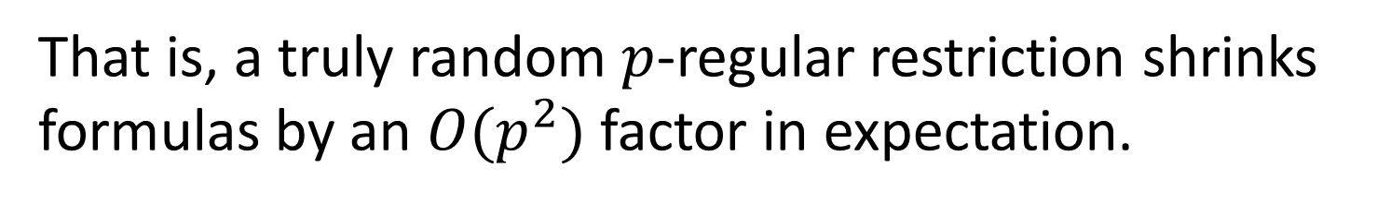
Shrinkage of Formulas
Definition: For $0<p<1$, a truly random $p$-regular restriction $ρ∼ℛ_{p}$:
$ρ(i)=\left\{\begin{aligned}⋆, w.p. p \\ &0, w.p. \left(1−p\right)/2 \\ 1, w.p. \left(1−p\right)/2\end{aligned}\right.$ (independently for all $i∈[n]$)
Shrinkage theorem [Håstad’98, Tal’14]: For all functions $f$,
$$E_{ρ∼ℛ_{p}}\left[L\left(f|_{ρ}\right)\right]≤O\left(p^{2}L\left(f\right)+p\sqrt{L(f)}\right)$$
requires $Ω\left(n\right)$ random bits to sample from $ℛ_{p}$…
That is, a truly random $p$-regular restriction shrinks formulas by an $O(p^{2})$ factor in expectation.
We present a derandomized version of the shrinkage theorem!
Notes:
A very important theorem, useful in proving state-of-the-art formula lower bounds…

Slide 23
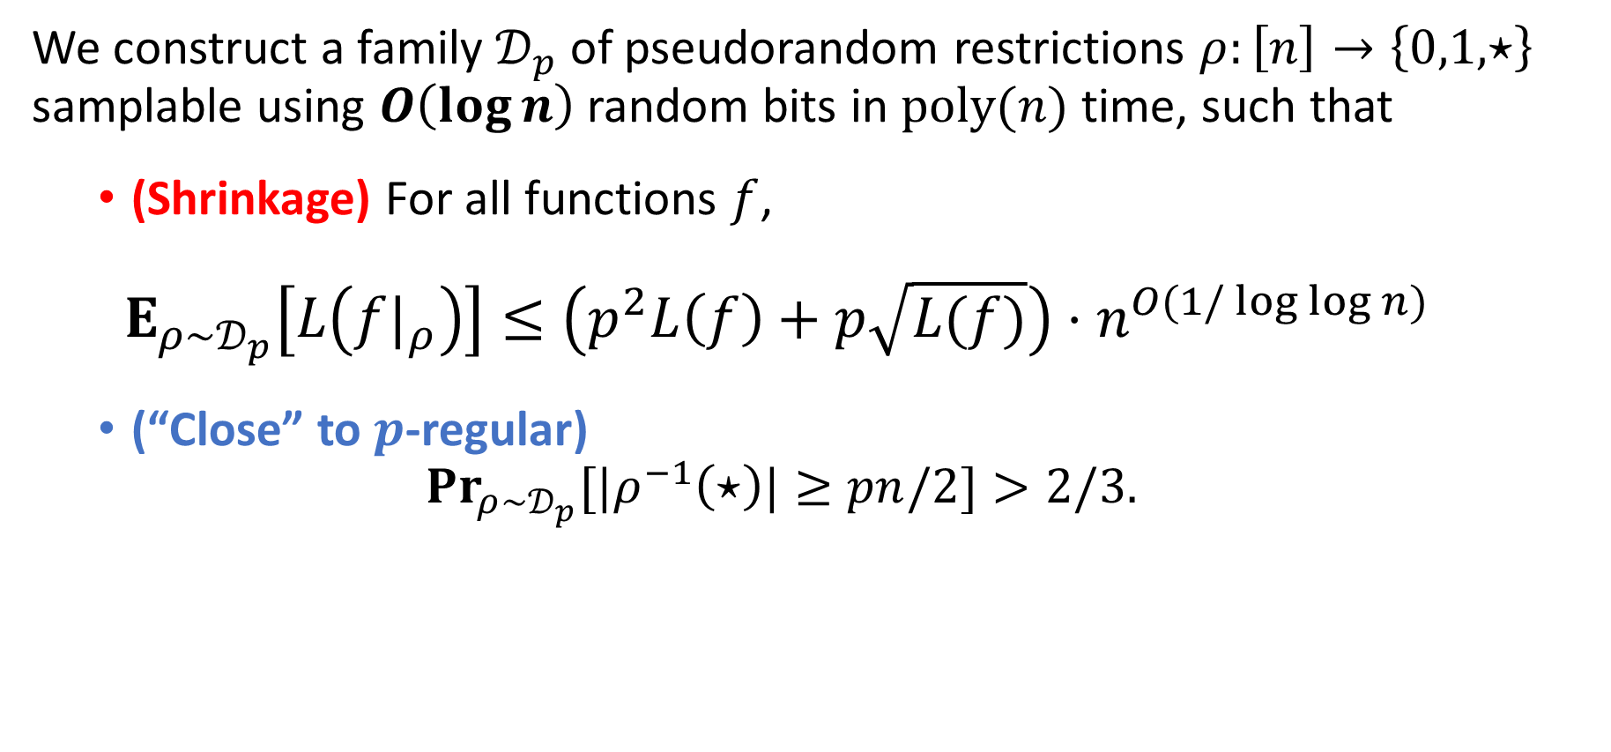

Derandomized Shrinkage Lemma
We construct a family $𝒟_{p}$ of pseudorandom restrictions $ρ:\left[n\right]→\left\{0,1,⋆\right\}$ samplable using $O\left(\log{n}\right)$random bits in $poly(n)$ time, such that
(Shrinkage) For all functions $f$,
$$E_{ρ∼𝒟_{p}}\left[L\left(f|_{ρ}\right)\right]≤\left(p^{2}L\left(f\right)+p\sqrt{L(f)}\right)⋅n^{O(1/\log{\log{n}) }}$$
(“Close” to $p$-regular)
$$Pr_{ρ∼𝒟_{p}}{[|ρ^{−1}\left(⋆\right)|≥pn/2]}>2/3.$$
Optimal $O(\log{n)}$ seed length.
Improves the $O\left(\log^{2}{n}\right)$ seed length by OPS’19.
Proof technique: More refined “iterated pseudorandom restrictions” [IMZ’12,HS’17,OPS’19]
Notes:
(a) ForeveryformulaF, applyingarandompartialassignmentρfromC “shrinks”theformulacomplexity
of F by about p 2 (with some n o(1) loss), and
(b) A random ρ from C has decent probability of leaving at least pn/2 variables unset

Slide 24

Sparse MCSP, MKtP
Lower Bounds
$O(log n)$-seed Pseudorandom Restrictions
Poly-time Quantified Derandomization
Explicit Obstructions

Slide 25





Formula Lower Bounds from pseudorandom restrictions Adapted from [HS’17] and [OPS’19]
Goal: MKtP[$O(log n)$] doesn’t have $N^{1.9}$-size probabilistic formulas $ℱ$
Let $p=N^{−0.98}$
MKtP[$O(log n)$]
Roughly speaking, it accepts a string $x∈{\left\{0,1\right\}}^{n}$ if it can be outputted by a universal Turing machine in poly$(n)$ time given $O(\log{n})$ bits as input
(Shrinkage) For all $T_{i}$,
$$E_{ρ∼𝒟_{p}}\left[L\left(T_{i}|_{ρ}\right)\right]≤\left(p^{2}L\left(T_{i}\right)+p\sqrt{L(T_{i})}\right)⋅N^{O(1/\log{\log{n}) }}$$
$$≤N^{−0.01}$$
$$E_{ρ∼𝒟_{p}}\left[\sum_{i∈[M]}{L\left(T_{i}|_{ρ}\right)}\right]≤M⋅N^{−0.01}≤O(N^{0.99})$$
(“Close” to $p$-regular)
$$Pr_{ρ∼𝒟_{p}}{[|ρ^{−1}\left(⋆\right)|≥pN/2]}>2/3.$$
$$Pr_{ρ∼𝒟_{p}}{[|ρ^{−1}\left(⋆\right)|≥N^{0.01}]}>2/3.$$
Observation on probabilistic formulas
Can assume that the support of the distribution of $ℱ$ has at most $M=O(N)$ formulas $T_{1},T_{2},…,T_{M}$
by a Chernoff bound and a union bound
Claim
There exists $ρ∈𝒟_{p}$ such that $\left|ρ^{−1}\left(∗\right)\right|≥N^{0.01}$, and at most $O(N^{0.99})$ formulas from $T_{1}{\left.​\right|}_{ρ},T_{2}{\left.​\right|}_{ρ},…,T_{M}{\left.​\right|}_{ρ}$ are non-constant, hence $ℱ$ must be constant on all inputs consistent with $ρ$.
Notes:
Talk about how pseudorandom restriction imply probabilistic formula lower bound

Slide 26







Formula Lower Bounds from pseudorandom restrictions Adapted from [HS’17] and [OPS’19]
Goal: MKtP[$O(log n)$] doesn’t have $N^{1.9}$-size probabilistic formulas $ℱ$
Claim 1
There exists $ρ∈𝒟_{p}$ such that $\left|ρ^{−1}\left(∗\right)\right|≥N^{0.01}$, and $ℱ$ must be constant on all inputs consistent with $ρ$.
Recall we set $p=N^{−0.98}$
MKtP[$O(log n)$]
Roughly speaking, it accepts a string $x∈{\left\{0,1\right\}}^{n}$ if it can be outputted by a universal Turing machine in poly$(n)$ time given $O(\log{n})$ bits as input
Therefore, $ℱ$ can’t compute $MKtP[O(\log{n})]$!
Claim 2
For such $ρ$, $MKtP{\left[O\left(\log{n}\right)\right]}_{ρ}$ is not constant
$MKtP{\left[O\left(\log{n}\right)\right]}_{ρ}$has a $1$-input
Since if we fill every $⋆$ in $ρ$ by $0$, then the corresponding input $x_{ρ}$ satisfies $MKtP\left[x_{ρ}\right]=1$
$MKtP{\left[O\left(\log{n}\right)\right]}_{ρ}$has a $0$-input
$MKtP[O(\log{n})]$ overall has at most $poly(n)$ 1-inputs, and there are $2^{n^{0.01}}$-inputs consistent with $ρ$.
Notes:
Talk about how pseudorandom restriction imply probabilistic formula lower bound

Slide 27
Sparse MCSP, MKtP
Lower Bounds
$O(log n)$-seed Pseudorandom Restrictions
Poly-time Quantified Derandomization
Explicit Obstructions

Slide 28






Explicit proofs from pseudorandom restrictions
Goal: an explicit proof that PARITY requires formulas of size$n^{2−O(1/log{\log{n})}}$
Apply our restriction generator with $p≔10/n$.
$O(\log{n)}$ seed $⇒$ $poly(n)$ many possible restrictions $ρ$.
For each $ρ$ that has a star, add two input-output pairs into our list:
$ρ$ =
1 | $$⋆$$ | $$⋆$$ | 0 | $$⋆$$
For any formula $F$ of size $n^{2−C/\log{\log{n}}}$, there exists a $ρ$ such that:
$L(F{\left.​\right|}_{ρ})=0$ (by shrinkage property)
$\left|ρ^{−1}\left(⋆\right)\right|≥1$ (by “close-to-$p$-regular”)
(
1 | 0 | 0 | 0 | 0
,1)
(
1 | 1 | 0 | 0 | 0
,0)
$x$, PARITY($x$)
So $F$ should output the same value on these strings.
But their parities are different $⇒F$ is wrong on one of them
Notes:
we set $x^{ρ,i}$ be the input obtained by extending $ρ$ so that the $i$-th variable is set to 1 and all other $⋆$’s filled with 0’s.
We add both ($x^{ρ}$,PARITY($x^{ρ}$)) and ($x^{ρ,i}$,PARITY($x^{ρ,i}$)) to our list $S$.

Slide 29
Techniques for constructing the pseudorandom restriction generator

Slide 30









Method of Iterated Pseudorandom Restrictions [Impagliazzo-Meka-Zuckerman’12, HS’17, OPS’19]
To sample a $p$-regular restriction, pick $q, r$ such that $p=q^{r}$.
In $i$-th stage ($1≤i≤r$): sample a $q$-regular pseudo-random restriction $φ_{i}$ that shrinks $F$ by an $O(q^{2})$ factor (in expectation)
$ρ≔φ_{r}∘⋯∘φ_{1}$ shrinks $F$ by ${\left(O\left(q^{2}\right)\right)}^{r}≈p^{2}$
$$φ_{1}$$
1 | $$⋆$$ | $$⋆$$ | 0
[HS’17, OPS’19]: $q=Θ\left(1\right),r=O(\log{n),}$ each stage uses $O(\log{n)}$ random bits. In total $O\left(\log^{2}{n}\right)$ random bits.
$$φ_{2}$$
0 | 1 | $$⋆$$ | $$⋆$$
Our construction:
$q=1/{\left(\log{n}\right)}^{0.01},r=O(\log{n}/\log{\log{n}}),$
each stage uses $O(\log{\log{n}})$random bits,
$$ρ=φ_{2}∘φ_{1}$$
1 | 1 | $$⋆$$ | 0

Slide 31













In each stage
Goal: sample $φ$ that shrinks each subformula $f_{k}$ by $O(q^{2})$ in expectation
Decompose into small subformulas $f_{k}$ [IMZ’12]
$$F$$
$$F′$$
$$F^{′}|_{φ}$$
$$f_{1}$$
$$f_{2}$$
$$f_{m}$$
$$⋯$$
Total size shrinks by ${O(q}^{2})$ in expectation
$L(f_{k})≤1/q^{2}$
$$q=1/{\left(\log{n}\right)}^{0.01}$$

Slide 32









“Micro” pseudorandom restrictions
First Consider “micro” restrictions $μ:\left[poly\left(1/q\right)\right]→\{0,1,⋆\}$ applied to $poly\left(1/q\right)$-variable $1/q^{2}$-size formulas $f$
$$f$$
A truly random $μ∼ℛ_{q}$ shrinks $f$ by $O(q^{2})$, for all $f$.
$$L\left(f\right)≤1/q^{2}$$
Requires $poly(1/q)$ random bits…
Only needs $O(\log{1/q})$ random bits!
$$y_{1}$$ | $$⋯$$ | $$y_{poly(1/q)}$$
Claim: Exists a pool of $S=poly(1/q)$ “micro” restrictions $μ_{1},…,μ_{S}$ , such that
a random $μ_{i} (i∈_{R}[S])$has a shrinkage property almost as good as a truly random $μ∼ℛ_{q}$
Proof: Pick i.i.d. random $μ_{1},…,μ_{S}∈ℛ_{q}$, and use Chenoff bound + union bound over all possible $f$. (can be derandomized by brute-force)
$$q=1/{\left(\log{n}\right)}^{0.01}$$

Slide 33






















Extend to $n$-variable restrictions
$h$ has seed length
$O\left(\log{poly(1/q})+\log{\log{n}}\right)$
$≤ O(\log{\log{n}})$ random bits
Compose our “micro” pseudorandom restriction $μ:\left[poly\left(1/q\right)\right]→\{0,1,⋆\}$ with an almost pairwise indep. hash function $h :[n] → [poly(1/q)]$ :
$$F′$$
$$φ≔μ∘h$$
$$f_{1}$$
$$f_{2}$$
$$f_{k}$$
$$f_{m}$$
$$⋯$$
w.p. $≥1−poly(1/q)$,
the variables that $f_{k}$ depends on
are hashed into distinct variables.
$L(f_{k})≤1/q^{2}$
$$x_{1}$$
$$x_{2}$$
$$⋯$$
$$x_{n}$$
Then, $f_{k}$ shrinks under $φ$ in the same way as a$poly\left(1/q\right)$-variable formula shrinks under $μ$!
$$h$$
$$y_{1}$$
$$⋯$$
$$y_{poly(1/q)}$$
$$q=1/{\left(\log{n}\right)}^{0.01}$$

Slide 34




Summary
Set $q=1/{\left(\log{n}\right)}^{0.01},r=O(\log{n}/\log{\log{n}})$, $q^{r}=p$
There are $r$ stages total, each stage uses $O(\log{\log{n}})$random bits
In $2^{ poly(1/q)}≤n$ time, find a collection $S$ of $poly\left(\frac{1}{q}\right)=polylog(n)$
micro q-regular restrictions from [poly($1/q$)]$→\{0,1,⋆\}$
For $i∈\left\{1,2,3,…,r\right\}$
Use $O(loglog n)$ bits to sample a random micro restriction $μ_{i}∈S$
Use $O(loglog n)$ bits to sample $h_{i}$ from a hash family from $\left[n\right]→[poly\left(1/q\right)]$
The $i$-th restriction is $φ_{i}=μ_{i}∘h_{i}$, shrinks formulas by a factor $O(q^{2})$
The final restriction $ρ≔φ_{r}∘⋯∘φ_{1}$,
shrinks formulas by a factor $O{\left(q\right)}^{2r}≈p^{2}$

Slide 35





Open Problems: Refuter
Relaxation on “explicit proof”
Given a circuit $C$ claiming to solve function $f$, an explicit proof should tell us a counter-example $x$ such that $C\left(x\right)≠f(x)$
An oblivious refuter, does not need to see $C$
An explicit obstruction against $S(n)$-size formulas is an algorithm that
in deterministic poly($n$)-time prints a poly($n$)-size list
$\left\{\left(x_{i},f\left(x_{i}\right)\right)\right\}⊆{\left\{0,1\right\}}^{n}×\{0,1\}$,
such that every $S(n)$-size formula is inconsistent with the (partially defined) function $f$.
Open Question
Does the existence of refuters against $N^{3.1}$-size formulas for any explicit function $f$ implies super-polynomial circuit lower bounds?
A refuter against $S(n)$-size formulas for function $f$ is a deterministic algorithm $R$ that given an $S(n)$-size formula $C$, outputs an $x$ such that $C\left(x\right)≠f(x)$
Notes:
Add a slide talk about refuter and what’s known

Slide 36


Hardness Magnification and proof theories
Open Question
Can we show hardness magnification phenomena for some weak proof theories?
Connection
a circuit lower bound for explicit functions in Cook’s theory $PV_{1}$ immediately implies
a polynomial-time refuter.
[Buss's witnessing theorem]
$N^{3+ε}$ formula size lower bound for any explicit function in Cook’s theory $PV_{1}$ implies $E⊄NC^{1}?$
A refuter against $S(n)$-size formulas for function $f$ is a deterministic algorithm $R$ that given an $S(n)$-size formula $C$, outputs an $x$ such that $C\left(x\right)≠f(x)$
Notes:
Add a slide talk about refuter and what’s known

Slide 37

Open Problems
Can we construct an explicit obstruction against $n^{2.01}$-size formulas? Are there any formal barriers?
Does our log-seed pseudorandom restriction generator have other applications?
The “Iterated Restrictions” approach for constructing PRGs is very popular recently, most of them incur $ω(log n )$-seed length. Does our idea help in that setting?
Thank you!

