Slide 1
Introduction to
Fine-Grained Complexity
Ce Jin @ UC Berkeley (11/18/2025)
(Based on slides of Virginia Vassilevska Williams and Ryan Williams)

Slide 2
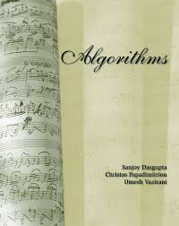
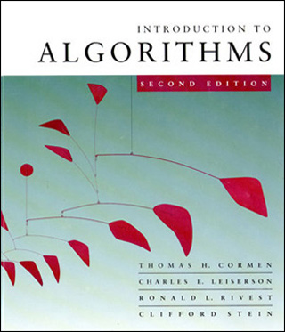


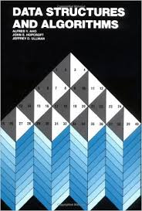
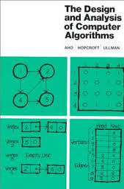
The Central Question of Algorithms Research
``How fast can we solve fundamental problems, in the worst case?’’
etc.

Slide 3
Hard problems
For many problems, all known techniques get stuck:
Very important problems from diverse areas
Simple, often brute-force, textbook algorithms
that are slow.
No improvements in many decades!

Slide 4


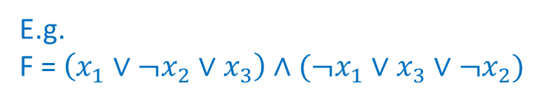
A canonical hard problem
Example 1
E.g.
F = $\left(x_{1}∨¬x_{2}∨x_{3}\right)∧(¬x_{1}∨x_{3}∨¬x_{2})$
k-SAT
Input: variables x₁, … ,x_{n} and a CNF formula F = C₁ ∧ C₂ ∧ … ∧ C_{m} , where each clause C_{i} has the form {y₁ ∨ y₂ ∨ … ∨ y_{k}} and ∀i, y_{i} is either x_{t} or ¬x_{t} for some t.
Output: YES if there is a Boolean assignment to {x₁,…,x_{n}} that satisfies all the clauses, or NO if the formula is not satisfiable
at most $m≤O(n^{k})$ clauses
Goes to 2^{n} as k grows.
Brute-force algorithm: try all $2^{n}$ assignments
Best known algorithm: $O\left(2^{n − \frac{cn}{k}} m^{d}\right)$ time for const c,d
Notes:
k is a constant . NP-complete for k>=3, believed to require super poly time.
Actually seems even harder : best-known algo is close to brute force.
The fastest known randomized algorithm for 3-SAT is due to Hertli [Her14], running in O(1.308n) time

Slide 5
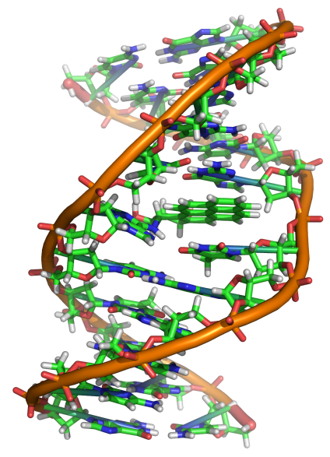
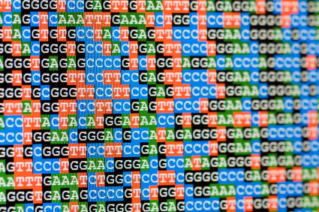

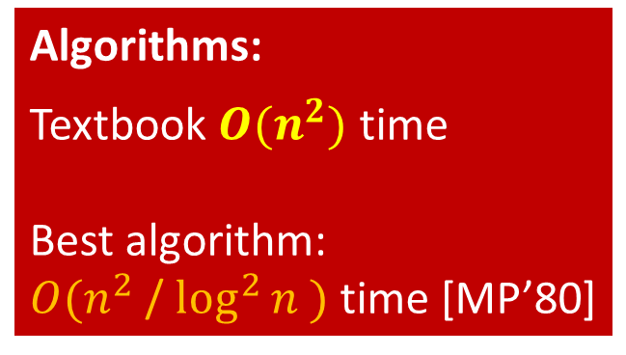
Another Hard problem: Edit Distance
(We use the standard word-RAM model)
???
Example 2
Given two strings on $≤n$ letters
How many edits (insertions/deletions/substitutions) are needed to transform the first string into the second?
Applications both in computational biology and in spellcheckers.
Algorithms:
Textbook $O(n^{2})$ time
Best algorithm:
$O(n^{2}$ / $\log^{2}{n })$ time [MP’80]
ATCGGGTTCCTTAAGGG
ATTGGTACCTTCAGG
ATCGGGTTCCTTAAGGG
AT T GG_TACCTTCA_GG
Solved daily on huge strings!
(Human genome: 3 x 10⁹ base pairs.)
Notes:
with O(log n) bit words

Slide 6
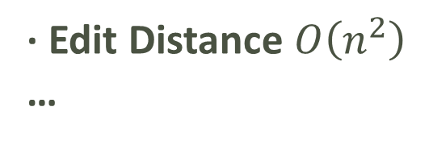
EXP
PSPACE
P
NP
(almost-)Linear Time:
· Graph BFS/DFS
· Sorting
· Max Flow
…
???
· k-SAT
· Edit Distance $O\left(n^{2}\right)$
…
· Clique
…
Poly time viewed as “EFFICIENT/EASY”
(Reasons: Composing two efficient algorithms results in an efficient algorithm. Also, model-independence.)
However, no one would consider an O(n^100) time algorithm efficient in practice.
If n is huge, then O(n^2) is also inefficient.

Slide 7


We are stuck on many problems, even just in $O(n^{2})$time
No $n^{2−ε}$ time algorithms known for:
Many sequence-similarity problems:
  Edit Distance, Longest Common Subsequence, Dynamic Time Warping Distance, …
$O(n^{2})$ time by Dynamic Programming
ATCGGGTTCCTTAAGGG
ATTGGTACCTTCAGG

Slide 8
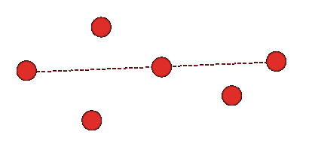
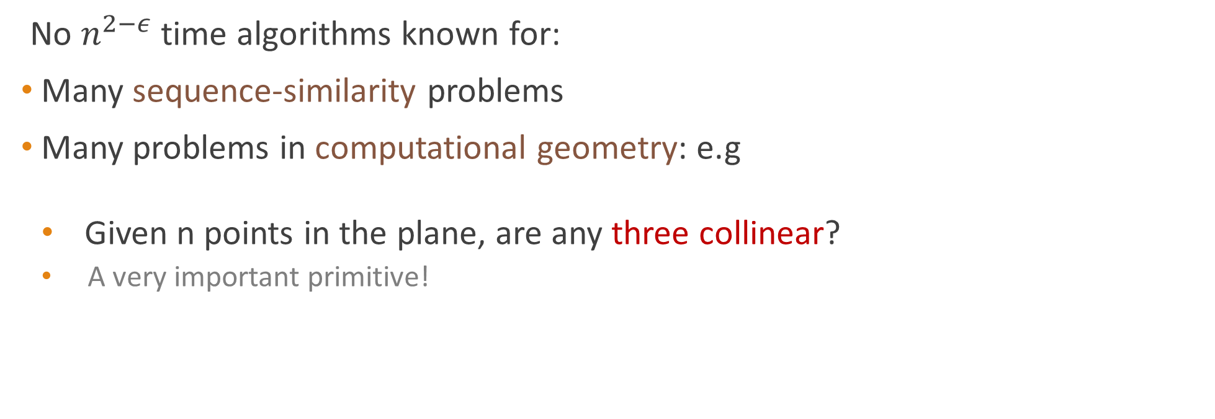
We are stuck on many problems, even just in $O(n^{2})$time
No $n^{2−ε}$ time algorithms known for:
Many sequence-similarity problems
Many problems in computational geometry: e.g
  Given n points in the plane, are any three collinear?
  A very important primitive!

Slide 9

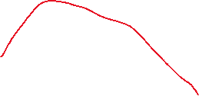

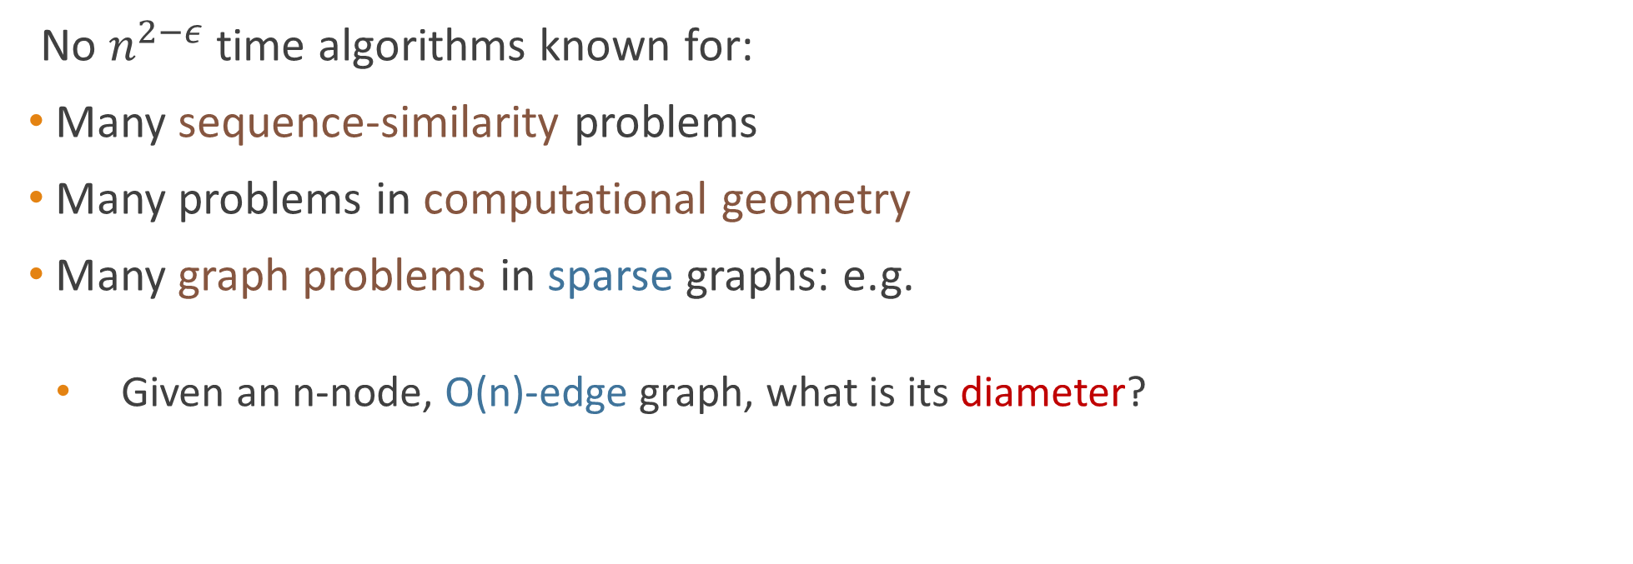
We are stuck on many problems, even just in $O(n^{2})$time
No $n^{2−ε}$ time algorithms known for:
Many sequence-similarity problems
Many problems in computational geometry
Many graph problems in sparse graphs: e.g.
  Given an n-node, O(n)-edge graph, what is its diameter?
(diameter = 3)
Notes:
Fundamental problem. Even approximation algorithms seem hard!

Slide 10
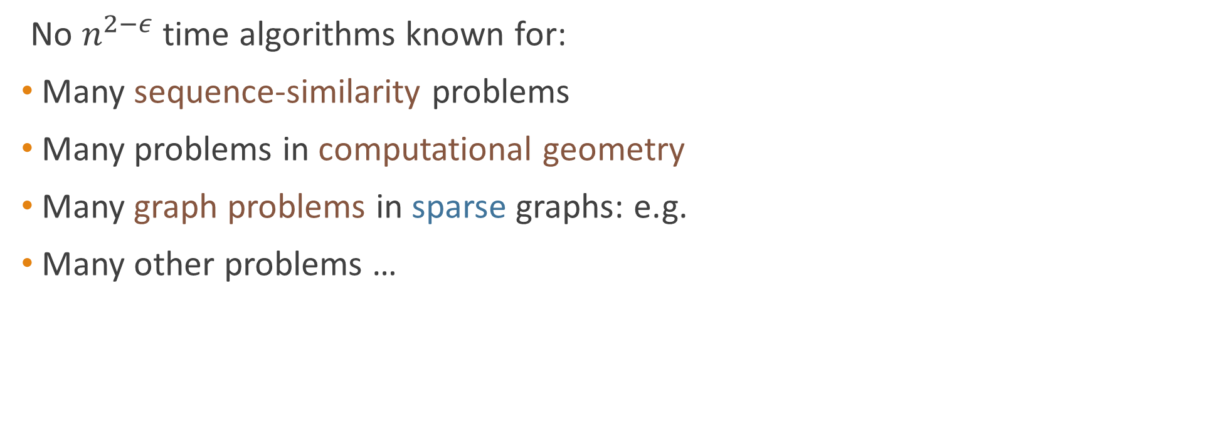
We are stuck on many problems, even just in $O(n^{2})$time
No $n^{2−ε}$ time algorithms known for:
Many sequence-similarity problems
Many problems in computational geometry
Many graph problems in sparse graphs: e.g.
Many other problems …
Why are we stuck?
Are we stuck because of the same reason?
Notes:
traditional complexity theory seems insufficient : polytime vs super-poly time

Slide 11
The success of NP-completeness theory
(not sufficient for our purpose!)
NP
1972: Karp’s 21
Max Cut
3DM
Vertex Cover
Chromatic Number
Independent Set
Partition
3-SAT
0-1 Integer Programming
Clique Cover
Exact Cover
poly(n) time
SAT
Knapsack
Clique
Set Packing
Feedback Arc Set
Hitting Set
Steiner Tree
Job Scheduling
Feedback Node Set
Hamiltonian Cycle
Notes:
traditional complexity theory seems insufficient : polytime vs super-poly time

Slide 12
We are stuck on many problems, even just in $O(n^{2})$time
No $n^{2−ε}$ time algorithms known for:
Many sequence-similarity problems
Many problems in computational geometry
Many graph problems in sparse graphs: e.g.
Many other problems …
Why are we stuck?
Are we stuck because of the same reason?
We need a complexity theory about concrete runtimes ($n^{2}$ vs $n^{2−ε}$)…

Slide 13
PLAN
Fine-Grained Complexity (a complexity theory about concrete runtimes)
Some basic results in FGC (with proofs)

Slide 14
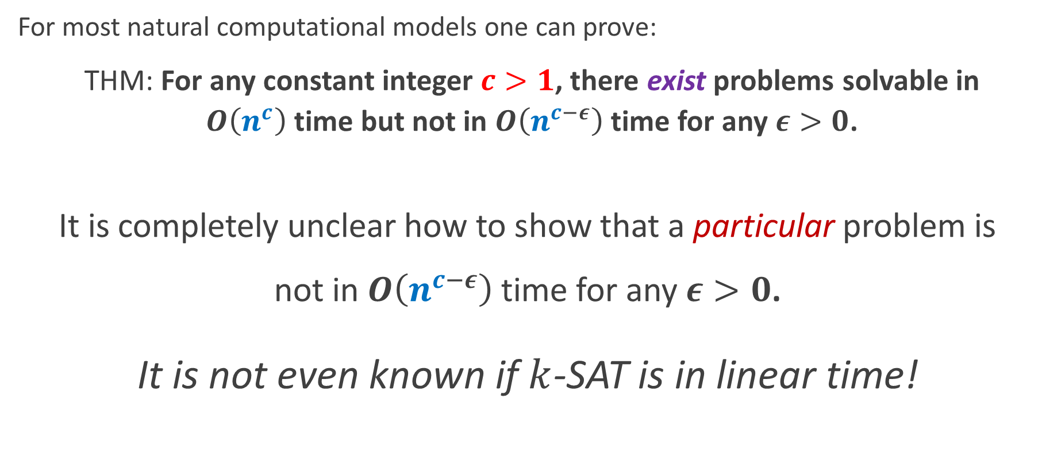
Time hierarchy theorems
For most natural computational models one can prove:
THM: For any constant integer $c>1$, there exist problems solvable in $O\left(n^{c}\right)$time but not in $O\left(n^{c−ε}\right)$time for any $ε>0$.
It is completely unclear how to show that a particular problem is
not in $O\left(n^{c−ε}\right)$time for any $ε>0$.
It is not even known if $k$-SAT is in linear time!
Notes:
simulate some computation, diagonalization
no insight for the problems we care about

Slide 15

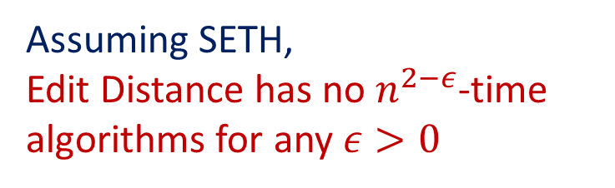
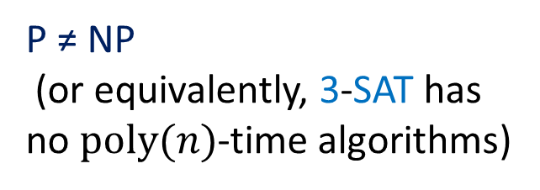
mimics NP-hardness, but is about concrete runtimes.
Theory of NP-Hardness
Fine-Grained Complexity Theory
Hardness Hypothesis
P ≠ NP
(or equivalently, 3-SAT has no $poly(n)$-time algorithms)
Problem H has no $f{\left(n\right)}^{1−ε}$-time algorithms for any $ε>0$
(e.g., SETH, 3SUM, APSP,… )
Reduction
Polynomial Time Reduction
Fine-Grained Reduction
(“coarse-grained”: allowing polynomial blowup)
Conclusion (for example):
Assuming P ≠ NP,
CLIQUE has no poly-time algorithms.
Assuming SETH,
Edit Distance has no $n^{2−ε}$-time algorithms for any $ε>0$
equivalent
(Conditional hardness)
(Conditional hardness)
(sometimes can show equivalence in FGC)
Notes:
reduce from 3-sat to clique, with arbitrary polynomial blow-up. (if CLIQUE has a polynomial time algorithm, then it can be used to solve SAT / any problem in NP in polynomial time)
Conditioned on a Believable hypothesis;
A single hypothesis -> many conditional hardness results. (Hamiltonian path, integer programming, ..)

Slide 16
PLAN
Fine-Grained Complexity
  Popular Hardness Hypotheses
  Fine-Grained Reduction
Some basic results in FGC (with proofs)

Slide 17
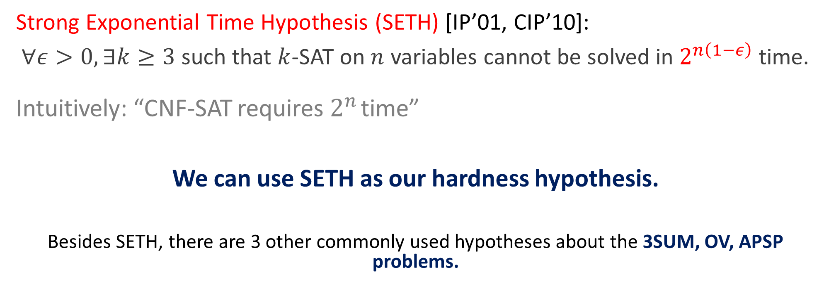

SAT is conjectured to be really hard
Much Stronger than P $≠$ NP!!!
Strong Exponential Time Hypothesis (SETH) [IP’01, CIP’10]:
$∀ε>0, ∃k≥3$ such that $k$-SAT on $n$ variables cannot be solved in $2^{n\left(1−ε\right)}$ time.
Intuitively: “CNF-SAT requires $2^{n}$ time”
We can use SETH as our hardness hypothesis.
Besides SETH, there are 3 other commonly used hypotheses about the 3SUM, OV, APSP problems.

Slide 18
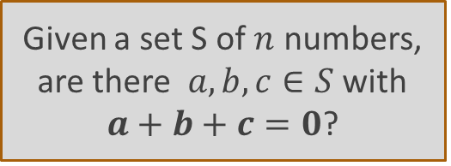
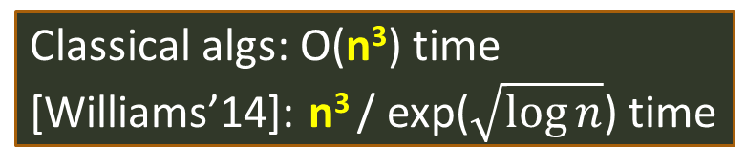
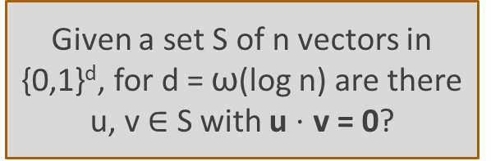
[Williams’05]: SETH implies OV hypothesis!
Hypothesis: Orthog. Vecs. requires n^{2-o(1)} time.
Given a set S of n vectors in {0,1}^{d}, for d = ω(log n) are there u, v $∈$ S with u $⋅$ v = 0?
Easy O(n² d) time alg
Best known [AWY’15]: n^{2 -Θ(1 / log (d/log n))}
Orthogonal vectors
Hypothesis: APSP requires n^{3-o(1)} time.
and more problems…
All pairs shortest paths: given an n-node weighted graph, find the distance between every two nodes.
Given a set S of $n$ numbers, are there $a,b,c∈S$ with
$a+b+c=0$?
3SUM
APSP
Easy O(n²) time alg
[BDP’05]: ~n² / log² n time for integers
[Chan’18] : ~n² / log² n time for reals
Hypothesis: 3SUM requires n^{2-o(1)} time.
Classical algs: O(n³) time
[Williams’14]: n³ / exp($\sqrt{\log{n}}$) time
Notes:
Strengthening of SETH [CGIMPS’16] suggests these are not equivalent…

Slide 19
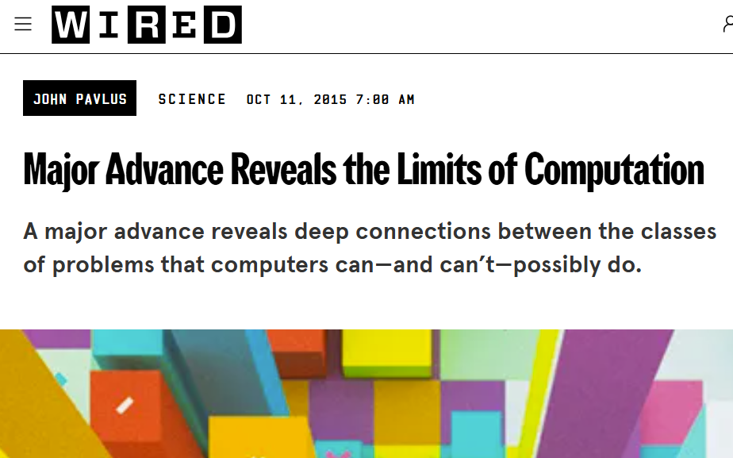

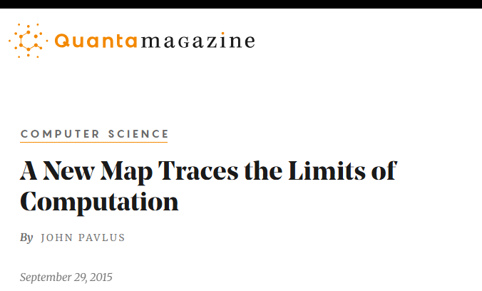

Example: ED is SETH-hard
Theorem [Backurs-Indyk 2015]:
Assuming SETH, Edit Distance does not have $n^{2−ε}$-time algorithms for any $ε>0$.
ATCGGGTTCCTTAAGGG
ATTGGTACCTTCAGG
(They actually reduce from Orthogonal Vectors (OV) to ED)
Notes:
alphabet 7, improved to binary alphabet later.

Slide 20
PLAN
Fine-Grained Complexity
  Popular Hardness Hypotheses
  Fine-Grained Reduction
Some basic results in FGC (with proofs)

Slide 21
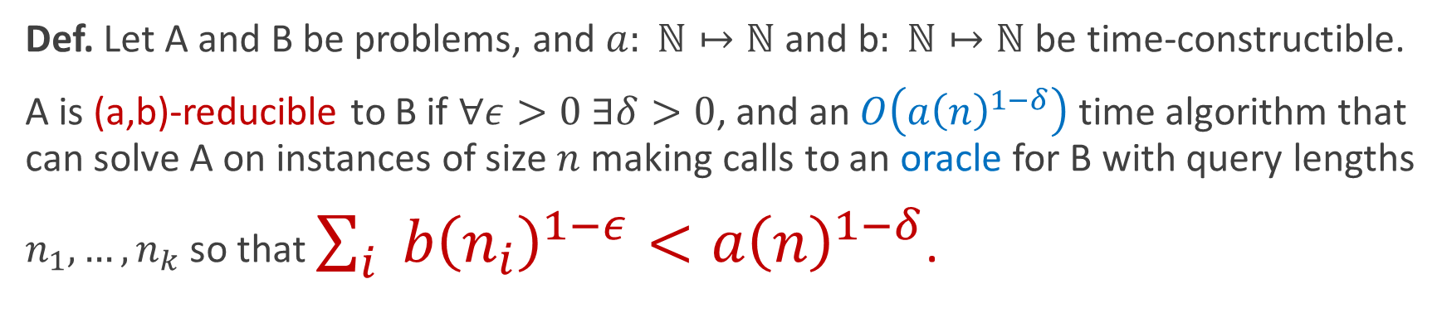
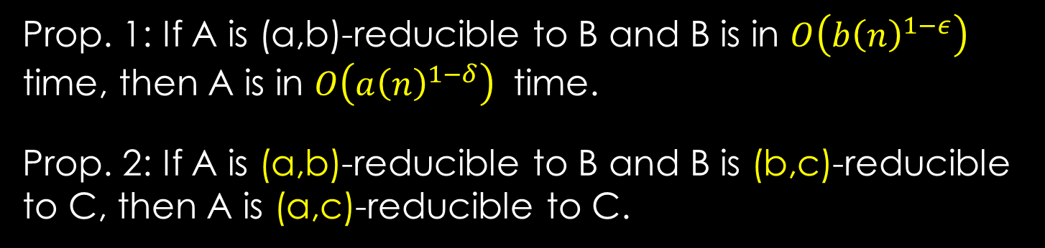
Fine-grained reductions
(Vassilevska and Williams’10)
Intuition: a(n),b(n) are the naive runtimes for A and B. A reducible to B implies that beating the naive runtime for B implies also beating the naive runtime for A.
Def. Let A and B be problems, and $a: ℕ↦ℕ$ and b$: ℕ↦ℕ$be time-constructible.
A is (a,b)-reducible to B if $∀ε>0 ∃δ>0$, and an $O\left(a{\left(n\right)}^{1−δ}\right)$ time algorithm that can solve A on instances of size $n$ making calls to an oracle for B with query lengths
$n_{1},…, n_{k}$ so that $\sum_{i}{ b{\left(n_{i}\right)}^{1−ε}<a{\left(n\right)}^{1−δ}}$.
n
A
Prop. 1: If A is (a,b)-reducible to B and B is in $O\left(b{\left(n\right)}^{1−ε}\right)$ time, then A is in $O\left(a{\left(n\right)}^{1−δ}\right)$ time.
Prop. 2: If A is (a,b)-reducible to B and B is (b,c)-reducible to C, then A is (a,c)-reducible to C.
a(n)^{1-δ}
B
B
B
B
n₁, n₂, …, n_{k}
Notes:
Delta can be smaller than epsilon. The ni’s are small so we can ask many questions on small subinstances.
even randomized is fine

Slide 22


Fine-Grained structure within P
Using other hardness assumptions, one can unravel even more structure
Many dynamic problems
[P’10],[AV’14], [HKNS‘15], [D16], [RZ’04], [AD’16],…
Graph diameter [RV’13,BRSVW’18], eccentricities [AVW’16] , local alignment, longest common substring* [AVW’14], Frechet distance [Br’14], Edit distance [BI’15], LCS, Dyn. time warping [ABV’15, BrK’15], subtree isomorphism [ABHVZ’15], Betweenness [AGV’15], Hamming Closest Pair [AW15], Reg. Expr. Matching [BI16,BGL17], Kernel and Neural Network Empirical Risk Minimization [BIS’17]…
N^{2- ε’}
Orthog. vectors
n^{3- ε}
N^{2- ε’}
N^{2- ε}
Huge literature in comp. geom. [GO’95, BHP98, …]: Geombase, 3PointsLine, 3LinesPoint, Polygonal Containment, Planar Motion Planning, 3D Motion Planning …
String problems: Sequence local alignment [AVW’14], jumbled indexing [ACLL’14], …
In dense graphs: radius, median, betweenness centrality [AGV’15], negative triangle, second shortest path, replacement paths, shortest cycle [VW’10], …
2^{(1 - δ)n}
[W’04]
$k$-SAT $∀k$
SETH
3SUM
APSP
$$\left(n^{3},n^{3}\right)$$
equivalent
N^{2- ε}
n^{3- ε}
Notes:
Convex polygon containment: O(n+m). non-convex (even if orthogonal) quadratic time.

Slide 23
PLAN
Fine-Grained Complexity
Some basic results (with proofs)
  SETH -> Orthogonal Vectors (OV)
  OV -> Diameter in sparse graphs
  (optional) All-pairs Shortest Paths (APSP) -> Negative Triangle

Slide 24

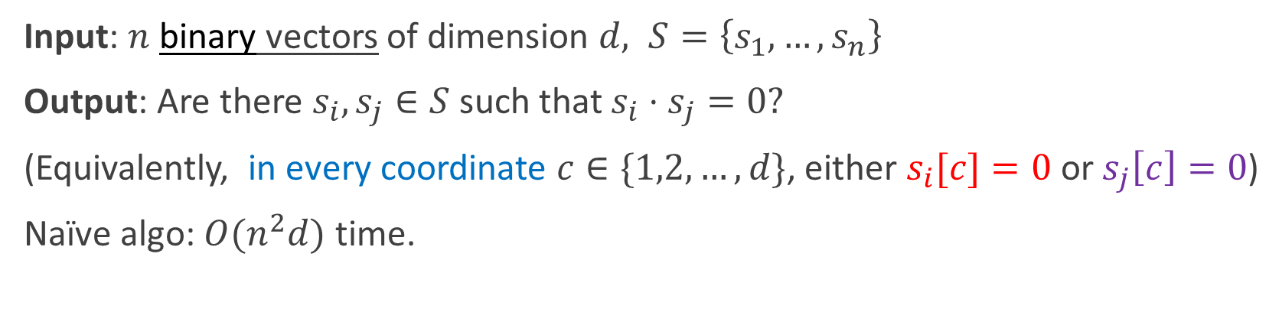
Orthogonal Vectors (OV)
(should think of $d=n^{o(1)}$)
Input: $n$ binary vectors of dimension $d, S=\left\{s_{1},…,s_{n}\right\}$
Output: Are there $s_{i},s_{j}∈S$ such that $s_{i}⋅s_{j}=0?$
(Equivalently, in every coordinate $c∈\{1,2,…,d\}$, either $s_{i}[c]=0$ or $s_{j}\left[c\right]=0$)
Naïve algo: $O(n^{2}d)$ time.
SETH: for every ε > 0, there is a k such that k-SAT on n variables cannot be solved in 2^{(1-ε)n} time.
Theorem [Williams’04]: If OV has an $O(n^{2−ε}⋅poly(d))$ time algorithm for any $ε>0$, then SETH is false!

Slide 25

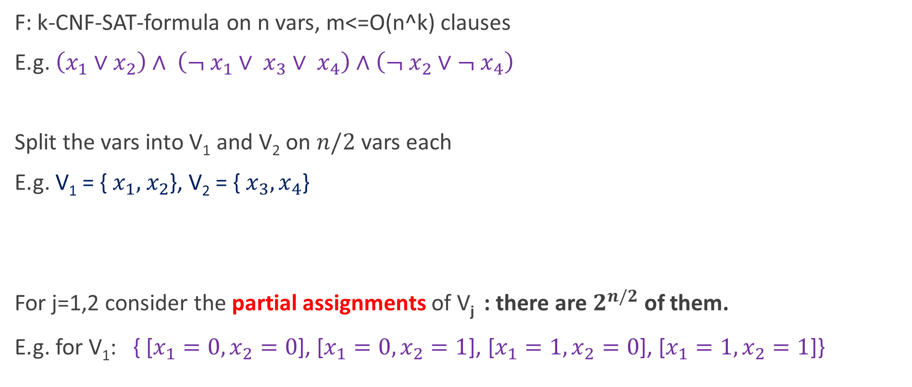
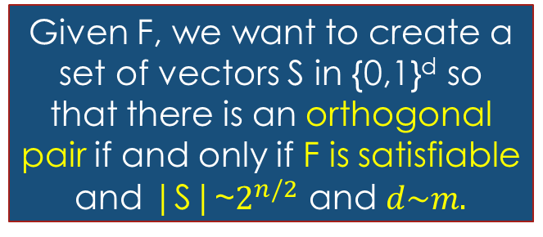
Fast OV implies SETH is false [Williams’04]
F: k-CNF-SAT-formula on n vars, m<=O(n^k) clauses
E.g. $\left(x_{1}∨x_{2}\right)∧ \left(¬ x_{1}∨ x_{3}∨ x_{4}\right)∧\left(¬ x_{2}∨¬ x_{4}\right)$
Split the vars into V₁ and V₂ on $n/2$ vars each
E.g. V₁ = { $x_{1}, { x}_{2}$}, V₂ = {$x_{3}, x_{4}$}
For j=1,2 consider the partial assignments of V_{j} : there are $2^{n/2}$of them.
E.g. for V₁: { [$x_{1}=0, x_{2}=0$], [$x_{1}=0, x_{2}=1$], [$x_{1}=1, x_{2}=0$], [$x_{1}=1, x_{2}=1$]}
OV: Given a set S of N vectors in {0, 1}^{d}, are there u, v $∈$S with u $⋅$ v = 0?
Given F, we want to create a set of vectors S in {0,1}^{d} so that there is an orthogonal pair if and only if F is satisfiable and |S|~$2^{n/2}$ and $d\sim m.$

Slide 26

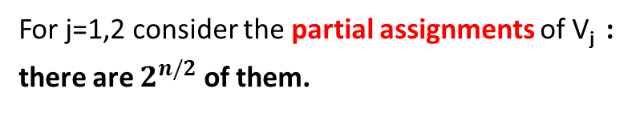
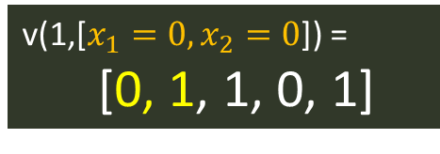
Fast OV implies SETH is false [Williams’04]
For j=1,2 consider the partial assignments of V_{j} :
there are $2^{n/2}$of them.
F- CNF-formula on n vars, m clauses
Split the vars into V₁ and V₂ on n/2 vars each
For j=1,2 and each partial assignment φ of V_{j} create (m+2) length vector v(j, φ):
E.g. $\left(x_{1}∨x_{2}\right)∧ \left(¬ x_{1}∨ x_{3}∨ x_{4}\right)∧\left(¬ x_{3}∨¬ x_{4}\right)$
clauses
V₁ = { $x_{1}, { x}_{2}$}, V₂ = {$x_{3}, x_{4}$}
v(1,[$x_{1}=0, x_{2}=0$]) =
[0, 1, 1, 0, 1]
0 | 1 | 0 | 1 | 0 | … | … | … | … | 1
for all v(1, φ)
0 if φ satisfies the clause, 1 otherwise
1 | 0 | 0 | 0 | 1 | … | … | … | … | 1
for all v(2, φ)
0 if φ satisfies the clause,
1 otherwise

Slide 27
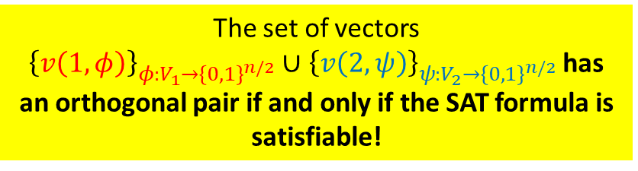
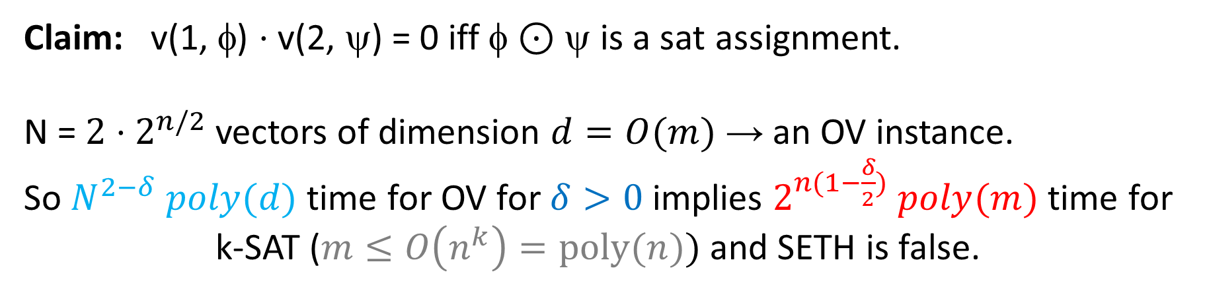


Fast OV implies SETH is false
$$v\left(1,φ\right)⋅v\left(1,φ^{′}\right)≠0$$
0 | 1 | 0 | 1 | 0 | … | … | … | … | 1
for all v(1, φ)
0 if φ satisfies the clause, 1 otherwise
$$v\left(2,φ\right)⋅v\left(2,φ^{′}\right)≠0$$
1 | 0 | 0 | 0 | 1 | … | … | … | … | 1
The set of vectors
${\left\{v\left(1,φ\right)\right\}}_{φ:V_{1}→{\left\{0,1\right\}}^{n/2}}∪$ ${\left\{v\left(2,ψ\right)\right\}}_{ψ:V_{2}→{\left\{0,1\right\}}^{n/2}}$ has an orthogonal pair if and only if the SAT formula is satisfiable!
for all v(2, ψ)
0 if ψ satisfies the clause,
1 otherwise
Claim: v(1, φ) $⋅$v(2, ψ) = 0 iff φ $⊙$ ψ is a sat assignment.
N = ${2⋅2}^{n/2}$ vectors of dimension $d=O(m)$ → an OV instance.
So $N^{2−δ} poly(d)$ time for OV for $δ>0$ implies $2^{n(1−\frac{δ}{2})} poly(m)$ time for k-SAT ($m≤O\left(n^{k}\right)=poly(n))$ and SETH is false.

Slide 28
PLAN
Fine-Grained Complexity
Some basic results (with proofs)
  SETH -> Orthogonal Vectors (OV)
  OV -> Diameter in sparse graphs
  (optional) All-pairs Shortest Paths (APSP) -> Negative Triangle

Slide 29
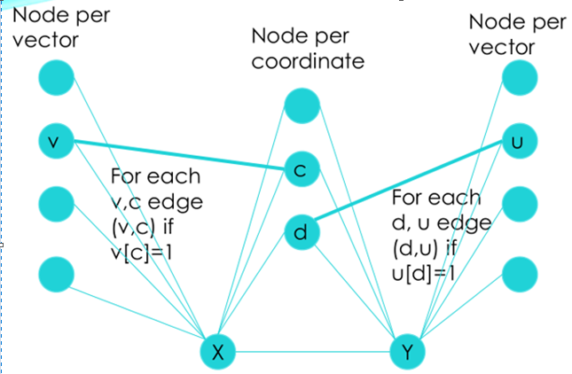
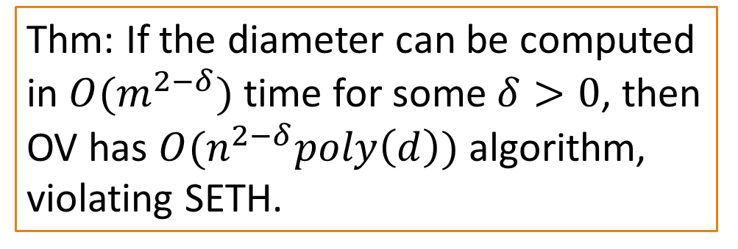
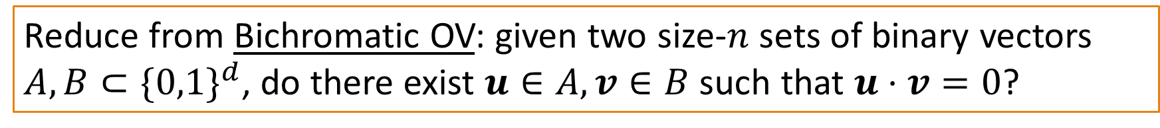



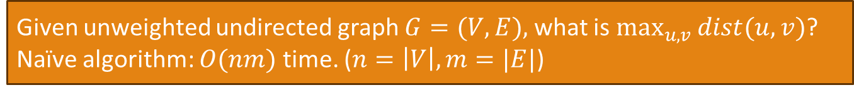
Sparse Graph Diameter (Roditty-Vassilevska W.’13)
Exercise: it’s fine-grained Equivalent to (mono-chromatic.) OV.
Given unweighted undirected graph $G=(V,E),$ what is $\max_{u,v}{dist(u,v)}$?
Naïve algorithm: $O(nm)$ time. ($n=\left|V\right|,m=|E|$)
Reduce from Bichromatic OV: given two size-$n$ sets of binary vectors $A,B⊂\{0,1\}^{d}$, do there exist $u∈A,v∈B$ such that $u⋅v=0$?
Observation: Diameter is 3 if exists orthogonal pair, and is 2 otherwise.
in $B$
in $A$
Graph has 𝑂(𝑛) nodes and $m=O(nd)$ edges
Thm: If the diameter can be computed in $O(m^{2−δ})$ time for some $δ>0$, then OV has $O(n^{2−δ}poly\left(d\right))$ algorithm, violating SETH.
Notes:
Any two vector nodes from the same side are at dist 2.
Any coordinate is at dist 2 from everyone, X and Y are at dist 2 from everyone.
Two vectors u and v from different sides are at dist 2 if exists a c with u[c]=v[c]=1, and at dist 3 otherwise.

Slide 30
PLAN
Fine-Grained Complexity
Some basic results (with proofs)
  SETH -> Orthogonal Vectors (OV)
  OV -> Diameter in sparse graphs
  (optional) All-pairs Shortest Paths (APSP) -> Negative Triangle

Slide 31
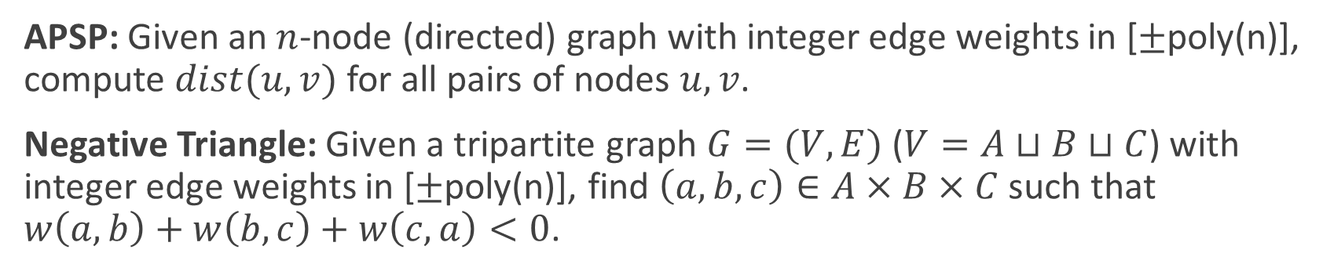
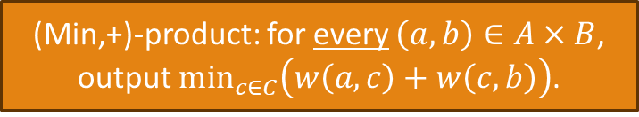
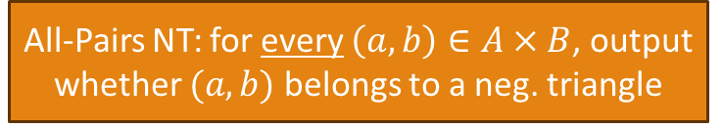
All-Pairs-Shortest-Paths -> Negative Triangle
[V. Vassilevska W. and R. Williams 2010]
APSP: Given an $n$-node (directed) graph with integer edge weights in [$±$poly(n)], compute $dist(u,v)$ for all pairs of nodes $u,v$.
Negative Triangle: Given a tripartite graph $G=(V,E)$ ($V=A⊔B⊔C$) with integer edge weights in [$±$poly(n)], find $\left(a,b,c\right)∈A×B×C$ such that $w\left(a,b\right)+w\left(b,c\right)+w\left(c,a\right)<0$.
(Min,+)-product: for every $\left(a,b\right)∈A×B$, output $\min_{c∈C}\left(w\left(a,c\right)+w\left(c,b\right)\right)$.
All-Pairs NT: for every $\left(a,b\right)∈A×B$, output whether $(a,b)$ belongs to a neg. triangle
Steps:
APSP -> (min,+)-matrix-product. (by repeated squaring)
(min,+)-matrix-product -> All-Pairs Negative Triangles (by parallel binary search)
All-Pairs Negative Triangles -> Negative Triangle (The Key Step)
Theorem: if NT is solvable in $O(n^{3−δ})$ time, then All-Pairs-NT is solvable in $O\left(n^{3−δ/3}\right)$ time.
Notes:
Proof on the board

Slide 32
Extensions of FGC
Dynamic Data Structures
Average case hardness
Hardness of approximation
Quantum Fine-grained complexity
…

Slide 33
THANK YOU

Slide 34
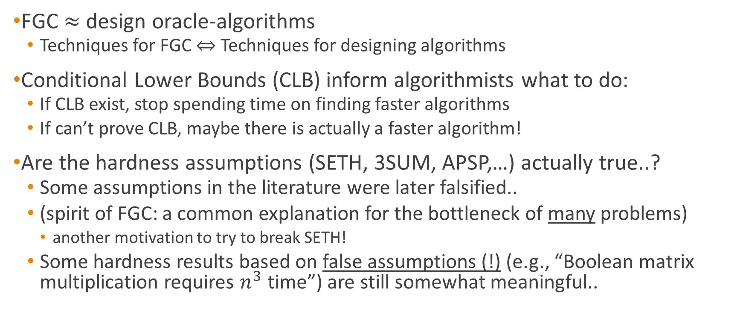
Fine-Grained Complexity & Algorithm Design
FGC $≈$ design oracle-algorithms
  Techniques for FGC $⇔$ Techniques for designing algorithms
Conditional Lower Bounds (CLB) inform algorithmists what to do:
  If CLB exist, stop spending time on finding faster algorithms
  If can’t prove CLB, maybe there is actually a faster algorithm!
Are the hardness assumptions (SETH, 3SUM, APSP,…) actually true..?
  Some assumptions in the literature were later falsified..
  (spirit of FGC: a common explanation for the bottleneck of many problems)
    another motivation to try to break SETH!
  Some hardness results based on false assumptions (!) (e.g., “Boolean matrix multiplication requires $n^{3}$ time”) are still somewhat meaningful..

