Slide 1
Collaborative Source Code Review
Django – based GitHub like code repository system

Slide 2
Presentation Agenda
Project Background
Functionalities
Demo
Process & Improvement

Slide 3
Project Background
Current Issues:
  Reviewers lack the ability to record and share their thoughts.
  GitHub does not support comment within a file.
  Uploaded file will not be automatically reformatted if the original format of src doc is malformed.
Goal of our project:
  Provide a platform for code reviewers to collaborate and share code from large codebases.
  Upload source code or link of a GitHub repo
  Code format and highlight according to language
  Freely add contributor

Slide 4

Functionalities
Account authentication management
registration / login / Edit profile
Review Statistic Dashboard (visualized table)
Code review
In-line comment
Auto-format file
Syntax highlight based on languages
Repository Management
Upload project locally
Clone repository from a GitHub account
Search by keywords
Invitation of collaborators

Slide 5
Demo

Slide 6
Process
Finished basic UI design by using HTML with Django template language
Designed database entities with Django model
Designed URI by configuring Django urls
User Authentication Module with Django auth
File format and comment with Javascript packages
Link with GitHub account to clone repositories

Slide 7
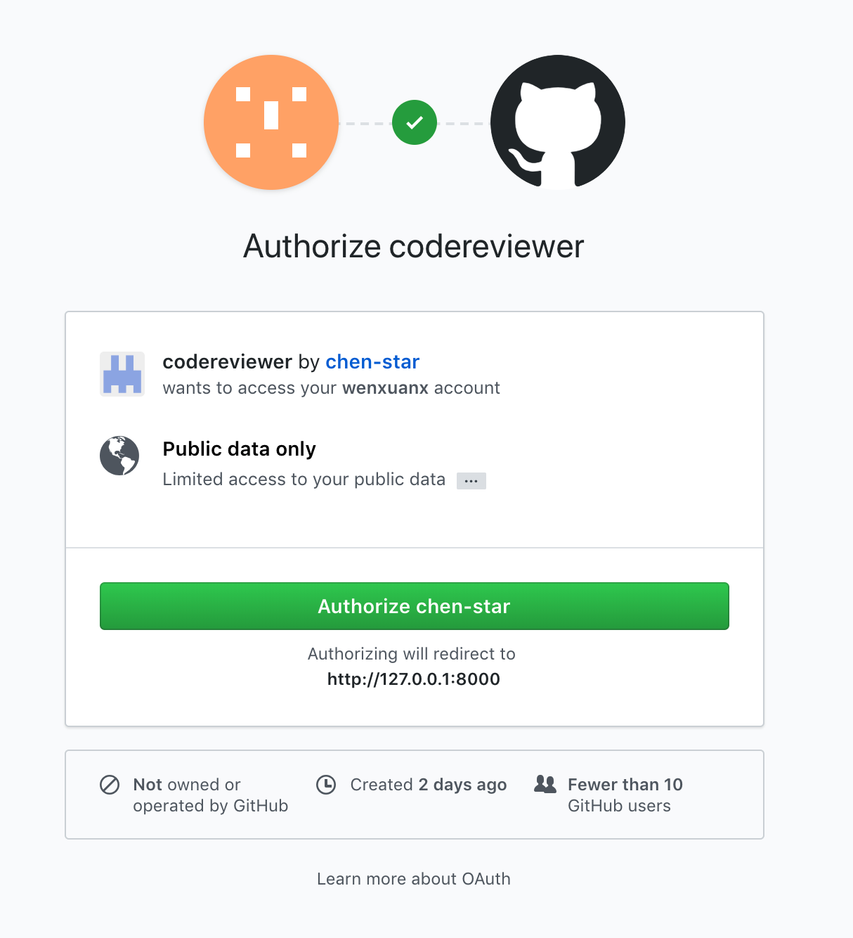
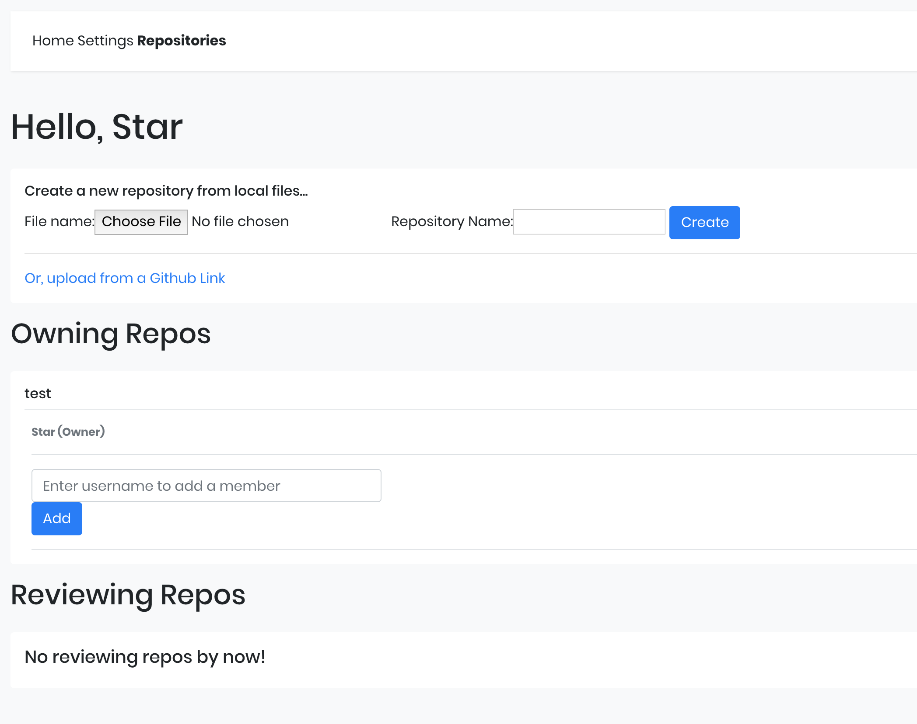
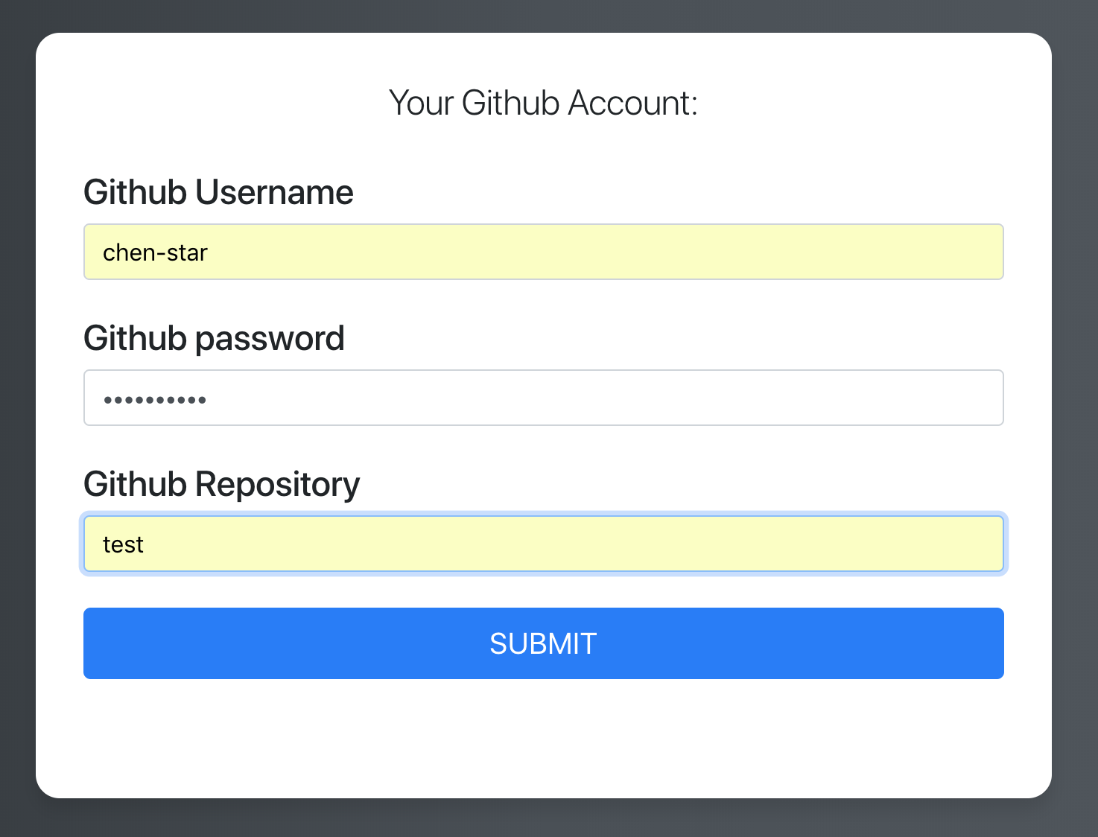
Improvements
data encryption for security concern
Integrated with GitHub

Slide 8
Thanks!

