Slide 1
Soil Moisture
METR 5633
Hydrometeorology

Slide 2
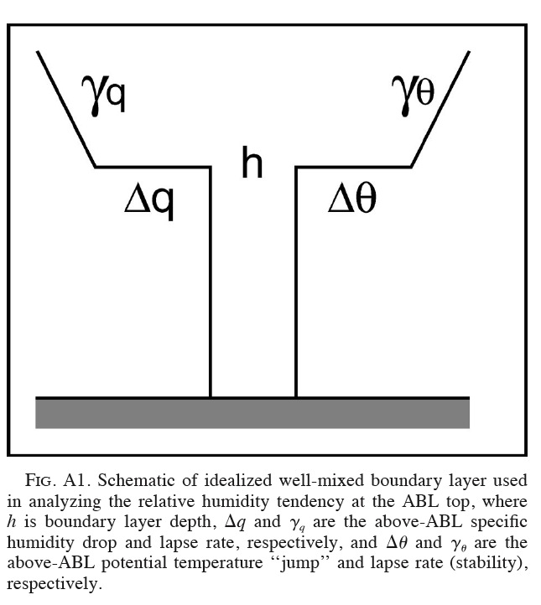
The Idealized PBL Scenario
Free Atmosphere
How do the varying characteristics of the surface impact the growth and development of the PBL?
Capping Inversion
“Well-Mixed” PBL
Ek and Holtslag (2004)

Slide 3
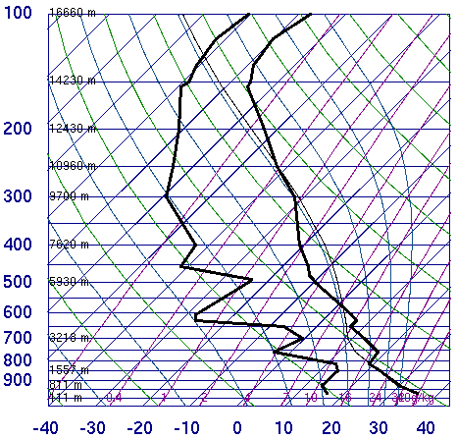
How do we typically determine the characteristics of the PBL?
How deep is it?
What does the thermal profile look like?
Humidity?
Rising/Sinking Motion?
Turbulence?

Slide 4
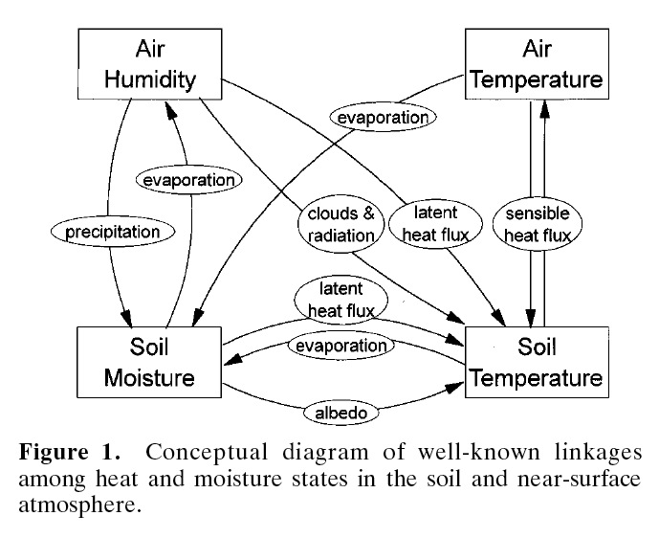
An Example of the Complex Interactions Between the Land Surface and the Atmosphere – Brubaker and Entekhabi (1996)

Slide 5
Q: What is soil moisture?
A: It is commonly referred to as the amount of water in the soil.

Slide 6
Q: In what direction, if any, will the water in the soils below move to obtain an equilibrium state?
Silt Loam
Volumetric Water
Content = 0.3
(30%)
Clay Loam
Volumetric Water
Content = 0.3
(30%)
A: From the silt loam to the clay loam.

Slide 7
What Governs the State of Soil Moisture?
“Soil is a wetting body. For this reason capillary moisture in the soil has a concave surface and is invariably under supplementary negative pressure [or suction]. Its magnitude is governed by the surface tension of the water and the radii of the curves, which depend on size and shape of the interstices, i.e., in the final analysis on the dispersion of the soil.” Razumova (1965)
Simply put, soil moisture is most directly influenced by a number of microscale physical properties which determine soil composition. These factors include soil texture (size, shape, and mineral composition of the soil particles), soil water potential (the energy state of soil water), organic matter and the magnitude of water contained in any given soil parcel.

Slide 8
A Quick Look at Soil Physics: Soil Texture
Sand 2 to 0.1 mm
Silt = 0.05 to 0.002 mm
Clay = < 0.002 mm

Slide 9
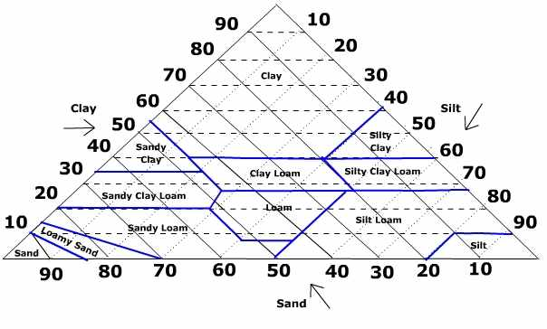
Soil Texture Can be Determined Using the Soil Texture Triangle

Slide 10
Soil Porosity: An index of the relative pore volume of the soil.
Sand
Silt
Clay
Porosity of Sand < Porosity of Silt < Porosity of Clay

Slide 11
Soil Water Content (θ_{s}): The total amount (mass,volume, etc.) of water that occupies the pore spaces of the soil.
Sand
Silt
Clay
At Field Capacity: θ_{s} of Sand < θ_{s} of Silt < θ_{s} of Clay

Slide 12
Soil Water Potential: The Energetics of Soil Water
As external forces attempt to remove water from the soil, water is restrained or held in the soil by adhesive and cohesive forces. This places the soil water under tension (soil matric potential).
Often expressed as a negative pressure (e.g., -100 kPa).
Soil water moves from regions of large potential values to regions of low potential values.

Slide 13
Back to a Previous Example
Silt Loam
Volumetric Water
Content = 0.3
(30%)
Clay Loam
Volumetric Water
Content = 0.3
(30%)
Water will move from the silt loam soil to the clay loam soil in order to bring the soils into potential equilibrium.
The relationship between soil water content and soil water potential are unique to each soil and can be defined using a soil water release curve.

Slide 14
More on Our Example
At a volumetric water content value of 0.3, the potential values are -10 kPA for Silt Loam, and -50 kPa for Clay Loam.
As a result, water will move from the Silt Loam to the Clay Loam to establish Potential Equilibrium.

Slide 15
Commonly Used Terms Describing Soil Moisture and the Associated Potential Values
Saturation: ~ 0 kPa
Field Capacity - The maximum value of soil water content after gravitational drainage: ~ -30 kPa
Wilting Point - The value of soil water at the point when plants can no longer extract water from the soil: ~ -1500 kPa
Available Water - The range of soil water between Field Capacity and Wilting Point.

Slide 16
Q: How Does Soil Moisture Impact Atmospheric Processes?
A: Mainly through the Partitioning of Energy in the Surface Energy Budget.

Slide 17
Typical Plot of The Surface Energy Balance
Net Radiation
Sensible Heat Flux
Latent Heat Flux
Recall:
Rn - G = SH + LH
Ground Heat Flux

Slide 18
The Impact of Soil Moisture Conditions for each of the Surface Energy Balance Terms
Net Radiation - Overall affects are negligible, however, soil moisture conditions can impact the surface albedo (absorbed shortwave radiation) and skin temperature (emitted longwave radiation).
Latent Heat Flux - Increased Soil Moisture => Increased Evaporation => Increased Latent Heat Flux (and Vice Versa)
Sensible Heat Flux - Increased Soil Moisture => Increased Evaporation => Cooler Surface => Decreased Sensible Flux (and Vice Versa)
Ground Heat Flux - Increased Soil Moisture => Increased Soil Heat Capacity => Increased Ground Heat Flux (and Vice Versa).

Slide 19
Plot of The Surface Energy Balance Revisited
Sensible Heat Flux
Latent Heat Flux
3
1
Net Radiation
2
2
1
3
Ground Heat Flux
3
Moist Soil Conditions
“Normal” Soil conditions
Very Dry Soil Conditions
2
1

Slide 20
Summary – Soil Moisture
Soil moisture conditions are controlled by complex relationships between soil texture and the magnitude of the water in the soil.
It has a significant impact on the surface energy budget (SEB) and near-surface state variables.
On local scales, the soil moisture interactions with the SEB significantly impacts PBL development.
Can also impact large-scale features when land-atmosphere interactions dominate.

