Slide 1



Data Privacy in Trigger-Action Systems
Yunang Chen*, Amrita Roy Chowdhury*, Ruizhe Wang*,
Andrei Sabelfeld†, Rahul Chatterjee*, Earlence Fernandes*
* University of Wisconsin-Madison
† Chalmers University of Technology

Slide 2











Online services with different APIs don’t talk to each other

Slide 3



Trigger-Action Platforms (TAPs) connect independent services to empower automation rules
Popular Commercial Trigger-Action Platforms

Slide 4


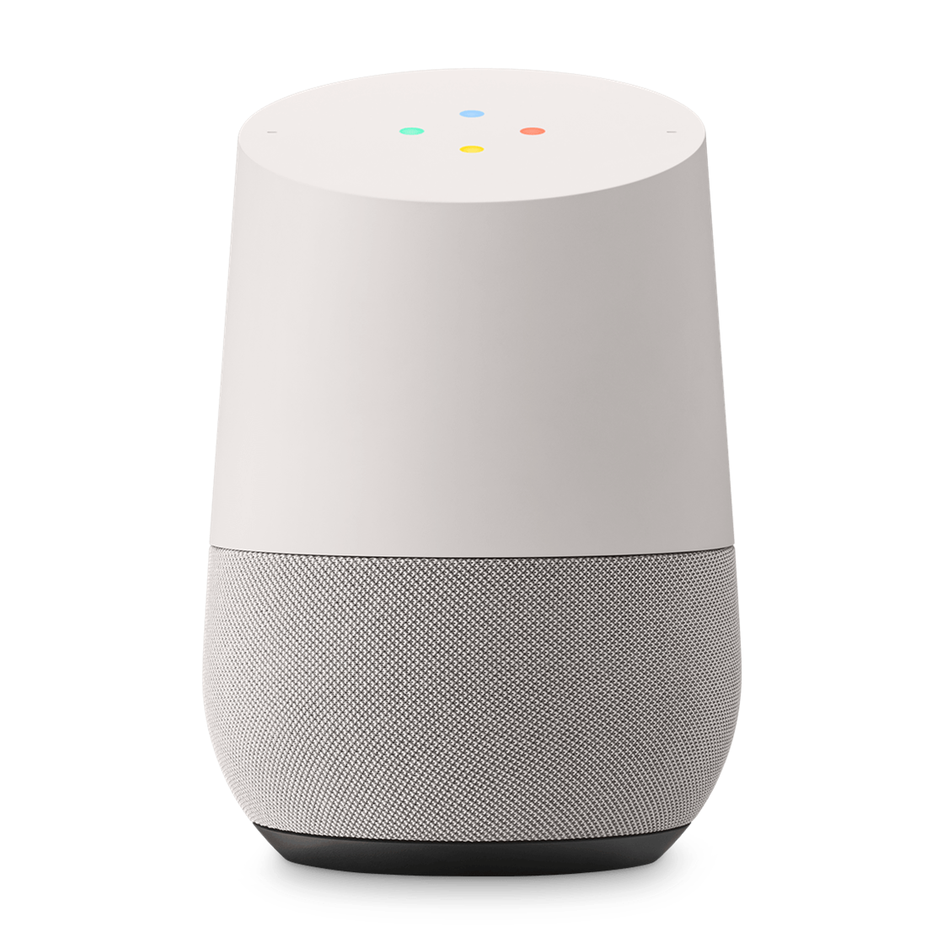


Trigger-Action Automation Rules
IF
room PM level
>
threshold
, THEN
turn on air purifier
IF
new email received
is from
bank
, THEN
ring smart speaker
IF
new transaction
happens with
transaction amount
>
$100
AND
transaction time
during
midnight
,
THEN
send SMS
with
receiver
=
phone number extract from
contact information
AND
message body
=
“Warning: ”
+
transaction details

Slide 5
However, users risk their privacy and security
Sensitive information is leaked
Arbitrary actions can be performed
What happens if TAP is compromised?
Control lights
Chat logs
Emails
Control power outlets
Social networks
Control ovens
Cloud files

Slide 6
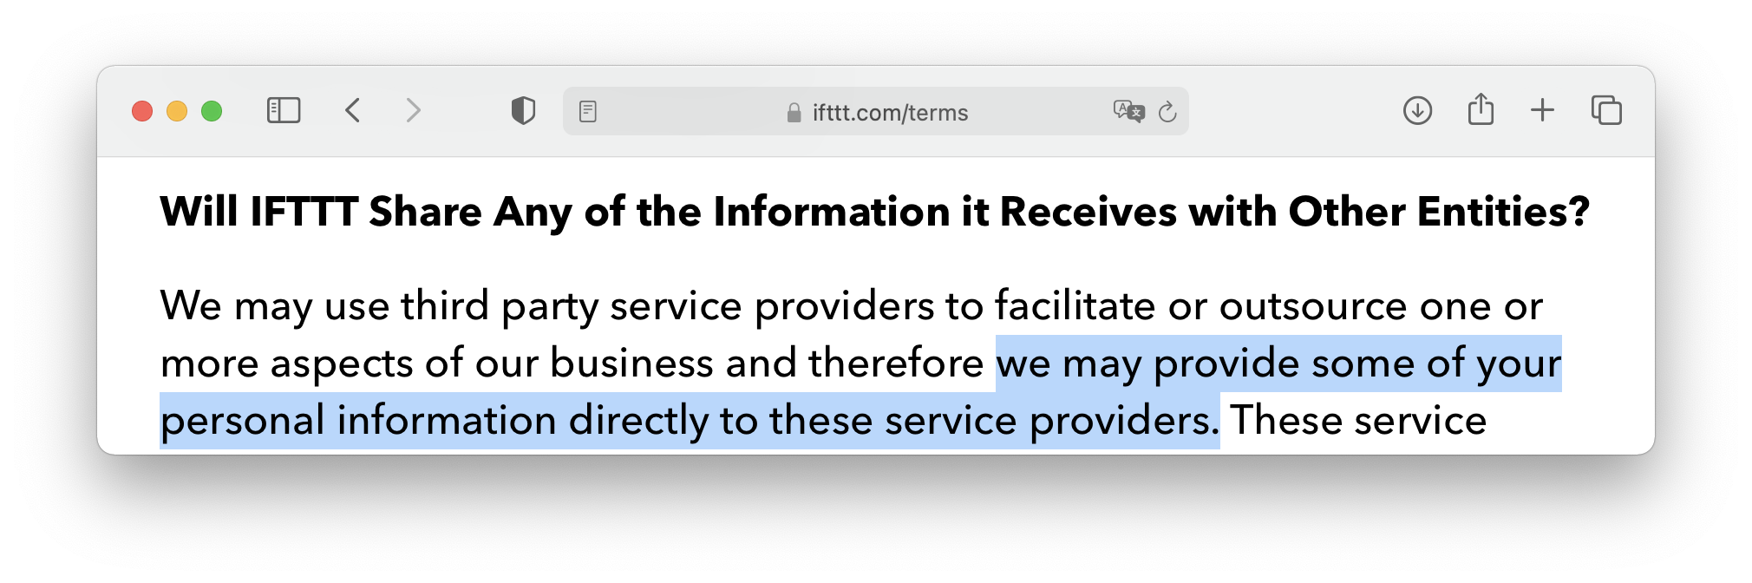
Security Concerns in TAPs: IFTTT as a Case Study
IFTTT’s Term of Use states…
IFTTT operates on lots of sensitive information
Integrated with 600+ services
Has 20M+ users

Slide 7


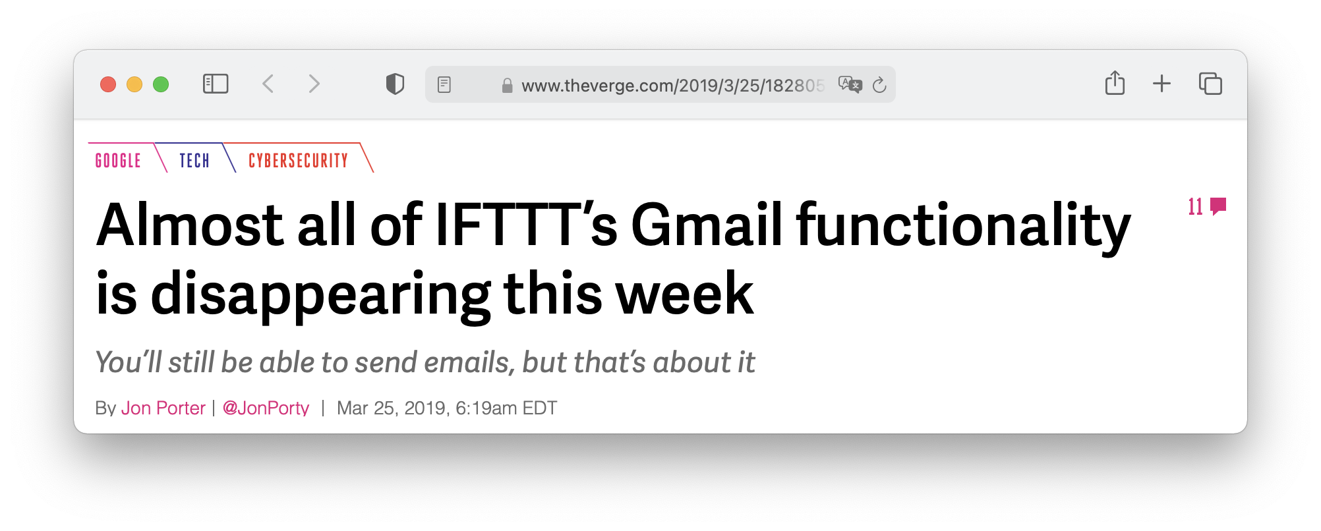

Security Concerns in TAPs: IFTTT as a Case Study
Access tokens acquired by IFTTT are overprivileged [Fernandes et al, 2018]
Gmail removed its triggers from IFTTT due to security concern in 2019
Give me a token that can
Access given files
Share given files
Delete given files
$⋯$
Trigger a rule when I upload a new file to Google Drive
Notes:
We use IFTTT, which is …, as an example to showcase the security concerns in TAPs

Slide 8
How to design a secure trigger-action system?

Slide 9

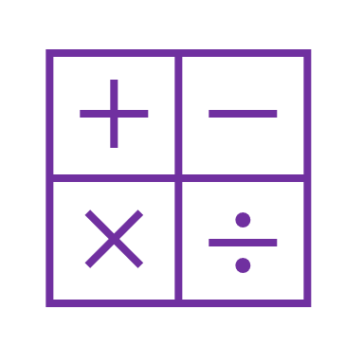


eTAP: encrypted Trigger-Action Platform
Protect data privacy and integrity
Support computations in rules
Optimize for string operations
Efficient protocol with low overhead

Slide 10
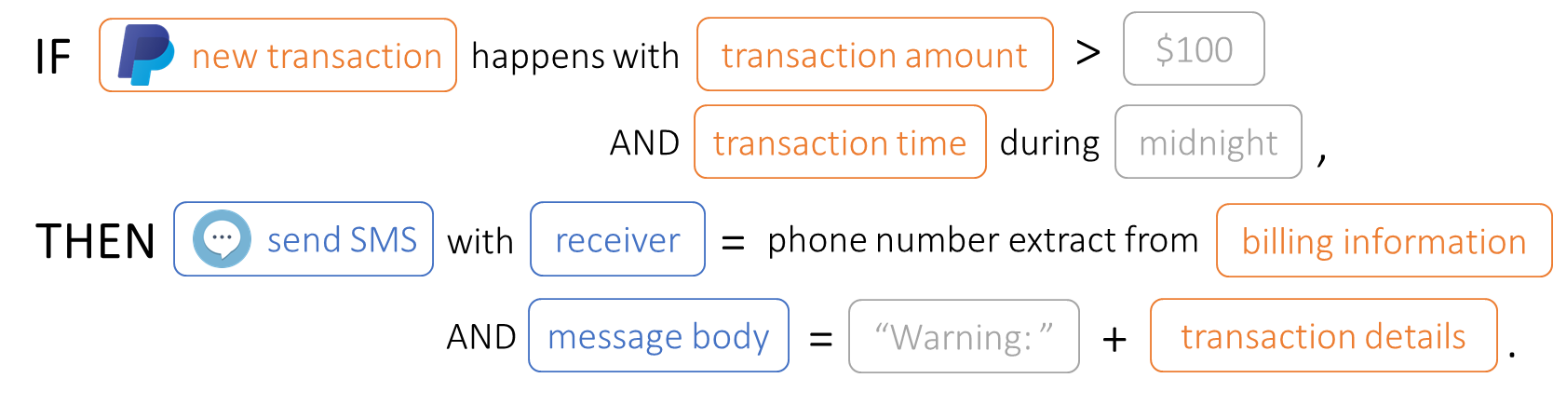

Abstract Paradigm of a Trigger-Action System
Programmed through User Client
Trigger-Action Platform (TAP)
Trigger Service
trigger data
action data
Action Service
IF f₁(trigger data, constant),
THEN action data = f₂(trigger data , constant)

Slide 11


Security Guarantees and Practical Consideration of eTAP
User Client
trusted
has fully infiltrated
Trigger-Action Platform (TAP)
Trigger Service
trigger data
action data
Action Service
IF f₁(trigger data, constant),
THEN action data = f₂(trigger data , constant)
honest but curious
honest but curious
malicious
Security Guarantees
Attacker can’t learn trigger and action data
Attacker can’t modify or delay action data
Action Service can’t learn trigger data and vice versa
Action Service can only learn action data when f₁ = true
Only client can learn user constant
Practical Consideration
Minimal changes to trigger and action service (no infrastructural change, constant extra storage per user, etc.)
Services don’t need to know each other or the rules
Client may not be always online
[Chiang et al, 2020]
[Fernandes et al, 2018],
[Chiang et al, 2020]

Slide 12
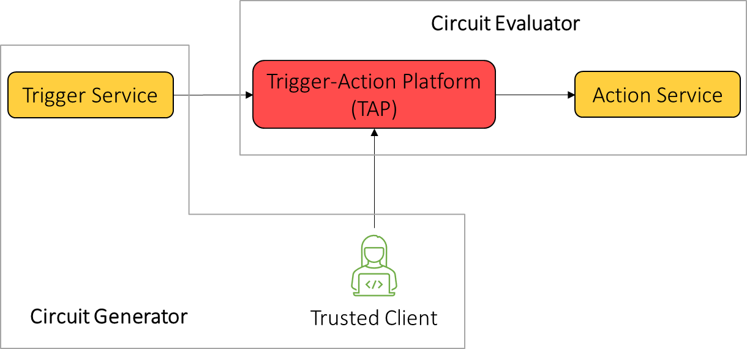
Design Overview of eTAP
Use Garbled Circuit for secure function evaluation
Extend Garbled Circuit to satisfy all security goals
Asymmetric trust assumptions lead to more optimizations
computationally efficient
Evaluate garbled circuit
Decode output data
can be pre-computed w/o input
Convert functions to garbled circuit
Encode input data

Slide 13


Phase #1: Setup (once, w/ client)
During OAuth negotiation with Trigger/Action Service
Trigger Service
Trigger-Action Platform (TAP)
Action Service
$$k_{T}$$
$$k_{A}$$
Trusted Client
trigger secret key to generate GC encoding information
action secret key to protect GC decoding information

Slide 14
Phase #2: Function Garbling (periodic, w/ client)
Given a Rule:
IF f₁(trigger data, constant),
THEN action data = f₂(trigger data , constant)
Trigger-Action Platform (TAP)
Client does:
garbled circuit,
garbled constant,
decode blob
constant
$$k_{T}$$
f₁, f₂
$$k_{A}$$
encode info
Trusted Client
Input Encoding
Garbled Circuit Generation
garbled constant
garbled circuit
decode info
Symmetric Encryption
decode blob

Slide 15

Phase #3: Execution (whenever trigger happens, w/o client)
garbled trigger data
Trigger-Action Platform (TAP)
Trigger Service
Action Service
Trigger Service does:
$$k_{T}$$
trigger data
encode info
Input Encoding
garbled trigger data

Slide 16
Phase #3: Execution (whenever trigger happens, w/o client)
garbled trigger data
Trigger-Action Platform (TAP)
garbled action data
Trigger Service
Action Service
decode blob
TAP does:
garbled circuit
garbled constant
garbled trigger data
Garbled Circuit Evaluation
garbled action data

Slide 17

Phase #3: Execution (whenever trigger happens, w/o client)
garbled trigger data
Trigger-Action Platform (TAP)
garbled action data
Trigger Service
Action Service
decode blob
Action Service does:
$$k_{A}$$
decode blob
garbled action data
Symmetric Decryption
decode info
Output Decoding
action data

Slide 18
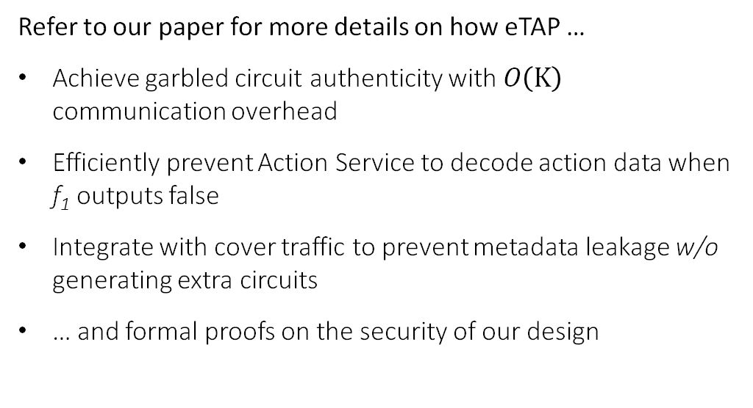
Benefits of eTAP’s Design
No need for oblivious transfer: All input data provided by “Circuit Generator”
Allows for efficient protocol: Extending semi-honest protocols with authenticity can defend against a malicious TAP
Refer to our paper for more details on how eTAP …
Achieve garbled circuit authenticity with $O\left(Κ\right)$ communication overhead
Efficiently prevent Action Service to decode action data when f₁ outputs false
Integrate with cover traffic to prevent metadata leakage w/o generating extra circuits
… and formal proofs on the security of our design

Slide 19
Common functions crawled from top IFTTT + Zapier rules
Function | Description
AND, OR, NOT | Boolean operations
<, >, ==, +, -, *, / | Basic numeric operations
x == “…” | String comparison
Map.lookup(x) | Look up the value for the key x in a map
x.contain(“…”) | Does x contain a string?
x.start/end_with(“…”) | Does x start/end with a string?
x.split(“…”, i) | Split x using a delimiter and select the i-th substring
x.replace(“…”, “…”) | Replace all occurrences in x
x.extract_phone/email() | Extract the first phone number/email found in x
x.strip_html/markdown() | Remove all HTML tags / convert to markdown
x.format() | Number formatting

Slide 20
Common functions crawled from top IFTTT + Zapier rules
Function | Description
AND, OR, NOT | Boolean operations
<, >, ==, +, -, *, / | Basic numeric operations
x == “…” | String comparison
Map.lookup(x) | Look up the value for the key x in a map
x.contain(“…”) | Does x contain a string?
x.start/end_with(“…”) | Does x start/end with a string?
x.split(“…”, i) | Split x using a delimiter and select the i-th substring
x.replace(“…”, “…”) | Replace all occurrences in x
x.extract_phone/email() | Extract the first phone number/email found in x
x.strip_html/markdown() | Remove all HTML tags / convert to markdown
x.format() | Number formatting
supported by common GC libraries / easy to implement

Slide 21
Common functions crawled from top IFTTT + Zapier rules
Function | Description
AND, OR, NOT | Boolean operations
<, >, ==, +, -, *, / | Basic numeric operations
x == “…” | String comparison
Map.lookup(x) | Look up the value for the key x in a map
x.contain(“…”) | Does x contain a string?
x.start/end_with(“…”) | Does x start/end with a string?
x.split(“…”, i) | Split x using a delimiter and select the i-th substring
x.replace(“…”, “…”) | Replace all occurrences in x
x.extract_phone/email() | Extract the first phone number/email found in x
x.strip_html/markdown() | Remove all HTML tags / convert to markdown
x.format() | Number formatting
supported by common GC libraries / easy to implement
can be implemented with simple regular expression
Challenge: How to evaluate regular expression efficiently in garbled circuits?

Slide 22
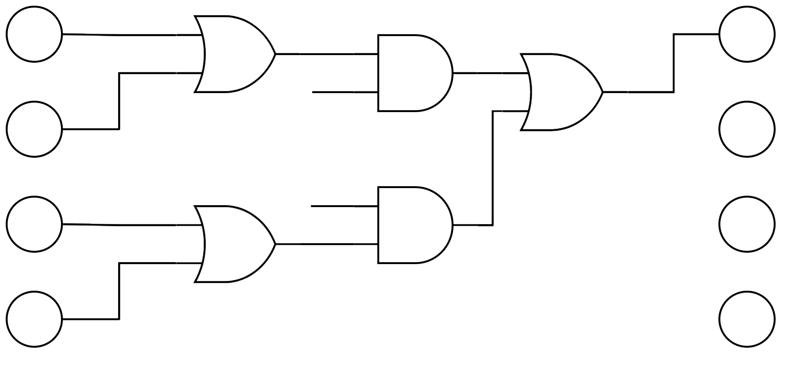
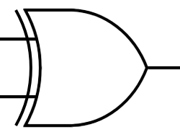
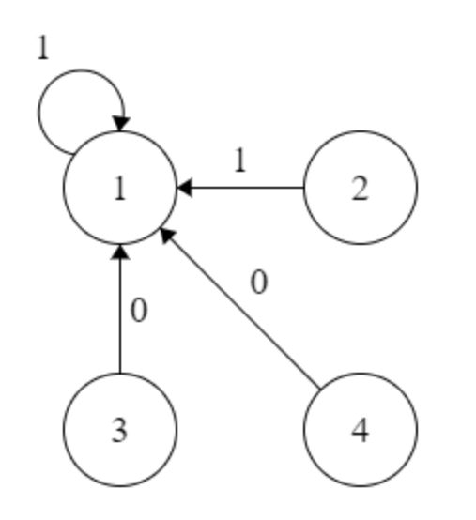
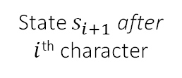
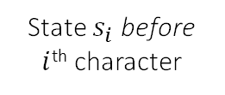


Optimize for Regular Expression
One-hot encoded
Can be replaced with XOR gate
State $s_{i}$ before $i$^{th} character
State $s_{i+1}$ after $i$^{th} character
Regular Expression
$$x_{i}$$
$$\overline{x_{i}}$$
Deterministic Finite Automaton (DFA)
State Transition Circuit
XOR gates can be computed for free

Slide 23
Common functions crawled from top IFTTT + Zapier rules
Function | Description
AND, OR, NOT | Boolean operations
<, >, ==, +, -, *, / | Basic numeric operations
x == “…” | String comparison
Map.lookup(x) | Look up the value for the key x in a map
x.contain(“…”) | Does x contain a string?
x.start/end_with(“…”) | Does x start/end with a string?
x.split(“…”, i) | Split x using a delimiter and select the i-th substring
x.replace(“…”, “…”) | Replace all occurrences in x
x.extract_phone/email() | Extract the first phone number/email found in x
x.strip_html/markdown() | Remove all HTML tags / convert to markdown
x.format() | Number formatting
supported by common GC libraries / easy to implement
eTAP supports 93.4% of all Zapier rules and 100% of top 500 IFTTT rules
can be implemented with simple regular expression
hard to implement efficiently

Slide 24
Modest overhead of running encrypted rules in eTAP
Avg. 55% increase
Avg. 59% decrease
Rule | #1 | #2 | #3 | #4 | #5 | #6 | #7 | #8
Functions Used | x.start_with(“…”) | x > n | x - n | x == “…” | x.replace(“…”, “…”) | x.split(“…”, i) | x.start_with(“…”); x.replace(“…”, “…”); Map.lookup(x) | x.contain(“…”)

Slide 25



Client Overhead Estimation
Based on prior study [Mi et al, 2017] [Cobb et al, 2020], assuming that
an average user has 26 rules installed
each rule will be executed once every 15 minutes
Client needs to spend 10.2 seconds per day to generate garbled circuits of size 61.7 MB in total
$≈$ 25
/ 1 min

Slide 26


Conclusion
Trigger-action platforms provide desirable functionality but pose security and privacy threats if compromised.
We propose eTAP, a clean-slate design for trigger-action platforms
Data privacy and integrity against malicious TAP
Efficiently support common string operations
Optimize garbled circuits with asymmetric trust assumptions
Modest performance reduction for rule execution
Yunang Chen yc@cs.wisc.edu
https://github.com/EarlMadSec/etap

