Slide 1
Capstone II :Vehicle fuel economy
Presented by: Zhonghai Chen

Slide 2
Project goal
Do regular and premium have significant impact to our fuel economy?
Regular
Premium

Slide 3
Why regular and premium?

Slide 4
Hypotheses
Null Hypothesis 1 (H₀):
Regular and Premium do not have significant effect on fuel economy.
Alternate Hypothesis 1 (H_{a}):
Regular and Premium do have significant effect on fuel economy.
------------------------------------------------
Null Hypothesis 2 (H₀):
With Electricity, Regular and Premium do not have positive effect on fuel economy significantly.
Alternate Hypothesis 2 (H_{a}):
With Electricity, Regular and Premium do have positive effect on fuel economy significantly.

Slide 5
Process
Collect data on both fuel types, regular and premium from Kaggle, given fuel economy scores for each type of fuels.
Conduct statistical analyses to see if there is any statistically significant difference or impact between regular and premium on fuel economy scores.

Slide 6
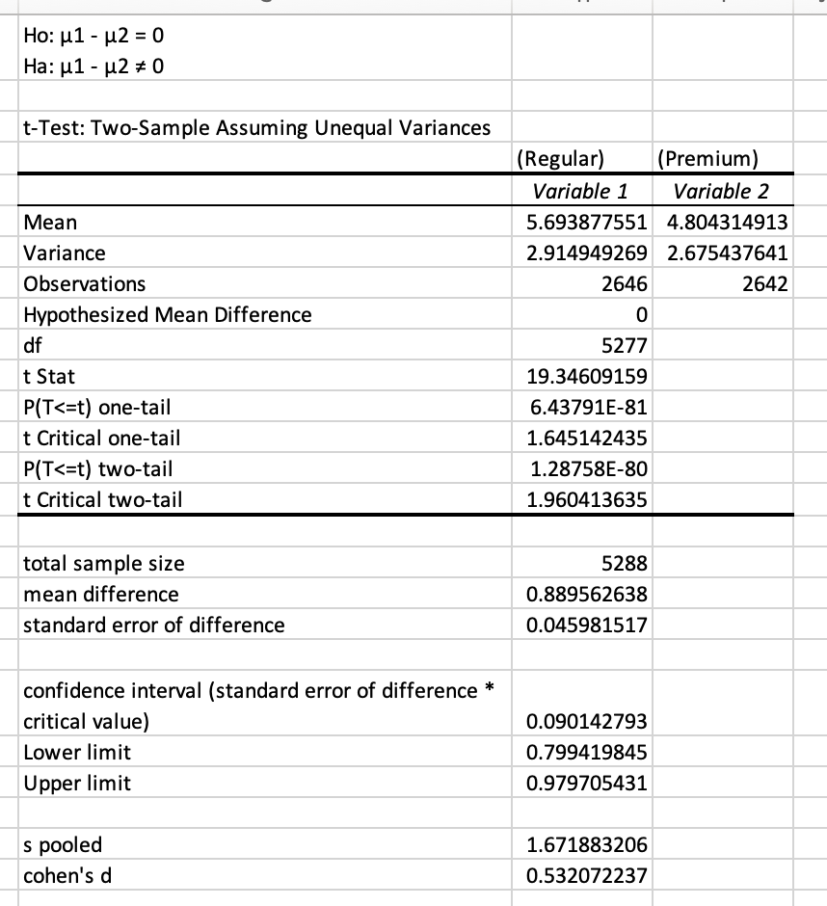
Analysis of Regular and Premium
(The null hypothesis 1 is rejected)
Conclusion 1:
There is significant difference (good or bad) between regular and premium on fuel economy score.

Slide 7
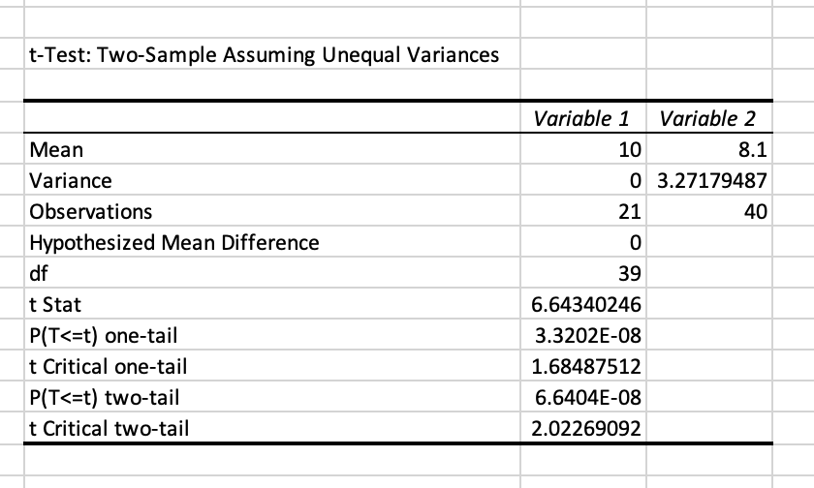
Analysis of Regular Vs. Premium (Including Electricity)
(The null hypothesis 2 is ALSO rejected)
Conclusion 2:
With electricity, Regular and Premium positively effect on fuel economy score significantly.

Slide 8
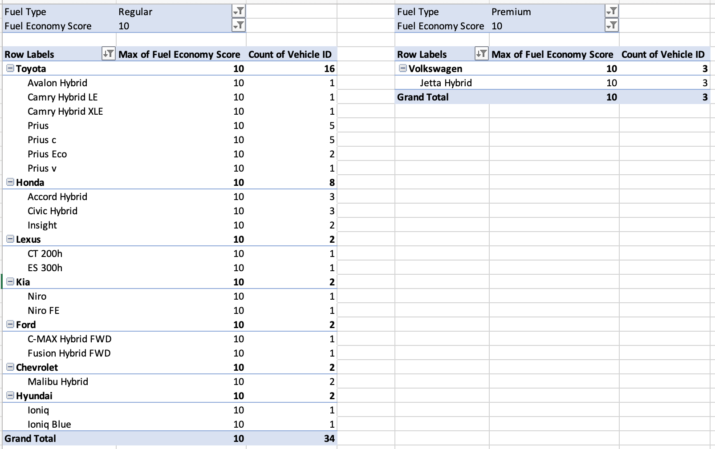
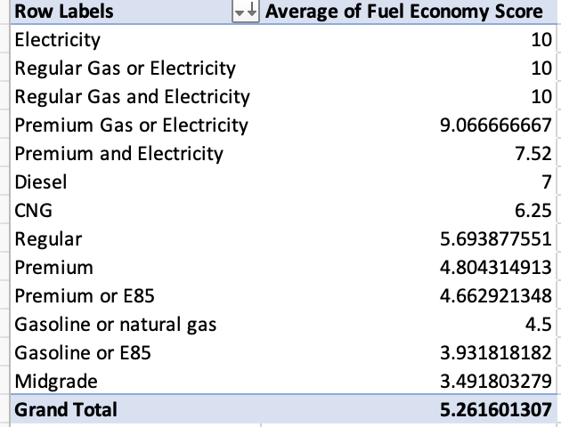
More FACTS

Slide 9
Final message and recommendations
The statistical analyses showed that Regular and Premium on fuel economy score:
Do have a significant impact on fuel economy score
Recommendation:
In order to improve fuel economy score from regular and premium, choosing specific car models and manufacturers is necessary. Furthermore, cars with electricity are recommended for improving fuel economy.

