Slide 1
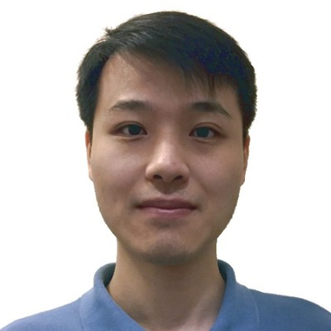
Chen Xu
Computer Science and Engineering
University at Buffalo
Advisor: Kenneth Regan
1
Notes:
Name: Chen Xu. Affiliation: Computer Science and Engineering, University at Buffalo. Advisor: Kenneth Regan. Verified against the University at Buffalo PhD roster: https://cse.buffalo.edu/ubcms/phd-roster/ . Portrait supplied by Chen Xu in this conversation.

Slide 2
Pre-AI work
2
Notes:
Content pending Chen’s details on pre-AI work. Timing and script will be completed after those details arrive.

Slide 3
Post-AI work
3
Notes:
Content pending Chen’s details on post-AI work. Timing and script will be completed after those details arrive.

Slide 4
Strengths
Elementary
Analytical
Irregular
4
Notes:
Strengths in Chen’s requested order: Elementary, Analytical, Irregular. Supporting examples and wording pending further details.

Slide 5
Future plan
5
Notes:
Future plan details pending from Chen. Complete the final two-minute script after all details arrive.

