Slide 1


Machine Learning
Ivan Chen
Feb 2020

Slide 2

Agenda
Background and Motivation
Job description classification & bill rate prediction
Existing approach and issues
Assessments and Solutions
Word2Vec for feature extraction
Deep neural network for learning
Implementation and Results
Principles and Best Practices
Demo
Q & A

Slide 3
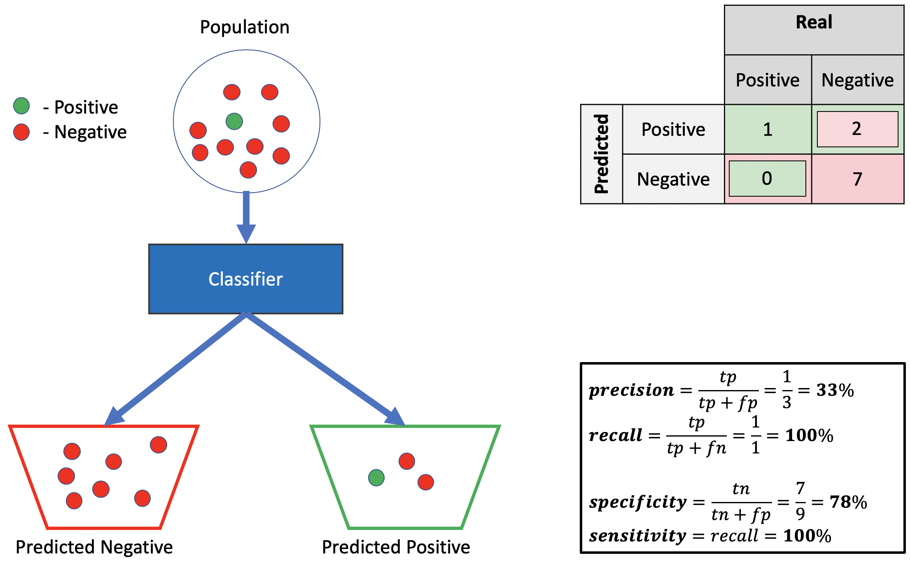
Precision vs. Recall

Slide 4
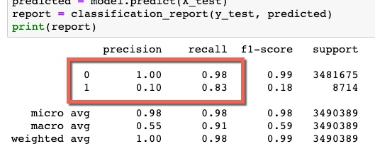
Precision vs. Recall
"Of all records that were labelled 1 by the model, 10% were actually 1 (90% incorrect predictions). Of all records that were truly labelled 1 we predicted 83% correctly.“
The reason the precision is so poor for label 1 is because there are many more "negatives" (0's) than "positives" (1) increasing the chance for false positives to occur, affecting the precision.

Slide 5



